Slide 1

Incorporating Bayesian inference into adaptation rules
AHA! System
Adaptation Rules
Incorporating Bayesian inference into adaptation rules
PhD. Report: | Incorporating Bayesian inference into adaptation rules (September 29th 2009)
Professor: | Pr. Dr. Dong Thi Bich Thuy
Researcher: | Nguyen Phuoc Loc
Affiliation: | Department of IS, Faculty of IT, University of Science

Slide 2
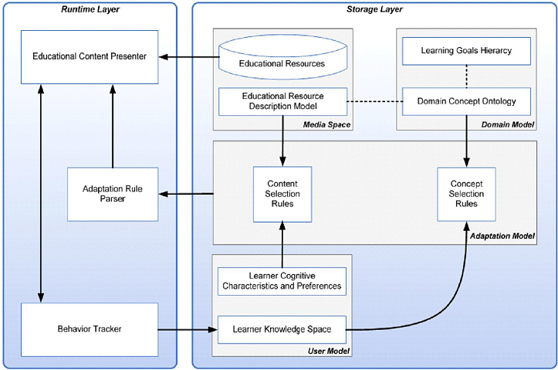
I. AHA! System
The architecture of AEHS

Slide 3
I. AHA! System
AHA!
AHA! is a Java-based open source soft is based on Dexter Hypertext Reference Model and aims to general-purpose adaptive hypermedia system
The AHA! architecture so-called AHAM complies with the standards of general architecture of AEHS
AHAM has three layers: runtime layer, storage layer, within-component layer

Slide 4
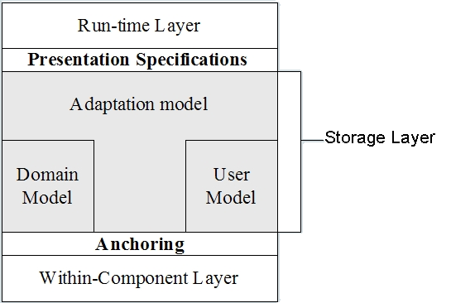
I. AHA! System
AHA! Architecture
The runtime layer represents the user interface (UI)
Storage layer is the core of AHA architecture. This layer has three main models with respective functions: domain model, user model and adaptation model
The within-component layer describes the internal, implementation-specific data objects which can be accessed by means of anchoring

Slide 5
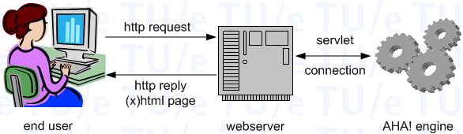
I. AHA! System
Implemented framework of AHA!

Slide 6
I. AHA! System
AHA! Engine manipulates three below models
Domain model (DM) contains domain concepts associated web learning resources. The relationships between concepts are also specified.
User model (UM) describes user information. UM is built up by applying overlay modeling approach. Hence, UM is the mastered subset of DM.
Adaptation model (AM) contains adaptive rules; each rule is associated to a domain concept and used to update UM when executing

Slide 7
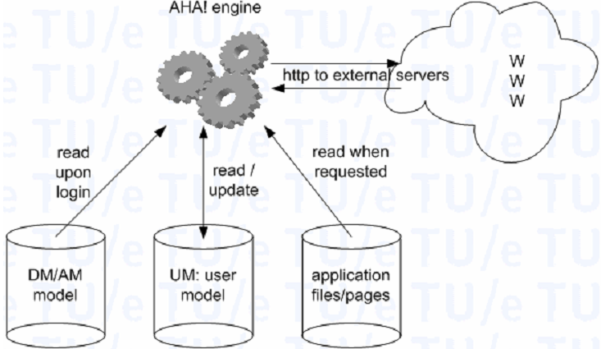
I. AHA! System
AHA! Engine

Slide 8
II. Adaptation Rules
A concept has:
An unique identifier (c-id)
A description structure called “concept information” constituted of three fixed part: a sequence of anchors, a presentation specification and a set of attribute-value pairs
Some usual attributes are showed:
  access: when a concept is accessed, this attributed is triggered. Attribute “access” is the starting point of process of executing adaptation rules
  knowledge: amount of knowledge that user are mastered over concept
  visited: this attribute indicates whether user visited the page associated with concept or not

Slide 9
II. Adaptation Rules
Adaptation Rules
Adaptation rules used to tailor learning concept & material to user characteristics in user model
Adaptation rules are attached to UM
Adaptation rule is considered the “bond” between UM and DM, UM and learning materials

Slide 10
II. Adaptation Rules
Adaptation Rules are categorized into two classes associated two purposes
Updating user model (ECA)
Defining adaptation effect by setting presentation specification (CA). For example: if user is mastered over concept “Control Structure”, he/she should be recommended concept “Loop” in programming language course.

Slide 11
II. Adaptation Rules
The adaptation rules whose purpose is to update user model are called event-condition-action (ECA) rules
They are triggered by an event, e.g. users access a concept by following a link
The condition which is Boolean expression is evaluated. The expression has terms which are domain/user model attribute in form “concept.attribute”.
When the condition is satisfied, the action is executed. The action performs an update to attribute value and can be trigger another rule. This is propagation mechanism.

Slide 12

II. Adaptation Rules
For example, the ECA rule “when the concept C is accessed and it was visited before, its attribute knowledge is set to be 100%” is interpreted as below:

Slide 13
II. Adaptation Rules
The adaptation rules whose purpose is top define adaptation effect are called condition-action (CA) rules
CA rules have no event. They are checked when the engine need to deliver learning objects to user
The condition in the form of Boolean expression in which terms are attributes is evaluated similarly to ECA rules.

Slide 14
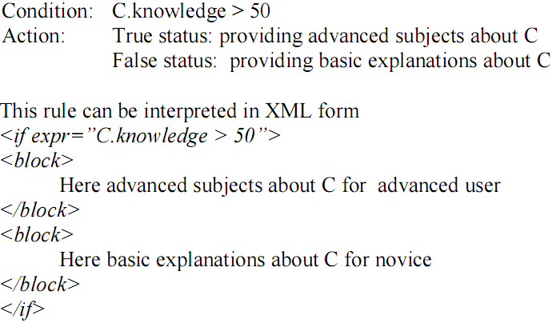
II. Adaptation Rules
For example, the CA rule “If user knowledge about concept C reaches or exceeds 50% then user is provided advanced subjects about C. Otherwise, user should pay attention to basic explanations”.

Slide 15
II. Adaptation Rules
Adaptive procedure
Adaptive procedure is processed by the AHA! engine
The interaction between user and AHA! happens through HTTP protocol
Whenever users send the HHTP request since the click on the link in course pages, adaptive process occurs as 4 steps: finding request concept, retrieving UM, executing adaptive rules, retrieving resource

Slide 16
II. Adaptation Rules
Adaptive procedure
Finding the request concept in DM and getting the resource (web pages, exercises, tests…) associated this concept
Retrieving UM
Executing ECA rules (in AM) attached to the request concept. These rules will update attributes of UM (users’ characteristics). The executing process spreads over AM since the update can trigger other rules associated updated attributes. So this process continues until no rule is triggered. UM is updated
The resources associated to request concept are retrieved and filtered by CA adaptive rules in AM so that they are suitable to users (tuned to UM).

Slide 17
III. Incorporating Bayesian inference into adaptation rules
Forward and backward reasoning
Suppose a student is recommended to learn concept “Class & Object” before concept “Interface & Package” in Java course. Namely, the “recommended” attribute of “Interface & Package” become true if and only if the “knowledge” attribute of “Class & Object” reaches 50%. Whenever the “knowledge” attribute changes its values, the “recommended” attribute is checked and can be re-assigned new value (“true”). This technique is called forward reasoning because the “recommended” attribute is determined as soon as it is possible and thus before it is actually needed, regardless of user requirement
Otherwise, the “recommended” attribute is only determined when students require learning “Interface & Package”. If user does not ask, “recommended” attribute is not considered even the “knowledge” is changed. This technique is called backward reasoning because the attribute is not pre-computed but it is tracked back when actually needed.

Slide 18
III. Incorporating Bayesian inference into adaptation rules
Suppose Java course is constituted of three concepts considered as knowledge variables whose links are dependency relationships.
Additionally, there are two evidence variables: "Questions > 10" and "Exercise: set up the class Human ". That learner asks more than 10 questions is to tell how much her/his amount of knowledge.
Like that, evidence "Exercise: set up..." proves whether or not he/she understands concept "Class & Object"

Slide 19
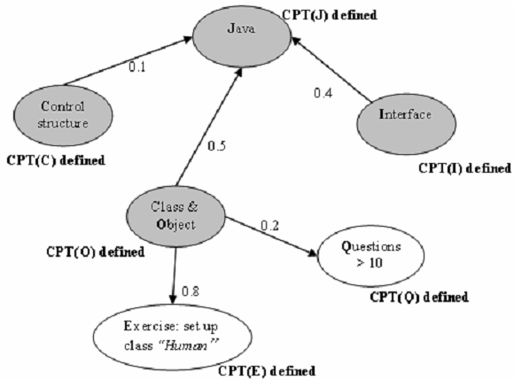
III. Incorporating Bayesian inference into adaptation rules

Slide 20
III. Incorporating Bayesian inference into adaptation rules
Note that five concepts O, I, J, E, Q denote knowledge variables (and evidences) Class & Object, Java, Interface, “Exercise: set up…” and “Questions > 10” respectively.
Concepts E, Q have the new attribute is_evidence indicating whether E, G are fit to become evidences or not.
Concepts O, I, J have the new dummy attribute do$bayes$infer. It called “dummy” because attribute do$bayes$infer does not exists actually in user model. It is only used as the denotation for backward reasoning with Bayesian network inference.
Namely, J. do$bayes$infer is the posterior probability tell us how mastered leaner is over the concept J.

Slide 21
III. Incorporating Bayesian inference into adaptation rules
We defined two ECA rules for updating evidences "Questions > 10", "Exercise: set up… " and one CA rule setting presentation specification.
The 1st ECA rule: If user asks more than 10 questions then the attribute Q. is_evidence is set to true.
The 2nd ECA rule: If user does exercise "Exercise: set up… " the attribute E.is_evidence is set to true.
The 3rd CA rule: If the probability of user knowledge about concept Java reaches or exceeds 0.5 then user is provided advanced subjects about Java. Otherwise, user should pay attention to basic explanations. The probability of user knowledge about concept Java is denoted as dummy attribute J. do$bayes$infer

Slide 22
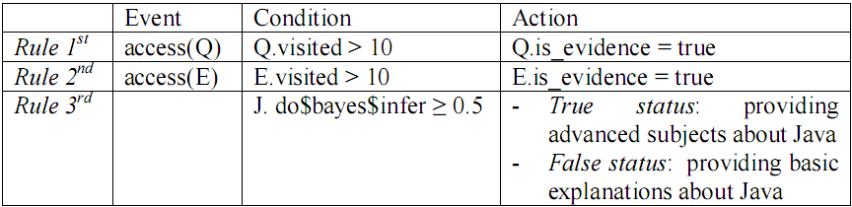
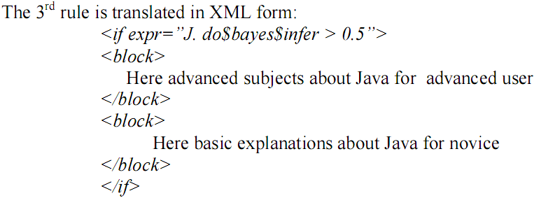
III. Incorporating Bayesian inference into adaptation rules

Slide 23
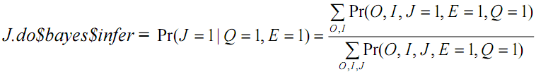
III. Incorporating Bayesian inference into adaptation rules
In 3rd rule, attribute J.do$bayes$infer is not stored and checked instantly but whenever adaptive engine requires to determine its value, it will be tracked back and computed by Bayesian inference.
This is backward reasoning

Slide 24
Conclusion
Our method is to use dummy attribute to execute backward reasoning. Whenever it is required to compute adaptation, the dummy attribute of a domain element (variable) which denotes the posterior probability representing user’s knowledge about this domain element is considered.Then adaptation rules will refer to such dummy attribute in order to decide adaptation strategies.
It is possible to extend our method into other inferences such as neural network, hidden Markov model…and there is no need to change main technique accepts that it is required to add new dummy attributes to domain element

Slide 25
Reference
Peter Brusilovsky. Methods and Techniques of Adaptive Hypermedia. User Modeling and User-Adapted Interaction, 6, 1996, 87-129. (Reprinted in Adaptive Hypertext and Hypermedia, Kluwer Academic Publishers, 1998, 1-43)
Nicola Henze, Wolfgang Nejdl. A Logical Characterization of Adaptive Educational Hypermedia. New Review of Hypermedia and Multimedia (NRHM), 10 (1), 77-113. 2004.
Ian H. Beaumont. User modeling in the interactive anatomy tutoring system ANATOM-TUTOR. In User Models and User Adapted Interaction, 4(1), pages 21–45, 1994
Wenger, E. (1987). Artificial Intelligence and Tutoring Systems: Computational and Cognitive Approaches to the Communication of Knowledge. Los Altos, CA: Morgan Kaufmann Publishers, Inc.
Paul De Bra, Licia Calvi. AHA! An open Adaptive Hypermedia Architecture. The New Review of Hypermedia and Multimedia, vol. 4, pp. 115-139, Taylor Graham Publishers, 1998
David Hauger and Mirjam Köck. State of the Art of Adaptivity in E-Learning Platforms. Proceedings of the 15th Workshop on Adaptivity and User Modeling in Interactive Systems (ABIS 2007). ISBN: 978-3-86010-907-6 (2007)
Owen Conlan. State of the Art: Adaptive Hypermedia. M-Zones State of the Art Paper, soa paper 05/03, Ireland. 2003.
Tomáš Kubeš. Overview of Existing Adaptive Hypermedia e-Learning Systems. Published in Proceedings of the 6th seminar Technologies for e-learning, TPEV 2007.[Pask 1976]. G. Pask. Styles and Strategies of Learning. British Journal of Educational Psychology, 1976.
IT@EDU 2008

Slide 26
THANK FOR CONSIDERATION
IT@EDU 2008

