Slide 1
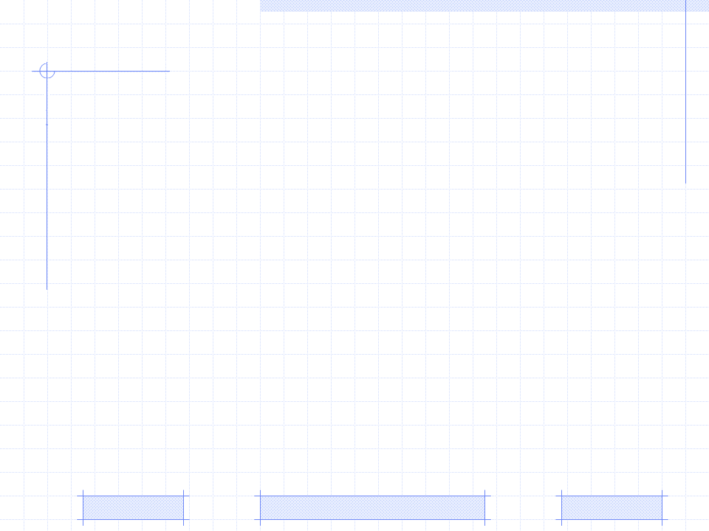
Computerized Adaptive Testing
Item Response Theory
Computerized Adaptive Testing
Bayesian approach for CAT in Zebra
Suggested stopping criterion in CAT
PhD. Report: | Computerized Adaptive Testing (August 25th 2009)
Professor: | Pr. Dr. Dong Thi Bich Thuy
Researcher: | Nguyen Phuoc Loc
Affiliation: | Department of IS, Faculty of IT, University of Science

Slide 2
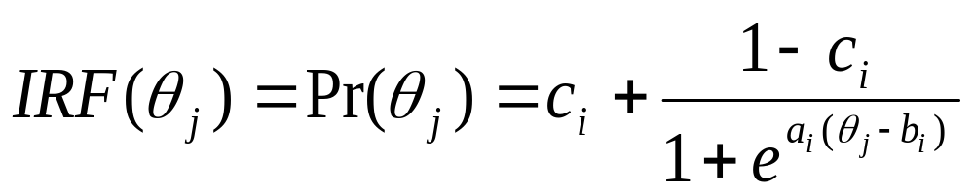
I. Item Response Theory
Item Response Theory is defined as a statistical model in which examinees can be described by a set of one or more ability scores that are predictive, through mathematical models, linking actual performance on test items, item statistics, and examinee abilities
Given examinee j and item i, IRT is modeled as a function of a true ability of examinee j (denoted θ_{j}) and three parameters of item i (denoted a_{i}, b_{i}, c_{i})
This function so-called Item Response Function (IRF) or Item Characteristic Curve (ICC) function computes the probability of a correct response of examinee j to item i

Slide 3
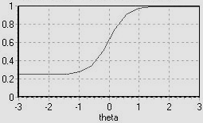
I. Item Response Theory
The horizontal axis θ is the scale of examinee’s ability, ranging from -3.0 to +3.0
The vertical axis is the probability of correct response to this item specified by three parameters: a_{i}=2.0, b_{i}=0, c_{i}=0.25
The left-hand of curve shows an easy item when the probability of correct response is high for low-ability
The center of curve shows a medium-difficulty item when the probability of correct response is around the middle of the ability scale
The right-hand of curve shows a difficult item when the probability of its correct response is low for most of ability scale
The lower asymptote at ci=0.25 indicates the probability of correct response for examinee with lowest ability and otherwise for the upper asymptote at 1.0

Slide 4
I. Item Response Theory
The a_{i} parameter so-called discriminatory parameter tells how well the item discriminates between examinees whose abilities aren’t different much. It defines the slope of the curve at the inflection point. The higher is the value of a_{i}, the steeper is the curve
The b_{i} parameter so-called difficult parameter indicates how difficult the item is. It specifies the location of inflection point of the curve along the θ axis (examinee’s ability). Higher value of b_{i} shifts the curve to the right and implicates that the item is more difficult
The c_{i} parameter so-called guessing parameter indicates that the probability of a correct response to item of low-ability examinees is very close to c_{i}. It determines the lower asymptote of the curve

Slide 5
II. Computerized Adaptive Testing
Computerized Adaptive Testing (CAT) is the iterative algorithm which begins providing examinee an (test) item so as to be best to her/his initial ability
After that the ability is estimated again and the process of item suggestion is continued until a stopping criterion is met

Slide 6
II. Computerized Adaptive Testing
CAT algorithm includes 4 steps
The initial ability of examinee must be defined and the items (in the pool) that have not yet been chosen are evaluated to choose the best one which is the most suitable to examinee’s current ability estimate
The best next item is chosen to give to examinee and the examinee responds. Such item is changed from pool to adaptive test
A new ability estimate is computed based on the responses to all of the chosen items
Steps 1 through 3 are repeated until a stopping criterion is met

Slide 7
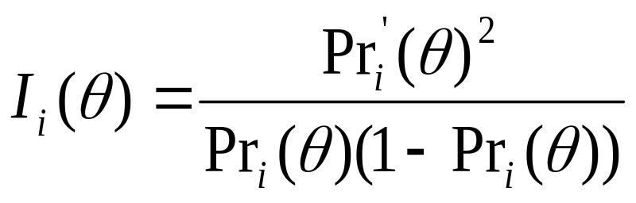
II. Computerized Adaptive Testing
How to evaluate the items to choose the best one in step 2
So each item i is qualified by the amount of information or entropy at given ability θ; such entropy is denoted I_{i}(θ)
The best next item is the one that provides the most information or has highest value of I_{i}(θ)
Where Pr_{i}(θ) is the ICC function and Pr_{i}’(θ) is the first-order derivative of Pr_{i}(θ)

Slide 8
II. Computerized Adaptive Testing
In step 3, there are some methods to compute the ability estimate such as maximum-likelihood, weighted likelihood, etc. But I aim to apply Bayesian approach into specifying ability estimate according to
The stopping criterion could be time, number of administered items, change in ability estimate, maximum-information of ability estimate, etc

Slide 9



III. Bayesian approach for CAT in Zebra
CAT applied into Zebra also includes four steps as above but we should redefine some concepts in order to take advantage of Bayesian rule
Suppose the indexes of items in pool are denoted as and the indexes of these items in the adaptive test is denoted as and so is the index of item i in the pool administered as the item k in the test is denoted i_{k}
Suppose S_{k} = {i₁, i₂, i_{k-1}} is the set of previous k-1 items that are administered and in a test now; of course they correspond with a set of k-1 responses denoted as
The set of items in the pool remaining after chosen items is denoted as

Slide 10


III. Bayesian approach for CAT in Zebra
ICC function is re-written
The likelihood function associated with the responses on the first k–1 items

Slide 11
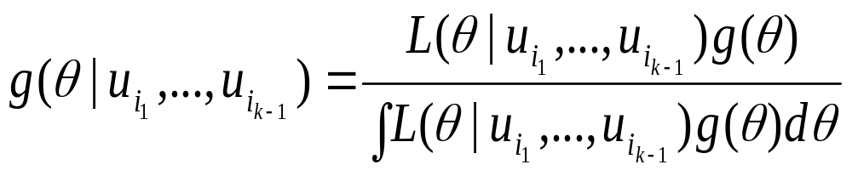
III. Bayesian approach for CAT in Zebra
Posterior distribution of ability estimate
Suppose the prior for the unknown value of examinee’s ability is assumed as g(θ).
The function g(θ) is also called as the prior distribution of θ. According to Bayesian rule, the posterior distribution of ability estimate is computed as below

Slide 12
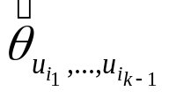

III. Bayesian approach for CAT in Zebra
Ability estimate
In step 3, after the responses to k-1 items, it is necessary to determine the ability estimate denoted or in brief
is the expectation of the posterior distribution

Slide 13
III. Bayesian approach for CAT in Zebra
This technique based on the posterior distribution of θ has an advantage when the ability estimate always exists and is easy to compute
Another method used to compute ability estimate is to determine the value that maximizes the likelihood function in over all possible values of θ but it isn’t optimal because maybe the maximizer isn’t found out and the essence of how to determine comes back the hazard of solving the expectation maximization (EM) problem

Slide 14
IV. Suggested stopping criterion in CAT
In normal the stopping criterion in CAT algorithm is often the number of (test) items, for example, if the test has ten items then the examinee’s final estimate is specified at 10th item and the test ends
Suppose in situation that user is the learner who wants to gains knowledge about some domain as much as possible and she/he doesn’t care about passing or failing the examination
It is possible to use another stopping criterion in which the exercise ends only when the learner can’t do it better or worse. At that time her/his knowledge becomes saturated and such knowledge is her/his actual knowledge

Slide 15
IV. Suggested stopping criterion in CAT
I use the standard deviation σ that assesses the saturation of learner’s knowledge.
The standard deviation is the root of the variance of the posterior distribution of θ
Given threshold ξ, if the standard deviation σ is less than ξ then the CAT algorithm stops. There is no restriction for the number of (question) items in exercises

Slide 16
Conclusion
The excellent points of CAT are to give adaptive test and to discriminate students by specifying three parameters a_{i}, b_{i}, c_{i} in Item Response Theory
CAT includes 4 steps so as to select the best item suitable to student’s ability.
Two most important problems in CAT are to compute the entropy of item and to estimating student’s ability

Slide 17
Conclusion
I use the Bayesian approach to compute ability estimate, namely, ability estimate is the expectation value of the posterior probability density. This expectation always exists and is easy to compute
Moreover, I suggests the stopping criterion in which the test will stop when the standard deviation is less than an pre-defined threshold. The reason is that the exercise ends only when the learner can’t do it better or worse. At that time her/his knowledge becomes saturated and such knowledge is her/his actual knowledge

Slide 18
THANK FOR CONSIDERATION
IT@EDU 2008

