Slide 1
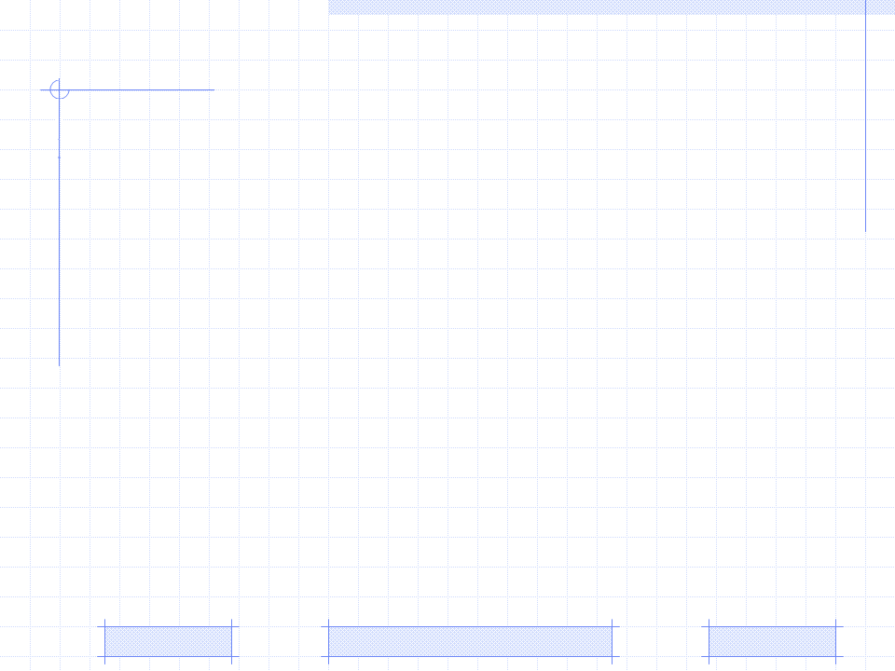
A User Modeling System for Adaptive Learning
Triangular Learner Model (TLM)
A user modeling system for TLM
Knowledge sub-model in TLM
ICTACS2010 Doctoral Consortium report: | A User Modeling System for Adaptive Learning (September 26 2010)
Professor: | Pr. Dr. Dong Thi Bich Thuy
Researcher: | Nguyen Phuoc Loc
Affiliation: | Department of IS, Faculty of IT, University of Science
Notes:
Good morning madam and sir
To day, it is my presentation about subject user modeling
Its title is “A User Modeling System for Adaptive Learning”
My supervisor is Professor Dong Thi Bich Thuy
Affiliation is the department of information system, Faculty of IT, University of Science
This presentation is includes three parts:
The proposed user model: Triangular Learner Model (TLM in abbreviation)
The user modeling system that manipulate TLM
Last, one sub-model in TLM, knowledge sub-model

Slide 2
I. Triangular Leaner Model
Adaptive System
User Modeling System
Selection Rules
User Model
Learning Materials
[4]
TARGET: Adaptive System changes its action to provide learning materials for every student in accordance with her/his model
Notes:
User model is the presentation of information/characteristics about user, which must be manipulated by user modeling system.
Note that the terms: user, learner, student are the same in learning context.

Slide 3
I. Triangular Leaner Model
User model is the presentation of information/characteristics about user, which must be manipulated by user modeling system (UMS). Following are existing user modeling systems:
User modeling shell
User modeling server
Agent-based user model
Mobile user model
Notes:
Shell is the component separated from adaptive application but it isn’t work independently. It is integrated into adaptive system
Server runs as database server. Instead of managing data table, it manages user information. Server provides information to other adaptive system
Agent-based user model is built up as agent collecting information about user.
Mobile user model is stored on mobile device. Its volume (content) is restricted by the storage capacity of mobile device.

Slide 4
I. Triangular Leaner Model
Problems of User Modeling
Too much information about individuals to model all users’ characteristics → it is necessary to choose essential characteristics from which a stable architecture of user model is built.
Some user modeling systems (UMS) lack of powerful inference mechanism → need a solid inference UMS
Notes:
Because of much information about user. Some UMS so-called generic UMS focus on generic user information like demographics, interest, etc but these UMS aren’t really useful in learning machine
Some UMS aiming to provide data like DBMS but adaptive application require more new information that inferred from user model. The inference mechanism is more and more important to modern UMS.
The hazard is each inference method is suitable to a concrete user characteristic -> It requires the solid inference

Slide 5
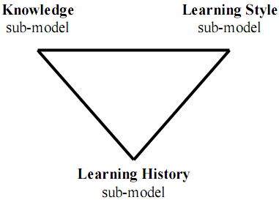
I. Triangular Leaner Model (TLM)
Triangular Learner Model (TLM)
Knowledge (K) sub-model is the combination of overlay model and Bayesian network
Learning style (LS) sub-model is defined as the composite of characteristic cognitive, affective and psychological factors
Learning history (LH) is defined as a transcript of all learners’ actions such as learning materials access, duration of computer use, doing exercise, taking an examination, doing test, communicating with teachers or classmates, etc
Notes:
K sub-model is about user knowledge. It uses Bayesian network for inference
H sub-model is to apply HMM into discover learning style verbal/visual, activist/reflector, pragmatist/theorist
Learning history is the most important sub-model because it has four main responsibilities:
1. Providing necessary information for two remaining sub-models: learning style sub-model and knowledge sub-model so that they perform inference
tasks. For example, knowledge sub-model needs learning evidences like learner’s results of test, frequency of accessing lectures
2. Supporting learning concept recommendation.
3. Mining learners’ educational data in order to discover other learners’ characteristics such as interests, background, goals…
Supporting collaborative learning through constructing learner groups.
That is the reason that LH sub-model is draw as base bottom vertice.

Slide 6
I. Triangular Leaner Model
Why TLM?
Knowledge, learning styles and learning history are prerequisite for modeling learner
While learning history changes themselves frequently, learning styles and knowledge are relatively stable. The combination of them ensures the integrity of information about learner
User knowledge is domain specific information and learning styles are personal traits. The combination of them supports user modeling system to take full advantages of both domain specific information and domain independent information
Notes:
Prerequisite
Integrity
Take full advantages of both domain specific information and domain independent information

Slide 7
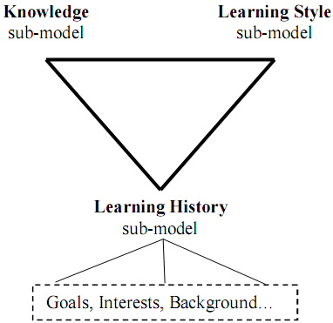
I. Triangular Leaner Model
extended Triangular Leaner Model
Notes:
This the importance of LH, it is used to extend TLM through discovering new information about user by mining technique.
Please see slide 5
1. Providing necessary information for two remaining sub-models: learning style sub-model and knowledge sub-model so that they perform inference
tasks. For example, knowledge sub-model needs learning evidences like learner’s results of test, frequency of accessing lectures
2. Supporting learning concept recommendation.
3. Mining learners’ educational data in order to discover other learners’ characteristics such as interests, background, goals…
Supporting collaborative learning through constructing learner groups.

Slide 8


I. Triangular Leaner Model
How to build up TLM?
How to manipulate (manage) TLM?
How to infer new information from TLM?
→ Zebra: the user modeling system for TLM
Notes:
The expectation is that Zebra is strong and run fast as Africa zebra
Moreover it is difficult to discover zebras when they are running on wild field because their strikes cause the illusion. This is similar to data disturbance technique in data mining privacy. The future trend is to apply privacy mechanism into user model so as to make it more secure.

Slide 9
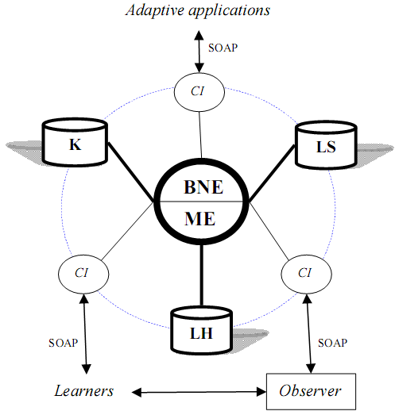
II. A user modeling system for TLM
Mining Engine (ME) manages learning history sub-model of TLM
Belief Network Engine (BNE) manages knowledge sub-model and learning style sub-model of TLM
Communication Interfaces (CI) allows users and adaptive systems to see or modify restrictedly TLM
Notes:
Outside applications can’t access or intervene ME and BNE, they can only retrieve user information through CI via network protocol like SOAP, RMI, HTTP, Socket.

Slide 10
II. A user modeling system for TLM
Mining Engine
Collecting learners’ data, monitoring their actions, structuring and updating TLM.
Providing important information to belief network engine
Supporting learning concept recommendation
Discovering some other characteristics (beyond knowledge and learning styles) such as interests, goals, etc
Supporting collaborative learning through constructing learner groups (communities)
Notes:
Mining engine uses mining and machine learning techniques

Slide 11
II. A user modeling system for TLM
Belief Network Engine
Inferring new personal traits from TLM by using deduction mechanism available in belief network
This engine applies Bayesian network and hidden Markov model into inference mechanism.
Two sub-models: knowledge & learning style are managed by this engine
Notes:
Believe network includes: Bayesian network, Markov model, Kalman filter…

Slide 12
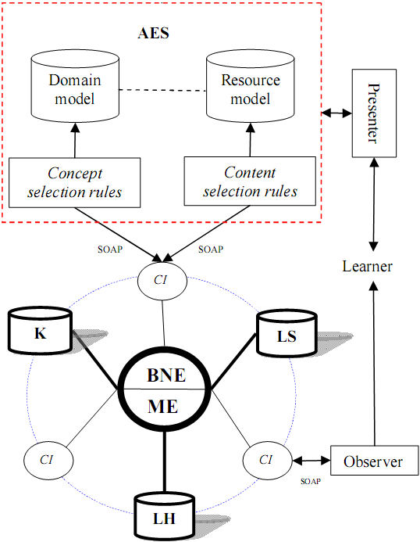
II. A user modeling system for TLM
The extended architecture of Zebra when interacting with AES
Notes:
The adaptation is makes through two kinds of rules: concept selection rules and content selection rules
Concept selection rules: what concepts user should learn
Content selection rules: what learning material (lecture, exercise) user should read/do
Domain model is mapped to resource model, for example one concept has one or more lectures/exercise

Slide 13
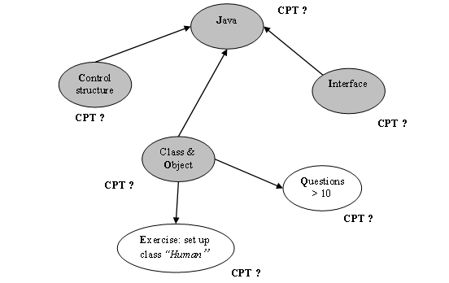
III. Knowledge sub-model
CPT is conditional probability table representing the strength of dependence
Knowledge sub-model = overlay model + Bayesian network (BN)
Notes:
Knowledge sub-model includes: topology (structure) and parameters (CPT)
The topology and initial arc weights are specified by expert, namely, teacher
CPT are computed by initial arc weights.
After that CPT can be improved by EM algorithm, see slide (17, 18)

Slide 14
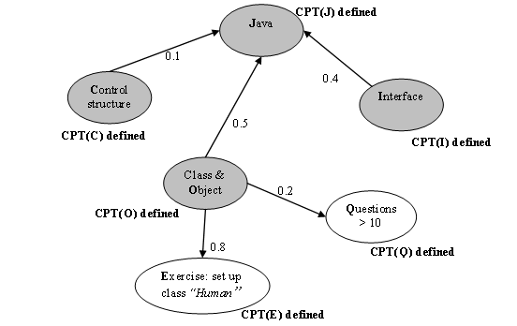
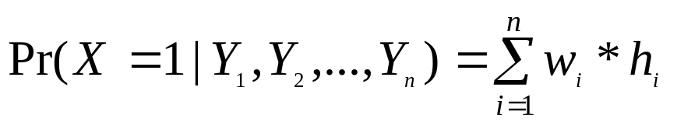
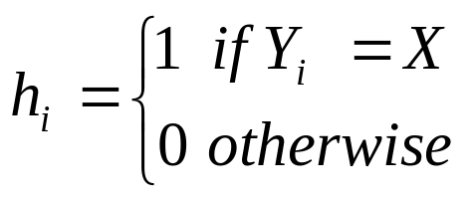
III. Knowledge sub-model
Determining CPT (s) is based on weights of arcs
Notes:
Pr(X|Y₁, Y₂,…, Y_{n}) is computed through the law of total probability
Or it can be considered as objective function

Slide 15
III. Knowledge sub-model
Determining CPT (s) is based on weights of arcs
T₁
C O I | p(J = 1) | P(J = 0) 1- p(J = 1)
1 1 1 | 1.0 (0.1*1 + 0.5*1 + 0.4*1) | 0.0
1 1 0 | 0.6 (0.1*1 + 0.5*1 + 0.4*0) | 0.4
1 0 1 | 0.5 (0.1*1 + 0.5*0 + 0.4*1) | 0.5
1 0 0 | 0.1 (0.1*1 + 0.5*0 + 0.4*0) | 0.9
0 1 1 | 0.9 (0.1*0 + 0.5*1 + 0.4*1) | 0.1
0 1 0 | 0.5 (0.1*0 + 0.5*1 + 0.4*0) | 0.5
0 0 1 | 0.4 (0.1*0 + 0.5*0 + 0.4*1) | 0.4
0 0 0 | 0.0 (0.1*0 + 0.5*0 + 0.4*0) | 1.0
T₂
E | Pr(E = 1) | Pr(E = 0) 1- Pr(E = 1)
1 | 0.8 (0.8*1) | 0.2
0 | 0.0 (0.8*0) | 1.0
T₃
Q | Pr(Q = 1) | Pr(Q = 0) 1- Pr(Q = 1)
1 | 0.2 (0.2*1) | 0.8
0 | 0.0 (0.2*0) | 1.0
Notes:
T₁, T₂, T₃ are CPT (s)
For example, suppose that user mastered three concepts “control & structure” (C), “class & object” (O) and “interface” (I) then the probability that user knows Java course is Pr(J=1|C=1,O=1,I=1) = 1. It means that user mastered Java course.
Note that if a node is binary and it has n parents then its CPT has 2^{n+1} entries.
K sub-model is work properly as Bayesian network.

Slide 16
III. Knowledge sub-model
Improving knowledge sub-model
Parameter Learning: using Expectation Maximization (EM) algorithm [2][5] or Maximum Likelihood Estimation (MLE) algorithm [3]. Both of them are used for beta distributions
Structure Learning and monitoring: using Dynamic Bayesian Network (DBN) [2]
Notes:
You see [2], [3], [5] for basic concepts about EM, MLE, DBN

Slide 17
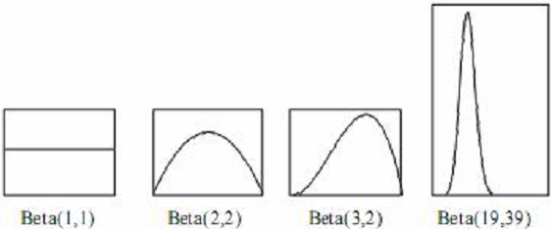



III. Knowledge sub-model (EM)
Beta density function
Notes:
There are “a” successful outcomes (for example, f =1) in “a+b” trials. Higher value of “a” is, higher ratio of success is, so, the graph leans forward right. Higher value of “a+b” is, the more the mass is concentrate around a/(a+b) and the more narrow the graph is.
“s” is also successful outcomes (X=1) though some experiments
“t” is also fail outcomes (X=0) though some experiments
“a”, “s” are opposite to “b”, “t”

Slide 18
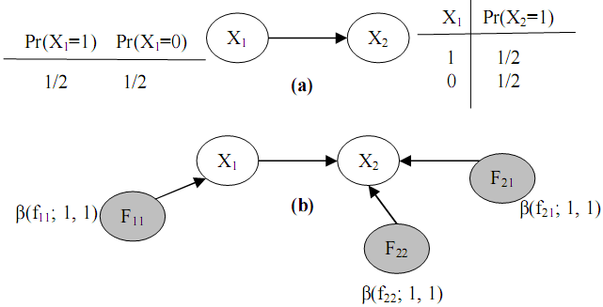
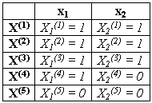

III. Knowledge sub-model (EM)
EM technique
Notes:
F₁₁ represents the probability Pr(X₁=1)
F₂₁ represents the conditional probability Pr(X₂=1 | X₁=1)
F₂₂ represents the conditional probability Pr(X₂=1 | X₁=0)
s₁₁ is the number of outcomes that X1=1
t₁₁ is the number of outcomes that X1=0
s₂₁ is the number of outcomes that X2=1 and X1=1
t₂₁ is the number of outcomes that X2=0 and X1=1
s₂₂ is the number of outcomes that X2=1 and X1=0
t₂₁ is the number of outcomes that X2=1 and X1=0
Suppose we have the sample data, it requires to re-computes probabilities: Pr(X₁=1), Pr(X₂=1 | X₁=1), Pr(X₂=1 | X₁=0)
We don’t need to compute Pr(X₁=0), Pr(X₂=0 | X₁=1), Pr(X₂=0 | X₁=0) because:
Pr(X₁=0) = 1 - Pr(X₁=1)
Pr(X₂=0 | X₁=1) = Pr(X₂=1 | X₁=1)
Pr(X₂=0 | X₁=0) = Pr(X₂=1 | X₁=0)

Slide 19
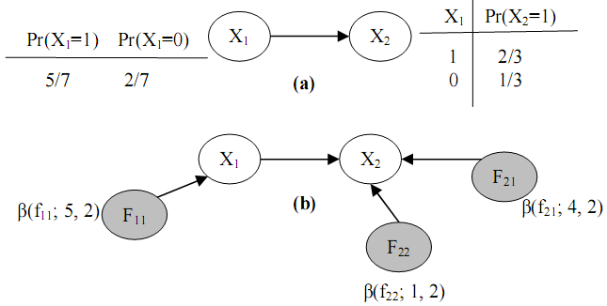

III. Knowledge sub-model (EM)
EM technique
Notes:
Pr(X₁=1) = (a₁₁ + s₁₁) / (b₁₁ + t₁₁) = (1+4)/(1+1) = 5/2
Pr(X₂=1|X₁=1) = (a₂₁ + s₂₁) / (b₂₁ + t₂₁) = (1+3)/(1+1) = 4/2
Pr(X₂=1|X₁=0) = (a₂₂ + s₂₂) / (b₂₂ + t₂₂) = (1+0)/(1+1) = 1/2
EM technique work properly in software. It runs fast and effectively

Slide 20
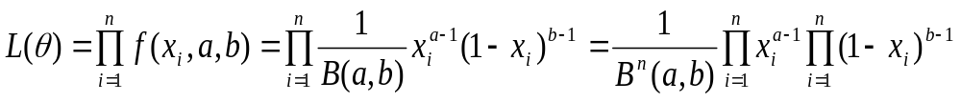
III. Knowledge sub-model (MLE)
MLE technique
The essence of maximizing the likelihood function is to find the peak of the curve of LnL(θ).
This can be done by setting the first-order partial derivative of LnL(θ) with respect to each parameter θ_{i} to 0 and solving this equation to find parameter θ_{i}
Notes:
The reason of taking logarithm of likelihood function LnL(θ) is that LnL(θ) transforms the product L(θ) into form repeated addition.
We use LnL(θ) instead of L(θ).
The way to specify L(θ) is described in another paper.

Slide 21
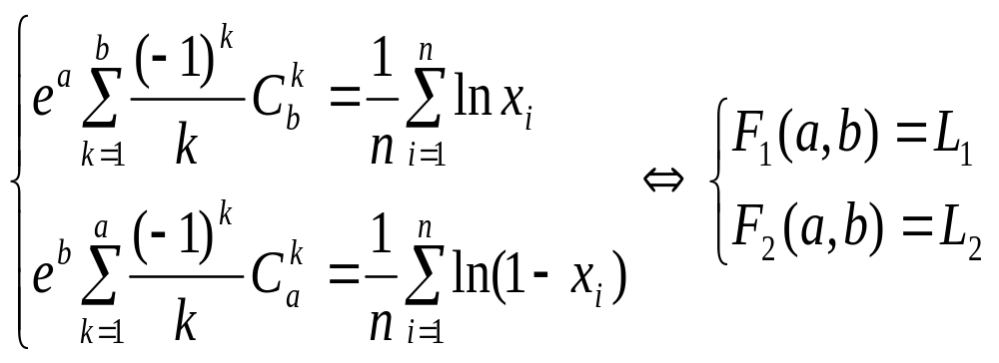
III. Knowledge sub-model (MLE)
The set of equations whose solutions are
parameter estimators
This set of equations is find out by taking the integration of L(θ) based on the assumption that a and b in beta function are positive whole number
Notes:
This set of equations is a variant of differential equations. Note that it is too difficult to solve differential equations.
The way to find out this set of equations is described in another paper.

Slide 22
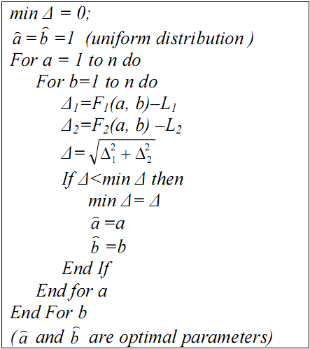

III. Knowledge sub-model (MLE)
Iterative Algorithm for MLE
The basic idea is to find out the approximate solutions
Notes:
The detail and example of this algorithm is described in another paper.
The accuracy of generic MLE and EM are the same but MLE requires huge data for running. It doesn’t have accumulative mechanism like EM
So in practice it work less effective than EM but it is suitable to first time learning.

Slide 23
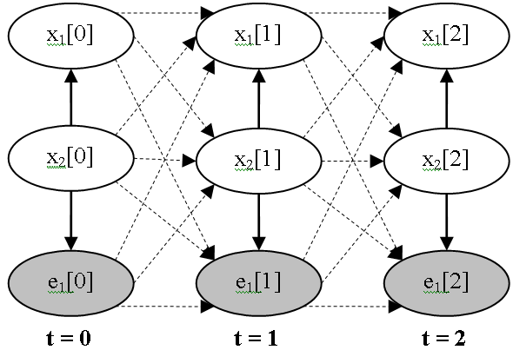
III. Knowledge sub-model (DBN)
A DBN is BN containing variables that comprise T variable vectors X[t]
An initial BN G₀ = {X[0], Pr(X[0]} at first time t = 0
A transition BN is a template consisting of a transition DAG G→ containing variables in X[t], X[t+1] and a transition probability distribution Pr→ (X[t+1] | X[t])
Notes:
The inference in DBN is similar to BN
But the joint probability of DBN is more complex than joint probability of BN. It must model the time transition through transition probability Pr→

Slide 24
III. Knowledge sub-model (DBN)
Strong points of DBN
DBN can model the temporal relationships among variables. It can capture the dynamic aspect
So DBN allows monitoring user’s process of gaining knowledge and evaluating her/his knowledge
Drawbacks of DBN
The size of DBN becomes numerous when the process continues for a long time
The number of transition dependencies among points in time is too large to compute posterior marginal probabilities
Notes:
Strong points of DBN are attractive features

Slide 25
III. Knowledge sub-model (DBN)
Purposes of suggested algorithm to improve DBN
To overcome these drawbacks, the new algorithm that both the size of DBN and the number of Conditional Probability Tables (CPT) in DBN are kept intact when the process continues for a long time
To solves the problem of temporary slip and lucky guess: “learner does (doesn’t) know a particular subject but there is solid evidence convincing that she/he doesn’t (does) understand it; this evidence just reflects a temporary slip (or lucky guess)”.
Notes:
Size of DBN is constant
Slip and guess

Slide 26
III. Knowledge sub-model (DBN)
The algorithm for DBN includes 6 steps for each iteration that repeated whenever evidences occur
Initializing DBN
Specifying transition weights
Re-constructing DBN
Normalizing weights of dependencies
Re-defining CPT (s)
Probabilistic inference
Notes:
The basic idea of 6-step algorithm is to make DBN evolved.
Note that each iteration has 6 steps but there are infinite iterations whenever evidences (user actions) occur

Slide 27
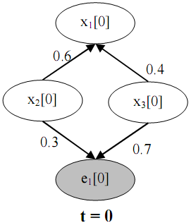
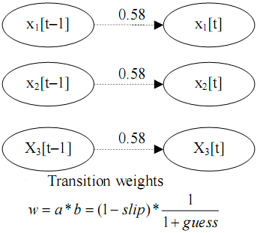
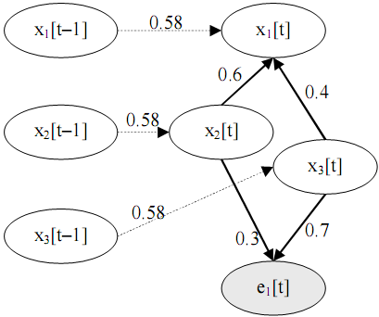
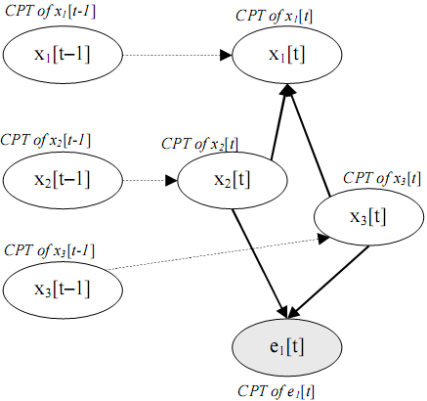
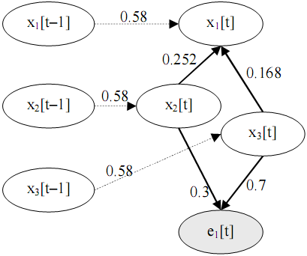
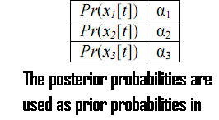
III. Knowledge sub-model (DBN)
1. Initializing DBN
2. Specifying transition weights
3. Re-constructing
6. Probabilistic inference
5. Re-defining CPT(s)
4. Normalizing weights
Notes:
The basic idea is to make the initial DBN evolved.
This 6-step algorithm based on DBN was implemented.
This is sophisticated algorithm. Its details are described in another paper.
In theory this algorithm is better than EM and MLE but it requires more experiments to evaluate it.

Slide 28
Conclusion
The “Triangular Learner Model (TLM)” composed by three underlying characteristics: knowledge, learning style and learning history aims to cover the whole of learner’s information required by learning adaptation process.
UMS which builds up and manipulates TLM so-called Zebra includes the core engine and a set of communication interfaces
The core engine is the composition of two sub-engines: mining engine and belief network engine.
  Mining engine applies data mining algorithms into discovering and structuring TLM
  Belief network engine is responsible for inferring new personal traits from TLM by using deduction mechanism available in belief network
Notes:
Experiments are done through three steps:
Implementing an solid architecture. It is was built up as an intelligent software that runs fast and stable. The correctness of TLM is proved by this implementation. If the architecture is wrong then it can’t be implemented. This step is done
Satisfying simulation data. This step is done
However adaptive application should be satisfy end-user. The software needs to be public for student using and student’s feedback will be collected and analyzed.

Slide 29
Reference
David Heckerman. A Tutorial on Learning With Bayesian Networks. Technical Report MSR-TR-95-06. Microsoft Research Advanced Technology Division, Microsoft Corporation.
Richard E. Neapolitan. Learning Bayesian Networks. Northeastern Illinois University Chicago, Illinois 2003
Scott M. Lynch. Maximum Likelihood Estimation. Soc. 504, February 2003
Alfred Kobsa. Generic User Modeling Systems. User Modeling and User-Adapted Interaction 2006 (UMUAI-2006).
Frank Dellaert. The Expectation Maximization Algorithm. College of Computing, Georgia Institute of Technology. Technical Report number GIT-GVU-02-20. February 2002
IT@EDU 2008

Slide 30
THANK FOR YOUR ATTENTION
IT@EDU 2008
Notes:
Thank for your attention
You feel free to give me questions

