Slide 1
Evaluation scenario
Evaluation scenario
Evaluation measurement
Report: | Evaluation scenario (May 24th 2011)
Professor: | Pr. Dr. Dong Thi Bich Thuy
Researcher: | Nguyen Phuoc Loc
Affiliation: | Department of IS, Faculty of IT, University of Science
Đề cương NCS
Notes:
Chú thích đầu trang
Chú thích cuối trang

Slide 2
I. Evaluation scenario
There steps to evaluate thesis
Firstly, the architecture in thesis was implemented as an intelligent software that runs fast and stable. The correctness of thesis is proved by this implementation. Done!
Secondly, program ran well on simulation data. Done!
Finally, it should satisfy students’ learning need and their feedback will be collected and analyzed → an evaluation scenario to measure the quality of thesis.
Đề cương NCS

Slide 3
I. Evaluation scenario
Modeling system itself is a standalone system that provides information about users to other adaptive (or any) system.
However this thesis aim to build up a modeling server which supports adaptive e-learning. So it will be evaluated in e-learning context.
Both teacher and students play the roles of actors/actress in this evaluation scenario.
Đề cương NCS
Notes:
Chú thích đầu trang
Chú thích cuối trang
Using AHA! Adaptive learning system as tool to evaluate

Slide 4
I. Evaluation scenario
Three main acts of scenario
E-learning can’t replace face-to-face teaching. It should exist parallel and support traditional education.
So this evaluation scenario is divided into three main parts
  Study act: Teacher teaches and students learn in both face-to-face manner and e-learning manner
  Feedback act: Students’ feedback are collect and analyzed
  Evaluation act: done by teacher based on two above acts
Đề cương NCS

Slide 5
I. Evaluation scenario
Study act has 5 scenes
Teacher build up school’s curriculums and set up adaptive e-learning website
Teacher teaches and students learn in face-to-face manner
Students go on website and study by themselves. Teacher monitors them and put up important notice.
Students do tests and exercises via website
Teacher evaluates students based on their test results.
Đề cương NCS

Slide 6
Evaluation scenario
Teacher’s roles in study act
Teaching face-to-face
Building up knowledge domain and creating web resources for this domain such as defining html lesions, tests, exercises, etc.
Creating Bayesian network and its weights for knowledge domain
Setting up modeling server and e-learning adaptive website
Monitoring students’ learning process
Sending test results and school report to students
Đề cương NCS

Slide 7
I. Evaluation scenario
Students’ roles in study act
Going on class to study in face-to-face manner
Studying themselves on adaptive learning web sites. Note that website / learning materials are adapted to each student based on their knowledge and characteristics
Doing tests / exercise on website
Đề cương NCS

Slide 8
I. Evaluation scenario
Feedback act has 3 scenes
Teacher creates the questionnaire to survey students’ feeling about both adaptive learning website and curriculum such as very satisfied, satisfied, not satisfied.
Students answer such questions online
Teacher collects students’ feedbacks and analyze them
Đề cương NCS

Slide 9
I. Evaluation scenario
Evaluation act based on two criterions
Students’ study result via tests / exercises. This criterion so-called academy criterion α reflects how well students learn via adaptive learning website. The weight of such criterion is 7/10 over whole evaluation.
Students’ feedback via questionnaire. This criterion so-called satisfaction criterion β reflects how much students satisfy with learning website and curriculum. The weight of such criterion is 3/10 over whole evaluation
Đề cương NCS

Slide 10
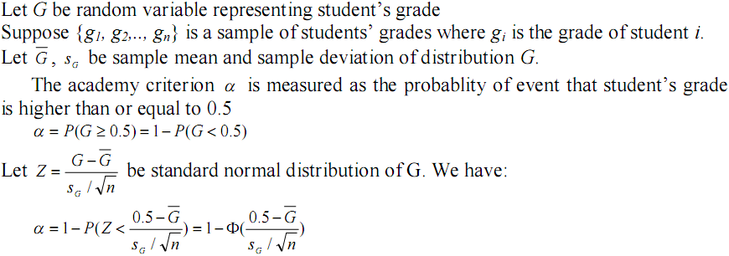
II. Evaluation measurement
Academy criterion
Đề cương NCS

Slide 11
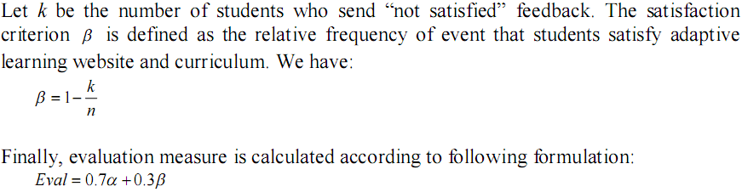
II. Evaluation measurement
Evaluation measure
Đề cương NCS

Slide 12
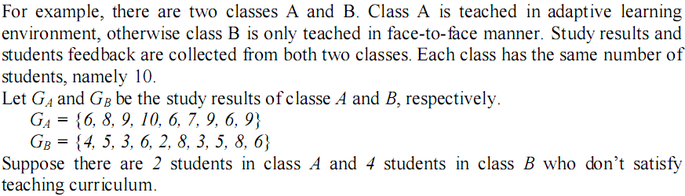
II. Evaluation measurement
Đề cương NCS

Slide 13
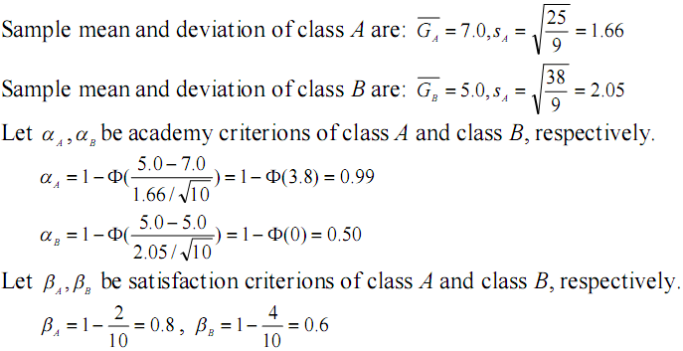
II. Evaluation measurement
Đề cương NCS

Slide 14
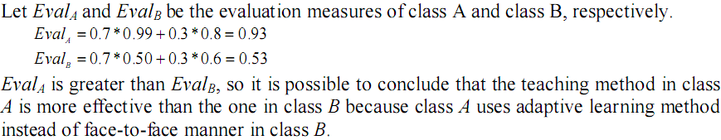
II. Evaluation measurement
Đề cương NCS

Slide 15
THANK FOR CONSIDERATION
Đề cương NCS

