Slide 1
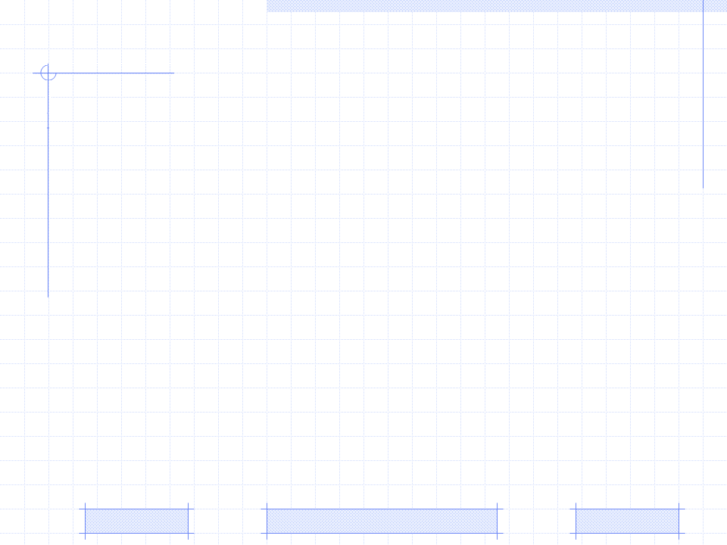
Discovering user interests based on document classification
Document Vector Model
Document classification
Discovering user interests based on document classification
PhD. Special Subject: | Discovering user interests based on document classification (August 24th 2009)
Professor: | Prf. Dr. Dong Thi Bich Thuy
Researcher: | Loc Nguyen
Affiliation: | The University of Science, Ho Chi Minh city, Vietnam

Slide 2


I. Document Vector Model
Vector model for representing documents
Every document D_{i} contains a set of key words so-called terms
The number of times a term occurs in a document is called term frequency
The inverse document frequency of term t_{j} is the ratio of the size of corpus to the number of documents that t_{j} occurs

Slide 3
I. Document Vector Model
Vector model for representing documents
The weight of term t_{j} in document D_{i} is defined as product of tf_{ij} and idf_{i}: w_{ij} = tf_{ij} * idf_{i}
Suppose there are n terms {t_{i}, t₂,…, t_{n}}, each document D_{i} is modeled as the vector which is composed of weights of such terms.
D_{i} = (w_{i1}, w_{i2}, w_{i3},…, w_{in})

Slide 4
II. Document classification based on SVM
Support Vector Machine (SVM)
Support vector machine (SVM) is a supervised learning algorithm for classification and regression
Given a set of n-dimensional vectors in vector space, SVM finds the separating hyper-plane that splits vector space into sub-set of vector; each separated sub-set is assigned one class
There is the constraint for this separating hyper-plane: “it must maximize the margin between two sub-sets”

Slide 5
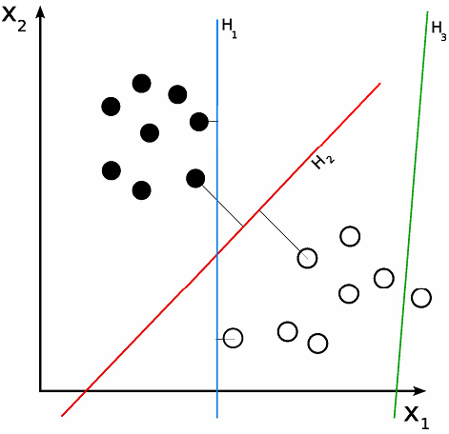
II. Document classification based on SVM
Separating Hyper-planes

Slide 6
II. Document classification based on SVM
Let {X₁, X₂,…, X_{n}} be the training set of vectors and let y_{i} = {1, -1} be the class label of vector X_{i}
The hyper-plane is written as the set of point satisfying: W^{T} * X_{i} + b = 0
W is a weight vector perpendicular to hyper-plane and b is the bias.
The b/|W| is the offset of the hyper-plane from the origin along the weight vector W

Slide 7
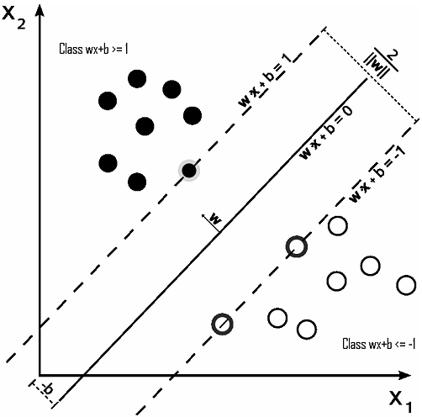
II. Document classification based on SVM
Maximum-margin hyper-plane

Slide 8
II. Document classification based on SVM
Weight Vector
To calculate the margin, two parallel hyper-planes are constructed, one on each side of the maximum-margin hyper-plane. Such two parallel hyper-planes are represented by two following equations
W^{T} * X_{i} + b = 1 and W^{T} * X_{i} + b = -1
All vectors belonging to two class y_{i}=1, y_{i}=-1 have two following constraints respectively
W^{T} * X_{i} + b = 1 (for X_{i} of class y_{i}=1)
W^{T} * X_{i} + b = 1 (for X_{i} of class y_{i}=-1)
For any new vector X, the rule for classifying it is computed as below:
f(X_{i}) = sign(W^{T}* X_{i} + b)

Slide 9
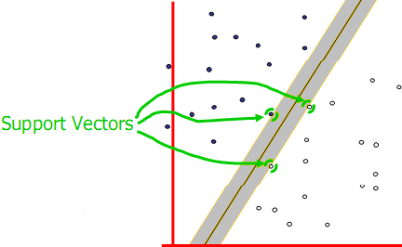
II. Document classification based on SVM
The essence of SVM is to find the weight vector so-called the classifier
The way to find W is the problem of quadratic programming (QP) optimization
Some vectors which lies on parallel hyper-planes are closest to the maximum-margin hyper-plane. They help to solve QP problem and are considered as support vectors. So this method is called Support Vector Machine

Slide 10
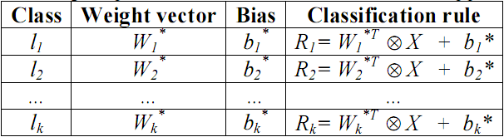
II. Document classification based on SVM
The technique of classification based on SVM is two-class classification in which the classes is +1, -1 for y_{i}=+1, -1 respectively
It is possible to extend two-class classification to k-class classification by constructing k two-class classifier

Slide 11
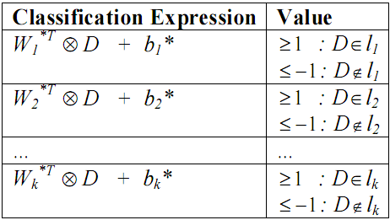
II. Document classification based on SVM
For each classification rule R_{i} = W_{i}^{T} *X + bi*, substituting each D into such rule. It means that vector X in such rule is replaced by document D: Expr_{i} = W_{i}^{T} * D + b_{i}
Suppose there is a sub-set of rules {R_{h+1}, R_{h+2},…, R_{h+r}} that the value of expression Expr_{i} = W_{i}^{T} * D + b is greater than or equal 1. We can conclude that document D is belongs to r classes {l_{h+1}, l_{h+2},…, l_{h+r}} where {l_{h+1}, l_{h+2},…, l_{h+r}} is sub-set of {l₁, l₂,…, l_{k}}

Slide 12
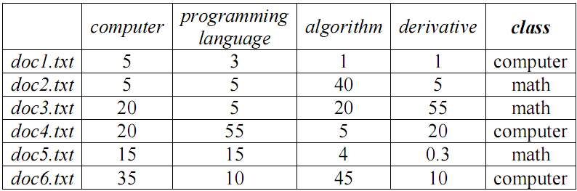
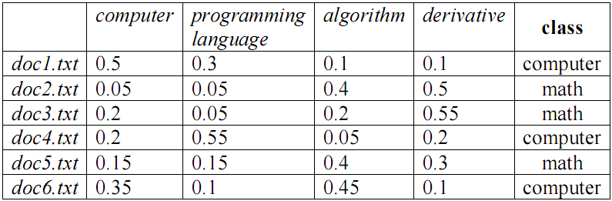
II. Document classification based on Decision Tree
Given a set of classes C = {computer science, math}, a set of terms T = {computer, programming language, algorithm, derivative} and the corpus D = {doc1.txt, doc2.txt, doc3.txt, doc4.txt, doc5.txt}
Term frequencies of documents
Normalized term frequencies

Slide 13
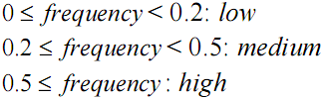
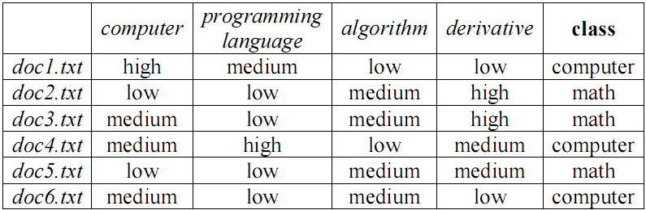
II. Document classification based on Decision Tree
Nominal term frequencies

Slide 14
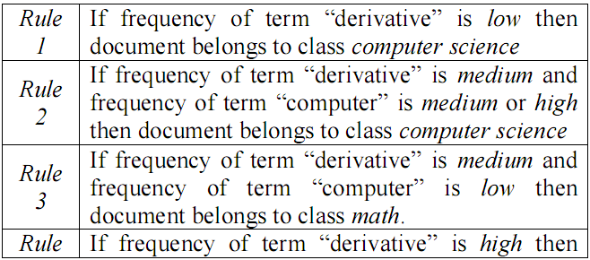
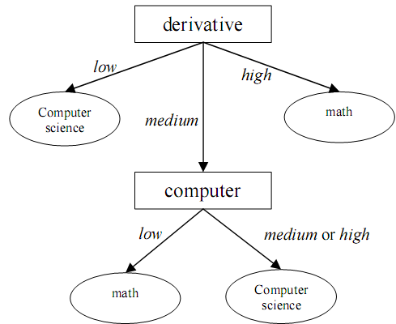
II. Document classification based on Decision Tree
Decision Tree

Slide 15
II. Document classification based on Decision Tree
Example
Suppose the numbers of times that terms computer, programming language, algorithm and derivative occur in document D are 5, 1, 1, and 3 respectively. D is normalized as term frequency vector: D = (0.5, 0.1, 0.1, 0.3)
Changing real number into nominal value, we have: D = (high, low, low, medium)
According to rule 2 in above table, D is computer science document

Slide 16
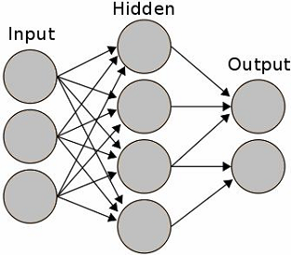
II. Document classification based on ANN
Artificial Neural Network (ANN) is the mathematical model based on biological neural network
It consists of a set of processing units which communicate together by sending signals to each other over a large number of weighted connections

Slide 17
II. Document classification based on ANN
There are three types of unit
Input units receive data from outside the network. These units structure the input layer
Hidden units own input and output signals that remain within the neural network. These units structure the hidden layer. There can be one or more hidden layers
Output units send data out of the network. These units structure the output layer

Slide 18
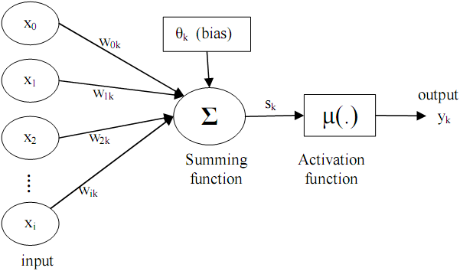
II. Document classification based on ANN
The process of computing the output of a unit
An adder so-called summing function sums up all the inputs multiplied by their respective weights. It is essential to compute the weighted sum. This activity is referred to as linear combination
An activation function controls the amplitude of the output of the neuron. This activity aims to determine the output

Slide 19
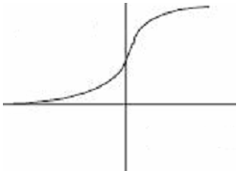
II. Document classification based on ANN
There are three types of activation function
Threshold function takes on value 0 if weighted sum is less than 0 and otherwise
Piecewise-linear function takes on values according to amplification factor in a certain region of linear operation
Sigmoid function takes on values in range [0, 1] or [-1, 1]. The formula of sigmoid function which is

Slide 20
II. Document classification based on ANN
There are two topologies of neural network
Feed-forward neural network. It is directed acyclic graphic in which flow of signal from input units to output units is one-way flow so-called feed-forward. There are no feedback connections
Recurrent neural network. The graph contains cycles; so there are feedback connections in network

Slide 21
II. Document classification based on ANN
Back-propagation algorithm for classification
The back-propagation algorithm is a famous supervised learning algorithm for classification, which is used in feed-forward neural network
It processes iteratively data tuples in training corpus and compares the network’s prediction for each tuple to the actual class of the tuple
For each time it feeds a training tuple, the weights are modified in order to minimize the mean squared error between network’s prediction and actual class
The modifications are made in backward direction, from output layer through hidden layer down to hidden layer

Slide 22
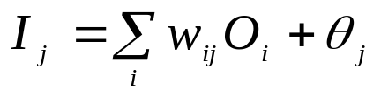
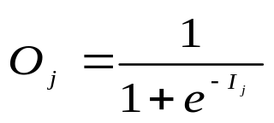
II. Document classification based on ANN
Back-propagation algorithm: 4 steps
Initializing the weights: the weights are initialized as random real number which should be in space [0, 1]. Each bias associated to each unit is also initialized
Propagating the input value forward. Training tuple is fed to input layer. Given the unit j, its input value denoted I_{j} and its output value denoted O_{j}.
  If unit j is the input: O_{j} = I_{j}
  If unit j is hidden or output, its input value I_{j} is the weighted sum of all output values of units from previous layer:
  The output value O_{j} is computed by applying activation function to its input value given activation function is sigmoid function

Slide 23

II. Document classification based on ANN
Back-propagation algorithm: 4 steps
Propagating the error backward: The error is propagated backward by updating the weights and biases to reflect the error of network’s prediction
  if unit j is output then its error is computed: Err_{j} = O_{j}(1 – O_{j})(T_{j} – O_{j})
  If unit j is hidden unit, the weighted sum of the errors of the units connected to it in the next higher layer is considered when its error is computed
Updating the weights and biases is based on the errors. The weights are updated so as to minimize the errors. Given Δw_{ij} is the change in weight w_{ij}
Δw_{ij} = (l)Err_{j}O_{i}
w_{ij} = w_{ij} + Δw_{ij}
The bias θj of unit j is updated as below:
Δθ_{j} = (l)Err_{j}
θ_{j} = θ_{j} + Δθ_{j}

Slide 24
II. Document classification based on ANN
Back-propagation algorithm:
Terminating Condition
All Δw_{ij} in some iteration are smaller than given threshold
Iterating through all possible training tuples

Slide 25
II. Document classification based on ANN
The ANN for Document classification
Given a set of classes C = {computer science, math}, a set of terms T = {computer, programming language, algorithm, derivative}
Suppose all input variables (units) are binary or Boolean, every document is represented as a set of input variables
Each term is mapped to an input variable in which value 1 indicates the existence of this term in document and otherwise value 0 indicates the lack of this term in document
So the input layer consists of four input units: “computer”, “programming language”, “algorithm” and “derivative”

Slide 26
II. Document classification based on ANN
The ANN for Document classification
The hidden layer is constituted of two hidden units: “computer science”, “math”. These units (variables) are also binary or Boolean
The output layer has only one unit named “document class” which is binary or Boolean (0 – documents belong to computer science class and 1 – documents belong to math class).
The evaluation function used in network is sigmoid function.
Our topology is feed-forward neural network in which the weights can be initialized arbitrarily.

Slide 27
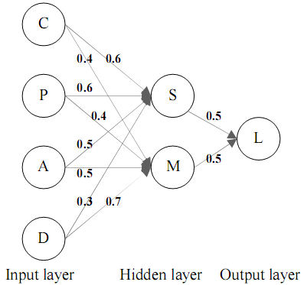
II. Document classification based on ANN
The ANN for Document classification

Slide 28
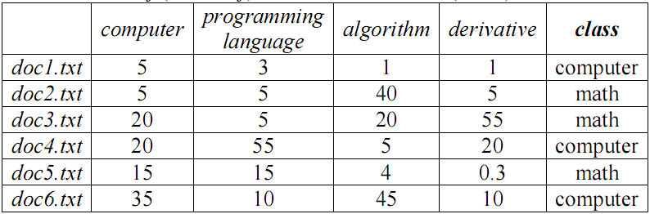
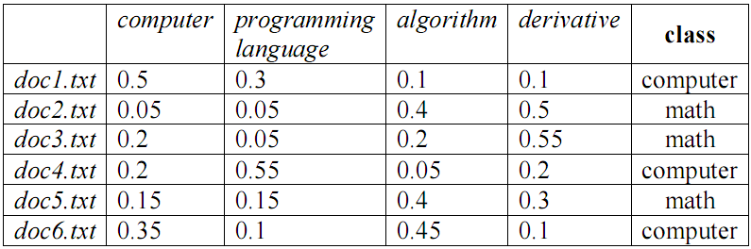
II. Document classification based on ANN
Given a set of classes C = {computer science, math}, a set of terms T = {computer, programming language, algorithm, derivative} and the corpus D = {doc1.txt, doc2.txt, doc3.txt, doc4.txt, doc5.txt}
Term frequencies of documents
Normalized term frequencies

Slide 29
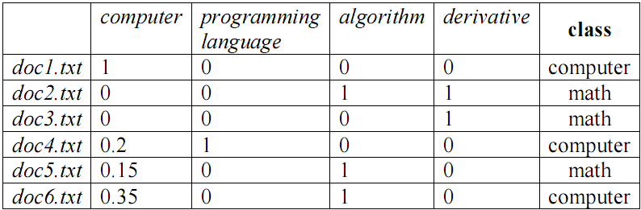
II. Document classification based on ANN
Given threshold α = 0.4, if the frequency of a term j in document i is equal or greater than α, we consider that term j exists in document i. Otherwise there is no existence of term j in document i.
So each document is represented as a Boolean vector
Boolean document vectors

Slide 30
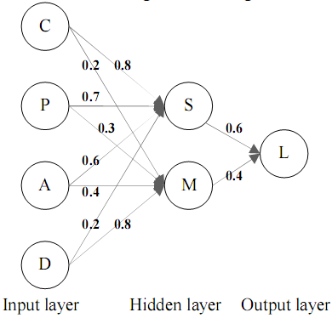
II. Document classification based on ANN
Such vectors are fed to our neural network. Back-propagation algorithm is used to train network; thus Boolean document vectors are considered training tuples
We suppose that the weights in neural network are changed as in below figure after training process

Slide 31
III. Discovering user interests based on document classification
User interest is one of personal traits attracting researchers’ attention in user modeling and user profiling
I propose a new approach for discovering user interest based on document classification. The basic idea is to consider user interests as classes of documents
The process of classifying documents is also the process of discovering user interests

Slide 32
III. Discovering user interests based on document classification
There are two new points of view
The series of user access in his/her history are modeled as documents. So user is referred indirectly to as “document”.
User interests are classes such documents are belong to

Slide 33
III. Discovering user interests based on document classification
Our approach includes four following steps
Documents in training corpus are represented according to vector model. Each element of vector is product of term frequency and inverse document frequency. However the inverse document frequency can be removed from each element for convenience
Classifying training corpus by applying decision tree or support vector machine or neural network.
Mining user’s access history to find maximum frequent itemsets. Each itemset is considered a interesting document and its member items are considered as terms. Such interesting documents are modeled as vectors
Applying classifiers (see step 3) into these interesting documents in order to choose which classes are most suitable to these interesting documents. Such classes are user interests

Slide 34
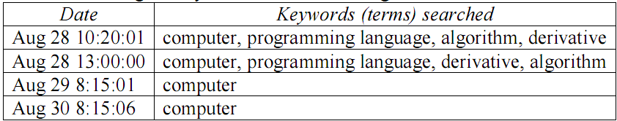
III. Discovering user interests based on document classification
Suppose in some library or website, user U do his search for his interesting books, documents
There is demand of discovering his interests so that such library or website can provide adaptive documents to him whenever he visits in the next time
Given there is a set of key words or terms {computer, programming language, algorithm, derivative} that user U often looking for, the his searching history is showed in following table:
User searching history

Slide 35
III. Discovering user interests based on document classification
Mining interesting documents
This history is considered as training dataset for mining maximum frequent itemsets
We propose the new point of view: “The maximum frequent itemsets are considered as documents and the classes of such documents are considered as user interests”
Such documents may be called interesting documents which are modeled as vectors. Discovering user’s interests is classifying these vectors
It is possible to use SVM or decision tree or neural network to classify these vectors

Slide 36
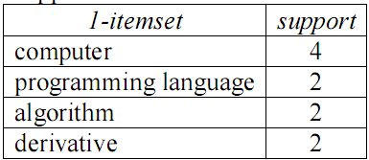

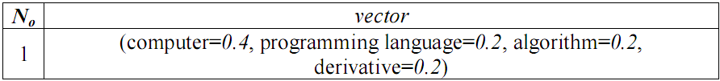
III. Discovering user interests based on document classification
Using SVM, ANN or Decision Tree to classify this vector
This vector belongs to class compute science → user interest is computer science

Slide 37
Conclusion
The series of user access in his/her history are modeled as documents. So user is referred indirectly to as document
User interests are classes that such documents are belong to

Slide 38
Reference
M. Zaki. An efficient algorithm for mining frequent sequences. Machine Learning, 40:31-60, 2001.
J. Han, J. Pei and Y. Yin. Mining frequent patterns without candidate generation. In Proc. 2000 ACM-SIGMOD Int. Conf. Management of Data (SIGMOD00), pp. 112, Dallas, TX, May 2000.
R. Srikant and R. Agrawal. Mining sequential patterns: Generalizations and performance improvements. In Proc. 5th Int. Conf. Extending Database Technology (EDBT96), pp. 317, Avignon, France, Mar. 1996.
R. Agrawal and R. Srikant. Mining sequential patterns. In Proc. 1995 Int. Conf. Data Engineering (ICDE95), pp.314, Taipei, Taiwan, Mar.1995.
R. Agrawal and R. Srikant. Fast algorithms for mining association rules. In Proc. 1994 Int. Conf. Very Large DataBases (VLDB94), pp. 487-499, Santiago, Chile, Sept. 1994. 〈〉

Slide 39
Conclusion
The technique of constructing vector model for representing document is not important to this approach. There are some algorithms of text segmentation for specifying all terms in documents
However the concerned techniques of document classification such as SVM, decision tree and neural network influence extremely on this approach.
SVM and neural network is more effective than decision tree in case of huge training data set but it is not convenient for applying classifiers (weight vector W*) into determining the classes of documents.
Otherwise it is easy to use classification rules taken out from decision tree for this task

Slide 40
Reference
N. Cristianini and J. Shawe-Taylor. An Introduction to Support Vector Machines. Cambridge University Press, 2000.
T. Mitchell. Machine Learning. McGraw-Hill International, 1997
C.Cortes and V.Vapnik. Support vector networks. Machine Learning, 20:273–297, 1995
Mohammad Alrifai, Peter Dolog, Wolfgang Nejdl. Learner Profile Management for Collaborating Adaptive eLearning Applications. APS'2006: Joint International Workshop on Adaptivity, Personalization and the Semantic Web at the 17th ACM Hypertext’06 conference, Odense, Denmark, August 2006
Rojas, R. Neural Networks: A Systematic Introduction. Springer, Berlin 1996
Lippmann, R. P. An introduction to computing with neural nets. IEEE Transactions on Acoustics, Speech, and Signal Processing 1987
Christos Papatheodorou. Machine Learning in User Modeling. Lecture Notes in Artificial Intelligence (LNAI), No 2049: Springer-Verlag, 2001, pp. 286-294
Jiawei Han and Michelline Kamber. Data Mining: Concepts and Techniques. Second Edition. © 2006 by Elsevier Inc.

Slide 41
THANK FOR CONSIDERATION

