Slide 1

Bayesian overlay model
Bayesian network
Bayesian applications
Bayesian overlay model
EM algorithm
Dynamic Bayesian network
PhD. Report: | Bayesian overlay model (August 15th 2009)
Professor: | Pr. Dr. Dong Thi Bich Thuy
Researcher: | Nguyen Phuoc Loc
Affiliation: | Department of IS, Faculty of IT, University of Science

Slide 2
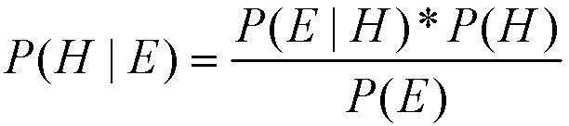
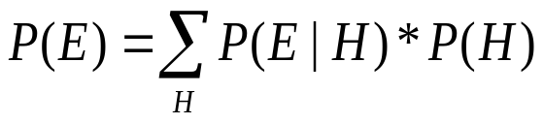
I. Bayesian network
H is probability variable denoting a hypothesis existing before evidence
E is also probability variable notating an observed evidence
P(H) is prior probability of hypothesis. It is also hypothesis’ initial value
P(H | E), conditional probability of H with given E, is called posterior probability. It tell us the changed belief in hypothesis when occurring evidence
P(E | H) is conditional probability of occurring evidence E when hypothesis was true. So we can consider P(E | H) as likelihood function of H with fixed E
P(E) is probability of occurring evidence E together all mutually exclusive cases of hypothesis. If H and E are discrete

Slide 3
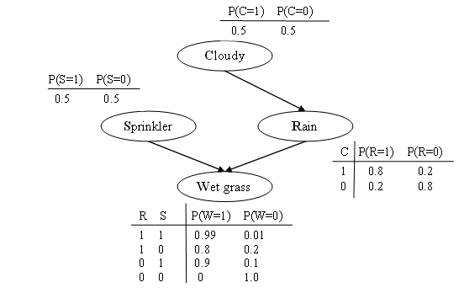
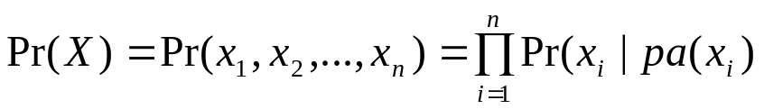
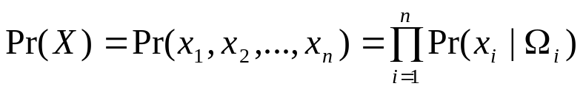
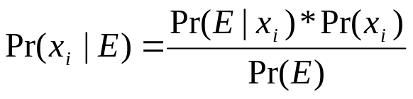
I. Bayesian network
Pr(X) is the Global Joint Probability Distribution
Ω_{i} is the subset of pa(x_{i}) such that xi must depend conditionally and directly on every variable in Ωi
Pr(x_{i} | E) is the Prior probability of random variable x_{i}

Slide 4
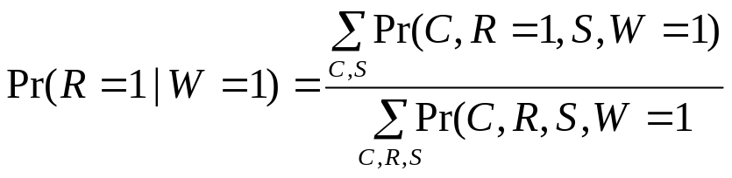
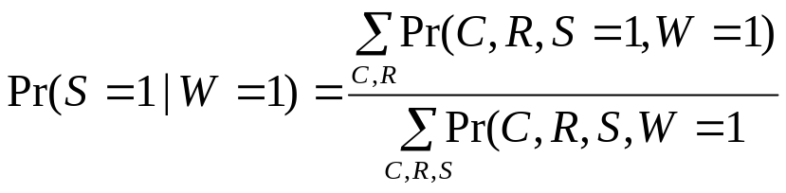
I. Bayesian network
Pr(R=1|W=1)=0.4475/0.7695=0.581< Pr(S=1|W=1)=0.4725/0.7695=0.614
It is concluded that sprinkler is the most likely cause of wet grass.

Slide 5
II. Bayesian applications
Three approaches to building up BN
Expert-centric method: The structure and conditional probabilities are defined totally by experts
Efficiency-centric method: The structure and conditional probabilities are specified and restricted based on some restrictions
Data-centric method: The structure and conditional probabilities are learned directly from real-world data by learning machine algorithms

Slide 6
II. Bayesian applications
KBS Hyperbook system
The domain is composed of a set of knowledge item (KI)
Suppose KI₁ is prerequisite for KI₂, the partial order is denoted as KI₁ < KI₂
User knowledge is represented as a knowledge vector
KV(u) = { Pr(KI₁|E), Pr(KI₂|E),..., Pr(KI_{n}|E) }

Slide 7
II. Bayesian applications
KBS: each KI has four discrete grades {E, F, A, N}
E is an abbreviation of expert, which refers that user has expert’s knowledge on a KI.
F refers that user has advanced knowledge on a KI with some difficulties but mainly excellent.
A refers that user has beginner’s knowledge on a KI.
N is an abbreviation of novice, which refers that user don’t know anything about a KI.

Slide 8
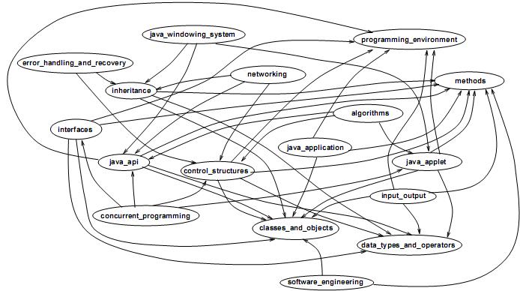
II. Bayesian applications
KBS: Dependency graph

Slide 9
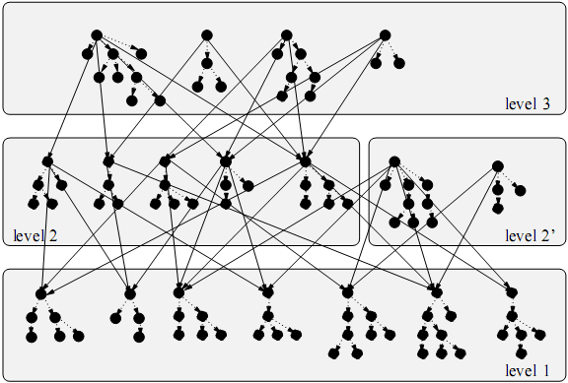
II. Bayesian applications
KBS: The levels of KI (s)
The first level includes top-most KI (s)
The second level includes KI (s) that require top-most KI (s). This level is further divided into two parts: one that is prerequisite for some third-level KI (s) and one that is not required by any third-level KI
The third level includes KI (s) that require second-level KI (s).

Slide 10
II. Bayesian applications
KBS: clustering
The computation expense of inference tasks increases exponentially when continuously directed cycles exists in network
Clustering is the technique used in KBS
A
A
B
C
BC
D
D

Slide 11
II. Bayesian applications
KBS: Yet Another Clustering Formalism
KBS develops a new clustering approach so-called Yet Another Clustering Formalism (YACF)
There are two kinds of nodes: the (normal) node that represents KI and the (additional) cluster node
Nodes of level 3
…..
Nodes of level 2’
Cluster 1
…..
Cluster 2
…..
…..
Nodes of level 2
Nodes of level 1

Slide 12
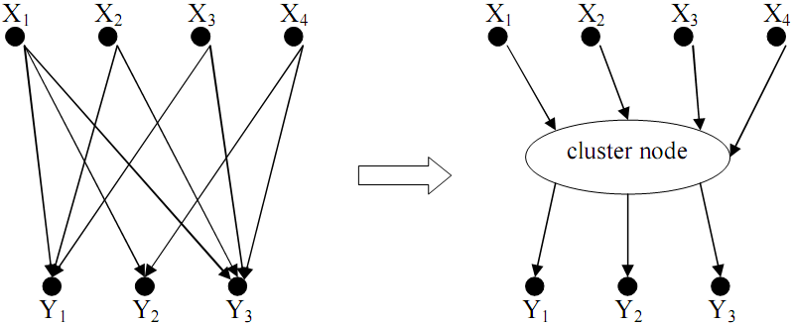
II. Bayesian applications
KBS: Cluster node

Slide 13
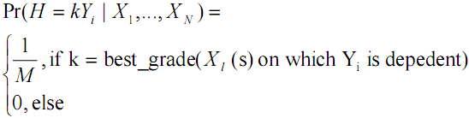
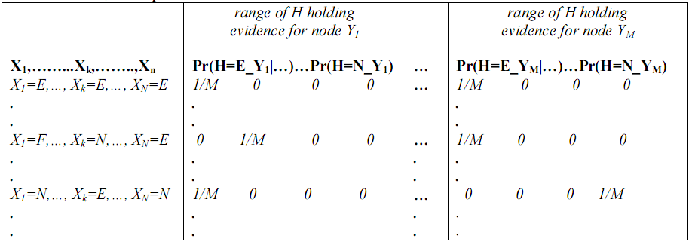
II. Bayesian applications
KBS: CPT of cluster node

Slide 14
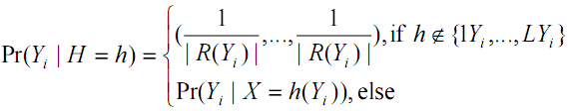

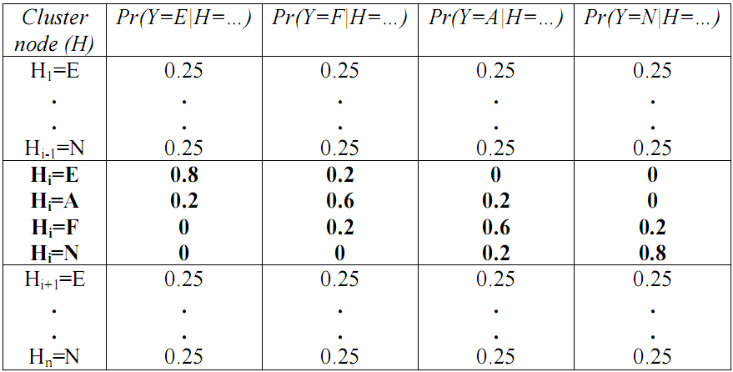
II. Bayesian applications
KBS: CPT of child node given cluster node

Slide 15
II. Bayesian applications
Andes
Cognitive Model
Physics Problem (rules)
Student Model
(Prior probabilities for all rules)
Problem
Solution Graph
Student
Bayesian Network
Student Data
Updated
Bayesian network
Output Student Model
(Posterior probabilities for all rules)
Student modeling in Andes →Bayesian network is converted from Solution Graph

Slide 16
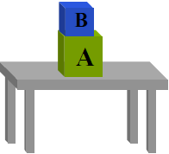
II. Bayesian applications
Andes: example
A block (A) of mass 50kg rests on top of a table. Another block (B) of mass 10kg rests on top of block A.
What is the normal force exerted by the table on block A?

Slide 17
II. Bayesian applications
G-find-N_{at}
R-try-Newton-2law
RA-try-Newton-2law
G-try-Newton-2law
R-choose-bodies
RA-choose-bodies
Andes: Solution Graph
R-choose-separate-bodies
G-choose-bodies
RA-choose-separate-bodies
G-define-bodies-A-B
F-B-is-body
F-A-is-body
G-define-forces-on-A

Slide 18
II. Bayesian applications
Andes: Bayesian network has two parts
Domain-general part that encodes the domain-general knowledge. It is stable & based on domain-general knowledge base including rules.
Task-specific part that encodes the task-specific knowledge. It is temporal when it is automatically generated from the solution graph of each problem or exercises on which students work.
When students finish their problem or exercise, the task-specific part is discarded and the posterior marginal probabilities of domain-general part is computed and used as the priors for next time.

Slide 19
II. Bayesian applications
Andes: Domain general part
Rule node represents a piece of knowledge in its fully general form
Context-rule node represents the mastery of a rule in concrete problem solving context.
Pr(context-rule=mastered | rule=mastered) = 1: student master the general knowledge then she/he can apply it to solve any problems
Pr(context-rule=mastered | rule=not-mastered): student solve successfully a problem even if she/he doesn’t master the general knowledge
rule
context-rule 1
context-rule 2
.....
context-rule n

Slide 20
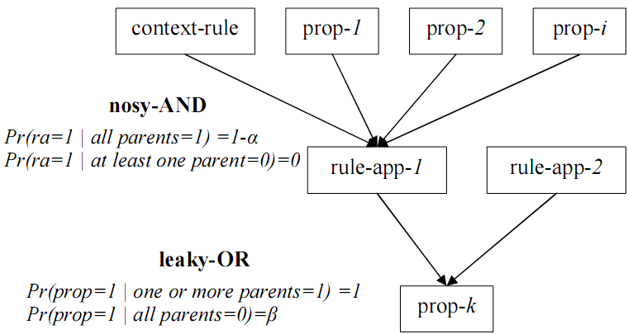
II. Bayesian applications
Andes: Task-specific part
The task-specific part includes rule-context nodes and four other nodes: fact, goal, rule-application, strategy which are denoted with prefix r-, f-, g-, ra-, s-. Fact and goal node are also called proposition node denoted with prefix prop-

Slide 21
II. Bayesian applications
G-find-N_{at}
0.99/0.99
R-try-Newton-2law
0.5/0.5
RA-try-Newton-2law
G-try-Newton-2law
0.32/0.33
R-choose-bodies
0.5/0.51
RA-choose-bodies
Andes: Inference
R-choose-separate-bodies
G-choose-bodies
0.24/0.25
0.5/0.51
RA-choose-separate-bodies
G-define-bodies-A-B
0.11/0.22
0.16/0.27
F-B-is-body
F-A-is-body
0.15/1.0
G-define-forces-on-A
0.12/0.24

Slide 22
II. Bayesian applications
SQL-Tutor: Constraint-Based Modeling (CBM)
A constraint is a pair <Cr, Cs> denoting relevance condition and satisfaction condition, respectively
Both Cr and Cs are patterns used to match the states of student’s solutions but Cs is more specific than Cr
For example, the Cr=(n1+n2=*) of a constraint is defined to match any string of form n1+n2=*
For example, Cs is n1+n2=add(n1, n2) where add is the function is responsible for adding two numbers

Slide 23
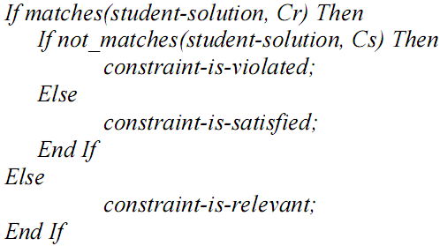
II. Bayesian applications
SQL-Tutor: Constraint-Based Modeling (CBM)
Satisfied: If student’s solution is matched with both Cr and Cs
Relevant: only Cr matches the solution
Violated: both Cr and Cs don’t match this solution

Slide 24
II. Bayesian applications
SQL-Tutor: Architecture
Student Models
CBM
Student Modeler
Constraints
Databases
Problems
Solutions
Pedagogical
Modules
Interface
students

Slide 25

II. Bayesian applications
SQL-Tutor: user model
The student model is constituted of a set of binary variables (matered₁, matered₂,…, matered_{n}) where matered_{c} expresses whether the constraint c is mastered
The initial value of Pr(matered_{c}=1) is the ratio of the frequency that constraint c is satisfied to the frequency that constraint c is relevant in the past

Slide 26
II. Bayesian applications
SQL-Tutor: updating user model
If constraint c is satisfied then Pr(mastered_{c}=1) increases by 10% of the value 1–Pr(mastered_{c}=0).
If constraint c is violated and no feedback about c is given then Pr(mastered_{c}=1) decreases by 20%.
If constraint c is violated but feedback is given about c then Pr(masteredc =1) increases by 20% of the value 1–Pr(masteredc=1).

Slide 27
II. Bayesian applications
SQL-Tutor: updating user model
Let L denote student’s mastery of constraint and let M denote the outcome of the last student’s solution at this constraint
L takes values 1 (mastered) and 0 (not mastered). M takes value 1 (satisfied) and 0 (violated).
Updating probability of student’s mastery is to compute the posterior probability Pr(L|M) when M is observed

Slide 28
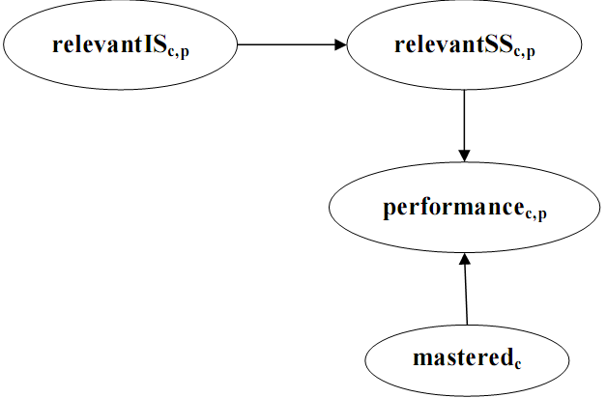
II. Bayesian applications
SQL-Tutor: Bayesian network
Let matered_{c} be the binary expressing whether where student masters constraint c
The binary relevantIS_{c,p} expresses whether constraint c is relevant to the ideal solution of problem p
The binary relevantSS_{c,p} expresses whether constraint c is relevant to the student’s solution to problem p
The variable performance_{c,p} having three values satisfied, violated and not-relevant denotes the performance of student given the problem p on constraint c

Slide 29
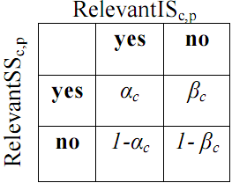
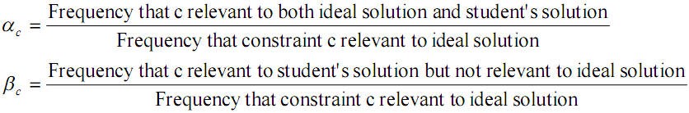
II. Bayesian applications
SQL-Tutor: The CPT of relevantSS_{c,p} given relevantIS_{c,p}
The parameter α_{c} (β_{c}) denotes the probability of constraint c being relevant to the student’s solution given that the student’s solution is (not) relevant to the problem’s ideal solution

Slide 30

II. Bayesian applications
Data-centric method
The correlation between two nodes is measured by the amount of information flow between them, so-called mutual information
The higher the mutual information of two nodes, the more the correlation between them is, in other words, the more likely there is an arc connecting them
X
Y

Slide 31
II. Bayesian applications
Data-centric method: three phases
Drafting phase: connect every pair (X,Y) has the I(X,Y) reaches a threshold. The output of this phase is the single-connected network
Thickening phase: for every pairs (X, Y), if there is no cut-set that d-separates X and Y then an arc is added between X. The output of this phase is the network that is full of arcs.
Thinning phase: remove redundant arcs from network. Firstly, for each pair of adjacent nodes (X,Y), we remove temporarily the arc connecting them. Secondly, we try to find the cut-set that separates X from Y. If such cut-set exists then this arc is removed permanently from network; otherwise it is kept intact.

Slide 32
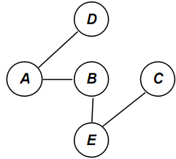
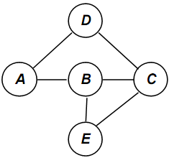
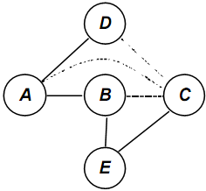
II. Bayesian applications
Data-centric method
Drafting phase
Thickening phase
Thinning phase

Slide 33
II. Bayesian applications
Evaluation
KBS Hyperbook: strong point is to eliminate cycle in network but it has no initiative in ITS
Andes: the instruction is very good but user model is slight complex. The separation between domain model and user model is not clear.
SQL-Tutor: The strong point is to build up and exploit short-term user model by constraint when student solve problem but the inference mechanism is poor.
Data-centric method: the strong point is to learning network from real data but in many situation it is very foolish because of the limitation and the confusion of heuristic algorithm. It is very difficult to reflect the real curriculum by using such algorithm.

Slide 34
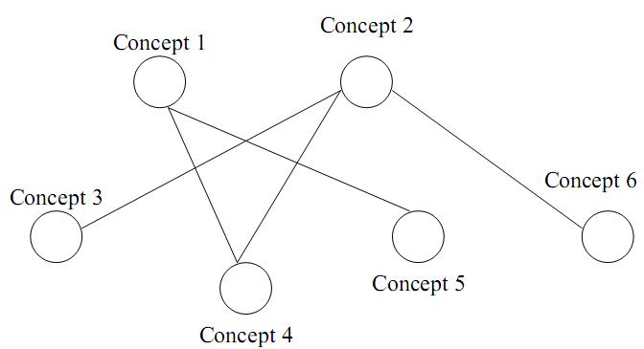
III. Bayesian overlay model
Overlay Model
Essential idea: The learner model is the subset of domain model
The domain is decomposed into a set of elements and the overlay model is simply a set of masteries over those elements.
Expert model is the overlay with 1 (mastered) for each element and the learner model is the overlay with at most 1 for each element
IT@EDU 2008

Slide 35
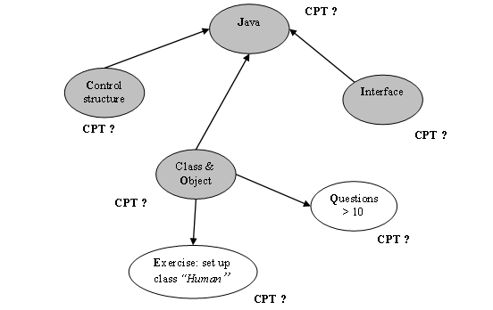
III. Bayesian Overlay Model
Combination of overlay model & Bayesian network
The structure of overlay model is considered as BN. Thus, knowledge elements in domain become variables (or nodes) in BN
The prerequisite relationships between knowledge elements are known as the conditional dependence assertions in BN. Accordingly, each node has a CPT
All knowledge elements are defined as hidden variables (hypothesis). Other learning objects or events (such as: tests, exams, exercises, user’s feedback, user’s activities) which are used to assess or evaluate user’s performance in learning process are consider as evidence variables

Slide 36
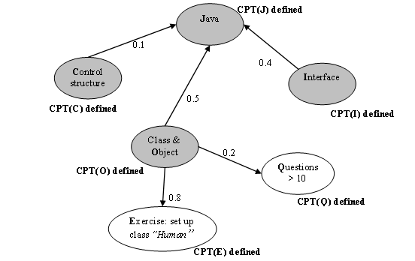
III. Bayesian Overlay Model
Defining the weights of arcs
The number (in range 0…1 ) that measures the relative importance of each prerequisite or evidence is defined as the weight of arc from parent node to child node
Prerequisite relationships among hidden variables
Diagnostic relationships of hidden variables to evidences

Slide 37
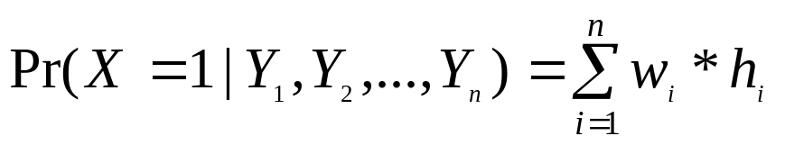
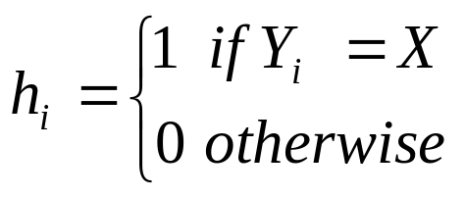
III. Bayesian Overlay Model
Specifying CPT from the weights of arcs
T₁
C O I | p(J = 1) | P(J = 0) 1- p(J = 1)
1 1 1 | 1.0 (0.1*1 + 0.5*1 + 0.4*1) | 0.0
1 1 0 | 0.6 (0.1*1 + 0.5*1 + 0.4*0) | 0.4
1 0 1 | 0.5 (0.1*1 + 0.5*0 + 0.4*1) | 0.5
1 0 0 | 0.1 (0.1*1 + 0.5*0 + 0.4*0) | 0.9
0 1 1 | 0.9 (0.1*0 + 0.5*1 + 0.4*1) | 0.1
0 1 0 | 0.5 (0.1*0 + 0.5*1 + 0.4*0) | 0.5
0 0 1 | 0.4 (0.1*0 + 0.5*0 + 0.4*1) | 0.4
0 0 0 | 0.0 (0.1*0 + 0.5*0 + 0.4*0) | 1.0
T₂
E | Pr(E = 1) | Pr(E = 0) 1- Pr(E = 1)
1 | 0.8 (0.8*1) | 0.2
0 | 0.0 (0.8*0) | 1.0
T₃
Q | Pr(Q = 1) | Pr(Q = 0) 1- Pr(Q = 1)
1 | 0.2 (0.2*1) | 0.8
0 | 0.0 (0.2*0) | 1.0

Slide 38
III. Bayesian Overlay Model
Evaluation
The expense of data storage is high. A BN which has n variables together n CPT_{(s)} with 2^{n} parameters (values in CPT_{(s)}) under constraint: “each variable is binary (0 and 1)”
→be only restricted by programming technique when implementing network and it would be best to declare binary variables
The computation of posterior probability which is basis of inference consumes much time when executing in runtime because it is rather complex
→use CPT instead of continuous probability density/distribution function for solving

Slide 39
III. Bayesian Overlay Model
Evaluation
Our technique, a kind of efficiency-centric method, is simple to implemented. It is not required complex learning algorithm like data-centric method and the performance of inference tasks in run time is kept stable and fast
But the structure and parameter of Bayesian network is assured quality because the experts who design network are teachers and they comprehend over the curriculum.
Moreover this thesis also introduces two other techniques to improve the conditional probability tables (or parameters) and the structure of Bayesian network: EM algorithm and dynamic Bayesian network

Slide 40
III. Bayesian Overlay Model
Two proposed techniques of improvement
Using EM algorithm to improve CPT. This process is called parameter learning
Using Dynamic Bayesian Network to monitor user’s learning process

Slide 41
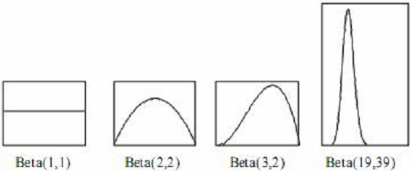

IV. EM algorithm
Beta density function

Slide 42
IV. EM algorithm
Parameter learning
Suppose the density function is the beta function β(f_{ij}; a_{ij}, b_{ij})
Variable X_{i} has the prior conditional probability Pr(X_{i}=1|pa_{ij}=1)=E(β(f_{ij}))= a_{ij}/N_{ij}
The parameter learning process based on a set of evidences is to update the posterior density function β(f_{ij}|E). It means that:
Pr(X_{i}=1|pa_{ij}=1, E)=(a_{ij}+s_{ij})/(N_{ij}+M_{ij})
Where s is the number of all evidences having value 1 (success), otherwise, t is the number of all evidences having value 0 (failed).

Slide 43
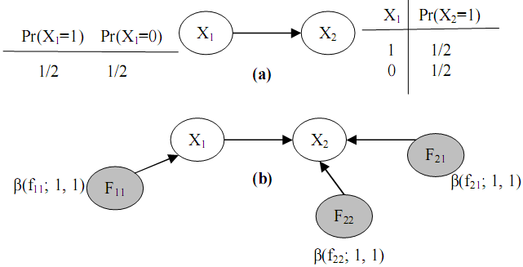
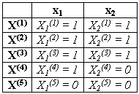

IV. EM algorithm
Parameter learning

Slide 44
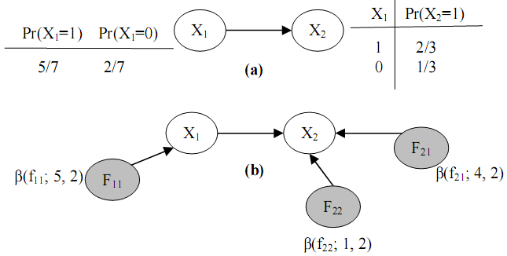

IV. EM algorithm
Parameter learning

Slide 45
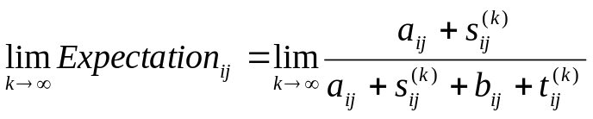
IV. EM algorithm
Parameter learning in case of data missing
Step1. We compute s’ij and t’ij based on the expected value of given β(fij), s’_{ij}=E(β(f_{ij})) and t’_{ij}=1- E(β(f_{ij})). Next, replacing missing data by s’ij and t’_{ij} . This step is called Expectation step
Step 2. We determine the posterior density function f_{ij} by computing its parameters a_{ij}=a_{ij}+s_{ij} and b_{ij}=b_{ij}+t_{ij}. Terminating algorithm if the stop condition becomes true, otherwise, reiterating step 1. This step is called the Maximization step.
After k^{th} iteration, will approach an certain limit

Slide 46
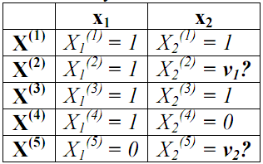
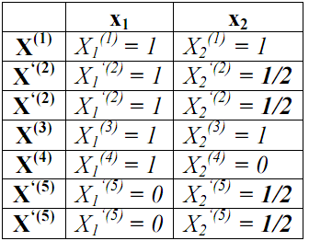


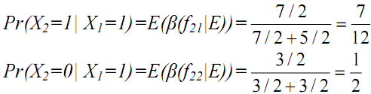
IV. EM algorithm
Parameter learning in case of data missing

Slide 47
V. Dynamic Bayesian network
What is Dynamic Bayesian network (DBN)
Given finite number T of time points
Let x_{i}[t] be the variable representing the value of x_{i} at time t where 0<= t <= T
Let X[t] be the temporal random vector denoting the random vector X at time t, X[t] = {x₁[t], x₂[t],…, x_{n}[t]}

Slide 48
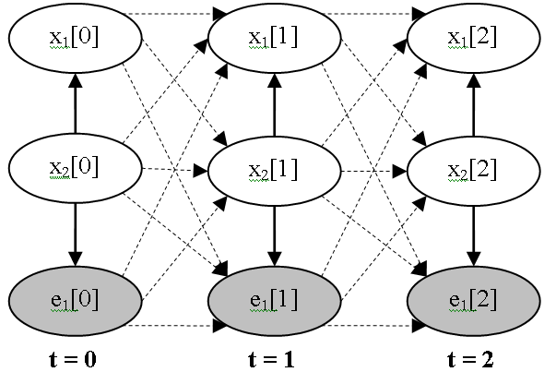
V. Dynamic Bayesian network
A DBN is BN containing variables that comprise T variable vectors X[t]
An initial BN G₀ = {X[0], Pr(X[0]} at first time t = 0
A transition BN is a template consisting of a transition DAG G→ containing variables in X[t], X[t+1] and a transition probability distribution Pr→ (X[t+1] | X[t])

Slide 49
V. Dynamic Bayesian network
Inference in DBN
The inference in DBN is similar to BN
But the Distributed Global Joint Probability Distribution of DBN is more complex than Global Joint Probability Distribution of BN

Slide 50
V. Dynamic Bayesian network
Strong points of DBN
DBN can model the temporal relationships among variables. It can capture the dynamic aspect
So DBN allows monitoring user’s process of gaining knowledge and evaluating her/his knowledge

Slide 51
V. Dynamic Bayesian network
Drawbacks of DBN
The size of DBN becomes numerous when the process continues for a long time
The number of transition dependencies among points in time is too large to compute posterior marginal probabilities

Slide 52
V. Dynamic Bayesian network
Purposes of suggested algorithm to improve DBN
To overcome these drawbacks, we propose the new algorithm that both the size of DBN and the number of Conditional Probability Tables in DBN are kept intact (not changed) when the process continues for a long time
Our algorithm also solves the problem of temporary slip and lucky guess: “learner does (doesn’t) know a particular subject but there is solid evidence convincing that she/he doesn’t (does) understand it; this evidence just reflects a temporary slip (or lucky guess)”.

Slide 53
V. Dynamic Bayesian network
Two constraints
Markov property: given the current time point t, the conditional probability of next time point t+1 is only relevant to the current time point t, not relevant to any past time point (t-1, t-2,…,0) .
Pr→(X[t+1] | X[0], X[1],…, X[t])=Pr→(X[t+1] | X[t])
Stationary: Pr→(X[t+1] | X[t]) is the same for all t

Slide 54
V. Dynamic Bayesian network
The algorithm includes 6 steps that repeated whenever evidences occur
Initializing DBN
Specifying transition weights
Re-constructing DBN
Normalizing weights of dependencies
Re-defining CPT (s)
Probabilistic inference

Slide 55
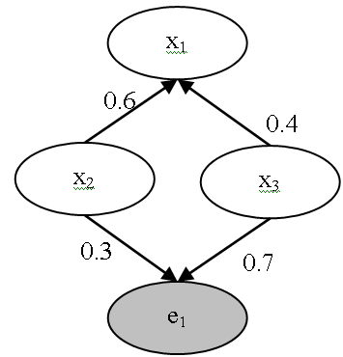
V. Dynamic Bayesian network
Step 1: Initializing DBN
If t > 0 then jumping to step 2
Otherwise, all variables (nodes) and dependencies (arcs) among variables of initial BN G₀ must be specified. The strength of dependency is considered as weight of arc

Slide 56


V. Dynamic Bayesian network
Step 2: Specifying transition weight
Given two factors: slip and guess where slip (guess) factor expresses the situation that user does (doesn’t) know a particular subject but there is solid evidence convincing that she/he doesn’t (does) understand it; this evidence just reflects a temporary slip (or lucky guess)
slip = Pr(not x[t+1] | x[t])
guess = Pr(x[t+1] | not x[t])

Slide 57

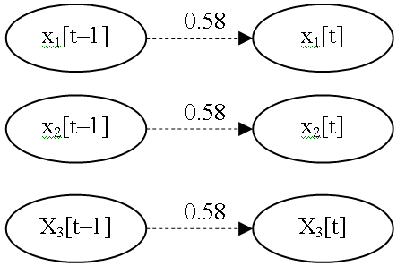
V. Dynamic Bayesian network
Step 2: Specifying transition weight
Suppose slip = 0.3 and guess = 0.2

Slide 58
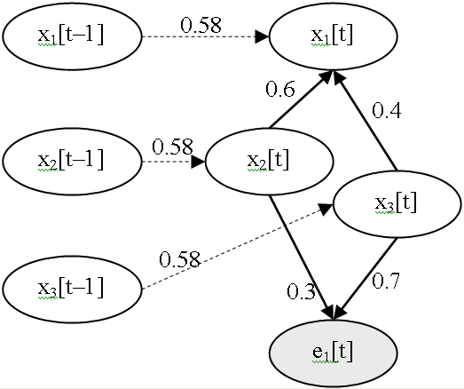
V. Dynamic Bayesian network
Step 3: Re-constructing DBN
For each time point t, we create a new BN G’[t] whose variables include all variables in X[t–1] X[t] except evidences in X[t–1]. G’[t] is called augmented BN at time point t
All conditional dependencies among variables in X[t–1] are removed from G’[t]

Slide 59
V. Dynamic Bayesian network
Step 4: Normalizing weights of dependencies
Suppose variable x_{i}[t] has k-1 weights w_{i2}, w_{i3},…, x_{ik} corresponding to k-1 parents and a transition weight w_{i1} of temporal relationship between x_{i}[t-1] and x_{i}[t]
We have:
w_{i2}=w_{i2}*(1–w_{i1}), w_{i3}=w_{i3}*(1–w_{i1}),…, w_{ik}=w_{ik}*(1–w_{i1})
 | w₁₁ | w₁₂ | w₁₃
x₁[t] | 0.58 | 0.6 | 0.4
x₁[t] (normalized) | 0.58 | 0.252 | 0.168

Slide 60
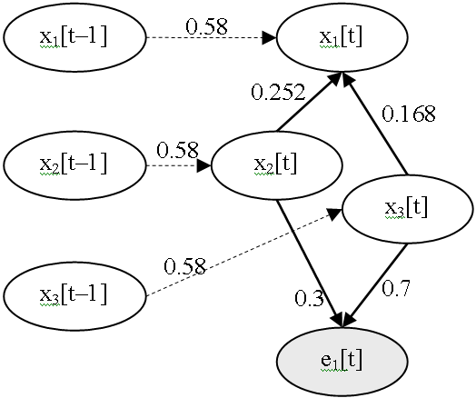
V. Dynamic Bayesian network
Step 4: Normalizing weights of dependencies

Slide 61
V. Dynamic Bayesian network
Step 5: Re-defining CPT_{(s)}
Determining CPT for each variable x_{i}[t-1] in X[t–1]
Re-defining CPT for each variable x_{i}[t] in X[t]

Slide 62
V. Dynamic Bayesian network
Step 5: Re-defining CPT_{(s)}
Determining CPT_{(s)} of X[t–1]. The CPT of x_{i}[t-1] is the posterior probabilities which were computed in step 6 of previous iteration
Pr(x₁[t-1]=1) | Pr(x₁[t-1]=0)
α₁: the posterior probability of x₁ computed at previous iteration | 1 – α₁
Pr(x₂[t-1]=1) | Pr(x₂[t-1]=0)
α₂: the posterior probability of x₂ computed at previous iteration | 1 – α₂
Pr(x₃[t-1]=1) | Pr(x₃[t-1]=0)
α₃: the posterior probability of x₃ computed at previous iteration | 1 – α₃

Slide 63

V. Dynamic Bayesian network
Step 5: Re-defining CPT_{(s)}
Re-defining CPT(s) of X[t]
x₁[t-1] x₂[t] x₃[t] | Pr(x₁[t]=1) | Pr(x₁[t]=0)
1 1 1 | 1.0 (0.58*1+0.252*1+0.168*1) | 0.0
1 1 0 | 0.832 (0.58*1+0.252*1+0.168*0) | 0.168
1 0 1 | 0.748 (0.58*1+0.252*0+0.168*1) | 0.252
1 0 0 | 0.58 (0.58*1+0.252*0+0.168*0) | 0.42
0 1 1 | 0.42 (0.58*0+0.252*1+0.168*1) | 0.58
0 1 0 | 0.252 (0.58*0+0.252*1+0.168*0) | 0.748
0 0 1 | 0.168 (0.58*0+0.252*0+0.168*1) | 0.832
0 0 0 | 0.0 (0.58*0+0.252*0+0.168*0) | 1.0

Slide 64
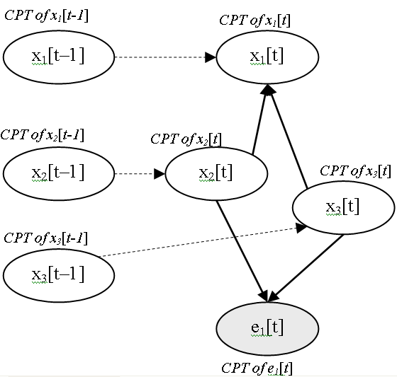
V. Dynamic Bayesian network
Step 5: Re-defining CPT(s)

Slide 65
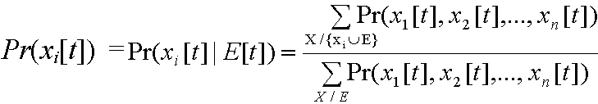
V. Dynamic Bayesian network
Step 6: Probabilistic Inference
The probabilistic inference in our augmented DBN can be done similarly to normal Bayesian network. It is essential to compute the posterior probabilities of non-evidence variable in X[t]
Such posterior probabilities are also used for determining CPT(s) of DBN in step 5 of next iteration. For example, posterior probabilities of x₁[t], x₂[t] and x₃[t] are α₁, α₂ and α₃ respectively
If the posterior probabilities are the same as before (previous iteration) then DBN converges when all posterior probabilities of variables x_{i}[t] gain stable values at any time. If so we can stop algorithm; otherwise turning back step 1

Slide 66
Conclusion
There are many features in user model but knowledge and learning style are the most important characteristic
There are some method to model user knowledge but overlay method is very appropriated to learning context
The combination of overlay model and Bayesian network give the powerful inference ability to user modeling system. It is not required complex learning algorithm but the structure and parameter of Bayesian network is assured quality because the experts who design network are teachers and they comprehend over the curriculum.
Moreover we improve Bayesian overlay model by parameter learning & structure learning. In this presentation we propose two improvement techniques: EM and DBN

Slide 67
Conclusion
The EM algorithm, a learning parameter algorithm, is applied to improve the quality of CPT(s) that specified by teachers
EM algorithm is implemented in offline process so as not to decrease the performance of inference task.
The EM is not so complicated but it is very efficient

Slide 68
Conclusion
The basic idea of improved DBN is to minimize the size of DBN and the number of transition probability in order to decrease expense of computation when the process of inference continues for a long time
However specifying slip factor and guess factor will solve the problem of temporary slip and lucky guess
The process of inference including six steps is done in succession through many iterations, the result of current iteration will be input for next iteration. After t^{th} iteration DBN will converge when the posterior probabilities of all variables x_{i}[t] gain stable values regardless of the occurrence of a variety evidences

Slide 69
Conclusion
In conclusion the method used to build up Bayesian network at here is the hybrid of efficiency-centric and data-centric method.
It takes advantages of both of them when it achieves the high-quality network (in data-centric method) and feasibility (in efficiency-centric)

Slide 70
Reference
David Heckerman. A Tutorial on Learning With Bayesian Networks. Technical Report MSR-TR-95-06. Microsoft Research Advanced Technology Division, Microsoft Corporation.
Eugene Charniak. Bayesian Network without Tears. AI magazine. 1991
Richard E. Neapolitan. Learning Bayesian Networks. Northeastern Illinois University Chicago, Illinois 2003
Flavia Sparacino. Sto(ry)chastics: a Bayesian Network Architecture for User Modeling and Computational Storytelling for Interactive Spaces. Lecture Notes in Computer Science, 2003
IT@EDU 2008

Slide 71
THANK FOR CONSIDERATION
IT@EDU 2008

