Slide 1
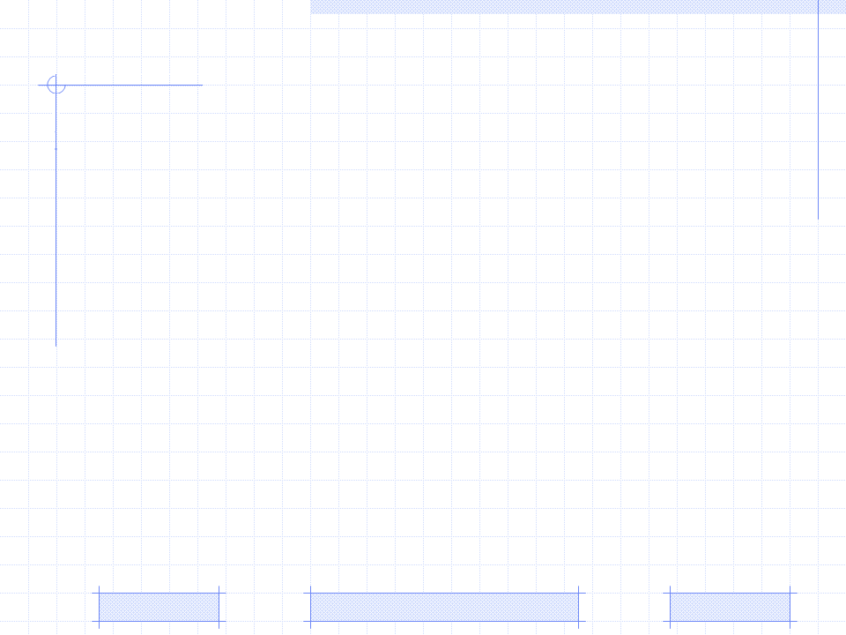
User Knowledge in User Modeling
User Model
Classification of User Model (focus on user knowledge)
Bayesian network
Bayesian overlay model
Dynamic Bayesian network
Improved Dynamic Bayesian network
PhD. Report: | User Knowledge in User Modeling (May 4th 2009)
Professor: | Pr. Dr. Dong Thi Bich Thuy
Researcher: | Nguyen Phuoc Loc
Affiliation: | Department of IS, Faculty of IT, University of Science

Slide 2
I. User Model
Basic Concept
User
Real World
machine – user interface
Learner Model
Computer
Static
Dynamic
Individual information
Pre-knowledge
Goals
Preference…
User Interaction with System
Knowledge
Learning Styles
IT@EDU 2008

Slide 3
I. User Model
Role of Learner Model
Interpret user action
System
User
Internal actions
Machine action
7 purposes of learner model (in e-learning):
- Assist a user during learning of a given topic.
- Offer information adjusted to the user.
- Adapt the interface to the user.
- Help user to ﬁnd information.
- Give the user feedback about his knowledge.
- Support collaborative work.
- Give assistance in the use of the system.
IT@EDU 2008

Slide 4
I. User Model
Content of Learner Model
Domain specific information (knowledge)
Vector model
Overlay model
Fault model
Domain Independent Information
Interests
Goals
Background & experience
Personal traits: Learning styles & Aptitudes
Preference
Demographic information: name, birth day, ID
IT@EDU 2008

Slide 5
I. User Model
Learning Styles
Learning styles | Description
Auditory | Prefer to listen to instructional content
Pictures | Prefer to perceive learning material as pictures
Text | Prefer to perceive learning material as text
Tactile Kinesthetic | Prefer to interact physically with learning material such as: puzzles, games
Internal Kinesthetic | Prefer to make connections (to personal and to past learning experiences)
Learner Group | Description
Activist | Like to have a go and see what happens
Reflector | Like to gather information and mull things over
Pragmatists | Prefer to perceive learning material as text
Theorist | Like tried and tested techniques which are relevant to my problems
IT@EDU 2008

Slide 6
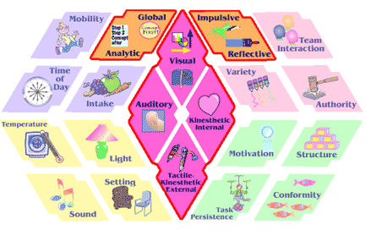
I. User Model
Learning Styles
Dum & Dunn model
IT@EDU 2008

Slide 7




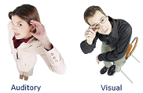

I. User Model
How to select and combine user characteristics?
IT@EDU 2008

Slide 8
II. Classification of User Model
Stereotype Model
Stereotype [Rich 1979] is a set of user's frequent characteristics
New learner will be classified according to their initial features, each classifier is a stereotype
Two kinds of stereotype: fix and default
ANY PERSON
NAÏVE-USER
AVERAGE-USER
EXPERT-USER
FRIENDLY-NAIVE
HOSTILE-NAIVE
IT@EDU 2008

Slide 9
II. Classification of User Model
Stereotype Model
There are three components in stereotype model
Trigger is used to active a stereotype. It is a condition (e.g. logic expression) to assign a stereotype to learner
Inference is inferring engine, responsible for deducing related information about user from stereotype
Retraction conditions are used to deactivate learner’s stereotype
IT@EDU 2008

Slide 10
II. Classification of User Model
Steps to build Stereotype Model
Steps to build Stereotype Model
Classify learner into groups, each group is candidate of stereotype
Determine key characteristic with its dependent information → identify trigger and inference engine
Build up hierarchy of stereotype, each stereotype is a group in full of important component such as: triggers, inference engine, retraction conditions
IT@EDU 2008

Slide 11
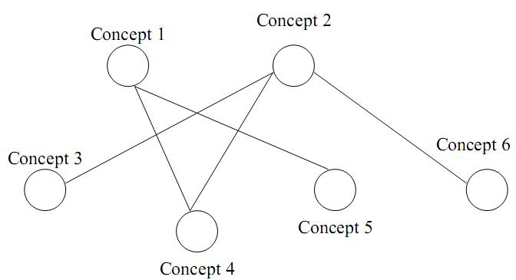
II. Classification of User Model
Overlay Model
Essential idea: The learner model is the subset of domain model
The domain is decomposed into a set of elements and the overlay model is simply a set of masteries over those elements.
Expert model is the overlay with 1 (mastered) for each element and the learner model is the overlay with at most 1 for each element
IT@EDU 2008

Slide 12
II. Classification of User Model
Differential Model
Similar to overlay model but based on expected knowledge which is knowledge that learner should be mastered at certain time
Differential model is basically an overlay on expected knowledge, which in turn is an overlay on expert’s domain knowledge
Differential model is instance of class “fault model”
IT@EDU 2008

Slide 13
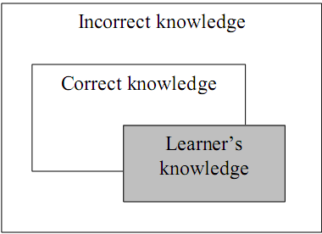
II. Classification of User Model
Perturbation Model
Perturbation model represents learners as the subset of expert’s knowledge (like overlay model) plus their mal-knowledge
Perturbation model is an instance of the class “fault model”.
IT@EDU 2008

Slide 14
II. Classification of User Model
Plan Model
Plan is a sequence of learners’ actions to achieve desires or concrete goals
Plan recognition was based on tracking input user's performance
There is the library consisting of all possible plans. User’s actions are regarded and matched to plans which store available in library.
The possible plan which is most similar to user’s actions is chosen as learner model
→ Complex computation and huge storage
IT@EDU 2008

Slide 15
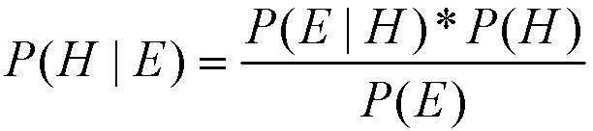
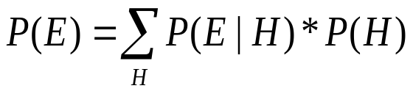
III. Bayesian network
H is probability variable denoting a hypothesis existing before evidence
E is also probability variable notating an observed evidence
P(H) is prior probability of hypothesis. It is also hypothesis’ initial value
P(H | E), conditional probability of H with given E, is called posterior probability. It tell us the changed belief in hypothesis when occurring evidence
P(E | H) is conditional probability of occurring evidence E when hypothesis was true. So we can consider P(E | H) as likelihood function of H with fixed E
P(E) is probability of occurring evidence E together all mutually exclusive cases of hypothesis. If H and E are discrete

Slide 16
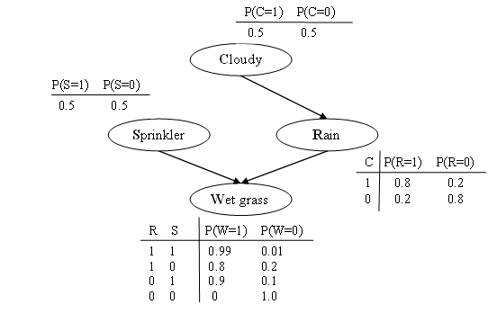
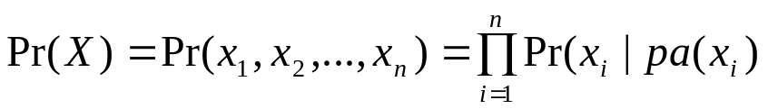
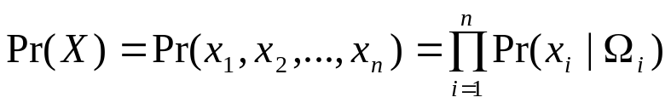
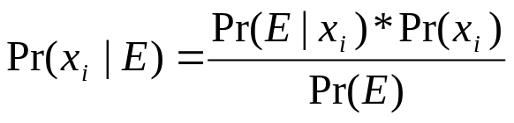
III. Bayesian network
Pr(X) is the Global Joint Probability Distribution
Ω_{i} is the subset of pa(x_{i}) such that xi must depend conditionally and directly on every variable in Ωi
Pr(x_{i} | E) is the Prior probability of random variable x_{i}

Slide 17
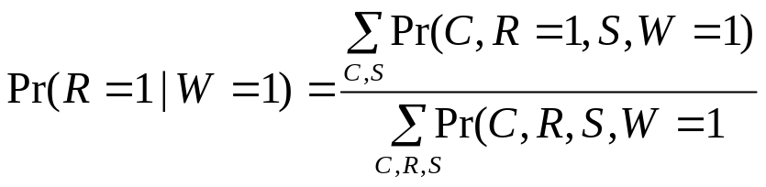
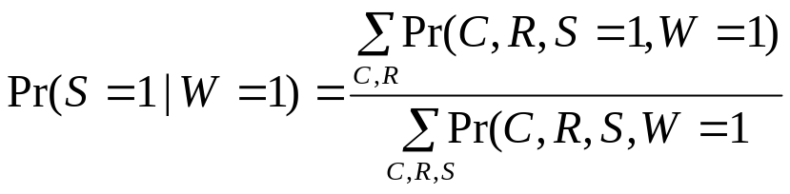
III. Bayesian network
Pr(R=1|W=1)=0.4475/0.7695=0.581< Pr(S=1|W=1)=0.4725/0.7695=0.614
It is concluded that sprinkler is the most likely cause of wet grass.

Slide 18
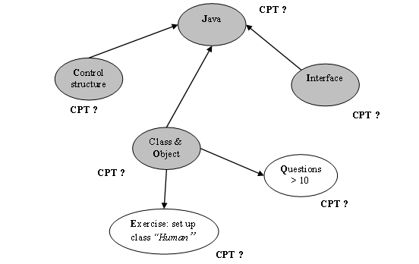
IV. Bayesian Overlay Model
Combination of overlay model & Bayesian network
The structure of overlay model is considered as BN. Thus, knowledge elements in domain become variables (or nodes) in BN
The prerequisite relationships between knowledge elements are known as the conditional dependence assertions in BN. Accordingly, each node has a CPT
All knowledge elements are defined as hidden variables (hypothesis). Other learning objects or events (such as: tests, exams, exercises, user’s feedback, user’s activities) which are used to assess or evaluate user’s performance in learning process are consider as evidence variables

Slide 19
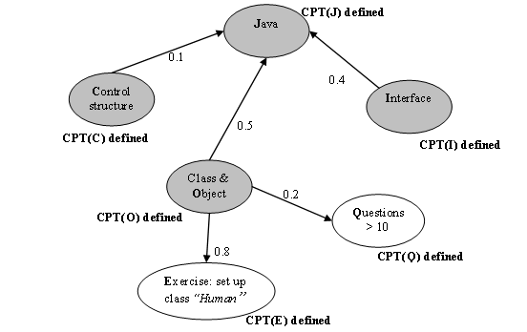
IV. Bayesian Overlay Model
Defining the weights of arcs
The number (in range 0…1 ) that measures the relative importance of each prerequisite or evidence is defined as the weight of arc from parent node to child node
Prerequisite relationships among hidden variables
Diagnostic relationships of hidden variables to evidences

Slide 20
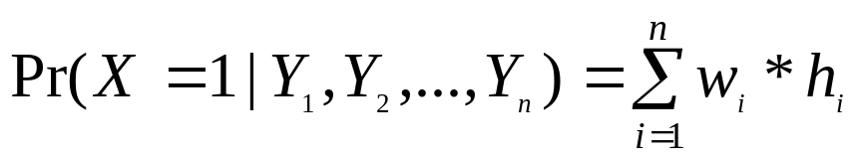
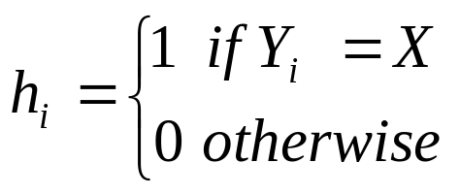
IV. Bayesian Overlay Model
Specifying CPT from the weights of arcs
T₁
C O I | p(J = 1) | P(J = 0) 1- p(J = 1)
1 1 1 | 1.0 (0.1*1 + 0.5*1 + 0.4*1) | 0.0
1 1 0 | 0.6 (0.1*1 + 0.5*1 + 0.4*0) | 0.4
1 0 1 | 0.5 (0.1*1 + 0.5*0 + 0.4*1) | 0.5
1 0 0 | 0.1 (0.1*1 + 0.5*0 + 0.4*0) | 0.9
0 1 1 | 0.9 (0.1*0 + 0.5*1 + 0.4*1) | 0.1
0 1 0 | 0.5 (0.1*0 + 0.5*1 + 0.4*0) | 0.5
0 0 1 | 0.4 (0.1*0 + 0.5*0 + 0.4*1) | 0.4
0 0 0 | 0.0 (0.1*0 + 0.5*0 + 0.4*0) | 1.0
T₂
E | Pr(E = 1) | Pr(E = 0) 1- Pr(E = 1)
1 | 0.8 (0.8*1) | 0.2
0 | 0.0 (0.8*0) | 1.0
T₃
Q | Pr(Q = 1) | Pr(Q = 0) 1- Pr(Q = 1)
1 | 0.2 (0.2*1) | 0.8
0 | 0.0 (0.2*0) | 1.0

Slide 21
IV. Bayesian Overlay Model
Evaluation
The expense of data storage is high. A BN which has n variables together n CPT_{(s)} with 2n parameters (values in CPT_{(s)}) under constraint: “each variable is binary (0 and 1)”
→be only restricted by programming technique when implementing network and it would be best to declare binary variables
The computation of posterior probability which is basis of inference consumes much time when executing in runtime because it is rather complex
→use CPT instead of continuous probability density/distribution function for solving

Slide 22
IV. Bayesian Overlay Model
Evaluation
The structure and parameters (CPT_{(s)}) in this method is fixed but they can be evolved after each occurrence of evidence.
However it is not necessary to improve the structure because it relates to school’s curriculum which is planned by teachers.

Slide 23
IV. Bayesian Overlay Model
Improvement
Using EM algorithm to improve CPT. This process is called parameter learning
Using Dynamic Bayesian Network to monitor user’s learning process

Slide 24
IV. Dynamic Bayesian Network
Given finite number T of time points
Let x_{i}[t] be the variable representing the value of x_{i} at time t where 0<= t <= T
Let X[t] be the temporal random vector denoting the random vector X at time t, X[t] = {x₁[t], x₂[t],…, x_{n}[t]}

Slide 25
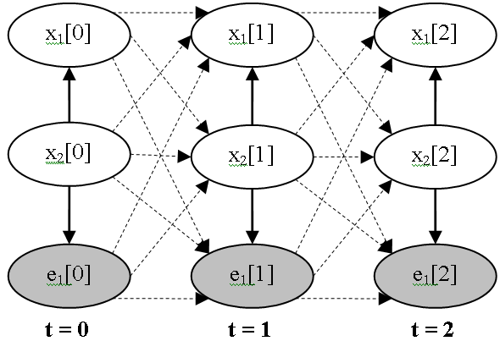
V. Dynamic Bayesian Network
A DBN is BN containing variables that comprise T variable vectors X[t]
An initial BN G0 = {X[0], Pr(X[0]} at first time t = 0
A transition BN is a template consisting of a transition DAG G→ containing variables in X[t]X[t+1] and a transition probability distribution Pr→ (X[t+1] | X[t])

Slide 26
V. Dynamic Bayesian Network
Inference in DBN
The inference in DBN is similar to BN
But the Distributed Global Joint Probability Distribution of DBN is more complex than Global Joint Probability Distribution of BN

Slide 27
V. Dynamic Bayesian Network
Strong points of DBN
DBN can model the temporal relationships among variables. It can capture the dynamic aspect
So DBN allows monitoring user’s process of gaining knowledge and evaluating her/his knowledge

Slide 28
V. Dynamic Bayesian Network
Drawbacks of DBN
The size of DBN becomes numerous when the process continues for a long time
The number of transition dependencies among points in time is too large to compute posterior marginal probabilities

Slide 29
VI. Improved DBN
Purposes
To overcome these drawbacks, we propose the new algorithm that both the size of DBN and the number of Conditional Probability Tables in DBN are kept intact (not changed) when the process continues for a long time
Our algorithm also solves the problem of temporary slip and lucky guess: “learner does (doesn’t) know a particular subject but there is solid evidence convincing that she/he doesn’t (does) understand it; this evidence just reflects a temporary slip (or lucky guess)”.

Slide 30
VI. Improved DBN
Two constraints
Markov property: given the current time point t, the conditional probability of next time point t+1 is only relevant to the current time point t, not relevant to any past time point (t-1, t-2,…,0) .
Pr→(X[t+1] | X[0], X[1],…, X[t])=Pr→(X[t+1] | X[t])
Stationary: Pr→(X[t+1] | X[t]) is the same for all t

Slide 31
VI. Improved DBN
The algorithm includes 6 steps that repeated whenever evidences occur
Initializing DBN
Specifying transition weights
Re-constructing DBN
Normalizing weights of dependencies
Re-defining CPT (s)
Probabilistic inference

Slide 32
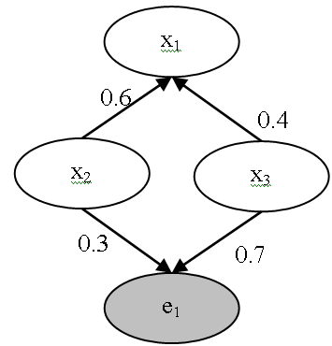
VI. Improved DBN
Step 1: Initializing DBN
If t > 0 then jumping to step 2
Otherwise, all variables (nodes) and dependencies (arcs) among variables of initial BN G₀ must be specified. The strength of dependency is considered as weight of arc

Slide 33


VI. Improved DBN
Step 2: Specifying transition weight
Given two factors: slip and guess where slip (guess) factor expresses the situation that user does (doesn’t) know a particular subject but there is solid evidence convincing that she/he doesn’t (does) understand it; this evidence just reflects a temporary slip (or lucky guess)
slip = Pr(not x[t+1] | x[t])
guess = Pr(x[t+1] | not x[t])

Slide 34

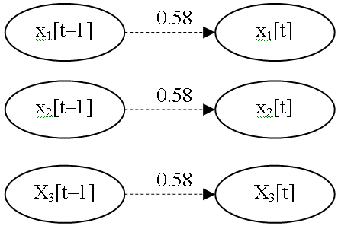
VI. Improved DBN
Step 2: Specifying transition weight
Suppose slip = 0.3 and guess = 0.2

Slide 35
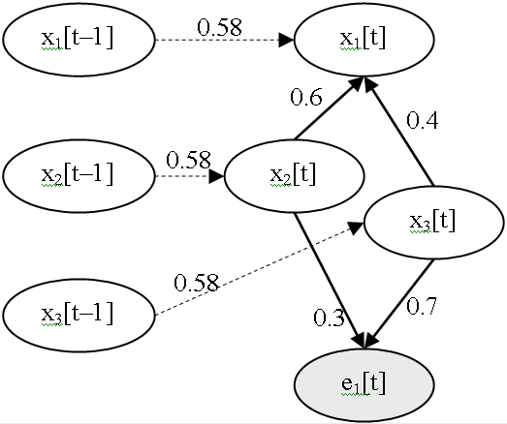
VI. Improved DBN
Step 3: Re-constructing DBN
For each time point t, we create a new BN G’[t] whose variables include all variables in X[t–1] X[t] except evidences in X[t–1]. G’[t] is called augmented BN at time point t
All conditional dependencies among variables in X[t–1] are removed from G’[t]

Slide 36
VI. Improved DBN
Step 4: Normalizing weights of dependencies
Suppose variable x_{i}[t] has k-1 weights w_{i2}, w_{i3},…, x_{ik} corresponding to k-1 parents and a transition weight w_{i1} of temporal relationship between x_{i}[t-1] and x_{i}[t]
We have:
w_{i2}=w_{i2}*(1–w_{i1}), w_{i3}=w_{i3}*(1–w_{i1}),…, w_{ik}=w_{ik}*(1–w_{i1})
 | w₁₁ | w₁₂ | w₁₃
x₁[t] | 0.58 | 0.6 | 0.4
x₁[t] (normalized) | 0.58 | 0.252 | 0.168

Slide 37
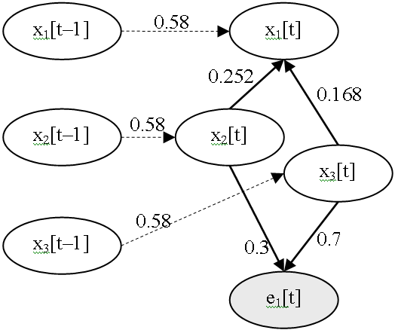
VI. Improved DBN
Step 4: Normalizing weights of dependencies

Slide 38
VI. Improved DBN
Step 5: Re-defining CPT_{(s)}
Determining CPT for each variable x_{i}[t-1] in X[t–1]
Re-defining CPT for each variable x_{i}[t] in X[t]

Slide 39
VI. Improved DBN
Step 5: Re-defining CPT_{(s)}
Determining CPT_{(s)} of X[t–1]. The CPT of x_{i}[t-1] is the posterior probabilities which were computed in step 6 of previous iteration
Pr(x₁[t-1]=1) | Pr(x₁[t-1]=0)
α₁: the posterior probability of x₁ computed at previous iteration | 1 – α₁
Pr(x₂[t-1]=1) | Pr(x₂[t-1]=0)
α₂: the posterior probability of x₂ computed at previous iteration | 1 – α₂
Pr(x₃[t-1]=1) | Pr(x₃[t-1]=0)
α₃: the posterior probability of x₃ computed at previous iteration | 1 – α₃

Slide 40

VI. Improved DBN
Step 5: Re-defining CPT_{(s)}
Re-defining CPT(s) of X[t]
x₁[t-1] x₂[t] x₃[t] | Pr(x₁[t]=1) | Pr(x₁[t]=0)
1 1 1 | 1.0 (0.58*1+0.252*1+0.168*1) | 0.0
1 1 0 | 0.832 (0.58*1+0.252*1+0.168*0) | 0.168
1 0 1 | 0.748 (0.58*1+0.252*0+0.168*1) | 0.252
1 0 0 | 0.58 (0.58*1+0.252*0+0.168*0) | 0.42
0 1 1 | 0.42 (0.58*0+0.252*1+0.168*1) | 0.58
0 1 0 | 0.252 (0.58*0+0.252*1+0.168*0) | 0.748
0 0 1 | 0.168 (0.58*0+0.252*0+0.168*1) | 0.832
0 0 0 | 0.0 (0.58*0+0.252*0+0.168*0) | 1.0

Slide 41
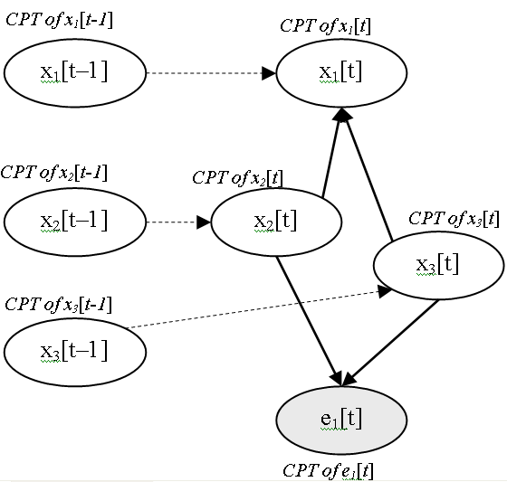
VI. Improved DBN
Step 5: Re-defining CPT(s)

Slide 42
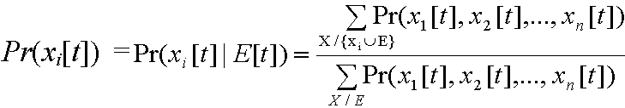
VI. Improved DBN
Step 6: Probabilistic Inference
The probabilistic inference in our augmented DBN can be done similarly to normal Bayesian network. It is essential to compute the posterior probabilities of non-evidence variable in X[t]
Such posterior probabilities are also used for determining CPT(s) of DBN in step 5 of next iteration. For example, posterior probabilities of x₁[t], x₂[t] and x₃[t] are α₁, α₂ and α₃ respectively
If the posterior probabilities are the same as before (previous iteration) then DBN converges when all posterior probabilities of variables x_{i}[t] gain stable values at any time. If so we can stop algorithm; otherwise turning back step 1

Slide 43
Conclusion
There are many features in user model but knowledge and learning style are the most important characteristic
There are some method to model user knowledge but overlay method is very appropriated to learning context
The combination of overlay model and Bayesian network give the powerful inference ability to user modeling system
However there is demand of improving Bayesian overlay model by structure learning & parameter learning. In this presentation we propose the technique that applies strong points of DBN but restricts its drawbacks

Slide 44
Conclusion
The basic idea of improved DBN is to minimize the size of DBN and the number of transition probability in order to decrease expense of computation when the process of inference continues for a long time
However specifying slip factor and guess factor will solve the problem of temporary slip and lucky guess
The process of inference including six steps is done in succession through many iterations, the result of current iteration will be input for next iteration. After t^{th} iteration DBN will converge when the posterior probabilities of all variables x_{i}[t] gain stable values regardless of the occurrence of a variety evidences

Slide 45
Reference
David Heckerman. A Tutorial on Learning With Bayesian Networks. Technical Report MSR-TR-95-06. Microsoft Research Advanced Technology Division, Microsoft Corporation.
Eugene Charniak. Bayesian Network without Tears. AI magazine. 1991
Richard E. Neapolitan. Learning Bayesian Networks. Northeastern Illinois University Chicago, Illinois 2003
Flavia Sparacino. Sto(ry)chastics: a Bayesian Network Architecture for User Modeling and Computational Storytelling for Interactive Spaces. Lecture Notes in Computer Science, 2003
IT@EDU 2008

Slide 46
THANK FOR CONSIDERATION
IT@EDU 2008

