Slide 1
Learner Model in Adaptive Learning
IT@EDU 2008
How is adaptation?
Adaptive Hypermedia System – AHS
Learner Model
Classification of Learner Model
Reported by: Msc. Phung Do
University of Information Technology, Vietnam
IT@EDU 2008
Notes:
ITEDU 2008Chú thích cuối trang
Chú thích đầu trang
Chú thích cuối trang

Slide 2
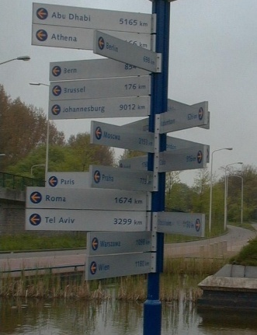
I. How is adaptation?
Adaptation is simplification
Too complex → ambiguous → should be simple and appropriate to individuals
IT@EDU 2008

Slide 3
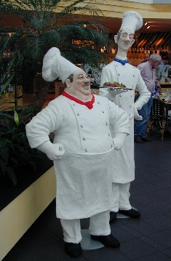
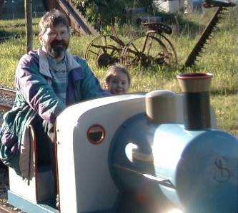
I. How is adaptation?
One size fit alls (!?)
But we are not all the same size → need adjustment for each person
IT@EDU 2008

Slide 4
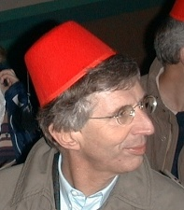
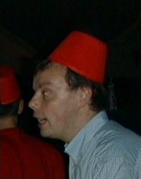
I. How is adaptation?
Information requires concrete context
Only recognize people when and where we meet them
→ context adaptation
IT@EDU 2008

Slide 5
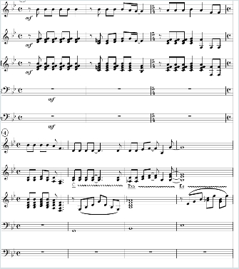
I. How is adaptation?
Adaptation of content and presentation
Content: some people need a simple version (1st line), other the complex one (3rd line).
Presentation: some people prefer text, others like audio, video, images
IT@EDU 2008

Slide 6
II. Adaptive Hypermedia System – AHS
What is Adaptive Hypermedia?
Hypermedia:
- different media types used in a single application (text, images, sound, video…).
- non-linear structure with navigation through hyperlink
Adaptive:
- Application can change its behavior based on user information which is modeled as user model..
- Application can change many aspects of this information, like the media used, the length of the presentation, the difficulty, style, etc
- Application can adapt to user context
→ Such applications are called AHS
IT@EDU 2008

Slide 7
II. Support in AHS
Presentation adaptation
- adapt information
- adapt presentation of that information
- select the media and media-related factors such as image or video quality and size
Navigation adaptation
- link anchors
- link destination
- provide the map for navigation support and orientation support
IT@EDU 2008

Slide 8
II. Support in AHS
An example
Before read information about University of Science
…
In University of Science (227 Nguyen Van Cu, Dis.5, HCMC found 1927), has Faculty of IT
…
After read about University of Science
…
In University of Science, Faculty of IT
…
IT@EDU 2008

Slide 9
II. Support in AHS
Adaptive multimedia presentation
Natural language adaptation
Insert/remove fragments
Adaptive text presentation
Adaptive presentation
Alter fragments
Canned Text adaptation
Stretch text
Adaptation of modality
Sort fragments
Dim fragments
IT@EDU 2008

Slide 10
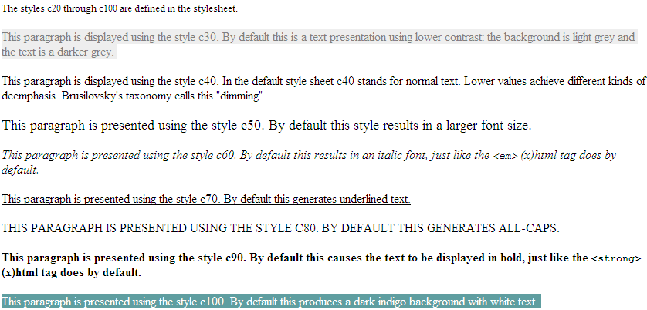
II. Support in AHS
An example about Adaptive Presentation
IT@EDU 2008
Notes:
ITEDU 2008Chú thích cuối trang

Slide 11
II. Support in AHS
Direct guidance
Adaptive link sorting
Hiding
Adaptive link hiding
Disabling
Adaptive navigation
Removal
Adaptive link annotation
Adaptive link generation
Map adaptation
IT@EDU 2008

Slide 12
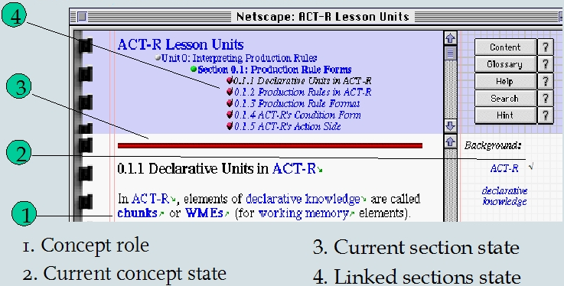
II. Support in AHS
An example about Adaptive Navigation
IT@EDU 2008

Slide 13
II. How AHS works?
Modeling & Adapting
User Profile
Collect
Modeling
System
Excute
User Model
Adapting
Adaptive Effect
IT@EDU 2008

Slide 14
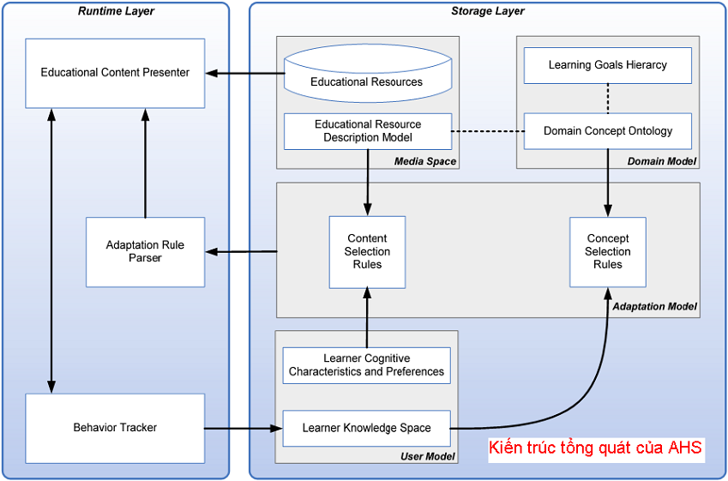
II. AHS General Architecture
IT@EDU 2008

Slide 15
II. AHS General Architecture
4 main models in AHS General Architecture
Media model: contains learning resource and associated descriptive information (metadata)
Domain model: constitutes the structure of domain knowledge
Adaptation model: the centric component which gives effect to adaptation & contains content selection rules and concept selection rules
User Model: information and data about user (described later)
IT@EDU 2008

Slide 16
III. Learner Model
Basic Concept
User
Real World
machine – user interface
Learner Model
Computer
Static
Dynamic
Individual information
Pre-knowledge
Goals
Preference…
User Interaction with System
IT@EDU 2008

Slide 17
III. Learner Model
Role of Learner Model
Interpret user action
System
User
Internal actions
Machine action
7 purposes of learner model (in e-learning):
- Assist a user during learning of a given topic.
- Offer information adjusted to the user.
- Adapt the interface to the user.
- Help user to ﬁnd information.
- Give the user feedback about his knowledge.
- Support collaborative work.
- Give assistance in the use of the system.
IT@EDU 2008

Slide 18
III. Learner Model
Content of Learner Model
Domain specific information
Vector model
Overlay model
Fault model
Domain Independent Information
Interests
Goals
Background & experience
Personal traits: Learning styles & Aptitudes
Preference
Demographic information: name, birth day, ID
IT@EDU 2008

Slide 19
III. Learner Model
Learning Styles
Learning styles | Description
Auditory | Prefer to listen to instructional content
Pictures | Prefer to perceive learning material as pictures
Text | Prefer to perceive learning material as text
Tactile Kinesthetic | Prefer to interact physically with learning material such as: puzzles, games
Internal Kinesthetic | Prefer to make connections (to personal and to past learning experiences)
Learner Group | Description
Activist | Like to have a go and see what happens
Reflector | Like to gather information and mull things over
Pragmatists | Prefer to perceive learning material as text
Theorist | Like tried and tested techniques which are relevant to my problems
IT@EDU 2008

Slide 20
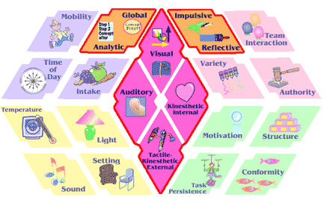
III. Learner Model
Learning Styles
Dum & Dunn model
IT@EDU 2008

Slide 21




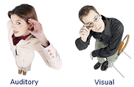

III. Learner Model
How to select and combine user characteristics?
IT@EDU 2008

Slide 22
IV. Classification of Learner Models
Stereotype Model
Stereotype [Rich 1979] is a set of user's frequent characteristics
New learner will be classified according to their initial features, each classifier is a stereotype
Two kinds of stereotype: fix and default
ANY PERSON
NAÏVE-USER
AVERAGE-USER
EXPERT-USER
FRIENDLY-NAIVE
HOSTILE-NAIVE
IT@EDU 2008

Slide 23
IV. Classification of Learner Models
Stereotype Model
There are three components in stereotype model
Trigger is used to active a stereotype. It is a condition (e.g. logic expression) to assign a stereotype to learner
Inference is inferring engine, responsible for deducing related information about user from stereotype
Retraction conditions are used to deactivate learner’s stereotype
IT@EDU 2008

Slide 24
IV. Classification of Learner Models
Steps to build Stereotype Model
Classify learner into groups, each group is candidate of stereotype
Determine key characteristic with its dependent information → identify trigger and inference engine
Build up hierarchy of stereotype, each sterotype is a group in full of important component such as: triggers, inference engine, retraction conditions
IT@EDU 2008

Slide 25
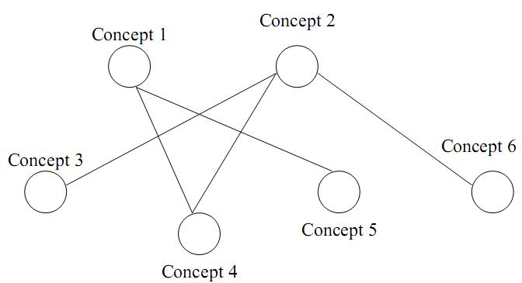
IV. Classification of Learner Models
Overlay Model
Essential idea: The learner model is the subset of domain model
The domain is decomposed into a set of elements and the overlay model is simply a set of masteries over those elements.
Expert model is the overlay with 1 (mastered) for each element and the learner model is the overlay with at most 1 for each element
IT@EDU 2008

Slide 26
IV. Classification of Learner Models
Differential Model
Similar to overlay model but based on expected knowledge which is knowledge that learner should be mastered at certain time
Differential model is basically an overlay on expected knowledge, which in turn is an overlay on expert’s domain knowledge
Differential model is instance of class “fault model”
IT@EDU 2008

Slide 27
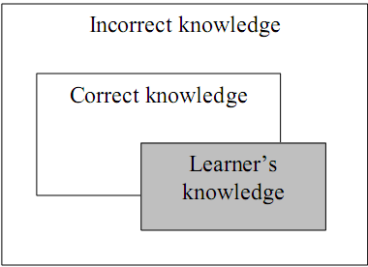
IV. Classification of Learner Models
Perturbation Model
Perturbation model represents learners as the subset of expert’s knowledge (like overlay model) plus their mal-knowledge
Perturbation model is an instance of the class “fault model”.
IT@EDU 2008

Slide 28
IV. Classification of Learner Models
Plan Model
Plan is a sequence of learnerss actions to achieve desires or concrete goals
Plan recognition was based on tracking input user's performance [Kobsa 1993]
There is the library consisting of all possible plans. User’s actions are regarded and matched to plans which store available in library.
The possile plan which is most similar to user’s actions is chosen as learner model
→ Complex computation and huge storage
IT@EDU 2008

Slide 29
Conclusion
User model has extremely important role in most user-oriented system, especially, adaptive learning system. However, we must try our best to build up
Initialization - the first step in user modeling gathers information and data about user and constructs user model from this information
Updating intends to keep user model up-to-date by observing user's actions, tracking user's performance, analyzing user's feedback
Reasoning new information about user out from available data in user model
IT@EDU 2008

Slide 30
Reference
[2006] Alfred Kobsa. Generic User Modeling Systems. Donald Bren School of Information and Computer Sciences, University of California, Irvine.
[2006] Aroyo, L., Dolog, P., Houben, G-J., Kravcik, M., Naeve, A., Nilsson, M. & Wild. Interoperability in Personalized Adaptive Learning. Educational Technology & Society, 9 (2), 4-18.
[2006] M. Bures, I. Jelinek. AUTOMATIC GENERATION OF USER MODEL FROM NON-TRIVIAL HYPERMEDIA IN ADAPTIVE E-LEARNING HYPERMEDIA SYSTEM. Dept. of Computer Science and Engineering, FEE, Czech Technical University in Prague.
[2005] Anandi Giridharan. Adaptive e-Learning Environment for Students with Divergent Knowledge Levels. IISc, Bangalore
[2005] Christoph Froschl. User Modeling and User Profiling in Adaptive E-learning Systems. Institute for Information Systems and Computer Media (IICM).
[2005] Ekaterina Vasilyeva. Knowledge Management Challenges in Web-Based Adaptive e-Learning Systems. Proceedings of I-KNOW ’05 Graz, Austria, June 29 - July 1, 2005.
[2005] Miha Grar, Dunja Mladeni, Marko Grobelnik. USER PROFILING FOR INTEREST-FOCUSED BROWSING HISTORY. Department of Knowledge Technologies Jozef Stefan Institute.
[2005] Peter Brusilovsky. KnowledgeTree: A Distributed Architecture for Adaptive E-learning. School of Information Sciences, University of Pittsburgh Pittsburgh PA 15260.
[2005] Peter Brusilovsky, Sergey Sosnovsky, Olena Shcherbinina. User Modeling in a Distributed E-Learning Architecture. School of Information Sciences, University of Pittsburgh, Pittsburgh PA 15260, USA.
[2005] Peter Brusilovsky, Sergey Sosnovsky, Michael Yudelson. Ontology-based Framework for User Model Interoperability in Distributed Learning Environments. School of Information Sciences, University of Pittsburgh, Pittsburgh PA 15260, USA.
[2005] P. Karampiperis and D. Sampson. Adaptive Learning Resources Sequencing in Educational Hypermedia Systems. University of Piraeus.
[2004] Nicola Henze and Wolfgang Nejdl. Logically Characterizing Adaptive Educational Hypermedia Systems. University of Hannover ISI Knowledge-Based Systems.
[2001] Christos Papatheodorou. Machine Learning in User Modeling. Division of Applied Technologies, NCSR "Demokritos", 15310 Athens, Greece.
[2000] Gerhard Fischer. User Modeling in Human-Computer Interaction. Contribution to the 10th Anniversary Issue of the Journal “User Modeling and User-Adapted Interaction (UMUAI)”.
[1996] Peter Brusilovsky. Methods and techniques of adaptive hypermedia. User Modeling and User Adapted Interaction, 1996, v 6, n 2-3, pp 87-129.
IT@EDU 2008

Slide 31
THANK FOR CONSIDERATION
IT@EDU 2008

