Slide 1
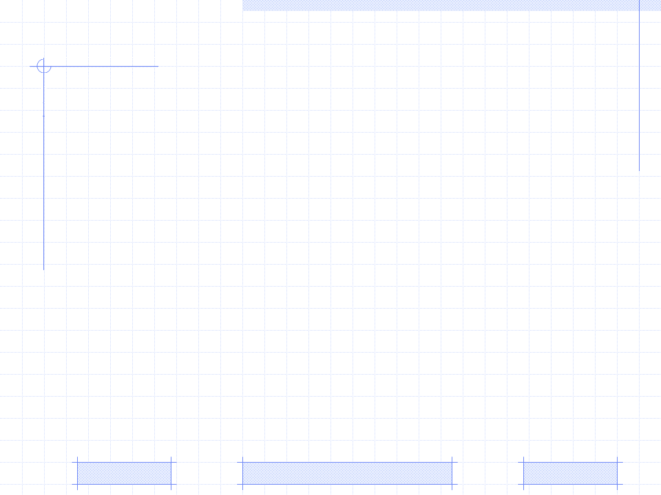
Learning Concept Recommendation based on Sequential Pattern Mining
Sequential pattern mining
Issue of learning sequential pattern mining
Approaches to sequential pattern mining
Breaking sequential pattern into sequential rules
Conclusion
PhD. Special Subject: | Selected Prominent Subjects in Data Mining (December 21th 2008)
Professor: | Dr. Hoai-Bac Le
Researcher: | Loc Nguyen
Affiliation: | The University of Science, Ho Chi Minh city, Vietnam

Slide 2
I. Sequential pattern mining
Recommendation methods
Rule-based filtering: manually or automatically generated decision rules that are used to recommend items to users
Content-based filtering: recommends items that are considered appropriate to user information in his profile
Collaborative filtering: considered as social filtering when it matches the rating of a current user for items with those of similar users in order to produce recommendations for new items

Slide 3
I. Sequential pattern mining
Sequential pattern
Sequential pattern mining belongs to collaborative filtering family
User does not rate explicitly items but his series of chosen items are recorded as sequences to construct the sequence database which mined to find frequently repeated patterns he can choose in future
In learning context, items can be domain concepts / learning objects which students access or learn

Slide 4
I. Sequential pattern mining
Definition
I = {i₁, i₂, i₃,…, i_{n}} is a set of all items
An itemset is a subset of I, denoted x_{i}=(i_{u},…, i_{v})
An sequence is an ordered list of itemsets, denoted s=〈x1, x2,…, xm〉, where xi is an itemset, xi is also called an element in sequence s
The length of sequence is the number of instances of items occurring in sequence. Sequence with length l is called l-sequence
Note: An item has only been once in an element of sequence but can occur multiple times in different elements in sequences

Slide 5

I. Sequential pattern mining
s₁=〈x₁, x₂,…, x_{m}〉 is sub-sequence of s₂=〈y₁, y₂,…, y_{m}〉
There is the ordered list of indexes k₁, k₂,…, k_{n}
1≤ k₁ ≤ k₂ ≤ …. ≤ k_{n} ≤ m
x₁ y_{k1}, x₂ y_{k2},…, x_{n} y_{kn}
“s₁ is sub-sequence of s2” equivalent to “s₂ is super-sequence of s₁”, denoted s₁containings₂, s₁ s₂, s₂containeds₁

Slide 6
I. Sequential pattern mining
Example
A set of all items I={i₁, i₂, i₃, i₄}
Three itemsets x₁=i₁, x₂=(i₁,i₃), x₃=(i₁,i₂,i₃), x₄=(i₁,i₂,i₃,i₄), x₅=i₃, x₆=(i₁,i₂)
Two sequences s₁, s₂ denoted as s₁=〈x₁,x₄〉, s₂=〈x₁,x₂,x₃〉 , s₃=〈x₅,x₆〉 but s₁, s₂ are often showed in detailed forms: s₁=〈i₁(i₁,i₂,i₃,i₄)〉, s₂=〈i₁(i₁,i₃)(i₁,i₂,i₃)〉, s₃=〈i₃(i₁,i₂)〉
s₁, s₂, s₃ are 5-length, 6-length, 3-length sequences, respectively. Note, item i₁ occurs 2 times in sequence s₁, so it contributes 2 to length of s₁
s₃ is sub-sequence of s₂ due to x₅containgx₂ and x₆containgx₃, s₁ is not sub-sequence of s₂ because x₁containgx₂ but x₄ is not subset of any subset in s₂

Slide 7
I. Sequential pattern mining
Sequential pattern
Sequential database S has a set of records 〈sid, s〉
A record 〈sid, s〉 is said to contain sequence α if α contained s
The support of sequence α is the fraction of total records containing α, denoted support(α)=|{ 〈sid, s〉 | α contained s}|
Given the threshold min_sup if support(α)≥ min_sup then α is called frequent or large sequence
Sequential pattern is the maximal frequent sequence, it means that all super-sequences of sequential pattern are infrequent
Note: In case property “maximal” is not paid attention, frequent sequence is considered as sequential pattern

Slide 8
I. Sequential pattern mining
Totally, given a sequence database S and the threshold min_sup, sequential pattern mining is to find all complete set of sequential patterns in S

Slide 9
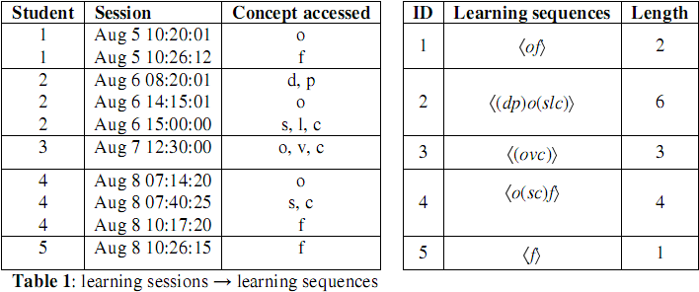
II. Issue of learning concept recommendation
Given problem
Suppose concepts in Java course: data type, package, class & OOP, selection structure, virtual machine, loop structure, control structure, and interface which in turn denoted as d, p, o, s, v, l, c, f
At our e-learning website, students access learning material relating such concepts in sessions, each session contains only one itemset and is ordered by time. The student's learning sequence is constituted of itemsets accessed in all his sessions

Slide 10
II. Issue of learning concept recommendation
Students accessed learning material in their past sessions, how system recommends appropriate concepts to student for next visits → mining sequential patterns → solution:
Applying techniques of mining user learning data to find learning sequential patterns
Breaking such patterns into concepts which are recommended to users

Slide 11
III. Approaches to sequential pattern mining
every non-empty sub-sequence of a frequent sequence is a frequent sequence
divide-and-conquer
Candidate generation and test approach
Pattern-growth approach
FreeSpan
Horizontal format
Vertical format
AprioriAll, GSP
SPADE

Slide 12
III. Approaches to sequential pattern mining
AprioriAll - Terms
Support of itemset x_{i} is the fraction of total sequences which containing x_{i}
x_{i} is contained in a sequence if any itemset in sequence contains it
If x_{i} occurs many times in the same sequence, its support is increased only once.
Itemset x_{i} is frequent itemset or large itemset or litemset if its support satisfies the support threshold (≥min_sup)
If sequence s is recognized as large sequence (frequent sequence) then all its itemsets are litemsets

Slide 13
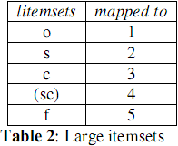
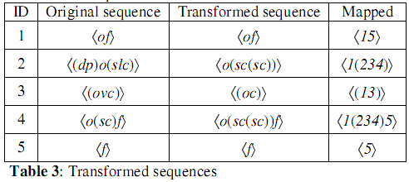
III. Approaches to sequential pattern mining
AprioriAll – 3 phases of algoritm
Large itemset phase: Find all litemsets in database with min_sup.
Transformation phase: Each itemset x_{i} in sequence database S are replaced by litemset l_{i} where l_{i} contains x_{i}
Sequence phase: Find all large sequences by scanning iteratively database many times to find the large k-sequences where k is increased until no large sequence can be found

Slide 14
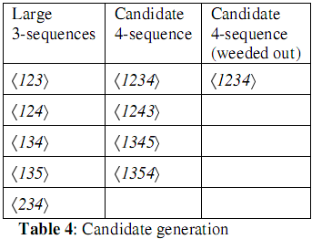
III. Approaches to sequential pattern mining
AprioriAll – sequence phases
At the beginning of k^{th} scan, all sequences in L_{k-1} are joined to generate C_{k} – the set of new potential large k-sequences which is also called candidate sequences.
After that, the supports of candidate sequences in C_{k} are computed and assessed whether they satisfy min_sup so that we can determine the actually large sequences. The set of actually large k-sequences is L_{k}.
L_{k} is re-used as the seed for generating L_{k+1}.

Slide 15
III. Approaches to sequential pattern mining
GSP – a variant of AprioriAll but has some differences
There is no large itemset phase and transformation phase. The length of sequence is actually the number of its items (not litemsets) like original definition. So all frequent sequences in L₁ have only one item in form 〈x〉
The way to generate candidate set produces total possible combination of sequences. For example, L₁={〈a〉, 〈b〉, 〈c〉} having three 1-sequences generate fifteen 2-sequences, C2={〈aa〉, 〈ab〉, 〈ac〉, 〈ba〉, 〈bb〉, 〈bc〉, 〈ca〉, 〈cb〉, 〈cc〉, 〈(ab)〉, 〈(ac)〉, 〈(ba)〉, 〈(bc)〉, 〈(ca)〉, 〈(cb)〉}.

Slide 16
III. Approaches to sequential pattern mining
GSP – Evaluation
Find more frequent sequences than AprioriAll because of generating full of candidate sets
Raise the problem of the large number of candidate sequences
If L₁ have n 1-sequence, it generates n₂ + n*(n-1)/2 elements in candidate set C₂

Slide 17
III. Approaches to sequential pattern mining
SPADE – Algorithm
Cracking the sequence database into a vertical format data set in which each single itemset associates with the sequence identifier (sid) and its individual event identifier (eid) to form the new record
The frequent 1-sequences are found by exploring frequent itemsets. Then, each candidate k-sequence is formed by joining two frequent (k-1)-sequences if they share the same sid and their event identifiers (eid) follow the sequential order

Slide 18
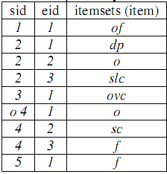
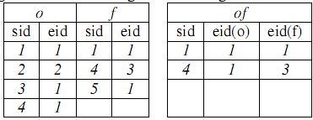
III. Approaches to sequential pattern mining
SPADE – Example

Slide 19
III. Approaches to sequential pattern mining
SPADE – Evaluation
Reduce frequency of global database access because candidate sequence generation is based on local vertical format data set
The weakness of exploring breadth-first search and generating large candidate sequences still exists in SPADE

Slide 20
III. Approaches to sequential pattern mining
FREESPAN – Algorithm
Determine a descending ordered set of all frequent item f_list = {x₁, x₂,…, x_{n}}. Where support(x₁) > support(x₂) >…> support(x_{n}).
According to f_list, all frequent sequences can be divided into n disjointed subset FS_{i} following condition: FS_{i} contains items x_{i} but no item after x_{i}.
Each subset FS_{i} is found separately by mining particularly x_{i}-projected database by other algorithms such as GSP, AprioriAll… where x_{i}-projected database is constructed by removing all items (after x_{i}) from each sequence of original database.

Slide 21
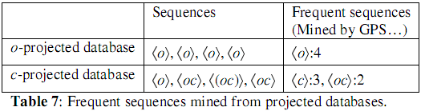
III. Approaches to sequential pattern mining
FREESPAN – Example
f_list = {o:4, c:3, f:3, s:2, d:1, p:1, v:1, l:1}
Let min_sup be 25%

Slide 22
III. Approaches to sequential pattern mining
SPADE – Evaluation
More efficient than Apriori-like algorithms since it projects recursively a large database into smaller databases according to current frequent sequences
Generation of longer sequences is done on such small databases leading to a smaller set of candidate
Can create redundant projected databases, which affects performance

Slide 23
IV. Issue of breaking sequence pattern
Problem
Suppose the sequential pattern 〈osc(sc)〉 discovered which means:
“class & OOP” → “selection structure” → ”control structure” → ”selection structure, control structure”
Pattern is considered as the learning "route" that student preferred or learned often in past
In the next time if a student chooses one concept, the adaptive learning system should recommend which next concepts?
→ the patterns should be broken into association rules with their confidence

Slide 24
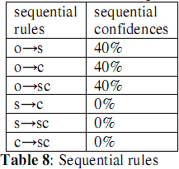
IV. Issue of breaking sequence pattern
Breaking technique
Breaking entire 〈osc(sc)〉 into litemsets such as o, s, c, (sc) and determining all possible large 2-sequences whose order must comply with the order of sequential pattern. There are six large 2-sequences: 〈os〉, 〈oc〉, 〈o(sc)〉, 〈sc〉, 〈s(sc)〉, 〈c(sc)〉.
Thus, we have six rules derived from these large 2-sequences in form: “left-hand litemset → right-hand litemset”, for example, rule “s→c” derived from 2-sequence 〈sc〉
Computing the confidences of rules and sorting them, confidence(x → y) = support(〈xy〉) / support((x)). The rules whose confidence is less than threshold min_conf is removed

Slide 25

IV. Issue of breaking sequence pattern
Recommended List
If student choose the concept (itemset) x, system will find whole rules broken from all sequential patterns and the left-hand litemset of each rule must contain x
Then, these rules are sorted by their confidences in descending order
Final outcome is an ordered list of right-hand litemsets (concepts), which are recommended to students
Recommended list
if user choose concept “class & oop”

Slide 26
IV. Issue of breaking sequence pattern
Evaluation
Evaluation
This methodology is similar to mining association rules but it achieves high performance and precise prediction since it derived from result of sequential pattern mining process.
The sequential rules stick close on user’s learning “route” because they are mined in accordance with sequential pattern and pay attention to the sequence order

Slide 27
IV. Issue of breaking sequence pattern
Although sequential pattern mining is applied in e-commercial for customer purchase but the extracted patterns can be used to predict user’s learning “route”
There are two sequential pattern mining approaches: candidate generation-and-test, pattern-growth.The first which is essentially a refinement of the Apriori-like is easy to implement but causes a problem of large candidate set and so, leads to performance downfall.The second which is a divide-and-conquer solution intends to reduce the number of candidate sequences. So, it is more efficient
Last, we propose the technique to break sequential patterns into rules containing recommendable concepts / learning materials. The ideology of this approach is derived from association rule mining but it is more efficient than association rules

Slide 28
V. Discovering Learning Styles
People have different views upon the same situation
Some have a preference for listening to instructional content
Some for perceiving materials as picture
Some for interacting physically with learning material
→Such characteristics about user cognition are called learning styles

Slide 29
V. Discovering Learning Styles
Learning style models are organized within the families such as
Constitutionally based learning styles and preferences
The cognitive structure
Stable personality type
Flexibly learning preferences
Each family has some models, this report introduce only popular models

Slide 30
V. Discovering Learning Styles
Dunn & Dunn model
Auditory: Preference to listen to instructional content
Visual (Picture): Preference to perceive materials as pictures
Visual (Text): Preference to perceive materials as text
Tactile Kinesthetic: Preference to interact physically with learning material
Internal Kinesthetic: Preference to make connections to personal and to past learning experiences
Impulsive: Preference to try out new material immediately
Reflective: Preference to take time to think about a problem
Global: Preference to get the ‘big picture’ first, details second
Analytical: Preference to process information sequentially: details first, working towards the ‘big picture’

Slide 31

V. Discovering Learning Styles
Riding model
Wholist-Analytic dimension expresses how an individual cognitively organize information either into whole or parts. Wholist tends to perceive globally before focusing on details. Otherwise, analytic tends to perceive everything as the collection of parts and focusing on such parts
Verbalizer-Imager dimension expresses how an individual tends to perceive information, either as text or picture. Verbalizer prefers to text. Imager prefers to picture.

Slide 32
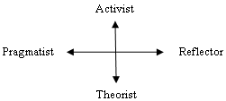
V. Discovering Learning Styles
Honey & Mumford model
Activist: learners are open-mined and comprehend new information by doing something with it
Reflector: learners prefer to think about new information first before acting on it
Theorist: learners think things through in logical steps, assimilate different facts into coherent theory
Pragmatist: learners have practical mind, prefer to try and test techniques relevant to problems

Slide 33
V. Discovering Learning Styles
Felder & Silverman model
Active/Reflective. Active students understand information only if they discussed it, applied it. Reflective students think thoroughly about things before doing any practice
Sensing/Intuitive. Sensing students learn from concrete tasks related to problems and facts that could be solved by well-behaved methods. Intuitive students discover alternate possibilities and relationships by themselves, working with abstractions and formula
Verbal/Visual. Verbal students like learning materials in text form. Otherwise visual student prefer to images, pictures…
Sequential/Global. Sequential students structure their learning process by logically chained steps, each step following from previous one. Global students prefer to learn in random jumps

Slide 34
V. Discovering Learning Styles
Providing adaptation of learning objects to learning styles
Active learners are provided activity-oriented approach: activity→example→theory→exercise
Reflective learners are provided example-oriented approach: example→theory→exercise→activity
Theorists are provided theory-oriented approach: theory→example→exercise→activity
Pragmatists are provided exercise-oriented approach: exercise→example→theory→activity

Slide 35
V. Discovering Learning Styles
Observation sequence database
Each learning object is assigned a type attribute which has four values: theory, example, exercise, and activity (game, puzzle…)
Whenever a student selects a learning object (LO), it raises observations depending on the attributes of learning object, i.e., theory, exercise…
The sequence of attributes of LO selected is considered as observation sequence
All users’ observation sequences constitute the sequence database S

Slide 36
V. Discovering Learning Styles
Learning style samples
Active sample:
activity→*→example→*→ theory→ *→exercise
Reflective sample:
example→*→theory→*→ exercise→ *→activity
Theorist sample:
theory→*→example→*→ exercise→ *→activity
Active sample:
exercise→*→example→*→ theory→ *→activity

Slide 37
V. Discovering Learning Styles
Discovering learning style algorithm
Using techniques of sequential pattern mining to find the most likely pattern of certain user in S. For example, pattern:
P = example → theory →… → exercise →… →activity
However, how to discover his/her style, based on P. We use some algorithms such as Knuth-Morris-Pratt, Boyer Moore to match P to learning style sample. Which sample has highest occurrence frequency in P is his/her style.

Slide 38
Reference
M. Zaki. An efficient algorithm for mining frequent sequences. Machine Learning, 40:31-60, 2001.
J. Han, J. Pei and Y. Yin. Mining frequent patterns without candidate generation. In Proc. 2000 ACM-SIGMOD Int. Conf. Management of Data (SIGMOD00), pp. 112, Dallas, TX, May 2000.
R. Srikant and R. Agrawal. Mining sequential patterns: Generalizations and performance improvements. In Proc. 5th Int. Conf. Extending Database Technology (EDBT96), pp. 317, Avignon, France, Mar. 1996.
R. Agrawal and R. Srikant. Mining sequential patterns. In Proc. 1995 Int. Conf. Data Engineering (ICDE95), pp.314, Taipei, Taiwan, Mar.1995.
R. Agrawal and R. Srikant. Fast algorithms for mining association rules. In Proc. 1994 Int. Conf. Very Large DataBases (VLDB94), pp. 487-499, Santiago, Chile, Sept. 1994. 〈〉

Slide 39
THANK FOR CONSIDERATION

