Slide 1
Learning Style in Zebra
What is learning style?
Learning style families
Adaptation & Learning Style
Hidden Markov Model
Applying HMM into constructing LS model
PhD. Report: | Learning Style in Zebra (August 21th 2009)
Professor: | Pr. Dr. Dong Thi Bich Thuy
Researcher: | Nguyen Phuoc Loc
Affiliation: | Department of IS, Faculty of IT, University of Science

Slide 2
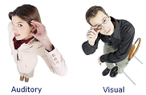
I. What is learning style
People have different views upon the same situation, the way they perceive and estimate the world is different
Some have a preference for listening to instructional content (so-called auditory learner), some for perceiving materials as picture (visual learner), some for interacting physically with learning material (tactile kinesthetic learner), some for making connections to personal and to past learning experiences (internal kinesthetic learner)

Slide 3
I. What is learning style
Learning styles are defined as the composite of characteristic cognitive, affective and psychological factors that serve as relatively stable indicators of how a learner perceives, interacts with and responds to the learning environment.
Learning style is the important factor in adaptive learning, which is the navigator helping teacher/computer to deliver the best instructions to students.

Slide 4
I. What is learning style
Learning style models are organized within following families
Constitutionally based learning styles and preferences (Dunn and Dunn)
The cognitive structure (Witkin, Riding)
Stable personality type (Myers-Briggs)
Flexibly learning preferences (Kolb, Honey-Mumford, Felder-Silverman, Pask and Vermunt model)

Slide 5
II. Learning style families
Constitutionally based learning styles and preferences
Dunn and Dunn model
Learning style is divided into 5 major strands:
Environmental: incorporates user preferences for sound, light, temperature…
Emotional: considers user motivation, persistence, responsibility…
Sociological: discovers user preference for learning alone, in pairs, as member of group
Physiological: surveys perceptual strengths such as visual, auditory, kinesthetic, tactile…
Psychological: focusing on user’s psychological traits namely incorporates the information-processing elements of global versus analytic and impulsive versus reflective behaviors

Slide 6
II. Learning style families
Constitutionally based learning styles and preferences
Dunn and Dunn model
Psychological strand classify LS into following modalities
Auditory: Preference to listen to instructional content
Visual (Picture): Preference to perceive materials as pictures
Visual (Text): Preference to perceive materials as text
Tactile Kinesthetic: Preference to interact physically with learning material
Internal Kinesthetic: Preference to make connections to personal and to past learning experiences

Slide 7
II. Learning style families
Constitutionally based learning styles and preferences family
Dunn and Dunn model
Physiological strand classify LS into following modalities
Impulsive: Preference to try out new material immediately
Reflective: Preference to take time to think about a problem
Global: Preference to get the ‘big picture’ first, details second
Analytical: Preference to process information sequentially: details first, working towards the ‘big picture’

Slide 8
II. Learning style families
Cognitive structure family
Witkin model
Field-dependence (FD) person process information globally and attend to the most salient cues regardless of their relevance.
Field-independency (FI) person are highly analytic, care more inherent cues in the field and are able to extract the relevant cues necessary to complete a task
Notes:
Field-dependence (FD) person process information globally and attend to the most salient cues regardless of their relevance. In general, they see the global picture, ignore details and approach the task more holistically. They often get confused with non-linear learning, so, they require guided navigation in hypermedia space.
Field-independency (FI) person are highly analytic, care more inherent cues in the field and are able to extract the relevant cues necessary to complete a task. In general, they focus on details and learn more sequentially. They can set learning path themselves and have no need of guidance.

Slide 9
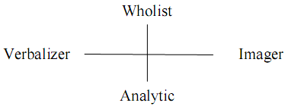
II. Learning style families
Cognitive structure family
Riding model
Wholist-Analytic dimension expresses how an individual cognitively organize information either into whole or parts. Wholist tends to perceive globally before focusing on details. Otherwise, analytic tends to perceive everything as the collection of parts and focusing on such parts
Verbalizer-Imager dimension expresses how an individual tends to perceive information, either as text or picture. Verbalizer prefers to text. Imager prefers to picture.

Slide 10
II. Learning style families
Stable personal family
Myers-Briggs Type Indicator
How does a person relate to the world?
  Extravert: try things out, focus on the world around, like working in teams
  Introvert: think things through, focus on the inner world of ideas, prefer to work alone
How does a person absorb/process information?
  Sensor: concrete, realistic, practical, detail-oriented, focus on events and procedures
  Intuitive: abstract, imaginative, concept-oriented, focus on meanings and possibilities
How does a person make decisions?
  Thinker: skeptical, tend to make decisions based on logic and rules
  Feeler: appreciative, tend to make decisions based on personal and human considerations
How does a person manage her/his life?
  Judger: organized, set and follow agendas, make decisions quickly
  Perceiver: disorganized, adapt to change environment, gather more information before making a decision.

Slide 11
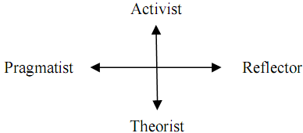
II. Learning style families
Flexible stable learning preference model
Honey & Mumford model
Activist: learners are open-mined and comprehend new information by doing something with it.
Reflector: learners prefer to think about new information first before acting on it
Theorist: learners think things through in logical steps, assimilate different facts into coherent theory
Pragmatist: learners have practical mind, prefer to try and test techniques relevant to problems

Slide 12
II. Learning style families
Flexible stable learning preference model
Felder-Silverman model
Active/Reflective. Active students understand information only if they discussed it, applied it. Reflective students think thoroughly about things before doing any practice
Sensing/Intuitive. Sensing students learn from concrete tasks related to problems and facts that could be solved by well-behaved methods. They are keen on details. Intuitive students discover alternate possibilities and relationships by themselves, working with abstractions and formula.
Verbal/Visual. Verbal students like learning materials in text form. Otherwise visual student prefer to images, pictures…
Sequential/Global. Sequential students structure their learning process by logically chained steps, each step following from previous one. Global students prefer to learn in random jumps.

Slide 13
II. Learning style families
Park model
Wholist. Learners understand problems by building up a global view
Serialist. Learners prefer to details of activities, facts and follow a step-by-step learning procedure

Slide 14
III. Adaptation & Learning style
We must solve the problem of “matching” learning materials with users’ learning styles
Adaptive (instruction) strategies are supposed according to common features of model because it is too difficult to describe comprehensively all features of model
So, features of all learning style models can be categorized into two groups: perception and understanding

Slide 15
III. Adaptation & Learning style
Perception group
The visual(picture)/visual(text) modality in Dunn and Dunn model, verbalizer/imager dimension in Riding model and verbal-visual dimension in Felder-Silverman model. Instructional strategy is that the teacher should recommend textual materials to verbalizer and pictorial materials to imager
The sensing/intuitive dimension in Felder-Silverman model , sensor/intuitive dimension in Myer Briggs Type Indicator. Sensing learners are recommended examples before expositions, otherwise, expositions before examples for intuitive learners
The perceptive-judging dimension in Myer Briggs Type Indicator. Perceptive learners are provided rich media such as the integrative use of pictures, tables and diagram. Otherwise, judging learners are provided lean materials

Slide 16
III. Adaptation & Learning style
Perception group
The impulsive/reflective modality in Dunn and Dunn model, the activist/reflector dimension in Honey and Mumford model, the active/reflective dimension in Felder-Silverman model and the extravert/introvert of Myers-Briggs Type Indicator. Active learners are provided activity-oriented approach: activity → example → theory → exercise. Reflective learners: example → theory → exercise → activity
The theorist/pragmatist dimension of Honey and Mumford model. Theorists: theory → example → exercise → activity. Pragmatists exercise → example → theory → activity
The accommodating/assimilating dimension of Kolb model, application-directed/ meaning-oriented dimension of Vermunt model. The adaptive strategy for accommodating style is to provide application-based information to learners. Otherwise, theory-based information for assimilating style.

Slide 17
III. Adaptation & Learning style
Understanding group
The global/analytical modality in Dunn and Dunn model, wholist-analytic dimension in Riding model, global/sequential dimension in Felder-Silverman model, wholist-serialist dimension in Pask model. Global learners are provided breadth-first structure of learning material. Otherwise, analytical learners are recommended depth-first structure of learning materials
The FD/FI dimension in Wikin model is correlated with undirected/reproduction­-oriented dimension in Vermunt model. FD learners are provided breadth-first structure of materials, guided navigation, illustration of ideas with visual materials, advance organizer and system control. FI learners are provided depth-first structure of materials or navigational freedom, user control and individual environment

Slide 18
III. Adaptation & Learning style
Three forms of learning style strategy
Selection of information: Information is presented in various types such as text, audio, video, graph, picture… Depending on user’s learning styles. For example, verbalizers are recommended text and imagers are suggested pictures, graphs
Ordering information or providing different navigation paths: The order in which learning materials are suggested For active learners, learning materials are presented in the order: activity→example→theory→exercise. For reflective learner, this order is changed such as example → theory → exercise → activity
Providing learners with navigation support tools: For example, FD learners are provided tools such as concept map, graphic path indicator. FI learners are provided with a control option showing a menu from which they can choose in any order (because they have high self-control).

Slide 19
IV. Hidden Markov Model
Hidden Markov Model (HMM)
Given sequence of observations symbols, there is demand of discovering real states
For example, there are some states of weather: sunny, cloudy, rainy. Based on observations such as wind speed, atmospheric pressure, humidity, temperature

Slide 20
IV. Hidden Markov Model
Markov property
Given the current state x_{k} of process P, the conditional probability of next state x_{k+1} is only relevant to current state x_{k}, not relevant any past state (x_{k-1}, x_{k-2}, x_{k-3},…)
Pr(x_{k} | x₀, x₁,…, x_{k-1}) = Pr(x_{k} | x_{k-1})

Slide 21
IV. Hidden Markov Model
HMM is the 5-tuple Δ=<S,θ,A,B,Π>
S={s₁, s₂,…, s_{n}} is the finite set of states
Ө={θ₁, θ₂,…, θ_{m}} is the set of observations
A is the transition probability matrix in which a_{ij} is the probability that, the process change the current state s_{i} to next state s_{j}
B is the observation probability matrix. Let b_{i}(k) be the probability of observation θ_{k} when the second stochastic process is in state s_{i}
∏ is the initial state distribution where π_{i} represents the probability that the stochastic process begins in state s_{i}

Slide 22
IV. Hidden Markov Model
Weather forecast example
Suppose you need to predict how whether is tomorrow: sun or cloud or rain since you know only observations about the humidity: dry, dryish, damp, soggy
S = {sun, cloud, rain}, Ө = {dry, dryish, damp, soggy}

Slide 23
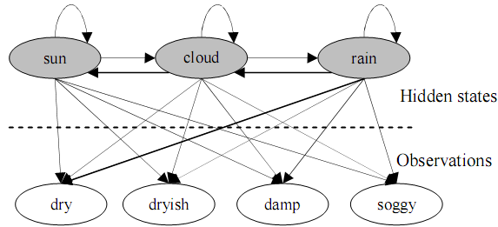

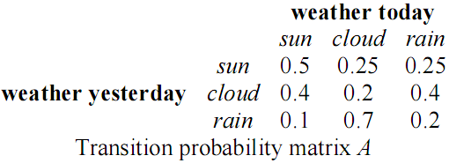
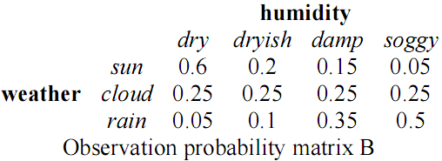
IV. Hidden Markov Model
Weather forecast example

Slide 24
IV. Hidden Markov Model
Uncovering problem
Given HMM and a sequence of observations O = {o₁ → o₂ →…→ o_{k}}, how to find the sequence of states U = {s_{k} → s_{k+1} →…→ s_{k+m}} so that U is most likely to have produced the observation sequence O
This is the uncovering problem: which sequence of state transitions is most likely to have led to this sequence of observations → Viterbi algorithm

Slide 25
IV. Applying HMM into constructing LS model
Basic idea
Each learning style is now considered as a state
Users’ learning actions are considered as observations
After monitoring users’ learning process, we collect observations about them and then discover their styles by using inference mechanism in HMM, namely Viterbi algorithm

Slide 26
IV. Applying HMM into constructing LS model
Basic idea
Suppose we choose Honey-Mumford model and Felder-Silverman model as principal models which are presented by HMM
We have three dimensions: Verbal/Visual, Activist/ Reflector, Theorist/ Pragmatist which are modeled as three HMM(s): ∆₁, ∆₂, ∆₃ respectively
∆₁ = 〈 S₁, Ө₁, A₁, B₁, ∏ ₁〉
∆₂= 〈 S₂, Ө₂, A₂, B₂, ∏ ₂〉.
∆₃ = 〈 S₃, Ө₃, A₃, B₃, ∏ ₃〉.

Slide 27
IV. Applying HMM into constructing LS model
Our method includes 5 steps
Defining states
Defining initial state distributions
Defining transition probability matrices
Defining observations
Defining observation probability matrices

Slide 28
IV. Applying HMM into constructing LS model
1. Defining states: each state is corresponding to a leaning style
S₁={verbal, visual},
S₂={activist, reflector}
S₃={theorist , pragmatist}

Slide 29
IV. Applying HMM into constructing LS model
2. Defining initial state distributions : we use uniform probability distribution for each ∏_{i}
∏₁ = {0.5, 0.5}: Pr(verbal)=Pr(visual)=0.5
∏₂ = {0.5, 0.5}; Pr(activist)=Pr(reflector) = 0.5
∏₃ = {0.5, 0.5}; Pr(theorist)=Pr(pragmatist)=0.5

Slide 30
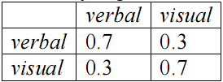
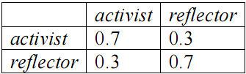
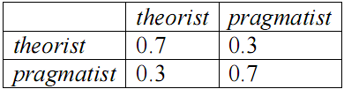
IV. Applying HMM into constructing LS model
3. Defining transition probability matrices
We suppose that learners tend to keep their styles
So the conditional probability of a current state on previous state is high if both current state and previous state have the same value and otherwise

Slide 31
IV. Applying HMM into constructing LS model
4. Defining observation
There is a relationship between learning object learned by users and their learning styles
We assign three attributes to each learning object
  Format attribute indicating the format of learning object has three values: text, picture, video
  Type attribute telling the type of learning object has four values: theory, example, exercise, and puzzle
  Interactive attribute indicates the “interactive” level of learning object. The more interactive learning object is, the more learners interact together in their learning path. This attribute has three values corresponding to three levels: low, medium, high
The dimension Verbal/Visual is involved in format attribute. The dimensions Activist/ Reflector and Theorist/ Pragmatist relate to both type attribute and interactive attribute
  Ө₁ = { text, picture, video }
  Ө₂ = { theory, example, exercise, puzzle, low (interaction), medium (interaction), high (interaction) }
  Ө₃ = { theory, example, exercise, puzzle, low (interaction), medium (interaction), high (interaction) }

Slide 32
IV. Applying HMM into constructing LS model
5. Defining observation probability matrices
Different observations (attributes of LO) effect on states (learning styles) in different degrees
The weights of observations: text, picture, video on state Verbal are in descending order.
The weights of observations: text, picture, video on state Visual are in ascending order
The weights of observations: puzzle, example, theory, exercise on state Activist are in descending order
The weights of observations: example, theory, exercise, puzzle on state Reflector are in descending order
The weight of observations: low (interaction), medium (interaction), high (interaction) on state Activist get values: 0, 0, 1 respectively
The weight of observations: low (interaction), medium (interaction), high (interaction) on state Reflector get values: 1, 0, 0 respectively

Slide 33


IV. Applying HMM into constructing LS model
5. Defining observation probability matrices

Slide 34
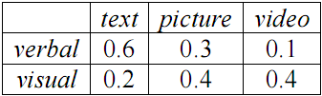
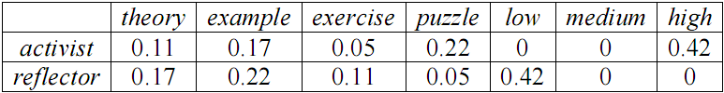
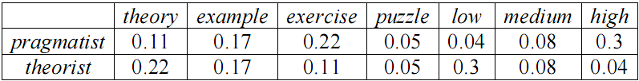
IV. Applying HMM into constructing LS model
5. Defining observation probability matrices

Slide 35
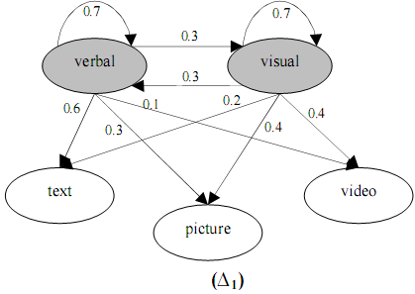
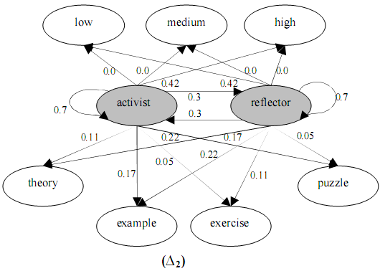
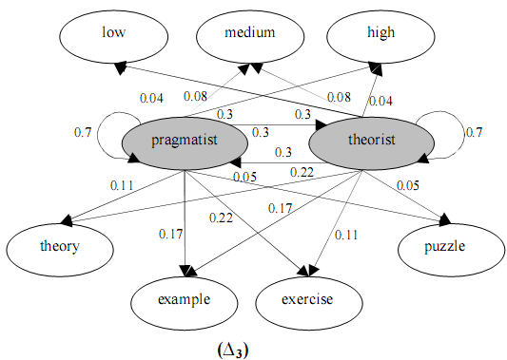
IV. Applying HMM into constructing LS model

Slide 36
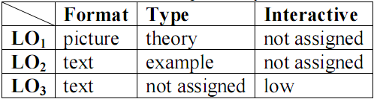
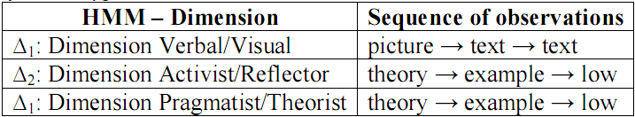
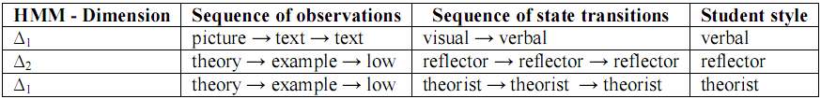
IV. Applying HMM into constructing LS model
An example for inferring student’s learning styles
Learning
objects
selected
Sequence of student observations
Sequence of state transitions → this student is a verbal, reflective and theoretical person.

Slide 37
Conclusion
HMM and Viterbi algorithm provide the way to model and predict users’ learning styles
We propose five steps to realize and apply HMM into two learning style models: Honey-Mumford and Felder-Silverman, in which styles are considered states and user’s selected learning objects are tracked as observations
The sequence of observations becomes the input of Viterbi algorithm for inferring the real style of learner

Slide 38
Conclusion
It is possible to extend our approach into other learning style models such as Witkin, Riding, Kolb
and there is no need to alter main techniques except that we should specify new states correlating with new learning styles and add more attributes to learning objects

Slide 39
Reference
[Dugad, Desai 1996]. R. Dugad, U. B. Desai. A tutorial on Hidden Markov models. Signal Processing and Artificial Neural Networks Laboratory, Dept of Electrical Engineering, Indian Institute of Technology, Bombay Technical Report No.: SPANN-96.1, 1996.
[Dunn, Dunn 2003]. Rita Dunn, Kenneth Dunn. The Dunn and Dunn Learning Style Model and Its Theoretical Cornerstone. St John's University, New York, 2003
[Felder, Silverman 1988]. R. M. Felder, L. K. Silverman. Learning and Teaching Styles in Engineering Education. Journal of Engineering Education, 1988.
[Kolb 1999]. D. A. Kolb. The Kolb Learning Style Inventory, Version3. Boston: HayGroup, 1999.
[Honey, Mumford 1992]. Peter Honey, Alan Mumford. The Manual of Learning Styles. Maidenhead: Peter Honey Publications, 1992.
[Pask 1976]. G. Pask. Styles and Strategies of Learning. British Journal of Educational Psychology, 1976.
IT@EDU 2008

Slide 40
Reference
[Riding, Rayner 1998]. R. Riding, S. Rayner. Cognitive Styles and Learning Strategies: Understanding Style Differences in Learning Behaviour. London: David Fulton Publishers Ltd, 1998.
[Stash, Cristea, De Bra 2005]. Natalia Stash, Alexandra Cristea, Paul De Bra. Explicit Intelligence in Adaptive Hypermedia: Generic Adaptation Languages for Learning Preferences and Styles. In Proceedings of HT2005 CIAH Workshop, Salzburg, Austria, 2005.
[Vermunt 1996]. J. D. Vermunt. Meta-cognitive, Cognitive and Affective Aspects of Learning Styles and Strategies: a Phenomenon graphic Analysis. Higher Education, 1996.
[Witkin, Moore, Goodenough, Cox 1997]. H. A. Witkin, C. A. Moore, D. R. Goodenough, P. W. Cox. Field-dependent and Field-independent Cognitive Styles and Their Educational Implications. Review of Educational Research, 1977.
[Wolf 2003]. Christian Wolf. iWeaver: Towards Learning Style-based e-Learning in Computer Science Education. Australasian Computing Education Conference (ACE2003), Adelaide, Australia. Conferences in Research and Practice in Information Technology, Vol.20.

Slide 41
THANK FOR CONSIDERATION
IT@EDU 2008

