Slide 1
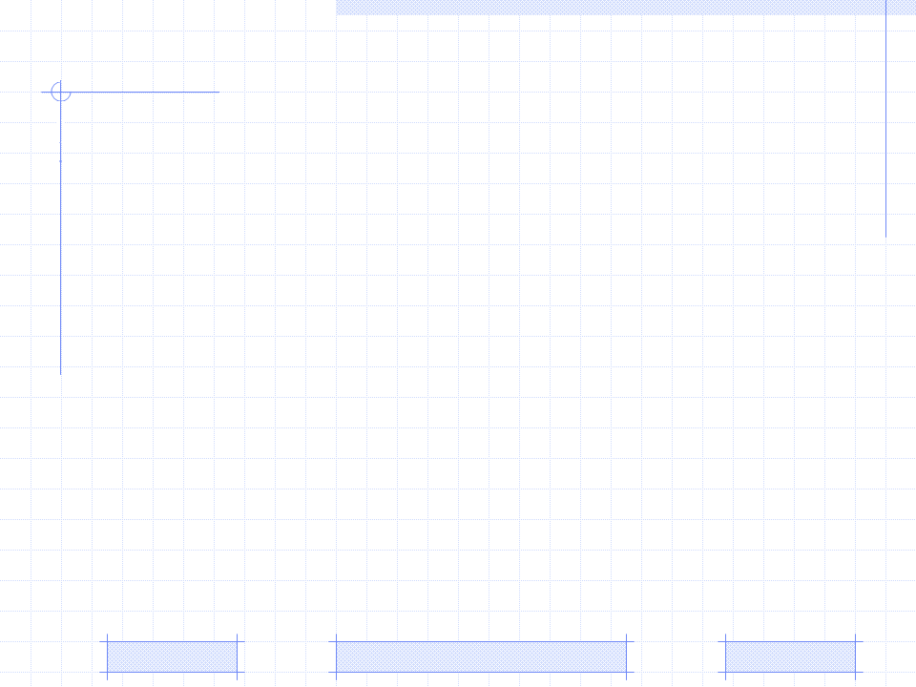
Parameter Learning
Beta distribution
EM algorithm
An Example
PhD. Report: | The architecture of Zebra (September 23th 2009)
Professor: | Pr. Dr. Dong Thi Bich Thuy
Researcher: | Nguyen Phuoc Loc
Affiliation: | Department of IS, Faculty of IT, University of Science

Slide 2
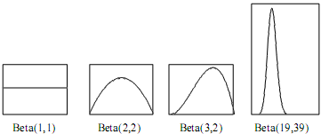
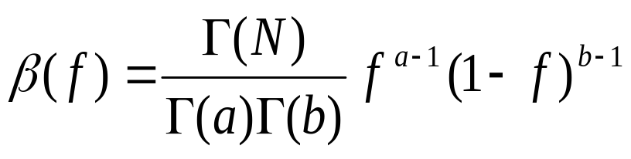
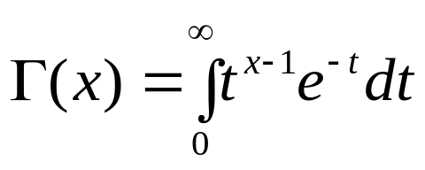
I. Beta distribution
Beta distribution
There are “a” successful outcomes (for example, f =1) in “a+b” trials
Higher value of “a” is, higher ratio of success is, so, the graph leans forward right
Higher value of “N=a+b” is, the more the mass concentrates around a/(a+b) and the more narrow the graph is

Slide 3

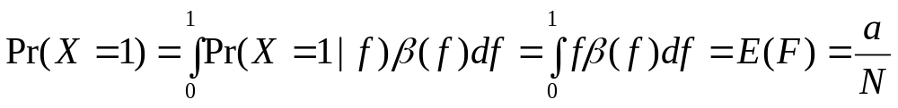
I. Beta distribution
Dummy variable and augmented Bayesian network
Dummy variable and augmented Bayesian network
Suppose binary variable X in network and the probability distribution of X is considered as relative frequency denoted by variable F.
Dummy variable F which acts as the parent of X and has a beta density function β(f; a, b), so as to Pr(X=1|f) = f
X and F constitute a simple network which is referred as augmented BN
Where N = a + b

Slide 4
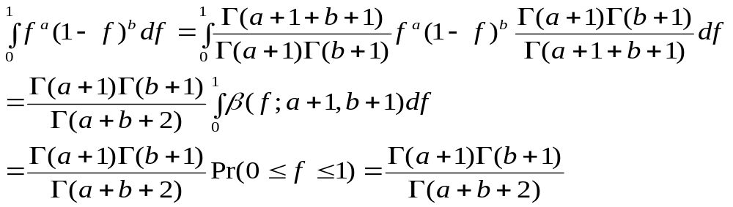
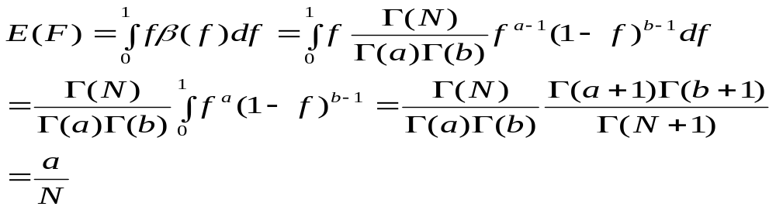
I. Beta distribution
Proof

Slide 5
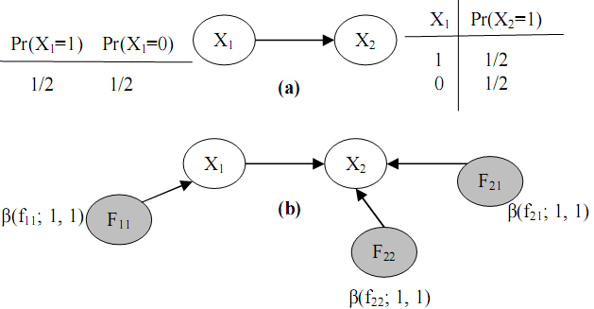
I. Beta distribution
extended augmented Bayesian network

Slide 6
II. EM algorithm
Parameter learning
Suppose the density function is the beta function β(f_{ij}; a_{ij}, b_{ij})
Variable X_{i} has the prior conditional probability Pr(X_{i}=1|pa_{ij}=1)=E(β(f_{ij}))= a_{ij}/N_{ij}
The parameter learning process based on a set of evidences is to update the posterior density function β(f_{ij}|E). It means that:
Pr(X_{i}=1|pa_{ij}=1, E)=(a_{ij}+s_{ij})/(N_{ij}+M_{ij})
Where s is the number of all evidences having value 1 (success), otherwise, t is the number of all evidences having value 0 (failed).

Slide 7
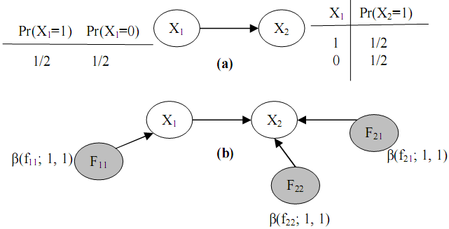
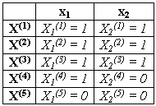

II. EM algorithm
Parameter learning

Slide 8
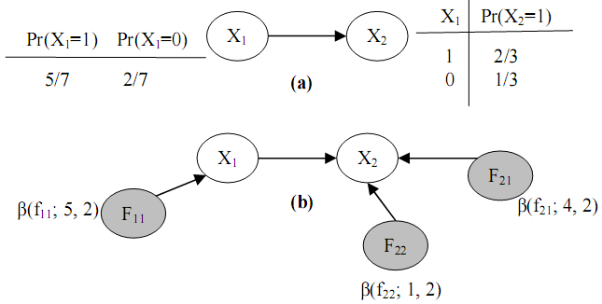

II. EM algorithm
Parameter learning

Slide 9
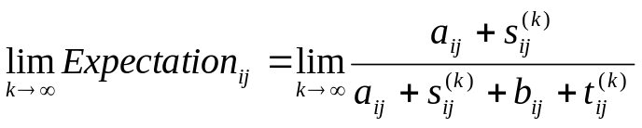
II. EM algorithm
Parameter learning in case of data missing
Step1. We compute s’ij and t’ij based on the expected value of given β(fij), s’_{ij}=E(β(f_{ij})) and t’_{ij}=1- E(β(f_{ij})). Next, replacing missing data by s’ij and t’_{ij} . This step is called Expectation step
Step 2. We determine the posterior density function f_{ij} by computing its parameters a_{ij}=a_{ij}+s_{ij} and b_{ij}=b_{ij}+t_{ij}. Terminating algorithm if the stop condition becomes true, otherwise, reiterating step 1. This step is called the Maximization step.
After k^{th} iteration, will approach an certain limit

Slide 10
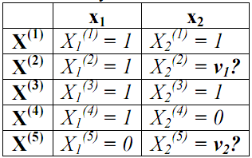
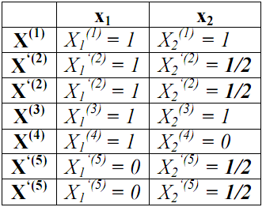


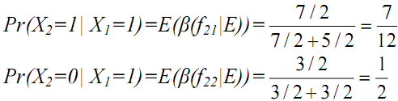
II. EM algorithm
Parameter learning in case of data missing

Slide 11
III. An example
Suppose Java course is constituted of three concepts considered as knowledge variables whose links are prerequisite relationships. Additionally, there are two evidence variables: "Questions > 10" and "Exercise: set up… ".
That learner asks more than 10 questions is to tell how much her/his amount of knowledge. Like that, evidence "Exercise: set up..." proves whether or not he/she understands concept "Class & Object"

Slide 12
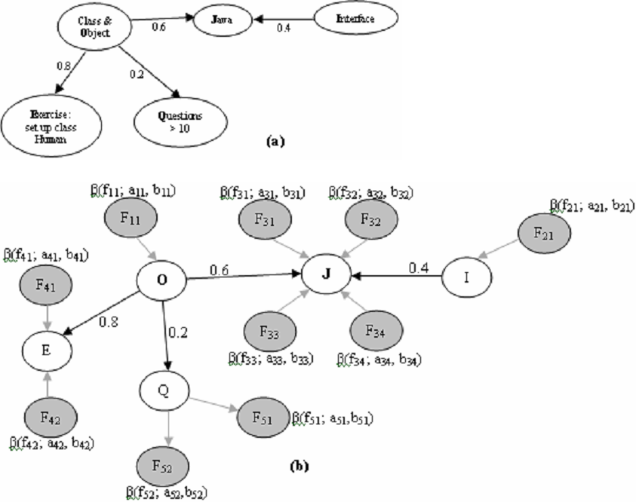
III. An example

Slide 13
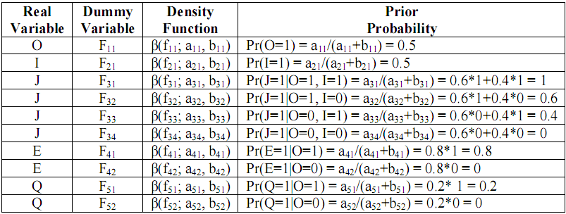
III. An example
Prior probabilities

Slide 14
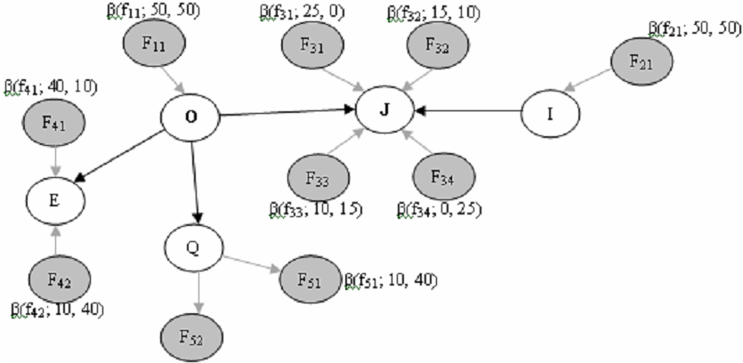
III. An example
Augmented Bayesian network with sample size 100

Slide 15
III. An example
Suppose two evidences X(1)=(E(1)=1, Q(1)=1) and X(2)=(E(2)=1, Q(2)=0)
The first observation: User does well the “Exercise…” and asks more than 10 question in course.
The second observation: User does well the “Exercise…” but asks less than 10 questions.

Slide 16
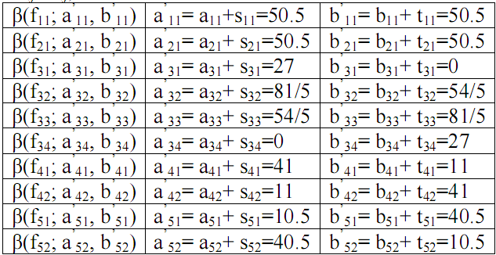
III. An example
Because it lacks information about other concepts such as O, J, I. Applying EM algorithm for missing data we have the posterior probabilities showed in following table

Slide 17
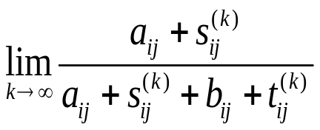
Conclusion
BN is a powerful mathematical tool for reasoning but it is restricted by unimproved initial parameters
If we apply EM algorithm whenever observed evidences are raised, the posterior density functions are updated and become more accurate after many iterations because the will gains certain value

Slide 18
Reference
David Heckerman. A Tutorial on Learning With Bayesian Networks. Technical Report MSR-TR-95-06. Microsoft Research Advanced Technology Division, Microsoft Corporation.
Eugene Charniak. Bayesian Network without Tears. AI magazine. 1991
Richard E. Neapolitan. Learning Bayesian Networks. Northeastern Illinois University Chicago, Illinois 2003
Flavia Sparacino. Sto(ry)chastics: a Bayesian Network Architecture for User Modeling and Computational Storytelling for Interactive Spaces. Lecture Notes in Computer Science, 2003
IT@EDU 2008

Slide 19
THANK FOR CONSIDERATION
IT@EDU 2008

