Slide 1
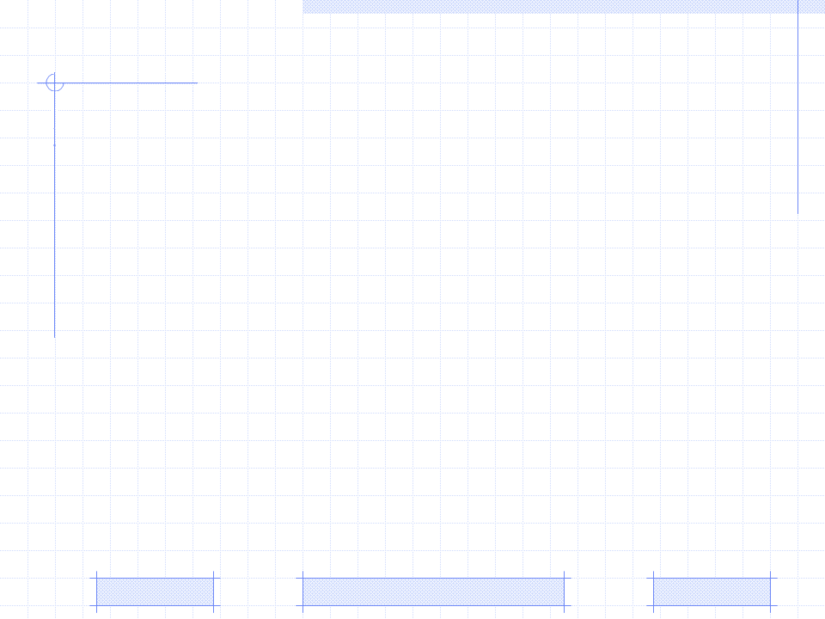
Specifying Parameters by MLE
Introduction
Maximum likelihood estimation
Beta likelihood estimation
Algorithm to solve estimating equation
An example
PhD. Report: | Beta likelihood eatimation (August 30th 2009)
Professor: | Pr. Dr. Dong Thi Bich Thuy
Researcher: | Nguyen Phuoc Loc
Affiliation: | Department of IS, Faculty of IT, University of Science

Slide 2
I. Introduction
Bayesian network (BN) provide the solid inference mechanism when convincing the hypothesis by collecting evidences. Bayesian network is instituted of two models: qualitative model (structure), quantitative model (parameters).
Parameters are conditional probability table (CPT) whose entries are probabilities quantifying the dependences among variables in network. The quality of CPT depends on the initialized values of its entries. Such initial values are prior probabilities
Because the beta function provides some conveniences when specifying CPT (s), this function is used as the basic distribution in our method. The problem of defining prior probabilities is involved in how to estimate parameters in beta distribution

Slide 3
I. Introduction
We propose the formula for estimating beta distribution’s parameters by applying the Maximum Likelihood Estimation (MLE) technique. Such optimal parameters that we must find out are called parameter estimators
It is slightly unfortunate when the equations whose solutions are parameter estimators are differential equations and it is too difficult to solve them. Thus we also propose the algorithm so as to find out the approximate solutions of these equations

Slide 4
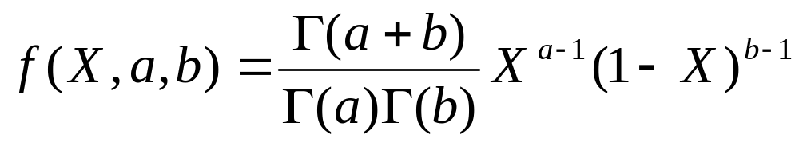
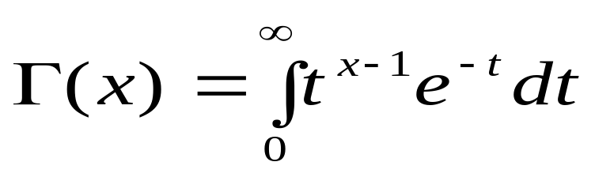
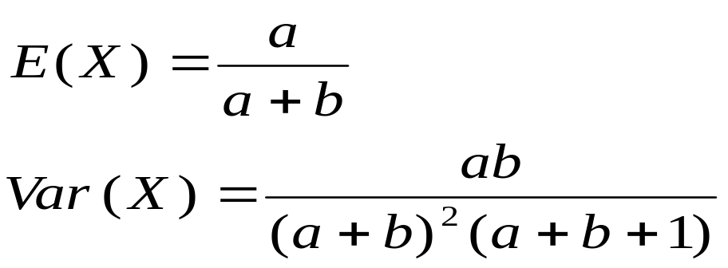
I. Introduction
Suppose every node X in BN obeys beta distribution with two parameters a and b
Where
The expectation and variance of beta distribution are defined as below:

Slide 5
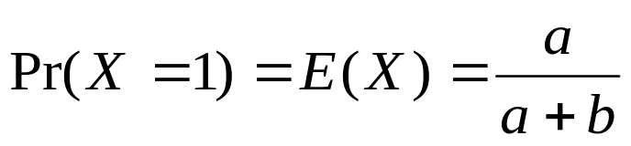
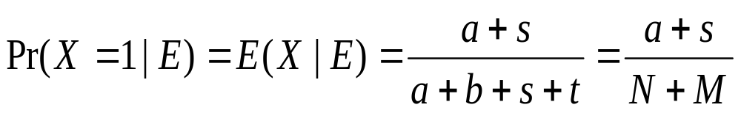
I. Introduction
The reason we choose beta function as the probability distribution for every node (variable) in BN is that the prior probability of X is the expectation of beta function and this value is very easy to compute
We need to compute the posterior probability of X denoted as Pr(X=1|E) where E is the set of evidences in which the numbers of evidences having value 1 and 0 are s and t, respectively.

Slide 6
I. Introduction
We recognize that the beta distribution provide us some convenience when specifying CPT (s) in BN
However, the quality of CPT is also dependent on the prior probability and so; the considerable problem is involved in how to estimate two parameters of beta distribution a and b
We used the maximum likelihood estimation (MLE) technique to estimate two parameters of beta distribution

Slide 7
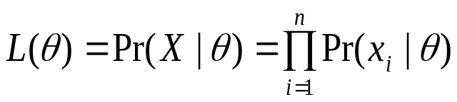
II. Maximum likelihood estimation
Let θ and X be the hypothesis and observation variable, respectively. Suppose x₁, x₂,…, x_{n} are instances of variable X in training data and they are observed independently
According multiplication rule in probability theory, the likelihood function L(θ) is the joint probability which is the product of condition probabilities of instances x_{i}, given hypothesis variable
Suppose θ={θ₁, θ₂,…, θ_{k}} is the vector of parameters specifying the distribution f, it is required to estimate the parameter vector and its standard deviation in distribution f so that the likelihood function takes the maximum value

Slide 8
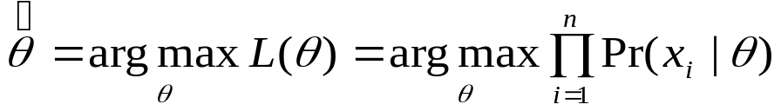
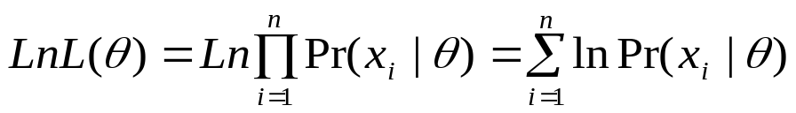
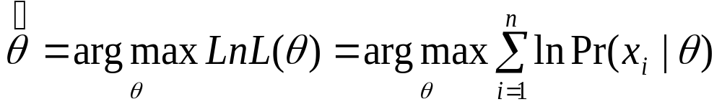
II. Maximum likelihood estimation
The parameter vector that maximizes likelihood function is called optimal parameter vector denoted as
Because it is too difficult to work with the likelihood function in the form of product of condition probabilities, we should take the logarithm of L(θ) so that the log function converts the repeated multiplication to repeated addition. The logarithm of L(θ) so-called log-likelihood is denoted LnL(θ)

Slide 9
II. Maximum likelihood estimation
The essence of maximizing the likelihood function is to find the peak of the curve of LnL(θ). This can be done by setting the first-order partial derivative of LnL(θ) with respect to each parameter θ_{i} to 0 and solving this equation to find parameter θ_{i}
Another important issue is how to determine the standard deviation in distributed f when we have already computed all parameters.
It is very fortunate when the second-order derivative of the log-likelihood function denoted can be computed and it is used to determine the variances of parameters.

Slide 10
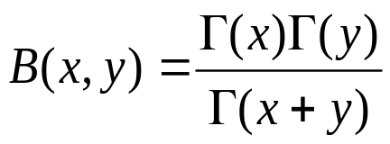
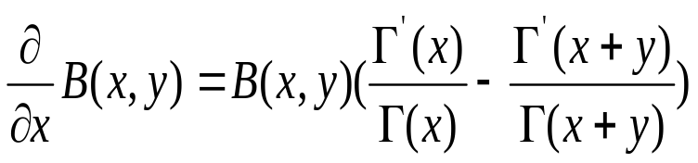

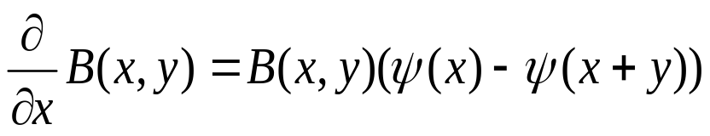
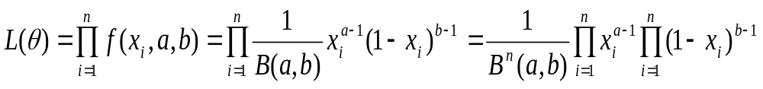
III. Beta likelihood estimation
Beta distribution
Beta function
The likelihood function of beta distribution

Slide 11
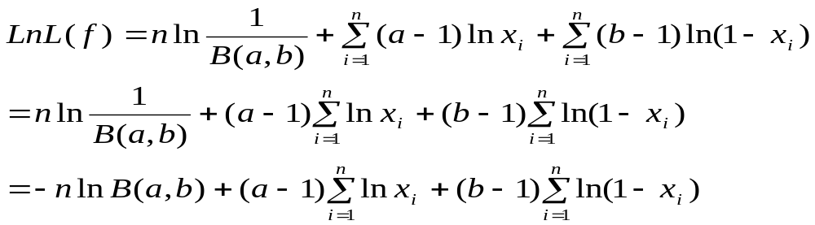
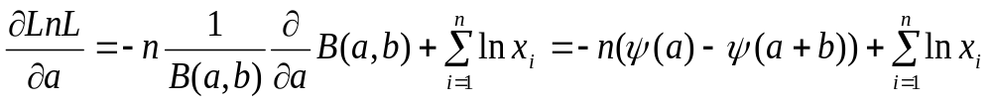
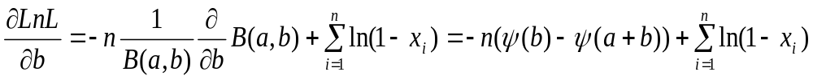
III. Beta likelihood estimation
The log-likelihood function
Two first-order partial derivatives corresponding to two parameters

Slide 12
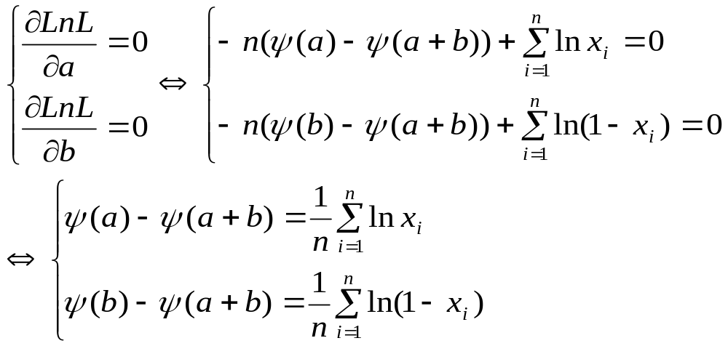
III. Beta likelihood estimation
Setting two partial derivatives equal to 0

Slide 13
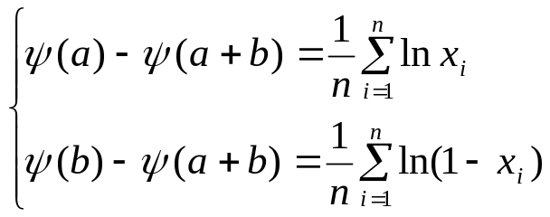
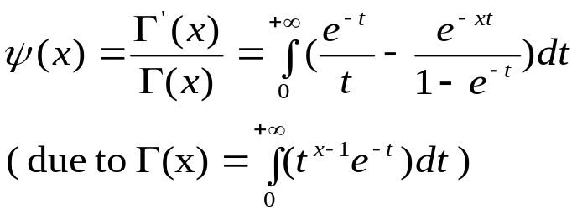
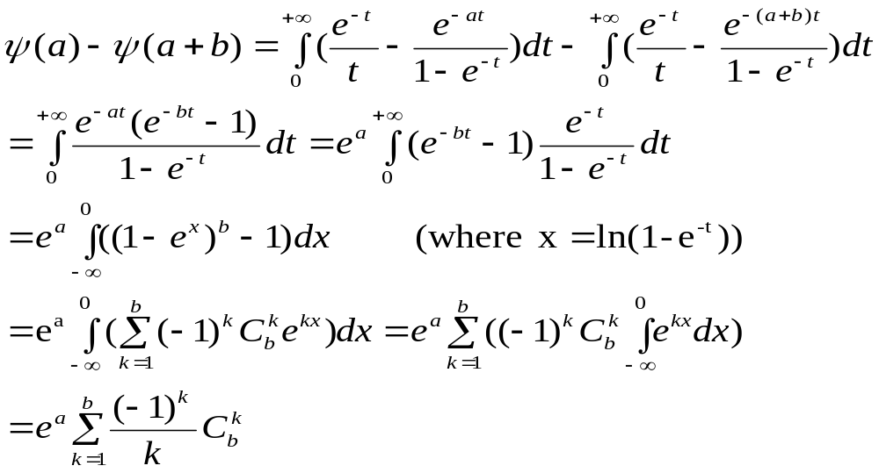
IV. Algorithm to solve estimating equation
Expanding the expression ψ(a) – ψ(a+b)

Slide 14
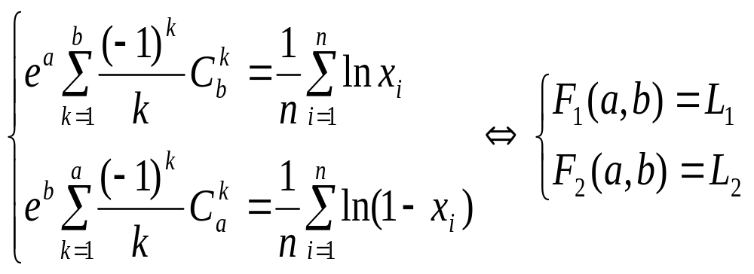
IV. Algorithm to solve estimating equation
The equations whose solutions are
parameter estimators

Slide 15

IV. Algorithm to solve estimating equation
Iterative Algorithm
Suppose the range of variables a and b is from 1 to n where n is the whole positive number and not greater than the number of evidences in training data
We propose the iterative algorithm that each pair values (a_{i}, b_{i}) which are values of variables a and b are fed to F₁, F₂ at each iteration
We compute two biases Δ₁, Δ₂ and the normal bias Δ at each iteration.
The pair (a,b) whose normal bias Δ is minimum are chosen as the parameter estimators

Slide 16
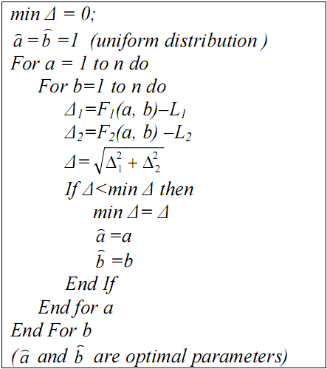
IV. Algorithm to solve estimating equation
Iterative Algorithm

Slide 17
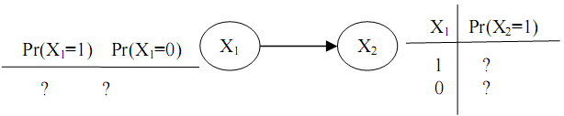
V. An example
Suppose there is the BN having two variables X₁, X₂ and one arc which links them together
Variables X₁ and X₂ obey beta distribution. We need to specify the prior CPT (s), namely the prior conditional probabilities Pr(X₁=1), Pr(X₂=1|X₁=1) and Pr(X₂=1|X₁=0)

Slide 18
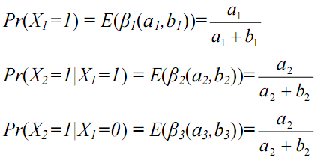
V. An example
Let β₁(a₁,b₁), β₂(a₂,b₂), β₃(a₃,b₃) be beta distributions of conditional probabilities Pr(X₁=1), Pr(X₂=1|X₁=1) and Pr(X₂=1|X₁=0). We have:

Slide 19
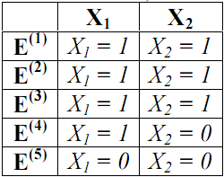
V. An example
It is necessary to determine three parameter pairs (a₁, b₁), (a₂, b₂) and (a₃, b₃) of β1, β2, β3, respectively
Suppose we perform 5 trials of a random process, the outcome of i^{th} trial denoted E^{(i)} is considered as an evidence in which X₁ and X₂ obtains value 0 or 1

Slide 20
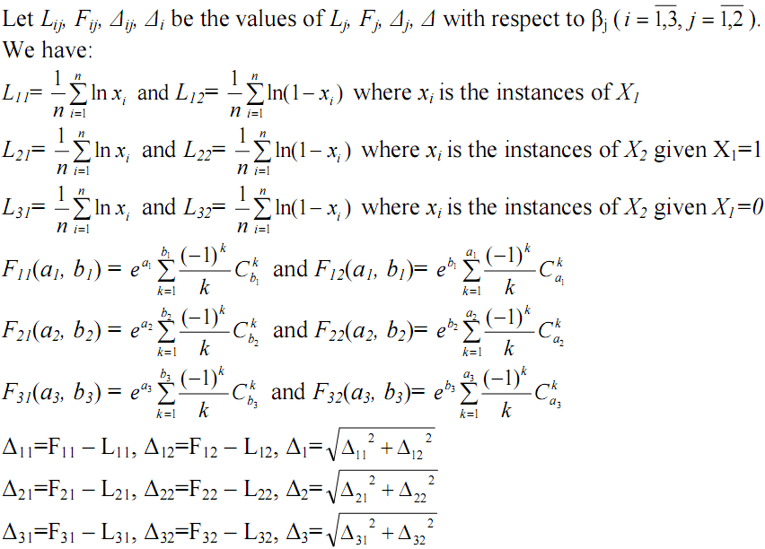
V. An example

Slide 21
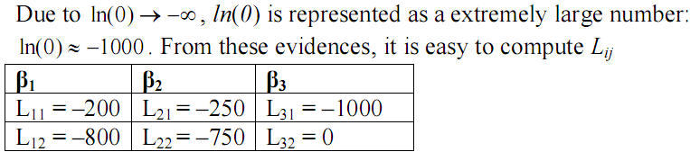
V. An example

Slide 22
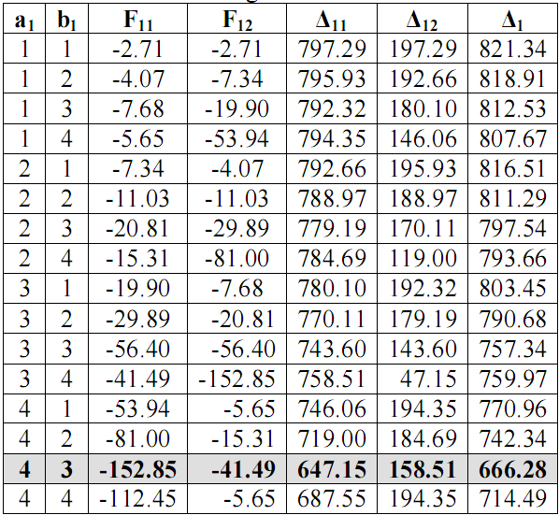
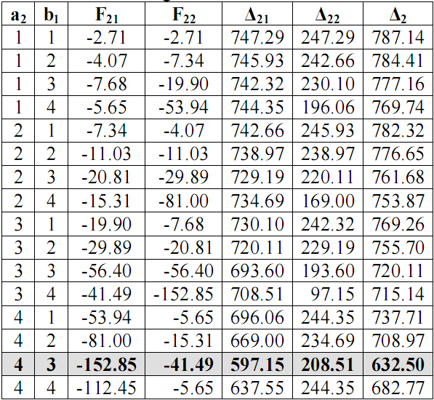
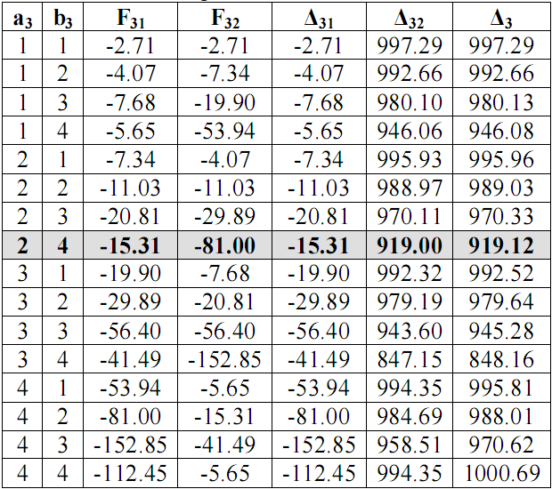
V. An example
The normal biases of all possible values of (a₁, b₁), (a₂, b₂), (a₃, b₃) with respect to β₁, β₂, β₂

Slide 23
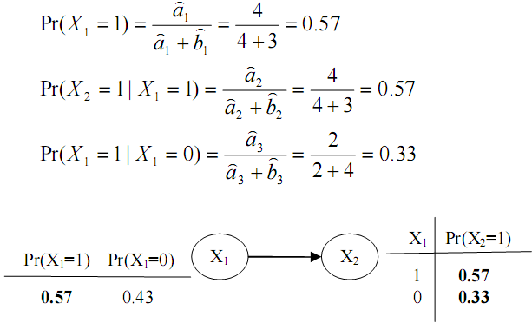
V. An example
From above tables, we recognize that when (a1,b1)=(4,3), (a2,b2)=(4,3) and (a3,b3)=(2,4), the normal biases of distributions β1, β2 and β3, respectively become minimum
So the parameter estimators corresponding to distributions β1, β1 and β3 are (4,3), (4,3) and (2,4), respectively

Slide 24
Conclusion
The basic idea of MLE is to sole the equation formed by setting the first-order derivation of log-likelihood function equal 0
We apply MLE into beta distribution so as to determine the equations for computing two parameters of beta distribution.
Although beta distribution is more complex to estimating its parameters than other distributions like binominal distribution and normal distribution, we showed that these equations exist

Slide 25
Conclusion
Because it is too difficult to solve such equations, we propose the algorithm so as to find out their approximate solutions
This is iterative algorithm in which a number of parameters are surveyed and the parameter whose bias with respect to the actual solution is minimum is the approximate solution
It impossible to find out the precise solution but it is easy and feasible to implement our algorithm as computer program.

Slide 26
Reference
[Amdeberhan, Espinosa, Moll]. Tewodros Amdeberhan, Olivier Espinosa and Victor H. Moll. The Laplace Transform of The Digamma Function: An Integral due to Glasser, Manna and Oloa
[Berg 2004]. Cristian Berg. Integral Representation of Some Functions Related to the Gamma Function. Mediterranean Journal of Mathematics, 433–439, 1660-5446/040433-7, DOI 10.1007/s00009-004-0022-6. Birkhäuser Verlag Basel/Switzerland 2004
[Hald 1999]. Anders Hald. On the History of Maximum Likelihood in Relation to Inverse Probability and Least Squares. Statistical Science 14 (2), May 1999
[Lynch 2003]. Scott M. Lynch. Maximum Likelihood Estimation. Soc. 504, February 2003

Slide 27
THANK FOR CONSIDERATION
IT@EDU 2008

