Slide 1
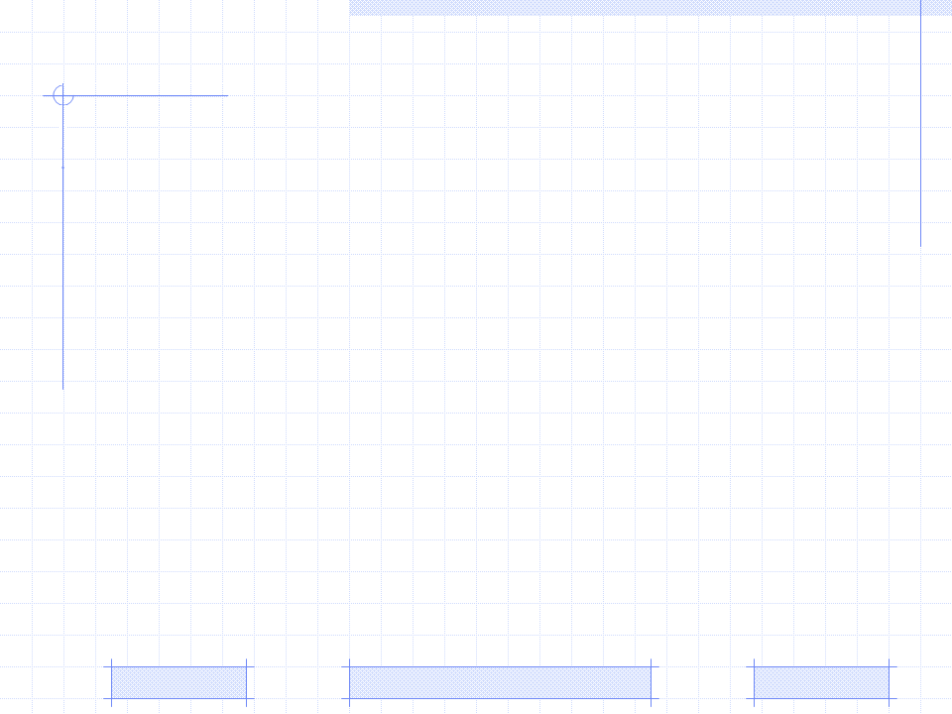
Triangular Learner Model
Triangular Learner Model (TLM)
Zebra: a user modeling system for TLM
Knowledge sub-model in TLM
Learning style sub-model in TLM
Learning history sub-model in TLM
PhD. Report: | Triangular Learner Model (November 17 2009)
Professor: | Pr. Dr. Dong Thi Bich Thuy
Researcher: | Nguyen Phuoc Loc
Affiliation: | Department of IS, Faculty of IT, University of Science

Slide 2
I. Triangular Leaner Model
Adaptive System
User Modeling System
Selection Rules
User Model
Learning Materials
TARGET: Adaptive System changes its action to provide learning materials for every student in accordance with her/his model

Slide 3
I. Triangular Leaner Model
Hazards of User Modeling
Too much information about individuals to model all users’ characteristics → it is necessary to choose essential characteristics from which a stable architecture of user model is built.
Some user modeling systems (UMS) lack of powerful inference mechanism → need a solid inference UMS

Slide 4
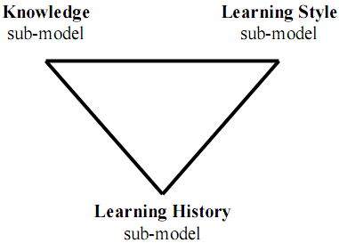
I. Triangular Leaner Model (TLM)
Triangular Learner Model (TLM)
Knowledge (K) sub-model is the combination of overlay model and Bayesian network
Learning style (LS) sub-model is defined as the composite of characteristic cognitive, affective and psychological factors
Learning history (LH) is defined as a transcript of all learners’ actions such as learning materials access, duration of computer use, doing exercise, taking an examination, doing test, communicating with teachers or classmates, etc

Slide 5
I. Triangular Leaner Model
Why TLM?
Knowledge, learning styles and learning history are prerequisite for modeling learner
While learning history changes themselves frequently, learning styles and knowledge are relatively stable. The combination of them ensures the integrity of information about learner
User knowledge is domain specific information and learning styles are personal traits. The combination of them supports user modeling system to take full advantages of both domain specific information and domain independent information

Slide 6
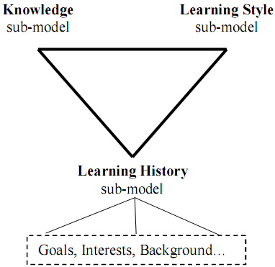
I. Triangular Leaner Model
extended Triangular Leaner Model

Slide 7


I. Triangular Leaner Model
How to build up TLM?
How to manipulate (manage) TLM?
How to infer new information from TLM?
→ Zebra: the user modeling system for TLM

Slide 8
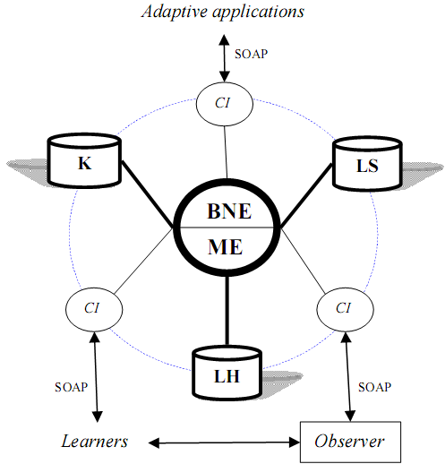
II. Zebra: a user modeling system for TLM
Mining Engine (ME) manages learning history sub-model of TLM
Belief Network Engine (BNE) manages knowledge sub-model and learning style sub-model of TLM
Communication Interfaces (CI) allows users and adaptive systems to see or modify restrictedly TLM

Slide 9
II. Zebra: a user modeling system for TLM
Mining Engine
Collecting learners’ data, monitoring their actions, structuring and updating TLM.
Providing important information to belief network engine
Supporting learning concept recommendation
Discovering some other characteristics (beyond knowledge and learning styles) such as interests, goals, etc
Supporting collaborative learning through constructing learner groups (communities)

Slide 10
II. Zebra: a user modeling system for TLM
Belief Network Engine
Inferring new personal traits from TLM by using deduction mechanism available in belief network
This engine applies Bayesian network and hidden Markov model into inference mechanism.
Two sub-models: knowledge & learning style are managed by this engine

Slide 11
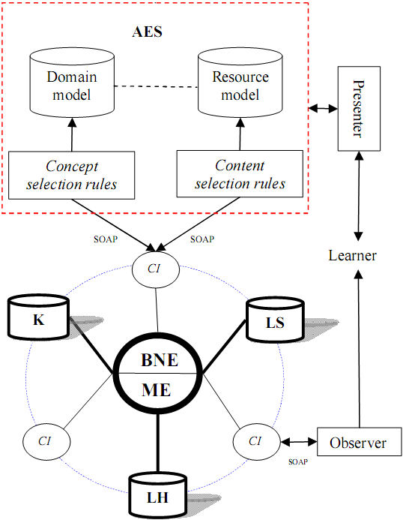
II. Zebra: a user modeling system for TLM
The extended architecture of Zebra when interacting with AES

Slide 12
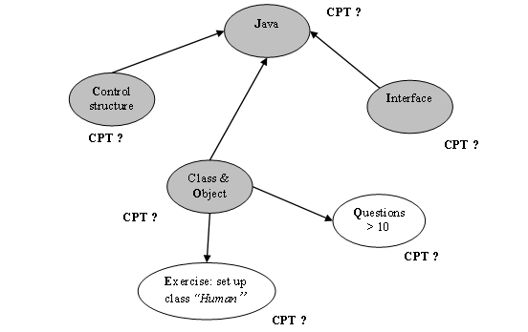
III. Knowledge sub-model
Knowledge sub-model = overlay model + Bayesian network (BN)

Slide 13
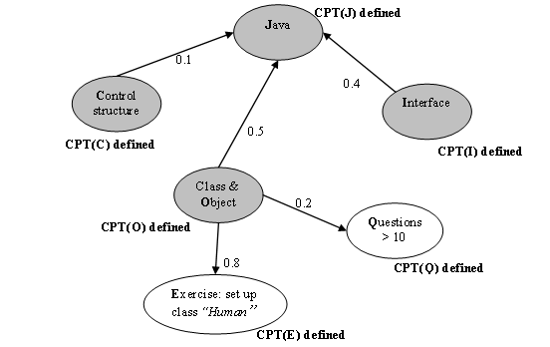
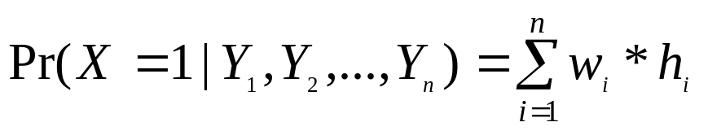
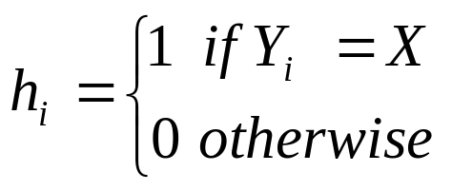
III. Knowledge sub-model
Determining CPT (s) is based on weights of arcs

Slide 14
III. Knowledge sub-model
Determining CPT (s) is based on weights of arcs
T₁
C O I | p(J = 1) | P(J = 0) 1- p(J = 1)
1 1 1 | 1.0 (0.1*1 + 0.5*1 + 0.4*1) | 0.0
1 1 0 | 0.6 (0.1*1 + 0.5*1 + 0.4*0) | 0.4
1 0 1 | 0.5 (0.1*1 + 0.5*0 + 0.4*1) | 0.5
1 0 0 | 0.1 (0.1*1 + 0.5*0 + 0.4*0) | 0.9
0 1 1 | 0.9 (0.1*0 + 0.5*1 + 0.4*1) | 0.1
0 1 0 | 0.5 (0.1*0 + 0.5*1 + 0.4*0) | 0.5
0 0 1 | 0.4 (0.1*0 + 0.5*0 + 0.4*1) | 0.4
0 0 0 | 0.0 (0.1*0 + 0.5*0 + 0.4*0) | 1.0
T₂
E | Pr(E = 1) | Pr(E = 0) 1- Pr(E = 1)
1 | 0.8 (0.8*1) | 0.2
0 | 0.0 (0.8*0) | 1.0
T₃
Q | Pr(Q = 1) | Pr(Q = 0) 1- Pr(Q = 1)
1 | 0.2 (0.2*1) | 0.8
0 | 0.0 (0.2*0) | 1.0

Slide 15
III. Knowledge sub-model
Improving knowledge sub-model
Parameter Learning: using Expectation Maximization (EM) algorithm or Maximum Likelihood Estimation (MLE) algorithm. Both of them are used for beta distributions
Structure Learning and monitoring: using Dynamic Bayesian Network (DBN)

Slide 16
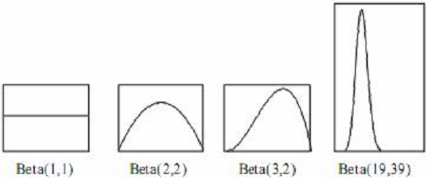



III. Knowledge sub-model (EM)
Beta density function

Slide 17
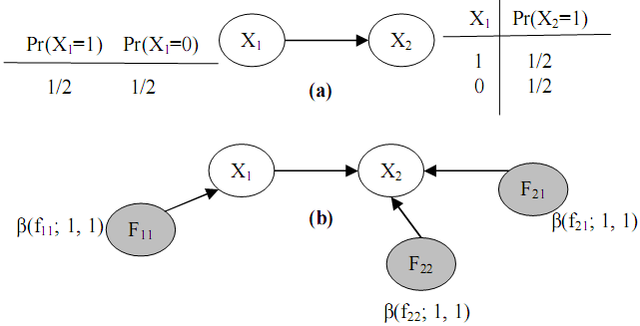
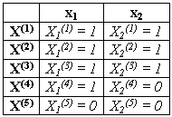

III. Knowledge sub-model (EM)
EM technique

Slide 18
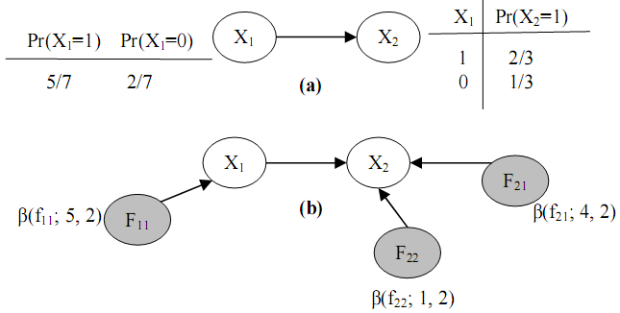

III. Knowledge sub-model (EM)
EM technique

Slide 19
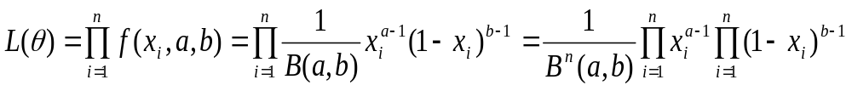
III. Knowledge sub-model (MLE)
MLE technique
The essence of maximizing the likelihood function is to find the peak of the curve of LnL(θ).
This can be done by setting the first-order partial derivative of LnL(θ) with respect to each parameter θ_{i} to 0 and solving this equation to find parameter θ_{i}

Slide 20
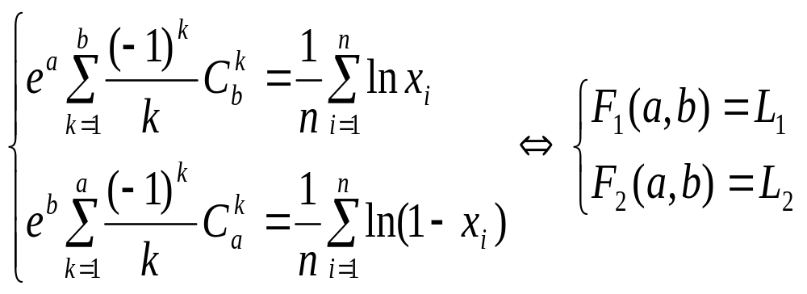
III. Knowledge sub-model (MLE)
The equations whose solutions are
parameter estimators

Slide 21
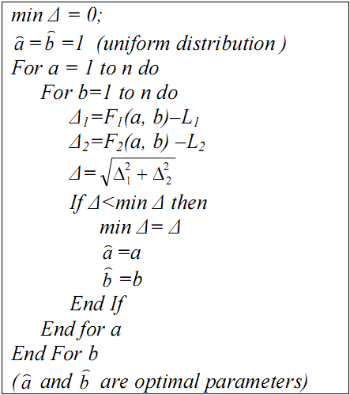

III. Knowledge sub-model (MLE)
Iterative Algorithm for MLE

Slide 22
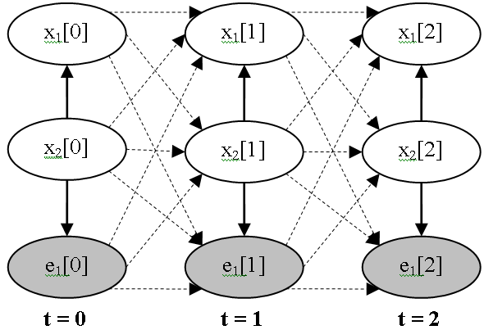
III. Knowledge sub-model (DBN)
A DBN is BN containing variables that comprise T variable vectors X[t]
An initial BN G₀ = {X[0], Pr(X[0]} at first time t = 0
A transition BN is a template consisting of a transition DAG G→ containing variables in X[t], X[t+1] and a transition probability distribution Pr→ (X[t+1] | X[t])

Slide 23
III. Knowledge sub-model (DBN)
Strong points of DBN
DBN can model the temporal relationships among variables. It can capture the dynamic aspect
So DBN allows monitoring user’s process of gaining knowledge and evaluating her/his knowledge
Drawbacks of DBN
The size of DBN becomes numerous when the process continues for a long time
The number of transition dependencies among points in time is too large to compute posterior marginal probabilities

Slide 24
III. Knowledge sub-model (DBN)
Purposes of suggested algorithm to improve DBN
To overcome these drawbacks, the new algorithm that both the size of DBN and the number of Conditional Probability Tables (CPT) in DBN are kept intact when the process continues for a long time
To solves the problem of temporary slip and lucky guess: “learner does (doesn’t) know a particular subject but there is solid evidence convincing that she/he doesn’t (does) understand it; this evidence just reflects a temporary slip (or lucky guess)”.

Slide 25
III. Knowledge sub-model (DBN)
The algorithm for DBN includes 6 steps that repeated whenever evidences occur
Initializing DBN
Specifying transition weights
Re-constructing DBN
Normalizing weights of dependencies
Re-defining CPT (s)
Probabilistic inference

Slide 26
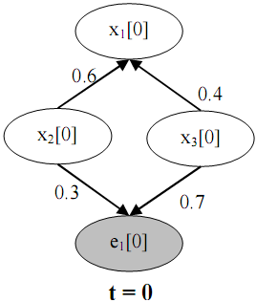
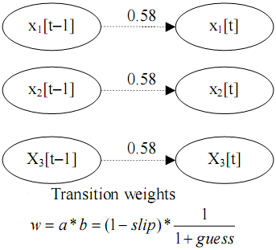
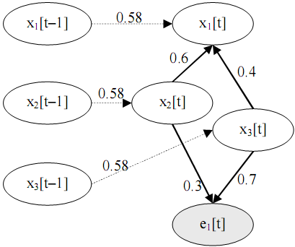
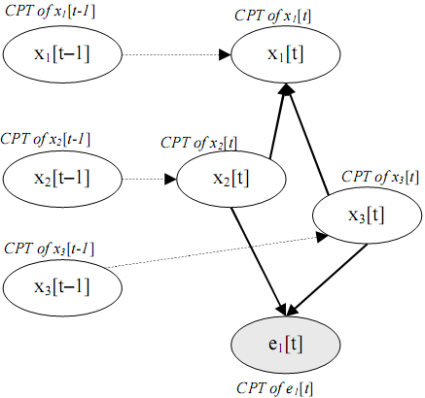
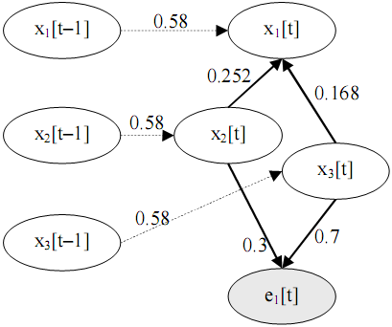
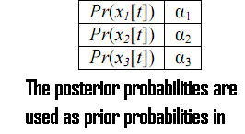
III. Knowledge sub-model (DBN)
1. Initializing DBN
2. Specifying transition weights
3. Re-constructing
6. Probabilistic inference
5. Re-defining CPT(s)
4. Normalizing weights

Slide 27
IV. Learning style sub-model
Hidden Markov Model (HMM) is the 5-tuple Δ=<S,θ,A,B,Π>
S={s₁, s₂,…, s_{n}} is the finite set of states
Ө={θ₁, θ₂,…, θ_{m}} is the set of observations
A is the transition probability matrix in which a_{ij} is the probability that, the process change the current state s_{i} to next state s_{j}
B is the observation probability matrix. Let b_{i}(k) be the probability of observation θ_{k} when the second stochastic process is in state s_{i}
∏ is the initial state distribution where π_{i} represents the probability that the stochastic process begins in state s_{i}

Slide 28
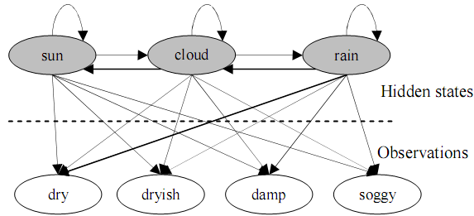

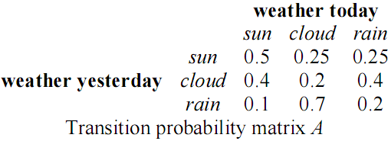
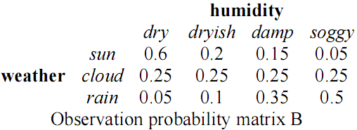
IV. Learning style sub-model
Weather forecast example

Slide 29
IV. Learning style sub-model
Uncovering problem
Given HMM and a sequence of observations O = {o₁ → o₂ →…→ o_{k}}, how to find the sequence of states U = {s_{k} → s_{k+1} →…→ s_{k+m}} so that U is most likely to have produced the observation sequence O
This is the uncovering problem: which sequence of state transitions is most likely to have led to this sequence of observations → Viterbi algorithm

Slide 30
IV. Learning style sub-model
Basic idea
Each learning style is now considered as a state
Users’ learning actions are considered as observations
After monitoring users’ learning process, we collect observations about them and then discover their styles by using inference mechanism in HMM, namely Viterbi algorithm

Slide 31
IV. Learning style sub-model
Basic idea
Suppose we choose Honey-Mumford model and Felder-Silverman model as principal models which are presented by HMM
We have three dimensions: Verbal/Visual, Activist/ Reflector, Theorist/ Pragmatist which are modeled as three HMM(s): ∆₁, ∆₂, ∆₃ respectively
∆₁ = 〈 S₁, Ө₁, A₁, B₁, ∏ ₁〉
∆₂= 〈 S₂, Ө₂, A₂, B₂, ∏ ₂〉.
∆₃ = 〈 S₃, Ө₃, A₃, B₃, ∏ ₃〉.

Slide 32
IV. Learning style sub-model
Technique includes 5 steps
Defining states (S₁, S₂, S₃)
Defining initial state distributions
(∏ _{1,} ∏ _{2,} ∏ ₃ )
Defining transition probability matrices (A₁, A₂, A₃)
Defining observations (Ө₁, Ө₂, Ө₁)
Defining observation probability matrices (B₁, B₂, B₃)

Slide 33
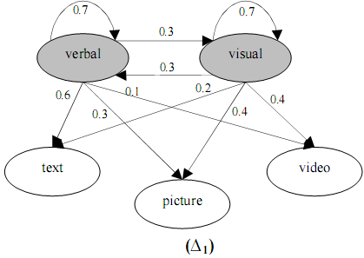
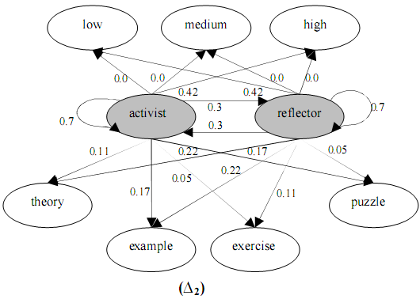
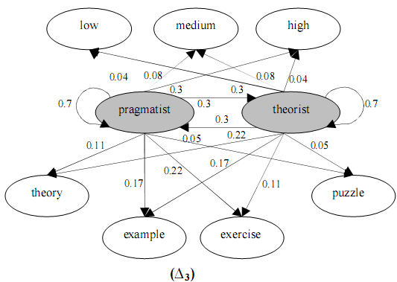
IV. Learning style sub-model

Slide 34
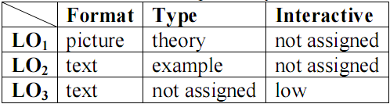
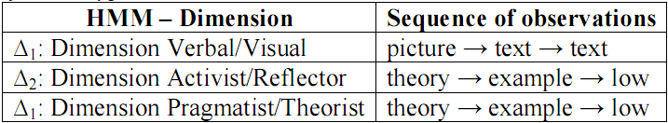
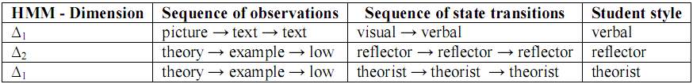
IV. Learning style sub-model
An example for inferring student’s learning styles
Learning
objects
selected
Sequence of student observations
Sequence of state transitions → this student is a verbal, reflective and theoretical person.

Slide 35
V. Learning history sub-model
Learning history managed by Mining Engine has four responsibilities
Providing necessary information for two remaining sub-models: learning style sub-model and knowledge sub-model
Supporting learning concept recommendation
Mining learners’ educational data in order to discover other learners’ characteristics such as interests, background, goals…
Supporting collaborative learning through constructing learner groups.

Slide 36
V. Learning history sub-model (recommendation)
Recommendation methods
Rule-based filtering: manually or automatically generated decision rules that are used to recommend items to users
Content-based filtering: recommends items that are considered appropriate to user information in his profile
Collaborative filtering: considered as social filtering when it matches the rating of a current user for items with those of similar users in order to produce recommendations for new items

Slide 37
V. Learning history sub-model (recommendation)
Sequential pattern
Sequential pattern mining belongs to collaborative filtering family
User does not rate explicitly items but his series of chosen items are recorded as sequences to construct the sequence database which mined to find frequently repeated patterns he can choose in future
In learning context, items can be domain concepts / learning objects which students access or learn

Slide 38
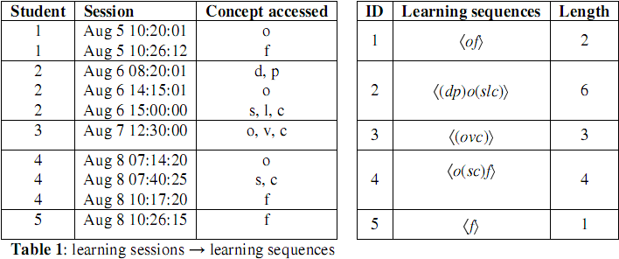
V. Learning history sub-model (recommendation)
Given problem
Suppose concepts in Java course: data type, package, class & OOP, selection structure, virtual machine, loop structure, control structure, and interface which in turn denoted as d, p, o, s, v, l, c, f
At our e-learning website, students access learning material relating such concepts in sessions, each session contains only one itemset and is ordered by time. The student's learning sequence is constituted of itemsets accessed in all his sessions

Slide 39
V. Learning history sub-model (recommendation)
Students accessed learning material in their past sessions, how system recommends appropriate concepts to student for next visits → mining sequential patterns → solution:
Applying techniques of mining user learning data to find learning sequential patterns (not discussed here)
Breaking such patterns into concepts which are recommended to users

Slide 40
V. Learning history sub-model (recommendation)
Problem
Suppose the sequential pattern 〈osc(sc)〉 discovered which means:
“class & OOP” → “selection structure” → ”control structure” → ”selection structure, control structure”
Pattern is considered as the learning "route" that student preferred or learned often in past
In the next time if a student chooses one concept, the adaptive learning system should recommend which next concepts?
→ the patterns should be broken into association rules with their confidence

Slide 41
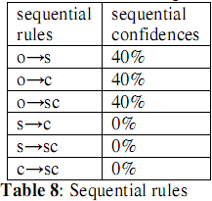
V. Learning history sub-model (recommendation)
Breaking technique
Breaking entire 〈osc(sc)〉 into litemsets such as o, s, c, (sc) and determining all possible large 2-sequences whose order must comply with the order of sequential pattern. There are six large 2-sequences: 〈os〉, 〈oc〉, 〈o(sc)〉, 〈sc〉, 〈s(sc)〉, 〈c(sc)〉.
Thus, we have six rules derived from these large 2-sequences in form: “left-hand litemset → right-hand litemset”, for example, rule “s→c” derived from 2-sequence 〈sc〉
Computing the confidences of rules and sorting them, confidence(x → y) = support(〈xy〉) / support((x)). The rules whose confidence is less than threshold min_conf is removed

Slide 42

V. Learning history sub-model (recommendation)
Recommended List
If student choose the concept (itemset) x, system will find whole rules broken from all sequential patterns and the left-hand litemset of each rule must contain x
Then, these rules are sorted by their confidences in descending order
Final outcome is an ordered list of right-hand litemsets (concepts), which are recommended to students
Recommended list
if user choose concept “class & oop”

Slide 43
V. Learning history sub-model (user interest)
There are two new points of view
The series of user access in his/her history are modeled as documents. So user is referred indirectly to as “document”.
User interests are classes such documents are belong to

Slide 44
V. Learning history sub-model (user interest)
Our approach includes four following steps
Documents in training corpus are represented according to vector model. Each element of vector is product of term frequency and inverse document frequency. However the inverse document frequency can be removed from each element for convenience
Classifying training corpus by applying decision tree or support vector machine or neural network.
Mining user’s access history to find maximum frequent itemsets. Each itemset is considered a interesting document and its member items are considered as terms. Such interesting documents are modeled as vectors
Applying classifiers (see step 3) into these interesting documents in order to choose which classes are most suitable to these interesting documents. Such classes are user interests

Slide 45
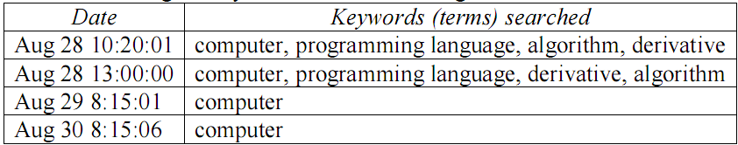
V. Learning history sub-model (user interest)
Suppose in some library or website, user U do his search for his interesting books, documents
There is demand of discovering his interests so that such library or website can provide adaptive documents to him whenever he visits in the next time
Given there is a set of key words or terms {computer, programming language, algorithm, derivative} that user U often looking for, the his searching history is showed in following table:
User searching history

Slide 46
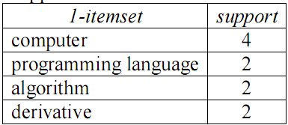

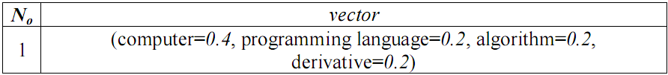
V. Learning history sub-model (user interest)
Using SVM, ANN or Decision Tree to classify this vector
This vector belongs to class compute science → user interest is computer science

Slide 47
V. Learning history sub-model (clustering)
There are two kinds of adaptations
Individual adaptation regards to each user
Community (or group) adaptation focuses on a community (or group) of users

Slide 48
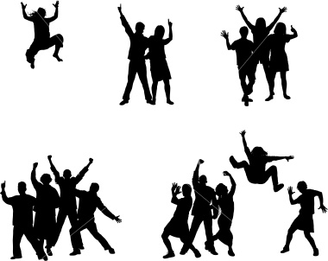
V. Learning history sub-model (clustering)
Common features in a group are relatively stable, so it is easy for adaptive systems to perform accurately adaptive tasks
If a new user logins system, she/he will be classified into a group and initial information of his model is assigned to common features in his group
It is very useful if the collaborative learning is restricted in a group of similar users
The problem that needs to be solved now is to cluster user models because a group is a cluster of similar user models.

Slide 49
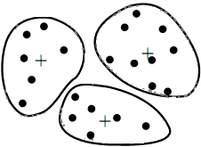
V. Learning history sub-model (clustering)
Clustering in case that user model is represented as a vector: U_{i} = {u_{i1}, u_{i2},…, u_{ij},…, u_{in}}
K-means algorithm
The dissimilarity of two user models is defined as Euclidean distance between them

Slide 50
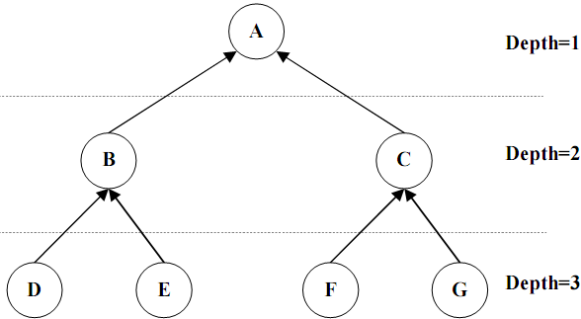
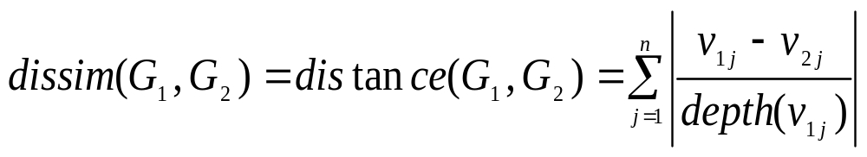
V. Learning history sub-model (clustering)
Clustering in case that user model is a overlay model (graph)
The dissimilarity of two graph models

Slide 51
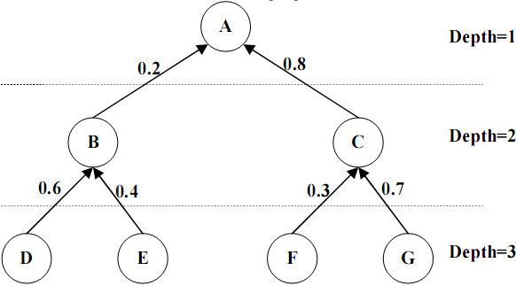
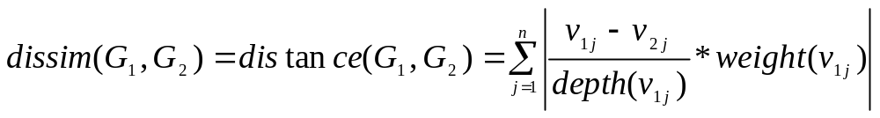
V. Learning history sub-model (clustering)
Clustering in case that user model is a weighted graph
The dissimilarity of two graphs

Slide 52
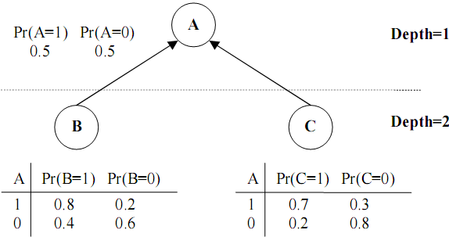
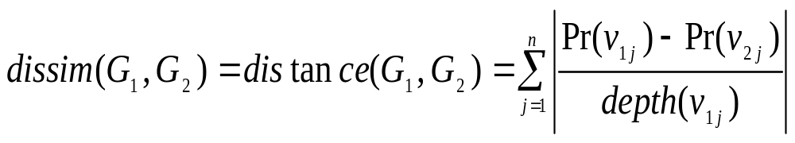
V. Learning history sub-model (clustering)
Clustering in case that user model is Bayesian network
The dissimilarity of two graph models

Slide 53
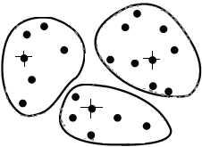
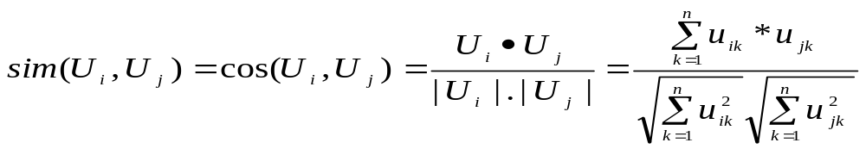
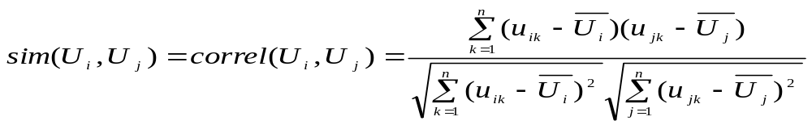
V. Learning history sub-model (clustering)
K-medoids algorithm and two similarity measures
Cosine similarity measure
Correlation coefficient

Slide 54
THANK FOR CONSIDERATION
IT@EDU 2008

