Slide 1
A User Modeling System for Adaptive Learning
Triangular Learner Model (TLM)
A user modeling system for TLM
Knowledge sub-model
Learning style sub-model
Learning history sub-model
Evaluating adaptive learning model
Report: | A User Modeling System for Adaptive Learning (October 19 2010)
Professor: | Pr. Dr. Dong Thi Bich Thuy
Researcher: | Nguyen Phuoc Loc
Affiliation: | Department of IS, Faculty of IT, University of Science
Notes:
Good morning madam and sir
Today, it is my presentation about subject user modeling
Its title is “A User Modeling System for Adaptive Learning”
My supervisor is Professor Dong Thi Bich Thuy
Affiliation is the Department of Information System, Faculty of IT, University of Science
This presentation includes 6 parts:
The proposed user model: Triangular Learner Model (TLM in abbreviation)
The user modeling system that manipulate TLM: Zebra
One sub-model in TLM, knowledge sub-model
Another sub-model in TLM, learning style sub-model
Learning history sub-model
Evaluating adaptive learning model

Slide 2
I. Triangular Leaner Model
Adaptive System
User Modeling System
Selection Rules
User Model
Learning Materials
[4]
TARGET: Adaptive System changes its action to provide learning materials for every student in accordance with her/his model
Notes:
User model is the presentation of information/characteristics about user, which must be manipulated by user modeling system.
Note that the terms: user, learner, student are the same in learning context.

Slide 3
I. Triangular Leaner Model
What is user model?
User profile is the representation of information / characteristics about user such as demography, knowledge, rating, interests, goal, personal traits… User profile is collected through two ways:
Explicit via questionnaires
Implicit via observations
User model is built up on user profile, which is organized (modeled) more normatively. Ability of inference is the most important in user model.
User model is managed by user modeling system (UMS) and retrieved by adaptive system for adaptations
Notes:
You should distinguish user profile and user model. They have both similar and different semantic. However their usefulness depend on their own applications. User model are never more shape or better than user profile.

Slide 4
I. Triangular Leaner Model
User Profile
User modeling
User Model
Adapting
Adaptive Effects
Notes:
There are two processes: user modeling process and adapting process. User modeling process is to construct user model based on user profile. Adapting process is to make adaptation effects

Slide 5
I. Triangular Leaner Model
Existing user modeling systems (UMS)
User modeling shell
User modeling server
Agent-based user model
Mobile user model
Notes:
Shell is the component separated from adaptive application but it isn’t work independently. It is integrated into adaptive system
Server runs as database server. Instead of managing data table, it manages user information. Server provides information to other adaptive system
Agent-based user model is built up as agent collecting information about user.
Mobile user model is stored on mobile device. Its volume (content) is restricted by the storage capacity of mobile device.

Slide 6
I. Triangular Leaner Model
Problems of User Modeling
Too much information about individuals to model all users’ characteristics → it is necessary to choose essential characteristics from which a stable architecture of user model is built.
Some user modeling systems (UMS) lack of powerful inference mechanism → need a solid inference UMS
Notes:
Because of much information about user. Some UMS so-called generic UMS focus on generic user information like demographics, interest, etc but these UMS aren’t really useful in learning machine
Some UMS aiming to provide data like DBMS but adaptive application require more new information that inferred from user model. The inference mechanism is more and more important to modern UMS.
The hazard is each inference method is suitable to a concrete user characteristic -> It requires the solid inference

Slide 7
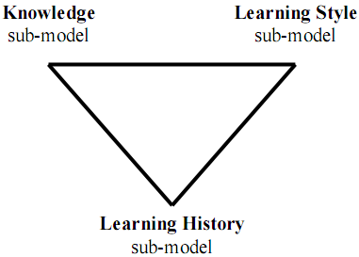
I. Triangular Leaner Model (TLM)
Triangular Learner Model (TLM)
Knowledge (K) sub-model is the combination of overlay model and Bayesian network
Learning style (LS) sub-model is defined as the composite of characteristic cognitive, affective and psychological factors
Learning history (LH) is defined as a transcript of all learners’ actions such as learning materials access, duration of computer use, doing exercise, taking an examination, doing test, communicating with teachers or classmates, etc
Notes:
K sub-model is about user knowledge. It uses Bayesian network for inference
H sub-model is to apply HMM into discover learning style verbal/visual, activist/reflector, pragmatist/theorist
Learning history is the most important sub-model because it has four main responsibilities:
1. Providing necessary information for two remaining sub-models: learning style sub-model and knowledge sub-model so that they perform inference
tasks. For example, knowledge sub-model needs learning evidences like learner’s results of test, frequency of accessing lectures
2. Supporting learning concept recommendation.
3. Mining learners’ educational data in order to discover other learners’ characteristics such as interests, background, goals…
Supporting collaborative learning through constructing learner groups.
That is the reason that LH sub-model is draw as base bottom vertice.

Slide 8
I. Triangular Leaner Model
Why TLM?
Knowledge, learning styles and learning history are prerequisite for modeling learner
While learning history changes themselves frequently, learning styles and knowledge are relatively stable. The combination of them ensures the integrity of information about learner
User knowledge is domain specific information and learning styles are personal traits. The combination of them supports user modeling system to take full advantages of both domain specific information and domain independent information
Notes:
Prerequisite
Integrity
Take full advantages of both domain specific information and domain independent information

Slide 9
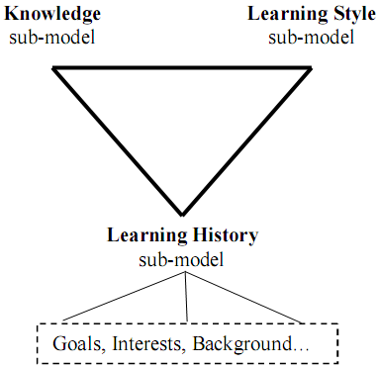
I. Triangular Leaner Model
extended Triangular Leaner Model
Notes:
This the importance of LH, it is used to extend TLM through discovering new information about user by mining technique.
Please see slide 5
1. Providing necessary information for two remaining sub-models: learning style sub-model and knowledge sub-model so that they perform inference
tasks. For example, knowledge sub-model needs learning evidences like learner’s results of test, frequency of accessing lectures
2. Supporting learning concept recommendation.
3. Mining learners’ educational data in order to discover other learners’ characteristics such as interests, background, goals…
Supporting collaborative learning through constructing learner groups.

Slide 10


I. Triangular Leaner Model
How to build up TLM?
How to manipulate (manage) TLM?
How to infer new information from TLM?
→ Zebra: the user modeling system for TLM
Notes:
The expectation is that Zebra is strong and run fast as Africa zebra
Moreover it is difficult to discover zebras when they are running on wild field because their strikes cause the illusion. This is similar to data disturbance technique in data mining privacy. The future trend is to apply privacy mechanism into user model so as to make it more secure.

Slide 11
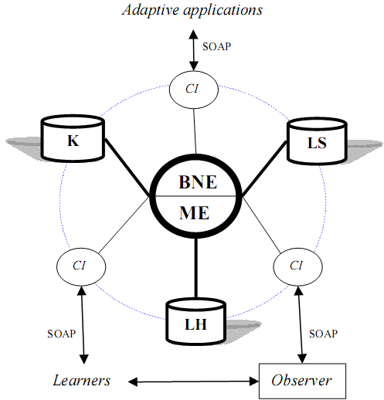
II. A user modeling system for TLM
Mining Engine (ME) manages learning history sub-model of TLM
Belief Network Engine (BNE) manages knowledge sub-model and learning style sub-model of TLM
Communication Interfaces (CI) allows users and adaptive systems to see or modify restrictedly TLM
Zebra architecture
Notes:
Outside applications can’t access or intervene ME and BNE, they can only retrieve user information through CI via network protocol like SOAP, RMI, HTTP, Socket.

Slide 12
II. A user modeling system for TLM
Mining Engine
Collecting learners’ data, monitoring their actions, structuring and updating TLM.
Providing important information to belief network engine
Supporting learning concept recommendation
Discovering some other characteristics (beyond knowledge and learning styles) such as interests, goals, etc
Supporting collaborative learning through constructing learner groups (communities)
Notes:
Mining engine uses mining and machine learning techniques

Slide 13
II. A user modeling system for TLM
Belief Network Engine
Inferring new personal traits from TLM by using deduction mechanism available in belief network
This engine applies Bayesian network and hidden Markov model into inference mechanism.
Two sub-models: knowledge & learning style are managed by this engine
Notes:
Believe network includes: Bayesian network, Markov model, Kalman filter…

Slide 14
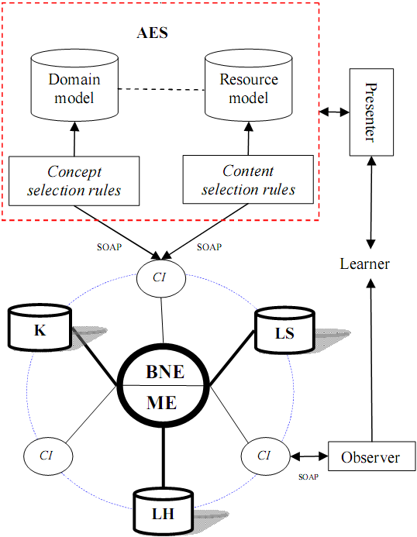
II. A user modeling system for TLM
The extended architecture of Zebra when interacting with AES
Notes:
The adaptation is makes through two kinds of rules: concept selection rules and content selection rules
Concept selection rules: what concepts user should learn
Content selection rules: what learning material (lecture, exercise) user should read/do
Domain model is mapped to resource model, for example one concept has one or more lectures/exercise

Slide 15
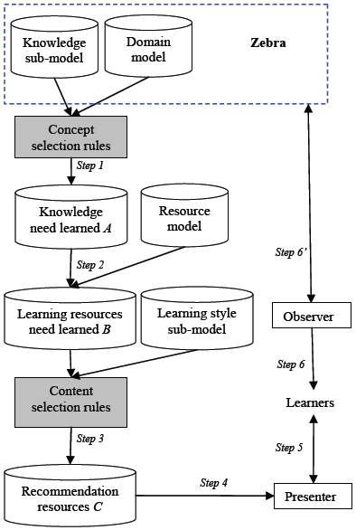
II. A user modeling system for TLM
Adaptation process in Zebra
Notes:
The adaptation process includes following steps:
Step 1: The projection of domain model onto knowledge sub-model by using concept selection rules results in a set of domain knowledge called A that student has to learn. This is concept selection process.
Step 2: A is used as filter to choose a set of learning resources called B that relating to A.
Step 3: The projection of B onto learning styles sub-model by using content selection rules results in a sub-set of learning resources (lectures, exercises, test…) called C tailoring to learner’s preferences. This is content selection process. C is considered as a set of recommendation resources.
Step 4: C is shown in content presenter. Presenter can be human-machine interfaces, web sites, learning management system (LMS), teaching support applications, etc.
Step 5: Learner studies C by interacting with content presenter.
Step 6: Observer monitors learners in order to catch and delivers learner’s observations to Zebra. Zebra uses such observations to update TLM.

Slide 16
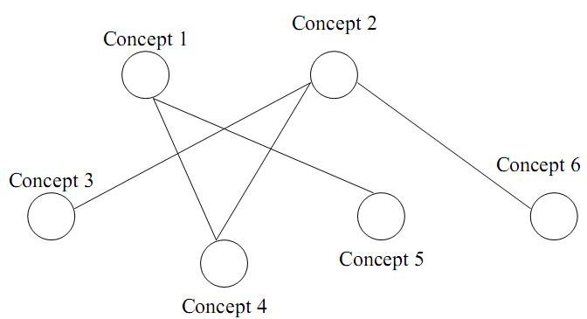
III. Knowledge sub-model
Overlay Model
Essential idea: The learner model is the subset of domain model
The domain is decomposed into a set of elements and the overlay model is simply a set of masteries over those elements.
Expert model is the overlay with 1 (mastered) for each element and the learner model is the overlay with at most 1 for each element
IT@EDU 2008
16
10/15/2013
16

Slide 17
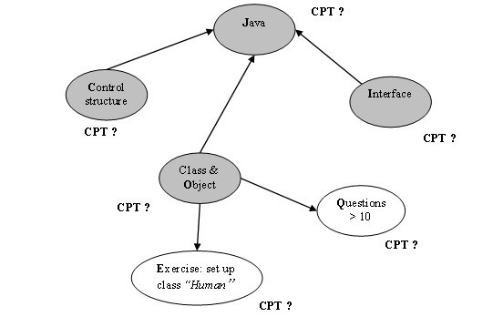
III. Knowledge sub-model
Knowledge sub-model = overlay model + Bayesian network
The structure of overlay model is considered as Bayesian network (BN). Thus, knowledge elements in domain become variables (or nodes) in BN
The prerequisite relationships between knowledge elements are known as the conditional dependence assertions in BN. Accordingly, each node has a conditional probability table (CPT)
All knowledge elements are defined as hidden variables (hypothesis). Other learning objects or events (such as: tests, exams, exercises, user’s feedback, user’s activities) which are used to assess or evaluate user’s performance in learning process are consider as evidence variables

Slide 18
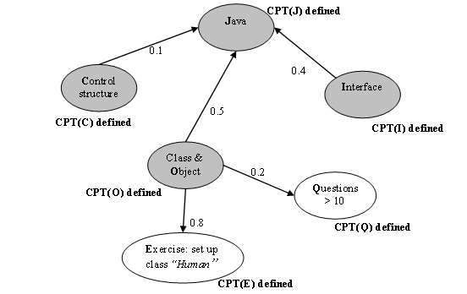
III. Knowledge sub-model
Defining the weights of arcs
The number (in range 0…1 ) that measures the relative importance of each prerequisite or evidence is defined as the weight of arc from parent node to child node
Prerequisite relationships among hidden variables
Diagnostic relationships of hidden variables to evidences
Notes:
Knowledge sub-model includes: topology (structure) and parameters (CPT)
The topology and initial arc weights are specified by expert, namely, teacher
CPT are computed by initial arc weights.
After that CPT can be improved by EM algorithm

Slide 19
III. Knowledge sub-model
Specifying CPT from the weights of arcs
T₁
C O I | p(J = 1) | P(J = 0) 1- p(J = 1)
1 1 1 | 1.0 (0.1*1 + 0.5*1 + 0.4*1) | 0.0
1 1 0 | 0.6 (0.1*1 + 0.5*1 + 0.4*0) | 0.4
1 0 1 | 0.5 (0.1*1 + 0.5*0 + 0.4*1) | 0.5
1 0 0 | 0.1 (0.1*1 + 0.5*0 + 0.4*0) | 0.9
0 1 1 | 0.9 (0.1*0 + 0.5*1 + 0.4*1) | 0.1
0 1 0 | 0.5 (0.1*0 + 0.5*1 + 0.4*0) | 0.5
0 0 1 | 0.4 (0.1*0 + 0.5*0 + 0.4*1) | 0.4
0 0 0 | 0.0 (0.1*0 + 0.5*0 + 0.4*0) | 1.0
T₂
E | Pr(E = 1) | Pr(E = 0) 1- Pr(E = 1)
1 | 0.8 (0.8*1) | 0.2
0 | 0.0 (0.8*0) | 1.0
T₃
Q | Pr(Q = 1) | Pr(Q = 0) 1- Pr(Q = 1)
1 | 0.2 (0.2*1) | 0.8
0 | 0.0 (0.2*0) | 1.0
Notes:
Pr(X|Y₁, Y₂,…, Y_{n}) is computed through the law of total probability
Or it can be considered as objective function
T₁, T₂, T₃ are CPT (s)
For example, suppose that user mastered three concepts “control & structure” (C), “class & object” (O) and “interface” (I) then the probability that user knows Java course is Pr(J=1|C=1,O=1,I=1) = 1. It means that user mastered Java course.
Note that if a node is binary and it has n parents then its CPT has 2^{n+1} entries.
K sub-model is work properly as Bayesian network.

Slide 20
III. Knowledge sub-model
The basic idea to construct knowledge sub-model is translate weights of arcs into respective CPT (s)
The translation formulation mentioned is based on the law of total probability in form of UNION-gate inference which is proofed in next slides.
UNION-gate inference is inspired from OR-gate inference in Bayesian network

Slide 21
III. Knowledge sub-model
UNION-gate: three assumptions
Cause inhibition: given cause-effect X→Y, the factor I is called inhibition of X if it inhibits X from causing Y.
Inhibition independency: Inhibitions are mutually independent
UNION condition: Suppose Y is the effect of many causes X₁, X₂,…, X_{n}. Let I_{i} be the inhibition of X_{i}. The effect Y is the union of all causes X_{i} (s).

Slide 22
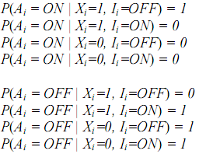

III. Knowledge sub-model
UNION-gate: dummy variables
Let A_{i} be dummy variable so that A_{i} is ON (=1) if X_{i} is equal to 1 and I_{i} is OFF (=0)
Applying “UNION condition”, the condition probability of Y is the probability of union of all A_{i} (s).

Slide 23
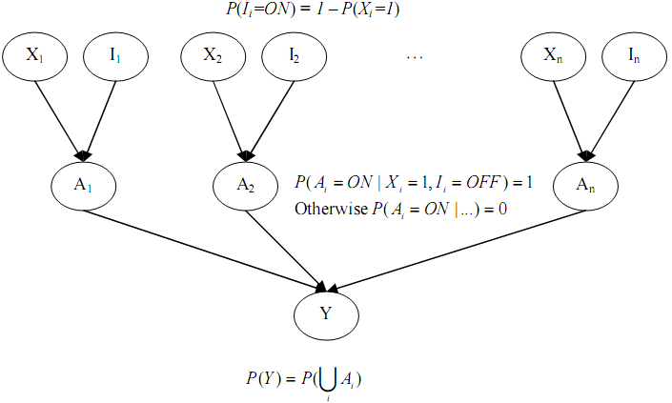
III. Knowledge sub-model
UNION-gate
?
Notes:
This is UNION-gate model

Slide 24
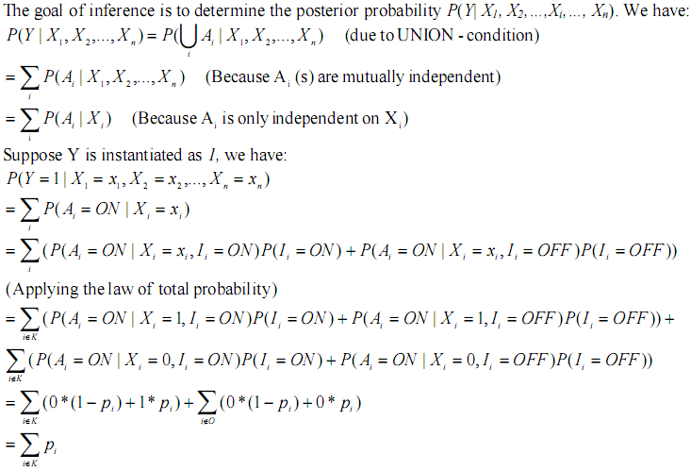
III. Knowledge sub-model
UNION-gate
Let P(X_{i}=1) = p_{i}
Let K be the set of such i that X_{i}=1

Slide 25
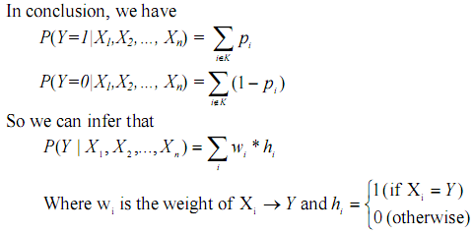
III. Knowledge sub-model
UNION-gate formulation

Slide 26
III. Knowledge sub-model
Evaluation
The expense of data storage is high. A BN which has n variables together n CPT_{(s)} with 2^{n} parameters (values in CPT_{(s)}) under constraint: “each variable is binary (0 and 1)”
→ be only restricted by programming technique when implementing network and it would be best to declare binary variables
The computation of posterior probability which is basis of inference consumes much time when executing in runtime because it is rather complex
→ use CPT instead of continuous probability density/distribution function for solving

Slide 27
III. Knowledge sub-model
Evaluation
Our technique, a kind of efficiency-centric method, is simple to implemented. It is not required complex learning algorithm like data-centric method and the performance of inference tasks in run time is kept stable and fast
But the structure and parameter of Bayesian network is assured quality because the experts who design network are teachers and they comprehend over the curriculum.
Moreover this thesis also introduces two other techniques to improve the conditional probability tables (or parameters) and the structure of Bayesian network: EM algorithm and dynamic Bayesian network

Slide 28
III. Knowledge sub-model (improvement)
Two proposed techniques of improvement
Using EM (expectation maximization) algorithm and MLE (maximum likelihood estimation) algorithm to improve CPT. This process is called parameter learning
Using Dynamic Bayesian Network (DBN) to monitor user’s learning process. This process is called structure learning
Notes:
You see next slides for basic concepts about EM, MLE, DBN

Slide 29
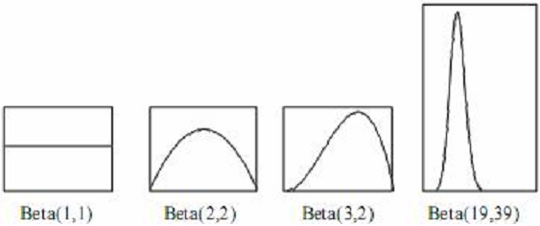



III. Knowledge sub-model (EM)
Beta density function
Notes:
There are “a” successful outcomes (for example, f =1) in “a+b” trials. Higher value of “a” is, higher ratio of success is, so, the graph leans forward right. Higher value of “a+b” is, the more the mass is concentrate around a/(a+b) and the more narrow the graph is.
“s” is also successful outcomes (X=1) though some experiments
“t” is also fail outcomes (X=0) though some experiments
“a”, “s” are opposite to “b”, “t”

Slide 30
III. Knowledge sub-model (EM)
The basic of EM algorithm
Suppose the density function is the beta function β(f_{ij}; a_{ij}, b_{ij})
Variable X_{i} has the prior conditional probability Pr(X_{i}=1 | pa_{ij}=1)=E(β(f_{ij}))= a_{ij} / N_{ij}
The parameter learning process based on a set of evidences is to update the posterior density function β(f_{ij}|E). It means that:
Pr(X_{i}=1|pa_{ij}=1, E)=(a_{ij}+s_{ij})/(N_{ij}+M_{ij})
Where s is the number of all evidences having value 1 (success), otherwise, t is the number of all evidences having value 0 (failed).

Slide 31
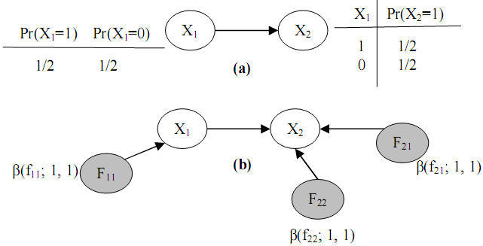
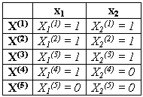

III. Knowledge sub-model (EM)
EM algorithm
Notes:
F₁₁ represents the probability Pr(X₁=1)
F₂₁ represents the conditional probability Pr(X₂=1 | X₁=1)
F₂₂ represents the conditional probability Pr(X₂=1 | X₁=0)
s₁₁ is the number of outcomes that X1=1
t₁₁ is the number of outcomes that X1=0
s₂₁ is the number of outcomes that X2=1 and X1=1
t₂₁ is the number of outcomes that X2=0 and X1=1
s₂₂ is the number of outcomes that X2=1 and X1=0
t₂₁ is the number of outcomes that X2=1 and X1=0
Suppose we have the sample data, it requires to re-computes probabilities: Pr(X₁=1), Pr(X₂=1 | X₁=1), Pr(X₂=1 | X₁=0)
We don’t need to compute Pr(X₁=0), Pr(X₂=0 | X₁=1), Pr(X₂=0 | X₁=0) because:
Pr(X₁=0) = 1 - Pr(X₁=1)
Pr(X₂=0 | X₁=1) = Pr(X₂=1 | X₁=1)
Pr(X₂=0 | X₁=0) = Pr(X₂=1 | X₁=0)

Slide 32
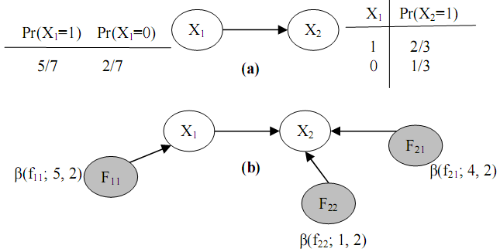

III. Knowledge sub-model (EM)
EM algorithm
Notes:
Pr(X₁=1) = (a₁₁ + s₁₁) / (b₁₁ + t₁₁) = (1+4)/(1+1) = 5/2
Pr(X₂=1|X₁=1) = (a₂₁ + s₂₁) / (b₂₁ + t₂₁) = (1+3)/(1+1) = 4/2
Pr(X₂=1|X₁=0) = (a₂₂ + s₂₂) / (b₂₂ + t₂₂) = (1+0)/(1+1) = 1/2
EM technique work properly in software. It runs fast and effectively

Slide 33
III. Knowledge sub-model (EM)
EM algorithm in case of data missing
Step 1. We compute s’_{ij} and t’_{ij} based on the expected value of given β(f_{ij}), s’_{ij}=E(β(f_{ij})) and t’_{ij}=1- E(β(f_{ij})). Next, replacing missing data by s’_{ij} and t’_{ij} . This step is called Expectation step
Step 2. We determine the posterior density function f_{ij} by computing its parameters a_{ij}=a_{ij}+s_{ij} and b_{ij}=b_{ij}+t_{ij}. Terminating algorithm if the stop condition becomes true, otherwise, reiterating step 1. This step is called the Maximization step.
After k^{th} iteration, will approach a certain limit

Slide 34
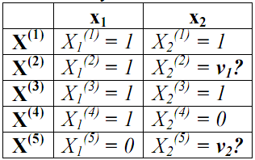
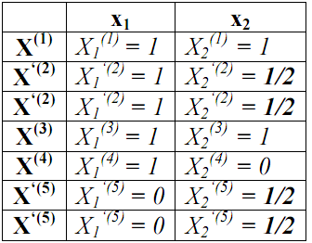


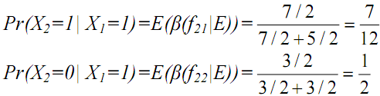
III. Knowledge sub-model (EM)
EM algorithm in case of data missing

Slide 35
III. Knowledge sub-model (MLE)
Maximizing Likelihood Estimation (MLE) technique
The essence of maximizing the likelihood function is to find the peak of the curve of parameter log-likelihood LnL(θ).
This can be done by setting the first-order partial derivative of LnL(θ) with respect to each parameter θ_{i} to 0 and solving this equation to find parameter θ_{i} , namely a and b.
Notes:
The reason of taking logarithm of likelihood function LnL(θ) is that LnL(θ) transforms the product L(θ) into form repeated addition.
We use LnL(θ) instead of L(θ).
The way to specify L(θ) is described in another paper.

Slide 36
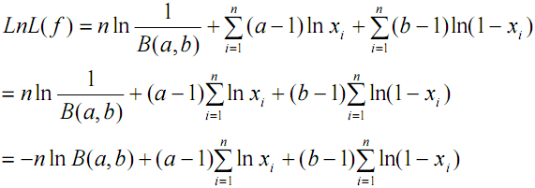
III. Knowledge sub-model (MLE)
Log-likelihood function and its partial derivatives

Slide 37
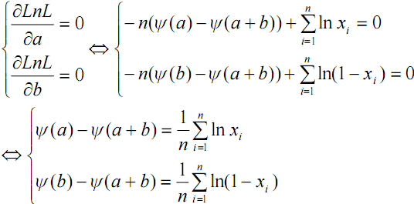

III. Knowledge sub-model (MLE)
Two partial derivatives are set to be equal 0 so as to find out respective parameters, namely a and b
Now we need to compute Ψ(a)-Ψ(a+b) and Ψ(b)-Ψ(a+b)

Slide 38

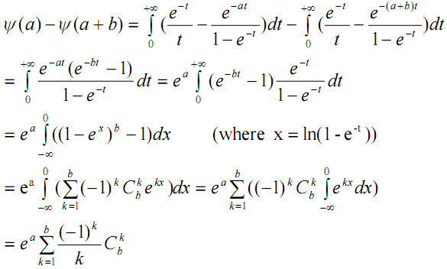
III. Knowledge sub-model (MLE)

Slide 39
III. Knowledge sub-model (MLE)
Finally, the set of equations whose solutions are
parameter estimators, namely a and b.
Conclude: This set of equations is find out by taking the integration of L(θ) based on the assumption that a and b in beta function are positive whole number
Notes:
This set of equations is a variant of differential equations. Note that it is too difficult to solve differential equations.
The way to find out this set of equations is described in another paper.

Slide 40
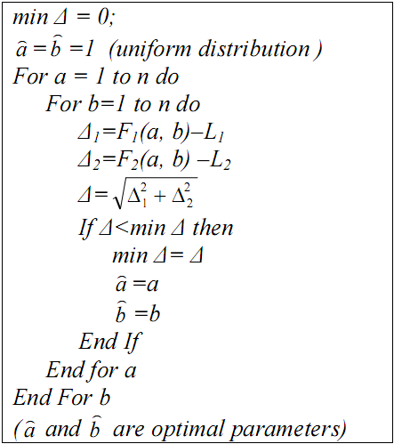

III. Knowledge sub-model (MLE)
Iterative Algorithm for MLE
The basic idea is to find out the approximate solutions
Notes:
The detail and example of this algorithm is described in another paper.
The accuracy of generic MLE and EM are the same but MLE requires huge data for running. It doesn’t have accumulative mechanism like EM
So in practice it work less effective than EM but it is suitable to first time learning.

Slide 41
III. Knowledge sub-model (DBN)
Dynamic Bayesian Network (DBN)
Given finite number T of time points
Let x_{i}[t] be the variable representing the value of x_{i} at time t where 0<= t <= T
Let X[t] be the temporal random vector denoting the random vector X at time t, X[t] = {x₁[t], x₂[t],…, x_{n}[t]}

Slide 42
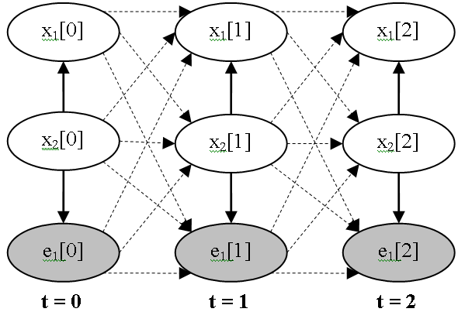
III. Knowledge sub-model (DBN)
A DBN is BN containing variables that comprise T variable vectors X[t]
An initial BN G₀ = {X[0], Pr(X[0]} at first time t = 0
A transition BN is a template consisting of a transition directed acyclic graph (DAG) G→ containing variables in X[t], X[t+1] and a transition probability distribution Pr→ (X[t+1] | X[t])
Notes:
The inference in DBN is similar to BN
But the joint probability of DBN is more complex than joint probability of BN. It must model the time transition through transition probability Pr→

Slide 43
III. Knowledge sub-model (DBN)
Strong points of DBN
DBN can model the temporal relationships among variables. It can capture the dynamic aspect
So DBN allows monitoring user’s process of gaining knowledge and evaluating her/his knowledge
Drawbacks of DBN
The size of DBN becomes numerous when the process continues for a long time
The number of transition dependencies among points in time is too large to compute posterior marginal probabilities
Notes:
Strong points of DBN are attractive features

Slide 44
III. Knowledge sub-model (DBN)
Purposes of suggested algorithm to improve DBN
To overcome these drawbacks, the new algorithm that both the size of DBN and the number of Conditional Probability Tables (CPT) in DBN are kept intact when the process continues for a long time
To solves the problem of temporary slip and lucky guess: “learner does (doesn’t) know a particular subject but there is solid evidence convincing that she/he doesn’t (does) understand it; this evidence just reflects a temporary slip (or lucky guess)”.
Notes:
Size of DBN is constant
Slip and guess

Slide 45
III. Knowledge sub-model (DBN)
Two constraints
Markov property: given the current time point t, the conditional probability of next time point t+1 is only relevant to the current time point t, not relevant to any past time point (t-1, t-2,…,0) .
Pr→(X[t+1] | X[0], X[1],…, X[t])=Pr→(X[t+1] | X[t])
Stationary: Pr→(X[t+1] | X[t]) is the same for all t

Slide 46
III. Knowledge sub-model (DBN)
The algorithm for DBN includes 6 steps for each iteration that repeated whenever evidences occur
Initializing DBN
Specifying transition weights
Re-constructing DBN
Normalizing weights of dependencies
Re-defining CPT (s)
Probabilistic inference
Notes:
The basic idea of 6-step algorithm is to make DBN evolved.
Note that each iteration has 6 steps but there are infinite iterations whenever evidences (user actions) occur

Slide 47
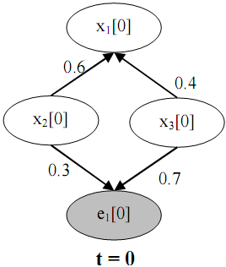
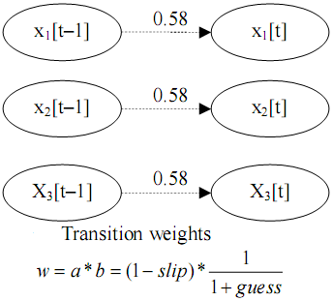
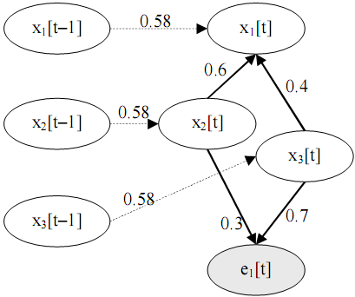
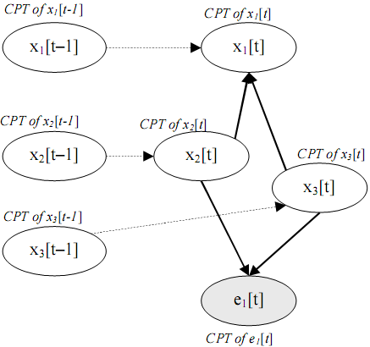
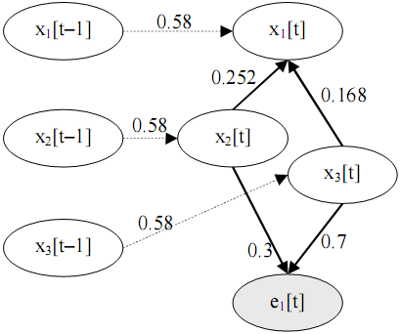
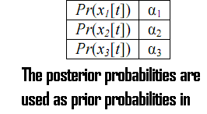
III. Knowledge sub-model (DBN)
1. Initializing DBN
2. Specifying transition weights
3. Re-constructing
6. Probabilistic inference
5. Re-defining CPT(s)
4. Normalizing weights
Notes:
The basic idea is to make the initial DBN evolved.
This 6-step algorithm based on DBN was implemented.
This is sophisticated algorithm. Its details are described in another paper.
In theory this algorithm is better than EM and MLE but it requires more experiments to evaluate it.

Slide 48
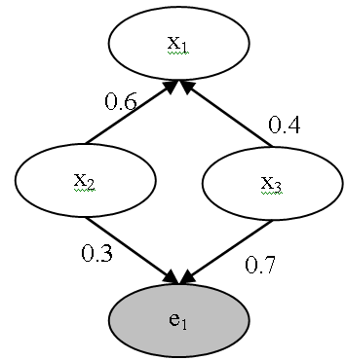
III. Knowledge sub-model (DBN)
Step 1: Initializing DBN
If t > 0 then jumping to step 2
Otherwise, all variables (nodes) and dependencies (arcs) among variables of initial BN G₀ must be specified. The strength of dependency is considered as weight of arc

Slide 49


III. Knowledge sub-model (DBN)
Step 2: Specifying transition weight
Given two factors: slip and guess where slip (guess) factor expresses the situation that user does (doesn’t) know a particular subject but there is solid evidence convincing that she/he doesn’t (does) understand it; this evidence just reflects a temporary slip (or lucky guess)
slip = Pr(not x[t+1] | x[t])
guess = Pr(x[t+1] | not x[t])

Slide 50

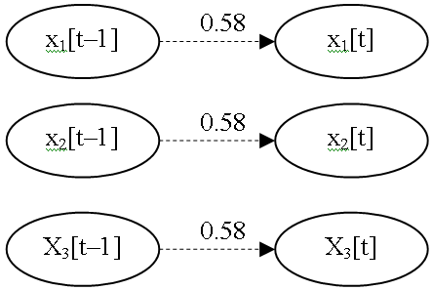
III. Knowledge sub-model (DBN)
Step 2: Specifying transition weight
Suppose slip = 0.3 and guess = 0.2

Slide 51
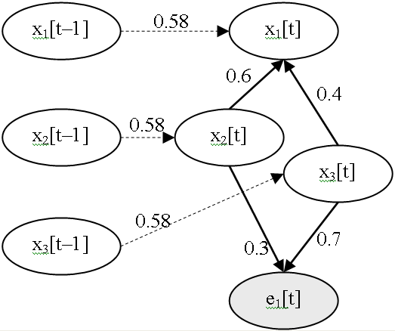
III. Knowledge sub-model (DBN)
Step 3: Re-constructing DBN
For each time point t, we create a new BN G’[t] whose variables include all variables in X[t–1] and X[t] except evidences in X[t–1]. G’[t] is called augmented BN at time point t
All conditional dependencies among variables in X[t–1] are removed from G’[t]

Slide 52
III. Knowledge sub-model (DBN)
Step 4: Normalizing weights of dependencies
Suppose variable x_{i}[t] has k-1 weights w_{i2}, w_{i3},…, x_{ik} corresponding to k-1 parents and a transition weight w_{i1} of temporal relationship between x_{i}[t-1] and x_{i}[t]
We have:
w_{i2}=w_{i2}*(1–w_{i1}), w_{i3}=w_{i3}*(1–w_{i1}),…, w_{ik}=w_{ik}*(1–w_{i1})
 | w₁₁ | w₁₂ | w₁₃
x₁[t] | 0.58 | 0.6 | 0.4
x₁[t] (normalized) | 0.58 | 0.252 | 0.168

Slide 53
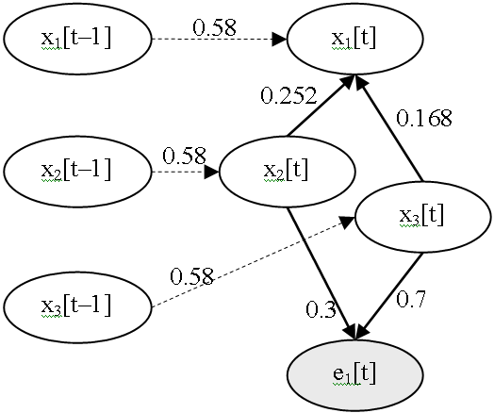
III. Knowledge sub-model (DBN)
Step 4: Normalizing weights of dependencies

Slide 54
III. Knowledge sub-model (DBN)
Step 5: Re-defining CPT_{(s)}
Determining CPT for each variable x_{i}[t-1] in X[t–1]
Re-defining CPT for each variable x_{i}[t] in X[t]

Slide 55
III. Knowledge sub-model (DBN)
Step 5: Re-defining CPT_{(s)}
Determining CPT_{(s)} of X[t–1]. The CPT of x_{i}[t-1] is the posterior probabilities which were computed in step 6 of previous iteration
Pr(x₁[t-1]=1) | Pr(x₁[t-1]=0)
α₁: the posterior probability of x₁ computed at previous iteration | 1 – α₁
Pr(x₂[t-1]=1) | Pr(x₂[t-1]=0)
α₂: the posterior probability of x₂ computed at previous iteration | 1 – α₂
Pr(x₃[t-1]=1) | Pr(x₃[t-1]=0)
α₃: the posterior probability of x₃ computed at previous iteration | 1 – α₃

Slide 56

III. Knowledge sub-model (DBN)
Step 5: Re-defining CPT_{(s)}
Re-defining CPT(s) of X[t]
x₁[t-1] x₂[t] x₃[t] | Pr(x₁[t]=1) | Pr(x₁[t]=0)
1 1 1 | 1.0 (0.58*1+0.252*1+0.168*1) | 0.0
1 1 0 | 0.832 (0.58*1+0.252*1+0.168*0) | 0.168
1 0 1 | 0.748 (0.58*1+0.252*0+0.168*1) | 0.252
1 0 0 | 0.58 (0.58*1+0.252*0+0.168*0) | 0.42
0 1 1 | 0.42 (0.58*0+0.252*1+0.168*1) | 0.58
0 1 0 | 0.252 (0.58*0+0.252*1+0.168*0) | 0.748
0 0 1 | 0.168 (0.58*0+0.252*0+0.168*1) | 0.832
0 0 0 | 0.0 (0.58*0+0.252*0+0.168*0) | 1.0

Slide 57
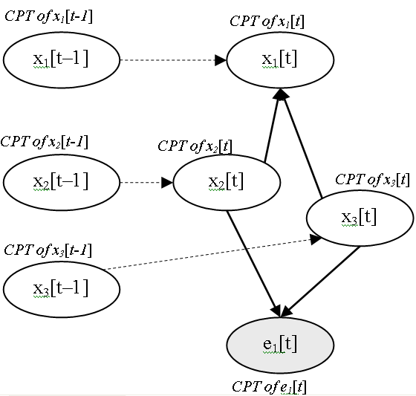
III. Knowledge sub-model (DBN)
Step 5: Re-defining CPT(s)

Slide 58
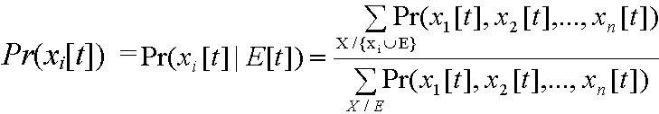
III. Knowledge sub-model (DBN)
Step 6: Probabilistic Inference
The probabilistic inference in our augmented DBN can be done similarly to normal Bayesian network. It is essential to compute the posterior probabilities of non-evidence variable in X[t]
Such posterior probabilities are also used for determining CPT(s) of DBN in step 5 of next iteration. For example, posterior probabilities of x₁[t], x₂[t] and x₃[t] are α₁, α₂ and α₃ respectively
If the posterior probabilities are the same as before (previous iteration) then DBN converges when all posterior probabilities of variables x_{i}[t] gain stable values at any time. If so we can stop algorithm; otherwise turning back step 1

Slide 59
III. Knowledge sub-model (Conclusion)
The combination of overlay model and Bayesian network give the powerful inference ability to user modeling system
We propose the UNION-gate inference so as to convert weights of arcs into CPT (s)
We propose two approaches to improve model: parameter learning and structure learning
Parameter learning: EM and MLE. Both algorithms aim to enhancing the quality of CPT (s) specified before. EM is more advanced in up-to-date and runtime process. MLE is more advanced in bulk data.
Structure learning and monitoring: DBN gets more advanced because it makes sense to knowledge accumulation via temporary learning process

Slide 60
III. Knowledge sub-model (Conclusion)
The basic idea of improved DBN is to minimize the size of DBN and the number of transition probability in order to decrease expense of computation when the process of inference continues for a long time
However specifying slip factor and guess factor will solve the problem of temporary slip and lucky guess
The process of inference including six steps is done in succession through many iterations, the result of current iteration will be input for next iteration. After t^{th} iteration DBN will converge when the posterior probabilities of all variables x_{i}[t] gain stable values regardless of the occurrence of a variety evidences

Slide 61
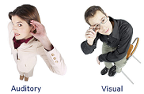
IV. Learning style sub-model
People have different views upon the same situation, the way they perceive and estimate the world is different
For example, some have a preference for listening to instructional content (auditory learner), some for perceiving materials as picture (visual learner)

Slide 62
IV. Learning style sub-model
What is learning style
Learning styles are defined as the composite of characteristic cognitive, affective and psychological factors that serve as relatively stable indicators of how a learner perceives, interacts with and responds to the learning environment [6][7][8]
Learning style is important in adaptive learning, which supports to deliver the best materials to students.
There are many patterns of learning styles but Honey & Mumford model and Felder-Silverman are easy to be figured out

Slide 63
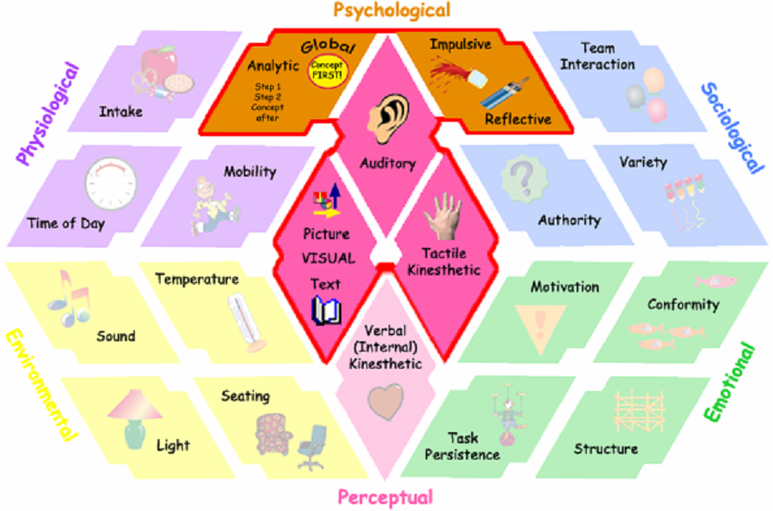
IV. Learning style sub-model
Overview of learning style [8]
Notes:
The pentagonal of learning style have five edges corresponding to five aspects of learning styles:
Physiological
Psychological
Sociological
Emotional
Perceptua

Slide 64
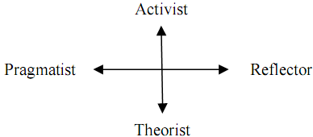
IV. Learning style sub-model
Honey & Mumford pattern
Activist: learners are open-mined and comprehend new information by doing something with it.
Reflector: learners prefer to think about new information first before acting on it
Theorist: learners think things through in logical steps, assimilate different facts into coherent theory
Pragmatist: learners have practical mind, prefer to try and test techniques relevant to problems
Notes:
There are two dimensions of learning style in Honey & Mumford pattern:
Activist / Theorist
Pragmatist / Reflector
Referring slide

Slide 65
IV. Learning style sub-model
Felder-Silverman pattern
Active/Reflective. Active students understand only after they practiced it. Reflective students think thoroughly before doing any practice
Sensing/Intuitive. Sensing students learn from concrete tasks related to problems and facts in details. Intuitive students learn with abstractions and formula.
Verbal/Visual. Verbal students like learning materials in text form. Otherwise visual student prefer to images, pictures…
Sequential/Global. Sequential students learn through logically chained steps, each step following from previous one. Global students prefer to learn in random jumps.
Notes:
There are two dimensions of learning style in Honey & Mumford pattern:
Active/ Reflective
Sensing / Intuitive
Verbal / Visual
Sequential / Global
Referring slide

Slide 66
IV. Learning style sub-model (HMM)
Hidden Markov Model (HMM) [9]
Given sequence of observations symbols, there is demand of discovering real states. For example, there are three weather states: sunny, cloudy, rainy. Based on observations such as wind speed, humidity, temperature
Markov property: given the current state x_{k} of process P, the conditional probability of next state x_{k+1} is only relevant to current state x_{k}, not relevant any past state (x_{k-1}, x_{k-2}, x_{k-3},…)

Slide 67
IV. Learning style sub-model (HMM)
HMM is the 5-tuple Δ=<S,θ,A,B,Π>
S={s₁, s₂,…, s_{n}} is the finite set of states
Ө={θ₁, θ₂,…, θ_{m}} is the set of observations
A is the transition probability matrix in which a_{ij} is the probability that, the process change the current state s_{i} to next state s_{j}
B is the observation probability matrix. Let b_{i}(k) be the probability of observation θ_{k} when the second stochastic process is in state s_{i}
∏ is the initial state distribution where π_{i} represents the probability that the stochastic process begins in state s_{i}
Notes:
Referring slide
In HMM, S which is hidden is discovered based on observations Ө and parameters A, B and ∏

Slide 68
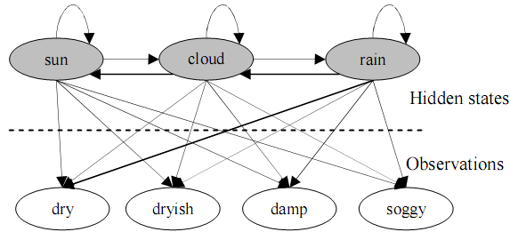

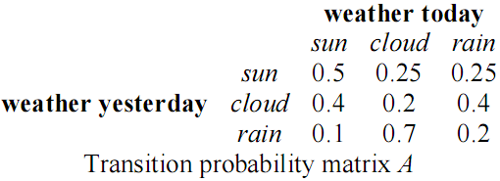
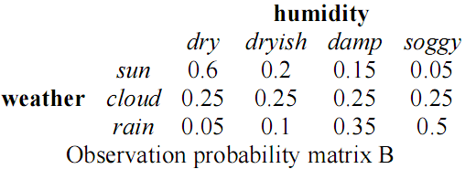
IV. Learning style sub-model (HMM)
Weather forecast example
Notes:
The hidden states are: sunny, cloudy and rainy
The observations of humidity are: dry, dryish, damp and soggy
The parameters of HMM: A, B and ∏ are specified
Referring slide

Slide 69
IV. Learning style sub-model (HMM)
Uncovering problem
Given HMM and a sequence of observations O = {o₁ → o₂ →…→ o_{k}}, how to find the sequence of states U = {s_{k} → s_{k+1} →…→ s_{k+m}} so that U is most likely to have produced the observation sequence O
This is the uncovering problem: which sequence of state transitions is most likely to have led to this sequence of observations → Viterbi algorithm

Slide 70
IV. Learning style sub-model (proposal)
Basic idea
Each learning style is now considered as a state
Users’ learning actions are considered as observations
After monitoring users’ learning process, we collect observations about them and then discover their styles by using inference mechanism in HMM, namely Viterbi algorithm

Slide 71
IV. Learning style sub-model (proposal)
Basic idea
Suppose we choose Honey-Mumford model and Felder-Silverman model as principal models which are presented by HMM
We have three dimensions: Verbal/Visual, Activist/ Reflector, Theorist/ Pragmatist which are modeled as three HMM(s): ∆₁, ∆₂, ∆₃ respectively
∆₁ = 〈 S₁, Ө₁, A₁, B₁, ∏ ₁〉
∆₂= 〈 S₂, Ө₂, A₂, B₂, ∏ ₂〉.
∆₃ = 〈 S₃, Ө₃, A₃, B₃, ∏ ₃〉.

Slide 72
IV. Learning style sub-model (proposal)
Our method includes 5 steps
Defining states
Defining initial state distributions
Defining transition probability matrices
Defining observations
Defining observation probability matrices

Slide 73
IV. Learning style sub-model (proposal)
1. Defining states: each state is corresponding to a leaning style
S₁={verbal, visual},
S₂={activist, reflector}
S₃={theorist , pragmatist}

Slide 74
IV. Learning style sub-model (proposal)
2. Defining initial state distributions : we use uniform probability distribution for each ∏_{i}
∏₁ = {0.5, 0.5}: Pr(verbal)=Pr(visual)=0.5
∏₂ = {0.5, 0.5}; Pr(activist)=Pr(reflector) = 0.5
∏₃ = {0.5, 0.5}; Pr(theorist)=Pr(pragmatist)=0.5
Notes:
Referring slide
In enhancement, we can use some learning machine algorithms to initialize state distribution instead of using uniform distribution

Slide 75
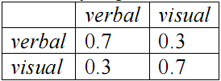
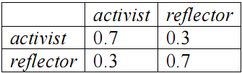
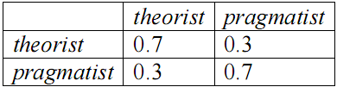
IV. Learning style sub-model (proposal)
3. Defining transition probability matrices
We suppose that learners tend to keep their styles
So the conditional probability of a current state on previous state is high if both current state and previous state have the same value and otherwise

Slide 76
IV. Learning style sub-model (proposal)
4. Defining observation
There is a relationship between learning object learned by users and their learning styles
We assign three attributes to each learning object
Format attribute indicating the format of learning object has three values: text, picture, video
Type attribute telling the type of learning object has four values: theory, example, exercise, and puzzle
Interactive attribute indicates the “interactive” level of learning object. The more interactive learning object is, the more learners interact together in their learning path. This attribute has three values corresponding to three levels: low, medium, high
The dimension Verbal/Visual is involved in format attribute. The dimensions Activist/ Reflector and Theorist/ Pragmatist relate to both type attribute and interactive attribute
Ө₁ = { text, picture, video }
Ө₂ = { theory, example, exercise, puzzle, low (interaction), medium (interaction), high (interaction) }
Ө₃ = { theory, example, exercise, puzzle, low (interaction), medium (interaction), high (interaction) }

Slide 77
IV. Learning style sub-model (proposal)
5. Defining observation probability matrices
Different observations (attributes of LO) effect on states (learning styles) in different degrees
The weights of observations: text, picture, video on state Verbal are in descending order.
The weights of observations: text, picture, video on state Visual are in ascending order
The weights of observations: puzzle, example, theory, exercise on state Activist are in descending order
The weights of observations: example, theory, exercise, puzzle on state Reflector are in descending order
The weight of observations: low (interaction), medium (interaction), high (interaction) on state Activist get values: 0, 0, 1 respectively
The weight of observations: low (interaction), medium (interaction), high (interaction) on state Reflector get values: 1, 0, 0 respectively

Slide 78


IV. Learning style sub-model (proposal)
5. Defining observation probability matrices

Slide 79
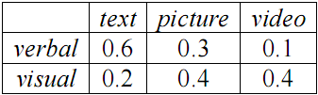
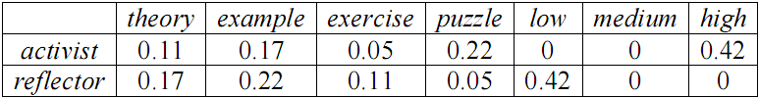
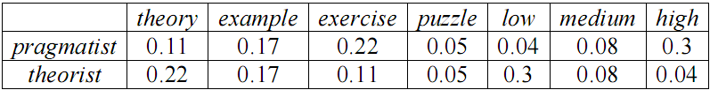
IV. Learning style sub-model (proposal)
5. Defining observation probability matrices

Slide 80
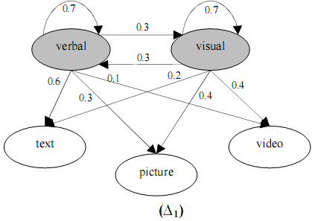
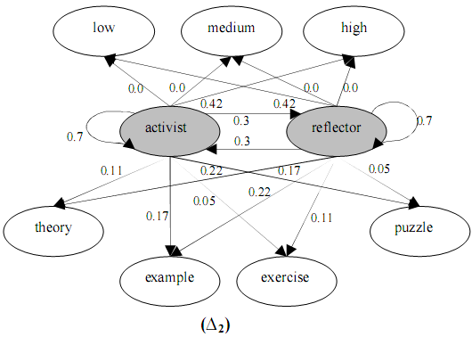

IV. Learning style sub-model (proposal)
Notes:
This is the figure of three HMM (s)

Slide 81



IV. Learning style sub-model (proposal)
An example for inferring student’s learning styles
Learning
objects
selected
Sequence of student observations
Sequence of state transitions → this student is a verbal, reflective and theoretical person.

Slide 82
IV. Learning style sub-model (conclusion)
HMM and Viterbi algorithm provide the way to model and predict users’ learning styles
We propose five steps to realize and apply HMM into two learning style patterns: Honey-Mumford and Felder-Silverman, in which styles are considered states and user’s selected learning objects are tracked as observations
The sequence of observations becomes the input of Viterbi algorithm for inferring the real style of learner
It is possible to extend our approach into other learning style models and there is no need to alter main techniques except that we should specify new states correlating with new learning styles and add more attributes to learning objects

Slide 83
V. Learning history sub-model
Learning history sub-model is the basic sub-models among three sub-models constituting the Triangular Learner Model (TLM).
Learning history is defined as a transcript of all learners’ actions such as learning materials access, duration of computer use, doing exercise, taking an examination, doing test, communicating with teachers or classmates, etc

Slide 84
V. Learning history sub-model
4 main tasks of learning history sub-model
Providing necessary information for two other sub-models: knowledge and learning style
Supporting learning concept recommendation: discussed in next slides about sequence pattern mining (SPM)
Mining learners’ educational data in order to discover other learners’ characteristics such as interests, background, goals… Especially, discovering user interests will be discussed later.
Supporting collaborative learning through constructing user groups. Constructing user groups or clustering user model is discussed later

Slide 85
V. Learning history sub-model (SPM)
Recommendation methods
Rule-based filtering: manually or automatically generated decision rules that are used to recommend items to users
Content-based filtering: recommends items that are considered appropriate to user information in his profile
Collaborative filtering: considered as social filtering when it matches the rating of a current user for items with those of similar users in order to produce recommendations for new items

Slide 86
V. Learning history sub-model (SPM)
Sequential pattern mining (SPM)
Sequential pattern mining belongs to collaborative filtering family
User does not rate explicitly items but his series of chosen items are recorded as sequences to construct the sequence database which mined to find frequently repeated patterns he can choose in future
In learning context, items can be domain concepts / learning objects which students access or learn

Slide 87
V. Learning history sub-model (SPM)
Definition [10]
I = {i₁, i₂, i₃,…, i_{n}} is a set of all items
An itemset is a subset of I, denoted x_{i}=(i_{u},…, i_{v})
An sequence is an ordered list of itemsets, denoted s=〈x₁, x₂,…, x_{m}〉, where x_{i} is an itemset, x_{i} is also called an element in sequence s
The length of sequence is the number of instances of items occurring in sequence. Sequence with length l is called l-sequence
Note: An item has only been once in an element of sequence but can occur multiple times in different elements in sequences

Slide 88
V. Learning history sub-model (SPM)
s₁=〈x₁, x₂,…, x_{m}〉 is sub-sequence of s₂=〈y₁, y₂,…, y_{m}〉
There is the ordered list of indexes k₁, k₂,…, k_{n}
1≤ k₁ ≤ k₂ ≤ …. ≤ k_{n} ≤ m
x₁ y_{k1}, x₂ y_{k2},…, x_{n} y_{kn}
“s₁ is sub-sequence of s₂” equivalent to “s₂ is super-sequence of s₁”, denoted s₁containings₂, s₁ s₂, s₂containeds₁

Slide 89
V. Learning history sub-model (SPM)
Example
A set of all items I={i₁, i₂, i₃, i₄}
Three itemsets x₁=i₁, x₂=(i₁,i₃), x₃=(i₁,i₂,i₃), x₄=(i₁,i₂,i₃,i₄), x₅=i₃, x₆=(i₁,i₂)
Two sequences s₁, s₂ denoted as s₁=〈x₁,x₄〉, s₂=〈x₁,x₂,x₃〉 , s₃=〈x₅,x₆〉 but s₁, s₂ are often showed in detailed forms: s₁=〈i₁(i₁,i₂,i₃,i₄)〉, s₂=〈i₁(i₁,i₃)(i₁,i₂,i₃)〉, s₃=〈i₃(i₁,i₂)〉
s₁, s₂, s₃ are 5-length, 6-length, 3-length sequences, respectively. Note, item i₁ occurs 2 times in sequence s₁, so it contributes 2 to length of s₁
s₃ is sub-sequence of s₂ due to x₅containgx₂ and x₆containgx₃, s₁ is not sub-sequence of s₂ because x₁containgx₂ but x₄ is not subset of any subset in s₂

Slide 90
V. Learning history sub-model (SPM)
Sequential pattern [10]
Sequential database S has a set of records 〈sid, s〉
A record 〈sid, s〉 is said to contain sequence α if α contained s
The support of sequence α is the fraction of total records containing α, denoted support(α)=|{ 〈sid, s〉 | α contained s}|
Given the threshold min_sup if support(α)≥ min_sup then α is called frequent or large sequence
Sequential pattern is the maximal frequent sequence, it means that all super-sequences of sequential pattern are infrequent
Note: In case property “maximal” is not paid attention, frequent sequence is considered as sequential pattern

Slide 91
V. Learning history sub-model (SPM)
Totally, given a sequence database S and the threshold min_sup, sequential pattern mining is to find all complete set of sequential patterns in S

Slide 92

V. Learning history sub-model (SPM)
Given problem
Suppose concepts in Java course: data type, package, class & OOP, selection structure, virtual machine, loop structure, control structure, and interface which in turn denoted as d, p, o, s, v, l, c, f
At our e-learning website, students access learning material relating such concepts in sessions, each session contains only one itemset and is ordered by time. The student's learning sequence is constituted of itemsets accessed in all his sessions

Slide 93
V. Learning history sub-model (SPM)
Students accessed learning material in their past sessions, how system recommends appropriate concepts to student for next visits → mining sequential patterns → solution:
Applying techniques of mining user learning data to find learning sequential patterns
Breaking such patterns into concepts which are recommended to users

Slide 94
V. Learning history sub-model (SPM)
Problem
Suppose the sequential pattern 〈osc(sc)〉 discovered which means:
“class & OOP” → “selection structure” → ”control structure” → ”selection structure, control structure”
Pattern is considered as the learning "route" that student preferred or learned often in past
In the next time if a student chooses one concept, the adaptive learning system should recommend which next concepts?
→ the patterns should be broken into association rules with their confidence

Slide 95

V. Learning history sub-model (SPM)
Breaking technique
Breaking entire 〈osc(sc)〉 into litemsets such as o, s, c, (sc) and determining all possible large 2-sequences whose order must comply with the order of sequential pattern. There are six large 2-sequences: 〈os〉, 〈oc〉, 〈o(sc)〉, 〈sc〉, 〈s(sc)〉, 〈c(sc)〉.
Thus, we have six rules derived from these large 2-sequences in form: “left-hand litemset → right-hand litemset”, for example, rule “s→c” derived from 2-sequence 〈sc〉
Computing the confidences of rules and sorting them, confidence(x → y) = support(〈xy〉) / support((x)). The rules whose confidence is less than threshold min_conf is removed

Slide 96

V. Learning history sub-model (SPM)
Recommended List
If student choose the concept (itemset) x, system will find whole rules broken from all sequential patterns and the left-hand litemset of each rule must contain x
Then, these rules are sorted by their confidences in descending order
Final outcome is an ordered list of right-hand litemsets (concepts), which are recommended to students
Recommended list
if user choose concept “class & oop”

Slide 97
V. Learning history sub-model (SPM)
Evaluation
Evaluation
This methodology is similar to mining association rules but it achieves high performance and precise prediction since it derived from result of sequential pattern mining process.
The sequential rules stick close on user’s learning “route” because they are mined in accordance with sequential pattern and pay attention to the sequence order

Slide 98
V. Learning history sub-model (SPM)
Although sequential pattern mining is applied in e-commercial for customer purchase but the extracted patterns can be used to predict user’s learning “route”
There are two sequential pattern mining approaches: candidate generation-and-test, pattern-growth.The first which is essentially a refinement of the Apriori-like is easy to implement but causes a problem of large candidate set and so, leads to performance downfall.The second which is a divide-and-conquer solution intends to reduce the number of candidate sequences. So, it is more efficient
Last, we propose the technique to break sequential patterns into rules containing recommendable concepts / learning materials. The ideology of this approach is derived from association rule mining but it is more efficient than association rules

Slide 99
V. Learning history sub-model (User Interests)
Discovering user interests based on document classification
User interest is one of personal traits attracting researchers’ attention in user modeling and user profiling
I propose a new approach for discovering user interest based on document classification. The basic idea is to consider user interests as classes of documents
The process of classifying documents is also the process of discovering user interests

Slide 100
V. Learning history sub-model (User Interests)
There are two new points of view
The series of user access in his/her history are modeled as documents. So user is referred indirectly to as “document”.
User interests are classes such documents are belong to

Slide 101
V. Learning history sub-model (User Interests)
Our approach includes four following steps
Documents in training corpus are represented according to vector model. Each element of vector is product of term frequency and inverse document frequency. However the inverse document frequency can be removed from each element for convenience
Classifying training corpus by applying decision tree or support vector machine (SVM) or neural network (ANN).
Mining user’s access history to find maximum frequent itemsets. Each itemset is considered a interesting document and its member items are considered as terms. Such interesting documents are modeled as vectors
Applying classifiers (see step 3) into these interesting documents in order to choose which classes are most suitable to these interesting documents. Such classes are user interests

Slide 102

V. Learning history sub-model (User Interests)
Suppose in some library or website, user U do his search for his interesting books, documents
There is demand of discovering his interests so that such library or website can provide adaptive documents to him whenever he visits in the next time
Given there is a set of key words or terms {computer, programming language, algorithm, derivative} that user U often looking for, the his searching history is showed in following table:
User searching history

Slide 103
V. Learning history sub-model (User Interests)
Mining interesting documents
This history is considered as training dataset for mining maximum frequent itemsets
We propose the new point of view: “The maximum frequent itemsets are considered as documents and the classes of such documents are considered as user interests”
Such documents may be called interesting documents which are modeled as vectors. Discovering user’s interests is classifying these vectors
It is possible to use SVM or decision tree or neural network to classify these vectors

Slide 104



V. Learning history sub-model (User Interests)
Using SVM, ANN or Decision Tree to classify this vector
This vector belongs to class compute science → user interest is computer science

Slide 105
V. Learning history sub-model (User Interests)
Conclusion
The series of user access in his/her history are modeled as documents. So user is referred indirectly to as document
User interests are classes that such documents are belong to

Slide 106
V. Learning history sub-model (User Interests)
Note about classification methods
The training corpus must be classified before any task of discovering interests
If SVM is applied in case of many classes, the solution is to use multi-classifiers.
If decision tree is applied, term frequencies should be nominal
If neural network is applied, document vector should be Boolean vector

Slide 107


V. Learning history sub-model (User Interests)
An example about corpus
Given a set of classes C = {computer science, math}, a set of terms T = {computer, programming language, algorithm, derivative} and the corpus D = {doc1.txt, doc2.txt, doc3.txt, doc4.txt, doc5.txt}
Term frequencies of documents
Normalized term frequencies

Slide 108

V. Learning history sub-model (User Clustering)
Two kinds of adaptations
Individual adaptation regards to each user
Community (or group) adaptation focuses on a community (or group) of users

Slide 109
V. Learning history sub-model (User Clustering)
Common features in a group which are the common information of all members in such group are relatively stable
If a new user logins system, she/he will be classified into a group and initial information of his model is assigned to common features in such group
In the collaborative learning, users need to learn or discuss together
The problem that needs to be solved now is how to determine user groups. This relates to cluster user model

Slide 110
V. Learning history sub-model (User Clustering)
Three clustering model methods according to the form of user model
Clustering vector model
Clustering overlay model
Clustering Bayesian network model

Slide 111

V. Learning history sub-model (User Clustering)
Clustering user vector model
If user model is in form of vector U_{i}=(u_{i1}, u_{i2},…, u_{in}). It is possible to apply traditional clustering methods such as K-means, K-centroids.
The dissimilarity of two user models is often defined as Euclidean distance between them

Slide 112
V. Learning history sub-model (User Clustering)
Clustering overlay model
Suppose two user overlay models U₁ and U₂ are denoted as
U₁=G₁=<V₁,E₁> and U₂=G₂=<V₂,E₂>
Where V_{i} and E_{i} are set of nodes and set of arcs, respectively
V_{i} is also considered as a vector whose elements are numbers representing user’s masteries of knowledge items:
V₂ = (v_{i1}, v_{i2},…, v_{in})

Slide 113


V. Learning history sub-model (User Clustering)
Clustering overlay model
Suppose graph model is in form of tree
Let depth(v_{ij}) is the depth level of node j of graph model G_{i}
The most important thing is how to determine the dissimilarity (distance) between two graph.

Slide 114



V. Learning history sub-model (User Clustering)
Clustering overlay model: dissimilarity of two graphs G₁ and G₂
For example, there are three graph models G₁, G₂, G₃ and their node values, respectively

Slide 115



V. Learning history sub-model (User Clustering)
In case that graph is weighted

Slide 116


V. Learning history sub-model (User Clustering)
Clustering Bayesian network
Note that Pr(v_{ij}) is the marginal probability of node j in network i

Slide 117
VI. Evaluating adaptive learning model
There are a lot of theories and practical methods to build up adaptive system and user modeling system. Each method has strong points and drawbacks and so it is very useful to evaluate these methods in order to determine which model is appropriate to which situation
This evaluation section has two goals:
Proposing criterions to evaluate adaptive learning model
Giving some scenarios as an example that applies criterions above into performing evaluation task in concrete situations

Slide 118
VI. Evaluating adaptive learning model
There are three criterions of evaluation
Criterion α so-called system criterion tells us how adaptive learning system works with/without user modeling system. The larger the measure α is, the better the level of precision of inference method is.
Criterion β so-called academic criterion tells us how well modeling server help users to study. The higher criterion β is, the better study result is.
Criterion γ so-called adaptation criterion or satisfaction criterion measures the quality of adaptation function of learning system with the support of modeling server. The higher criterion γ is, the better quality of adaptation is.

Slide 119
VI. Evaluating adaptive learning model
There are two ways to calculate criterion α:
Using hypothesis testing
Using regression model

Slide 120
VI. Evaluating adaptive learning model
Criterion α – using hypothesis testing
Let K_{U} = {k₁^{U}, k₂^{U},…, k_{n}^{U}} be knowledge vectors of user U, where each measure k_{c}^{U} represents the mount of knowledge C that user U mastered
Given group A and group B are groups of students learning via adaptive system with and without support of user model, respectively
Two users i and j are picked randomly in group A and group B, respectively
K_{i} = {k_{i}^{U}, k_{i}^{U},…, k_{i}^{U}} has sample variance s_{i}²
K_{j} = {k_{j}^{U}, k_{j}^{U},…, k_{j}^{U}} has sample variance s_{j}²

Slide 121
VI. Evaluating adaptive learning model
Criterion α – using hypothesis testing
Hypothesis test aims to variance test instead of mean test. Null hypothesis is stated that two variances are equal
H₀ : s_{i}² = s_{j}²
H₁: s_{i}² = s_{j}²
Suppose the significant level is 0.05, F-distribution is used to test two variances: F = s_{i}² / s_{j}²
If F < f_{0.95, n-1, n-1} then the null hypothesis is rejected → group A with support of user modeling system improve adaptive learning system much more than group B. So, criterion α get true, indicating the preeminence of user modeling system.

Slide 122
VI. Evaluating adaptive learning model
Criterion α – using regression model
Suppose that partial user knowledge items like chapters, sessions, etc are represented as a set of random variable are X₁, X₂, X₃,…, X_{n}
Let Y represents the total knowledge that users gain over whole course like Java course, Oracle course, etc
We try to find out the linear function of random variables X_{i} (s) so that Y is the expected value of such function.
Y = a₀ + a₁X₁ + a₂X₂ + a₃X₃ +…+a_{n}X_{n}
Notes:
The essence of α is to measure the level of precision of inference methods with/without user model. By using regression technique, if an inference method is good, its predictive value, namely the whole knowledge user achieves, and all partial knowledge items user study at every stage on learning path will satisfy well a function or equation. In other words, this predictive value has small deviation/error. Suppose that partial user knowledge items like chapters, sessions, etc are represented as a set of random variable are X₁, X₂, X₃,…, X_{n}. Let Y represents the total knowledge that users gain over whole course like Java course, Oracle course, etc. We try to find out the linear function of random variables X_{i} (s) so that Y is the expected value of such function.
Y = a₀ + a₁X₁ + a₂X₂ + a₃X₃ +…+a_{n}X_{n}

Slide 123
VI. Evaluating adaptive learning model
Criterion α – using regression model
When linear function is determined, it is applied back to each user in both group A and B so as to predict her/his knowledge so-called estimated knowledge.
Estimated knowledge is compared to real knowledge of users. The deviation of estimated knowledge and real knowledge is called prediction error.
The square sum of all prediction error reflects the measure α

Slide 124
VI. Evaluating adaptive learning model
Criterion α – using regression model – 4 steps
Firstly, the regression coefficients a_{i} (s) are computed by the method of mean least square. Note that because we have two linear functions for group A and B, there are two sets of regression coefficients, each set for one group.
Secondly, let ek_{i}^{A} and ek_{i}^{B} be estimated knowledge of user i^{th} in group A and B, respectively. Note that ek_{i}^{A} and ek_{i}^{B} are calculated by applying linear function determined in the first step.
ek_{i}^{A} = Y^{A} = a₀ + a₁X₁ + a₂X₂ + a₃X₃ +…+a_{n}X_{n} _{(in group A)}
ek_{i}^{B} = Y^{B} = a₀ + a₁X₁ + a₂X₂ + a₃X₃ +…+a_{n}X_{n} _{(in group B)}
Thirdly, let k_{i}^{A} and k_{i}^{B} be the real knowledge of user i^{th} in group A and B from database, respectively. Let err_{i}^{A} and err_{i}^{B} be the prediction error of user i^{th} in group A and B, respectively. We have err_{i}^{A} = | ek_{i}^{A} – k_{i}^{A}| and err_{i}^{B} = | ek_{i}^{B} – k_{i}^{B}|
Finally, the measure α is simple inverse of square sum of all prediction errors. We have α_{A} = 1 / Sigma((err_{i}^{A})²) and α_{B} = 1 / Sigma((err_{i}^{B})²).

Slide 125


VI. Evaluating adaptive learning model
Criterion β
Let K_{A}, K_{B} be the knowledge vectors of group A and B, respectively where k_{i}^{A} and k_{i}^{B} is the average grades of students in group A and B over concept i, respectively.
K_{A} = (k₁^{A}, k₂^{A},…, k_{n}^{A}) has sample variance s_{A}² and sample mean
K_{B} = (k₁^{B}, k₂^{B},…, k_{n}^{B}) has sample variance s_{B}² and sample mean
The measure β for each group is computed as accumulative probability of assumption user in such group has mastered over course.

Slide 126

VI. Evaluating adaptive learning model
Criterion γ
Suppose a questionnaire is built up by expert and it is composed of n questions Q = (q₁, q₂,…, q_{n}).
Users in each group rate on each question where rating value may be binary satisfied and unsatisfied.
By the simplest way, criterion γ is defined as the ratio of the number of satisfied users to the whole number of users.

Slide 127
VI. Evaluating adaptive learning model
Criterion γ
In enhance method, the rating values range in an interval, for example [0…5], where value 0 and 5 indicates least and most satisfied.
Therefore, we have two rating matrices A and B for two groups
Each row in rating matrix is composed of rating values of a user; in other words, each cell represents a rating that a user gives to a question.
The criterion γ is calculated by compressing these rating matrices

Slide 128




VI. Evaluating adaptive learning model
Criterion γ – three steps
Firstly, rating matrix is “shrunk” by projecting it onto its eigenvectors. The number of columns is k << n. These columns represent essential questions.
Secondly, each column of matrix corresponding to each question is assumed as a statistical distribution F_{i}. Thus the mean of F_{i} is estimated by μ_{i}.
Finally, the mean vector of this matrix is composed of all estimates μ_{i} and the criterion γ is the module of such mean vector.

Slide 129
VI. Evaluating adaptive learning model
Evaluation scenario is divided into three main acts in which students and teacher play the roles of actors
Study act: Teacher teaches and students learn in both face-to-face manner and e-learning manner via website. Suppose students are classified into three groups: represent face-to-face manner (A), e-learning manner via website (B), and e-learning manner with support of user model (C)
Feedback act: Students give feedbacks to teacher and teacher collects and analyzes them.
Evaluation act is done by teacher; thus, criterions α, β and γ are calculated according to data collected from two above acts. The quality of adaptive learning in groups A, B and C are determined based on such criterions.

Slide 130
VI. Evaluating adaptive learning model
Study act has 5 scenes
Teacher builds up school’s curriculums and set up adaptive e-learning website with/without the support of user modeling system.
Teacher teaches and students in group A, B and C learn by face-to-face manner.
Students in group B and C go on website and study by themselves. Teacher monitors them and put up important notice.
Students in group A, B and C do tests and exercises via website.
Teacher evaluates students based on their test results.

Slide 131
VI. Evaluating adaptive learning model
Teacher’s role in study act
Teaching face-to-face in traditional manner.
Building up knowledge domain and creating web resources for this domain such as defining html lesions, tests, exercises, etc.
Creating user model, for example, creating Bayesian network and its weights for knowledge domain.
Setting up user modeling system and e-learning adaptive website.
Monitoring students’ learning process.
Sending test results and school report to students.

Slide 132
VI. Evaluating adaptive learning model
Students’ role in study act
Students in group A, B and C go to class to study in face-to-face manner.
Students in group B and C learn themselves on adaptive learning web sites. Note that website / learning materials are adapted to each student based on their knowledge and characteristics.
Students in group A, B and C do tests / exercise via website.

Slide 133
VI. Evaluating adaptive learning model
Feedback act has 3 scenes
Teacher creates the questionnaire to survey students’ feeling about both adaptive learning website and curriculum such as very satisfied, satisfied and not satisfied.
Students answer or rate on such questions online.
Teacher collects students’ feedbacks and analyzes them.

Slide 134
VI. Evaluating adaptive learning model
Evaluation act has 2 scenes
Teacher calculates three criterions based on students’ feedback and test results.
Teacher makes the decision about the quality of face-to-face teaching manner and e-learning manner with/without support of user modeling system.

Slide 135




VI. Evaluating adaptive learning model
An example
Class A is only taught in face-to-face manner. Class B is taught both in face-to-face manner and adaptive learning environment
Suppose there are 4 students in class A and 2 students in class B who don’t satisfy teaching curriculum. Sample mean and deviation of class A are G_{A} = 5.0 and s_{A} = 2.05. Sample mean and deviation of class B are G_{B} = 7.0 and s_{B} = 1.66. We have:
Suppose the weights of criterion α and criterion β are 0.7 and 0.3, respectively. Let eval_{A} and eval_{B} be the total evaluations on group A and group B, respectively. We have:
eval_{A} = 0.7*0.5 + 0.3*0.6 = 0.53
eval_{B} = 0.7*0.99 + 0.3*0.8 = 0.93
When eval_{A} is greater than eval_{B}, it is possible to conclude that the teaching method in class B is more effective than the one in class A because class B takes advantages of adaptive learning method

Slide 136
VI. Evaluating adaptive learning model (conclusion)
As aforementioned, there are three criterions such as system criterion α, academy criterion β and adaptation criterion γ.
That two of three criterions, concretely α and β, assessing user knowledge implicates that evaluation of adaptive learning model focuses on the effect of education which is ability to help student to improve their knowledge although adaptation and personalization is significant topic in adaptive learning.
Evaluation scenario indicates that study is lifelong process for everyone.
Both students and teachers are actors and their roles can mutually interchange, for example, teaching is the best way to learn and student is the best teacher of teacher.

Slide 137
Conclusion
The “Triangular Learner Model (TLM)” composed by three underlying characteristics: knowledge, learning style and learning history aims to cover the whole of learner’s information required by learning adaptation process.
UMS which builds up and manipulates TLM so-called Zebra includes the core engine and a set of communication interfaces
The core engine is the composition of two sub-engines: mining engine and belief network engine.
Mining engine applies data mining algorithms into discovering and structuring TLM
Belief network engine is responsible for inferring new personal traits from TLM by using deduction mechanism available in belief network
Notes:
Experiments are done through three steps:
Implementing an solid architecture. It is was built up as an intelligent software that runs fast and stable. The correctness of TLM is proved by this implementation. If the architecture is wrong then it can’t be implemented. This step is done
Satisfying simulation data. This step is done
However adaptive application should be satisfy end-user. The software needs to be public for student using and student’s feedback will be collected and analyzed.

Slide 138
Reference
David Heckerman. A Tutorial on Learning With Bayesian Networks. Technical Report MSR-TR-95-06. Microsoft Research Advanced Technology Division, Microsoft Corporation.
Richard E. Neapolitan. Learning Bayesian Networks. Northeastern Illinois University Chicago, Illinois 2003
Scott M. Lynch. Maximum Likelihood Estimation. Soc. 504, February 2003
Alfred Kobsa. Generic User Modeling Systems. User Modeling and User-Adapted Interaction 2006 (UMUAI-2006).
Frank Dellaert. The Expectation Maximization Algorithm. College of Computing, Georgia Institute of Technology. Technical Report number GIT-GVU-02-20. February 2002
R. Riding, S. Rayner. Cognitive Styles and Learning Strategies: Understanding Style Differences in Learning Behaviour. London: David Fulton Publishers Ltd, 1998.
138
10/15/2013
138

Slide 139
Natalia Stash, Alexandra Cristea, Paul De Bra. Explicit Intelligence in Adaptive Hypermedia: Generic Adaptation Languages for Learning Preferences and Styles. In Proceedings of HT2005 CIAH Workshop, Salzburg, Austria, 2005.
Christian Wolf. iWeaver: Towards Learning Style-based e-Learning in Computer Science Education. Australasian Computing Education Conference (ACE2003), Adelaide, Australia.
R. Dugad, U. B. Desai. A tutorial on Hidden Markov models. Signal Processing and Artificial Neural Networks Laboratory, Dept of Electrical Engineering, Indian Institute of Technology, Bombay Technical Report No.: SPANN-96.1, 1996
R. Agrawal and R. Srikant. Mining sequential patterns. In Proc. 1995 Int. Conf. Data Engineering (ICDE95), pp.314, Taipei, Taiwan, Mar.1995.

Slide 140
THANK FOR YOUR ATTENTION
10/15/2013
140
Notes:
Thank for your attention
You feel free to give me questions

