Slide 1

Ubiquitous User Modeling
Overview of Ubiquitous User Modeling
Knowledge representation of situation model
Ubiquitous World
Ubiquitous user model service
Incorporating Zebra into Ubiquitous User Model Service
PhD. Report: | Ubiquitous User Modeling (August 24th 2009)
Professor: | Pr. Dr. Dong Thi Bich Thuy
Researcher: | Nguyen Phuoc Loc
Affiliation: | Department of IS, Faculty of IT, University of Science

Slide 2
I. Overview of Ubiquitous User Modeling
What is ubiquitous user modeling
Nowadays there is a need for users to interact with many IT systems at anywhere, for examples: they withdraw cash by ATM card or book airplane ticket online or play games on mobile phones...
This tends to develop ubiquitous user modeling system which performs ongoing modeling, ongoing sharing and ongoing exploitation of user models in ubiquitous computing environment that shifts from desktop interaction to mobile interaction
Ubiquitous user model is defined as the user model which is monitored at any time, at any location and in any interaction context

Slide 3
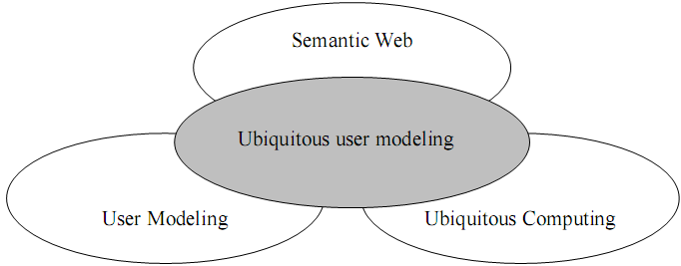
I. Overview of Ubiquitous User Modeling
Ubiquitous user modeling is considered as the intersection of three domains: user modeling, ubiquitous computing and semantic web

Slide 4
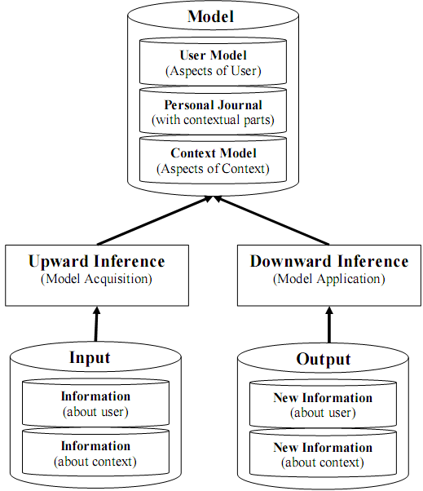
I. Overview of Ubiquitous User Modeling
User Modeling in ubiquitous domain focus on context much

Slide 5
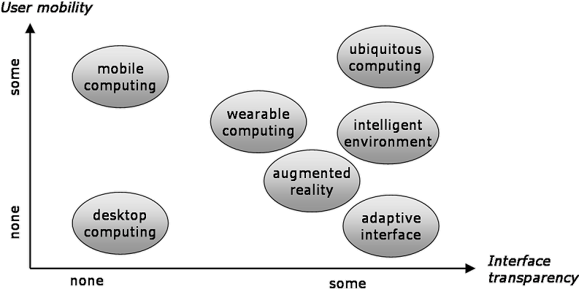
I. Overview of Ubiquitous User Modeling
Two properties of ubiquitous computing
User mobility reflects the degree of freedom that user can move around, when interacting with system
Interface transparency reflects the attention that system requires of user

Slide 6
I. Overview of Ubiquitous User Modeling
Situation model and situated interaction
Situations are constituted of objects owning properties and standing in relationships. The real world consists of many situations
Each situation is established at a concrete time and place

Slide 7
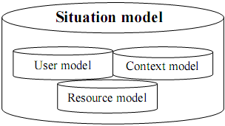
I. Overview of Ubiquitous User Modeling
Situation model
User model comprises user-related information such as knowledge, goals, personal traits
Context model comprise user perception and actions which are independent of individual user
Resource model gives support to resource-adaptive process that is aware of what resources are available to (ubiquitous computing) system at any time

Slide 8
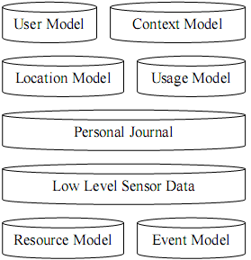
I. Overview of Ubiquitous User Modeling
Extended situation model

Slide 9
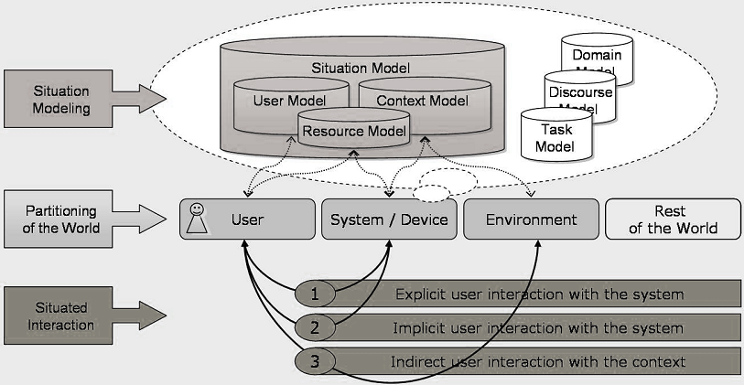
I. Overview of Ubiquitous User Modeling
Situated interaction and situation modeling for ubiquitous computing

Slide 10
I. Overview of Ubiquitous User Modeling
Semantic Web
According to W3Consortium, semantic web is a web of data. It is about common formats for integration and combination of data drawn from diverse sources and about language for recording how the data relates to real world objects
The basic idea of semantic web is the use of ontology to annotate resource in the World Wide Web. Semantic web is based on the Resource Description Framework (RDF)
RDF is the mean to represent the meta-data about resources on internet such as title, author, modification date, copyright, license information… about web document

Slide 11
II. Knowledge representation of situation model
Situational statement
Situation model has many situations which are represented as situational statements
Each situational statement contains information about user model entries, context data, sensor data, data on mobile devices, environment
The concept “situational statement” derived from the integration of three domains: user modeling, ubiquitous computing and semantic web give us the way to represent knowledge base of ubiquitous user modeling

Slide 12

II. Knowledge representation of situation model
The representation of situational statement is based on RDF and FrameNet approach
RDF is based on the triples of subject, predicate and object which are resources referring to different ontologies (OWL or GUMO)
For example, the triples “subject = Susan; predicate = blood pressure; object = high” denotes the statement “Susan has high blood pressure”
RDF triple

Slide 13
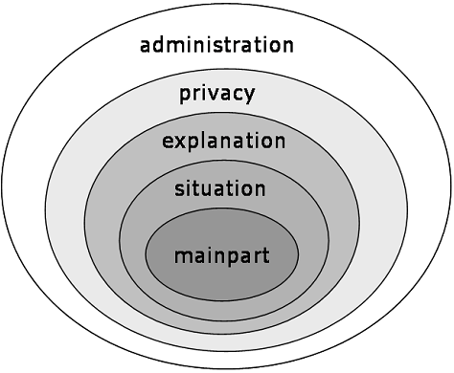
II. Knowledge representation of situation model
Representation of Situational statement
Each situational statement is represented as the onion model with five layers. Each layer containing attributes is considered a collection or box
There are five boxes: main part, situation, explanation, privacy and administration
The attributes in each box are arranged in form of RDF triple: subject–predicate-object

Slide 14
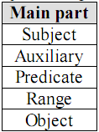
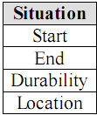
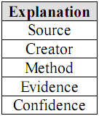
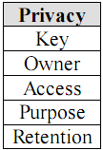
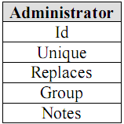
II. Knowledge representation of situation model
Main part box contains main information about statement in form of attribute-value pairs. For example, the main part box of statement “Susan’s mark of math test is 5” is expressed as: “subject = Susan”, “predicate = mark of math test” and “range = 5”
Situation box contains information about the temporal and spatial embedding of situational statement
Explanation box consists of attributes which are required by the user’s right for explanation and by the conflict resolution mechanism inferred user modeling data
Privacy box provides critical information about privacy of user model data, especially in case of distributing sensitive data
Administration box is the outermost layer in the onion model of statement. It fastens organizational issues in huge sets of situation statements

Slide 15
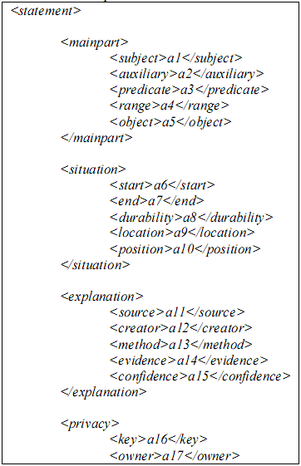
II. Knowledge representation of situation model
XML form of situational statement so-called SituationML or UserML

Slide 16
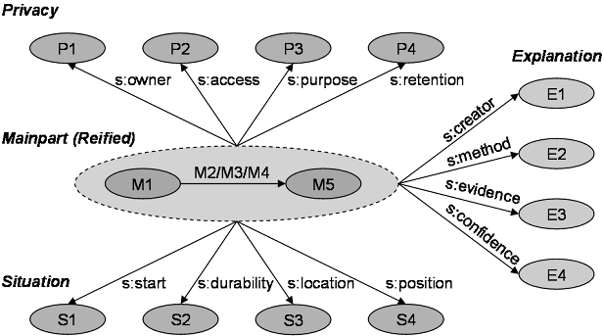
II. Knowledge representation of situation model
The schema of statement model in RDF graph notation

Slide 17
III. Ubiquitous World
Ubiquitous World (UbisWorld) is considered as the partial copy of real world. It represents some parts of real world such as office, school, airport…
UbisWorld includes persons, objects, locations as well as times, events and their properties and features in real world
So UbisWorld is also defined as the uniform virtual world used for simulation, inspection and control
All tasks in ubiquitous user modeling are assumed to take place in UbisWorld

Slide 18
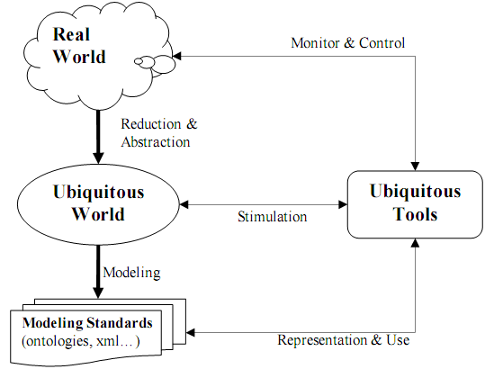
III. Ubiquitous World
The correlation between UbisWorld and real world

Slide 19
III. Ubiquitous World
There are three main process relating to UbisWorld
UbisWorld is reduced and abstracted from real world
UbisWorld is modeled by modeling standards like ontologies and markup languges
UbisWorld is simulated and used by ubiquitous tools

Slide 20
III. Ubiquitous World
An example about UbisWorld
Suppose there is a room in real world having a light switch and table. Such room is abstracted as UbisWorld room
The UbisTools can simulate the light-on, light-off behavior of the real room; thus if the virtual switch gets pressed, the virtual light in UbisWorld room will shine
The UbisWorld room can be used to monitor the real room; for example every time the real switch in real room gets pressed, the virtual light in UbisWorld room will shine
Moreover the UbisWorld room can control real room; for example that the virtual switch gets pressed causes the real light to shine

Slide 21
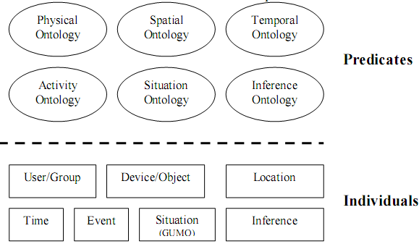
III. Ubiquitous World
UbisWorld can use many ontologies such as physical ontology, spatial ontology, temporal ontology, activity ontology, situation ontology (GUMO) and inference ontology

Slide 22
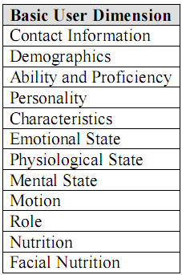
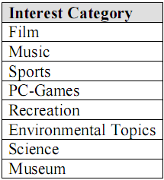
III. Ubiquitous World
Some information about Generic User Model Ontology (GUMO)

Slide 23
IV. Ubiquitous user model service
Ubiquitous user model service is responsible for manipulating ubiquitous user model
Ubiquitous user model service is an application independent server with a distributed approach for accessing and storing user information, the possibility to exchange and understand between different applications as well as adding privacy and transparency to the statements about user
The semantics of user information (situational statement) is mapped to the ontology GUMO. In brief, we call ubiquitous user model service as ubiquitous service in user modeling context.

Slide 24
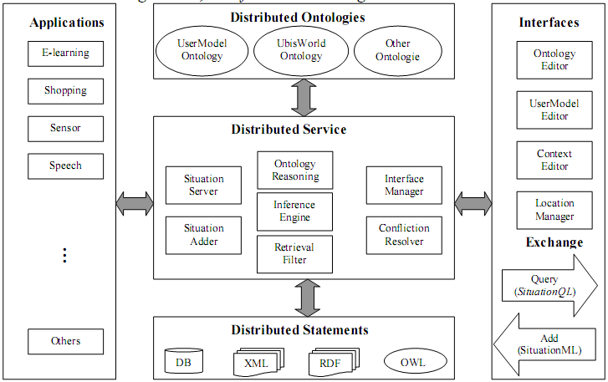
IV. Ubiquitous user model service
The architecture of ubiquitous user model service consists of three boxes: Distributed Services box, Application box, Distributed Statements box, Distributed Ontologies box, Interfaces & Exchange box

Slide 25
IV. Ubiquitous user model service
Distributed Service box includes 7 modules
Situation Server is the web server that manages the storage of statements about user.
Situation Adder is the parser which analyzes incoming new statements and writes them to repositories.
Retrieval Filter is responsible for controlling the retrieval of situational statements
Conflict Resolution is responsible for detecting and resolving possible conflicts
Inference Engine is the proactive engine that applies meta rules, writes new statements and triggers events
Interface Manager has a control mechanism that integrates user interfaces
Ontology Reasoning is responsible for applying knowledge from various ontologies

Slide 26
IV. Ubiquitous user model service
Other boxes
Application box lists applications that possibly cooperate with distributed services such as e-learning, sensors, airport service, mobile phone….
Distributed Statements box plays the role of distributed database management system. It is responsible for storing and managing situational statements about user
Distributed ontologies box is responsible for manipulating and integrating various ontologies into modeling service
Interfaces & Exchange box separates the user model service from the user interfaces and development tools

Slide 27
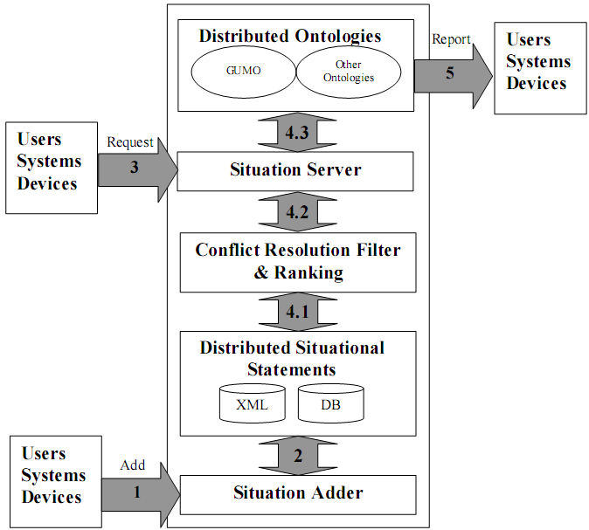
IV. Ubiquitous user model service
Ubiquitous user model service supports three operations: Add, Request and Report. The work flow of them is showed in this figure

Slide 28
IV. Ubiquitous user model service
Main work flow of ubiquitous user model service
The system, users or sensors add statements in form of SituationML (1)
The statements are sent to module Situation Adder that analyzes the incoming data and distributes them to repositories in Distributed Statements box (2)
The system, users or sensors request statements in form of SituationQL (3)
Some repositories are chosen from Distributed Statements box in order to retrieve appropriate situational statements (4.1)
The conflict resolution strategies are applied into such statements (4.2)
Such statements are mapped to ontologies (4.3)
Final statements are sent to users/system in form of SituationML (5)

Slide 29
V. Incorporating Zebra into Ubiquitous User Model Service
Comparison between ubiquitous service and Zebra
The ubiquitous service lacks of the robust inference mechanism. The Inference Engine in Distributed Services box only writes statements and triggers events
On the contrary, Zebra has two robust inference engines: mining engine & belief network engine with ability to infer new assumptions about user and to support personal recommendation
But Zebra don’t support ubiquitous computing and user model in distributed environment

Slide 30
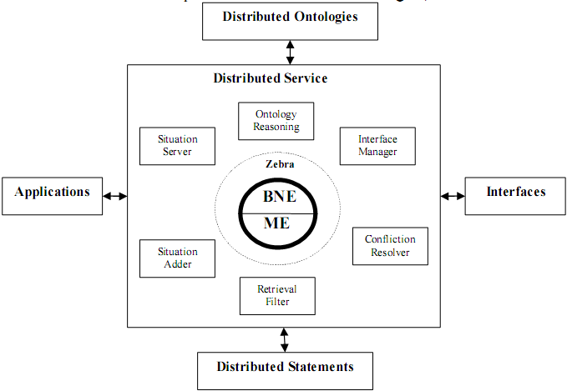
V. Incorporating Zebra into Ubiquitous User Model Service
The combination of Zebra and ubiquitous user model service is successful derives a new user modeling system that takes advantage of both Zebra and ubiquitous computing. Thus it is possible to predict situational statement in ubiquitous environment
Incorporating Zebra into ubiquitous service

Slide 31
V. Incorporating Zebra into Ubiquitous User Model Service
The obstacles when incorporating ubiquitous service into Zebra
Firstly, this is how Zebra interacts with Distributed Services box of ubiquitous service when the database and data structure in Zebra such as Bayesian network, HMM, sequential pattern, etc are very different from statement repositories in ubiquitous service
Secondly, almost techniques in Zebra like data mining, artificial intelligence, learning machine are unfamiliar to ubiquitous service
Finally, the most serious obstacle is that the output of inference process in Zebra such as new information about user, new personal recommendations… is represented in the form which is incompatible with knowledge representation of situation model in ubiquitous service such as ontologies, RDF…

Slide 32
V. Incorporating Zebra into Ubiquitous User Model Service
Communication Interfaces (CI) and request-response protocol
These problems can be solved by getting the best out of the communication interfaces (CI) in architecture of Zebra
Ubiquitous service will interact with Zebra by special CI by request-response protocol including 5 steps

Slide 33
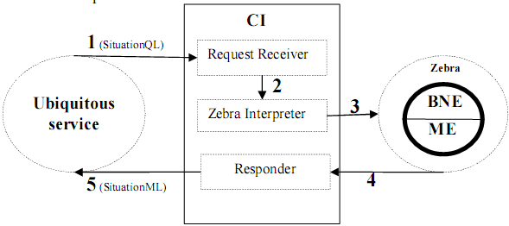
V. Incorporating Zebra into Ubiquitous User Model Service
Ubiquitous service sends one request statement in form of SituationQL to CI
CI interprets this statement into the data structure which inference engines of Zebra such as mining engine & belief network engine are aware of.
The request in form of data structure that Zebra knows is sent to Zebra.
Inference engines perform some concrete deduction tasks in order to take out some new assumptions, information, personal recommendations about user. This output is sent back CI
CI interprets such output into a XML-file in form of SituationML which is readily understandable for ubiquitous service and sends it to ubiquitous service

Slide 34
Conclusion
Ubiquitous user modeling is the considerable future trend.
Two important things in ubiquitous user modeling are: ubiquitous computing & ontologies. Especially, ontologies are used to realized Ubiquitous World
Semantic web is considered as the bridge that connects two components: user modeling, ubiquitous computing

Slide 35
Conclusion
Ubiquitous service lacks of the robust inference mechanism which is the strong point of Zebra
The combination of Zebra and ubiquitous service creates new user modeling system which has strong inference ability about user information in distributed environment
We use CI as the means to incorporating Zebra into ubiquitous service
The request-response protocol is established to solve the incompatible-data problem between Zebra and ubiquitous service

Slide 36
THANK FOR CONSIDERATION
IT@EDU 2008

