Slide 1
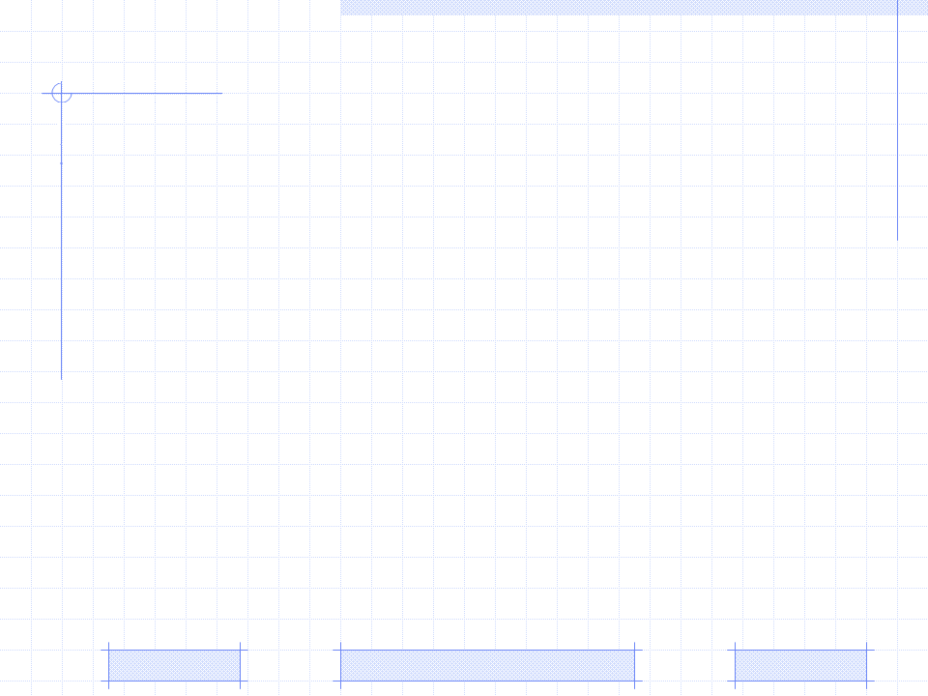
The architecture of Zebra
Existing User Modeling Systems (UMS)
Triangular Learner Model (TLM)
Architecture of Zebra
Interaction between Zebra and AES
PhD. Report: | The architecture of Zebra (August 23th 2009)
Professor: | Pr. Dr. Dong Thi Bich Thuy
Researcher: | Nguyen Phuoc Loc
Affiliation: | Department of IS, Faculty of IT, University of Science

Slide 2
I. Existing UMS (s)
Early user modeling system
Early UMS (s) concentrate on question-answer (dialog) system and human-computer interaction. They are components embedded in concrete application
GRUNDY, the first user modeling system, play the role of book recommender in the library when it calculates recommendation of books, based on assumptions about users’ personal traits
GRUNDY use stereotype method to build up user model, based on users’ answers to questions during their first usage of system

Slide 3
I. Existing UMS (s)
User Modeling Shell
The term “shell” is borrowed from the field of expert system.
Thereby, the purpose of shells is to separate user modeling functionality from adaptive application

Slide 4
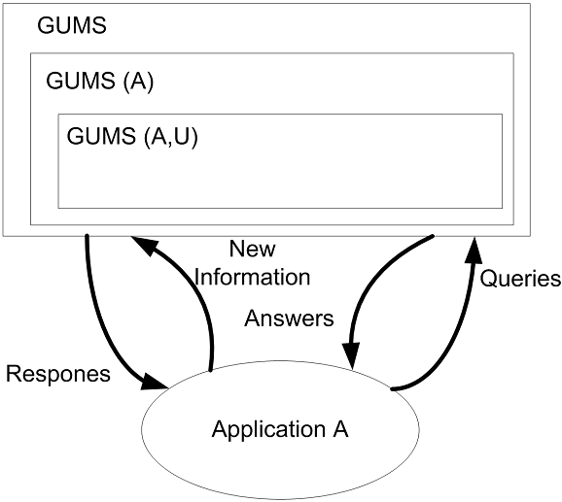
I. Existing UMS (s)
User Modeling Shell: GUMS
GUMS is a first modeling shell that abstracts information about user by allowing defining the simple stereotype hierarchies in form a tree of structure
Each stereotype is associated facts and rules describing system’s reasoning about it. Users are classified into such stereotypes

Slide 5
I. Existing UMS (s)
User Modeling Shell: UMT, PROTUM, TAGUS, um
UMT (User Modeling Tool) developed by models information about users as stereotypes which contain their assumptions in form of attribute-value pairs
PROTUM (PROlog based Tool for User Modeling) is written by the programming language PROLOG. It is more powerful than UMT although it uses stereotype method to model user like UMT did because its hierarchy of stereotypes is not limited to tree structure
TAGUS also applies stereotype method into modeling user. Thus it allows defining the hierarchical stereotype but each assumption about user in stereotype is represented in first-order formulas with meta-operators expressing the type of assumption such as belief, goal
um developed by [Kay 1995] aims to provide the library of user modeling functionalities in which assumptions about users’ knowledge, goal, background… are represented in attribute-value pairs

Slide 6
I. Existing UMS (s)
User Modeling Server
User modeling server has the same purpose with user modeling shell when both of them aim to separate user modeling functionality from adaptive system
However user modeling server is totally independent on application
The communication between user modeling server and adaptive application is based on client-server architecture in which modeling server is responsible for answering application’s requests

Slide 7
I. Existing UMS (s)
User Modeling Server: BGP-MS including four components
Individual user model contains assumptions about user
Stereotype component manages the hierarchy of stereotypes
Automatic stereotype management is responsible for the activation and deactivation of assigned stereotypes of an individual user model
These main components communicate together through the functional interface.

Slide 8
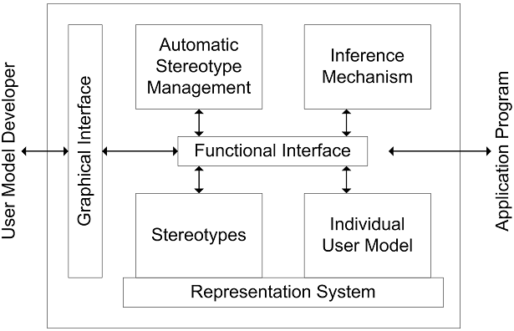
I. Existing UMS (s)
User Modeling Server: BGP-MS
Notes:
Individual user model contains assumptions about user.
Stereotype component manages the hierarchy of stereotypes. Both stereotypes and individual user model are based on the representation system which is the integrated suite of knowledge representation mechanism for representing assumptions about user. Representation system is based on the SB-ONE [Kobsa 1991] knowledge-representation tool.
Automatic stereotype management is responsible for the activation and deactivation of assigned stereotypes of an individual user model

Slide 9
I. Existing UMS (s)
User Modeling Server: Doppelänger
Doppelgänger is the server that monitors users’ actions and discovers patterns from these actions. Basing on such patterns, Doppelgänger aims to deliver user a personalized daily newspaper
The architecture of Doppelgänger is split into two levels: sensor level and sever level
  Sensor level. There are sensors having responsibility for gathering information about user. Sensors can be either software or hardware
  Server level. Doppelgänger makes inferences on information provided by sensors

Slide 10
I. Existing UMS (s)
User Modeling Server: CUMMULATE
Information about user is represented on two levels: event storage and inferenced user model
Student actions (events) being monitored are sent to event storage.
The event storage allows several inference agents that process events in different ways and convert these events into user model , for example, some agents monitor user’s knowledge and others predict user’s interests user model
The architecture of CUMMULATE is open to a variety of external inference agents that receive requests from event storage and manipulate user model

Slide 11
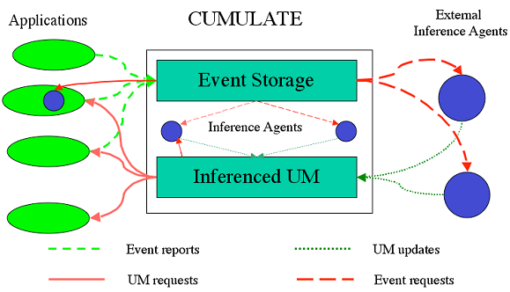
I. Existing UMS (s)
User Modeling Server: CUMMULATE

Slide 12
I. Existing UMS (s)
User Modeling Server: Personis
Personis is the modeling server whose considerable feature is to allow user to control and scrutinize his/her model
The architecture of Personis is divided into four parts:
  The server itself is responsible for managing user model
  A set of Adaptive Hypermedia Application are denoted AHA₁, AHA₂,…, AHA_{n}.
  A set of views in which each view of user model available to each AHA is responsible for defining the components used by such AHA

Slide 13
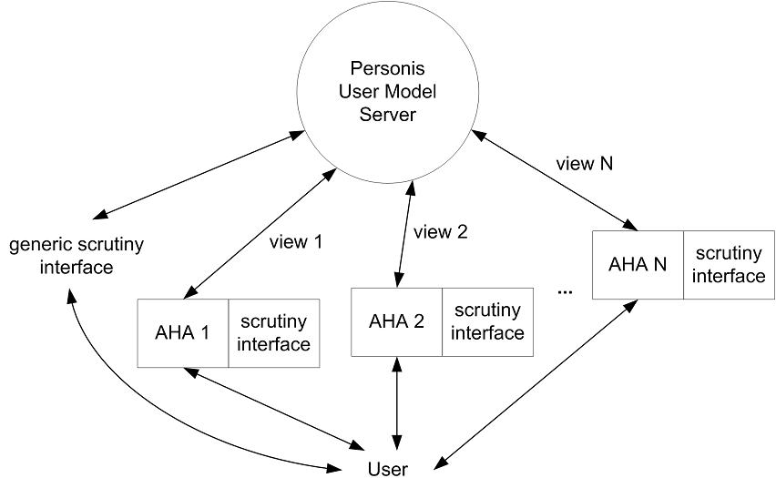
I. Existing UMS (s)
User Modeling Server: Personis

Slide 14
I. Existing UMS (s)
User Modeling Server: LDAP-UMS
LDAP-UMS is the user modeling severs based on Lightweight Directory Access Protocol (LDAP)
UMS is composed of several pluggable user modeling components and can be accessed by external clients
The core of architecture is the Directory Component attached its three sub-components: Communication, Representation and Scheduler.

Slide 15
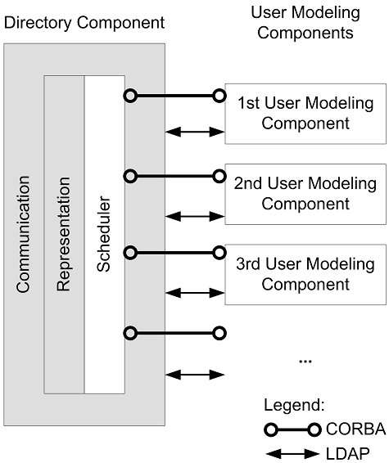
I. Existing UMS (s)
User Modeling Server: LDAP-UMS

Slide 16
I. Existing UMS (s)
User Modeling Server: LDAP-UMS
Communication sub-component handles the communication between external clients and Directory Component, between Directory Component and User Modeling Components. Each User Modeling Component is dedicated to perform user modeling tasks such as collecting user information, inferring new assumptions about user…The Directory Component and User Modeling Components interact together via CORBA and LDAP.
Representation sub-component is responsible for managing the directory contents.
Scheduler sub-component is responsible for wrapping the underlying LDAP server with a component interface

Slide 17
II. Triangular Learner Model
The core of adaptive system is the user model that is the representation of information about an individual
The system that collects user information to build up user model and reasons out new assumptions about user is called user modeling system (UMS)
There are two main tendencies towards implementing UMS: domain-independent UMS and domain-dependent UMS

Slide 18
II. Triangular Learner Model
Purpose
There is too much information about individuals to model all users’ characteristics and each modeling method is only appropriate to respective characteristic like knowledge or learning style or goal, etc. There is no modeling method fit all characteristics
On the other hand, the domain-independent UMS is too generic to “cover” all learners’ characteristics in e-learning, which may cause unpredictable bad consequences in adaptation process
Moreover almost user modeling systems require effective inference techniques in their modeling tasks but this is impossible if we can’t recognize which individual characteristics are important

Slide 19
II. Triangular Learner Model
Purpose
To overcome these obstacles, we propose the new learner model that contains three most important characteristics of user: knowledge (K), learning styles (LS) and learning history (LH)
Such three characteristics form a triangle; so our model is called Triangular Learner Model (TLM). TLM with three underlying characteristics will cover the whole of user’s information required by learning adaptation process
The UMS which builds up and manipulates TLM is called Zebra

Slide 20
III. Triangular Learner Model
Why TLM cover the whole of user’s information required by learning adaptation process
Knowledge, learning styles and learning history are prerequisite for modeling learner
While learning history and knowledge change themselves frequently, learning styles are relatively stable. The combination of them ensures the integrity of information about learner
User’s knowledge is domain specific information and learning styles are personal traits. The combination of them supports UMS to take full advantages of both domain specific information and domain independent information in user model.

Slide 21
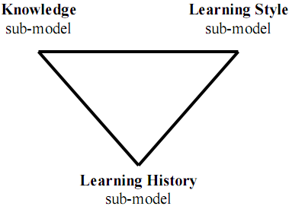
III. Triangular Learner Model
Triangular Learner Model (TLM)

Slide 22
III. Triangular Learner Model
Knowledge sub-model
In overlay method, the domain is decomposed into a set of knowledge elements and the overlay model is simply a set of masteries over those elements
The Bayesian network is the directed acyclic graph (DAG) in which the nodes are linked together by arcs; each arc expresses the dependence relationships between nodes. The strengths of dependences are quantified by Conditional Probability Table (CPT)
Knowledge sub-model so-called as Bayesian overlay sub-model is the combination between overlay model and BN is done through following steps

Slide 23
III. Triangular Learner Model
Knowledge sub-model: two steps so as to combine overlay model & Bayesian network
The structure of overlay model is translated into Bayesian network, each user knowledge element becomes an node in Bayesian network
Each prerequisite relationship between domain elements in overlay model becomes a conditional dependence assertion signified by CPT of each node in Bayesian network

Slide 24
III. Triangular Learner Model
Learning style sub-model
Learning styles are defined as the composite of characteristic cognitive, affective and psychological factors that serve as relatively stable indicators of how a learner perceives, interacts with and responds to the learning environment
We choose Honey-Mumford and Felder-Silverman model as principal models which are presented by Hidden Markov Model (HMM)

Slide 25
III. Triangular Learner Model
Learning style sub-model
Verbal/Visual. Verbal students like learning materials in text form. Otherwise visual student prefer to images, pictures…
Active/Reflective. Active students understand information only if they discussed it, applied it. Reflective students think thoroughly about things before doing any practice
Theorist/ Pragmatist. Theorists think things through in logical steps, assimilate different facts into coherent theory. Pragmatists have practical mind, prefer to try and test techniques relevant to problems

Slide 26
III. Triangular Learner Model
Learning style sub-model
Each learning style is now considered as a state
The essence of state transition in HMM is the change of user’s learning style, thus, it is necessary to recognize the learning styles which are most suitable to user
After monitoring users’ learning process, we collect observations about them and then discover their styles by using inference mechanism in HMM
→Learning style sub-model is modeled as HMM

Slide 27
III. Triangular Learner Model
Learning history sub-model
All learners’ actions: learning materials access, duration of computer use, doing exercise, taking an examination, doing test, communicating with teachers or classmates… are logged and manipulated in learning history sub-model
Information in this sub-model is necessary for data mining in e-learning to discover not only knowledge and learning styles but also other learners’ characteristics such as interests, background, goals…
The mining engine in the core of Zebra often uses this sub-model for many mining tasks. For this reason, this sub-model is drawn as the apex at the bottom of triangle in architecture of TLM → It is the most important sub-model

Slide 28
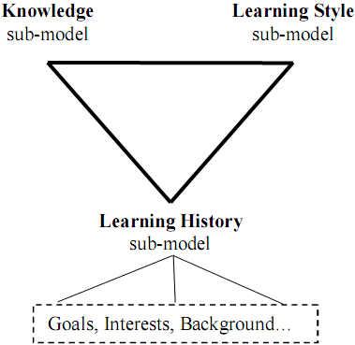
III. Triangular Learner Model
The TLM can be extended to interpret more detailed about learner by attaching more learners’ characteristics such as interests, background, goals… into the sub-model Learning History.

Slide 29
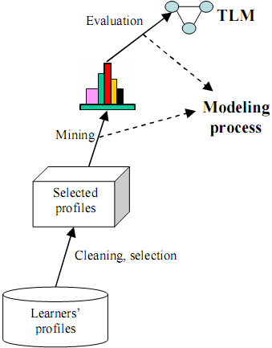
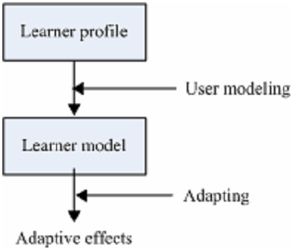
III. Architecture of Zebra
The essence of user modeling systems is mining user’s profile to discover valuable patterns in form of user’s features
The purpose of Zebra is to mine user’s learning profile to build up her/his TLM

Slide 30
III. Architecture of Zebra
Architecture of Zebra
The architecture of Zebra include the core and some communication interfaces (CI)
The core of Zebra is the composition of two engines: mining engine (ME) and belief network engine (BNE).

Slide 31
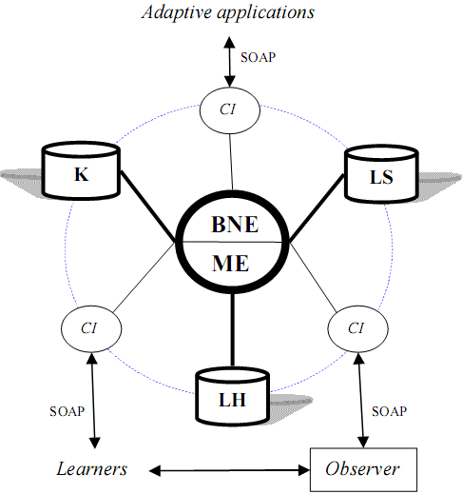
III. Architecture of Zebra
Architecture of Zebra

Slide 32
III. Architecture of Zebra
Two engines in the core of Zebra
Mining engine
  collecting learners’ data, monitoring their actions, structuring and updating TLM
  providing important information to belief network engine
  applying data mining algorithms to discover user characteristics
Belief network engine
  inferring new personal traits from TLM by using deduction mechanism available in belief network like Bayesian network, HMM
  Two sub-models: knowledge & learning style are managed by this engine

Slide 33
III. Architecture of Zebra
Communication Interfaces (CI)
Allowing users to see or modify restrictedly their TLM
Allowing adaptive applications to interact with Zebra
Implemented as web services used widely on internet
Using SOAP protocol for communication

Slide 34
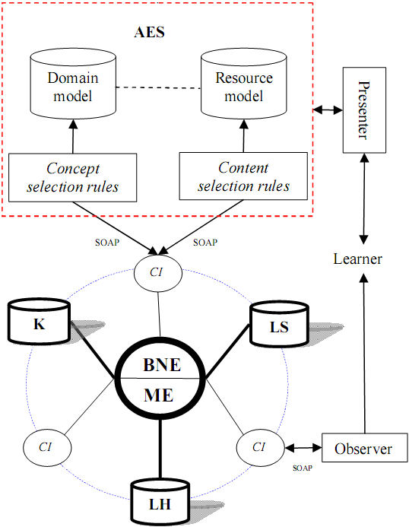
IV. Interaction between Zebra and AES
The extended architecture of Zebra when interacting with AES
Adaptive Education System (AES) is the most popular adaptive learning system supporting personalized learning environment

Slide 35
IV. Interaction between Zebra and AES
The adaptation process has two sub-processes: concept selection & content selection
In concept selection process, concept selection rules are used to match learners’ knowledge to concepts in domain model. In other words, these concepts are filtered to find ones which is necessary for learners to learn in their course.
In content selection process, learning resources are selected from resource component based on content selection rules that match learners’ learning styles to attributes of resources in resource space. In other words, this process finds the resources that learner preferred or suitable to learner.

Slide 36
IV. Interaction between Zebra and AES
Knowledge sub-model
Domain model
Zebra
Concept selection rules
Step 1
Knowledge
need learned A
Resource model
Step 2
Step 6’
The adaptation process includes 6 steps
Learning style sub-model
Learning resources
need learned B
Observer
Step 6
Content selection rules
Learners
Step 3
Step 5
Recommendation resources C
need learned
Step 4
Presenter

Slide 37
IV. Interaction between Zebra and AES
The adaptation process includes 6 steps
Step 1: The projection of domain model onto knowledge sub-model by using concept selection rules results in a set of domain knowledge called A that student has to learn. This is concept selection process
Step 2: A is used as filter to choose a set of learning resources called B that relating to A.
Step 3: The projection of B onto learning styles sub-model by using content selection rules results in a sub-set of learning resources (lectures, exercises, test…) called C tailoring to learner’s preferences. This is content selection process. C is considered as a set of recommendation resources.
Step 4: C is show in content presenter. Presenter can be human-machine interfaces, web sites, learning management system (LMS), teaching support applications…
Step 5: Learner study C by interacting with content presenter.
Step 6: Observer monitors learners in order to catch and delivers learner’s observations to Zebra. Zebra uses such observations to update TLM.

Slide 38
Conclusion
The “Triangular Learner Model (TLM)” composed by three underlying characteristics: knowledge, learning style and learning history aims to cover the whole of learner’s information required by learning adaptation process
UMS which builds up and manipulates TLM so-called Zebra includes the core engine and a set of communication interfaces
Communication interfaces allow users to see or modify restrictedly their TLM and adaptive applications also interact with Zebra through them

Slide 39
Conclusion
The core engine is the composition of two sub-engines: mining engine and belief network engine.
Mining engine applies data mining algorithms into discovering and structuring TLM
Belief network engine is responsible for inferring new personal traits from TLM by using deduction mechanism available in belief network

Slide 40
Reference
Elaine Rich. User Modeling via Stereotypes. COGNITIVE SCIENCE 3, 329-354 (1979)
Tim Finin, David Drager. GUMS: A General User Modeling System. Proceedings of the Canadian Society for Computational Studies of Intelligence 1986 (CSCSI-86).
Brajnik, G. and Tasso, C. A Shell for Developing Non-monotonic User Modeling Systems. International Journal of Human-Computer Studies 40, (1994) 31-62, DOI: 10.1006/ijhc.1994.1003
Vergara, H. PROTUM: A Prolog Based Tool for User Modeling. WG Knowledge-Based Information Systems, Department of Information Science, University of Konstanz, Germany, WIS-Report 10, (1994)
Paiva, A. and Self, J. TAGUS: A User and Learner Modeling System. Proceedings of the Fourth International Conference on User Modeling. Hyannis, MA (1994) 43-49.
Judy Kay. The um Toolkit for Cooperative User Modelling. User Modeling and User-Adapted Interaction, vol. 4, no. 3 p.p. 149-196, 1995 (UMUA 95)
Alfred Kobsa, Wolfgang Pohl. The User Modeling Shell System BGP-MS. User Modeling and User-Adapted Interaction 4(2), 59-106, 1995 (UMUAI-1995)
Alfred Kobsa. First experiences with the SB-ONE knowledge representation workbench in natural-language applications. ACM SIGART Bulletin, vol. 2, no. 3 p.p. 70-76, 1991
IT@EDU 2008

Slide 41
Reference
Jonathan L. Orwant. Doppelgänger: A User Modeling System. Bachelor thesis. Masschusetts institute of Technology June 1991
Peter Brusilovsky. KnowledgeTree: A Distributed Architecture for Adaptive E-Learning. Thirteen International World Wide Web Conference, WWW 2004 (Alternate track papers and posters), New York, NY (2004) 104-113, 10.1145/1013367.1013386
Judy Kay, Bob Kummerfeld, Piers Lauder. Personis: A server for user models. Proceedings of the 2nd International Conference on Adaptive Hypermedia and Adaptive Web-Based Systems (AH'2002), P.p. 201-212, 2002
Alfred Kobsa, Josef Fink. An LDAP-Based User Modeling Server and its Evaluation. User Modeling and User-Adapted Interaction 2006 (UMUAI-2006)
Eugene Charniak. Bayesian Network without Tears. AI magazine. 1991
Peter Honey, Alan Mumford. The Manual of Learning Styles. Maidenhead: Peter Honey Publications, 1992.
R. M. Felder, L. K. Silverman. Learning and Teaching Styles in Engineering Education. Journal of Engineering Education, 1988.
R. Dugad, U. B. Desai. A tutorial on Hidden Markov models. Signal Processing and Artificial Neural Networks Laboratory, Dept of Electrical Engineering, Indian Institute of Technology, Bombay Technical Report No.: SPANN-96.1, 1996
IT@EDU 2008

Slide 42
THANK FOR CONSIDERATION
IT@EDU 2008

