Slide 1
WELCOME TO MY TEAM
Group members:
Trần Hoàng Thịnh (Leader) | ITITIU19054
Lê Thị Huỳnh Giao | ITITIU19012
Nguyễn Gia Phúc | ITITIU19041
Phạm Hồng Đăng | ITITIU19009
Phan Thị Duyên Anh | ITDSIU19030

Slide 2





Android Local Train Ticketing

Slide 3
Introduction
The epidemic is becoming serious. However, many people still choose to travel by train.
=> Dangerous and take times.
Therefore, our team decide to choose the Android Local Train Ticketing for our topic

Slide 4
BENEFITS !
FOR THE COMPANY
Save money
easier access to customers
easier payment methods
FOR THE USER
Protect your health
Save time

Slide 5
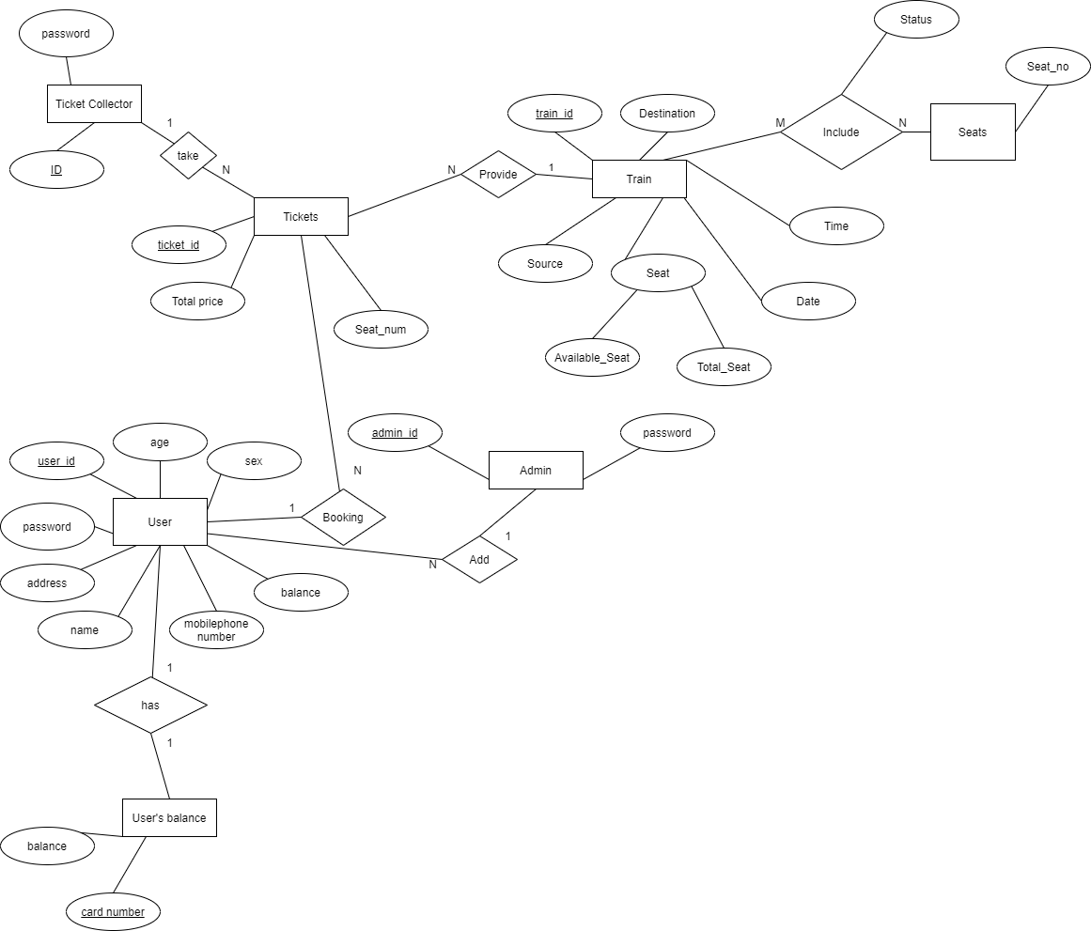
Entity – Relationship Diagram

Slide 6
ADVANTAGES: • Easy to visualize the relationship among entities and relationships. • Effective communication tool for database designer. • Highly integrated with the relational model.
DISADVANTAGES:
• Some information could be hidden in ER model.
• Limited relationship representation
• No representation of data manipulation
• Popular for high level design

Slide 7
RELATIONAL MODEL

Slide 8
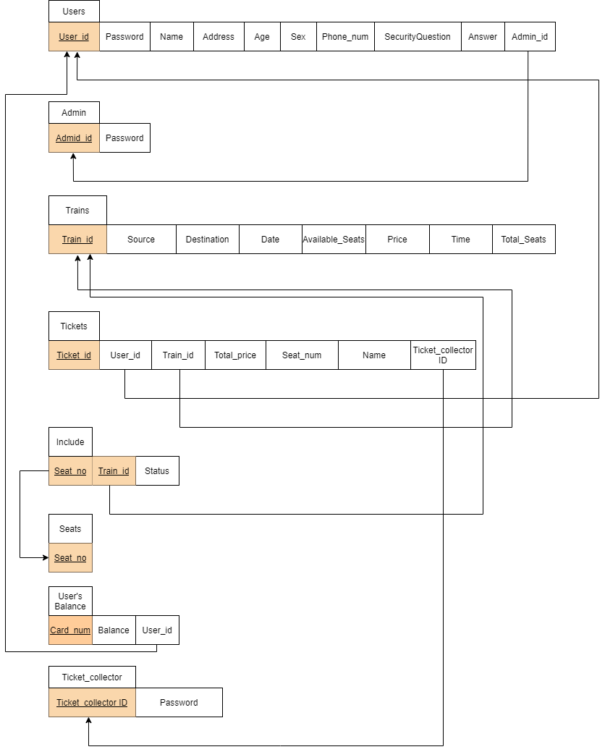

Slide 9
EXPLANATION
FOR THE ENTITY:
From ERD → seven schemas.
Users(User_id, Password, Name, Address, Age, Sex, Phone Number, Security Question, Answer)
Admin(Admin_id, Password)
Train(Train_id, Source, Destination, Date, Available_Seats, Price, Time, Total_Seats)
Tickets(Ticket_id, Total_price, Seat_num, Name)
User’s Balance(Card_num, Balance)
Ticket Collector(Ticket_collector ID, Password)
Seats (Seat_no)
THE RELATION SCHEMA:
Users (User_id, Password, Name, Address, Age, Sex, Phone Number, Security Question, Answer, Admin_id)
Admin(Admin_id, Password)
Train(Train_id, Source, Destination, Date, Available_Seats, Price, Time, Total_Seats)
Tickets(Ticket_id, Users_id, Train_id, Total_price, Seat_num, Name, Ticket_collector ID)
Seats(Seat_no)
User’s Balance(Card_num, Balance, User_id)
Ticket Collector (Ticket_collector ID, Password)
Include(Seat_no, Train_id, Status)

Slide 10









DATABASE STRUCTURE

Slide 11
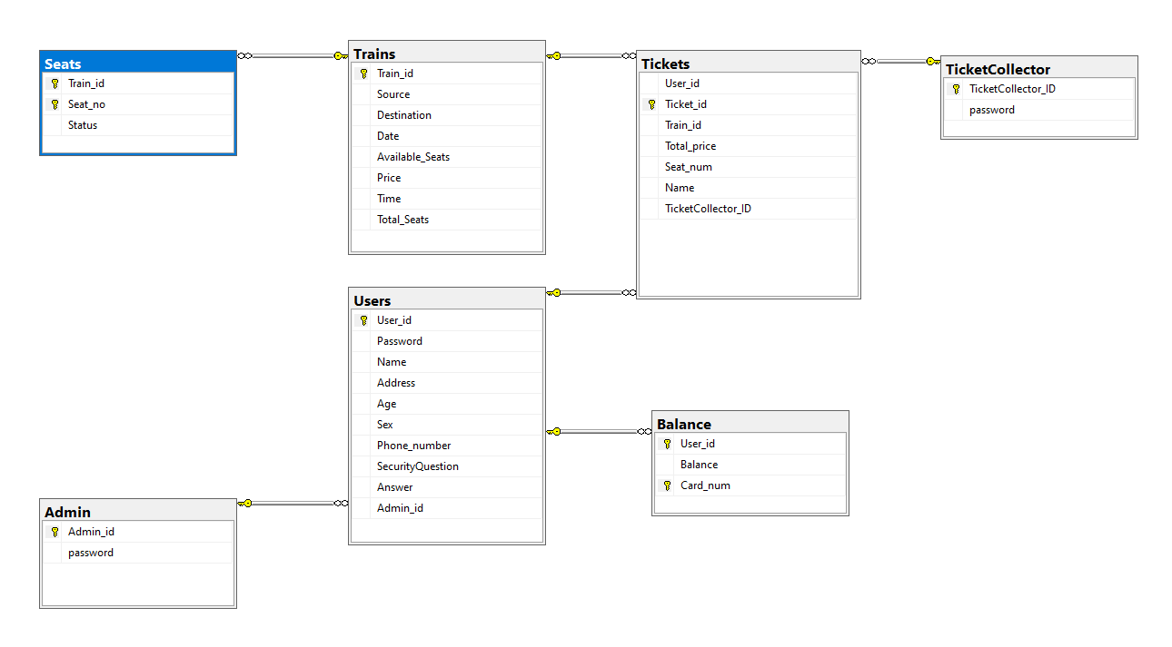
DATABASE DIAGRAM

Slide 12

EXECUTION

Slide 13
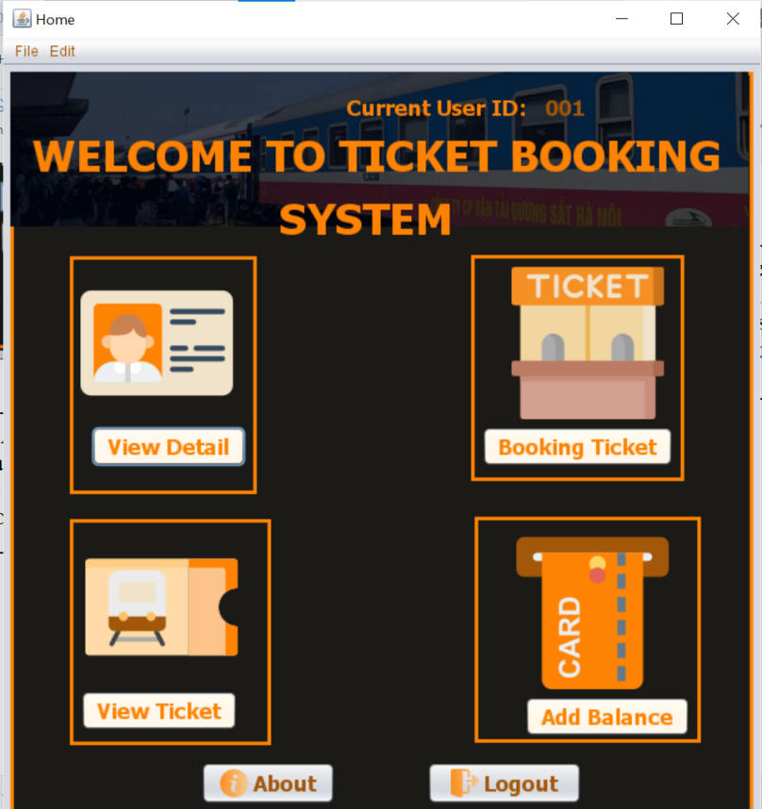
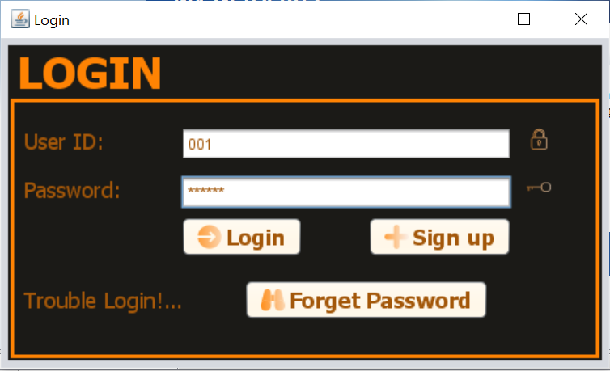
I. USER
A) LOGIN & LOGOUT

Slide 14
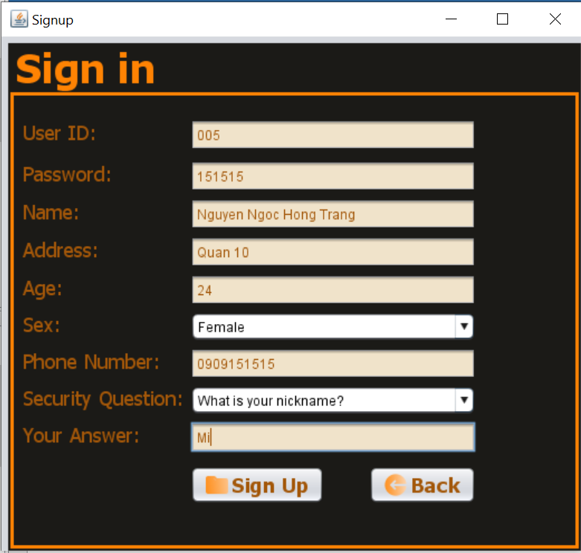
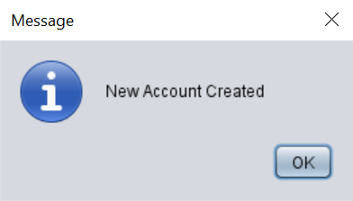
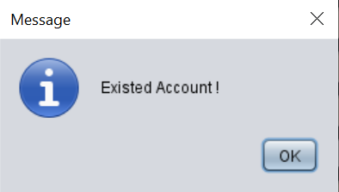
B) SIGN UP:
Sign Up Button: When the users push this button, the system will check whether the User’s id is exited in the system or not.
+ If it is not existed the following message will be shown to announce that the account has been created. Then, the system will insert user’s information into database to store.
+ If there is an user’s id existed already in the system, the below message will be shown.

Slide 15
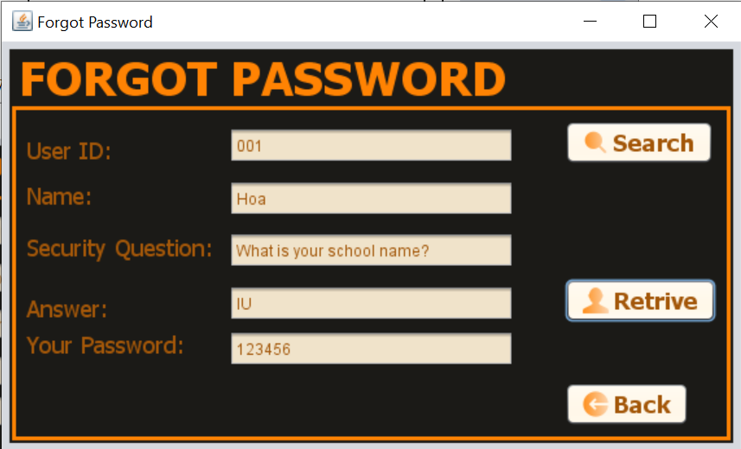
C) FORGOT PASSWORD:

Slide 16
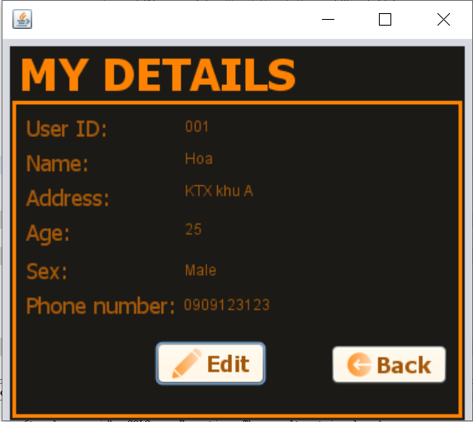
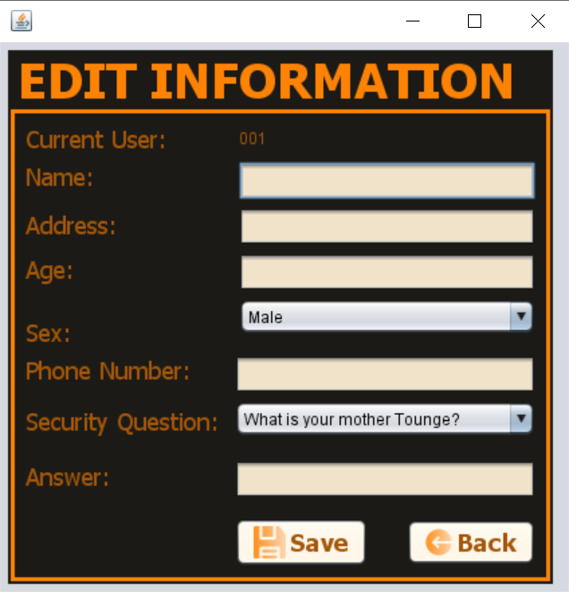
D) VIEW USER’S DETAIL:

Slide 17
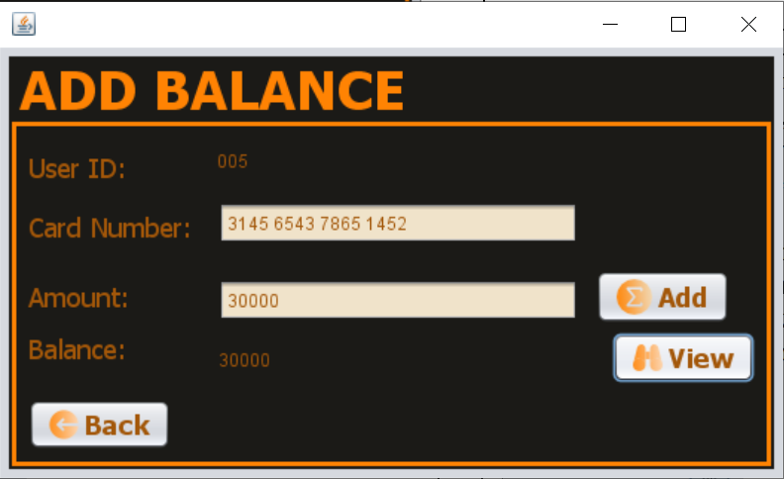
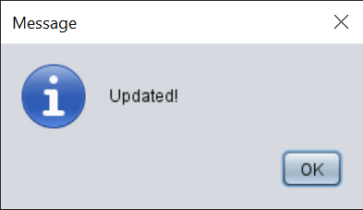
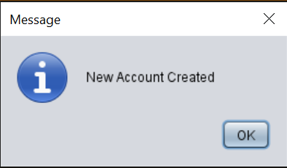
E) ADD BALANCE:
Add Button: After inputting the card number and the amount, the users push this button. Then, the system will check if the account has existed in the database or not.
+ If the account has been existed, the card number and amount will be updated for the user’s account. The message below will also be shown.
+ If the account has not been existed in the system (it means this is the new users ), the system will create the new account on the system. The message will be shown.

Slide 18
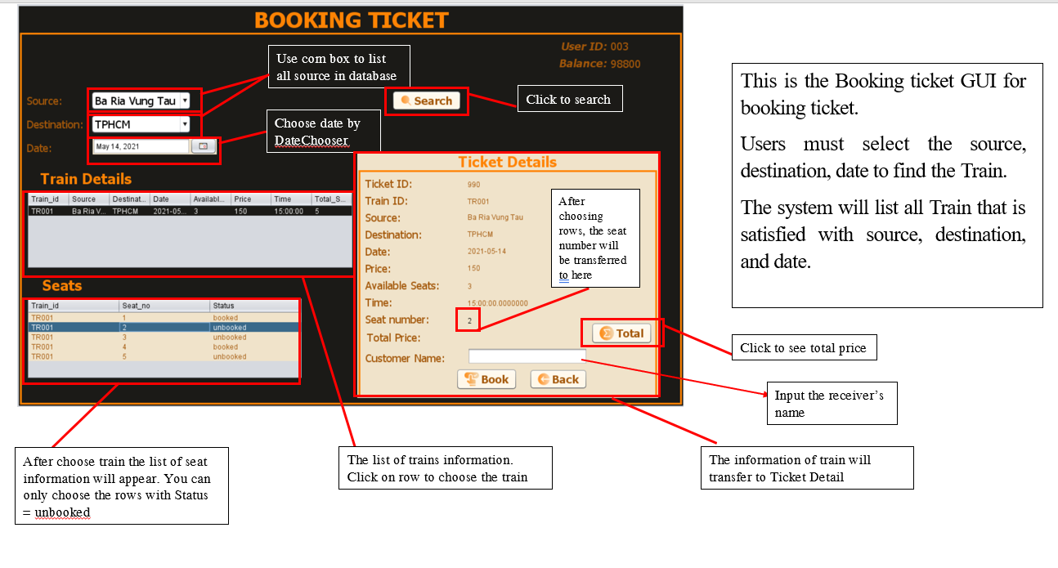

Slide 19
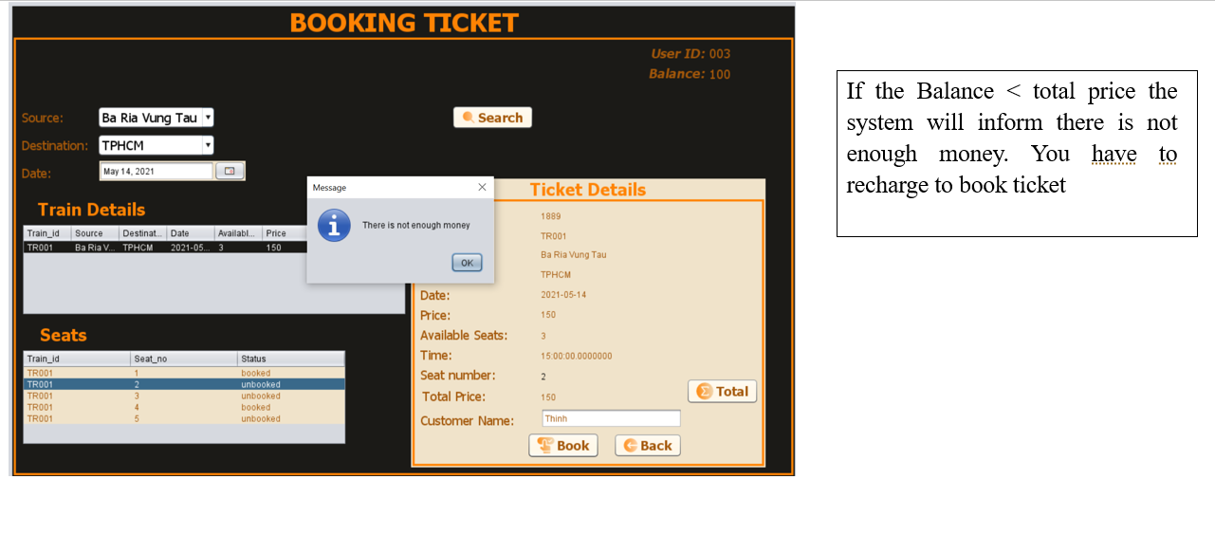

Slide 20
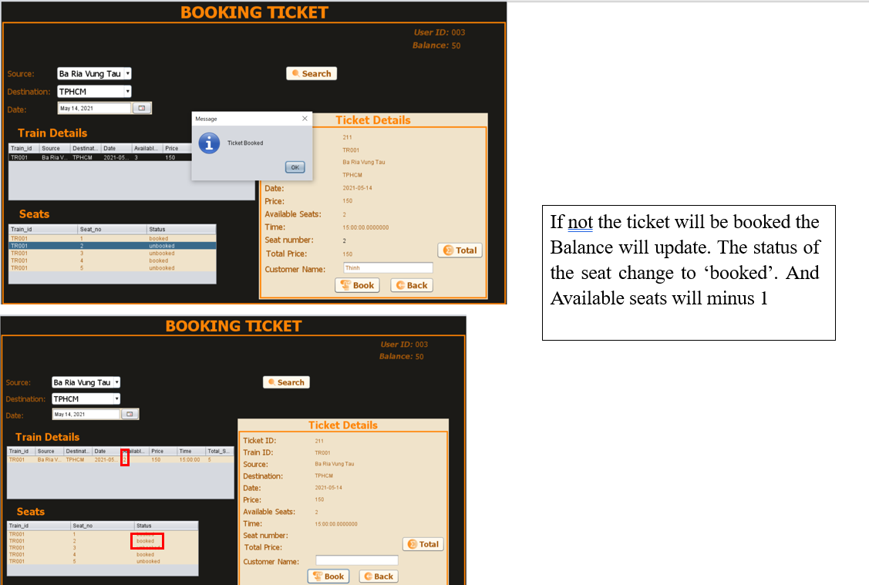

Slide 21
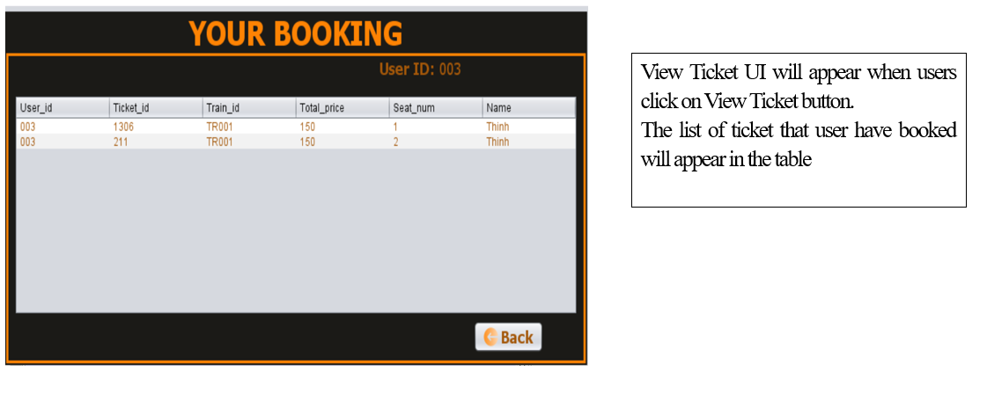
G) VIEW TICKET:

Slide 22
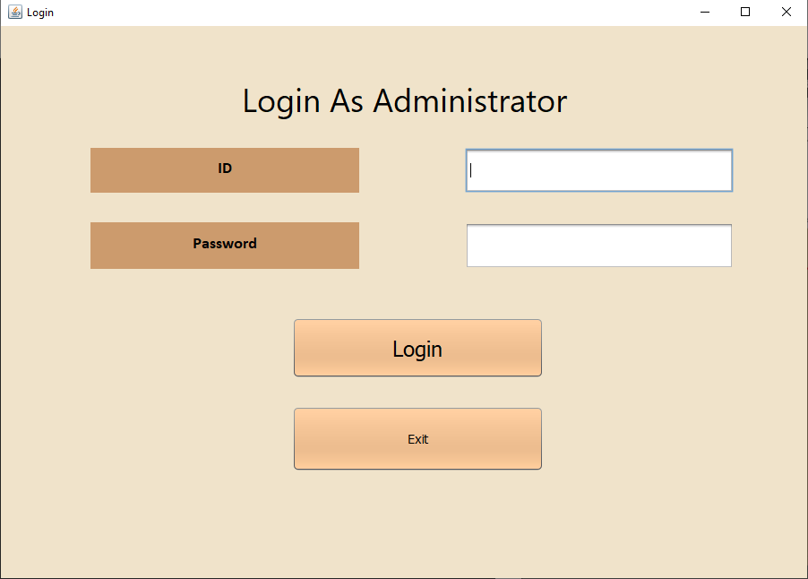
II. ADMIN:
A) LOGIN FRAME:

Slide 23
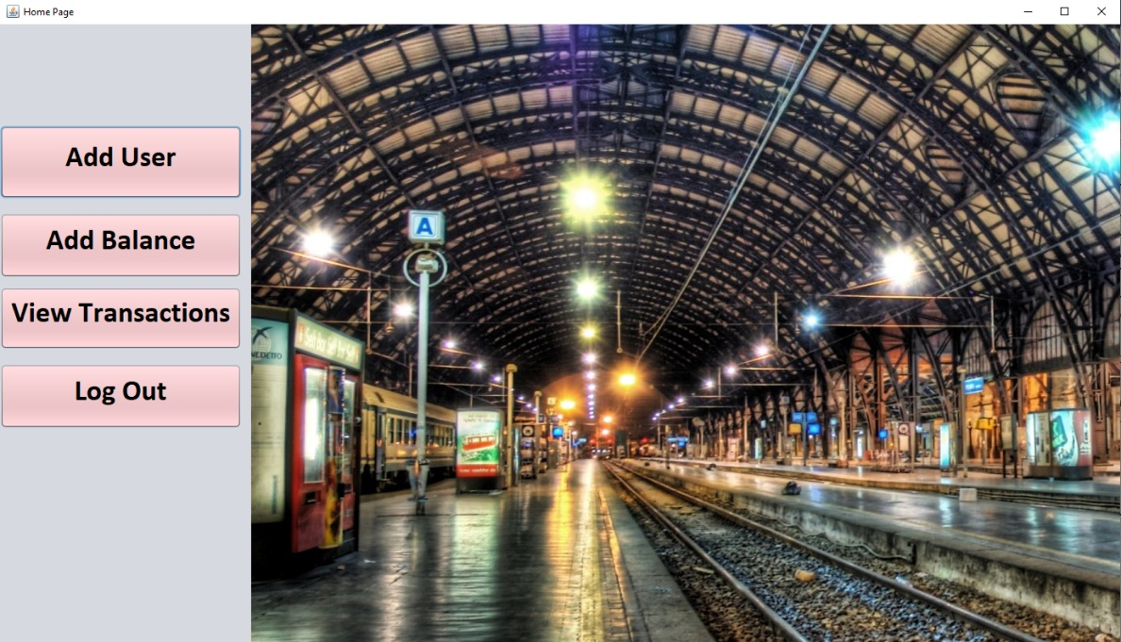
B) HOME PAGE:

Slide 24
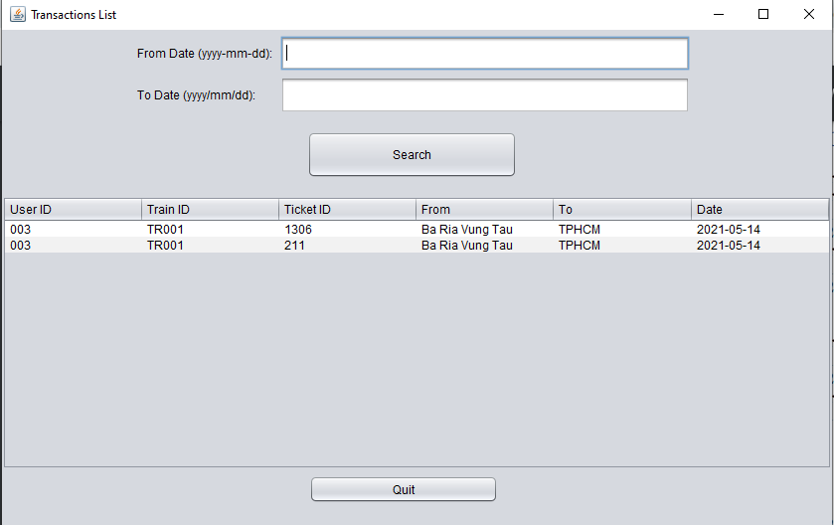
C) VIEW TRANSACTION:

Slide 25
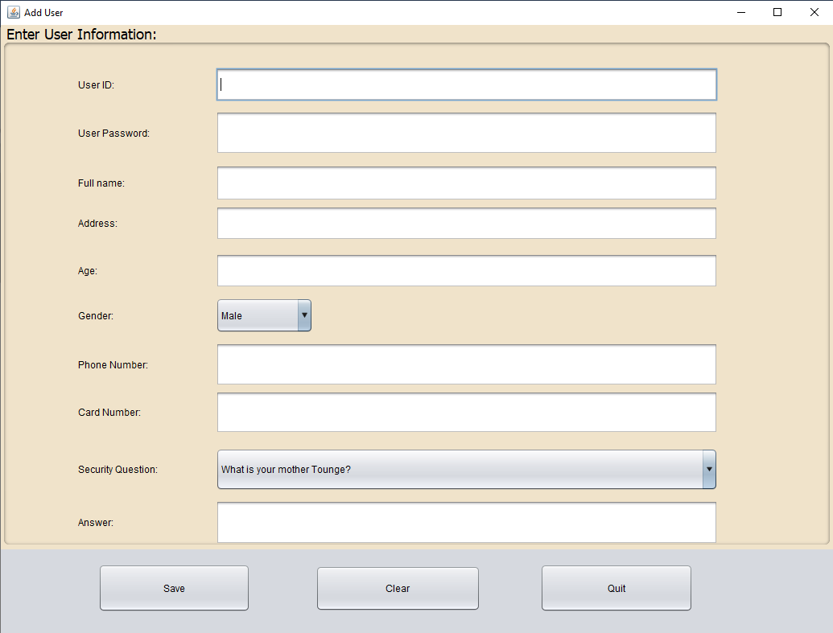
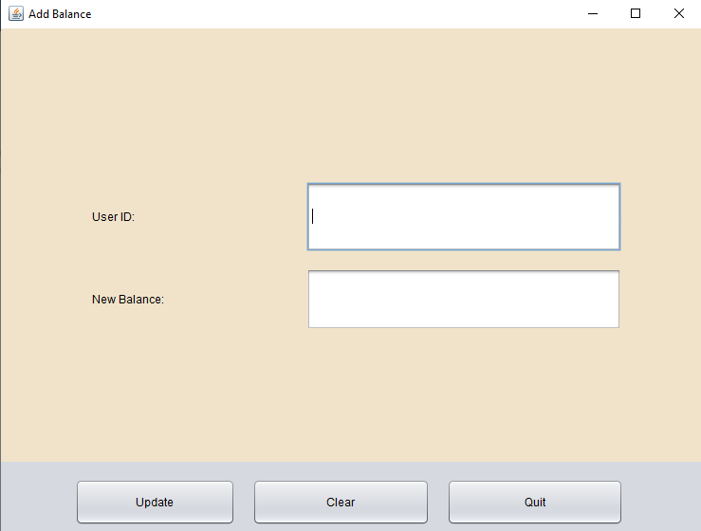
D) ADD USER:

Slide 26
THANKS FOR YOUR LISTENING !

