Slide 1
ASP Presentation
Group Members:
Joston lee
Ng Qi jie

Slide 2
Project Objective
The Objective is to create a graph on the countries and year that we are given to code in python.
We are also given to do a unittest on the code to check if there are any errors.
Joston

Slide 3
The Packages We Used
The packages we use are:
Xlrd
Numpy
Pandas
Scipy
Joston

Slide 4
How We Did It
We started doing the VCS, then started coding for the project. We had trouble at first so we started to look it up online to find the possible solution.
After finding some solution, we plan out on which code works the best and decide that we are going to stick with that code. We did took some time to complete the project. Even if we didn’t finish in time, we still continue doing at home so we can complete the coding by the day we do.
Joston

Slide 5
How Did We Share
We discuss on our idea to see which code works best. We tried to use different method to get the same output. We also tried to debug the code if we had some errors.
Joston

Slide 6
What Was Our Task
Joston Lee
Did the first few of the output
Did the first graph
Did half of the code explanation
Qi Jie
Did the last few of the output
Did the second graph
Did the other half of the code explanation
Qi Jie

Slide 7
Our Project Code Flow
Created Github
Import Packages
First Part of the code
Second Part of the code
1st graph
2nd graph
Unittest
Doing the word documents
Qi Jie

Slide 8
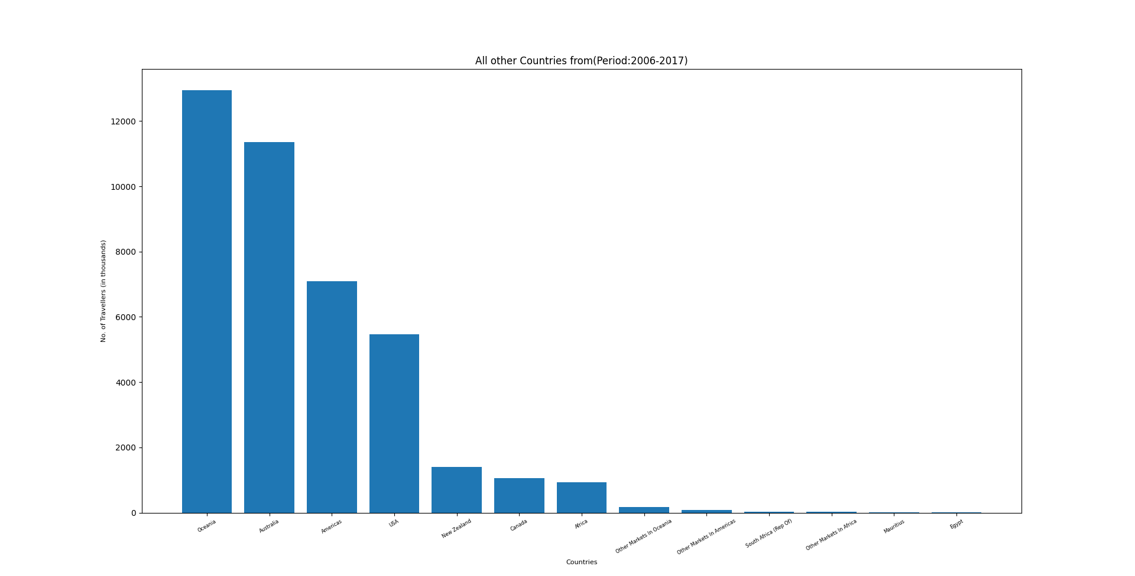
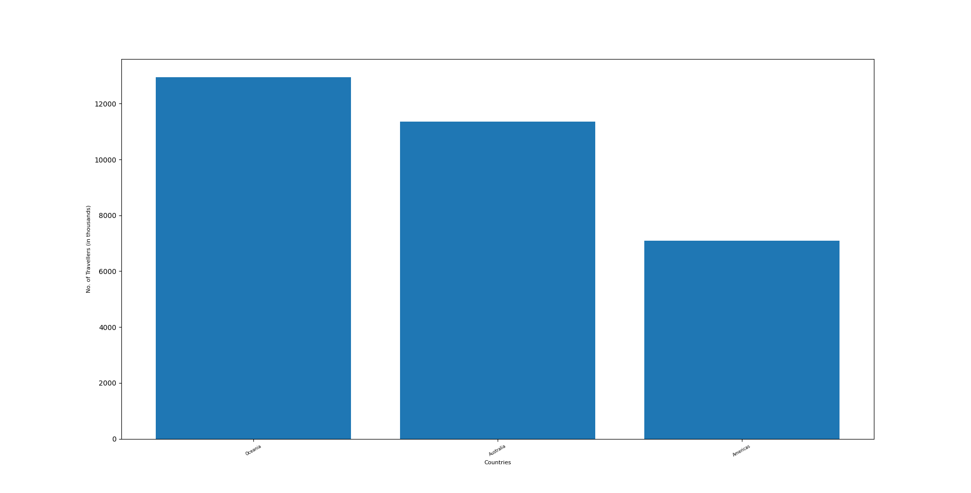
Analysis the Result
Qi Jie

Slide 9
Unit Test Case
We are only able to complete the Unit Testing for Error.
We had some Errors doing the Unit Testing for No Error
Qi Jie

Slide 10
What Have I Benefitted From this Project
We have benefitted:
Teamwork
Communication
Positive mindset
Distributing work equally
Having good productivity
Qi Jie

