Slide 1
Flowchart Template
(for program code)

Slide 2
Copy and Past these symbols for your Flowcharts
ECE 1022
Terminator (Beginning or End of Section)
#
On-Page Connector
Begin
End
text
Input / Output
#
Off-Page Connector
text
Decision / Test
Flow/Path Line
text
Loop
Node
text
Statement / Process
text
Description or Logic of Path

Slide 3
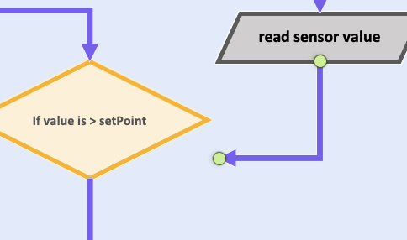
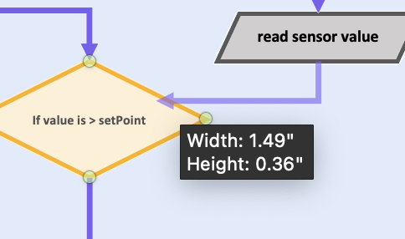
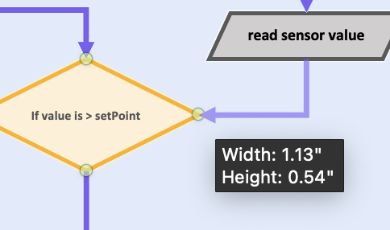

Power Point Power User :
Using Shapes and Shape Formatting in Powerpoint to Create Code Flowcharts
Identify what actions your subsystem is responsible for and when+how they will occur
2. Break your actions into individual steps that concisely summarize what code for that action will do. Identify which symbols should represent that action.
3. Begin diagramming by copying and pasting symbols, then editing the text. Feel free to change the text size or margins, but keep the colors and symbol types the same.
4. Use arrows to connect different symbols appropriately. Click and drag one end of the arrow until green circles appear on the shape you want to connect to. Connect the arrow to the desired side of the symbol. Now the symbol can be moved, and the arrow will adjust with it.

Slide 4
CubeSat EPS
System Overview Flowchart (LEVEL 0)
Start
Initialize Hardware (USB, I2C)
WiFi Task (Priority 2)
Sensor Task (Priority 1)
Webserver Task (Priority 1)
Start WiFi AP "Pico2W-AP"
Init INA238 Init BME280
Wait for WiFi
Start DHCP Server 192.168.4.x
loop() - every 1 sec
Start HTTP Server Port 80
Handle DHCP Requests
Read INA238 (V, I, P)
Handle HTTP Requests
Read BME280 (T, H)
Store in sensor_data_t (mutex protected)
SSI data
Wait poll_interval vTaskDelayUntil()
Generate Web Page (SSI tags)
Loop (idle)
Loop again
Loop (wait for request)
Quick Reference: WiFi SSID: Pico2W-AP | Password: password123 | AP IP: 192.168.4.1 | I2C: GPIO 4/5 | Poll: 1000ms | Web refresh: 3s

Slide 5
Examples for reference are included on the remaining slides

Slide 6
ECE 1022
if statements
from Sensor subsystem
#
if
Description: checks a condition, then executes its code block if true. Otherwise (if false), the statement block is skipped
Parameter: a Boolean expression (result will be true or false)
Syntax:
if(conditionIsTrue) {
doThing();
doAsManyThingsAsWeWant();
}
Example:
if(value > setPoint) {
TurnOnFan();
}
Notes: • multiple conditions can be nested inside the parentheses
• multiple statements can be inside the brackets
https://www.arduino.cc/reference/cs/language/structure/control-structure/if/
Start
read sensor value
If value is > setPoint
(if true)
turn fan on
(if false)
fan output = ON
Continue in code

Slide 7
ECE 1022
if-else statements
from Sensor subsystem
#
Start
read sensor value
If, else if, and else
If sensor value > setpoint1
Description: checks for true condition and enters any first true if()
or else, then exits the control structure. Only one of
the if, else if, or else blocks will execute.
Parameter: a Boolean expression (result will be true or false)
Syntax:
if(condition1) {
doThing();
}
else if(condition2) {
doThing2();
}
else {
doThing3();
}
Notes: • multiple conditions can nest inside the parentheses
• multiple statements can be inside the brackets
https://www.arduino.cc/reference/cs/language/structure/control-structure/else/
fan ON
true
false
turn on fan
turn off heat
If sensor value < setpoint2
heat OFF
fan OFF
true
false
turn off fan
turn on heat
else
heat ON
do nothing
Continue in code

Slide 8
ECE 1022
while loops
from User Input subsystem
#
while
Description: checks for true condition and executes code block.
Loops within code block until condition is false Parameter: a Boolean expression (result will be true or false)
Syntax:
while(condition) {
doThing();
}
Example:
while(buttonState==HIGH) {
value++;
constrain(value, 0, 100)
updateUserDisplay(value);
delay(50);
}
Notes: • multiple conditions can nest inside the parentheses
• multiple statements can be inside the brackets
https://www.arduino.cc/reference/cs/language/structure/control-structure/while/
Start
read button state
While button is pressed
to User Output subsystem
false
true
#₂
Increment value.
Constrain Value.
Update Screen.
Delay 50ms
Continue in code
user display updated

Slide 9
Heat-Tracking Fan
Pseudocode Flowchart (LEVEL 0)
setup() code
Display error on User Interface
global code
status == false
Include libraries
Set things up (pins, variables, objects, etc.)
Start
Check sensor status
status == true
loop() code
Loop again
• Read sensor
• Filter data
• store values in 8x8 vector
Update servo position to the left or right towards user
Update screen with grid of temperature-based colors
• Determine if Off-Center
• update “direction” variable

Slide 10
Position-Tracking Subsystem
Pseudocode Flowchart (LEVEL 1)
( to user I/O )
setup() code
Print to Screen:
“Sensor not working; check wiring!”
global code
Include libraries
<Wire.h>
<Adafruit_AMG88xx.h>
<Filter.h>
• Create sensor object
• Set delay interval
• Set pixel array size
status == false
Start
Check sensor status
status == true
loop() code
Loop again
• Read sensor, store in vector
fxn: getPosition()
• Get rotation direction
For each data point,
• apply exponential filter
• save new value

Slide 11
getPosition() function
Position-Tracking Subsystem (part of LEVEL 2 diagram)
from loop()
false
Mark current column as highest
If avg is higher than previous column
true
Array of pixel data
Start
For each column in array
Check avg value of column
( to servo )
fxn: setServo()
End
Set rotation direction based column with highest avg
New servo position

