Slide 1
Outline
Why R? (10 minutes)
Using R with exercises (2 hours)
Basics
Vectors
Data.frames
Data management
Reshaping
Aggregation
Visualization (ggplot)
Workflow for data cleaning/extraction (30 minutes)

Slide 2
Outline
Why R? (10 minutes)
Using R with exercises (2 hours)
Basics
Vectors
Data.frames
Data management
Reshaping
Aggregation
Visualization (ggplot)
Workflow for data cleaning/extraction (30 minutes)
Probability/sampling/simulation
Regression
Machine learning
Managing/analyzing spatial data
Interactive web-based visualization

Slide 3
R | Stata
Object-oriented language | Stata-specific logic
Free, open-source | Proprietary
General statistical learning | By economists, for economists
Huge academic/private community, massive presence on Stack Overflow | Small, shrinking community that is sustained by academia
Fast, scales extremely well | Slow, scales very poorly
Tons of easy-to-use APIs (Google, Twitter, Facebook, Census/ACS, etc.) | N/A
Web scraping, text analysis | N/A
Validated packages for Bayesian analysis | Limited
Spatial data structures and modeling | N/A
Machine learning (neural networks, random forests, boosted-regression-trees, etc.) | N/A

Slide 4

When is R maybe not so good?
Text analysis
Princeton SICCS workshop uses R
Managing array-like data
Most data used in statistical learning is tabular (i.e. rows and columns)
Sometimes we have spatial structures, which have their own classes
Some machine learning applications
Many APIs can’t be easily queried in R
Though the big ones have R APIs: IPUMS, Facebook, Twitter, Google, etc.

Slide 5
When is R maybe not so good?
Text analysis
Princeton SICCS workshop uses R
Managing array-like data
Most data used in statistical learning is tabular (i.e. rows and columns)
Sometimes we have spatial structures, which have their own classes
Some machine learning applications
Many APIs can’t be easily queried in R
Though the big ones have R APIs: IPUMS, Facebook, Twitter, Google, etc.
Alternative language: Python

Slide 6
When is R maybe not so good?
Text analysis
Princeton SICCS workshop uses R
Managing array-like data
Most data used in statistical learning is tabular (i.e. rows and columns)
Sometimes we have spatial structures, which have their own classes
Some machine learning applications
Many APIs can’t be easily queried in R
Though the big ones have R APIs: IPUMS, Facebook, Twitter, Google, etc.
Alternative language: Python
(but statistical learning and visualization are way harder)

Slide 7
Data cleaning/extraction
Philosophy of coding:
Efficient
Transparent
Reproducible
Avoiding “hard-coding”, or the inclusion of “data” in your scripts
Typically we consider “data” to be the actual information stored (e.g. income) but there is also “metadata” (e.g. the name of the variable containing income values, labels for categories, etc.)
All metadata should be in one place and easy to change/check/reference
Should be able to easily move across languages (R, Stata, Python)

Slide 8
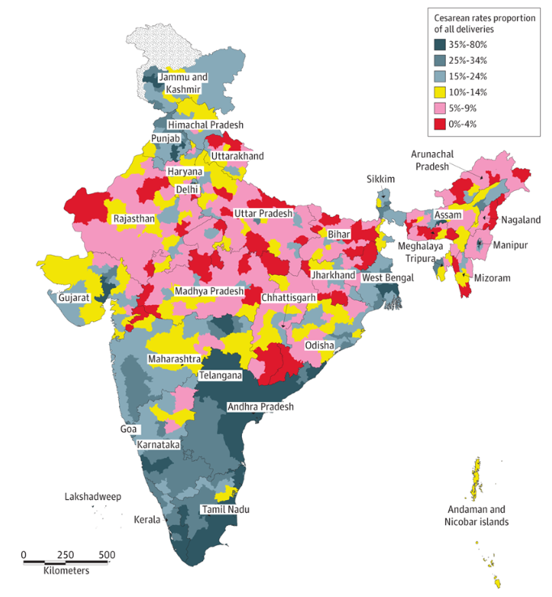
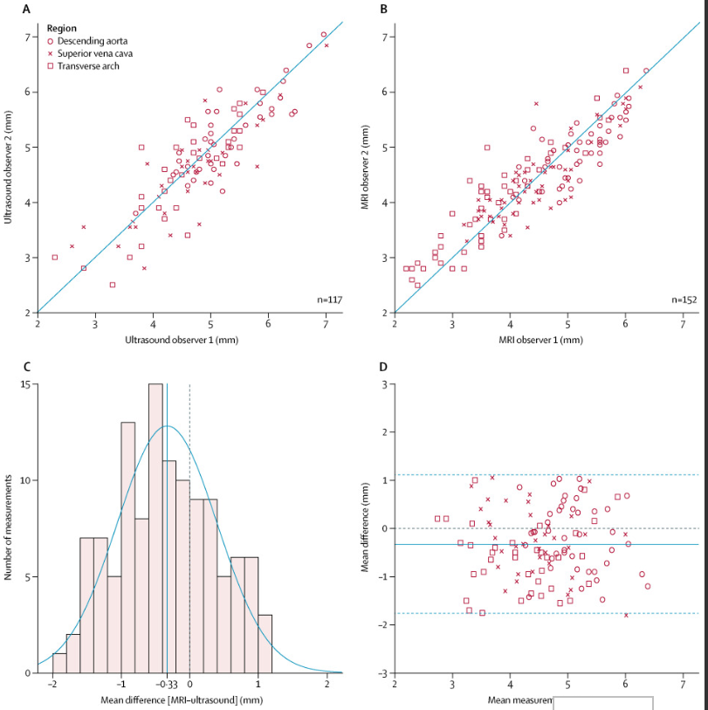

Slide 9
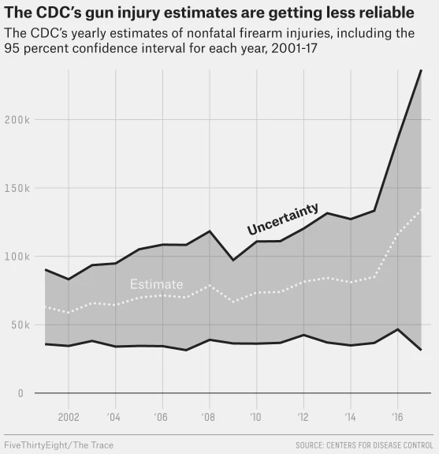
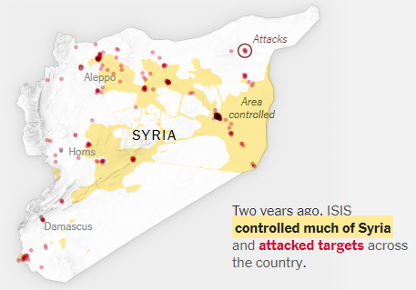

Slide 10
http://r-statistics.co/Top50-Ggplot2-Visualizations-MasterList-R-Code.html

Slide 11
Specific trainings/tutorial (Data Bootcamp)
Tabular data management (tidyverse/dplyr or data.table)
Subsetting, indexing, assigning, merging, collapsing, reshaping
Workflow (writing and applying functions)
Github (code versioning)
RMarkdown (integrating code/plots with text documents)
RShiny (hosting public, interactive web tools)

