Slide 1
Guess Me
Isaac Angle, Nathaniel Graham, Chris Roberts

Slide 2
MIPS Instructions Used
lw load word
jal call procedure
rem remainder
sw store word
sub subtract
li load immediate
move move
la load address
beq branch if equal
bne branch if not equal
j unconditional jump
mul multiplication
jr return to prev location

Slide 3
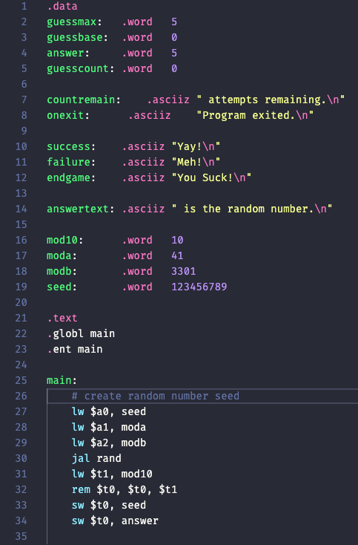
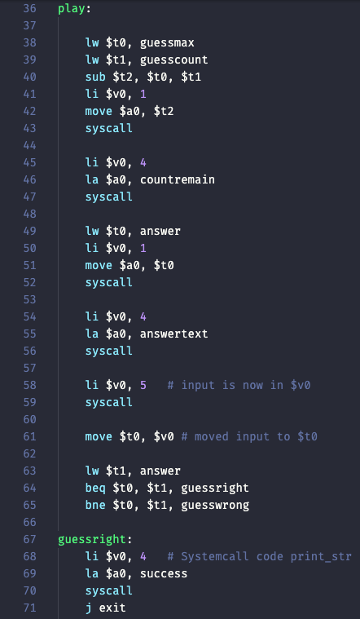
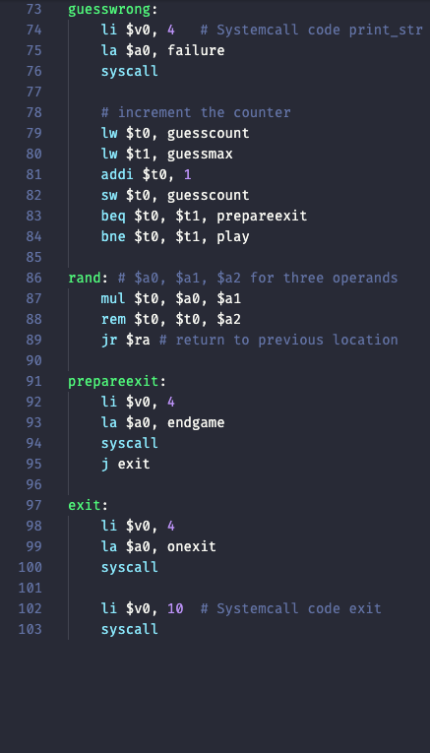

Slide 4
Demo

Slide 5
Algorithm
What we liked about our algorithm
A lot of different instructions were used
The game is fun to play
A few thing we disliked
Not very complex
Could use more math-based calculations
The algorithm is efficient, we used the least amount of instructions we could.
A similar algorithm could work for the future.

