Slide 1
RESEARCH PRESENTATION
Remote Work
& Productivity
The Role of Home Office Quality
Research Questions
Is the number of WFH days associated with employee productivity?
Does this relationship depend on home office quality?
Notes:
My project studies whether working from home more days per week is related to employee productivity, and whether this changes depending on the quality of the employee's home office.

Slide 2
DATASET
Data Overview
remote_work_productivity_analysis.csv
1,500
13
0
Observations
Variables
Missing Values
employee-level
retained for analysis (17 original)
clean dataset, no duplicates
📍 Data source: Remote employee surveys — Australia
Notes:
I used a dataset with 1,500 employee-level observations. It includes categorical and numerical variables, so it was appropriate for this project. The data were already in good condition, since there were no missing values or duplicates.

Slide 3
VARIABLES
Main Variables
OUTCOME
MAIN PREDICTOR
CONTEXTUAL
productivity_score
wfh_days_per_week
home_office_group
Employee productivity
Days worked from home per week
Poor/Average · Good/Excellent
Control Variables
work_hours_per_week
meetings_per_week
stress_level
job_satisfaction
years_experience
job_level
Notes:
The main outcome is productivity. The main predictor is the number of days worked from home each week. I also included home office quality because I expected the effect of remote work to depend on the working conditions at home.

Slide 4
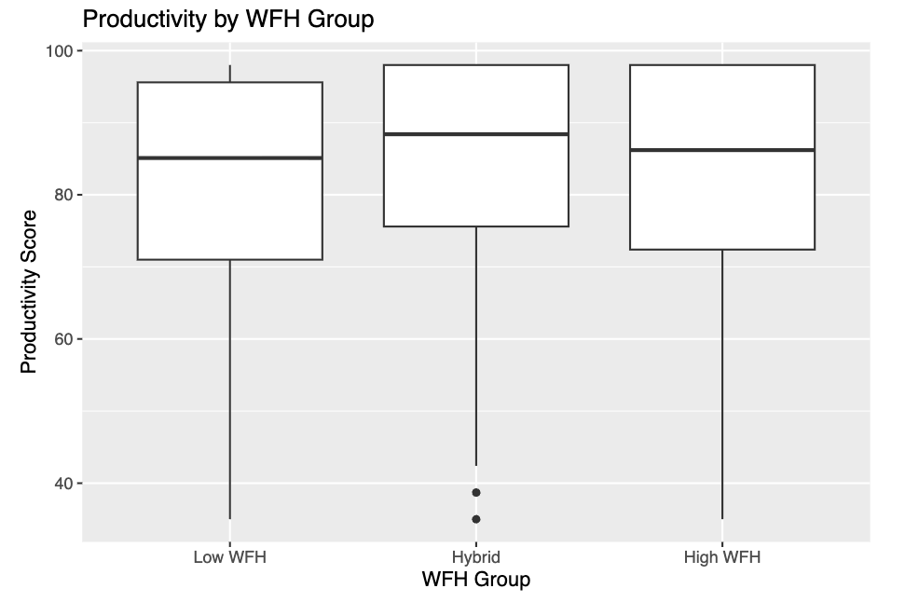
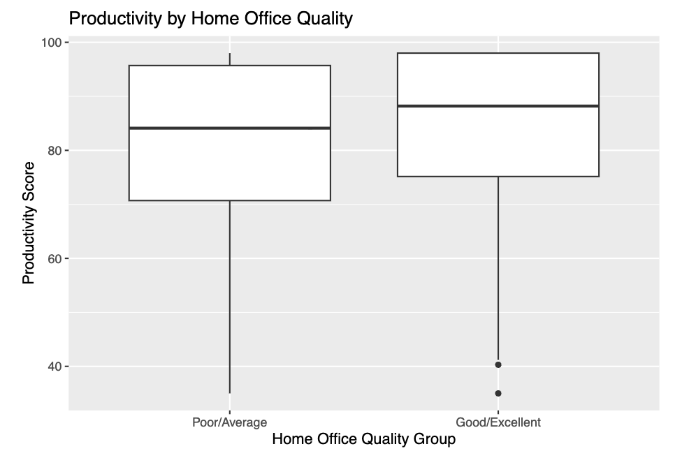
EXPLORATORY ANALYSIS
Exploratory Analysis
Productivity is generally high across all WFH groups
Hybrid workers show slightly higher productivity
Better home office quality clearly associates with higher productivity
Notes:
In the exploratory analysis, productivity was relatively high across all WFH groups, although hybrid workers seemed to have slightly higher values. A clearer pattern appeared with home office quality, since employees with better home office conditions tended to show higher productivity.

Slide 5
MODELS & RESULTS
Models & Main Results
Model 1
Model 2
Model 3
Simple Regression
Multiple Regression
Home Office Quality Model ★
WFH days → weak positive association
Effect remains small with controls added
Best AIC · Best adjusted R²
Key Findings
wfh_days_per_week
Small, non-significant effect on productivity
home_office_group (Good/Excellent)
Positive and statistically significant
job_satisfaction + years_experience
Also important predictors
Notes:
I compared several models, from simple to more complete ones. The final model was the Home Office Quality Model, because it gave the best balance between fit and interpretation. The results show that the number of WFH days has only a very small effect, while better home office quality is more clearly associated with higher productivity.

Slide 6
CONCLUSION
Conclusion
📊
🏠
⭐
WFH Frequency
Home Office Quality
Other Factors
Working from home more days is NOT a strong predictor of productivity on its own.
Better home office conditions are more clearly associated with higher productivity.
Job satisfaction and years of experience also contribute meaningfully to productivity.
Key Takeaway
Remote work is not only about frequency — it's about the context and quality of the work environment.
Notes:
The main conclusion is that remote work frequency by itself does not explain productivity very well. What seems more important is the context in which remote work happens, especially the quality of the home office. This suggests that companies should not focus only on how many days employees work from home, but also on the conditions in which they do it.

