Slide 1
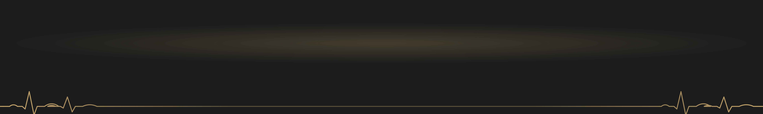
































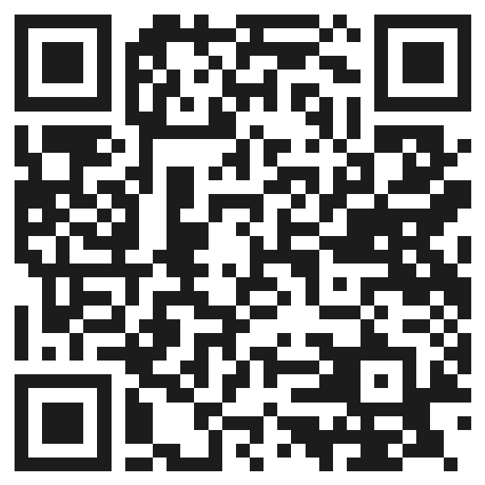
The Association Between Moderate Physical Activity and Self-Reported Depression Outcomes
Paper in press –
University of Michigan Undergraduate Journal of Public Health
VANDERBILT
Evidence from the National Health Interview Survey, 2010–2023
UNIVERSITY
Nicolas Greco
Departments of Economics & Psychology, Vanderbilt University, Nashville, TN
Independent study conducted at Pace University (Pforzheimer Honors College), New York, NY.
BACKGROUND
RESULTS
DISCUSSION
21M
280M
17.2%
−2.92
percentage points
KEY FINDING
Adults active 4–6 times a week were 2.92 percentage points less likely to report frequent depressive symptoms than inactive adults.
95% CI: −4.4 to −1.4 · Specification 3
4–6 sessions a week had the largest link with fewer frequent depressive symptoms
U.S. adults had a major depressive episode in 2021 (8.3%)¹
people live with depression worldwide²
of U.S. adults aged 18–25 had depression in 2020, up from 10.3% in 2015³
Better self-rated health at every activity level (−22.7 to −35.9 pp)
Fits prior work linking activity to lower depression risk^{4,5}
Treatment barriers
Physical activity
Socioeconomic status matters: welfare receipt consistently predicted worse outcomes⁷
High costs
→
Low-cost
Figure 1. Change in each outcome vs. no activity, by activity level (Spec 3, 95% CI)
No link with depression level: all CIs include 0 (R² = 0.038)
Long waitlists
No prescription
Significant (filled, colored by activity level)
Not significant (hollow)
Provider shortages
Flexible, anywhere
A. Poor general health
B. Frequent depression
C. Depression level
Limitations
Prior evidence: activity is linked to lower depression risk
Self-report bias
Unmeasured confounders
Any activity⁴
17% lower odds
Low
1–3×/wk
−22.7
−0.454
−0.324
Association, not cause
Income only in categories
Half the recommended dose⁵
18% lower risk
Full recommended dose⁵
25% lower risk
Medium
4–6×/wk
−34.2
−2.92
−1.45
The gap: few nationally representative studies compare how often people exercise across several dimensions of depression.
Activity level
CONCLUSIONS
High
7+×/wk
−35.9
−2.50
−0.397
1
Being moderately active 4–6 times a week was linked to a lower chance of feeling depressed often.
AIMS
−40
−30
−20
−10
0
−4
−2
0
−4
−2
0
2
2
Any regular moderate activity – even 1–3 times a week – was linked to better self-rated health.
Q
Question: Is how often U.S. adults do moderate physical activity linked to their self-reported depression and general health?
Difference vs. inactive adults (percentage points)
◄ shaded side = less likely than inactive adults · each panel has its own scale
3
Activity was not linked to how strongly depression is felt, so it is a low-cost complement to care, not a cure.
H
Hypothesis: Since activity can lower stress and aid sleep, more frequent activity is linked to better depression outcomes.
Takeaway: better general health at every activity level; fewer frequent depressive symptoms only at 4–6 and 7+ sessions a week.
Moderate physical activity
General health
Figure 2. Who was studied: sample by activity level (N = 332,521)
Big picture: as depression rises and care stays hard to reach, regular moderate activity is a low-cost tool worth promoting.
Depression frequency
1 dot = 0.1%
Future directions
frequency
Depression level
Test activity as a treatment for people clinically diagnosed with depression, tracking real-time, individual-level change.
+ demographic & socioeconomic controls
0%
25%
50%
75%
100%
Cumulative share of sample (%)
METHODS
None (0)
124,773 · 37.5%
Low (1–3)
146,241 · 44.0%
Medium (4–6)
40,660 · 12.2%
High (7+)
20,847 · 6.3%
ACKNOWLEDGEMENTS
Takeaway: most adults were inactive or low-activity; only 12.2% reached the 4–6 times-a-week level linked to fewer depressive symptoms.
Data: IPUMS NHIS⁶, 2010–2023
Table 1. Specification 3 estimates, percentage points [95% CI]
I thank Professor Osborne for his helpful feedback on the manuscript, and my mom and dad for their constant support and encouragement.
N = 332,521 U.S. adults · self-reported · nationally representative
Activity level | General health (poor) | Depression frequency | Depression level
Low (1–3) | −22.7* [−23.8, −21.6] | −0.454 [−1.5, 0.6] | −0.324 [−1.9, 1.3]
Medium (4–6) | −34.2* [−35.7, −32.7] | −2.92* [−4.4, −1.4] | −1.45 [−3.7, 0.8]
High (7+) | −35.9* [−37.9, −33.9] | −2.50* [−4.5, −0.5] | −0.397 [−3.3, 2.5]
Observations | 161,344 | 160,974 | 66,089
R² | 0.204 | 0.252 | 0.038
Exposure: moderate activity, times/week
Funding: This independent study received no external funding.
Data: IPUMS NHIS v8.1 (Blewett et al., 2025).
None 0
Low 1–3
Medium 4–6
High 7+
Author Contribution Statement
NG (sole author) conceived and designed the study, prepared the data, performed all analyses, interpreted the results, wrote the manuscript, and designed this poster.
Outcomes: 3 self-reported measures
General health
Dep. frequency
Dep. level
Model: OLS regression vs. no activity
Selected references
1. NIMH (n.d.). Major Depression.
2. WHO (2025). Depressive disorder (depression).
3. Goodwin, R. D., et al. (2022). Am. J. Prev. Med., 63(5), 726–733.
4. Kandola, A., et al. (2019). Neurosci. Biobehav. Rev., 107, 525–539.
5. Pearce, M., et al. (2022). JAMA Psychiatry, 79(6), 550–559.
6. Blewett, L. A., et al. (2025). IPUMS Health Surveys: NHIS, v8.1. doi.org/10.18128/D071.V8.1
7. Alzahrani, H., et al. (2024). J. Adv. Trends Med. Res., 862–869.
(3) + Socioeconomic: marital status, income, poverty ratio, meds ★ preferred
(2) + Demographic: age, sex, race
(1) Activity only
Connect on LinkedIn
How to read: each estimate is the percentage-point difference vs. inactive adults.
* Significant (95% CI excludes 0); highlighted. Reference group: no moderate activity.

