Slide 1
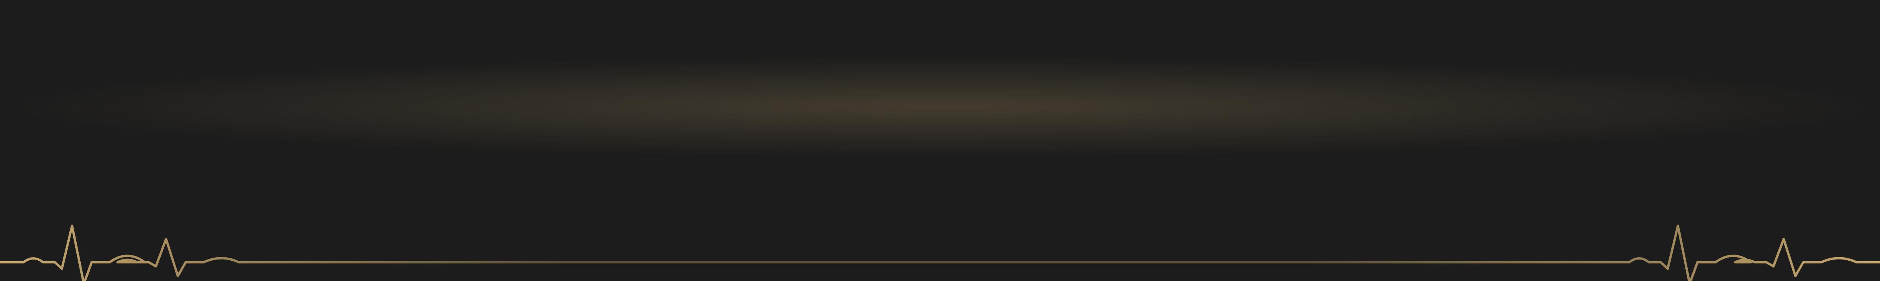



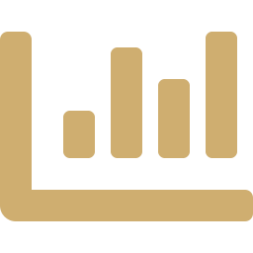




























The Association Between Moderate Physical Activity and Self-Reported Depression Outcomes
Paper in press –
University of Michigan Undergraduate Journal of Public Health
VANDERBILT
Evidence from the National Health Interview Survey, 2010–2023
UNIVERSITY
Nicolas Greco
Departments of Economics & Psychology, Vanderbilt University, Nashville, TN
Independent study conducted at Pace University (Pforzheimer Honors College), New York, NY.
BACKGROUND
RESULTS
DISCUSSION
21M
280M
17.2%
−2.92
percentage points
KEY FINDING
Adults active 4–6 times a week were 2.92 percentage points less likely to report frequent depressive symptoms than inactive adults.
95% CI: −4.4 to −1.4 · Specification 3
4–6 sessions a week had the largest link with fewer frequent depressive symptoms
U.S. adults had a major depressive episode in 2021 (8.3%; NIMH)
people live with depression worldwide (WHO)
of U.S. adults aged 18–25 had depression in 2020, up from 10.3% in 2015 (Goodwin et al., 2022)
Better self-rated health at every activity level (−22.7 to −35.9 pp)
Treatment barriers
Physical activity
Fits prior work (Kandola et al., 2019; Pearce et al., 2022); plausible via less stress & better sleep
High costs
→
Low-cost
Figure 1. Change in each outcome vs. no activity, by activity level (Spec 3, 95% CI)
Socioeconomic status matters: welfare receipt consistently predicted worse outcomes
Long waitlists
No prescription
Significant (filled, colored by activity level)
Not significant (hollow)
No link with depression level: all CIs include 0 (R² = 0.038)
Provider shortages
Flexible, anywhere
A. Poor general health
B. Frequent depression
C. Depression level
Prior evidence: activity is linked to lower depression risk
Limitations
Any activity
Kandola et al., 2019
17% lower odds
Low
1–3×/wk
−22.7
−0.454
−0.324
Self-report bias
Unmeasured confounders
Half the recommended dose
Pearce et al., 2022
18% lower risk
Association, not cause
Income only in categories
Full recommended dose
Pearce et al., 2022
25% lower risk
Medium
4–6×/wk
−34.2
−2.92
−1.45
The gap: few nationally representative studies compare how often people exercise across several dimensions of depression.
Activity level
High
7+×/wk
−35.9
−2.50
−0.397
CONCLUSIONS
AIMS
1
Being moderately active 4–6 times a week was linked to a lower chance of feeling depressed often.
Question: Is how often U.S. adults do moderate physical activity linked to their self-reported depression and general health?
−40
−30
−20
−10
0
−4
−2
0
−4
−2
0
2
2
Q
Difference vs. inactive adults (percentage points)
Any regular moderate activity – even 1–3 times a week – was linked to better self-rated health.
H
Hypothesis: More frequent moderate activity is associated with better depression-related outcomes.
◄ shaded side = less likely than inactive adults · each panel has its own scale
3
Exercise is not a cure: it was not linked to how severe depression feels, so it should complement, not replace, treatment.
Moderate physical activity
General health
Figure 2. Who was studied: sample by activity level (N = 332,521)
Depression frequency
1 dot = 0.1%
Future directions
frequency
Depression level
0%
25%
50%
75%
100%
Test activity as a treatment for people clinically diagnosed with depression, tracking real-time, individual-level change.
+ demographic & socioeconomic controls
Cumulative share of sample (%)
None (0)
124,773 · 37.5%
Low (1–3)
146,241 · 44.0%
Medium (4–6)
40,660 · 12.2%
High (7+)
20,847 · 6.3%
METHODS
ACKNOWLEDGEMENTS
Table 1. Specification 3 estimates, percentage points [95% CI]
I thank Professor Osborne for his helpful feedback on the manuscript, and my mom and dad for their constant support and encouragement.
Data: IPUMS NHIS, 2010–2023
Activity level | General health (poor) | Depression frequency | Depression level
Low (1–3) | −22.7* [−23.8, −21.6] | −0.454 [−1.5, 0.6] | −0.324 [−1.9, 1.3]
Medium (4–6) | −34.2* [−35.7, −32.7] | −2.92* [−4.4, −1.4] | −1.45 [−3.7, 0.8]
High (7+) | −35.9* [−37.9, −33.9] | −2.50* [−4.5, −0.5] | −0.397 [−3.3, 2.5]
Observations | 161,344 | 160,974 | 66,089
R² | 0.204 | 0.252 | 0.038
N = 332,521 U.S. adults · self-reported · nationally representative
Funding: This independent study received no external funding.
Data: IPUMS NHIS v8.1 (Blewett et al., 2025).
Exposure: moderate activity, times/week
None 0
Low 1–3
Medium 4–6
High 7+
Author Contribution Statement
NG (sole author) conceived and designed the study, prepared the data, performed all analyses, interpreted the results, wrote the manuscript, and designed this poster.
Outcomes: 3 self-reported measures
General health
Dep. frequency
Dep. level
Model: OLS regression vs. no activity
Selected references
Alzahrani, H., et al. (2024). J. Adv. Trends Med. Res., 862–869.
Blewett, L. A., et al. (2025). IPUMS Health Surveys: NHIS, v8.1. doi.org/10.18128/D071.V8.1
Goodwin, R. D., et al. (2022). Am. J. Prev. Med., 63(5), 726–733.
Kandola, A., et al. (2019). Neurosci. Biobehav. Rev., 107, 525–539.
Pearce, M., et al. (2022). JAMA Psychiatry, 79(6), 550–559.
NIMH (n.d.). Major Depression. · WHO (2025). Depressive disorder (depression).
(3) + Socioeconomic ★ preferred
(2) + Demographic
* Significant (95% CI excludes 0); highlighted. Reference group: no moderate activity.
(1) Activity only

