Slide 1
NIRPS Transmission/Efficiency
Original:
effs.txt – original file from Bruno Canto ETC
(190740, 33) with columns:
Wavelength
Tel_clean
Fiber-end
Back-End
H4RG
HA (with different columns for seeing equal to 0.7, 0.9, 1.2 paired I equal to 9 through 12)
HE (with different columns for seeing equal to 0.7, 0.9, 1.2 paired I equal to 9 through 12)
Blaze
Order
New:
NIRPS-3000-GEN-RP-108_3.4_NIRPS_Transmission_Budget (up to date, "as built") by François Wildi
Excel File with tabs showing transmission for:
Atmospheric transmittance from TAPAS model (same as old ETC)
Telescope transmission (clean and dirty)
Front-end (with mirror and from FP1) – WFS wavelength range
Fiber throughput HA fiber
Fiber throughput HE fiber
Backend (YJH spectrometer)
H4RG QE
DM241
Fiber coupling HA & HE for Imag vs seeing
Can use recent wave matrix NIRPS_WAVE_MATRIX_A.fits by Danuta for wavelengths of each order and /data/NIRPSDRS/DRS-2.2.11/reduced/2021-06-15/r.NIRPS_HA_FLAT166_0002_BLAZE_A.fits for blaze of each order / wavelength
Nolan Grieves
1 February 2022

Slide 2
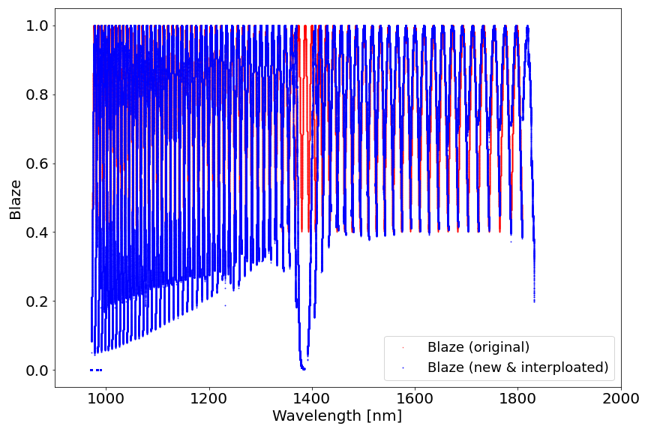
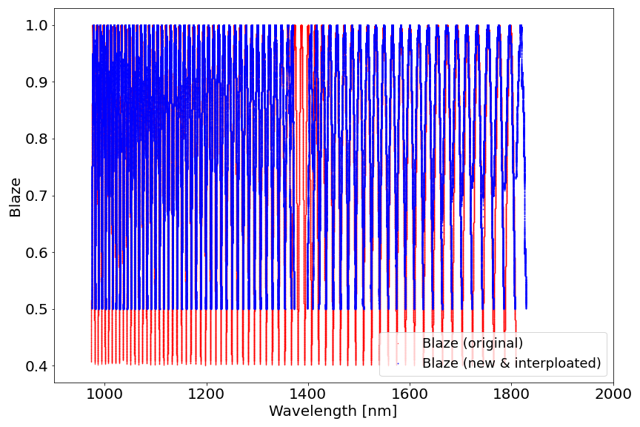
Total Spectral Range
Free Spectral Range
*rest of plots show values using TSR – can be switched to FSR in code update_effs.py

Slide 3
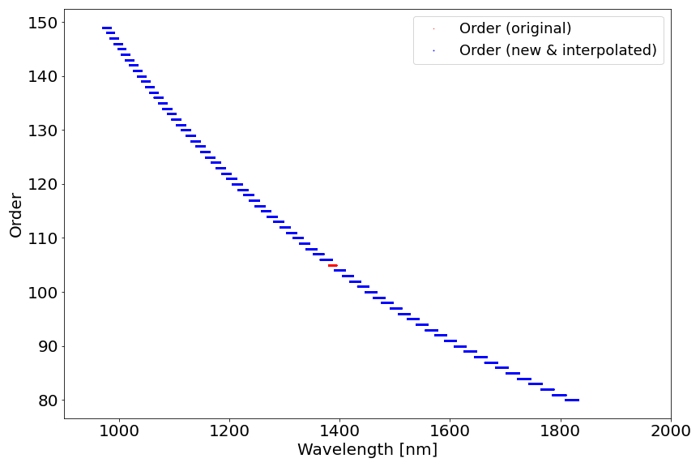

Slide 4
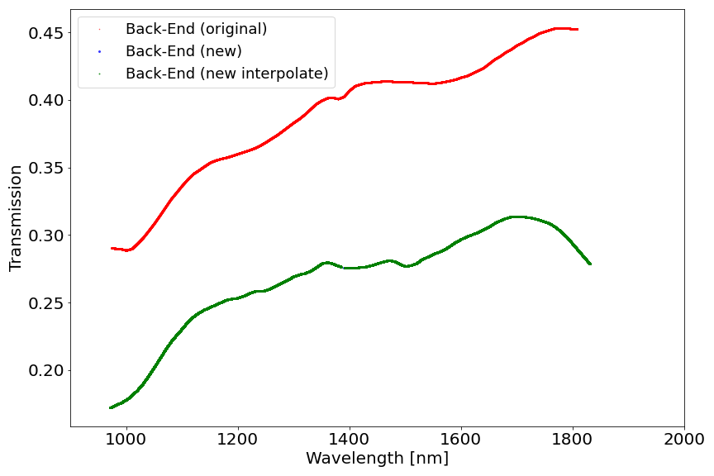

Slide 5
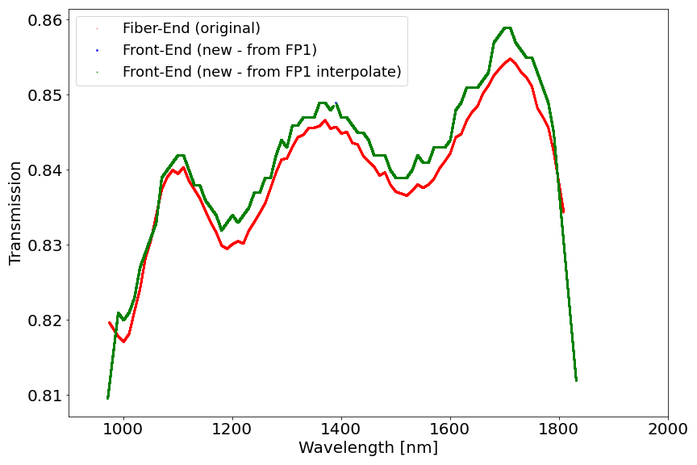

Slide 6
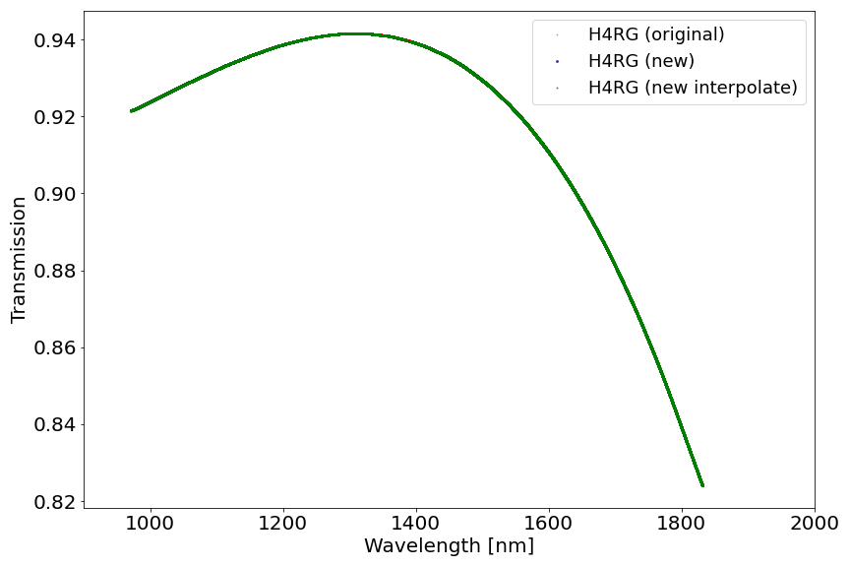

Slide 7
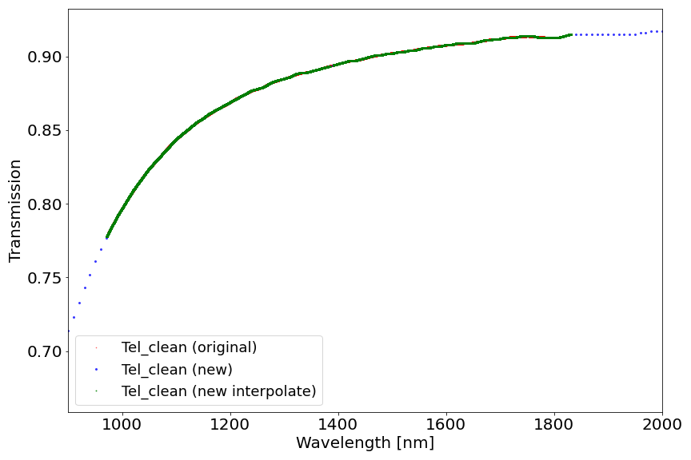

Slide 8
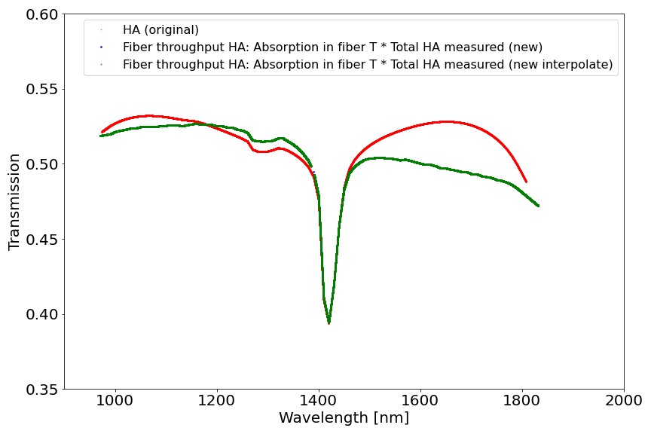

Slide 9
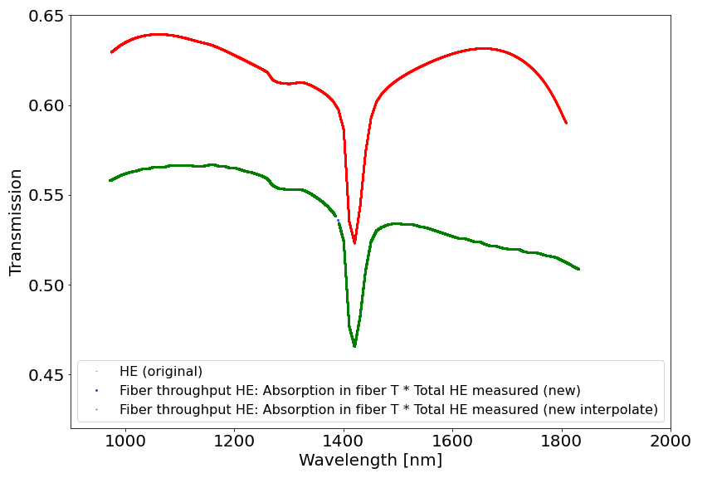

Slide 10
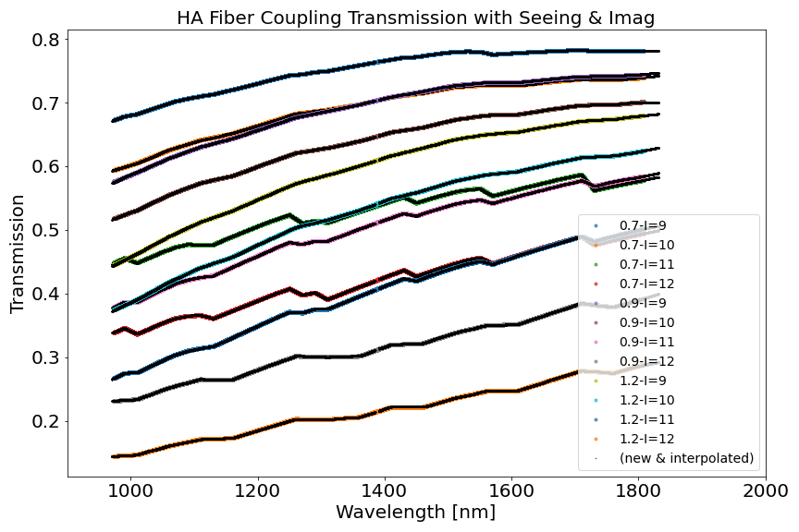

Slide 11
