Slide 1
The Science and Art of Video Games
By Nicholas Grogg

Slide 2
Background
Computer Science Major
Primary background is Linux, server work, systems programming
Pretty far away from games
Video games are a hobby
Have made games before
Nothing online currently
I work here

Slide 3
First thing you wanna do?

Slide 4
Picking a game genre
What do you want your game to be?
RPG, Simulation, etc.
For today’s program I made a side scrolling game
Helps keep project simple
Prevent feature creep
Helps with choosing a programming language

Slide 5
Once you have a design idea, what’s next?

Slide 6
Art design
Art design
Rough ideas
Helps make goals
Paper prototypes
Interactive diorama
Art programs
Photoshop? Krita? Paint?
2d? 3d?
Art style
Cartoony, realistic, etc.

Slide 7
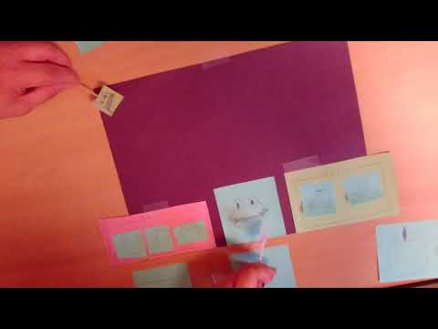
Paper prototype

Slide 8
Now that you have a game idea and an art style, what’s next?

Slide 9
Pick a programming language
Depending on age and skill level
Scratch, a beginner friendly language for kids
Python, a more forgiving programming language for those ready to start coding
Perfect for beginning programmers
HaxeFlixel, what today’s program was written in
Built for making video games, somewhat difficult to use
Java/C++, the big languages used for games
Minecraft was written in Java
C#, Very difficult to use but very powerful
DirectX
Unity, Unreal Engine

Slide 10
Next steps
Start programming and testing
This is the most difficult part
Debugging
This game, finish line wouldn’t load
This is the most tedious part
Very time consuming
Why a lot of games released now have patches
Or don’t work at launch

Slide 11
Publishing
Once game has been tested and is deemed stable enough, it can then be released
I currently don’t have anything active
Two main options for publishing your game
Game hosting sites
Kongregate or Newgrounds
Online stores
Steam, GOG

Slide 12
Part 2
Now we’re going to break into 5 groups and make art for a game
I made this game for this presentation
Has placeholder art
Each group will create a piece of art for the game

Slide 13
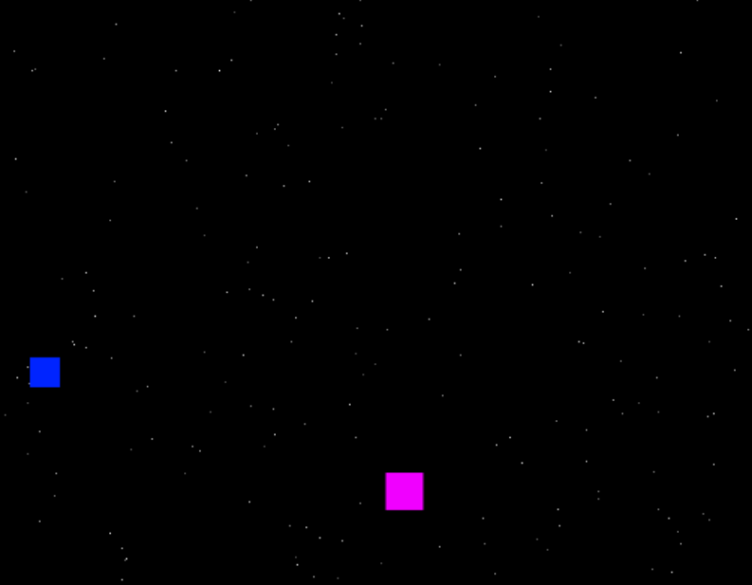
Placeholders
Placeholder squares
Used to test game mechanics
Object collision and such
Going to replace with group’s art
Then everyone gets to try the game
Part 3!

Slide 14
Questions?

