Slide 1
Technology Stack - XPS

Slide 2
Contents
WHY – Why we did this exercise
WHAT – What we did in this exercise
HOW – How we concluded

Slide 3

Why this exercise ?
Web Components V0
Polymer 1.x
Web Components V1
Polymer 3.x -> LitElement
Source: https://www.polymer-project.org/blog/2018-10-02-webcomponents-v0-deprecations

Slide 4
Why this migration is not same as Polymer 0.5x to Polymer 1.x ?
Polymer 1.x
Custom Elements v0
Shadow DOM V0
LitElement
Custom Elements V1
Shadow DOM v1
NO HTML Imports -> ES6 Module
HTML Imports
Two Way data binding
One Way Data Binding

Slide 5
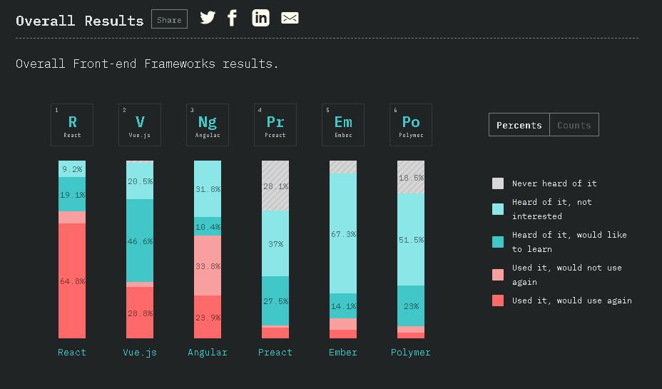
Source : https://2018.stateofjs.com/front-end-frameworks/overview/

Slide 6
LitElement
React
Angular

Slide 7
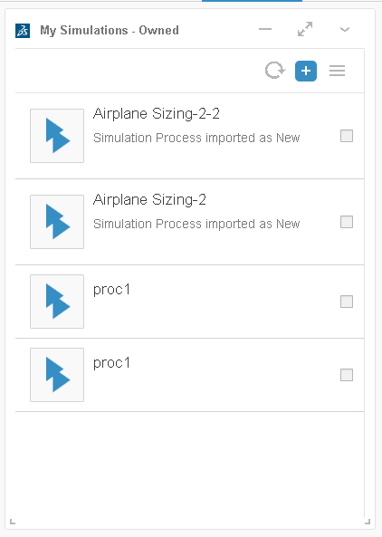
POC – Problem Statement
Create Something similar to My Simualtion widget

Slide 8

Angular POC
Source Code: \\vdevpriw175plp\Home\XPS_Shared\AngularDemo
Demo: https://vdevpril730plp.ux.dsone.3ds.com/3DSpace/webapps/SMAProcPSUI/sample-app/dist/Minimus/index.html
Pros:
1) Easy Setup
2) Inbuilt test framework for unit tests
3) Modular pattern for everything (everything pre defined to make module, util, service etc)
4) commands to generate boilerplate
5) Inbuilt compile and build using webpack
6) Ideal for fresh development
Cons:
1) Typescript dependency
2) Definitive approach on building things
3) Difficult to debug in IE
4) Integration with Redux is difficult

Slide 9

React POC
Source Code: \\vdevpriw175plp\Home\XPS_Shared\ReactDemo
Demo : https://vdevpril730plp.ux.dsone.3ds.com/3DSpace/webapps/SMAProcPSUI/sampleApp/build/index.html\
Pros
Very good support.
Good design patterns available
Component based – promotes reusability
Cons
Dependency on build tools due to JSX.
Doesn’t use native web components technology

Slide 10
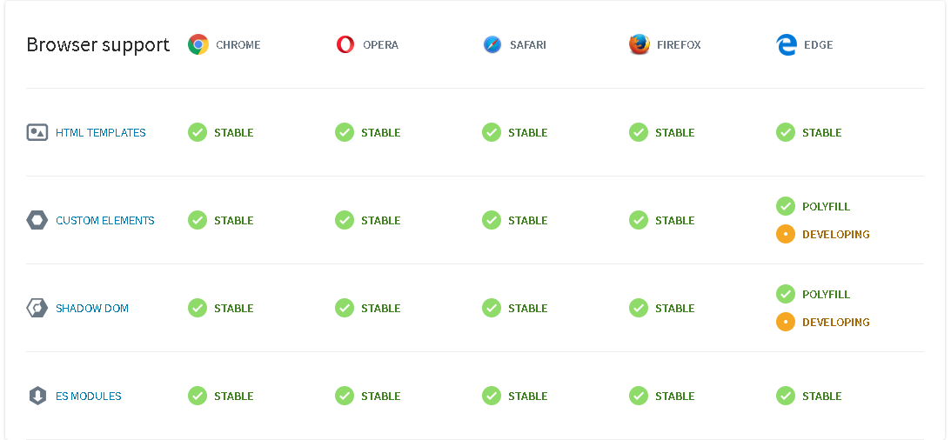
LitElement – Web components v1
Based on web components V1 Spec
Source : https://www.webcomponents.org/

Slide 11
Criteria to decide Library
Compatibility
Reusability
Community / Maturity
User Experience (Performance, Usability...)
Migration Effort
Backward compatibility
Guiding Principle: Do not dependency on any library unless it is actually required.

Slide 12
Angular or LitElement|React
Angular
It’s a full fledged framework
For every task there is a fix way
LitElement | React
It’s a library to create components
App can be architected in customized way
As a team we believe in creating whole app as reusable components. For us everything is component ( small or big , doesn’t matter). In the end whole app is also one component

Slide 13
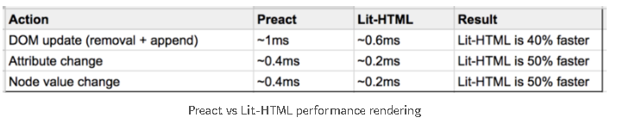
LitElement or React
React
Most popular library
Very good community support
Based on Virtual DOM
LitElement
Based on Web Components V1
Better rendering performance than React
Source: https://medium.com/@lucamezzalira/a-night-experimenting-with-lit-html-585a8c69892a

Slide 14
Why we choose LitElement
https://medium.com/@tjmonsi/why-did-i-chose-polymer-because-it-will-be-gone-3b5aff6d7416
Web Components provide a standard way to expose our components.
Currently we provide a way using which customers can create there own UI components and add to XS.
We will re-architect PS monitoring in same way, so that monitoring experience is also customizable.
The idea is try to create maximum number of pure web components. At least leaf level components should be pure.
No need to put UI less components as LitElement component. They can be simple class.

Slide 15
In short the idea of exposing everything as web component convinced us to go with LitElement.

Slide 16
Sources
https://gist.github.com/WebReflection/ab43649d9e4a53ac900b5924c77a310e
https://www.youtube.com/watch?v=uCHZJy2n8Qs

