Slide 1

Introduction to
NGS Technologies
Ignacio Medina
im411@cam.ac.uk
Head of Computational Biology Lab
HPC Service, University of Cambridge, UK
EMBL-EBI Scientific collaborator
Genome Campus, Hinxton, Cambridge, UK

Slide 2
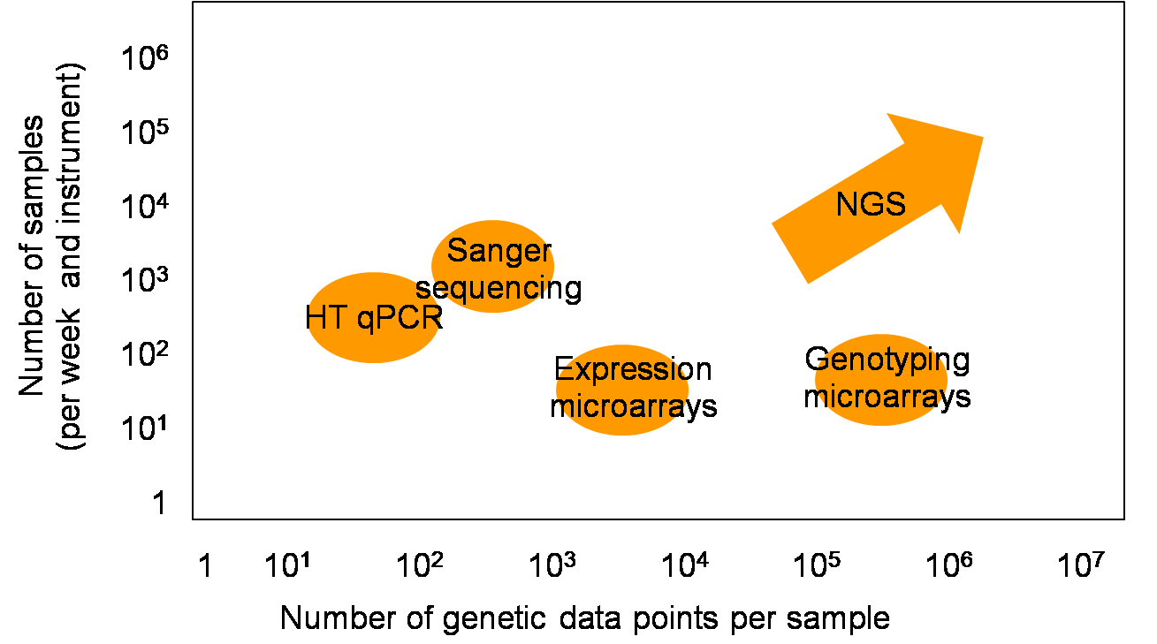
Relative throughput of the different HT technologies
NGS emerges with a potential of data production that will, eventually wipe out conventional HT technologies in the years coming
Too many sequences to be handled
in a standard computer
Notes:
02/04/12

Slide 3
 | Sanger (1st-gen) Sequencing | Next-Gen Sequencing, and 3rd generation
Whole Genome | Human (early drafts), model organisms, bacteria, viruses and mitochondria (chloroplast), low coverage | New human (!), individual genome, exomes, 2,500 normal (1K genome project), 25,000 cancer (TCGA and ICGC initiatives), CNV, matched control pairs, time course, rare-samples
RNA | cDNA clones, ESTs, Full Length Insert cDNAs, other RNAs | RNA-Seq: Digitization of transcriptome, alternative splicing events, miRNA, allele specific transcripts
Communities | Environmental sampling, 16S RNA populations, ocean sampling, | Human microbiome, deep environmental sequencing, Bar-Seq
Other |  | Epigenome, rearrangements, ChIP-Seq
Notes:
02/04/12

Slide 4





NGS technologies
Cost-effective
Fast
Ultra throughput
Cloning-free
Short reads
Notes:
01/30/12

Slide 5
Differences between the various platforms:
Nanotechnology used.
Read length
Chemistry and enzymology.
Signal to noise detection in the software
Software/images/file size/pipeline
Cost
Applications
Notes:
02/04/12

Slide 6
Similarities- LOTS of DATA
General ways of dealing at the sequences
Assemble them and look at what you have
You map them (align against a known genome) and then look at what you have.
Or a mixture of both!
Sometimes you select the DNA you are sequencing
or you try to sequence everything
Depends on biological question, sequencing machine you have, and how much time and money you have.
NGS is relatively cheap but think what you want to answer, because the analysis won’t do magic
Notes:
02/04/12

Slide 7
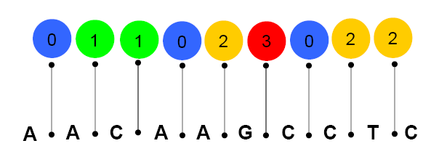
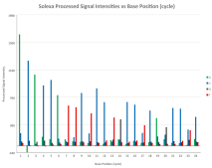
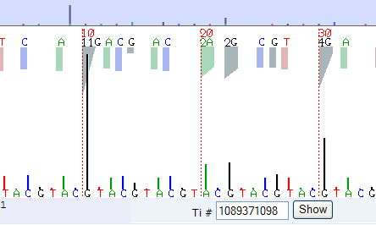

Next-gen sequencers
From John McPherson, OICR
Illumina/HiSeq short-read sequencers 10-600Gb, 150/150 bp, 11 days
100 Gb
bases per
machine run
AB/SOLiD5500, 200+Gb,75/35 bp reads, 10 days
10 Gb
1 Gb
Roche 454 GS FLX+ 2.8
(0.2-1Gb in 800-1000 bp reads,
1M reads, 20 hours)
100 Mb
10 Mb
ABI capillary sequencer
(0.04-0.08 Mb in 450-800 bp reads,
96 reads, 1-3 hours)
1 Mb
10 bp
100 bp
1,000 bp
read length
Notes:
02/04/12
Very different types of data. Different run times. Different costs

Slide 8
Next Generation Sequencers
In the past 3 main platforms:
- Solexa/illumina
- Roche 454
- ABI SOLiD
  Follow an approach similar to Sanger sequencing, but do away with separation of fragments by size and “read” the sequence as the reaction occurs
  Several different “next generation” sequencing platforms developed and commercialized, more on the way.
  Simultaneously sequence entire libraries of DNA sequence fragments
Notes:
02/04/12

Slide 9
454 (Roche)
First next generation method to be commercially available
Uses a “sequencing by synthesis” (SBS) approach:
    DNA is broken into pieces of 500-1,400 bp, ligated to adaptors, and amplified on tiny beads by PCR (emulsion PCR)
    Beads (with DNA attached) are placed into tiny wells (one bead per well) on a PicoTiter Plate that has millions of wells. Each well is connected to an optical fibre.
    DNA is sequenced by adding polymerase and DNA bases containing pyrophosphate. The different bases (A,C,G,T) are added sequentially in a flow chamber
    When a base complementary to the template is added, the pyrophosphate is released and a burst of light is produced
    The light is detected and used to call the base
- Initially 100-150 bp, but they have been improved to 600-1000 bp
- >1 million, filter-passed reads per run (20 hours)
- 1 billion bases per day
Notes:
02/04/12

Slide 10
Roche 454: GS FLX System
Good for
    “de novo“ sequencing (longer reads)
    Resequencing (expensive)
    New bacterial genomes.
    Amplicons
Pyrosequencing. Bias with long polinucleotide streches
Notes:
02/04/12

Slide 11
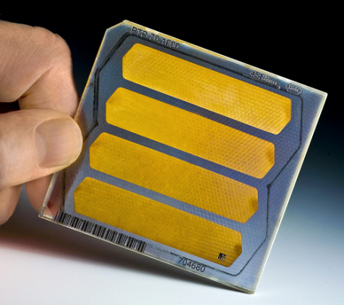
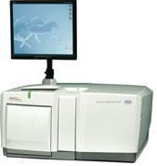
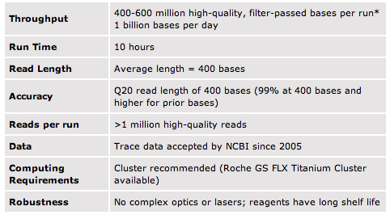
Roche 454 GS FLX
Notes:
01/30/12

Slide 12
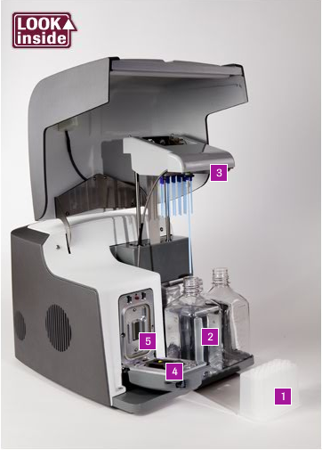
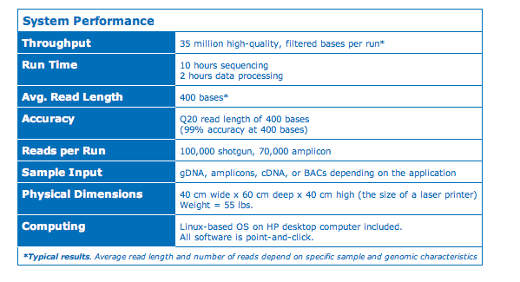
GS Junior, benchtop
Notes:
01/30/12

Slide 13
Illumina
Over 90% of all sequencing data is produced on Illumina systems.
Uses a “sequencing by synthesis” approach:
    DNA is broken into small fragments and ligated to an adaptor.
    The fragments are attached to the surface of a flow cell and amplified.
    DNA is sequenced by adding polymerase and labeled reversible terminator nucleotides (each base with a different color).
    The incorporated base is determined by fluorescence.
    The fluorescent label is removed from the terminator and the 3’ OH is unblocked, allowing a new base to be incorporated
Started with 35 bp, increased now to up to 150 bp
One run can give up to 10-600 Gb, 300-6000 million paired-end reads
75-85% of bases at or above Q30
Notes:
02/04/12

Slide 14
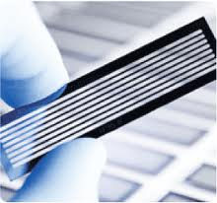
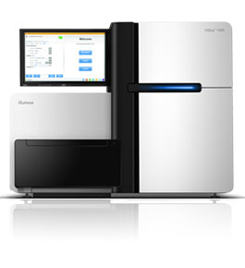
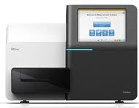
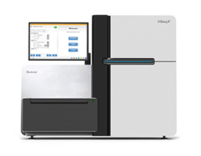
Illumina HiSeq 2500
Illumina Systems
Illumina MiSeq
600 Gb/run in 11 days
2x100 bp fragments
3-6 billion reads per run
175-245 Mb 4h 1x 36bp
1.5-2.0 Gb 27h 2x150 bp
Illumina HiSeq X Ten
1800 Gb/run in <3 days
2x150 bp fragments
6 billion reads per run
Consists of a set of 10 HiSeq X ultra-high-throughput instruments that deliver over 18,000 human genomes per year at the price of $1000 per genome.
Notes:
01/30/12

Slide 15
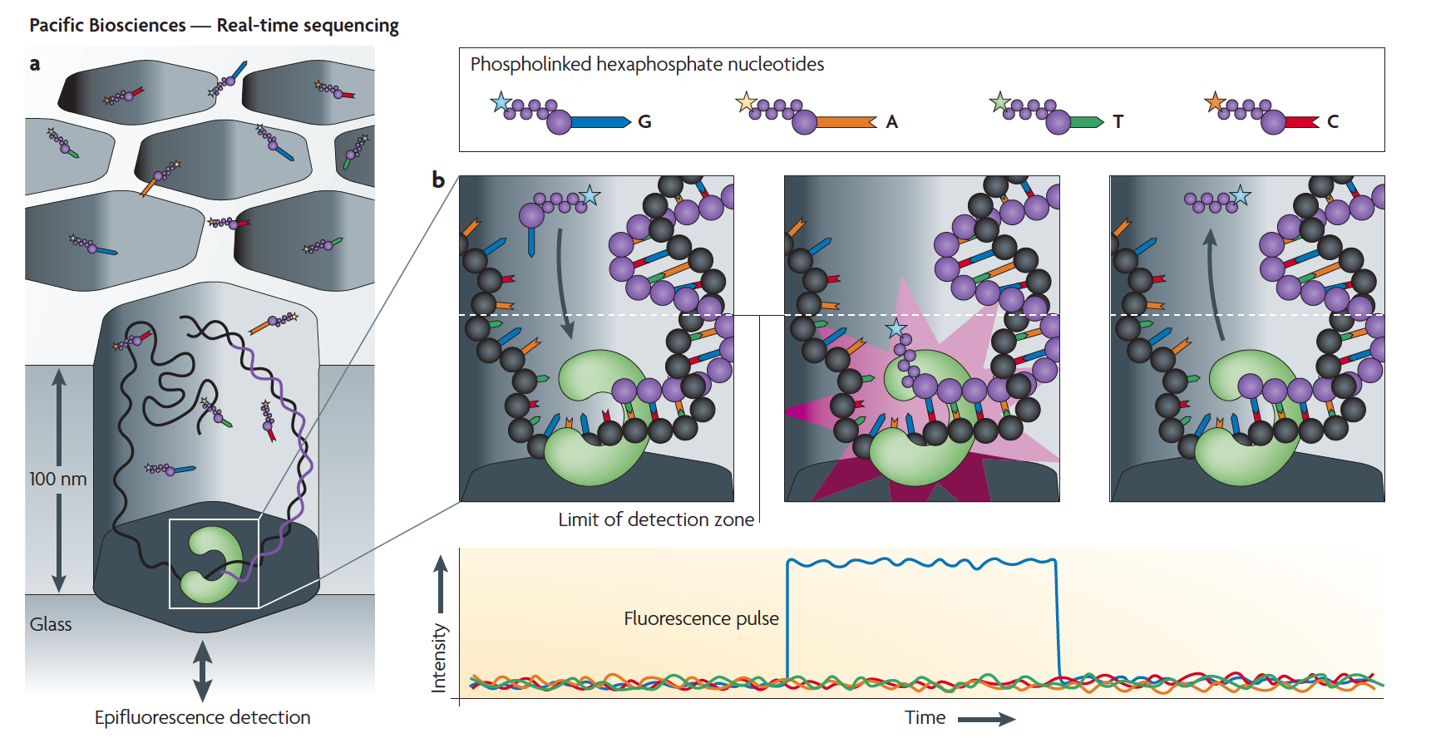
PacBio
From Michael Metzker, http://view.ncbi.nlm.nih.gov/pubmed/19997069
Notes:
02/04/12

Slide 16
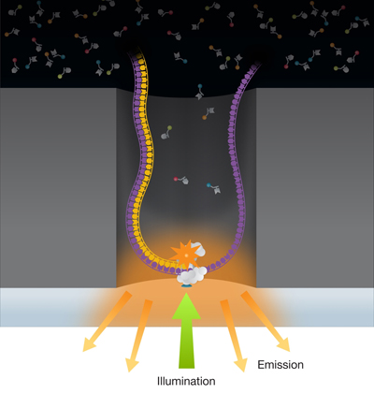
Pacific
Bioscience
SMRT: Singel Molecule Real time DNA synthesis
Up to 12000 nt
50 bases/second
ZMW: Zero Mode Waveguide
Notes:
01/30/12

Slide 17
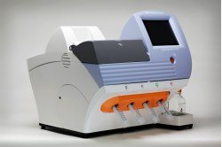
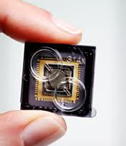
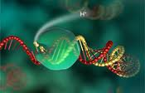
Ion Torrent
$ 50.000
$ 500 /sample
1 hour/run
> 200 nt lengths
Reads H+ released by DNA polymerase
Notes:
01/30/12

Slide 18
Comparison
Roche 454
Illumina
SOLiD
Long fragments
Errors: poly nts
Low throughput
Expensive
De novo sequencing
Amplicon sequencing
RNASeq
Short fragments
Errors: Hexamer bias
High throughput
Cheap
Resequencing
De novo sequencing
ChipSeq
RNASeq
MethylSeq
Short fragments
Color-space
High throughput
Cheap
Resequencing
ChipSeq
RNASeq
MethylSeq
Notes:
01/30/12

Slide 19
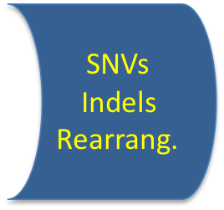
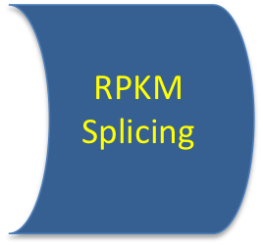
Basic steps NGS data processing
QC and
read cleaning
Mapping
Feature
identification
Notes:
01/30/12

Slide 20
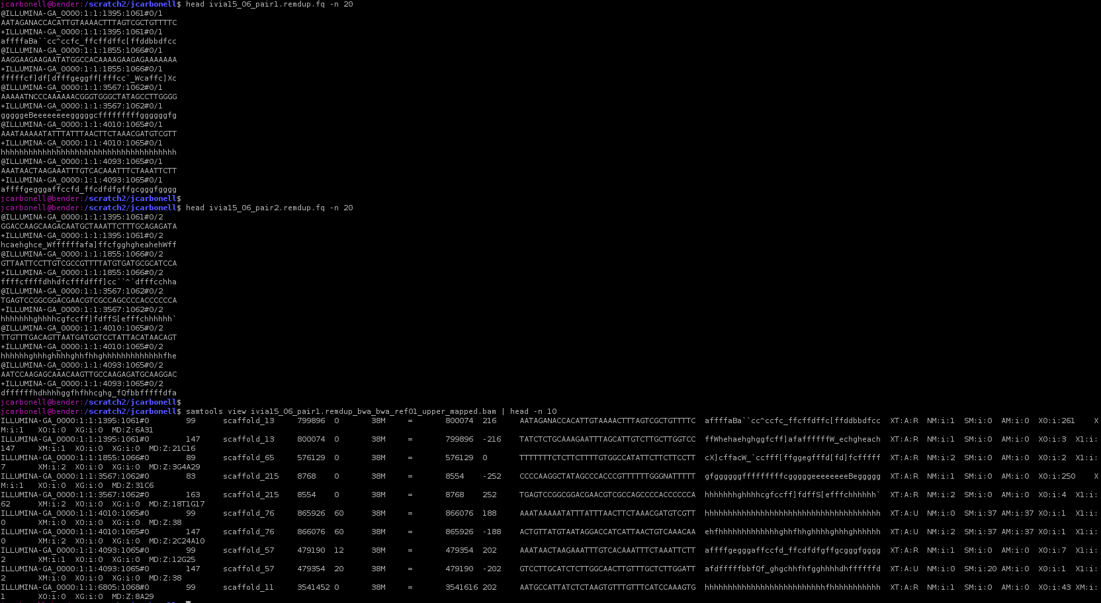
File formats
fastq: sequence data and qualities
SAM/BAM: mapping data and qualities
Notes:
01/30/12

Slide 21
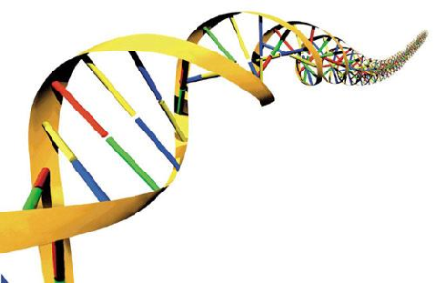
Most common applications of NGS
Resequencing
Mutation calling
Profiling
Genome annotation
RNA-seq /Transcriptomics
Quantitative
Descriptive
Alternative splicing
miRNA profiling
De novo sequencing
Exome sequencing
Targeted sequencing
ChIP-seq /Epigenomics
Protein-DNA interactions
Active transcription factor binding sites
Histone methilation
Copy number variation
Metagenomics
Metatranscriptomics
Notes:
02/04/12

Slide 22
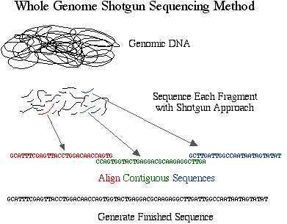
DNA sequencing - 1
Whole GENOME Resequencing
  Need reference genome
  Variation discovery

Slide 23
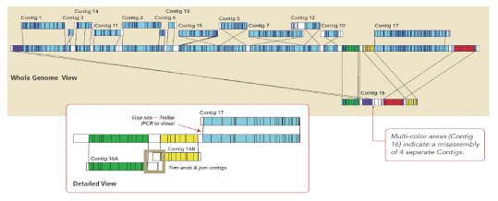
DNA sequencing - 2
Whole GENOME “de novo” sequencing
  Uncharacterized genomes with no reference genome available
  known genomes where significant structural variation is expected.
  Long reads or mate-pair libraries. Sequencing mostly done by Roche 454 and also Illumina.
  Assembly of reads is needed: Computational intensive
  E.g. Genome bacteria sequencing

Slide 24
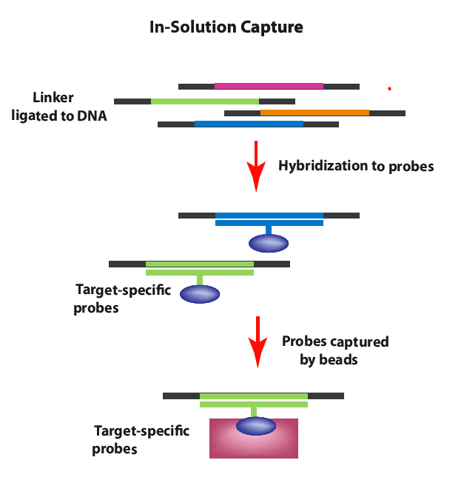
DNA sequencing - 3
Whole EXOME Resequencing
  Need reference genome
    Available for Human and Mouse
  Variation discovery on ORFs
    2% of human genome (lower cost)
    85% disesease mutation are in the exome
  Need probes complementary to exons
    Nimblegen
    Agilent
E.g. Human exome

Slide 25
DNA sequencing - 4
Targeted Resequencing
  Capture of specific regions in the genome
Custom genes panel sequencing
  Allows to cover high number of genes related to a disease
  E.g. Disease gene panel
Low cost and quicker than capillary sequencing
Multiplexing is possible
Need custom probes complementary to the genomic regions
  Nimblegen
  Agilent

Slide 26
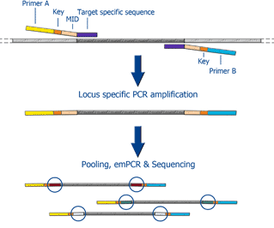
DNA sequencing - 5
Amplicon sequencing
  Sequencing of regions amplified by PCR.
  Shorter regions to cover than targeted capture
  No need of custom probes
  Primer design is needed
  High fidelity polymerase
  Multiplexing is needed
E.g. P53 exon amplicon sequencing

Slide 27
Transcriptomics - 1
RNA-Seq
  Sequencing of mRNA
  rRNA depleted samples
  Very high dynamic range
  No prior knwoledge of expressed genes
  Gives information about (richer than microarrays)
    Differential expression of known or unknown transcripts during a treatment or condition
    Isoforms and
    New alternative splicing events
    Non-coding RNAs
    Post-transcriptional mutations or editing,
    Gene fusions.

Slide 28
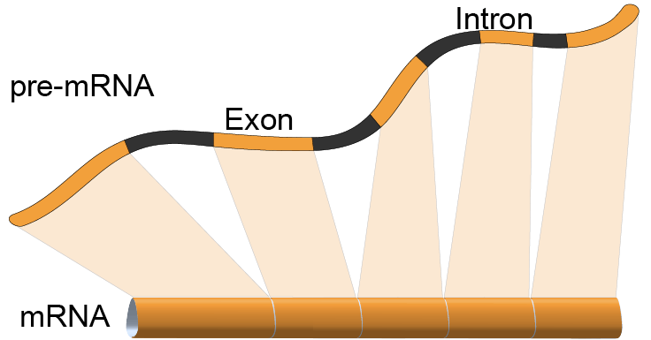
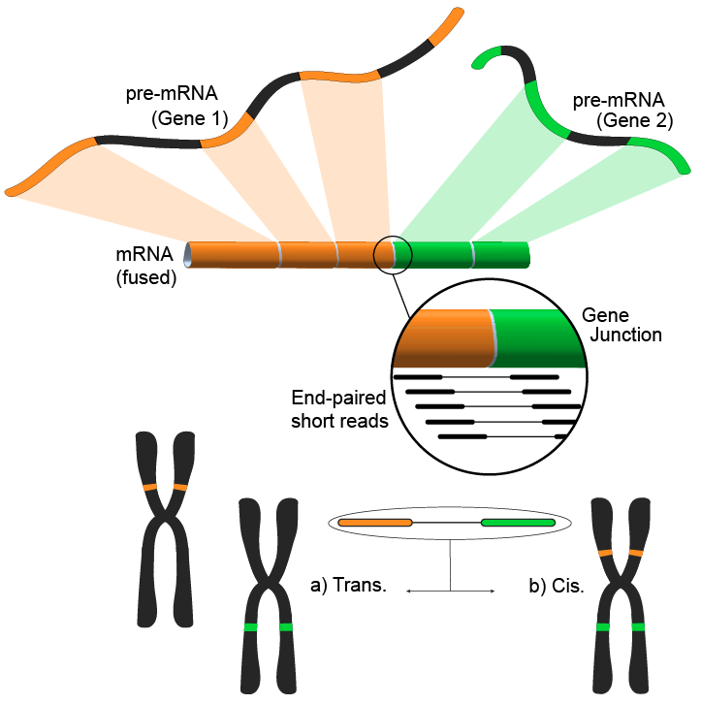
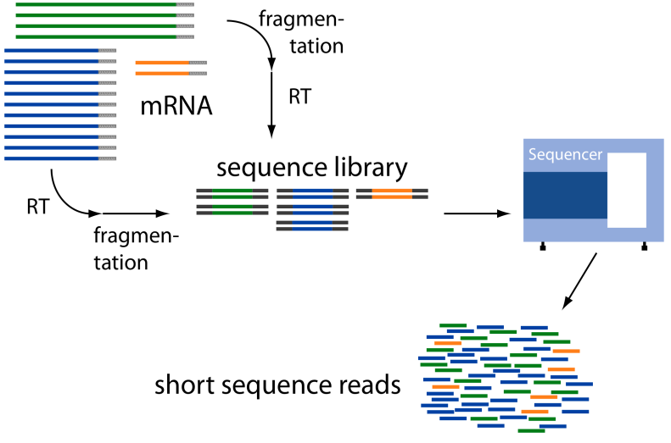
Transcriptomics - 2
RNA-Seq
  Sequencing of mRNA
  Detecting gene fusions

Slide 29
Applications of RNAseq
Qualitative:
* Alternative splicing
* Antisense expression
* Extragenic expression
* Alternative 5’ and 3’ usage
* Detection of fusion transcripts
….
Quantitative:
* Differential expression
* Dynamic range of gene expression
….
Tophat/Cufflinks
Scripture
Alexa
edgeR
DESeq
baySeq
NOISeq
Notes:
01/30/12

Slide 30
Advantages of RNAseq?
RNAseq
microarrays
* Non targeted transcript detection
* No need of reference genome
* Strand specificity
* Find novels splicing sites
* Larger dynamic range
* Detects expression and SNVs
* Detects rare transcripts
….
* Restricted to probes on array
* Needs genome knowledge
* Normally, not strand specific
* Exon arrays difficult to use
* Smaller dynamic range
* Does not provide sequence info
* Rare transcripts difficult
….
and…. are there any disadvantages?????
Notes:
01/30/12

Slide 31
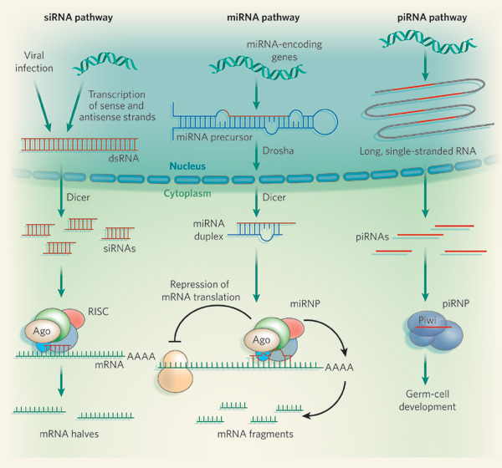
Transcriptomics - 3
miRNA/small nonCoding RNA sequencing
  RNA Size selection step
    18-40 bp
  Profiling of known miRNAs
  miRNA discovery

Slide 32
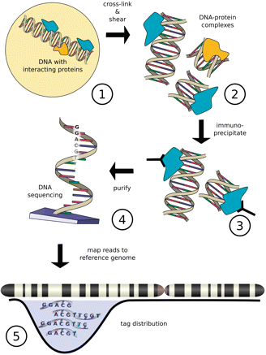
TFBS detection
ChIP-Seq
  Identification of genomic region for gDNA binding proteins:
    Transcription Factor binding site detection

Slide 33
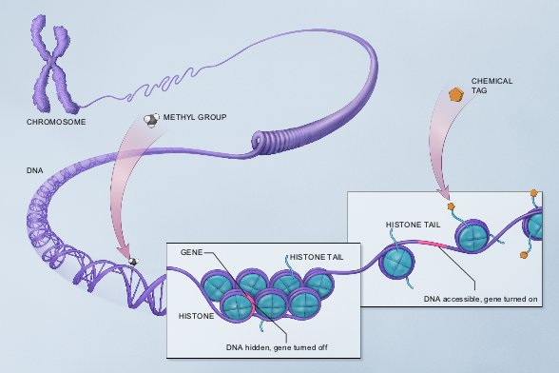
Epigenomics - I
Epigenomics refers to functionally relevant modifications to the genome that do not involve a change in the nucleotide sequence
  Play a role in turning genes off or on
Epigenomic Marks.
Methyl groups attach to the backbone of a DNA molecule.
A variety of chemical tags attach to the tails of histones. This action affects how tightly DNA is wound around the histones.
ChIP-Seq: Histone methylation detection

Slide 34
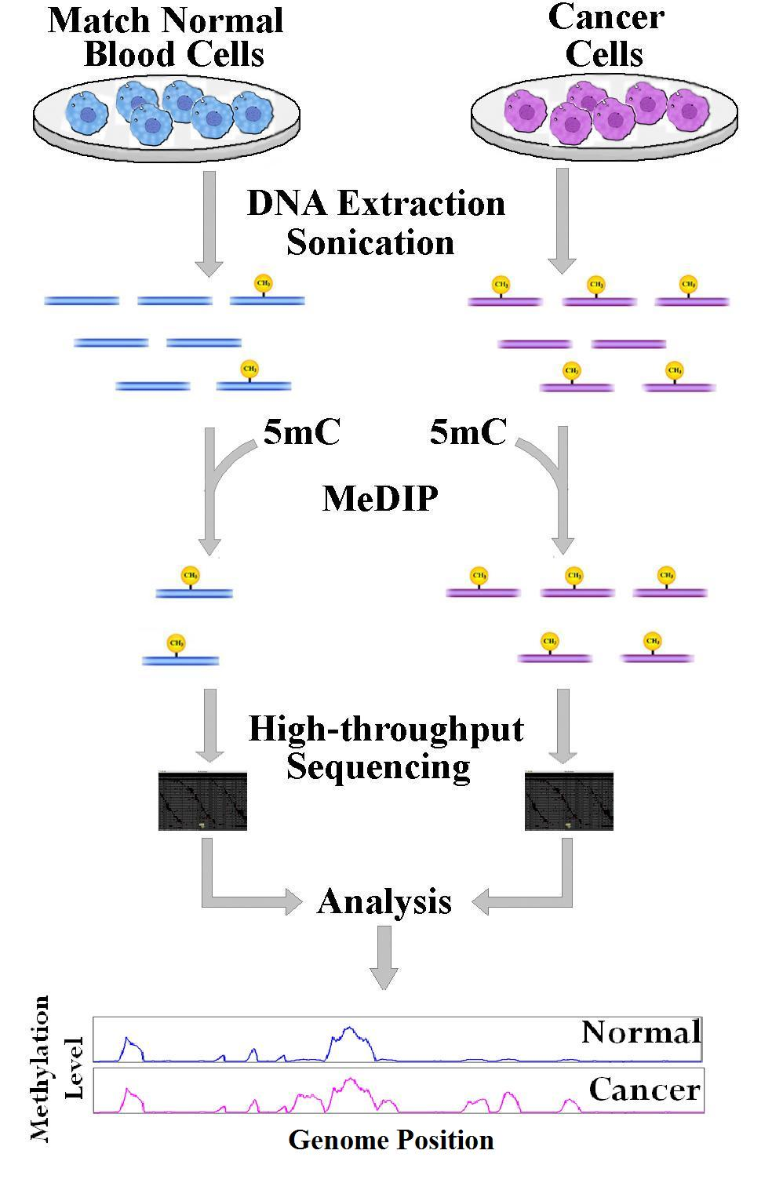
Epigenomics - 2
Methyl-Seq
  CpG island methylation
  Bisulfite sequencing-based method
> E.g. Cancer studies.
    Different degree of chromatin methylation affects expression of genes

Slide 35
New huge projects coming
Notes:
01/30/12

Slide 36
Many big projects during the last years:
  ENCODE http://genome.ucsc.edu/ENCODE/
  1000 Genomes projects http://www.1000genomes.org/
  ICGC http://icgc.org/
  ...
New projects coming soon:
  BRIDGE https://bridgestudy.medschl.cam.ac.uk/index.shtml
  Genomics England (http://www.genomicsengland.co.uk/) will produce tens of PB of data (1PB == 1000TB)
Notes:
01/30/12

Slide 37
Successful NGStories
Notes:
01/30/12

Slide 38
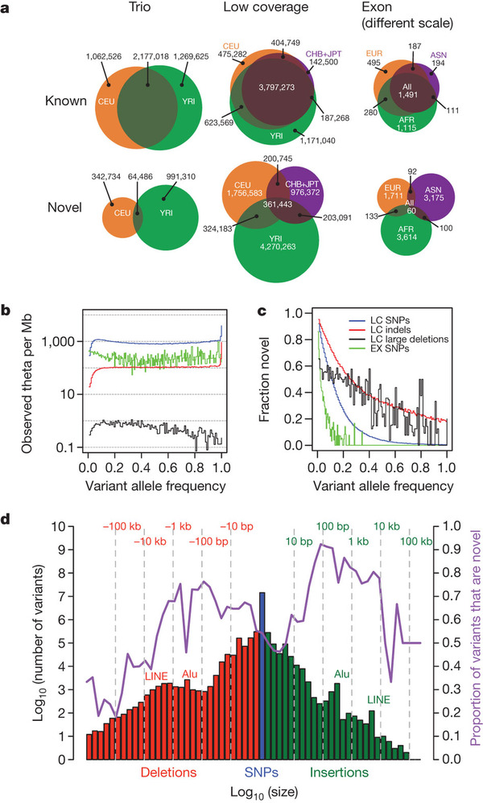
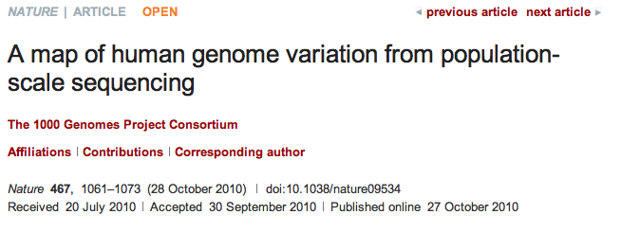
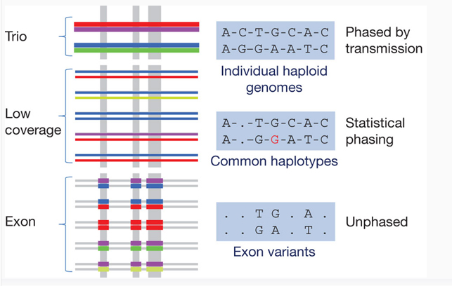
Notes:
01/30/12

Slide 39
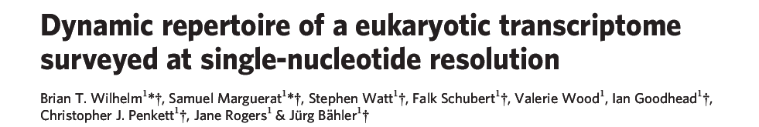
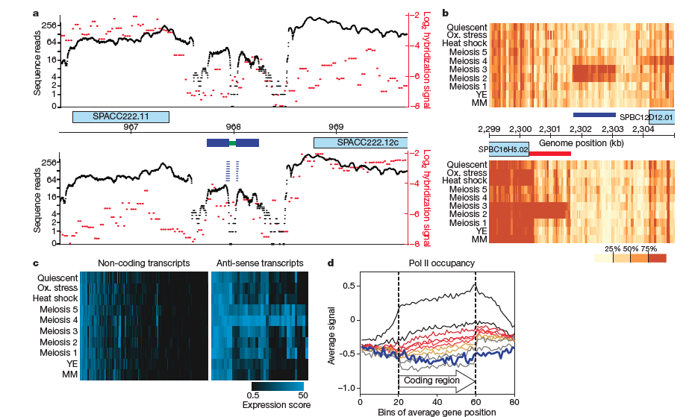
Notes:
01/30/12

Slide 40
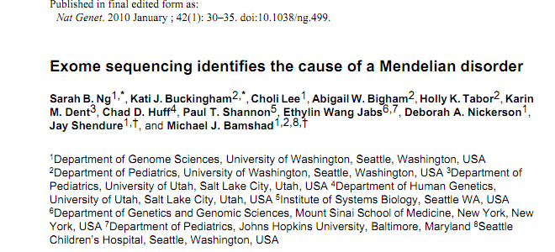
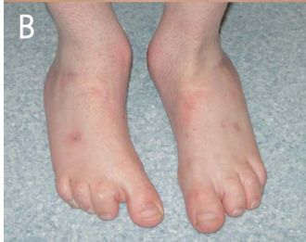
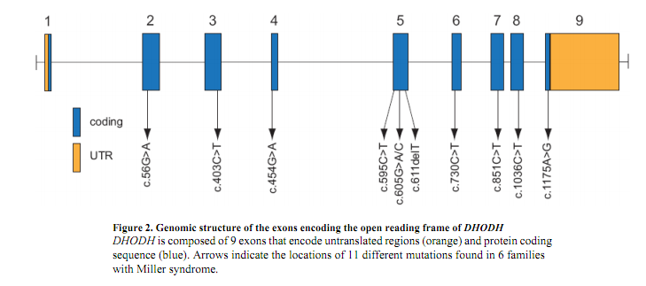
Miller syndrome
Notes:
01/30/12

Slide 41
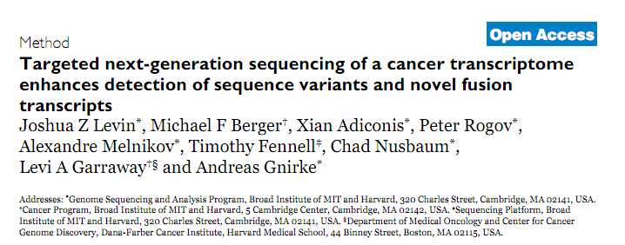
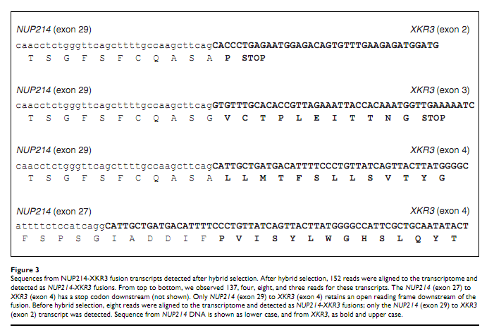
Notes:
01/30/12

Slide 42
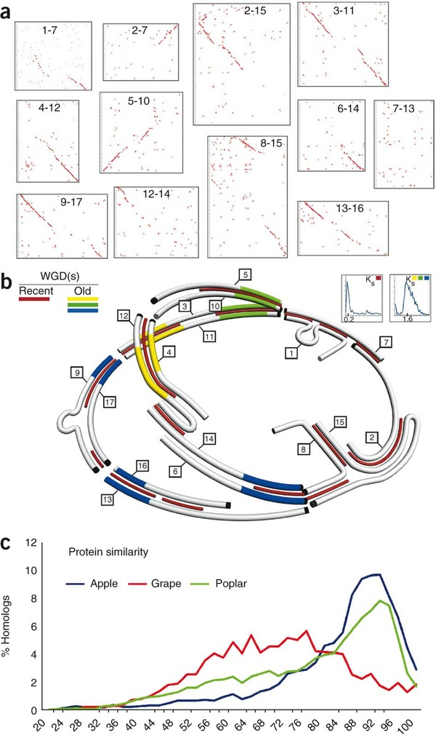
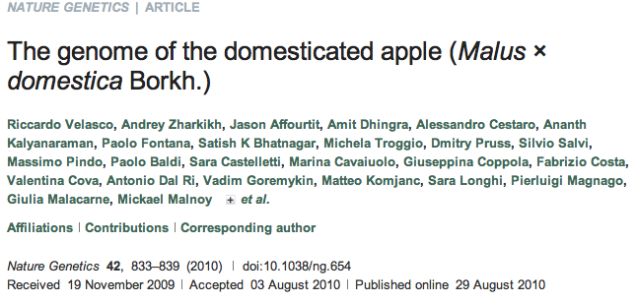
Notes:
01/30/12

Slide 43
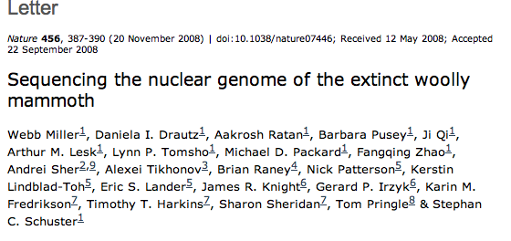
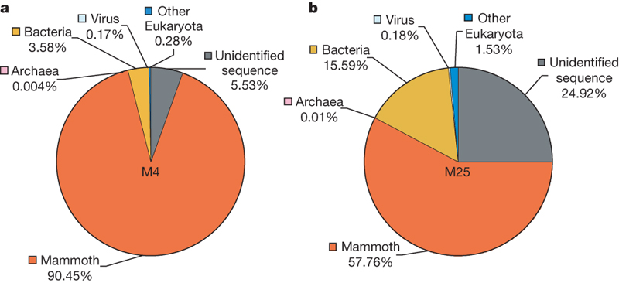

Species composition of metagenomic DNA
extracted from mammoth hair
Notes:
01/30/12

Slide 44
Not that easy, some challenges

Slide 45
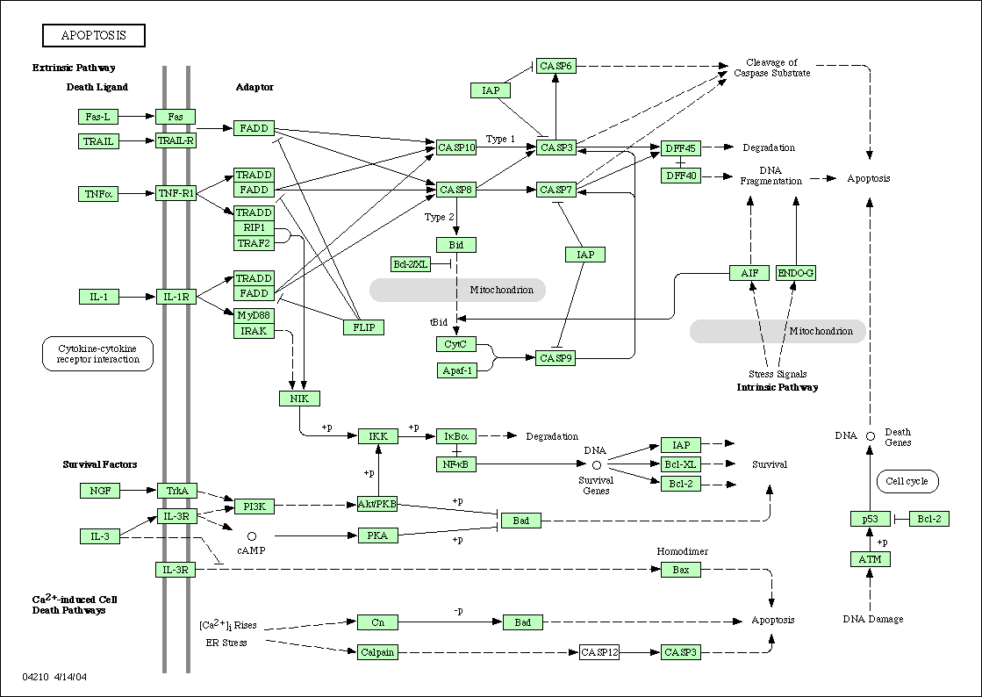
Secondary analysis:
Finding the mutations causative of diseases
The simplest case: monogenic disease due to a single gene
A
C
B
D
E
Controls
Cases

Slide 46
The principle: comparison of patients (or families) and reference controls
mutation
Patient 1
Patient 2
Patient 3
Control 1
Control 2
Control 3
candidate gene (shares mutation for all patients but no controls)

Slide 47
Is this approach realistic?
Can we detect such rare variants so easily?
Interrogating 50Mb produces too many variants
In many cases we are not hunting new but known variants
Same phenotype can be due to different mutations and different genes

Slide 48
Filtering with multiple family information
 | Families
 | 1 | 2 | 3 | 4 | 5 | 6
Variants | 3403 | 82 | 4 | 0 | 0 | 0
Genes | 2560 | 331 | 35 | 8 | 1 | 0
Problem: how to prioritize putative candidate genes

Slide 49
Clear individual gene associations are difficult to find in some diseases
Controls
Cases
They can have different mutations (or combinations).
Many cases have to be used to obtain significant associations to many markers.
The only common element is the pathway (yet unknow) affected.

Slide 50
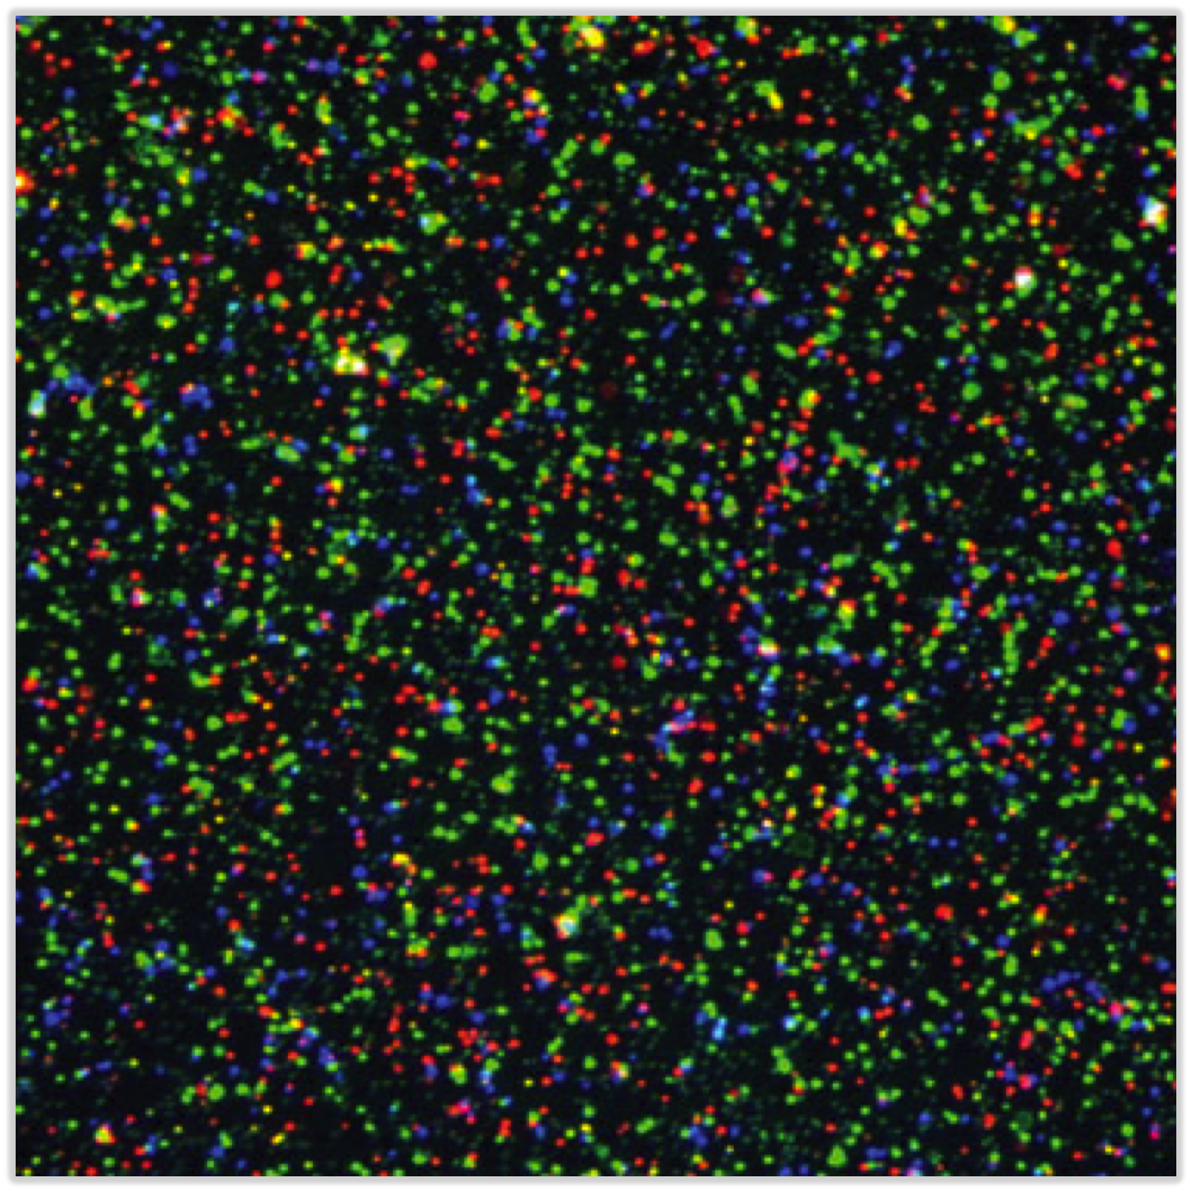
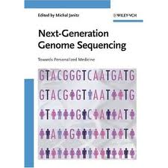
Conclusions
NGS is revolutionizing how we do genome research
But it will also revolutionize our lives….
If we manage to process and analyze ALL the DATA
Notes:
01/30/12

