Slide 1

Variant calling
Detecting variants in NGS data
The Genome Analysis ToolKit (GATK)
Edinburgh Genomics
Edinburgh, UK
23rd October 2015

Slide 2
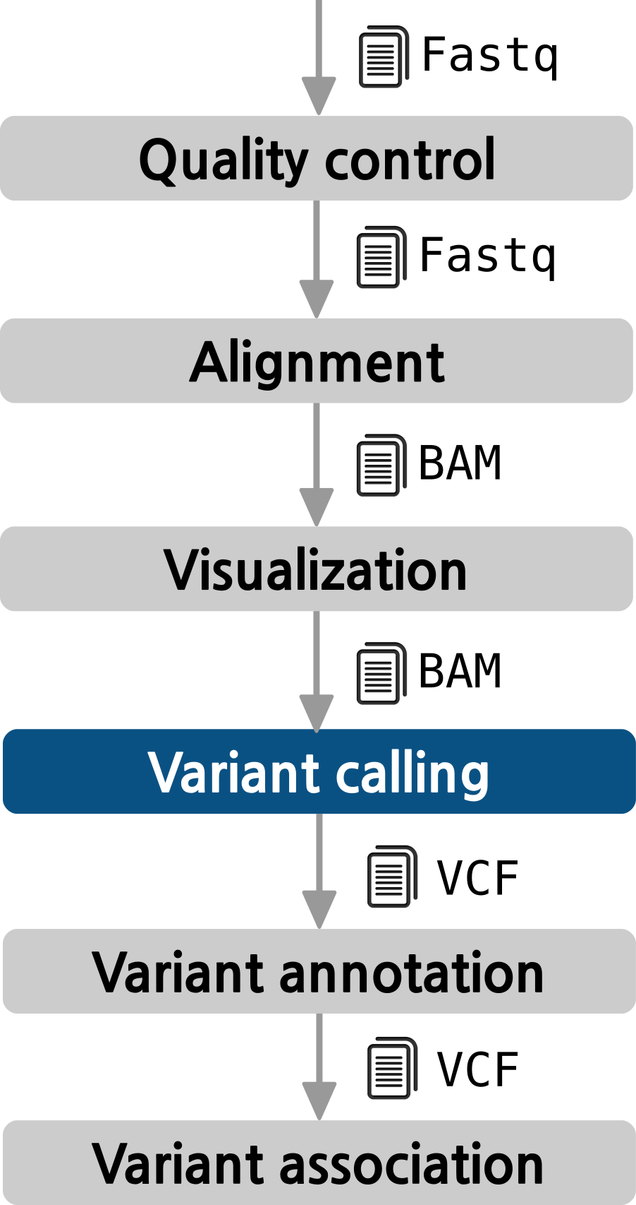
The pipeline

Slide 3
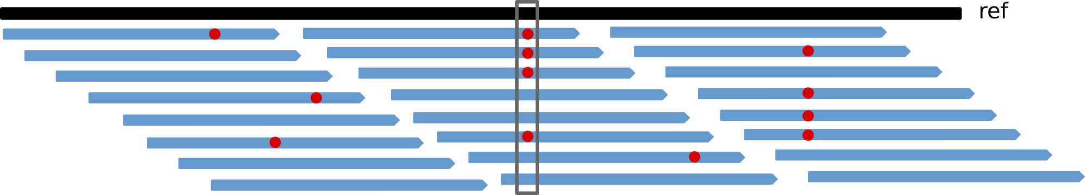
Objective
Assign a genotype to each position
Problems
Some variation observed in BAM files is caused by mapping and sequencing artifacts:
PCR artifacts:
  Mismatches due to errors in early PCR rounds
  PCR duplicates
Sequencing errors: erroneous call, either for physical reasons or to properties of the sequenced DNA
Mapping errors: often happens around repeats or other low-complexity regions
Separate true variation from machine artifacts
Notes:
PCR artefacts. Many NGS methods involve one ore multiple PCR steps. PCR errors will show as mismatches in the alignment, and especially errors in early PCR rounds will show up in multiple reads, falsely suggesting genetic variation in the sample. A related error would be PCR duplicates, where the same read pair occurs multiple times, skewing coverage calculations in the alignment.
Sequencing errors. The sequencing machine can make an erroneous call, either for physical reasons (e.g. oil on an Illumina slide), or due to properties of the sequenced DNA (e.g., homopolymers). As sequencing errors are often random, they can be filtered out as singleton reads during variant calling.
Mapping errors. The mapping algorithm can map a read to the wrong location in the reference. This often happens around repeats or other low-complexity regions.

Slide 4
Variant calling process pipeline
Mark duplicates
  Duplicates should not be counted as additional evidence
Local realignment around INDELS
  Reads mapping on the edges of INDELS often get mapped with mismatching bases introducing false positives
Base quality score recalibration (BQSR)
  Quality scores provided by sequencing machines are generally inaccurate and biased
Variant calling
  Discover variants and their genotypes

Slide 5
1. Mark duplicates
The same DNA molecule can be sequenced several times during PCR
Not informative
Not to be counted as additional evidence for or against a putative variant
Can result in false variant calls
Tools
Samtools: samtools rmdup
Picard: MarkDuplicates
Notes:
DNA molecules can be sequenced several times.
Duplicate reads are not informative and should not be counted as additional evidence for or against a putative variant.
The duplicate marking process identifies these reads as such so that the GATK tools know they should ignore them.
These steps are performed with tools such as Samtools or Picard. The preferred option is Picard although it is slower than Samtools since it can handle inter chromosomal changes.

Slide 6
1. Mark duplicates
The same DNA molecule can be sequenced several times during PCR
Not informative
Not to be counted as additional evidence for or against a putative variant
Can result in false variant calls
Tools
Samtools: samtools rmdup
Picard: MarkDuplicates
Notes:
DNA molecules can be sequenced several times.
Duplicate reads are not informative and should not be counted as additional evidence for or against a putative variant.
The duplicate marking process identifies these reads as such so that the GATK tools know they should ignore them.
These steps are performed with tools such as Samtools or Picard. The preferred option is Picard although it is slower than Samtools since it can handle inter chromosomal changes.

Slide 7
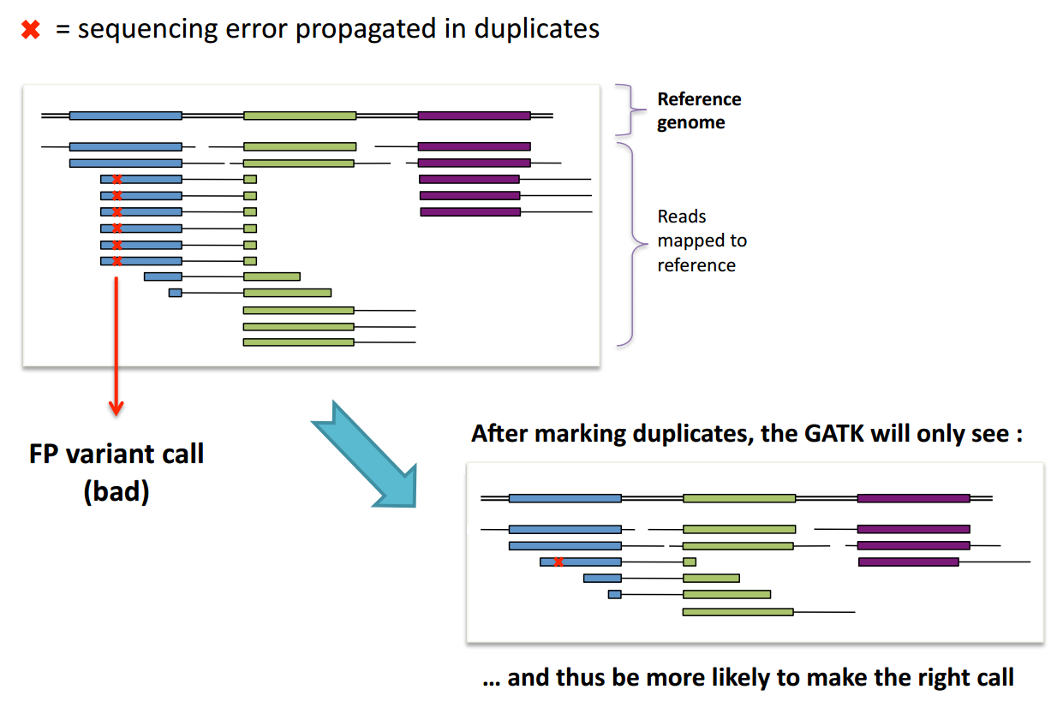
1. Mark duplicates
The reason why duplicates are bad

Slide 8
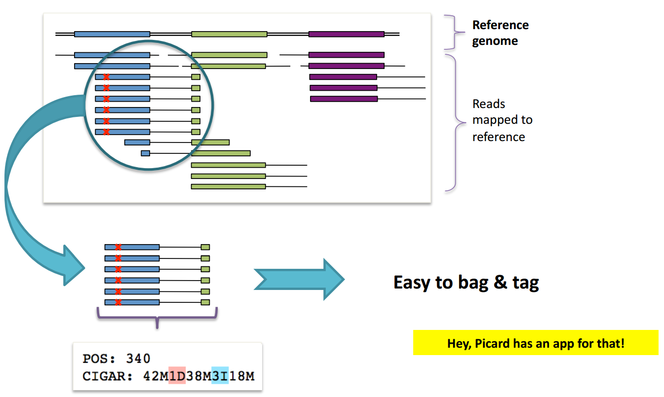
1. Mark duplicates
Duplicate identification
Duplicates have the same starting position and the same CIGAR string
Notes:
DNA molecules can be sequenced several times.
Duplicate reads are not informative and should not be counted as additional evidence for or against a putative variant.
The duplicate marking process identifies these reads as such so that the GATK tools know they should ignore them.
These steps are performed with tools such as Samtools and Picard that are not part of GATK, so we don't provide detailed documentation of all the options available. For more details, please see those tools' respective documentations.

Slide 9
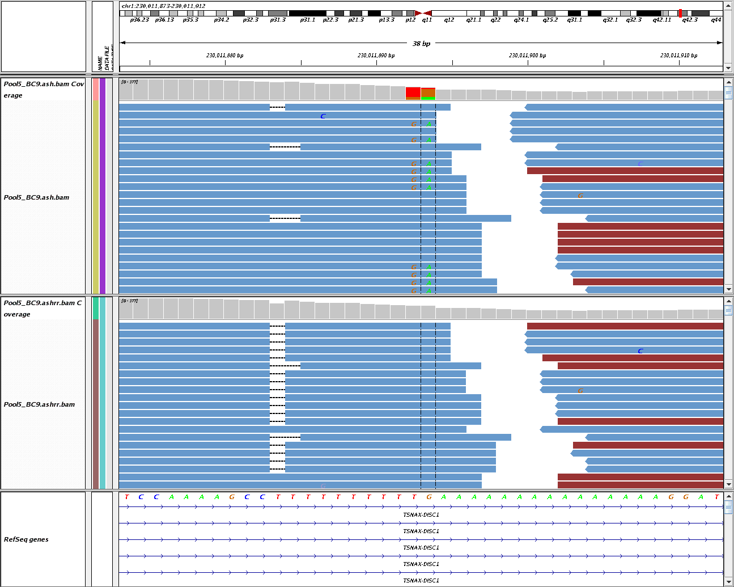
2. Local realignment around INDELS
Reads near INDELS are mapped with mismatches
Realignment can identify the most consistent placement for these reads
  Identify problematic regions
  Determine the optimal consensus sequence
Minimizes mismatches with the reference sequence
Refines location of INDELS
Potential FP SNPs
10bp “T” homopolymer
15bp “A” homopolymer
DePristo MA, et al. A framework for variation discovery and genotyping using next-generation DNA sequencing data. Nat Genet. 2011 May;43(5):491-8. PMID: 21478889

Slide 10
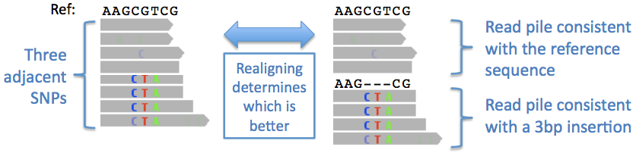
2. Local realignment around INDELS
Reads near INDELS are mapped with mismatches
Realignment can identify the most consistent placement for these reads
  Identify problematic regions
  Determine the optimal consensus sequence
Minimizes mismatches with the reference sequence
Refines location of INDELS
DePristo MA, et al. A framework for variation discovery and genotyping using next-generation DNA sequencing data. Nat Genet. 2011 May;43(5):491-8. PMID: 21478889

Slide 11
3. Base quality score recalibration
Calling algorithms rely heavily on the quality scores assigned to the individual base calls in each sequence read
Unfortunately, the scores produced by the machines are subject to various sources of systematic error, leading to over- or under-estimated base quality scores in the data
How?
Analyze covariation among several features of a base:
  Reported quality score
  Position within the read
  Preceding and current nucleotide
Use a set of known variants (i.e.: dbSNP) to model error properties of real polymorphism and determine the probability that novel sites are real
Adjust the quality scores of all reads in a BAM file
Notes:
Improvements:
More accurate base qualities
Better accuracy of our variant calls

Slide 12
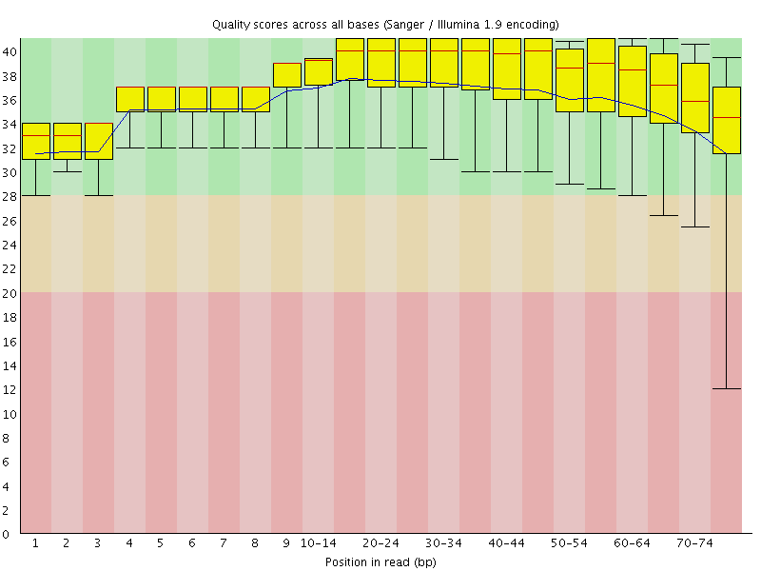
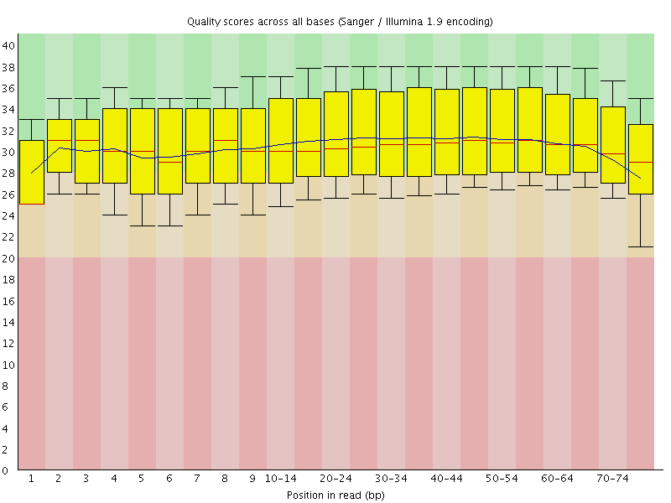

3. Base quality score recalibration
Before
After
Phred Quality score:
A score of 20 corresponds to 1% error rate in base calling
Notes:
Improvements:
More accurate base qualities
Better accuracy of our variant calls

Slide 13
4. Variant calling
Variant discovery process
Steps
  Variant calling: Identify the positions that differ from the reference
  Genotype calling: calculate the genotypes for each sample at these sites
Initial approach
  Independent base assumption
  Counting the number of times each allele is observed
Evolved approach
  Bayesian inference → Compute genotype likelihood
  Advantages:
    Provide statistical measure of uncertainty
    Lead to higher accuracy of genotype calling

Slide 14
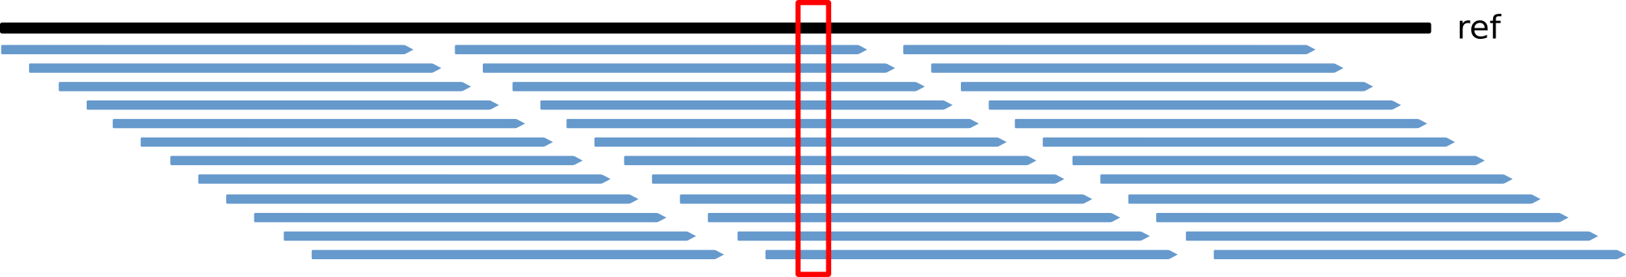
4. Variant calling
Variant discovery process
Reference = A

Slide 15
4. Variant calling
Variant discovery process
Reference = A
AAAAAAAAAAAAAAAAAAAAAAAAAAAAAA N=30, X=0
N = nucleotides
G = true genotype
R = reference base
V = variant base
X = variant nucleotides
Outcomes:
RR RV VV

Slide 16
4. Variant calling
Variant discovery process
Reference = A
AAAAAAAAAAAAAAAAAAAAAAAAAAAAAA N=30, X=0
GGGGGGGGGGGGGGGGGGGGGGGGGGGGGG N=30, X=30
N = nucleotides
G = true genotype
R = reference base
V = variant base
X = variant nucleotides
Outcomes:
RR RV VV

Slide 17
4. Variant calling
Variant discovery process
Reference = A
AAAAAAAAAAAAAAAAAAAAAAAAAAAAAA N=30, X=0
GGGGGGGGGGGGGGGGGGGGGGGGGGGGGG N=30, X=30
AAAAAAAAAAAAAAAGGGGGGGGGGGGGGG N=30, X=15
N = nucleotides
G = true genotype
R = reference base
V = variant base
X = variant nucleotides
Outcomes:
RR RV VV

Slide 18
4. Variant calling
Variant discovery process
Reference = A
AAAAAAAAAAAAAAAAAAAAAAAAAAAAAA N=30, X=0
GGGGGGGGGGGGGGGGGGGGGGGGGGGGGG N=30, X=30
AAAAAAAAAAAAAAAGGGGGGGGGGGGGGG N=30, X=15
AAAAAAAAAAAAAAAAGGGGGGGGGGGGCT N=30, X=12
N = nucleotides
G = true genotype
R = reference base
V = variant base
X = variant nucleotides
Outcomes:
RR RV VV

Slide 19
4. Variant calling
Variant discovery process
Reference = A
AAAAAAAAAAAAAAAAAAAAAAAAAAAAAA N=30, X=0
GGGGGGGGGGGGGGGGGGGGGGGGGGGGGG N=30, X=30
AAAAAAAAAAAAAAAGGGGGGGGGGGGGGG N=30, X=15
AAAAAAAAAAAAAAAAGGGGGGGGGGGGCT N=30, X=12
AAAGGGCCTT N=10, X=3
N = nucleotides
G = true genotype
R = reference base
V = variant base
X = variant nucleotides
Outcomes:
RR RV VV

Slide 20
4. Variant calling
Variant discovery process
Reference = A
AAAAAAAAAAAAAAAAAAAAAAAAAAAAAA N=30, X=0
GGGGGGGGGGGGGGGGGGGGGGGGGGGGGG N=30, X=30
AAAAAAAAAAAAAAAGGGGGGGGGGGGGGG N=30, X=15
AAAAAAAAAAAAAAAAGGGGGGGGGGGGCT N=30, X=12
AAAGGGCCTT N=10, X=3
Cutoff for X → value or proportion
c1 = 10%, c2 = 30% X ≤ c1 → RR
c1 < X < c2 → RV
X ≥ c2 → VV
N = nucleotides
G = true genotype
R = reference base
V = variant base
X = variant nucleotides
Outcomes:
RR RV VV

Slide 21
4. Variant calling
Variant discovery process
Reference = A
AAAAAAAAAAAAAAAAAAAAAAAAAAAAAA N=30, X=0 → RR
GGGGGGGGGGGGGGGGGGGGGGGGGGGGGG N=30, X=30 → VV
AAAAAAAAAAAAAAAGGGGGGGGGGGGGGG N=30, X=15 → RV
AAAAAAAAAAAAAAAAGGGGGGGGGGGGCT N=30, X=12 → RV
AAAGGGCCTT N=10, X=3 → ??
Cutoff for X → value or proportion
c1 = 10%, c2 = 30% X ≤ c1 → RR
c1 < X < c2 → RV
X ≥ c2 → VV
N = nucleotides
G = true genotype
R = reference base
V = variant base
X = variant nucleotides
Outcomes:
RR RV VV

Slide 22
4. Variant calling
Variant discovery process
Bayesian approximation
α = nucleotide-base error rate
N = nucleotides
G = true genotype
R = reference base
V = variant base
X = variant nucleotides
Outcomes:
RR RV VV
P of all R calls being correct and all V calls being wrong
P of all V calls being correct and all R calls being wrong
P of all R and V calls being correct

Slide 23
4. Variant calling
Variant discovery process
Bayesian approximation
α = nucleotide-base error rate
N = nucleotides
G = true genotype
R = reference base
V = variant base
X = variant nucleotides
Outcomes:
RR RV VV

Slide 24
4. Variant calling
Variant discovery process
Bayesian approximation
α = nucleotide-base error rate
pVV
pVR
N = nucleotides
G = true genotype
R = reference base
V = variant base
X = variant nucleotides
Outcomes:
RR RV VV
Prior probabilities

Slide 25
VCF file format
Specification defined by the 1000 genomes (current version 4.2):
http://samtools.github.io/hts-specs/VCFv4.2.pdf
Commonly compressed and indexed with bgzip/tabix
Single-sample or multi-sample VCF
##fileformat=VCFv4.1
##fileDate=20090805
##source=myImputationProgramV3.1
##reference=file:///seq/references/1000GenomesPilot-NCBI36.fasta
##contig=<ID=20,length=62435964,assembly=B36,md5=f126cdf8a6e0c7f379d618ff66beb2da,species="Homo sapiens",taxonomy=x>
##phasing=partial
##INFO=<ID=NS,Number=1,Type=Integer,Description="Number of Samples With Data">
##INFO=<ID=DP,Number=1,Type=Integer,Description="Total Depth">
##INFO=<ID=AF,Number=A,Type=Float,Description="Allele Frequency">
##INFO=<ID=AA,Number=1,Type=String,Description="Ancestral Allele">
##INFO=<ID=DB,Number=0,Type=Flag,Description="dbSNP membership, build 129">
##INFO=<ID=H2,Number=0,Type=Flag,Description="HapMap2 membership">
##FILTER=<ID=q10,Description="Quality below 10">
##FILTER=<ID=s50,Description="Less than 50% of samples have data">
##FORMAT=<ID=GT,Number=1,Type=String,Description="Genotype">
##FORMAT=<ID=GQ,Number=1,Type=Integer,Description="Genotype Quality">
##FORMAT=<ID=DP,Number=1,Type=Integer,Description="Read Depth">
##FORMAT=<ID=HQ,Number=2,Type=Integer,Description="Haplotype Quality">
#CHROM POS ID REF ALT QUAL FILTER INFO FORMAT NA00001 NA00002 NA00003
20 14370 rs6054257 G A 29 PASS NS=3;DP=14;AF=0.5;DB;H2 GT:GQ:DP:HQ 0|0:48:1:51,51 1|0:48:8:51,51 1/1:43:5:.,.
20 17330 . T A 3 q10 NS=3;DP=11;AF=0.017 GT:GQ:DP:HQ 0|0:49:3:58,50 0|1:3:5:65,3 0/0:41:3
20 1110696 rs6040355 A G,T 67 PASS NS=2;DP=10;AF=0.333,0.667;AA=T;DB GT:GQ:DP:HQ 1|2:21:6:23,27 2|1:2:0:18,2 2/2:35:4
20 1230237 . T . 47 PASS NS=3;DP=13;AA=T GT:GQ:DP:HQ 0|0:54:7:56,60 0|0:48:4:51,51 0/0:61:2
20 1234567 microsat1 GTC G,GTCT 50 PASS NS=3;DP=9;AA=G GT:GQ:DP 0/1:35:4 0/2:17:2 1/1:40:3

Slide 26
VCF file format
#CHROM POS ID REF ALT QUAL FILTER INFO
20 14370 rs6054257 G A 29 PASS NS=3;DP=14;AF=0.5;DB;H2
FORMAT NA00001 NA00002 NA00003
GT:GQ:DP:HQ 0|0:48:1:51,51 1|0:48:8:51,51 1/1:43:5:.,.
genotype genotype quality read depth haplotype qualities
CHROM: chromosome
POS: position
ID: identifier
REF: reference base(s)
ALT: non-reference allele(s)
QUAL: quality score of the calls (phed scale)
FILTER: “PASS” or a filtering tag
INFO: additional information
FORMAT: describes the information given by sample

Slide 27
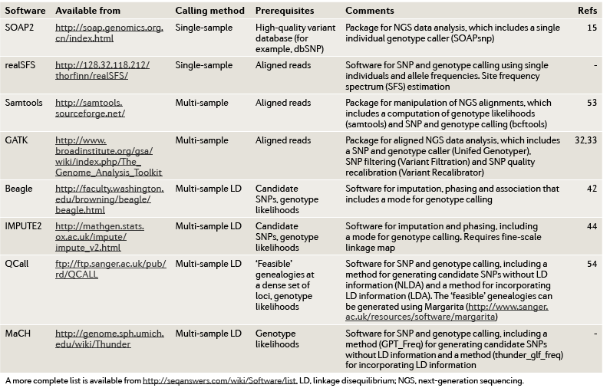
Software

Slide 28
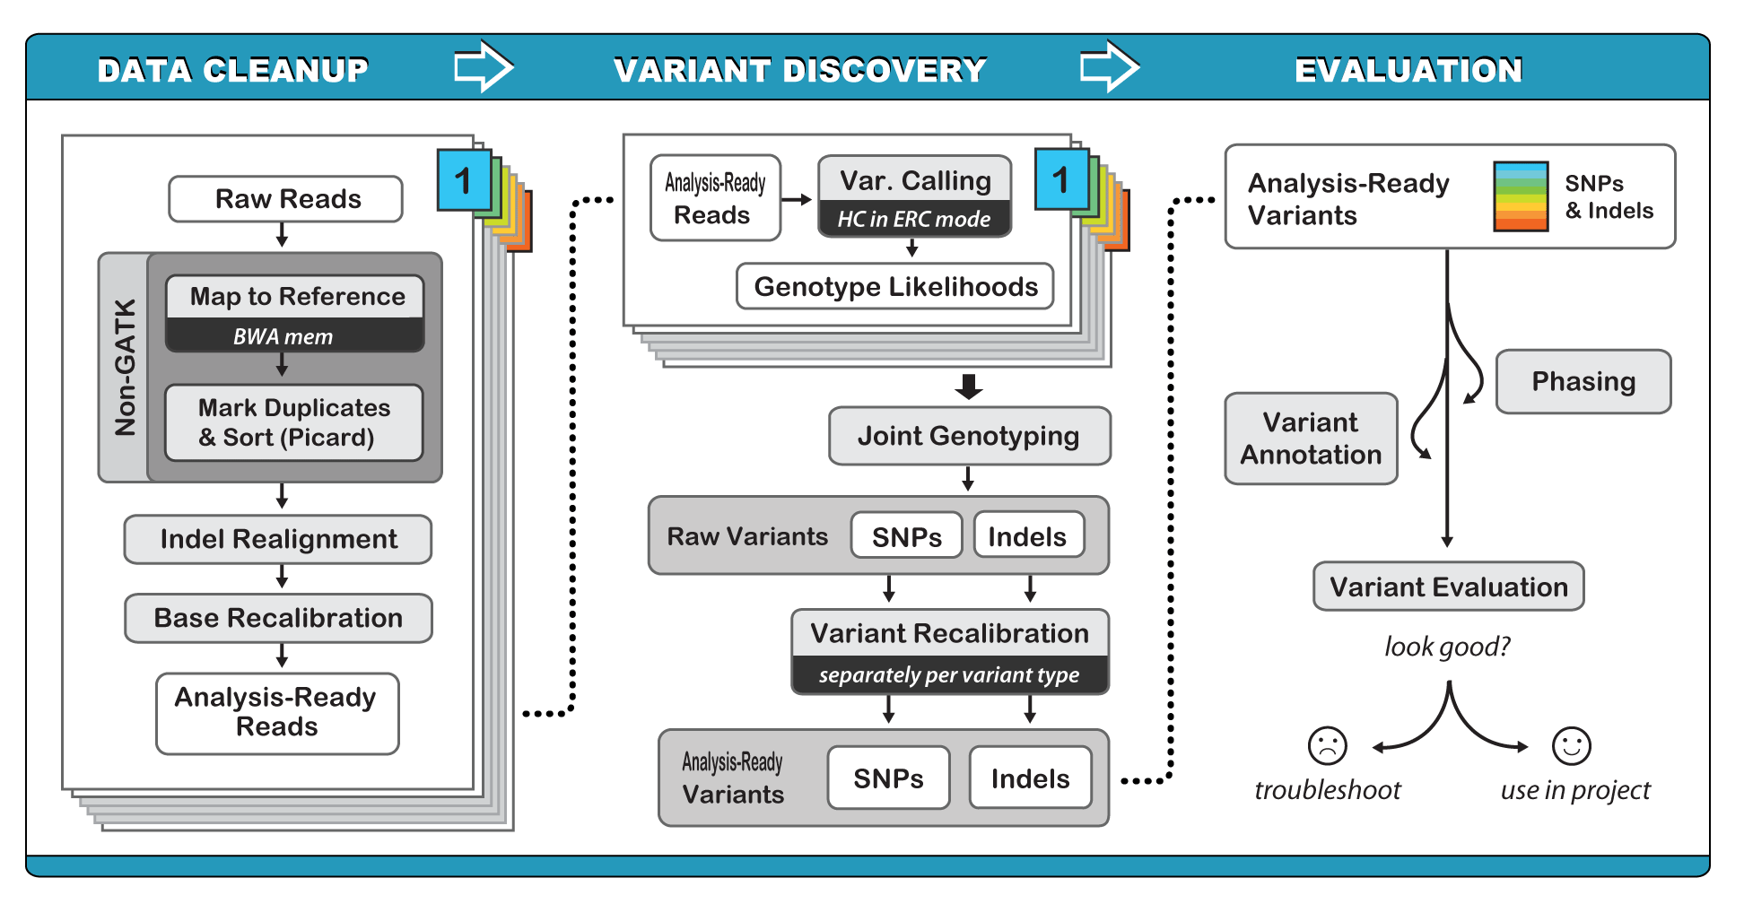
GATK (Genome Analysis ToolKit)
http://www.broadinstitute.org/gatk/
Probabilistic method: Bayesian estimation of the most likely genotype
Calculates many parameters for each position of the genome
INDEL realignment
Base quality recalibration
SNP and INDEL calling
Multi-sample calling
Uses standard input and output files
Used in many NGS projects, including the 1000 Genomes Project, The Cancer Genome Atlas, etc.

Slide 29

Prerequisites: JAVA and Picard tools
Requires Java (http://www.oracle.com/technetwork/java/javase/downloads/index.html)
  Check your java version
  GATK ≥ 2.6 → Requires Java version ≥ 1.7
Picard (current version 1.140)
  Website: http://broadinstitute.github.io/picard/
  For a compiled version click on “Latest Release”
  and download picard-tools-1.140.zip
  Testing:
  Usage
java –version
java -jar picard.jar -h
java –jar picard.jar <ToolName> [options]

Slide 30
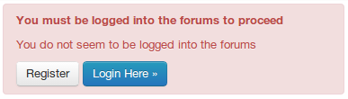

GATK installation
GATK 3.4-46 download
  http://www.broadinstitute.org/gatk/
  We need to register before download
  Go to Downloads and click
  Accept the license agreement
  Extract the file
Check if GATK is working
Usage
Shows GATK help
java –jar GenomeAnalysisTK.jar -h
java –jar GenomeAnalysisTK.jar -T <ToolName> [arguments]

Slide 31
THANK YOU.

Slide 32
Filtering recomendations
Filtering recommendations for SNPs:
  QD < 2.0
  MQ < 40.0
  FS > 60.0
  HaplotypeScore > 13.0
  MQRankSum < -12.5
  ReadPosRankSum < -8.0
Filtering recommendations for indels:
  QD < 2.0
  ReadPosRankSum < -20.0
  InbreedingCoeff < -0.8
  FS > 200.0
Notes:
Improvements:
More accurate base qualities
Better accuracy of our variant calls

Slide 33
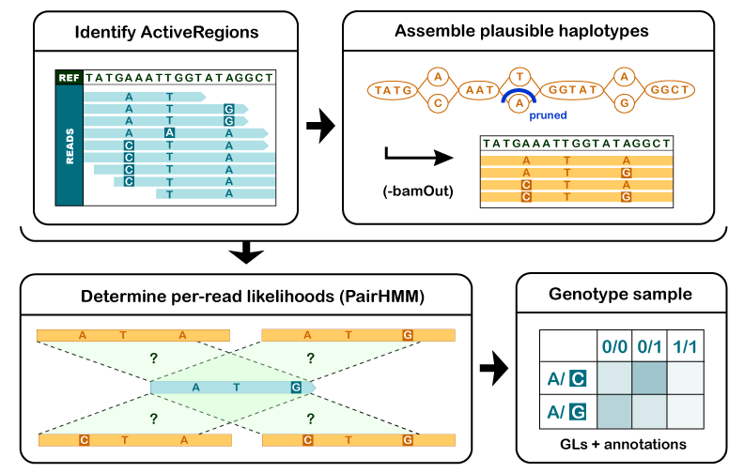
GATK (Genome Analysis ToolKit)

Slide 34
Genomic variation
Terminology
Variant: sequence data difference that exists between individuals in a population
Mutation: molecular event that created a variant
Allele: forms of the bases occupying the same position on matching chromosomes
Genotype: allelic state in a specific individual
  AA homozygous or AT heterozygous at specific base
Polymorphism: sequence variation that is common within a population
  "SNP on chromosome 16 associated with obesity"
Types of Genome Sequence Variants
Single Nucleotide Variants (SNVs)
Single base changes, e.g., A→T.
Insertions-Deletions (Indels)
Consisting of one or a few bases, e.g., +ATGA, ΔT.
Structural Variants (SVs)
Everything else: large deletions, insertions, duplications, inversions, translocations, mobile element insertions, horizontal gene transfer

Slide 35
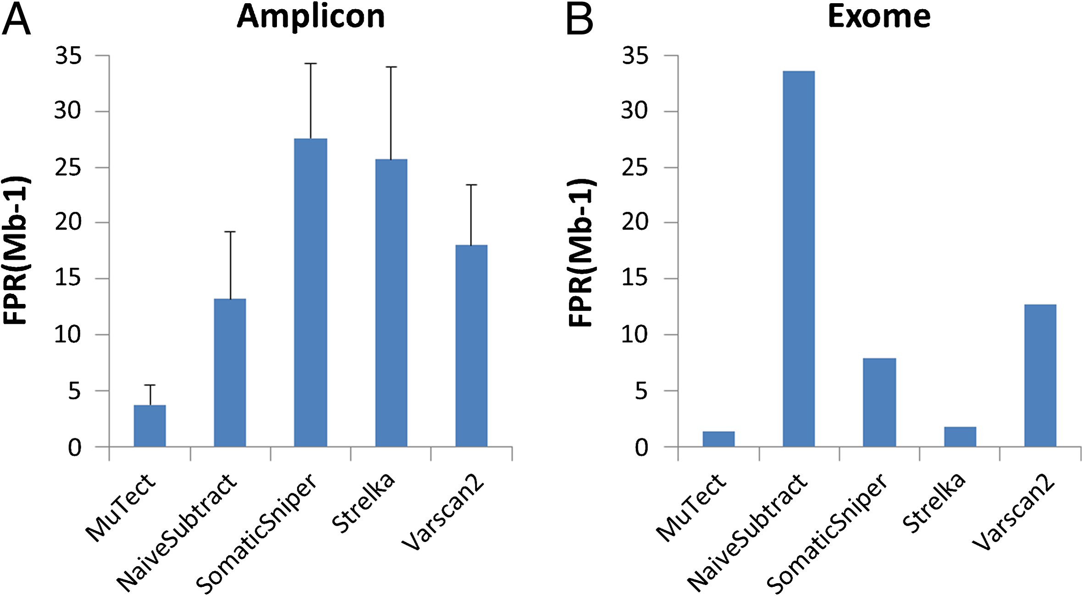
Somatic calling
Comparison
Xu, Huilei, et al. "Comparison of somatic mutation calling methods in amplicon and whole exome sequence data." BMC genomics 15.1 (2014): 244.
Notes:
MuTect, the star of our Cancer Genome Analysis (CGA) Suite, has been used in many studies since the method was originally published in 2013. In that paper, the authors reported the tool had a consistent validation rate of ~95% in coding regions. They also offered a direct comparison of MuTect’s accuracy compared to several common variant callers and concluded that MuTect surpases other variant callers in terms of the trade off between specificity and sensitivity.
Nevertheless, we often get asked how MuTect’s sensitivity and specificity compare to other available somatic variant callers (and even to tools not specifically geared to cancer studies, such as the GATK).
So I was interested to see a recent article by Qiagen that compared five popular somatic variant callers: MuTect, Strelka, SomaticSniper, VarScan2, and GATK UnifiedGenotyper followed by subtraction. Using the NIST-GIAB gold standard, the authors reported that while each of these methods were applicable to both targeted amplicon sequencing and exome sequencing data, their sensitivities varied based on the allelic fraction of mutations in the tumor sample.
As shown in figure 1, MuTect and Strelka achieved the highest sensitivity, especially at low allelic fractions. At the lowest purity (4%), Strelka achieved the highest sensitivity at 85% while MuTect in high confidence mode achieved the second highest sensitivity at 60%.

