Slide 1

Somatic variant calling and identification of de novo mutations
MuTect and DeNovoGear
Edinburgh Genomics
Edinburgh, UK
23rd October 2015
* Slides based on GATK presentations (link)

Slide 2
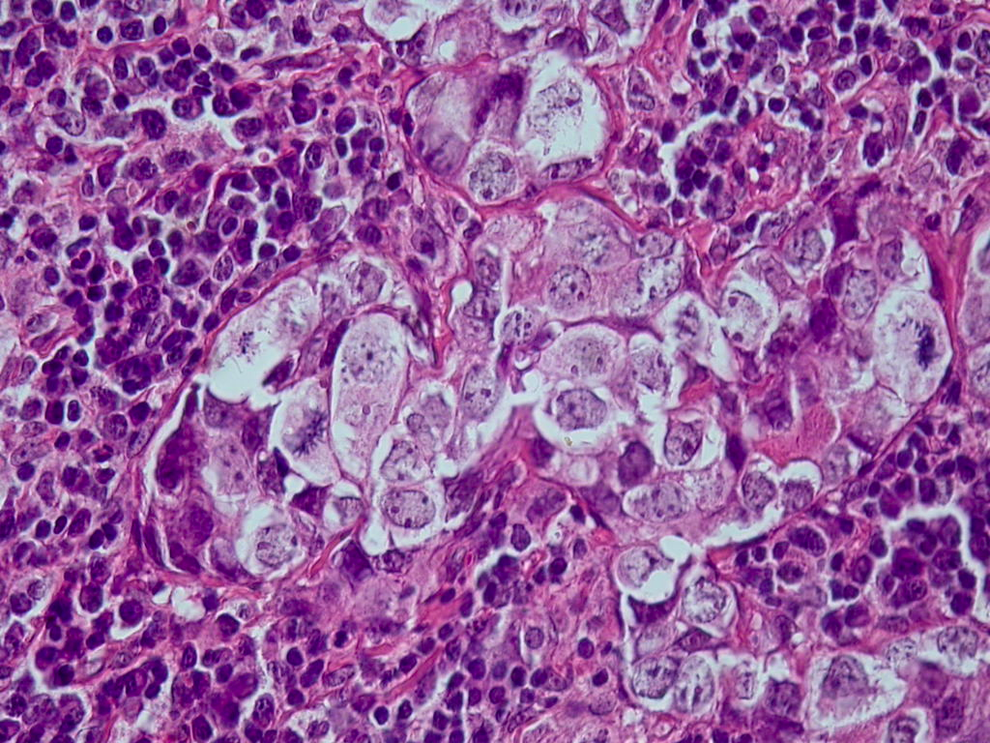

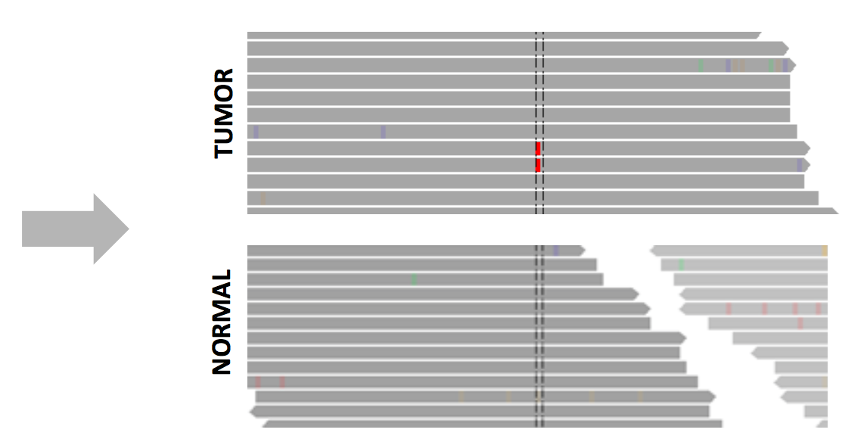
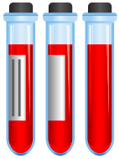
Somatic calling
Tumor vs normal
Tumor
Germline

Slide 3
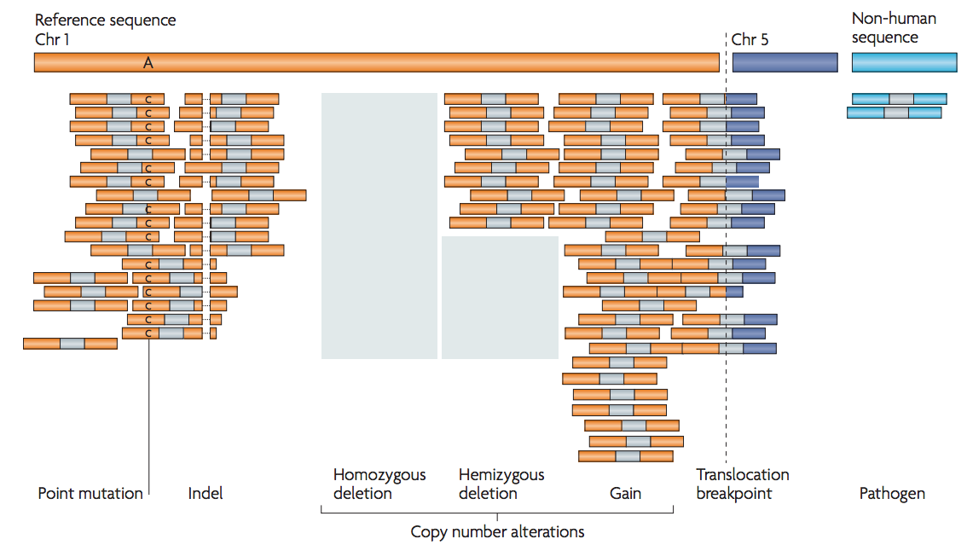
Somatic calling
Type of variants
Meyerson, Gabriel and Getz. Nat. Rev. Genet. (2010)

Slide 4
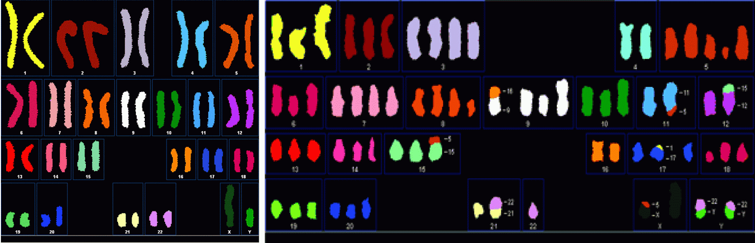
Somatic calling
Number of somatic mutations
In a genome of 3 x 109 bases:
1000s to 10,000s somatic single nucleotide variations (sSNVs)
100s to 1,000s somatic small insertions and deletions (sINDELs)
100s to 1,000s somatic structural variations (sSVs)
100s to 1,000s somatic copy number alterations (sCNAs)

Slide 5
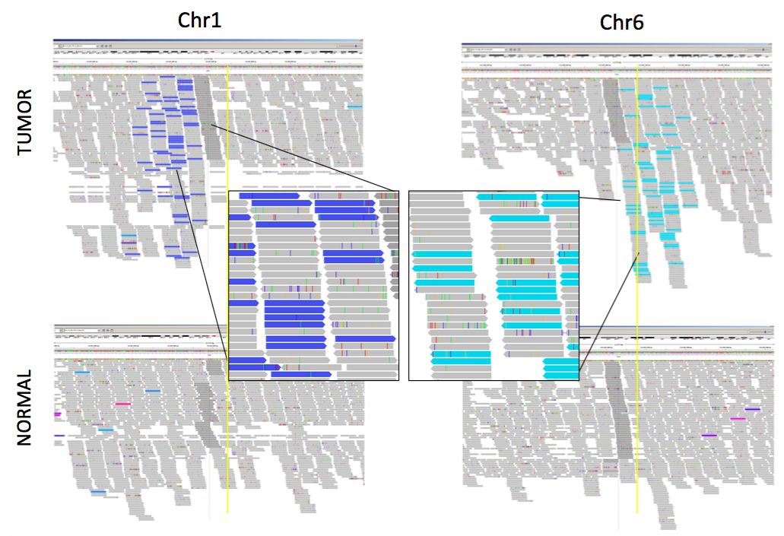
Somatic calling
Visualization of rearrangements

Slide 6
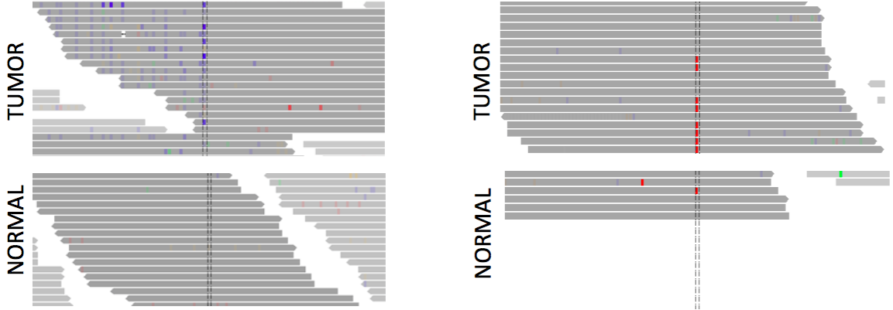
Somatic calling
False positives
Noise
Germline mutation

Slide 7
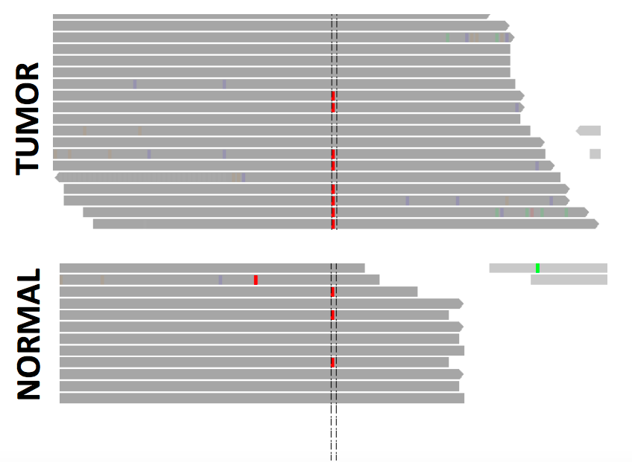
Somatic calling
False positives
Contamination of the normal sample

Slide 8
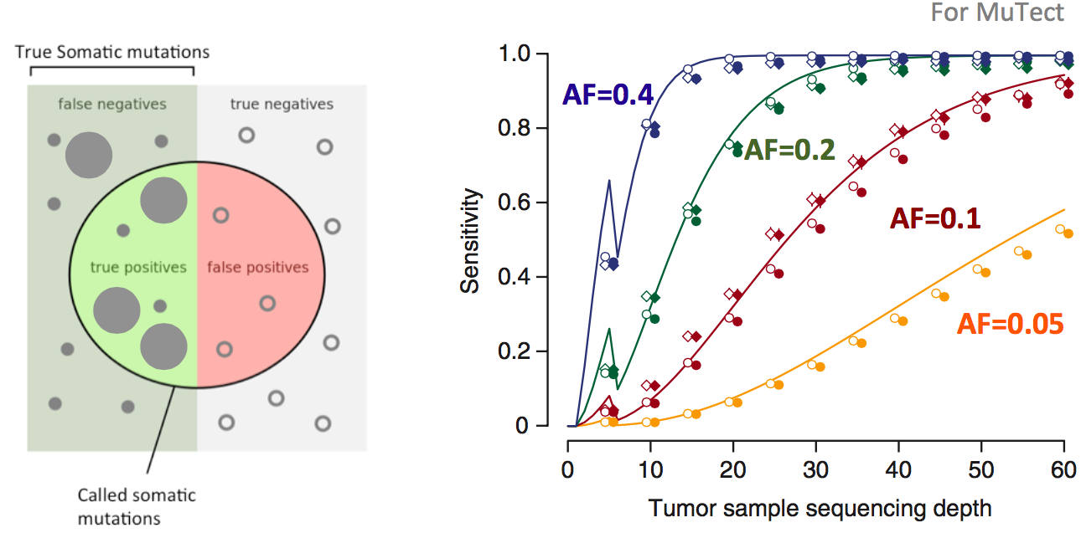
Somatic calling
Deep sequencing required

Slide 9
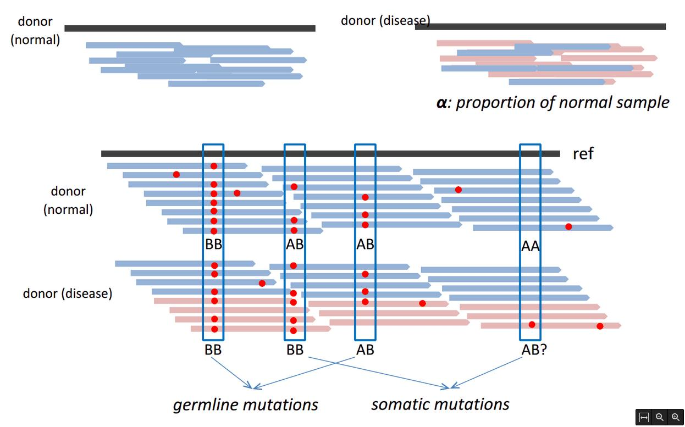
Somatic calling
Detecting somatic SNVs in cancer
Challenges:
Somatic variants occur at low frequency in genome
Most tumors are impure and heterogeneous

Slide 10
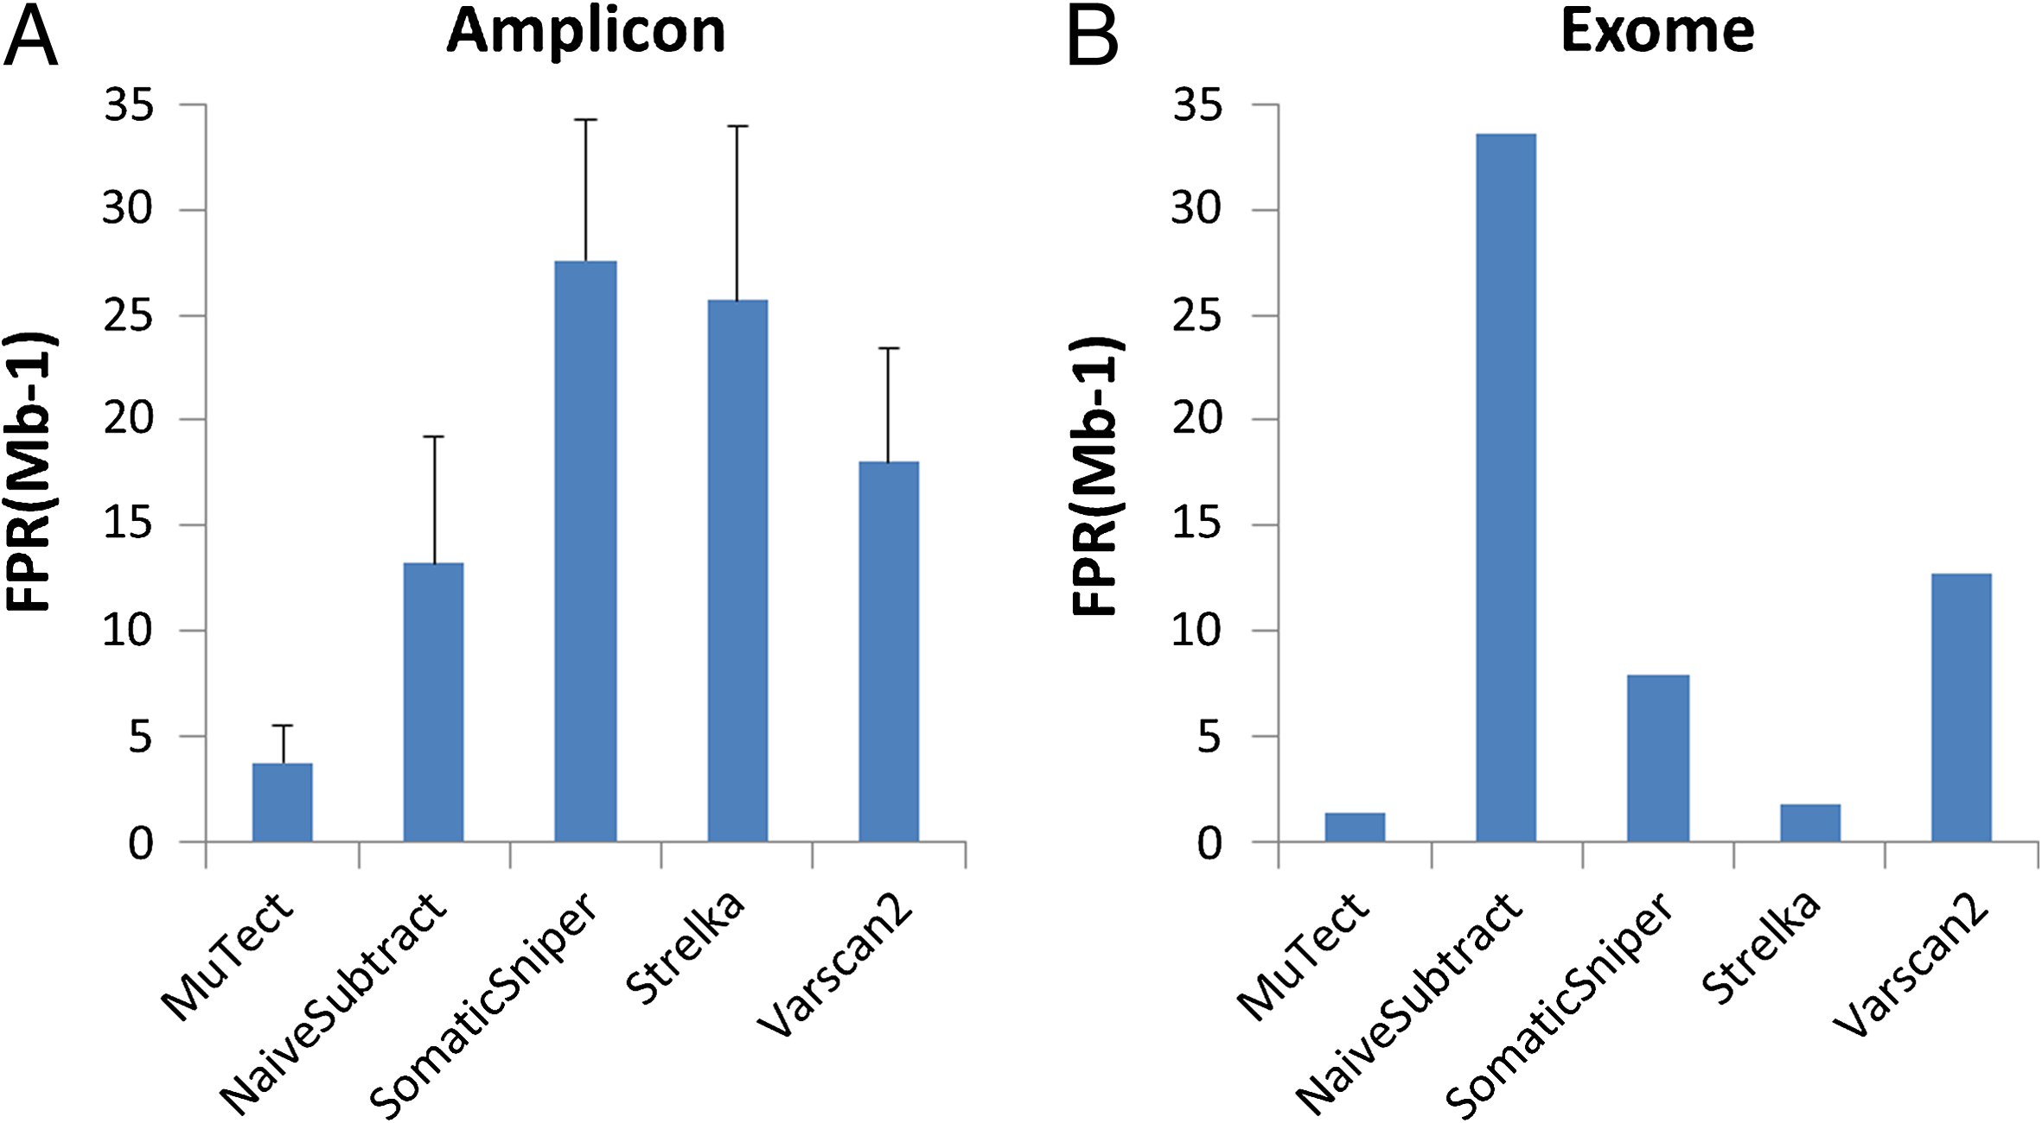
Somatic calling
Software
Xu, Huilei, et al. "Comparison of somatic mutation calling methods in amplicon and whole exome sequence data." BMC genomics 15.1 (2014): 244.
Notes:
MuTect, the star of our Cancer Genome Analysis (CGA) Suite, has been used in many studies since the method was originally published in 2013. In that paper, the authors reported the tool had a consistent validation rate of ~95% in coding regions. They also offered a direct comparison of MuTect’s accuracy compared to several common variant callers and concluded that MuTect surpases other variant callers in terms of the trade off between specificity and sensitivity.
Nevertheless, we often get asked how MuTect’s sensitivity and specificity compare to other available somatic variant callers (and even to tools not specifically geared to cancer studies, such as the GATK).
So I was interested to see a recent article by Qiagen that compared five popular somatic variant callers: MuTect, Strelka, SomaticSniper, VarScan2, and GATK UnifiedGenotyper followed by subtraction. Using the NIST-GIAB gold standard, the authors reported that while each of these methods were applicable to both targeted amplicon sequencing and exome sequencing data, their sensitivities varied based on the allelic fraction of mutations in the tumor sample.
As shown in figure 1, MuTect and Strelka achieved the highest sensitivity, especially at low allelic fractions. At the lowest purity (4%), Strelka achieved the highest sensitivity at 85% while MuTect in high confidence mode achieved the second highest sensitivity at 60%.

Slide 11
Somatic calling
Software
Xu, Huilei, et al. "Comparison of somatic mutation calling methods in amplicon and whole exome sequence data." BMC genomics 15.1 (2014): 244.
Notes:
MuTect, the star of our Cancer Genome Analysis (CGA) Suite, has been used in many studies since the method was originally published in 2013. In that paper, the authors reported the tool had a consistent validation rate of ~95% in coding regions. They also offered a direct comparison of MuTect’s accuracy compared to several common variant callers and concluded that MuTect surpases other variant callers in terms of the trade off between specificity and sensitivity.
Nevertheless, we often get asked how MuTect’s sensitivity and specificity compare to other available somatic variant callers (and even to tools not specifically geared to cancer studies, such as the GATK).
So I was interested to see a recent article by Qiagen that compared five popular somatic variant callers: MuTect, Strelka, SomaticSniper, VarScan2, and GATK UnifiedGenotyper followed by subtraction. Using the NIST-GIAB gold standard, the authors reported that while each of these methods were applicable to both targeted amplicon sequencing and exome sequencing data, their sensitivities varied based on the allelic fraction of mutations in the tumor sample.
As shown in figure 1, MuTect and Strelka achieved the highest sensitivity, especially at low allelic fractions. At the lowest purity (4%), Strelka achieved the highest sensitivity at 85% while MuTect in high confidence mode achieved the second highest sensitivity at 60%.

Slide 12
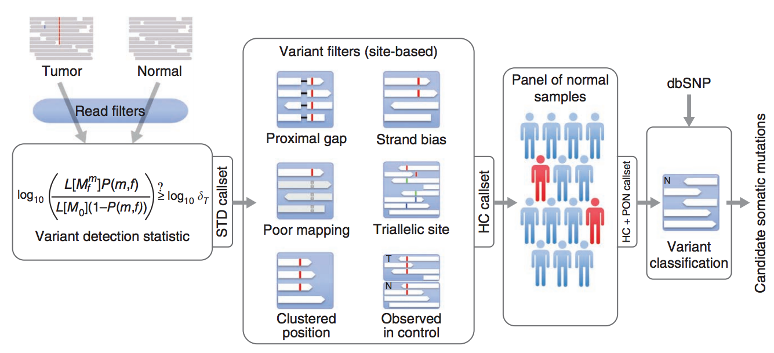
Somatic calling
MuTect
Preprocess
Preprocess
Notes:
MuTect, the star of our Cancer Genome Analysis (CGA) Suite, has been used in many studies since the method was originally published in 2013. In that paper, the authors reported the tool had a consistent validation rate of ~95% in coding regions. They also offered a direct comparison of MuTect’s accuracy compared to several common variant callers and concluded that MuTect surpases other variant callers in terms of the trade off between specificity and sensitivity.
Nevertheless, we often get asked how MuTect’s sensitivity and specificity compare to other available somatic variant callers (and even to tools not specifically geared to cancer studies, such as the GATK).
So I was interested to see a recent article by Qiagen that compared five popular somatic variant callers: MuTect, Strelka, SomaticSniper, VarScan2, and GATK UnifiedGenotyper followed by subtraction. Using the NIST-GIAB gold standard, the authors reported that while each of these methods were applicable to both targeted amplicon sequencing and exome sequencing data, their sensitivities varied based on the allelic fraction of mutations in the tumor sample.
As shown in figure 1, MuTect and Strelka achieved the highest sensitivity, especially at low allelic fractions. At the lowest purity (4%), Strelka achieved the highest sensitivity at 85% while MuTect in high confidence mode achieved the second highest sensitivity at 60%.

Slide 13
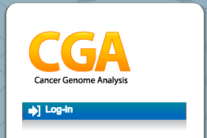
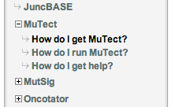
MuTect installation
MuTect download
  http://www.broadinstitute.org/cancer/cga/mutect
  Click Log-in and go to the Create new account tab
  Fill the form
  Go to How do I get mutect and accept the license agreement
  Download the latest version
  muTect-1.1.4-bin.zip
  Extract the file in the applications folder
Check if MuTect is working
Usage
java –jar muTect-1.1.4.jar -h
java –jar muTect-1.1.4.jar --analysis_type MuTect [arguments]

Slide 14

De novo mutations
De novo mutation, An alteration in a gene that is present for the first time in one family member as a result of a mutation in a germ cell (egg or sperm) of one of the parents or in the fertilized egg itself.
Somatic variants
De novo mutations
- Mutation in tumor only
- Non inheritable
- Can be inherited
- All cells affected in offspring

Slide 15
De novo mutations
On average, humans acquire ~74 de novo single nucleotide variants (SNVs) per genome per generation.
The de novo mutational load seems correlated with paternal (as opposed to maternal) age.
The rate of de novo mutations seems higher in individuals with genetic diseases, particularly sporadic disorders such as intellectual disability and autism.
De novo mutations tend to be more deleterious than inherited variation because they haven’t undergone the same level of evolutionary selection.
Because true de novo mutations occur randomly (and newly) in individuals, there’s no database like dbSNP to guide discovery. We must instead rely on deeper sequence coverage, better algorithms, and ultimately, orthogonal validation.
The best evidence to implicate a gene requires looking across a significant number of samples, to find genes that:
  Harbor mutations in multiple (unrelated) cases with a similar phenotype, and
  Lack similarly damaging mutations in populations of unaffected individuals
Veltman JA, & Brunner HG (2012). De novo mutations in human genetic disease. Nature reviews. Genetics, 13 (8), 565-75 PMID: 22805709

Slide 16
THANK YOU.

