Slide 1



Variant prioritization
University of Cambridge
Cambridge, UK
10th June 2014

Slide 2
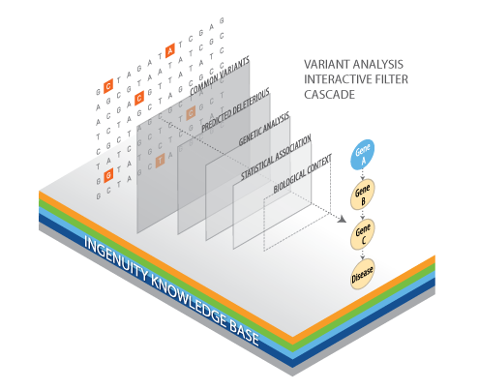
The objective

Slide 3
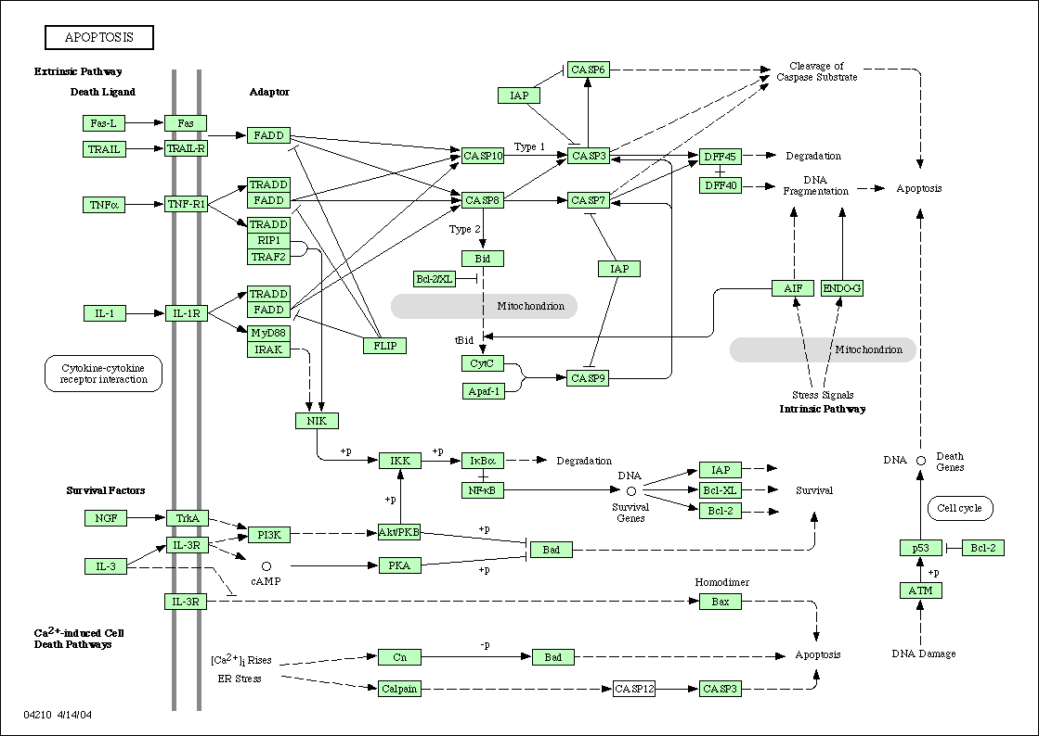
And now what?
Finding the mutations causative of diseases
The simplest case: monogenic disease due to a single gene
A
C
B
D
E
Controls
Cases

Slide 4
And now what?
Finding the mutations causative of diseases
Controls
Cases
Clear individual gene associations are difficult to find in some diseases
Same phenotype can be due to different mutations and different genes (or combinations)
Many cases have to be used to obtain significant associations to many markers
The only common element is the pathway (yet unknown) affected

Slide 5
Strategies
Filtering using family information
Network (Systems biology) approaches
  PPIs
  Gene regulatory elements (miRNAs, Tfs)
  GO terms
GWAS

Slide 6
Using family information
Families containing control and disease individuals can help us to reduce the number of variants obtained
Individuals from the same family → less variability
Filter variants present in healthy people

Slide 7
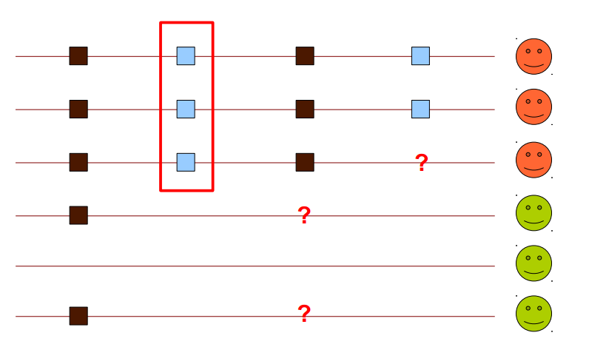
Using family information
Dominant inheritance

Slide 8
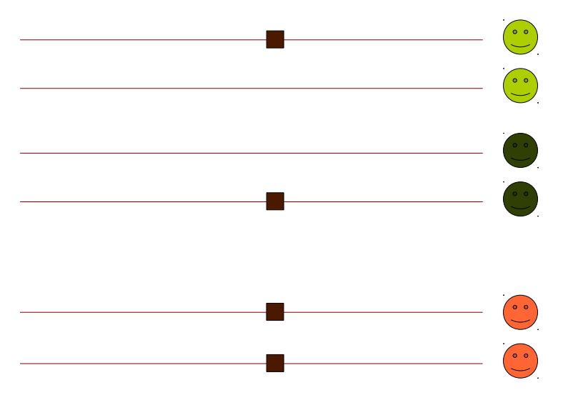
Using family information
Recessive homozygous

Slide 9
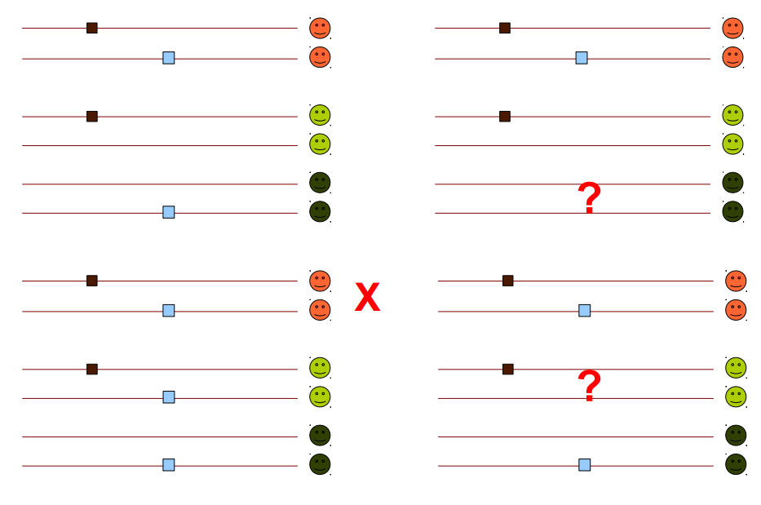
Using family information
Recessive – Compound heterozygosity

Slide 10
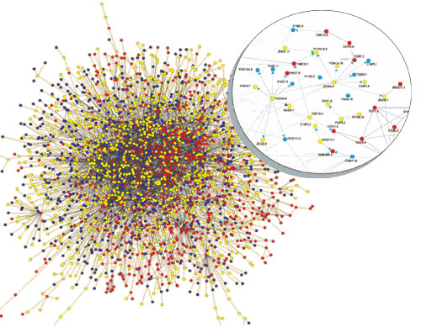
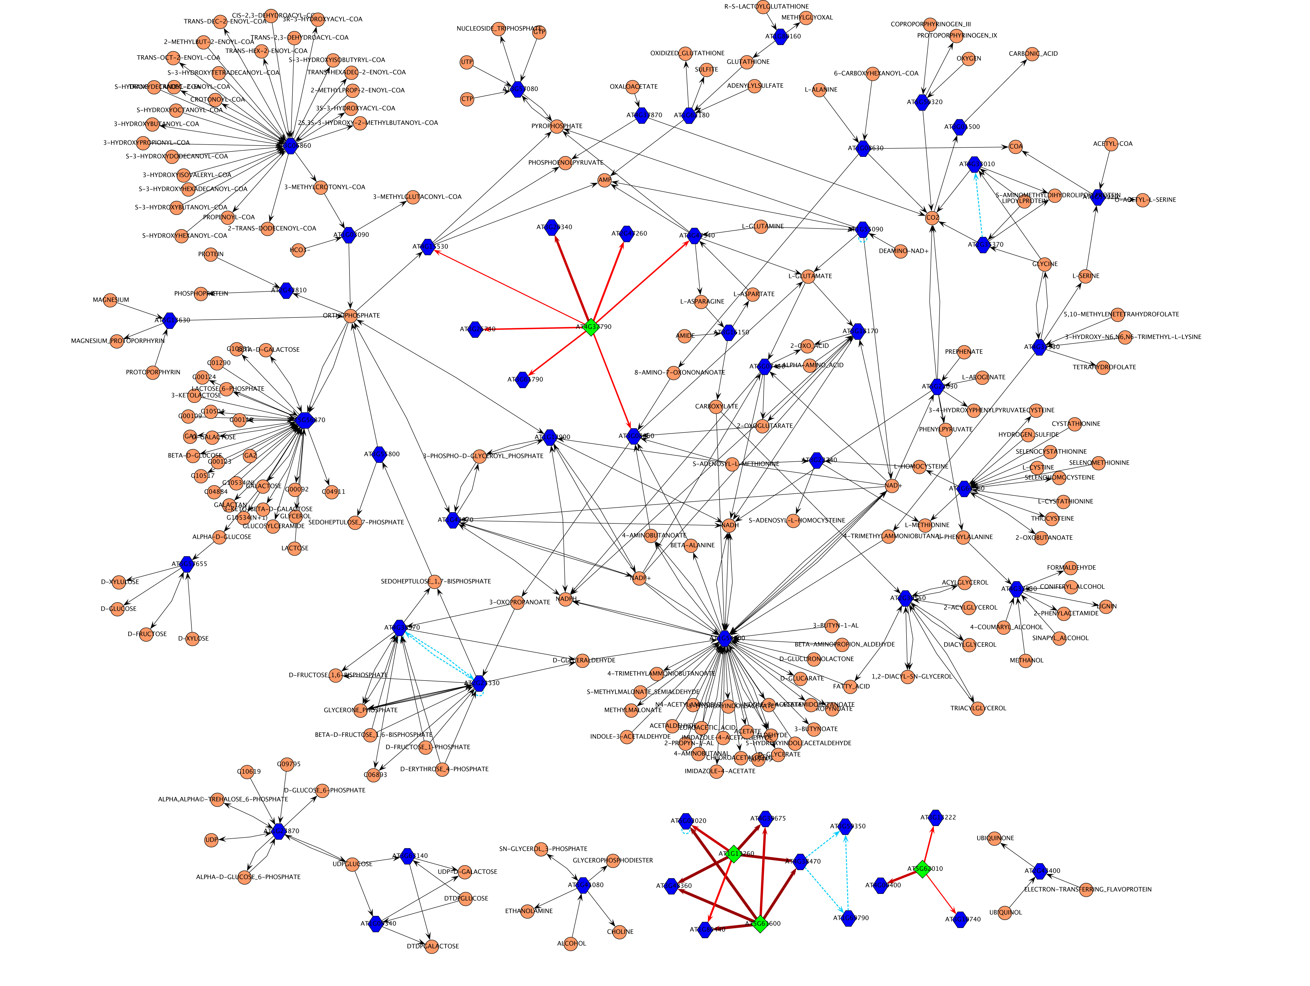
Using network information

Slide 11
Example with Inherited Retinal Dystrophies (IRD)
Prevalence 1 in 3000
Clinically and genetically very heterogeneous
190 GENES account for aprox. 50% of IRDs.
Is genetic overlapping among IRDs related to protein interaction?
Notes:
Las distrofias de retina con un grupo de enfermedades genética y fenotípicamente heterogéneas caracterizadas por la degeneración de la retina, que conduce a una ceguera parcial o total.
La identificación de nuevos genes responsables de enfermedades de retina es la base por tanto de los avances en el conocimiento de la fisiología y la patología de la retina; de esta manera, será posible establecer nuevas líneas celulares y modelos animales para estudiar las funciones de los genes relevantes que permitan en última instancia mejorar las alternativas terapéuticas para las distrofias de retina.

Slide 12
Example with Inherited Retinal Dystrophies (IRD)
BBS
LCA
ARL6, BBS2, BBS4,
BBS5, BBS7, BBS9,
BBS10, BBS12,, INPP5E,
LZTFL1, MKKS, MKS1,
SDCCAG8, TRIM32, TTC8
LCA5,
RD3
CORD/COD
CEP290
CACNA1F,
CACNA2D4
CVD
CABP4,
GNAT2
CORD/COD
AIPL1,
GUCY2D,
RPGRIP1
CRB1, IMPDH1,
LRAT, MERTK,
RDH12, RPE65,
SPATA7, TULP1
BBS1
GRK1,
GRM6,
NYX,
TRPM1
NB
PDE6B,
RHO,
SAG
ADAM9,
GUCA1A,
HRG4/UNC119,
KCNV2, PDE6H,
PITPNM3, RAX2,
RDH5, RIM1
CRX
C2ORF71, C8ORF37,
CA4,CERKL, CNGA1, CNGB1,
DHDDS,EYS, FAM161A, IDH3B,KLHL7
IMPG2, MAK, NRL, PAP1, PDE6A,
PDE6G, PRCD, PRF3, PRPF8, PRPF31
RBP3, RGR, ROM1, RP1, RP2,
SNRNP200, TOPORS, TTC8
ZNF513
RLBP1,
SEMA4A
RP
LCA-Leber Congenital Amaurosis
CORD/COD- Cone and cone-rod dystro.
CVD- Colour Vision Defects
MD- Macular Degeneration
ERVR/EVR- Erosive and Exudative
Vitreoretinopathies
USH- Usher Syndrome
RP- Retinitis Pigmentosa
NB- Night Blindness
BBS- Bardet-Biedl Syndrome
ABCA4,
PROM1,
PRPH2,
RPGR
CVD
CNGA3,
PDE6C
BCP,
GCP,
RCP
FSCN2,
GUCA1B
CLRN1,
USH2A
C1QTNF5,
EFEMP1,
ELOVL4,
HMNC1,
RS1,
TIMP3
BEST1
NR2E3
ABHD12, CDH23, CIB2, DFNB31, GPR98, HARS, MYO7A, PCDH15, USH1C, USH1G
FZD4, KCNJ13,
LRP5, NDP,
TSPAN12, VCAN
MD
USH
ERVR/EVR

Slide 13
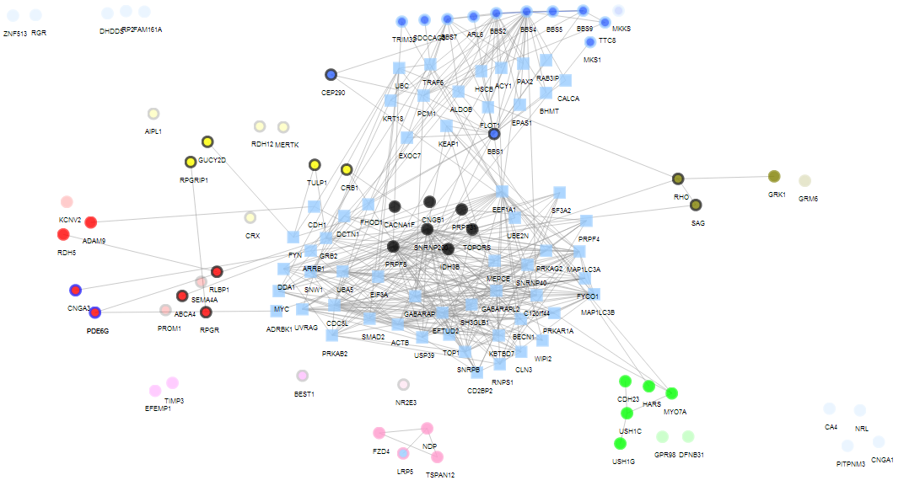
Example with Inherited Retinal Dystrophies (IRD)
LCA-Leber Congenital Amaurosis
CORD/COD- Cone and cone-rod dystro.
CVD- Colour Vision Defects
MD- Macular Degeneration
ERVR/EVR- Erosive and Exudative
Vitreoretinopathies
USH- Usher Syndrome
RP- Retinitis Pigmentosa
NB- Night Blindness
BBS- Bardet-Biedl Syndrome
Significant Clustering coefficient,
p-value=0.0103
LCA
BBS
CORD/COD
NB
RP
CVD
USH
MD
ERVR/EVR
SNOW Tool. Minguez et al., NAR 2009 Implemented in Babelomics (http://www.babelomics.org)

Slide 14
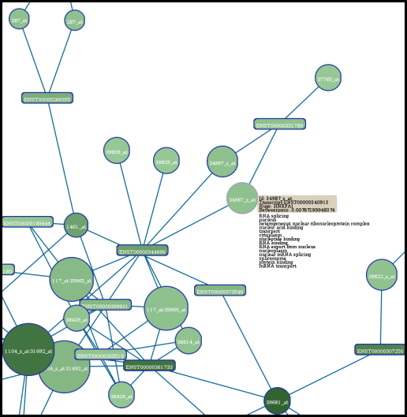
SNOW
The SNOW tool introduces protein-protein interaction data into the functional profiling of genomic data
  Evaluates role of the list within the interactome: identifies hubs in the list of proteins/genes (nodes) and evaluates the topological parameters of the within the interactome
  Evaluates the list’s cooperative behaviour as a functional module
http://babelomics.bioinfo.cipf.es/functional.html

Slide 15
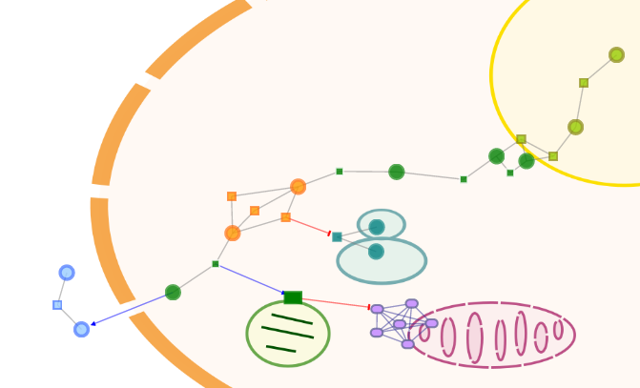
NetworkMiner
Prioritizing disease candidate genes
Scenario
You have:
a list of disease candidates (ranked by their populational frequency)
a list of genes that are known to be associated to the disease
You want to see:
which of your candidates are functionally related or interacting with the known disease genes
NetworkMiner Study
Tests whether any of the candidates is significantly located in the neighborhood of the known disease genes
http://babelomics.bioinfo.cipf.es/functional.html

Slide 16
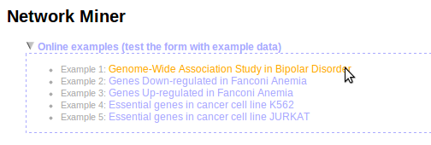
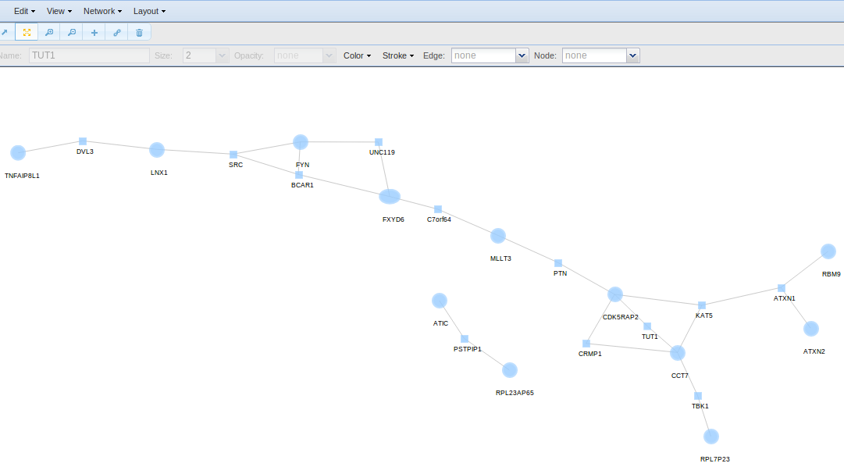
NetworkMiner
Prioritizing disease candidate genes
Example: Genome-Wide Association Study in Bipolar Disorder
Seed list: Genes associated to Bipolar Disorder
Ranked list: Genes ranked according the association degree in a Case-Control Association Study
Known Disease Gene (Elipse)
Candidate (Circle)
Intermediate (Square)

Slide 17
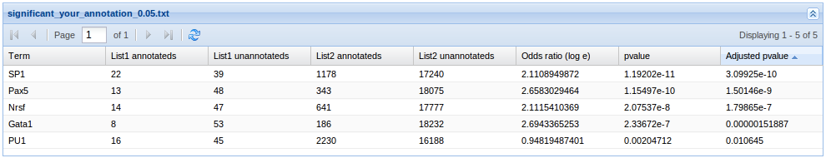
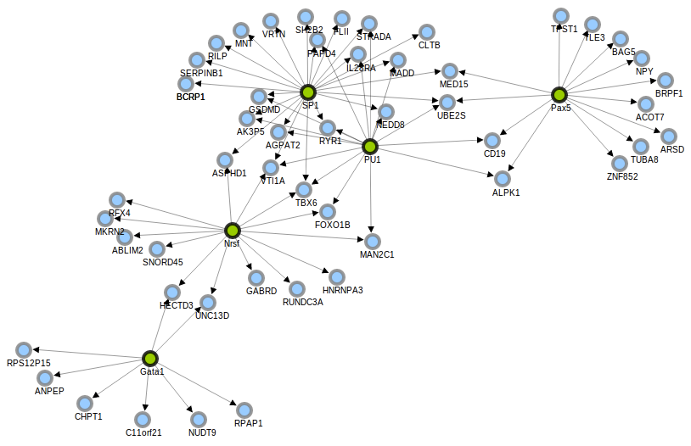
RENATO (REgulatory Network Analsis TOol)
Identifying common regulatory elements
Sometimes, the problem is not in the gene
Example: Mutation in the DNA binding domain of a TF
Tool for the interpretation and visualization of transcriptional (TFs) and post-transcriptional (miRNAs) regulatory information
Designed to identify common regulatory elements in a list of genes
RENATO maps these genes to the regulatory network, extracts the corresponding regulatory connections and evaluate each regulator for significant over-representation in the list.
http://renato.bioinfo.cipf.es

Slide 18
THANK YOU.

