Slide 1


Variant annotation
ANNOVAR and HPG-VARIANT
University of Cambridge
Cambridge, UK
24th February 2015

Slide 2

The pipeline
Fastq
Sequence preprocessing
Fastq
Mapping
BAM
Visualization
BAM
Variant calling
RNA-Seq processing
VCF
Count matrix
Exome analysis
RNA-Seq analysis
Variant annotation
RNA-Seq data analysis
Association studies
Functional analysis

Slide 3
What is functional annotation?
Intronic variant
Intergenic variant
GENOME
Promoter
variant
Coding variant
Splice variant
UTR variant
Non-coding RNA variant
Why we do that?
Each individual exome carries ~25,000 variants → PRIORITIZATION!
We want to identify a small subset of functionally important variants to pinpoint the putative disease causal variants
We need strategies to estimate the deleteriousness of our variants to better identify disease-causal variants
CAUTION!
On average, each normal person is found to carry:
  ~11,000 synonymous variants
  ~11,000 non-synonymous variants
  250 to 300 los-of-function variants in annotated genes
  50 to 100 variants previously implicated in inherited disorders
1000 Genomes Project Consortium. A map of human genome variation from population-scale sequencing. Nature. 2010 Oct 28;467(7319):1061-73. PubMed PMID: 20981092

Slide 4


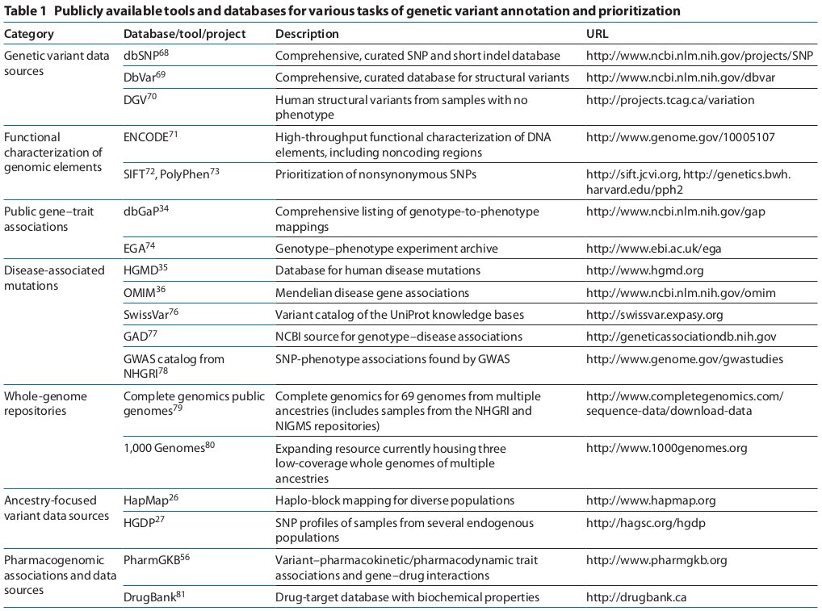





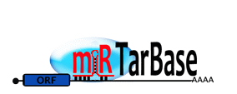

Sources of functional information
Cordero P, Ashley EA. Whole-genome sequencing in personalized therapeutics. Clin Pharmacol Ther. 2012 Jun ;91(6):1001-9. PubMed PMID: 22549284

Slide 5
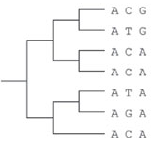
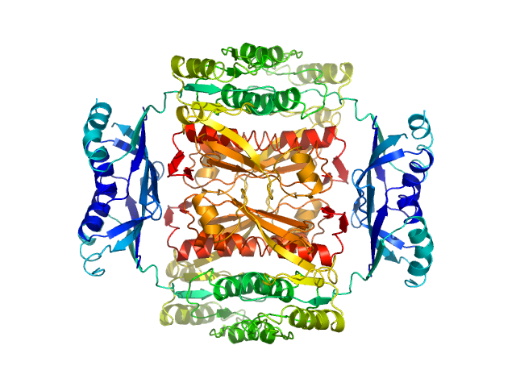
Computational method and tools
Annotated information is sometimes limited, particularly for rare and complex traits
Computational methods can measure deleteriousness by using comparative genomics and knowledge of protein biochemistry and structure
Comparative Genomics
Focus on sequences that have not been remove by natural selection.
Quantify evolutionary changes in genes or genomes and define conserved and neutral regions.
Variants observed in conserved sites are highly likely to be deleterious.
Effects in protein-coding variants
Can combine evolutionary and biochemical information.
Use alignments of homologous proteins to estimate mutational deleteriousness.
Use biochemical data such as amino acid properties, binding information and structural information to estimate the impact.
Effects in non-coding variants
The majority of the human genetic variation is in non-coding regions.
No detectable conservation outside vertebrates.
Main strategy for estimation is testing the mammalian conservation of the non-coding variants.
Cooper GM, Shendure J. Needles in stacks of needles: finding disease-causal variants in a wealth of genomic data. Nature Reviews Genetics. 2011 Aug 18;12(9):628-40. Pubmed PMID: 21850043

Slide 6
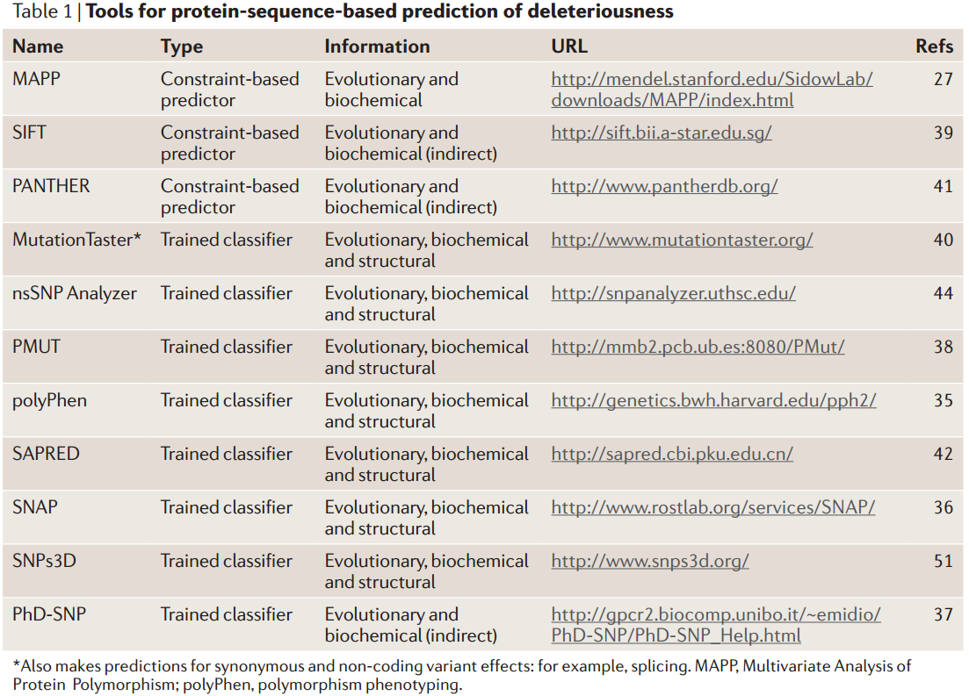
Computational methods and tools
Prediction scores for non-synonymous variants
Kircher M. et al. A general framework for estimating the relative pathogenicity of human genetic variants. Nature Genetics. 2014; Pubmed PMID: 24487276.
Shihab H. A.. et al. An integrative approach to predicting the functional effects of non-coding and coding sequence variation. Bioinformatics. 2014; Pubmed PMID: 25583119.
Cooper GM, Shendure J. Needles in stacks of needles: finding disease-causal variants in a wealth of genomic data. Nature Reviews Genetics. 2011 Aug 18;12(9):628-40. Pubmed PMID: 21850043

Slide 7
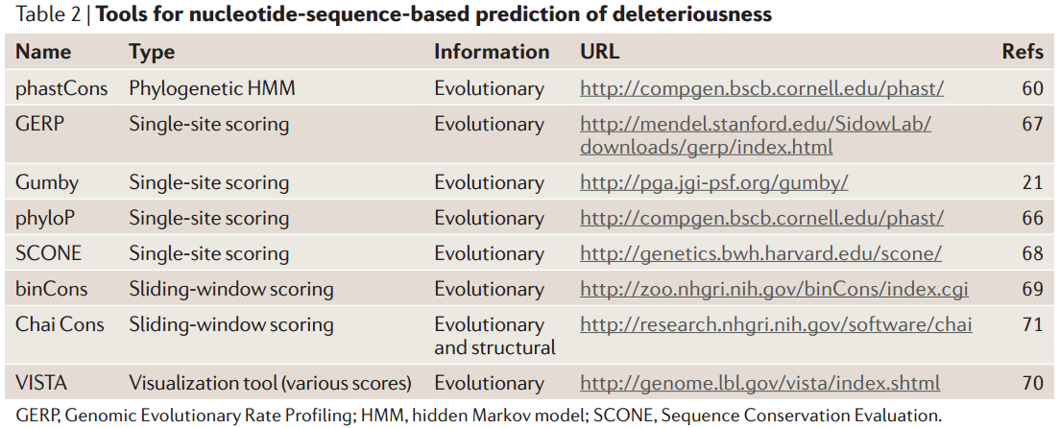
Computational methods and tools
Prediction scores for non-coding variation
Cooper GM, Shendure J. Needles in stacks of needles: finding disease-causal variants in a wealth of genomic data. Nature Reviews Genetics. 2011 Aug 18;12(9):628-40. Pubmed PMID: 21850043

Slide 8
Tools for functional annotation
We need to measure the impact of each variant in the genome
We cannot annotate 25,000 variants manually checking more than 20 databases
Tools integrate biological information and ease the functional annotation of hundreds of thousand variants
PANTHER
HPG VARIANT
SNPseek
SeattleSeq
Annotation
PMUT
LS-SNP
Parepro
SNPs&GO
Oncotator
SNPHunter
CandiSNPer
SCONE
SNPnexus
SNPeffect 4.0
HSF
PHAST
PupaSNP Finder
CUPSAT
FANS
SNP Function Portal
CHASM and SNVBox
SNPper
F-SNP
SNPdbe
SIFT
ABSOLUTE
SCAN
nsSNPAnalyzer
Auto-mute
MutationTaster
PolyPhen-2
AnnTools
FastSNP
PhD-SNP
FOLD-X
MAPP
pfSNP
SNAP
SAPRED
GERP++
PESX
HOPE
QuikSNP
ResqueESE
SNPs3D
SeqAnt
FESD
VEP
PolyDoms
ANNOVAR
MutaGeneSys
MutPred
NGS-SNP
SVA
SiPhy
ESEfinder
GSITIC
ESRSearch
PolyMAPr
MuD
MutSIg
dbNSFP
SeqProfCod
Stephan Pabinger et al. A survey of tools for variant analysis of next-generation genome sequencing data. Briefings in Bioinformatics. 2013 Jan. Pubmed PMID: 23341494
SNP@Domain
I-Mutant2.0
MutationAssesor
Align GVD

Slide 9


AnnoVar
ANNOVAR web site: http://www.openbioinformatics.org/annovar/
Free and open source
Can annotate SNV, insertions and deletions
Regulatory information: Conserved genomic regions, TFBSs, miRNA targets and predicted miRNA secondary structures. ENCODE DNAse I hypersensitive sites, Histone methylations, ChIP and RNA-Seq peaks
DbSNP, 1000 genomes, SIFT and GERP filtering
Predictions: Polyphen, LRT, MutationTaster, PhyloP
Can handle custom annotations in GFF3
Can handle 1 o 0-based coordinates
5 Species (human, mouse, worm, fly, yeast)
Accepts VCF4, GFF3-SOLiD and CSV BUT after conversion to their particular input file:
Perl written program
Installation required
Users need to download every annotation database and save them locally (~35GB per assembly)
Need to be run several times
Output: several files depending on the query
Chr | Start | End | Ref | Obs | Comments
1 | 161003 | 161003 | C | T | comments: rs1000050
Wang K, Li M, Hakonarson H. ANNOVAR: Functional annotation of genetic variants from next-generation sequencing data. Nucleic Acids Research. Sep;38(16):e164 Pubmed PMID: 20601685

Slide 10
AnnoVar
EXAMPLE of ANNOVAR usage
DOWNLOADING BIOLOGICAL DATA:
user@computer:~$ annotate_variation.pl -buildver hg19 -downdb refgene humandb/
user@computer:~$ annotate_variation.pl -buildver hg19 -downdb snp135 -webfrom annovar humandb/
user@computer:~$ annotate_variation.pl -buildver hg19 -downdb phastConsElements46way humandb/
user@computer:~$ annotate_variation.pl -buildver hg19 -downdb 1000g2012apr -webfrom annovar humandb/
user@computer:~$ annotate_variation.pl -buildver hg19 -downdb cytoBand humandb/
EXTRACTING THE EFFECT:
user@computer:~$ annotate_variation.pl -geneanno example/ex1.human humandb/
user@computer:~$ annotate_variation.pl -regionanno -dbtype band example/ex1.human humandb/
user@computer:~$ annotate_variation.pl -filter -dbtype 1000g2012apr_eur example/ex1.human humandb/

Slide 11
Variant Effect Predictor (VEP)
VEP documentation site: http://www.ensembl.org/info/docs/variation/vep/index.html
Backed by Ensembl
Free and open source
3 ways of functionality: web interface, standalone Perl script and Ensembl's Perl API
Input formats: CSV, VCF, Pileup and HGVS
Regulatory information: TFBSs
Filtering by coding regions and MAF
Predictions: SIPF, PolyPhen
1000 genomes and dbSNP information
Uses Sequence Ontology
Many species
Regulatory information does not include miRNA targets
The standalone Perl script needs:
  Perl and MySQL support
  Download, install and update every ~ 2 months
Perl API requires:
  Installation
  Downloads and update
  API documentation → Hard to understand
McLaren W, Pritchard B, Rios D, Chen Y, Flicek P, Cunningham F. Deriving the consequences of genomic variants with the Ensembl API and SNP Effect Predictor. BMC Bioinformatics 26(16):2069-70(2010) Pubmed PMID: 20562413

Slide 12
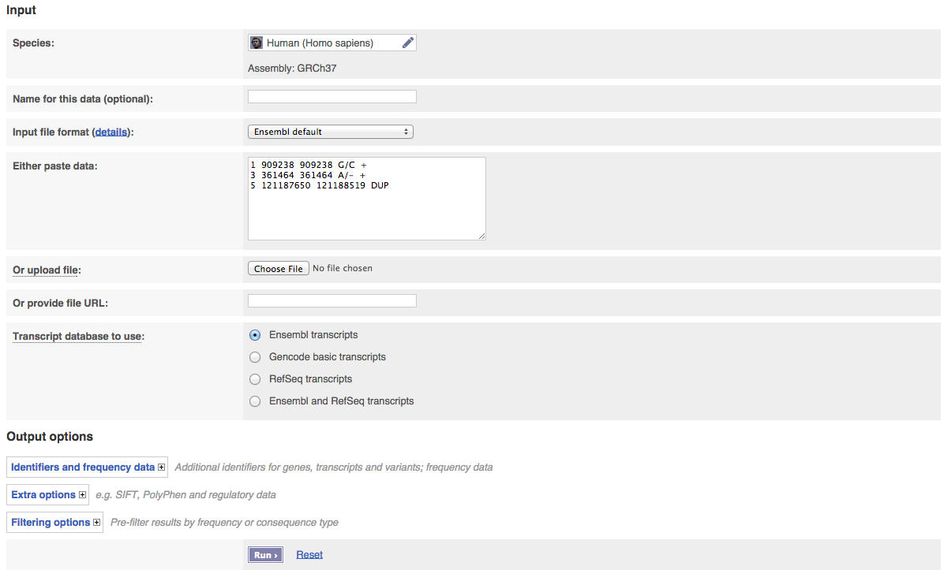
Variant Effect Predictor (VEP)
VEP web interface: http://www.ensembl.org/Homo_sapiens/Tools/VEP
McLaren W, Pritchard B, Rios D, Chen Y, Flicek P, Cunningham F. Deriving the consequences of genomic variants with the Ensembl API and SNP Effect Predictor. BMC Bioinformatics 26(16):2069-70(2010) Pubmed PMID: 20562413

Slide 13
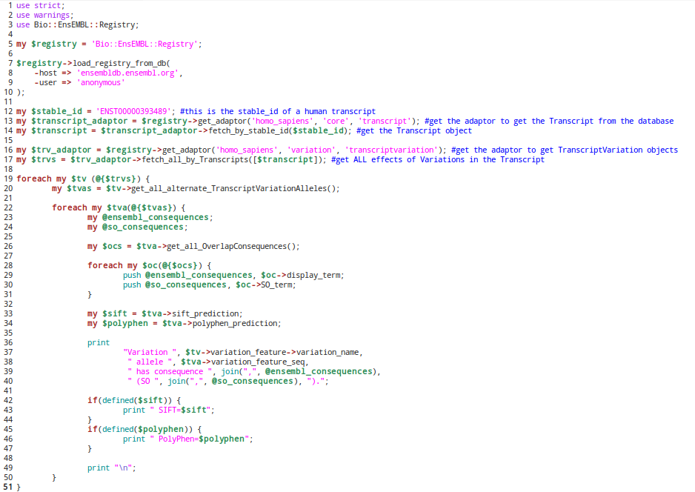
Variant Effect Predictor (VEP)
EXAMPLE of API usage: Getting all variations in a particular human transcript and see what is the effect of that variation in the transcript
McLaren W, Pritchard B, Rios D, Chen Y, Flicek P, Cunningham F. Deriving the consequences of genomic variants with the Ensembl API and SNP Effect Predictor. BMC Bioinformatics 26(16):2069-70(2010) Pubmed PMID: 20562413

Slide 14

HPG-VARIANT (aka VARIANT)
HPG-VARIANT web site: http://www.opencb.org/projects/hpg/doku.php?id=variant:overview
Free and open source.
3 ways of functionality: C CLI program, Web application and Java RESTful WS API
Cloud variant annotator. Requires no installation or updates
Regulatory information: Conserved genomic regions, TFBSs and miRNA targets. ENCODE DNAse I hypersensitive sites and Histone methylations
dbSNP and 1000genomes information
Phenotypic information: HGMD, COSMIC and OMIM
Cross-link with many other DDBB (Ensembl, UniProt, PDB, etc)
Polyphen and SIFT
Input: VCF, GFF and BED. Accepts compressed files in tar.gz
11 species (human, mouse, rat, zebra fish, worm, fly, yeast, dog, pig, mosquito and plasmodium)
HPG-VARIANT-GWAS to test for association
Young program, many new features coming
  PhastCons, GERP
  Many more species (~25 new species)
  Large structural variants annotation
Medina I, De Maria A, Bleda M, Salavert F, Alonso R, Gonzalez CY, Dopazo J. VARIANT: Command Line, Web service and Web interface for fast and accurate functional characterization of variants found by Next-Generation Sequencing. Nucleic Acids Research. 2012 Jul;40(Web Server issue):W54-8 Pubmed PMID: 22693211

Slide 15
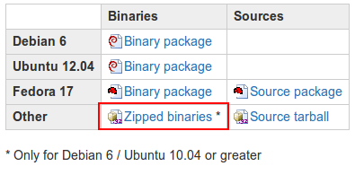
HPG-VARIANT (CLI Program)
Download the program and save it into your course/variant_annotation folder :
http://wiki.opencb.org/projects/hpg/doku.php?id=variant:downloads
Extract the contents
Add the folder to your PATH
echo "export PATH=$PATH:/home/Desktop/hpg-variant-1.0" >> ~/.bashrc
source ~/.bashrc
Usage:
hpg-var-effect -v CHB.exon.2010_03.sites.vcf --outdir effect_output/

Slide 16
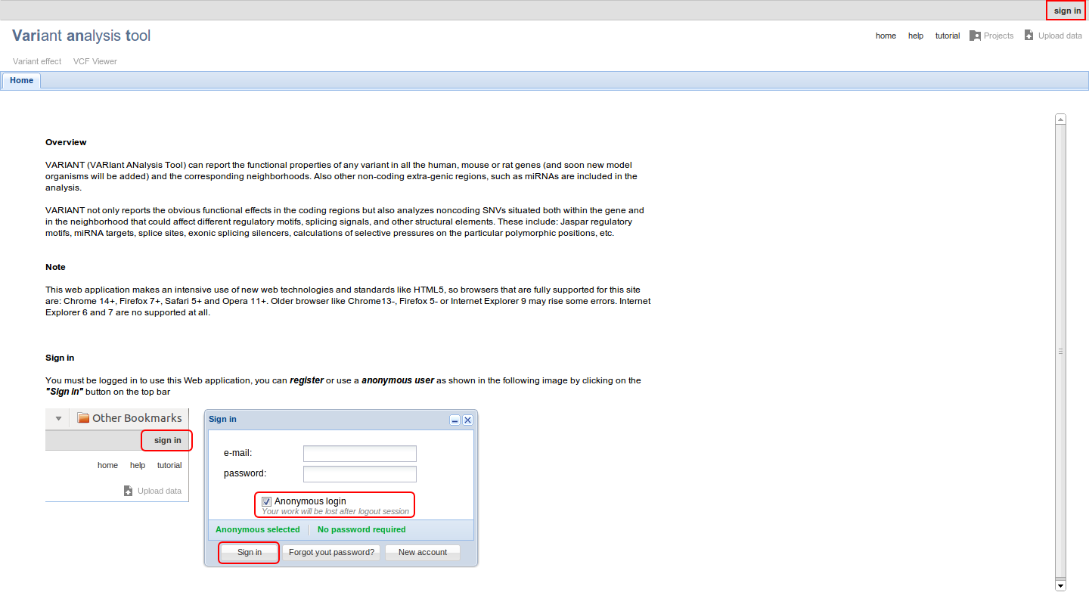
HPG-VARIANT
Web application
Web application
http://variant.bioinfo.cipf.es/

Slide 17
CellBase – New v3.1.0 coming soon... https://github.com/opencb/cellbase/
NoSQL database that integrates the most relevant biological information:
  Core features: genes, transcripts, exons, proteins, genome sequence, etc.
  Regulatory: Ensembl regulatory, TFBS, miRNA targets, CTCF, Open chromatin, etc.
  Functional annotation: OBO ontologies (Gene Ontology, Human Disease Ontology), etc.
  Genomic variation: Ensembl Variation, ClinVar, COSMIC, etc.
  Systems biology: IntAct , Biogrid, Reactome, gene co-expression, etc.
  More than 20 species available
An exhaustive RESTful Web service API has been implemented:
  http://wwwdev.ebi.ac.uk/cellbase/webservices/rest/v3/hsapiens/genomic/region/22:17449263:17449264/gene
New features included in v3.1.0
  New CLI that integrates CellBase building and query commands
  New Variant Annotation functionality
  New data:
    RefSeq annotation
    DisGeNET
Bleda M, et al. CellBase, a comprehensive collection of RESTful web services for retrieving relevant biological information from heterogeneous sources. Nucleic Acids Research. 2012 Pubmed PMID: 22693220

Slide 18
CellBase – Annotator features https://github.com/opencb/cellbase/
Free and open source
Functionality
  CLI
  cellbase.sh query –category genomic –subcategory variant –id-file CHB.exon.2010_03.sites.vcf > CHB.exon.2010_03.sites.annotations.json
  RESTful API
  http://wwwdev.ebi.ac.uk/cellbase/webservices/rest/v3/hsapiens/genomic/variant/19:45411941:T:C/full_annotation
Variant annotation data:
  Consequence type in Ensembl and RefSeq genes (Sequence Ontology)
  Regulatory regions: TFBS, miRNA target, ENCODE
  Conservation scores: GERP++, phastCons and phyloP.
  Protein substitution effect scores: PolyPhen-2, SIFT
  Control studies frequencies: 1000 genomes, GoNL, Spanish Variation, EVS and uk10k
  CADD, MutationTaster, FATHMM-MKL
  Gene/Transcript Expression: Gene Expression Atlas
  Drugs: DrugBank data
  Clinical phenotype information: ClinVar, COSMIC, GWAS catalog, HGMD, disease gene panels
  Functional annotation: GO and Reactome
  Systems Biology: PPI centrality from IntAct data.
Bleda M, et al. CellBase, a comprehensive collection of RESTful web services for retrieving relevant biological information from heterogeneous sources. Nucleic Acids Research. 2012 Pubmed PMID: 22693220

Slide 19
CellBase – Annotator features https://github.com/opencb/cellbase/
No installation needed
No need to download databases
  No point on moving Gbs of data to every local machine
  No worries about data updates. Data will only be updated in the server
  Do not need great computer specs on the client machine: annotation code is run in a remote server
Bleda M, et al. CellBase, a comprehensive collection of RESTful web services for retrieving relevant biological information from heterogeneous sources. Nucleic Acids Research. 2012 Pubmed PMID: 22693220

Slide 20
THANK YOU.

Slide 21
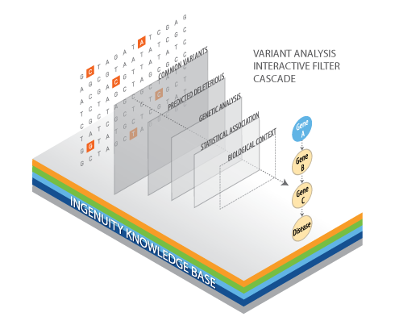
The objective

Slide 22

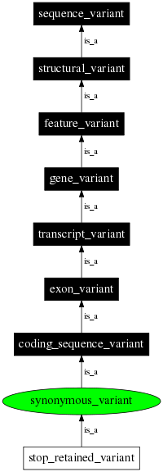
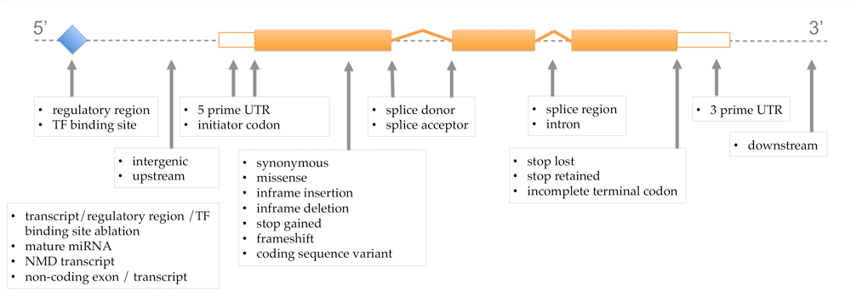
Consequence types
The standard: Common vocabulary
Label | SO accession | Description
Coding sequence | SO:0001580 | In coding sequence with in determinate effect
Synonymous codon | SO:0001588 | In coding sequence, not resulting in an amino acid change (silent mutation)
Non-synonymous codon | SO:0001583 | In coding sequence and results in an amino acid change in the encoded peptide sequence
Stop gained | SO:0001587 | In coding sequence, resulting in the gain of a stop codon
Stop lost | SO:0001587 | In coding sequence, resulting in the gain of a stop codon
Splice site | SO:0001630 | 1-3bps in to an exon or 3-8bps into an intron
Splice acceptor | SO:0001574 | A splice variant that changes the 2 base region at the 3' end of an intron
Splice donor | SO:0001575 | A splice variant that changes the 2 base region at the 5' end of an intron
5' UTR | SO:0001623 | In 5 prime untranslated region
3' UTR | SO:0001624 | In 3 prime untranslated region
Upstream | SO:0001635 | Within 5kb upstream of the 5 prime end of a transcript
Downstream | SO:0001633 | Within 5kb downstream of the 3 prime end of a transcript
TFBS | SO:0001782 | A sequence variant located with in a transcription factor binding site
miRNA target | SO:0000934 | A binding site where the molecule is a microRNA
Intergenic | SO:0001628 | More than 5 kb either upstream or downstream of a transcript
More information: http://www.ensembl.org/info/docs/variation/predicted_data.html

Slide 23
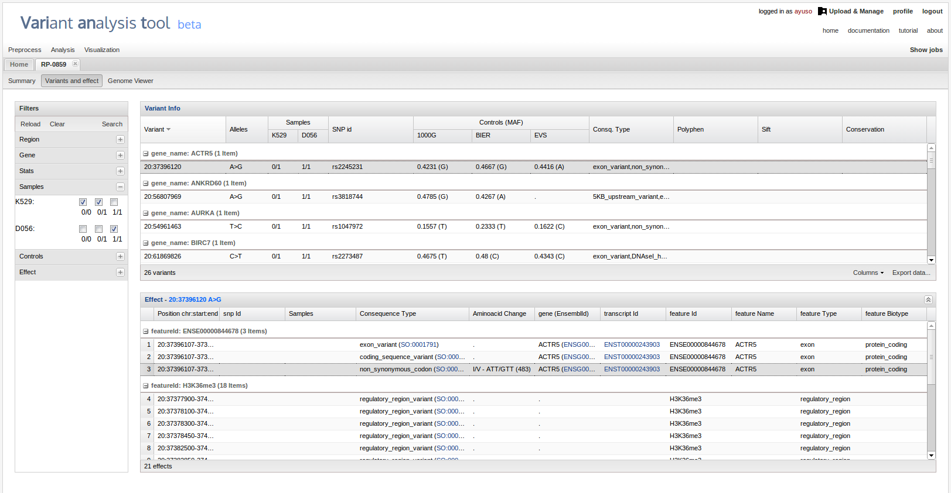
BierApp
Bierapp.babelomics.org

Slide 24

HPG VARIANT – CLI program
Open the effect_output directory and let's see what is in!
Is there any variant affecting a splice donor site?
Yes! There are 4 variants in a splice donor site affecting 5 genes: CEP104, HSE4, C1orf159, CALML6 and C1ORF222.
Is there any SNP with known phenotype?
Yes! There are 39 SNPs with known phenotype. They have been associated with Migraine, Alzheimer's disease, Ulcerative colitis, Rheumatoid arthritis, etc.

