Slide 1



Course Presentation
Ignacio Medina
im411@cam.ac.uk
Presentation

Slide 2
Index
Introduction
Agenda
Analysis pipeline
Some considerations
Ignacio Medina
im411@cam.ac.uk
Presentation

Slide 3
Introduction
Who we are
Teachers:
  Marta Bleda: Computational Biologist and Data Analyst at Department of Medicine, Addenbrooke's Hospital (University of Cambridge)
  Ignacio Medina:
    Head of Computational Biology Lab, HPCS, University of Cambridge, UK
    Team Leader for Bioinformatic Software Development, Genomics England, London, UK
    Scientific Collaborator at EMBL-EBI Variation team (Cambridge, UK)
Everything started at Joaquin Dopazo's group at CIPF:
  http://bioinfo.cipf.es/
More than 10 years of experience in microarrays & NGS data analysis and developing methodologies and bioinformatics tool for data analysis. Many suites and tools developed: GEPAS, Babelomics, Genome Maps, BierApp, VARIANT, ...
More than 60 papers in the last 8 years in peer reviewed journals: NAR, Bioinformatics, Nat. Biotech., …
Many active collaborations with experimental and clinic groups
Many international courses run during last years: Massive Data Analysis (MDA)
Ignacio Medina
im411@cam.ac.uk
Presentation

Slide 4
Introduction
Goals, ambitious
To learn the basics to understand and be able to conduct a standard NGS data analysis from scratch in a Linux environment
To know and understand the different data analysis pipelines and formats (FASTQ, SAM/BAM, VCF)
To preprocess and perform QC of raw and processed data
To learn and use the most widely used tools to perform NGS data analysis and visualization
To learn the basics of the functional interpretation of variant (DNA re-sequencing)
To understand the limitation of current technologies and know where are we heading
Optional, learn how to install NGS software in Linux and how to tune up data analysis pipelines by simulating data
Ignacio Medina
im411@cam.ac.uk
Presentation

Slide 5
Program
First day
09:00 Welcome and Course presentation
09:30 Introduction to Next Generation Sequencing (NGS)
10:15 Introduction to NGS data analysis & GNU/Linux shell
10:45 Coffee Break
11:00 FastQ Quality Control for NGS Raw Data (theory & hands-on)
12:30 Lunch Break
13:30 Mapping NGS Reads for Genomic (theory & hands-on)
15:00 Coffe Break
15:15 Mapping NGS Reads for Genomic (theory & hands-on)
16:00 Mapping Quality Control and Visualization (theory and hands-on)
17:00 Optional: A more advanced Linux session. NGS software Installation (1h)
Ignacio Medina
im411@cam.ac.uk
Presentation

Slide 6
Program
Second day
09:00 Germline Variant Calling and variant visualization (theory & hands-on)
10:30 Coffee Break
10:45 Somatic Variant Calling and discovery of de novo mutations
12:00 Variant filtering
12:30 Lunch Break
13:30 Variant Annotation (theory & hands-on)
14:15 OpenCGA Variant Storage
15:15 Tea Break
15:30 Rare variant association tests: single variant and burden analysis
16:30 Troubleshooting and help with own data analysis
??:?? Finish
Ignacio Medina
im411@cam.ac.uk
Presentation

Slide 7

Analysis pipeline
Fastq
Sequence preprocessing
FastQC, Cutadapt
Fastq
Mapping
DNA: BWA, HPG Aligner, ...
RNA: TopHat, STAR, HPG Aligner
BAM
Visualization
IGV, Genome Maps
Exome and Genome Analysis
(DNA)
BAM
RNA-seq Analysis
(RNA)
GATK
MuTect
Variant calling
RNA-Seq processing
CuffLinks
VCF
Count matrix
Ensembl VEP
Annovar
CellBase
Variant annotation
RNA-Seq data analysis
CuffDiff
BierApp, ...
Prioritization
Functional analysis
Babelomics
Ignacio Medina
im411@cam.ac.uk
Presentation

Slide 8

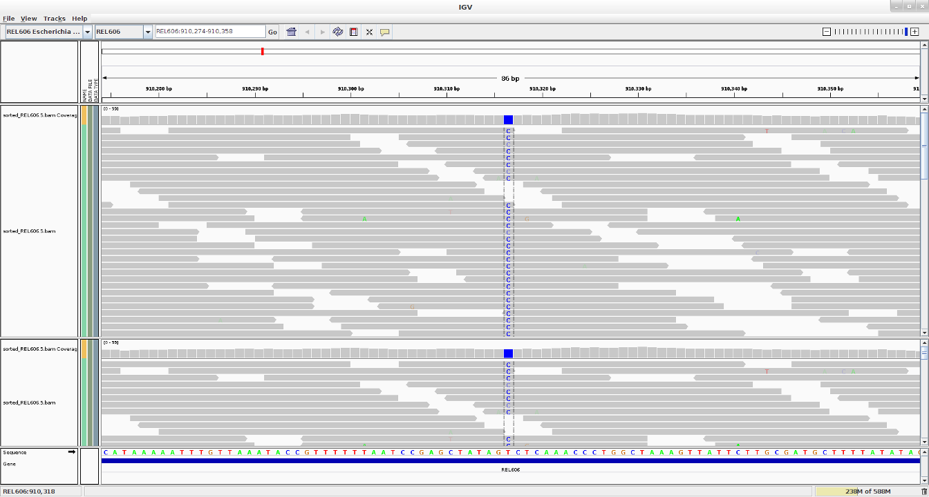
Analysis pipeline
Aligning reads, the coverage
Coverage (read depth or depth) is the average number of reads representing a given nucleotide in the reconstructed sequence.
It can be calculated from the length of the original genome (G), the number of reads(N), and the average read length(L) as NxL/G. For example, a hypothetical genome with 2,000 base pairs reconstructed from 8 reads with an average length of 500 nucleotides will have 2x redundancy.
Useful for:
Error sequencing detection
Copy number detection
Genotyping
...
Current re-sequencing projects target to 40x depth
Ignacio Medina
im411@cam.ac.uk
Mapping NGS reads for genomic studies

Slide 9
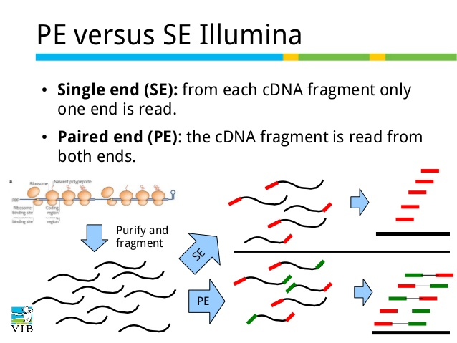
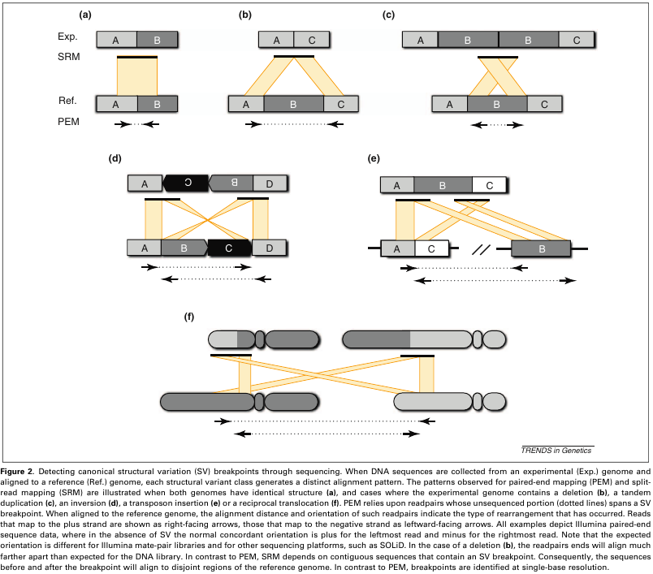
Analysis pipeline
paired-end vs single-end alignment
Paired-end sequencing:
Improves read alignment and therefore variant calling
Helps to detect structural variation
Can detect gene fusions and splice junctions
Useful for de novo assembly
...
Ignacio Medina
im411@cam.ac.uk
Mapping NGS reads for genomic studies

Slide 10
Some considerations
NGS data can be big, very big, huge! Biology is now a Big Data science
  There are not many web-based or graphical applications to perform analysis yet, sorry.
  Most tools developed to work on Linux, many command line programs
How to work in NGS?
  Small datasets (<1TB): workstations
  Medium sized datasets (<100TB): clusters
  Big datasets (100TB-20PB): big clusters and/or cloud based solutions
Exercises during this course the NGS alignment will be done using the human chromosome 21 as a reference genome. By doing this we can speed up exercises and avoid using too much memory. Under real circumstances, when using the standard reference genome, all the commands are exactly the same
Software has been already installed to save time, so you are not expected to download and install all the software it is going to be used. However, it's usually good to learn the basics of software installation in Linux, there is an optional session at the end of the first day for those that want to learn how to install NGS software in a standard Linux
Ignacio Medina
im411@cam.ac.uk
Presentation

Slide 11
What about you?
Brief presentation
Who are you?
Which is your background?
Which is your interest?
What do you expect of this course?
Ignacio Medina
im411@cam.ac.uk
Presentation

