Slide 1





Introduction to Linux Shell
Ignacio Medina
imedina@ebi.ac.uk
Presentation

Slide 2
Index
Introduction
Most useful shell commands
Ignacio Medina
imedina@ebi.ac.uk
Presentation

Slide 3
Introduction
What is GNU/Linux and the Shell?
GNU/Linux is a free and open-source operating system developed by thousands of contributors and led by Linus Torvalds since the beginning in 1991
Linux shells (commonly Bash) allow users to execute more than 200 commands and to write pipelines in the Shell Script programming language to automatize tasks
Linux is widely used in research and super computers, more than 96% of super computers use Linux:
  http://www.top500.org/statistics/list
It's an essential tool for bioinformatics and big data analysis and research
Ignacio Medina
imedina@ebi.ac.uk
Presentation

Slide 4
Introduction
Why we use Linux?
Linux offers:
  Ease to program and work with big data
  Stability
  Security
  Low price
  High-performance computing
  ...
Usually visual graphical interfaces to software does not exist
Ignacio Medina
imedina@ebi.ac.uk
Presentation

Slide 5
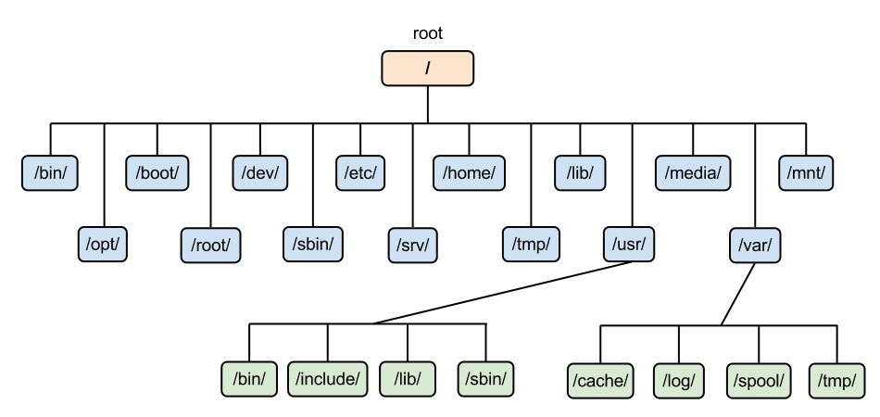
Introduction
Linux filesystem
All paths start at '/' called root, no C: or D: like in Windows. Similar to other Unix-like systems such as Mac OS
Users home folders under '/home', ie. /home/participant
Ignacio Medina
imedina@ebi.ac.uk
Presentation

Slide 6
Introduction
Understanding paths
A path identifies uniquely a file or directory in the file system.
The character '/' is used to concatenate directories
IMPORTANT - Two types of paths:
  Absolute: Always start with '/' which is the root folder. Example:
    ls /home/participant/Desktop
  Relative: All paths not beginning with '/' but with a file o folder name. Example
    ls Desktop
'Tab' key is your friend, auto-completes the paths for you if you press twice
Ignacio Medina
imedina@ebi.ac.uk
Presentation

Slide 7
Introduction
Understanding $PATH variable
A $PATH is a environment variable that list all directories with binaries (executable programs)
You can see the list by executing:
  echo $PATH
All binaries in one of these directories can be executed automatically in the shell, no absolute path is needed
You can use 'Tab' key twice to autocomplete the binary name
Ignacio Medina
imedina@ebi.ac.uk
Presentation

Slide 8
Most useful commands
Working with files and directories
Many tutorials and documentation:
  http://linuxcommand.org/learning_the_shell.php
Inline help in the shell using command 'man', ie. man ls
Some useful shell commands:
  cd
  ls
  mkdir and rm
  pwd
  mv
  cp
  less, head and tail
  tree
  Output redirection: '>'
  ...
Ignacio Medina
imedina@ebi.ac.uk
Presentation

