Slide 1




Ignacio Medina
im411@cam.ac.uk
Head of Computational Biology Lab, HPCS
University of Cambridge, UK
EMBL-EBI Scientific Collaborator (imedina@ebi.ac.uk)
Ignacio Medina
im411@cam.ac.uk
Mapping NGS reads for genomic studies

Slide 2

Where are we?
Fastq
Sequence preprocessing
Fastq
Alignment
BAM
Visualization
BAM
Variant calling
RNA-Seq processing
Exome analysis
VCF
Count matrix
RNA-Seq analysis
Variant annotation
RNA-Seq data analysis
Prioritization
Functional analysis
Ignacio Medina
im411@cam.ac.uk
Mapping NGS reads for genomic studies

Slide 3
Index
Introduction
Algorithms and Tools
HPG Aligner
SAM/BAM specification
Best practices
Data repositories
Hands on
QC alignment
Ignacio Medina
im411@cam.ac.uk
Mapping NGS reads for genomic studies

Slide 4
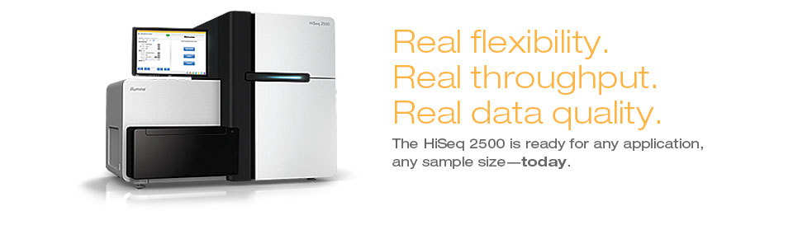
Introduction
The NGS data, some numbers and features
Read length: current read sizes ranging from 100-800bp, up to 15kb coming soon
Sequencing libraries: single-end and paired-end sequencing
Some pitfalls: sequencing errors, low quality reads, duplicated reads
Different Analysis pipelines: Exome vs Genome sequencing, RNA-seq (transcriptomics), germline vs somatic variant call, BS-seq, ChIP-seq, ...
Illumina series:
  HiSeq 2500 provides high-quality 2x125bp: 50-1000Gb in 1-6 days, 90.2% bases above Q30. One human genome at ~60x coverage
  HiSeq 4000 provides high-quality 2x150bp: 125-1500Gb in 1-4 days, >75% bases above Q30. Up to 12 human genomes at ~40x coverage
Each sample produces a fastq file ~500-1500GB size containing ~500-2500M reads
New Illumina X Ten: Consists if 10 ultra-high-throughput HiSeq X sequencers. First $1000 human genome sequencer, it can sequence up to 20.000 genomes per year
Mapping goes from FASTQ to SAM/BAM files
Ignacio Medina
im411@cam.ac.uk
Mapping NGS reads for genomic studies

Slide 5
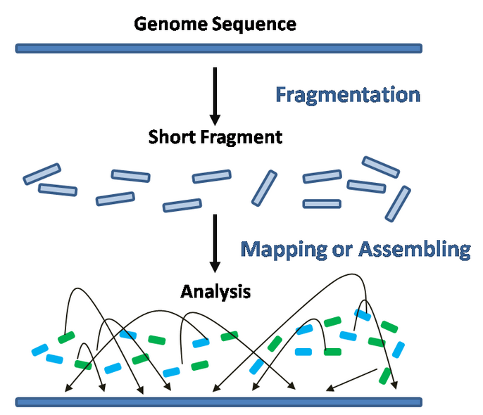
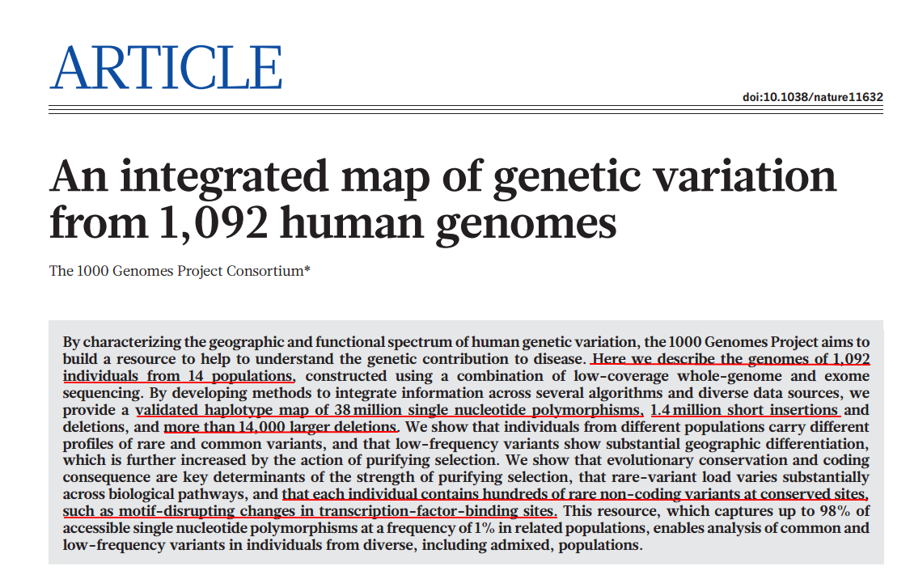
Introduction
Aligning reads, the challenges
Mapping reads onto a reference genome, a simple concept but there are some challenges:
  Natural variability: SNPs, de novo mutations, INDELS, copy number, translocations, …
  Repetitive regions
  Sequencing errors
  RNA-seq: gapped alignment
  BS-seq: C → T conversion strategy
  High computing resources needed: multicore CPUs and a lot of RAM
We must deal with genomic variation in an efficient way
Simple idea, but with some challenges
Ignacio Medina
im411@cam.ac.uk
Mapping NGS reads for genomic studies

Slide 6

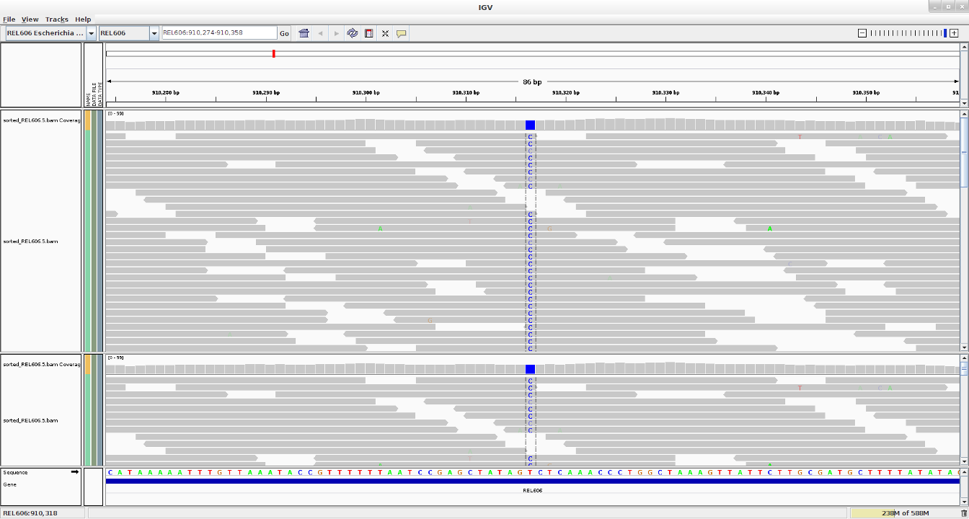
Introduction
Aligning reads, the coverage
Coverage (read depth or depth) is the average number of reads representing a given nucleotide in the reconstructed sequence.
It can be calculated from the length of the original genome (G), the number of reads(N), and the average read length(L) as NxL/G. For example, a hypothetical genome with 2,000 base pairs reconstructed from 8 reads with an average length of 500 nucleotides will have 2x redundancy.
Useful for:
Error sequencing detection
Copy number detection
Genotyping
...
Current re-sequencing projects target to 40x depth
Ignacio Medina
im411@cam.ac.uk
Mapping NGS reads for genomic studies

Slide 7
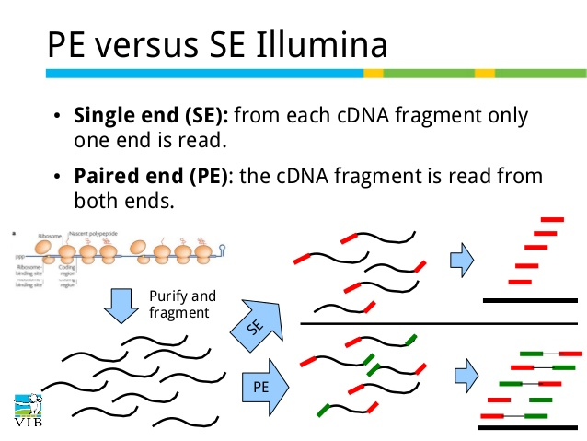
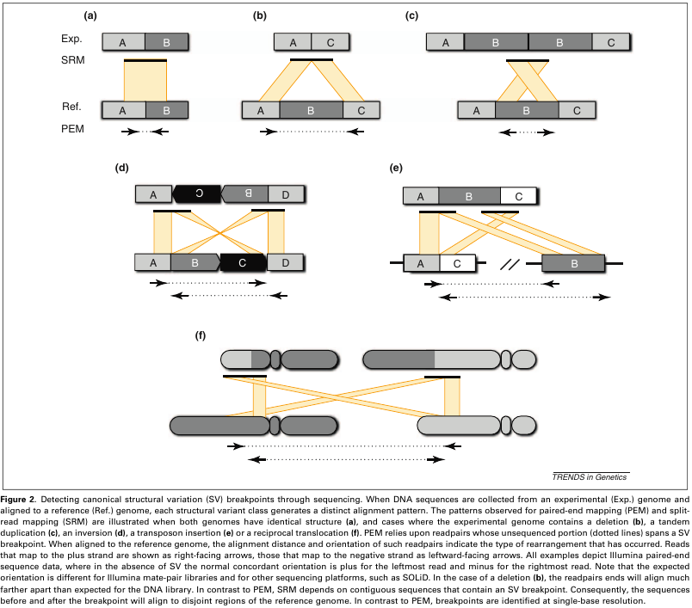
Introduction
single-end vs paired-end alignment
Paired-end sequencing:
Improves read alignment and therefore variant calling
Helps to detect structural variation
Can detect gene fusions and splice junctions
Useful for de novo assembly
...
Ignacio Medina
im411@cam.ac.uk
Mapping NGS reads for genomic studies

Slide 8
Introduction
Getting a reference genome
A reference genome is a consensus sequence built up from high quality sequenced samples from different populations. It is the control reference sequence to compare our samples
Genome Reference Consortium (GRC) created to deliver assemblies:
  http://www.ncbi.nlm.nih.gov/projects/genome/assembly/grc/
Current human assembly is GRCh38, released in the summer of 2014. Many genomic regions corrected and improved such as centromeres. There are 261 new ALT regions. NGS aligners and variant callers not ALT-aware yet. Major projects are considering to use it.
Reference genomes can be downloaded from:
  GRC: Human genome available at: ftp://ftp.ncbi.nlm.nih.gov/genbank/genomes/Eukaryotes/vertebrates_mammals/Homo_sapiens/GRCh37/Primary_Assembly/assembled_chromosomes/FASTA/
  Ensembl: many available vertebrates genomes http://www.ensembl.org/info/data/ftp/index.html
  Ensembl Genomes: http://ensemblgenomes.org/
Ignacio Medina
im411@cam.ac.uk
Mapping NGS reads for genomic studies

Slide 9
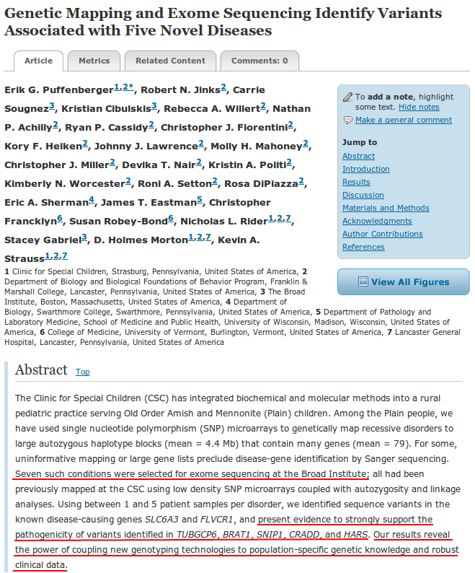
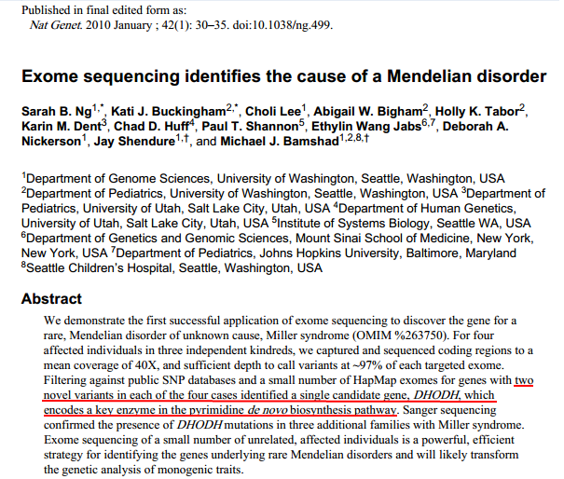
Introduction
NGS in clinics, proof of concept
Ignacio Medina
im411@cam.ac.uk
Mapping NGS reads for genomic studies

Slide 10
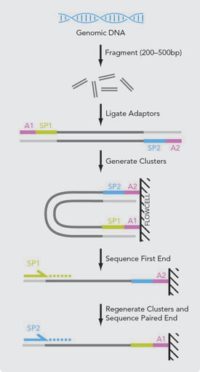
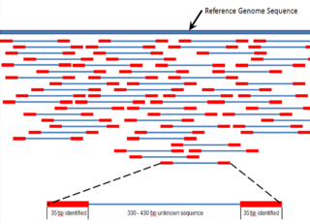
Introduction
The mapping process considerations
Considerations:
  Which tool to use? What am I looking for? SNVs? INDELS? Long reads?
  Is it DNA or RNA?
  Single-end or paired-end? Paired-end when:
    For very short reads, reduce the number
    of false positives alignments
    Re-sequencing projects, Rna-seq?
    Am I interested in Structural variation or
    gene fusions?
    Reduce number of false positive variants
  Should I allow multiple hits?
  Should I remove low quality reads?
In general for genomic variant analysis we need high quality reads, paired-end datasets work better, and no multiple hits must be allowed
Taken from Illumina
Ignacio Medina
im411@cam.ac.uk
Mapping NGS reads for genomic studies

Slide 11
Algorithms and tools
Desirable features of a aligner
Goals
  Sensitivity, we are looking for genomic variants, reads with mismatches and INDELS must be properly aligned
  Specificity, no wrong alignments should be provided
  Being able to perform gapped alignments (RNA), exons must be correctly located
  Good performance, efficiency matters
  Easy to use
  Open-source and maintained
  Capable of align different data types: DNA, RNA-seq, BS-seq, …
Unfortunately... most tools or algorithms only work well in a specific scenario
New project called High-Performance Genomics (HPG) that is part of the OpenCB initiative tries to solve this
Ignacio Medina
im411@cam.ac.uk
Mapping NGS reads for genomic studies

Slide 12
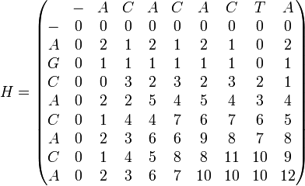
Algorithms and tools
Smith-Waterman (SW) algorithm
SW finds the optimal local alignment between:
Sequence 1 = ACACACTA
Sequence 2 = AGCACACA
Very popular algorithm developed in 1981
Provides a very high sensitivity, allowing alignments with any number of mismatches, insertions and deletions
Gives an optimal alignment between two sequences given a penalties, it is not a mapper but an sequence aligner
No suitable for whole genome alignment: for a 100bp read and the human genome 3Gb, the matrix dimension: 100x3.10⁹, using 4 Bytes for integers: 1.2TB of RAM !!
Although dynamic programming techniques are applied to make SW more efficient, the CPU requirements are still too high, SW is too slow for NGS
Given gap-scoring penalties:
w(match) = +2
w(a,-) = w(-,b) = w(mismatch) = -1
Alignment result:
Sequence 1 = A - C A C A C T A
Sequence 2 = A G C A C A C - A
Ignacio Medina
im411@cam.ac.uk
Mapping NGS reads for genomic studies

Slide 13
Algorithms and tools
BLAST, Basic Local Alignment Search Tool
BLAST is one of the most widely used programs in Bioinformatics developed in 1990 at NIH. Allows comparing and searching amino-acid and DNA sequences in a database of sequences
BLAST uses a heuristic algorithm to speed-up searches, it is much faster than calculating an optimal alignment with Smith-Waterman, but it cannot guarantee the optimal alignment of the query sequence in the database. It searches the most relevant seeds from query sequence in exact way and then SW is applied
It presents a high sensitivity, allowing alignments with any number of mismatches, insertions and deletions, it can be used to align sequence between species
However, it is still too slow for NGS mapping, blast can align few thousands sequences per hour
Ignacio Medina
im411@cam.ac.uk
Mapping NGS reads for genomic studies

Slide 14
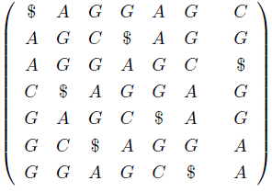
Algorithms and tools
Burrows-Wheeler Transform (BWT) algorithm
BWT is an algorithm used in data compression techniques such as bzip2
It efficiently align short sequencing reads against a large reference sequence such as the human genome, a prefix tree index is created using reference genome
In the transformation all permutations are sorted and all suffixes are grouped
It is much faster than BLAST, it can align hundred of thousands sequences per second!
However, it presents a lower sensitivity, it can allow a few mismatches, and in some implementation one INDEL
0,6
C
1,2
A
G
3,3
^
G
C
4,6
G
1,2
4,4
4,4
A
G
5,5
G
1,2
6,6
A
6,6
^
G
A
1,1
A
1,2
4,4
2,2
G
0 1 2 3 4 5 6
2,2
G
^
4,4
R= “A G G A G C $”
^
6,6
2,2
G
0
1
2
3
4
5
6
6
3
0
5
2
4
1
2,2
A
6,6
2,2
A
^
2,2
2,2
^
2,2
Ignacio Medina
im411@cam.ac.uk
Mapping NGS reads for genomic studies

Slide 15
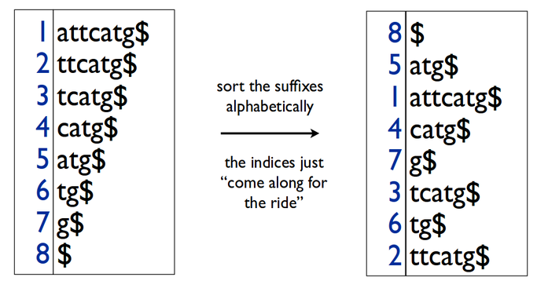
Algorithms and tools
Suffix Arrays (SA) algorithm
SA uses more memory than other related compressed data structures like BWT
It very efficiently aligns sequencing reads against a large reference sequence such as the human genome, a suffix array index is created using reference genome
Since it is not compressed the performance achieved is higher than with BWT, it can align million sequences per second in modern CPUs!
Depending on the alignment strategy, a high sensitivity can be achieved, it can allow a relative high number of mismatches, and in some implementations several INDELs
Ignacio Medina
im411@cam.ac.uk
Mapping NGS reads for genomic studies

Slide 16
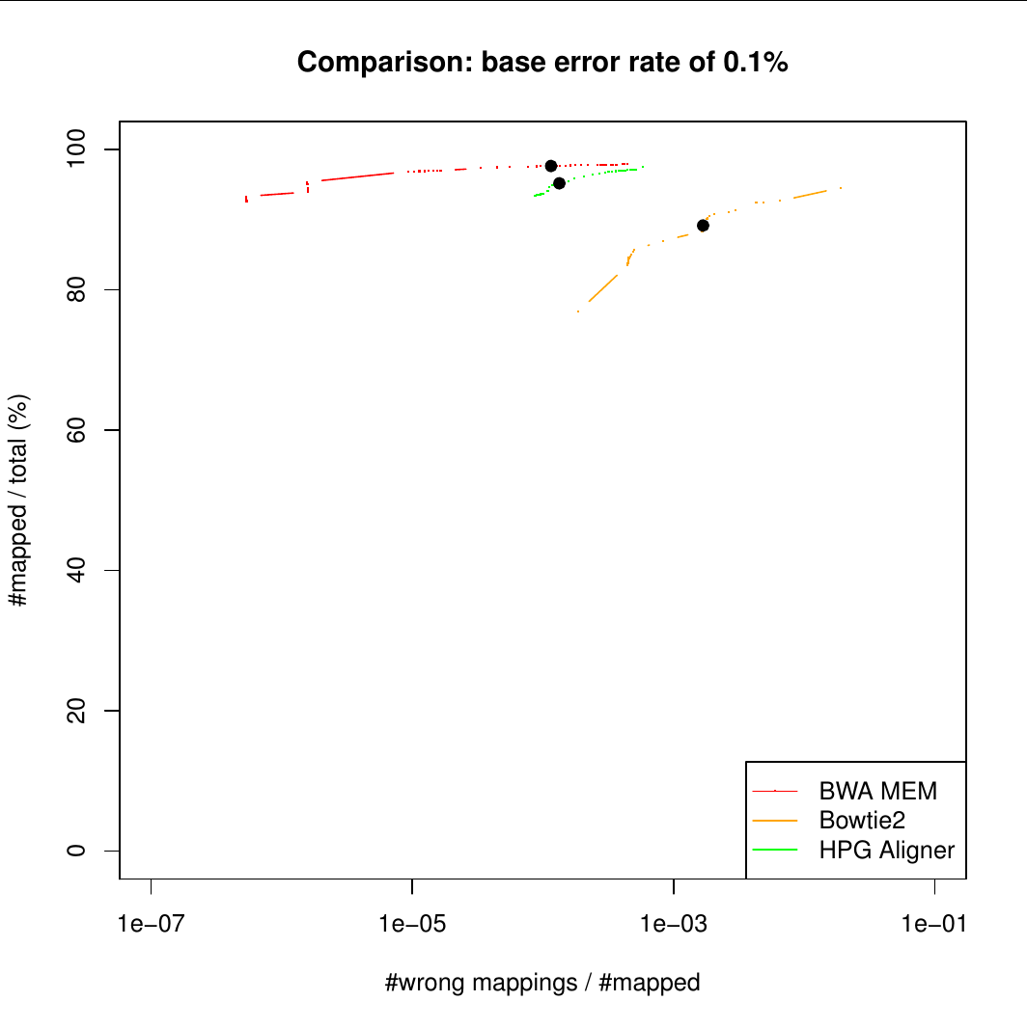
Algorithms and tools
Many aligners available, which to use?
Many aligners available, more than 70!!
  http://wwwdev.ebi.ac.uk/fg/hts_mappers/
Can be difficult to select one, some criteria
  Type of analysis: dna, rna, meth
  Number of cites
  ...
Selecting an aligner: simulate datasets to choose the best:
  Which one is more sensitive to INDELS?
  Which produce less false positives alignments
  Which RNA aligner works better with low coverage?
  …
All of them work similarly
  Reference genome index: this index can be a Burrows-Wheeler Transform (BWT), Suffix array (SA), …
  The reads are aligned to that index or are split in seeds an then aligned, seeds aligned are clustered together
  In general poor performance when high number of mismatches or INDELS are present
Ignacio Medina
im411@cam.ac.uk
Mapping NGS reads for genomic studies

Slide 17
Algorithms and tools
DNA: BWA, BWA-SW and BWA-MEM
BWA stands from Burrows-Wheeler Aligner, developed by R. Durbin at Sanger Institute
  http://bio-bwa.sourceforge.net/
It was one of the first NGS mappers and is the most widely used, provides very good results in common scenarios
It implements BWT and Suffix Arrays (SA) with support for few errors:
  BWA-SW and BWA-MEM both tolerate more errors given longer alignment. Simulation suggests that they may work well given 2% error for an 100bp alignment, 3% error for a 200bp, 5% for 500bp and 10% for 1000bp or longer alignment
Implementation is in C and it is multi-thread, but lacks some features such as support for RNA-seq or big INDELS
Not designed to take advantage of new technologies and clusters, not specially fast
Ignacio Medina
im411@cam.ac.uk
Mapping NGS reads for genomic studies

Slide 18
Algorithms and tools
DNA: Bowtie and Bowtie2
Bowtie allowed a few mismatches (<3) and no gaps, claimed to be the fastest, but it missed many reads
Bowtie2 improved sensitivity when compared to Bowtie:
  http://bowtie-bio.sourceforge.net/bowtie2/index.shtml
Widely used, however it is a little bit less sensitivity than BWA, fail to correctly map many mismatches and INDELS
Implementation is in C and it is multi-thread, but lacks some biological features such as support for RNA or big INDELS
Not designed to take advantage of new technologies and clusters
Ignacio Medina
im411@cam.ac.uk
Mapping NGS reads for genomic studies

Slide 19
Algorithms and tools
RNA-seq: TopHat, the standard RNA-seq aligner
TopHat is the standard for RNA-seq mapping
  http://tophat.cbcb.umd.edu/
It uses Bowtie2 to align reads, so it is not very sensitive, usually maps 75% of reads
Not ready for long reads (>150bp), mapping decrease to below 50%
Poor performance, can take several hours to map
Big memory footprint and a lot of disk used
Mapping fall down with mismatches, INDELS and longer reads
Written in Python and C. Not designed to take advantage of new technologies and clusters
Ignacio Medina
im411@cam.ac.uk
Mapping NGS reads for genomic studies

Slide 20
Algorithms and tools
RNA-seq: STAR and MapSplice
STAR developed for ENCODE project
  https://code.google.com/p/rna-star/
  High-performance, not very high sensitivity
MapSplice
  http://www.netlab.uky.edu/p/bioinfo/MapSplice2
  Not bad sensitivity but slow
Ignacio Medina
im411@cam.ac.uk
Mapping NGS reads for genomic studies

Slide 21
Algorithms and tools
Meth: Bismark, a BS-seq mapper
Bismark can map BS-seq data:
  http://www.bioinformatics.babraham.ac.uk/projects/bismark/
It uses Bowtie2 for mapping
Sensitivity and performance very poor
Written in Perl and Python. Not designed to take advantage of new technologies and clusters
Ignacio Medina
im411@cam.ac.uk
Mapping NGS reads for genomic studies

Slide 22
HPG Aligner
Why another NGS read mapper, motivation
Bioinformatics needs
  Reads sizes are increasing, first mappers were designed to 50bp
  More sensitivity is needed: more variability and indels than expected
  Genomic rearrangements: copy number, translocations, …
  INDELS realignment, mapping recalibration
  One tool to rule them all: DNA, RNA-seq, BS-seq, BAM QC, …
  Only one execution from FASTQ to BAM file, easy pipelines
Computational needs
  Performance and memory usage is not acceptable in most cases, software democratization
  HPC technologies can be applied: multi-core, SSE (SIMD), GPU, ...
  Software not ready for scientific clusters: MPI
  Software must be designed for working on clouds
  Poor software engineering: lack of libs
  HPG project released: http://www.opencb.org/technologies/hpg
  HPG is part of the OpenCB initiative released to the community http://www.opencb.org
Ignacio Medina
im411@cam.ac.uk
Mapping NGS reads for genomic studies

Slide 23

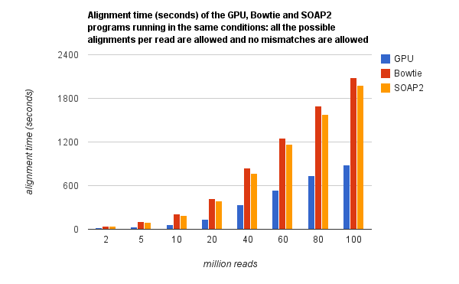
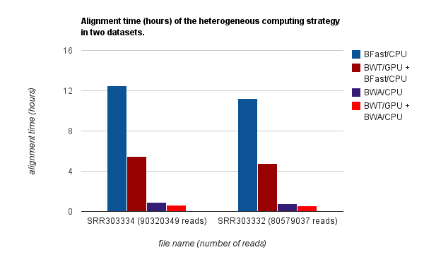
HPG Aligner
Architecture and features
Current read aligners software tend to fit in one of these groups:
  Very fast, but no too sensitive: no gaps, no indels, rna-seq...
  Slow, but very sensitive: up to 1 day by sample
Current aligners show bad performance with long reads
Current read Aligner algorithms
  Burrows-Wheeler Transform (BWT): very fast! No sensitive
  Smith-Waterman (SW): very sensitive but very slow
Hybrid approach (papers in preparation):
  HPG-BWT implemented with OpenMP and Nvidia CUDA
  HPG-SW implemented using OpenMP and SSE (~26x in 8-core)
Fastq file
HPG-BWT
OpenMP+GPU
Architecture
< 2 errors
>= 2 errors
Find CALs with HPG-BWT (seeds)
~50x with SSE
HPG-SW
OpenMP+SSE
Testing BWT-GPU
SAM file
Ignacio Medina
im411@cam.ac.uk
Mapping NGS reads for genomic studies

Slide 24
HPG Aligner
Benchmarks and results: DNA alignment
First results show an amazing performance and the best sensitivity
DNA 40M simulated datasets
DNA 4M simulated INDEL datasets
Program | 100nt %mapped Time(min) | 150nt %mapped Time(min) | 400nt %mapped Time(min)
HPG Aligner 2.0 dna mode | 98.77% 20.57min | 99.54% 22.90min | 99.93% 31.35min
BWA MEM 0.7.5 | 96.99% 29.34min | 98.09% 43.35min | 99.12% 124.16min
Bowtie2 2.1.0 | 94.67% 29.40min | 96.71% 47.61min | 98.82% 209.26min
Program | 100nt %mapped I10 | 150nt %mapped I10 | 400nt %mapped I15
HPG Aligner 2.0 dna mode | 84.69% | 88.23% | 88.94%
BWA MEM 0.7.5 | 83.37% | 81.92% | 77.36%
Bowtie2 2.1.0 | 68.50% | 66.28% | 52.13%
Correctly mapped results
No GPUs were used
Other tools were benchamarked: GEM, SOAP, BFAST,... but no positive result were obtained
Published, Bioinformatics 2014
http://bioinformatics.oxfordjournals.org/content/early/2014/09/01/bioinformatics.btu553.long
Ignacio Medina
im411@cam.ac.uk
Mapping NGS reads for genomic studies

Slide 25
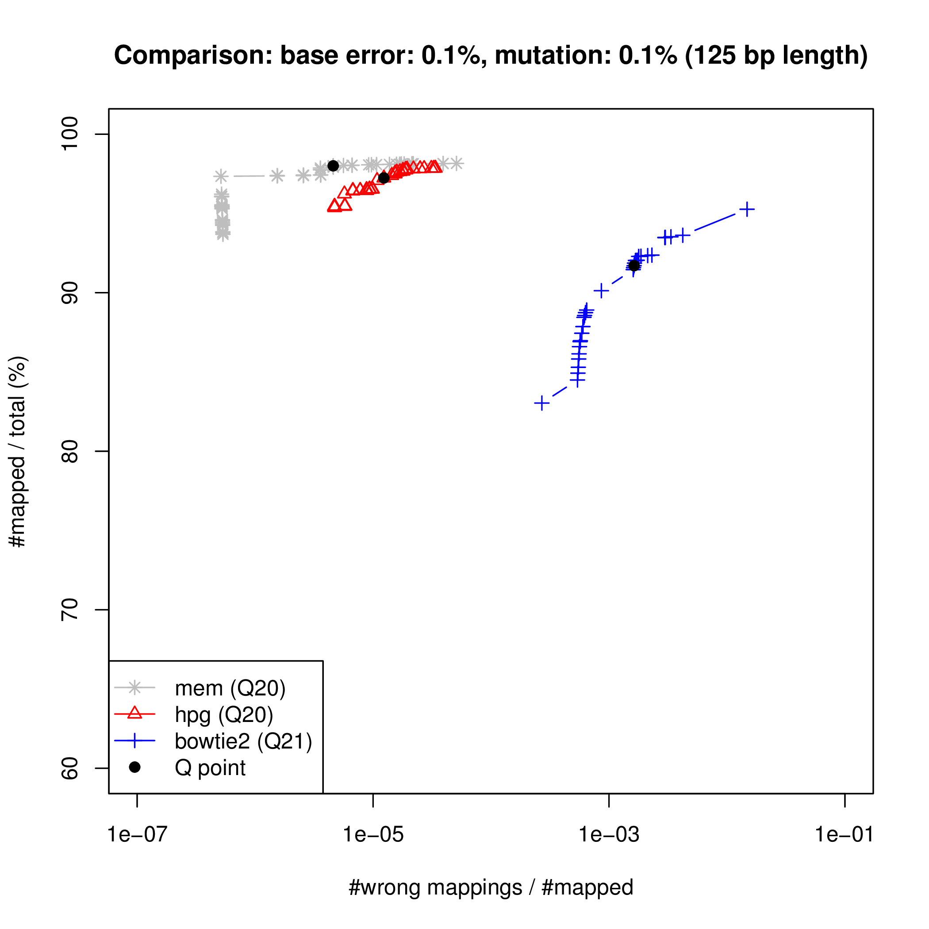
HPG Aligner
Benchmarks and results: DNA alignment
First results show an amazing performance and the best sensitivity
Simulation studies are very valuable to set up a analysis pipeline
Several simulators for DNA and RNA-seq available
Ignacio Medina
im411@cam.ac.uk
Mapping NGS reads for genomic studies

Slide 26
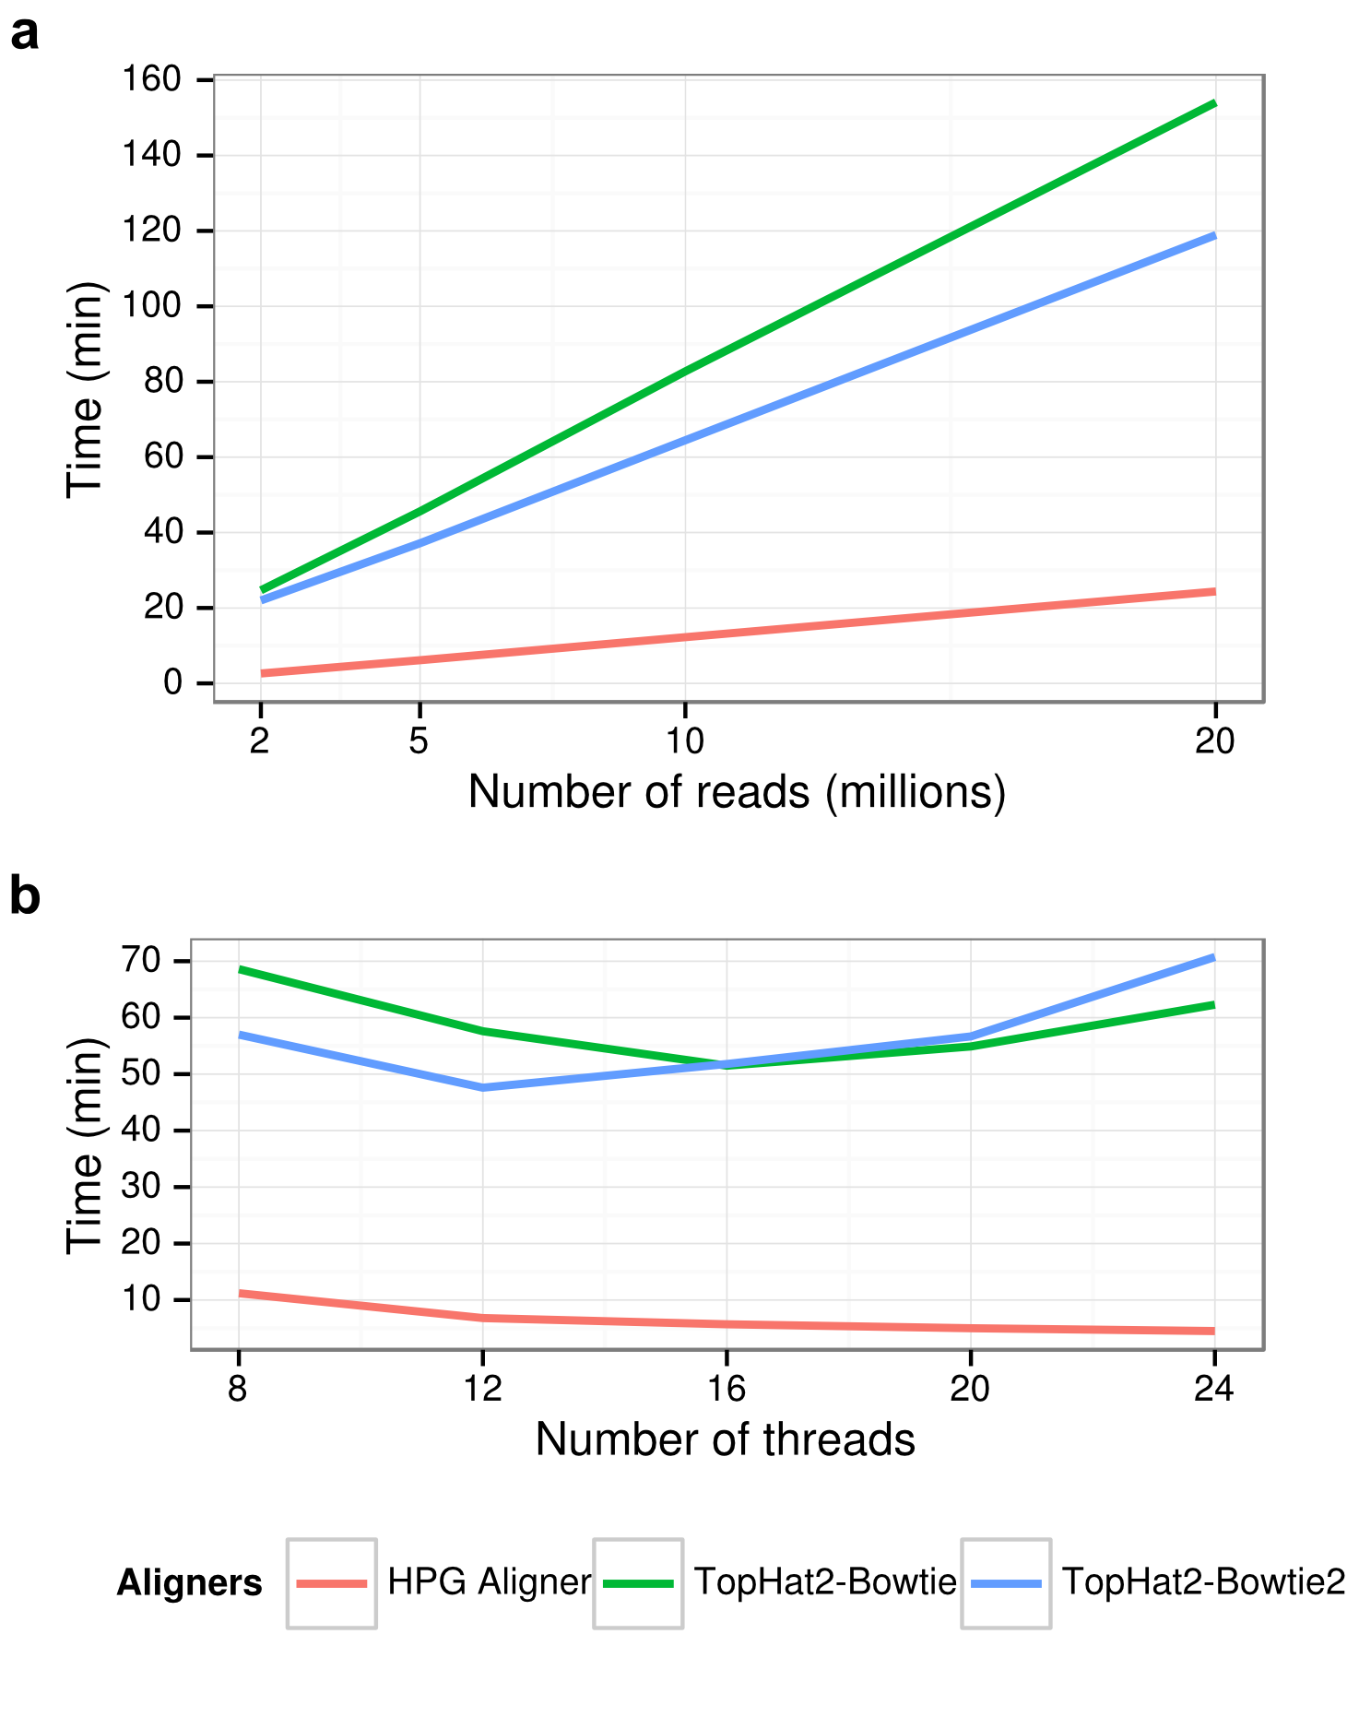
HPG Aligner
Benchmarks and results: RNA-seq
Comparative results with TopHat2 using both Bowtie and Bowtie2
RNA-seq 1M simulated datasets
Program | 75nt %mapped Time(min) | 100nt %mapped Time(min) | 150nt %mapped Time(min)
HPG Aligner rna mode | 96.6% 1.03min | 97.47% 1.2min | 98.35% 2.28min
TopHat 2.0.4 | 74.4% 15.6min | 62.1% 20.1min | 37.1% 36.2min
Notes:
Max errors allowed
Similar results are obtained with real datasets
TopHat doubles disk space and big memory needs
15x faster!!
Hardware scalability tests
Under review in Bioinformatics
Ignacio Medina
im411@cam.ac.uk
Mapping NGS reads for genomic studies

Slide 27
HPG Aligner
Main and coming features
Part of the HPG suite (http://www.opencb.org/technologies/hpg) with other tools: hpg-fastq, hpg-bam, hpg-aligner, hpg-variant
Only one execution is needed to generate the BAM output file (saves disk)
Faster index creator, multi-core implementation
Designed to provide the better sensitivity
Soft clipping of adaptors
HPC technologies used to provide the fastest runtime: multicore, SSE, GPUs, …
Open-source and open development, code at GitHub https://github.com/opencb-hpg
Part of the OpenCB project: http://www.opencb.org
Coming features
  DNA: INDEL realignment (GATK algorithm)
  BS-seq: for methylation analysis (being testing)
  RNA-seq: suport for no canonical splices
  Hadoop implementation will allow to run it in a distributed environment
  Performance improvements
Ignacio Medina
im411@cam.ac.uk
Mapping NGS reads for genomic studies

Slide 28
SAM/BAM specification
Mapping output: SAM/BAM format
SAM Specification: http://samtools.sourceforge.net/SAM1.pdf
Take a quick look:
@PG ID:HPG-Aligner VN:1.0
@SQ SN:20 LN:63025520
HWI-ST700660_138:2:2105:7292:79900#2@0/1 16 20 76703 60 75M * 0 0 GTTTAGATACTGAAAGGTACATACTTCTTTGTAGGAACAAGCTATCATGCTGCATTTCTATAATATCACATGAATA GIJGJLGGFLILGGIEIFEKEDELIGLJIHJFIKKFELFIKLFFGLGHKKGJLFIIGKFFEFFEFGKCKFHHCCCF AS:i:254 NH:i:0 NM:i:0
HWI-ST700660_138:2:2208:6911:12246#2@0/1 16 20 76703 50 75M * 0 0 GTTTAGATACTGAAAGGTACATACTTCTTTGTAGGAACAAGCTATCATGCTGCATTTCTATAATATCACATGAATA HHJFHLGFFLILEGIKIEEMGEDLIGLHIHJFIKKFELFIKLEFGKGHEKHJLFHIGKFFDFFEFGKDKFHHCCCF AS:i:254 NH:i:1 NM:i:0
HWI-ST700660_138:2:1201:2973:62218#2@0/1 0 20 76655 50 75M * 0 0 AACCCCAAAAATGTTGGAAGAATAATGTAGGACATTGCAGAAGACGATGTTTAGATACTGAAAGGGACATACTTCT FEFFGHHHGGHFKCCJKFHIGIFFIFLDEJKGJGGFKIHLFIJGIEGFLDEDFLFGEIIMHHIKL$BBGFFJIEHE AS:i:248 NH:i:1 NM:i:1
HWI-ST700660_138:2:1203:21395:164917#2@0/1 256 20 68253 20 4M1D71M * 0 0 NCACCCATGATAGACCAGTAAAGGTGACCACTTAAATTCCTTGCTGTGCAGTGTTCTGTATTCCTCAGGACACAGA #4@ADEHFJFFEJDHJGKEFIHGHBGFHHFIICEIIFFKKIFHEGJEHHGLELEGKJMFGGGLEIKHLFGKIKHDG AS:i:228 NH:i:3 NM:i:1
HWI-ST700660_138:2:1105:16101:50526#6@0/1 16 20 126103 50 52M4D23M * 0 0 AAGAAGTGCAAACCTGAAGAGATGCATGTAAAGAATGGTTGGGCAATGTGCGGCAAAGGGACTGCTGTGTTCCAGC
FEHIGGHIGIGJI6FCFHJIFFLJJCJGJHGFKKKKGIJKHFFKIFFFKHFLKHGKJLJGKILLEFFLIHJIEIIB AS:i:218 NH:i:1 NM:i:4
Ignacio Medina
im411@cam.ac.uk
Mapping NGS reads for genomic studies

Slide 29
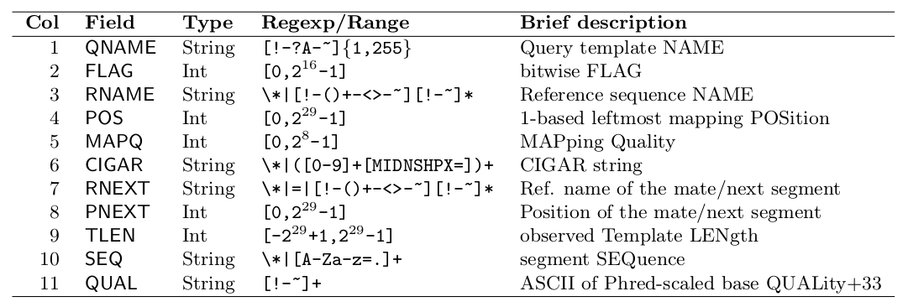
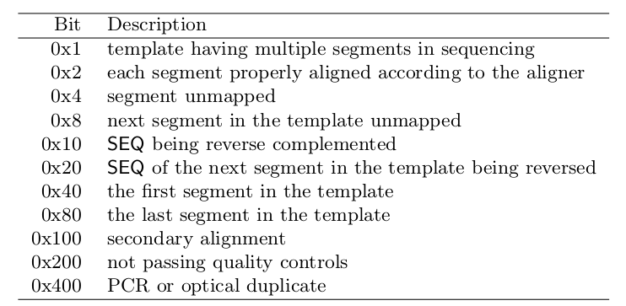
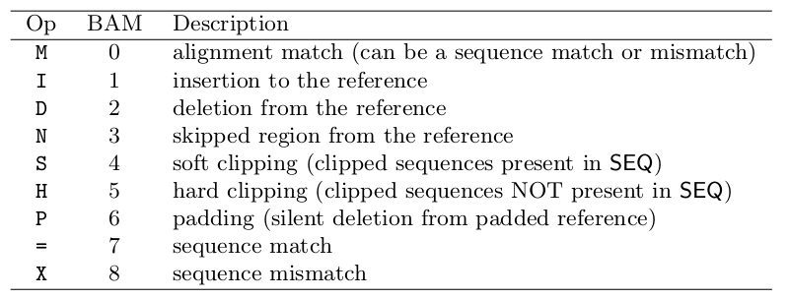
SAM/BAM specification
Mapping output, mandatory fields
First columns are mandatory
Flags
CIGAR
Ignacio Medina
im411@cam.ac.uk
Mapping NGS reads for genomic studies

Slide 30
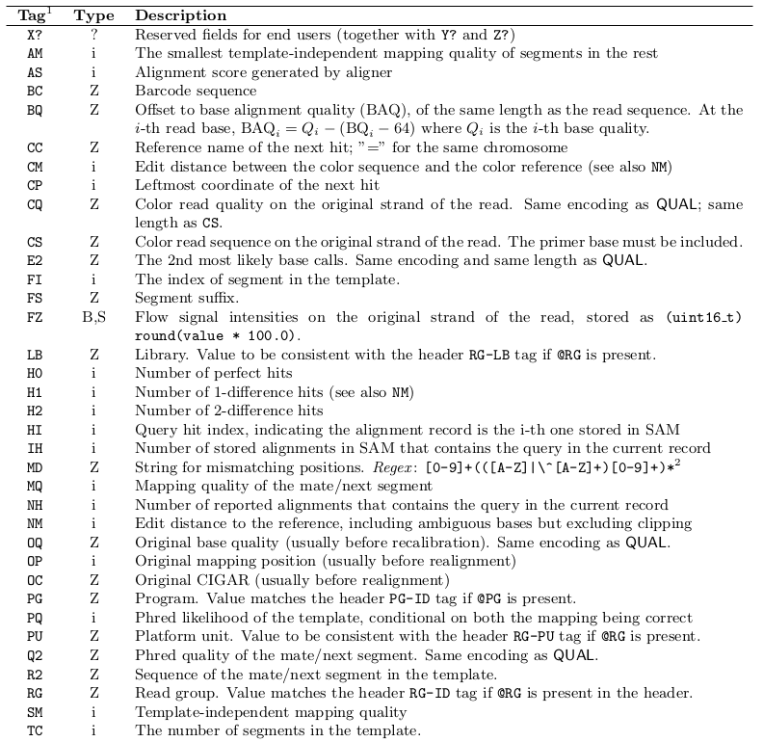
SAM/BAM specification
Mapping output, optional fields
Some optionals fields, in the aligner section
SAM specification is part of SAMtools package. More info at: http://samtools.sourceforge.net/
A binary SAMtools is distributed freely to:
SAM ↔ BAM
Depth
Merge
Sort
...
Ignacio Medina
im411@cam.ac.uk
Mapping NGS reads for genomic studies

Slide 31
Best practices
Take home messages
Choose the best aligner for your analysis and hardware
Remove duplicated and low qualities reads from FASTQ
Try to use paired-end datasets for variant calling and structural variation analysis. In RNA-seq paired-end can detect gene fusions
Do not allow multiple hits for variant calling analysis. RNA-seq depending on read size and the analysis to perform
Realign INDELS and recalibrate mapping quality for variant calling analysis
Simulation can be very useful for choosing the right aligner
Ignacio Medina
im411@cam.ac.uk
Mapping NGS reads for genomic studies

Slide 32
Data repositories
Open and controlled access repositories
1000 Genome project
  http://www.1000genomes.org/
SRA, Short Read Archive
  http://www.ncbi.nlm.nih.gov/sra
EGA, European Genome-Phenome Archive
  https://www.ebi.ac.uk/ega
… and many others
Ignacio Medina
im411@cam.ac.uk
Mapping NGS reads for genomic studies

Slide 33
Hands-on
Tutorial
Go to:
http://ngs-course.github.io/Course_Materials/alignment/tutorial/example.html
Ignacio Medina
im411@cam.ac.uk
Mapping NGS reads for genomic studies

Slide 34
QC alignment
Motivation
We need to know how well the alignment process went
Hundreds of million of mapped reads
Some biases can occur
Some useful information
  % reads mapped
  Mean average error
  Error distribution
  Length distribution
  Coverage
  …
Not many software for QC available, sometimes you have to use more than one
Ignacio Medina
im411@cam.ac.uk
Mapping NGS reads for genomic studies

Slide 35
QC alignment
Download QC software
SAMstat, download from http://samstat.sourceforge.net/
  Uncompress
    tar zxvf samstat.tgz
    cd samstat/src
    make
    Move the binary userhome/bin folder
HPG-BAM, download from http://wiki.opencb.org/projects/hpg/doku.php?id=utilities:bam
  Uncompress
    gunzip hpg-bam.gz
    Move the binary userhome/bin folder
Ignacio Medina
im411@cam.ac.uk
Mapping NGS reads for genomic studies

Slide 36
QC alignment
SAMstat
SAMstat, easy to execute:
  ./samstat hq-test_pe.bam
Produces a HTML5 page, use Google Chrome or Firefox to open it, some useful info:
  % mapped (grouped by mapping quality)
  Error distribution
  Length distribution
  ...
Download BAM file from 1000Genomes to study real data
Ignacio Medina
im411@cam.ac.uk
Mapping NGS reads for genomic studies

Slide 37
QC alignment
HPG-BAM
HPG-BAM, we want to use 'stats' command, read tutorial from http://wiki.opencb.org/projects/hpg/doku.php?id=utilities:bam
  ./hpg-bam stats -b hq-test1.bam -o /tmp
Produces some plots and txt files with stats:
  Coverage
  Error distribution
  GC content
  …
Download BAM file from 1000Genomes to study real data
Cloud based version being developed
Ignacio Medina
im411@cam.ac.uk
Mapping NGS reads for genomic studies

