Slide 1




Course Presentation
David Montaner
dmontaner@cipf.es
RNA-seq

Slide 2
Where are we?
Sequence preprocessing
NGS
pipeline
Mapping
RNA-seq
Transcriptomics
Variant prioritization
Isoform detection
Functional annot.
GWAS Analysis
Differ. expression
Functional Analysis
David Montaner
dmontaner@cipf.es
RNA-seq

Slide 3
General context
Reference genome
  Yes: map against it
  No: try to assemble transcripts an then map
Reference transcriptome
  Yes: estimate known transcripts abundance &
  discover new transcripts
  No: find expressed regions &
  their transcript combination
David Montaner
dmontaner@cipf.es
RNA-seq

Slide 4
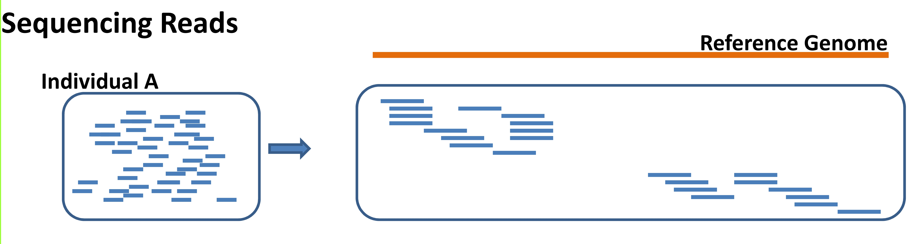
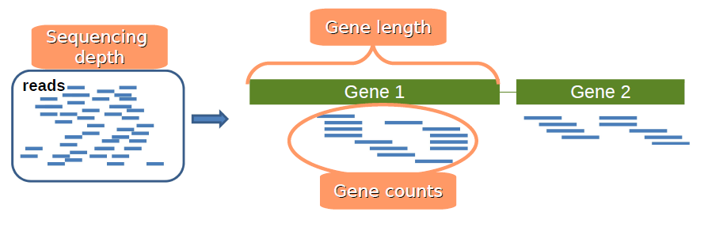
General context
David Montaner
dmontaner@cipf.es
RNA-seq

Slide 5
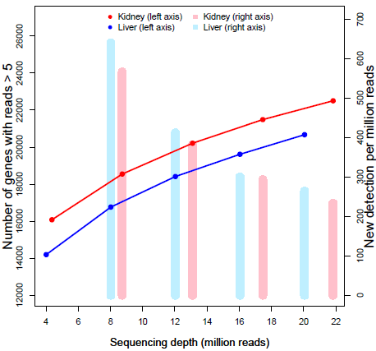
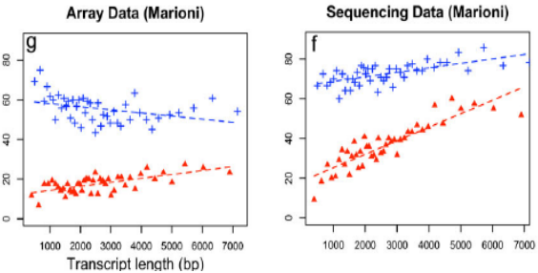
Gene/transcript length dependence
Counts are proportional to...
  the transcript length
  the mRNA expression level.
David Montaner
dmontaner@cipf.es
RNA-seq

Slide 6
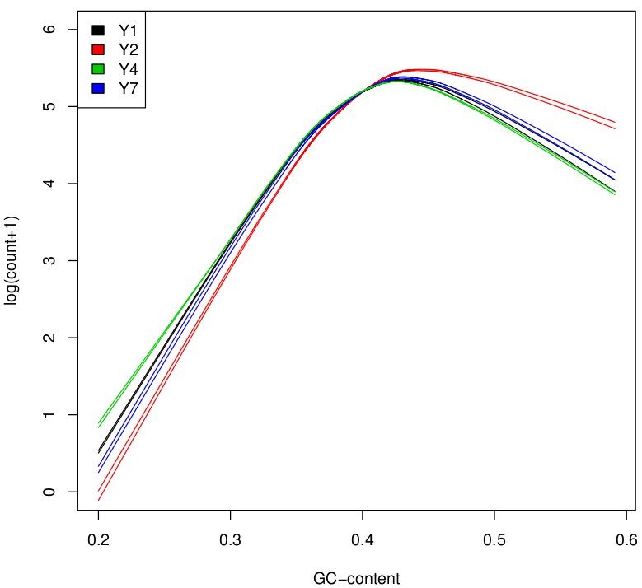
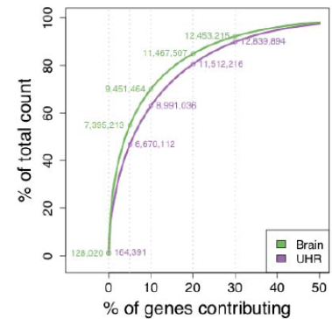
Count Normalization
Transcript length: within library
Library size: between libraries
Many other biases ...
  Differences on the read count distribution among samples.
  GC content of the gene affects the detection of that gene (Illumina)
  sequence-specific bias is introduced during the library preparation
David Montaner
dmontaner@cipf.es
RNA-seq

Slide 7
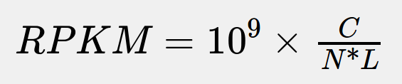
Count Normalization
RPKM: Reads Per Kilobase of the transcript per Million mapped reads
C is the number of mappable reads mapped onto the gene's exons.
N is the total number of mappable reads in the experiment.
L is the total length of the exons in base pairs.
Fragments Per Kilobase of exon per Million fragments mapped (FPKM),
David Montaner
dmontaner@cipf.es
RNA-seq

Slide 8
Count Normalization
RPKM (Mortazavi et al., 2008)
TC: Gene counts are divided by the sequencing depth associated to that sample and multiplied by the average of the total counts across all the samples. Gene counts are divided by the gene length (kb) times the total number of millions of mapped reads.
Upper-quartile (Bullard et al., 2010): Gene counts are divided by the upper quartile of counts for genes with at least one read.
Median (Bullard et al., 2010): Gene counts are divided by the median of counts for genes with at least one read.
Quantile (Irizarry et al., 2003): This method matches the gene count distributions across samples.
TMM (Robinson & Oshlack, 2010): Trimmed Mean of M-values. Basd on the hypothesis that most of the genes are not DE. A sample is taken as the reference. For each sample, the scaling factor is the weighted mean of log ratios between this sample and the reference after removing the most expressed genes and those with the largest log ratios. Gene counts are divided by this factor re-scaled by the mean of the normalized library sizes.
DESeq (Anders & Huber, 2010): Based on the hypothesis that most of the genes are not DE. The scaling factor for a given sample is the median of the ratio, for each gene, of its counts over its geometric mean across all the samples. Gene counts are divided by this scaling factor.
FPKM (Trapnell et al., 2010): implemented in Cufflinks, isimilar to RPKM .
David Montaner
dmontaner@cipf.es
RNA-seq

Slide 9
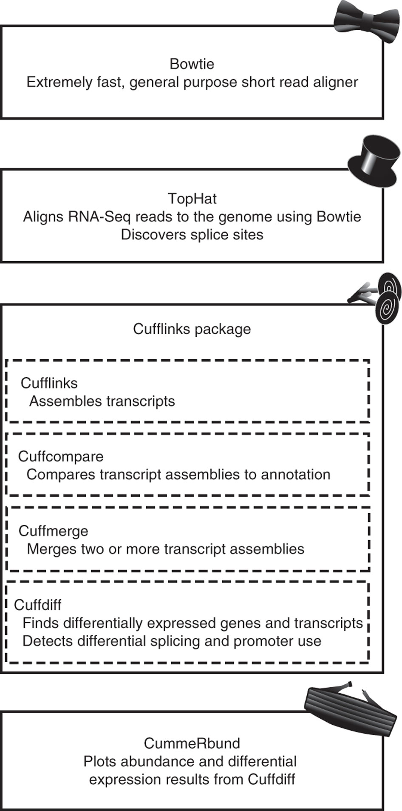
Software
Cufflinks:
  assembly
  compare with the known transcripts
Cuffdiff: differential expression
  estimate fragment length distribution
  calculate transcript abundances FPKM
  sequence bias correction
David Montaner
dmontaner@cipf.es
RNA-seq

Slide 10
Software
TopHat
Cufflinks:
  assembly
  compare with the known transcripts
Cuffdiff: differential expression
  estimate fragment length distribution
  calculate transcript abundances FPKM
  sequence bias correction
CummeRbund:
an R package to handle results
David Montaner
dmontaner@cipf.es
RNA-seq

Slide 11
T
David Montaner
dmontaner@cipf.es
RNA-seq

