Slide 1

Variant annotation
Variant Effect Predictor (VEP)
Edinburgh Genomics
Edinburgh, UK
23rd October 2015

Slide 2
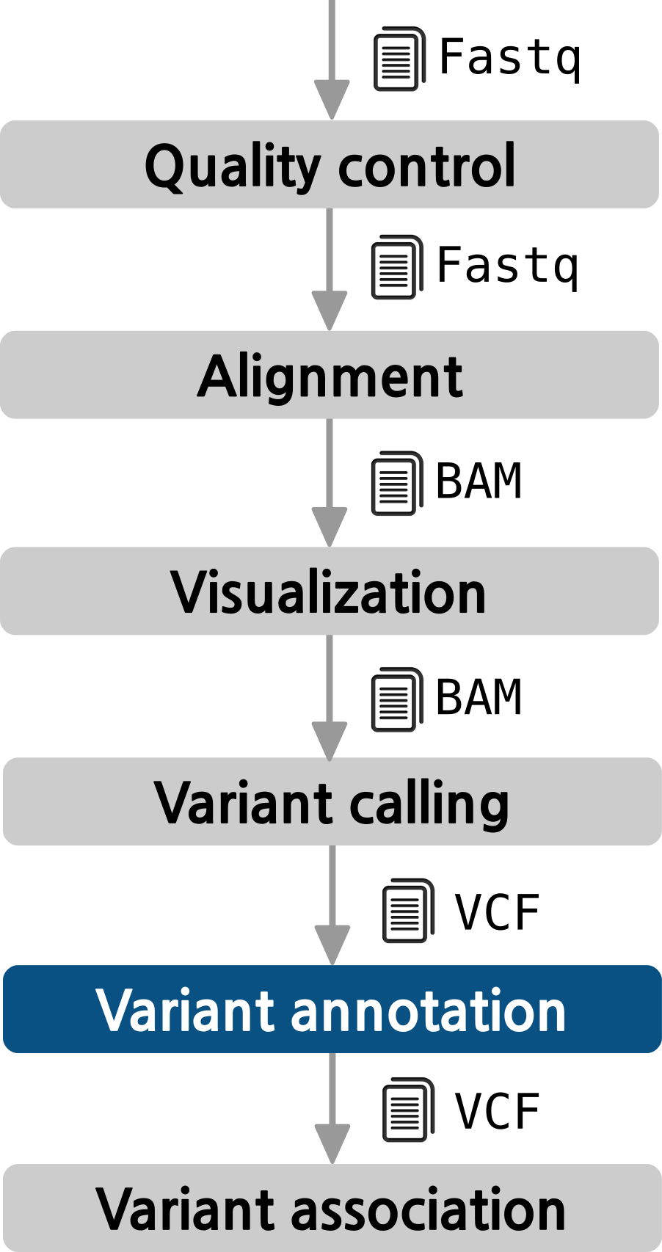
The pipeline

Slide 3
What is functional annotation?
Intronic variant
Intergenic variant
GENOME
Promoter
variant
Coding variant
Splice variant
UTR variant
Non-coding RNA variant
Why we do that?
Each individual exome carries ~25,000 variants → PRIORITIZATION!
We want to identify a small subset of functionally important variants to pinpoint the putative disease causal variants
We need strategies to estimate the deleteriousness of our variants to better identify disease-causal variants
CAUTION!
On average, each normal person is found to carry:
  ~11,000 synonymous variants
  ~11,000 non-synonymous variants
  250 to 300 los-of-function variants in annotated genes
  50 to 100 variants previously implicated in inherited disorders
1000 Genomes Project Consortium. A map of human genome variation from population-scale sequencing. Nature. 2010 Oct 28;467(7319):1061-73. PubMed PMID: 20981092

Slide 4


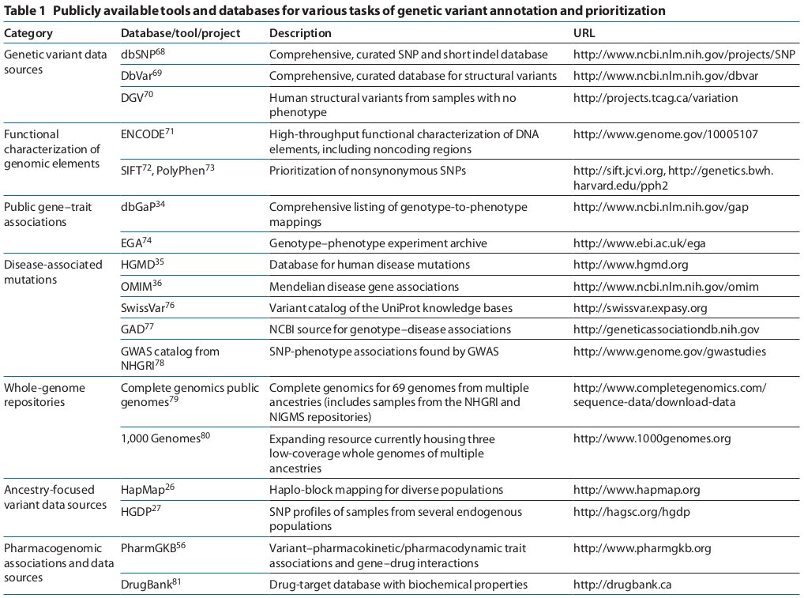





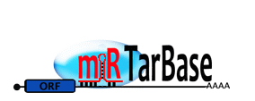

Sources of functional information
Cordero P, Ashley EA. Whole-genome sequencing in personalized therapeutics. Clin Pharmacol Ther. 2012 Jun ;91(6):1001-9. PubMed PMID: 22549284

Slide 5
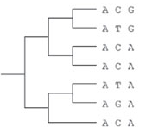
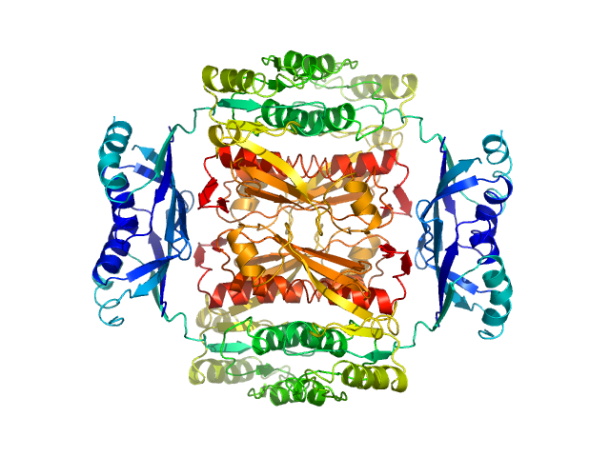
Computational method and tools
Annotated information is sometimes limited, particularly for rare and complex traits
Computational methods can measure deleteriousness by using comparative genomics and knowledge of protein biochemistry and structure
Comparative Genomics
Focus on sequences that have not been remove by natural selection.
Quantify evolutionary changes in genes or genomes and define conserved and neutral regions.
Variants observed in conserved sites are highly likely to be deleterious.
Effects in protein-coding variants
Can combine evolutionary and biochemical information.
Use alignments of homologous proteins to estimate mutational deleteriousness.
Use biochemical data such as amino acid properties, binding information and structural information to estimate the impact.
Effects in non-coding variants
The majority of the human genetic variation is in non-coding regions.
No detectable conservation outside vertebrates.
Main strategy for estimation is testing the mammalian conservation of the non-coding variants.
Cooper GM, Shendure J. Needles in stacks of needles: finding disease-causal variants in a wealth of genomic data. Nature Reviews Genetics. 2011 Aug 18;12(9):628-40. Pubmed PMID: 21850043

Slide 6
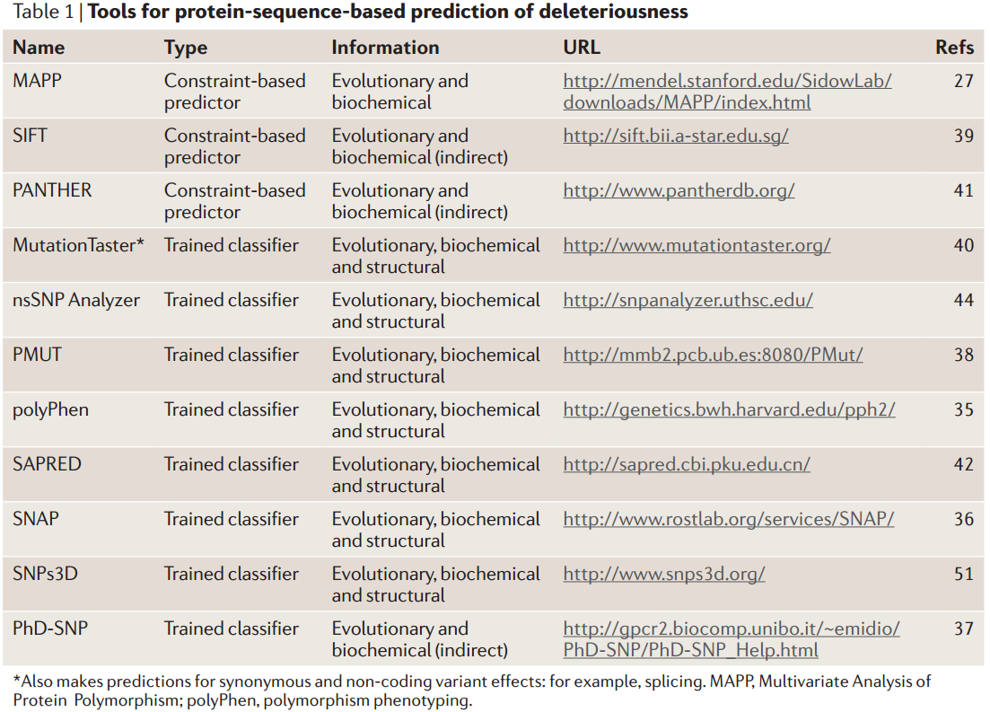
Computational methods and tools
Prediction scores for non-synonymous variants
Kircher M. et al. A general framework for estimating the relative pathogenicity of human genetic variants. Nature Genetics. 2014; Pubmed PMID: 24487276.
Shihab H. A.. et al. An integrative approach to predicting the functional effects of non-coding and coding sequence variation. Bioinformatics. 2014; Pubmed PMID: 25583119.
Cooper GM, Shendure J. Needles in stacks of needles: finding disease-causal variants in a wealth of genomic data. Nature Reviews Genetics. 2011 Aug 18;12(9):628-40. Pubmed PMID: 21850043

Slide 7
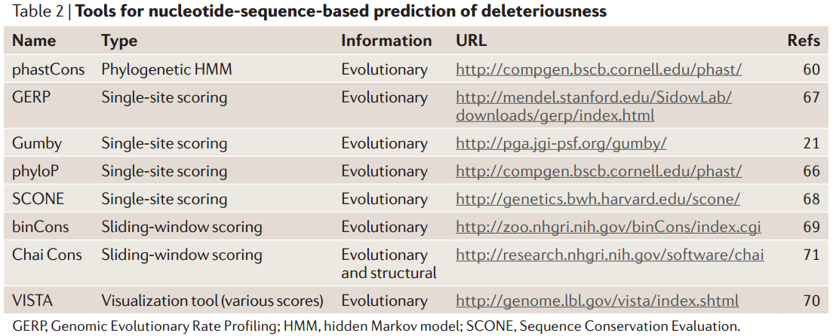
Computational methods and tools
Prediction scores for non-coding variation
Cooper GM, Shendure J. Needles in stacks of needles: finding disease-causal variants in a wealth of genomic data. Nature Reviews Genetics. 2011 Aug 18;12(9):628-40. Pubmed PMID: 21850043

Slide 8
Tools for functional annotation
We need to measure the impact of each variant in the genome
We cannot annotate 25,000 variants manually checking more than 20 databases
Tools integrate biological information and ease the functional annotation of hundreds of thousand variants
PANTHER
CellBase
SNPseek
SeattleSeq
Annotation
PMUT
LS-SNP
Parepro
SNPs&GO
Oncotator
SNPHunter
CandiSNPer
SCONE
SNPnexus
SNPeffect 4.0
HSF
PHAST
PupaSNP Finder
CUPSAT
FANS
SNP Function Portal
CHASM and SNVBox
SNPper
F-SNP
SNPdbe
SIFT
ABSOLUTE
SCAN
nsSNPAnalyzer
Auto-mute
MutationTaster
PolyPhen-2
AnnTools
FastSNP
PhD-SNP
FOLD-X
MAPP
pfSNP
SNAP
SAPRED
GERP++
PESX
HOPE
QuikSNP
ResqueESE
SNPs3D
SeqAnt
FESD
VEP
PolyDoms
ANNOVAR
MutaGeneSys
MutPred
NGS-SNP
SVA
SiPhy
ESEfinder
GSITIC
ESRSearch
PolyMAPr
MuD
MutSIg
dbNSFP
SeqProfCod
Stephan Pabinger et al. A survey of tools for variant analysis of next-generation genome sequencing data. Briefings in Bioinformatics. 2013 Jan. Pubmed PMID: 23341494
SNP@Domain
I-Mutant2.0
MutationAssesor
Align GVD

Slide 9


Variant Effect Predictor (VEP)
VEP documentation site: http://www.ensembl.org/info/docs/variation/vep/index.html
Backed by Ensembl
Free and open source
3 ways of functionality: web interface, standalone Perl script and REST API
Input formats: CSV, VCF, Pileup and HGVS
Regulatory information: TFBSs
Filtering by coding regions and MAF
Predictions: SIPF, PolyPhen
1000 genomes and dbSNP information
Uses Sequence Ontology
Many species
Regulatory information does not include miRNA targets
The standalone Perl script needs:
  Perl and MySQL support
  Download, install and update every ~ 2 months
McLaren W, Pritchard B, Rios D, Chen Y, Flicek P, Cunningham F. Deriving the consequences of genomic variants with the Ensembl API and SNP Effect Predictor. BMC Bioinformatics 26(16):2069-70(2010) Pubmed PMID: 20562413

Slide 10
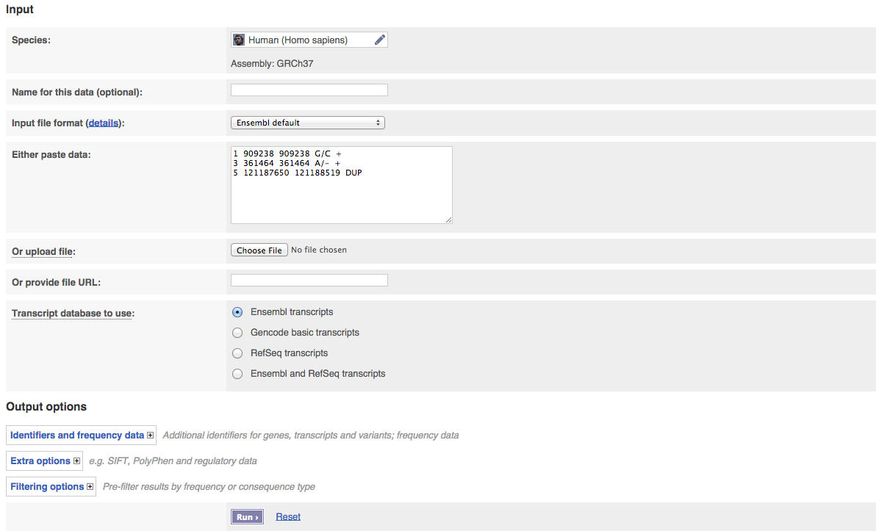
Variant Effect Predictor (VEP)
VEP web interface: http://www.ensembl.org/Homo_sapiens/Tools/VEP
McLaren W, Pritchard B, Rios D, Chen Y, Flicek P, Cunningham F. Deriving the consequences of genomic variants with the Ensembl API and SNP Effect Predictor. BMC Bioinformatics 26(16):2069-70(2010) Pubmed PMID: 20562413

Slide 11
CellBase v3.2.0 https://github.com/opencb/cellbase/
NoSQL database that integrates the most relevant biological information:
  Core features: genes, transcripts, exons, proteins, genome sequence, etc.
  Regulatory: Ensembl regulatory, TFBS, miRNA targets, CTCF, Open chromatin, etc.
  Functional annotation: OBO ontologies (Gene Ontology, Human Disease Ontology), etc.
  Genomic variation: Ensembl Variation, ClinVar, COSMIC, etc.
  Systems biology: IntAct , Biogrid, Reactome, gene co-expression, etc.
  More than 30 species available
An exhaustive RESTful Web service API has been implemented:
  http://wwwdev.ebi.ac.uk/cellbase/webservices/rest/v3/hsapiens/genomic/region/22:17449263:17449264/gene
New features included in v3.2.0
  New Variant Annotation functionality
  New data:
    RefSeq annotation
    DisGeNET
    Gene Expression Atlas
Bleda M, et al. CellBase, a comprehensive collection of RESTful web services for retrieving relevant biological information from heterogeneous sources. Nucleic Acids Research. 2012 Pubmed PMID: 22693220

Slide 12


CellBase v3.2.0 annotator https://github.com/opencb/cellbase/
CellBase documentation site: https://github.com/opencb/cellbase/wiki
Free and open source.
Institutions using it: EBI – EVA, GEL
2 ways of functionality: CLI program, Java RESTful WS API
Cloud variant annotator. Requires no installation or updates
Consequence type in Ensembl and RefSeq genes (Sequence Ontology)
Regulatory regions: TFBS, miRNA target, ENCODE
Conservation scores: phastCons and phyloP.
Protein substitution effect scores: PolyPhen-2, SIFT
Control studies frequencies: 1000 genomes, EVS
Gene/Transcript Expression: Gene Expression Atlas
Clinical phenotype information: ClinVar, COSMIC, GWAS catalog
More than 30 species (human, mouse, rat, zebra fish, worm, fly, yeast, dog, pig, mosquito, etc.)
Young program, many new features coming
  UniProt, InterPro, Intact, Emory clinical data, DGIdb, GERP++ and many others
  Large structural variants annotation
Bleda M, et al. CellBase, a comprehensive collection of RESTful web services for retrieving relevant biological information from heterogeneous sources. Nucleic Acids Research. 2012 Pubmed PMID: 22693220

Slide 13
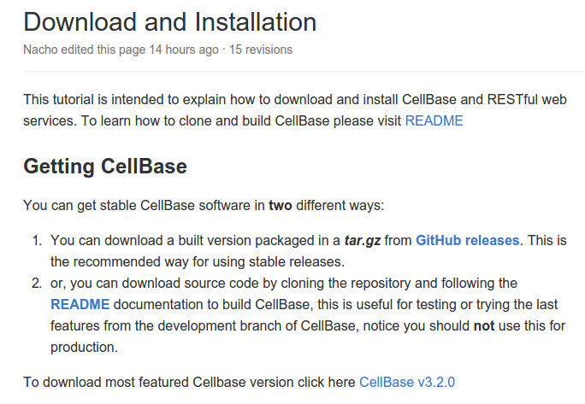
CellBase v3.1.0 annotator https://github.com/opencb/cellbase/
Download CellBase code and save it into your course/variant_annotation folder:
https://github.com/opencb/cellbase/wiki/Download-and-Installation
Extract the contents
Usage:
cellbase.sh variant-annotation --input-file file.vcf --output-file file.vep
REST API:
  http://bioinfodev.hpc.cam.ac.uk/cellbase/webservices/rest/v3/hsapiens/genomic/variant/19:45411941:T:C/full_annotation

Slide 14
AnnoVar
ANNOVAR web site: http://www.openbioinformatics.org/annovar/
Free and open source
Can annotate SNV, insertions and deletions
Regulatory information: Conserved genomic regions, TFBSs, miRNA targets and predicted miRNA secondary structures. ENCODE DNAse I hypersensitive sites, Histone methylations, ChIP and RNA-Seq peaks
DbSNP, 1000 genomes, SIFT and GERP filtering
Predictions: Polyphen, LRT, MutationTaster, PhyloP
Can handle custom annotations in GFF3
Can handle 1 o 0-based coordinates
5 Species (human, mouse, worm, fly, yeast)
Accepts VCF4, GFF3-SOLiD and CSV BUT after conversion to their particular input file:
Perl written program
Installation required
Users need to download every annotation database and save them locally (~35GB per assembly)
Need to be run several times
Output: several files depending on the query
Chr | Start | End | Ref | Obs | Comments
1 | 161003 | 161003 | C | T | comments: rs1000050
Wang K, Li M, Hakonarson H. ANNOVAR: Functional annotation of genetic variants from next-generation sequencing data. Nucleic Acids Research. Sep;38(16):e164 Pubmed PMID: 20601685

Slide 15
AnnoVar
EXAMPLE of ANNOVAR usage
DOWNLOADING BIOLOGICAL DATA:
user@computer:~$ annotate_variation.pl -buildver hg19 -downdb refgene humandb/
user@computer:~$ annotate_variation.pl -buildver hg19 -downdb snp135 -webfrom annovar humandb/
user@computer:~$ annotate_variation.pl -buildver hg19 -downdb phastConsElements46way humandb/
user@computer:~$ annotate_variation.pl -buildver hg19 -downdb 1000g2012apr -webfrom annovar humandb/
user@computer:~$ annotate_variation.pl -buildver hg19 -downdb cytoBand humandb/
EXTRACTING THE EFFECT:
user@computer:~$ annotate_variation.pl -geneanno example/ex1.human humandb/
user@computer:~$ annotate_variation.pl -regionanno -dbtype band example/ex1.human humandb/
user@computer:~$ annotate_variation.pl -filter -dbtype 1000g2012apr_eur example/ex1.human humandb/

Slide 16
THANK YOU.

