Slide 1

Variant association and prioritization
Edinburgh Genomics
Edinburgh, UK
23rd October 2015
Marta Bleda Latorre
mb2033@cam.ac.uk
Research Assistant at the Department of Medicine
University of Cambridge
Cambridge, UK

Slide 2
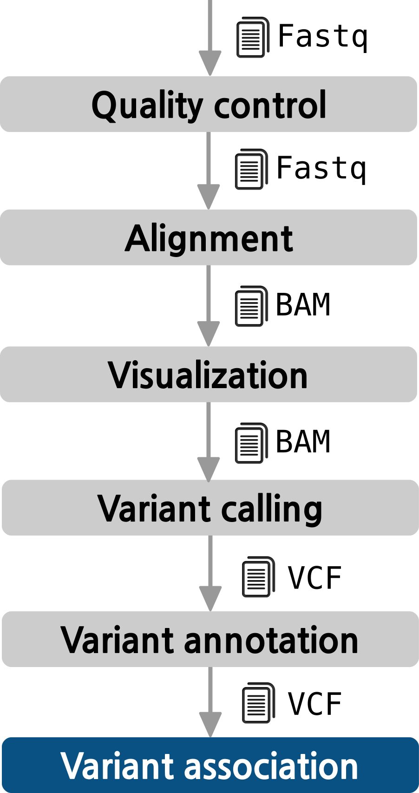
The pipeline

Slide 3
The challenge
Intronic variant
Intergenic variant
GENOME
Promoter
variant
Coding variant
Splice variant
UTR variant
Non-coding RNA variant
Still a challenge
Each individual exome carries between 25,000 and 50,000 variants
A whole genome can carry 3.5 million variants on average
After annotating there will be hundreds of deleterious variants
CAUTION!
On average, each normal person is found to carry:
  ~11,000 synonymous variants
  ~11,000 non-synonymous variants
  250 to 300 los-of-function variants in annotated genes
  50 to 100 variants previously implicated in inherited disorders
1000 Genomes Project Consortium. A map of human genome variation from population-scale sequencing. Nature. 2010 Oct 28;467(7319):1061-73. PubMed PMID: 20981092

Slide 4

The challenge

Slide 5
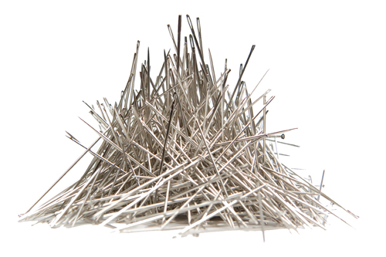
The challenge

Slide 6
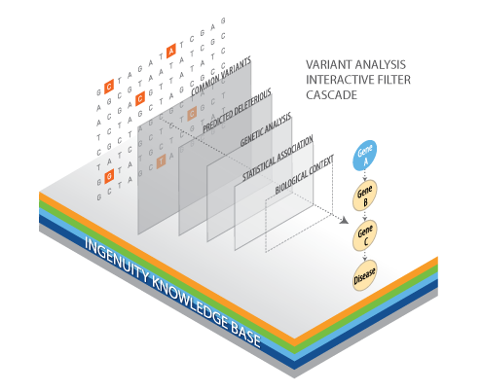
The objective

Slide 7
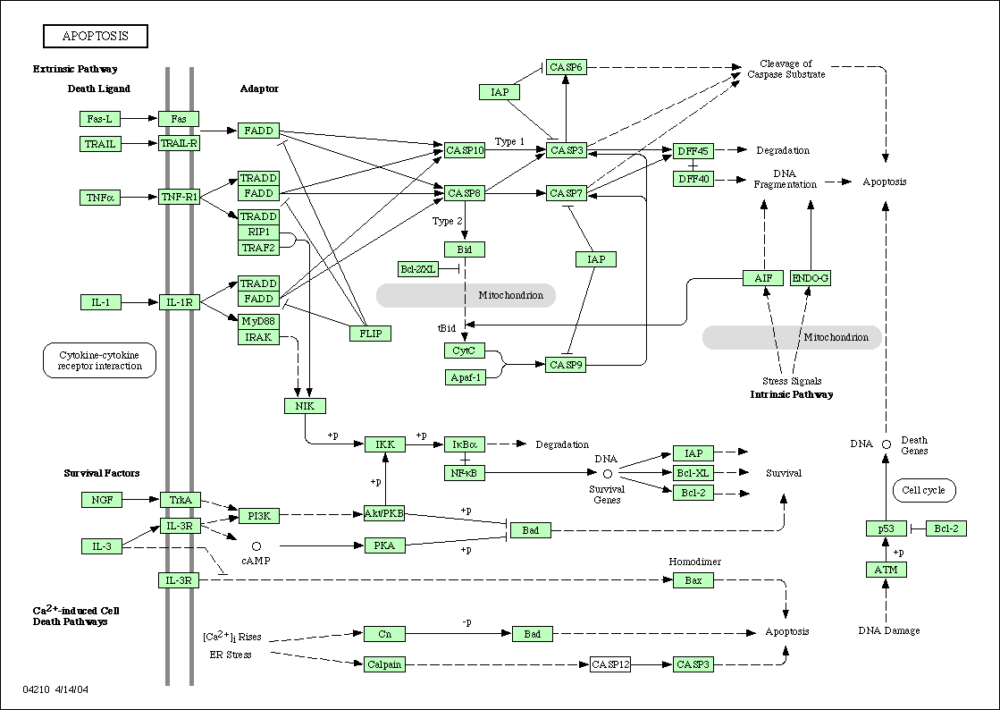
And now what?
Finding the mutations causative of diseases
The simplest case: monogenic disease due to a single gene
A
B
C
E
Controls
Cases
D

Slide 8
And now what?
Finding the mutations causative of diseases
Controls
Cases
Clear individual gene associations are difficult to find in some diseases
Same phenotype can be due to different mutations and different genes (or combinations)
Many cases have to be used to obtain significant associations to many markers
The only common element is the pathway (yet unknown) affected

Slide 9
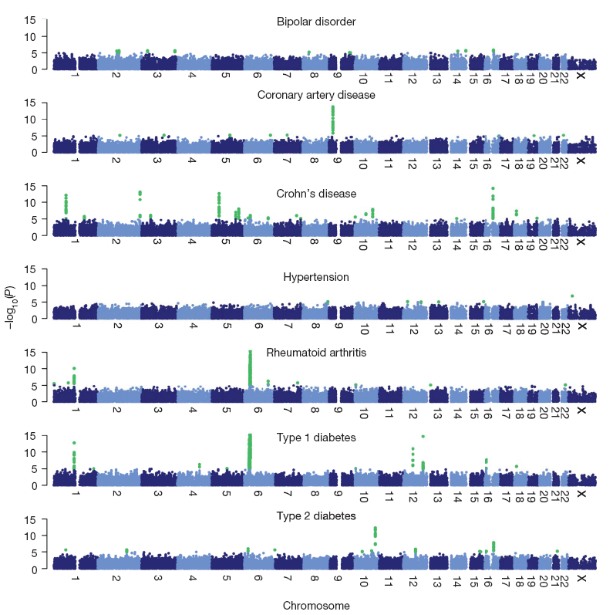
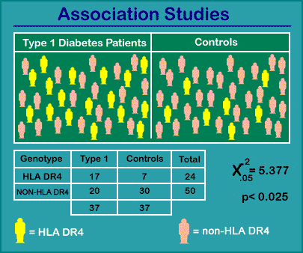

Genome-Wide Association Studies (GWAS)
Odds Ratio: 3.6
95% CI = 1.3 to 10.4

Slide 10
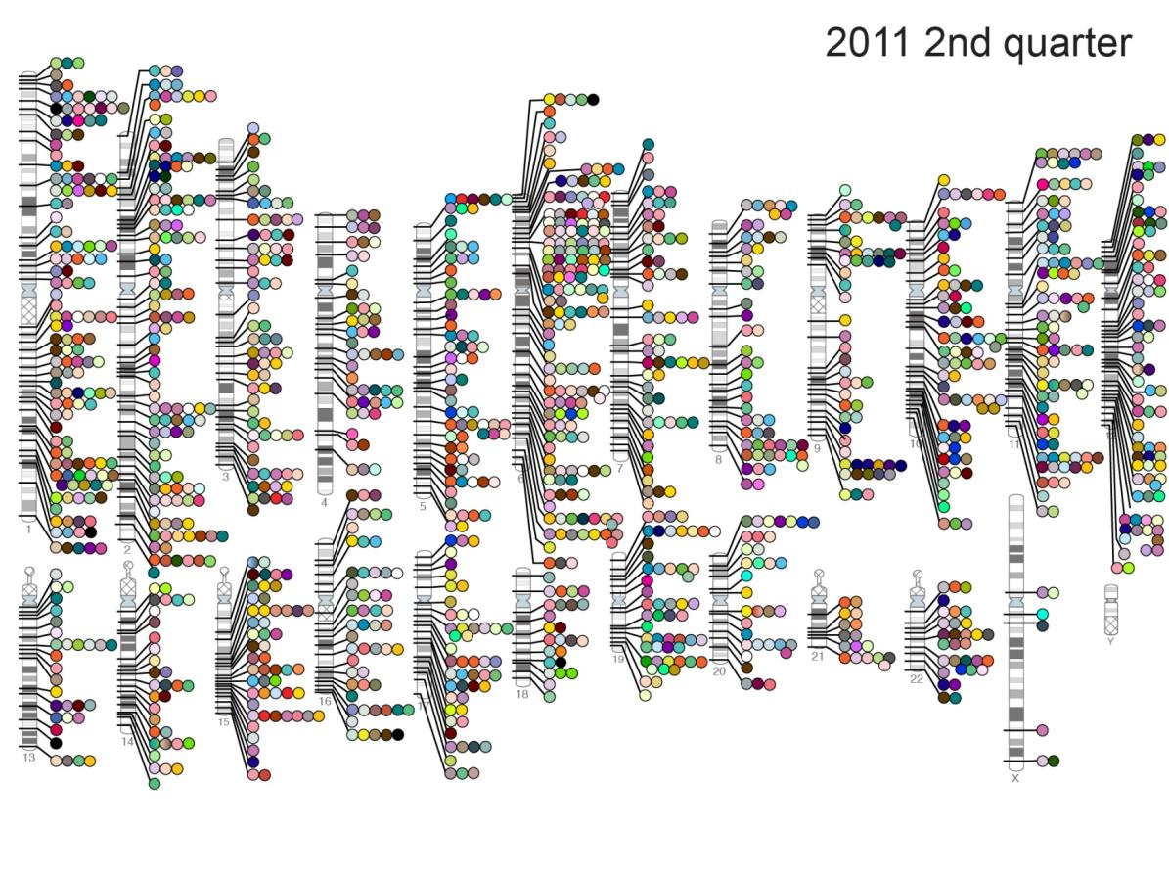
Genome-Wide Association Studies (GWAS)
By the time of the completion of the human genome sequence, in 2005, just a few genetic variants were known to be significantly associated to diseases.
When the first exhaustive catalogue of GWAS was compiled, in 2008, only three years later, more than 500 single nucleotide polymorphisms (SNPs) were associated to traits.
Today, the catalog has collected more than 1,900 papers reporting 15,396 SNPs significantly associated to more than 1,500 traits.
NHGRI GWA Catalog
www.genome.gov/GWAStudies

Slide 11

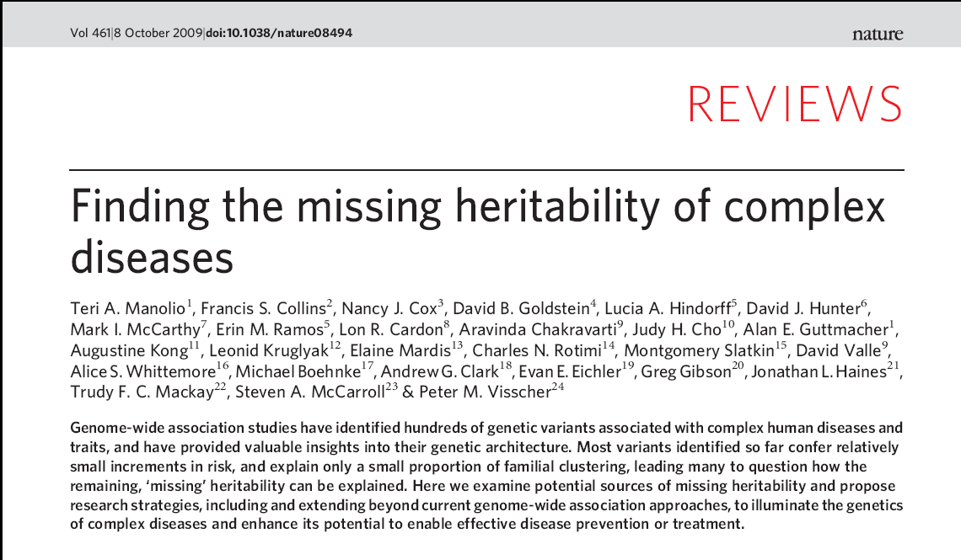
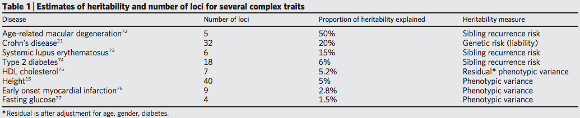
The missing heritability problem
How to explain this problem?
Rare Variants, rare CNVs, epigenetics or epistatic effects?

Slide 12
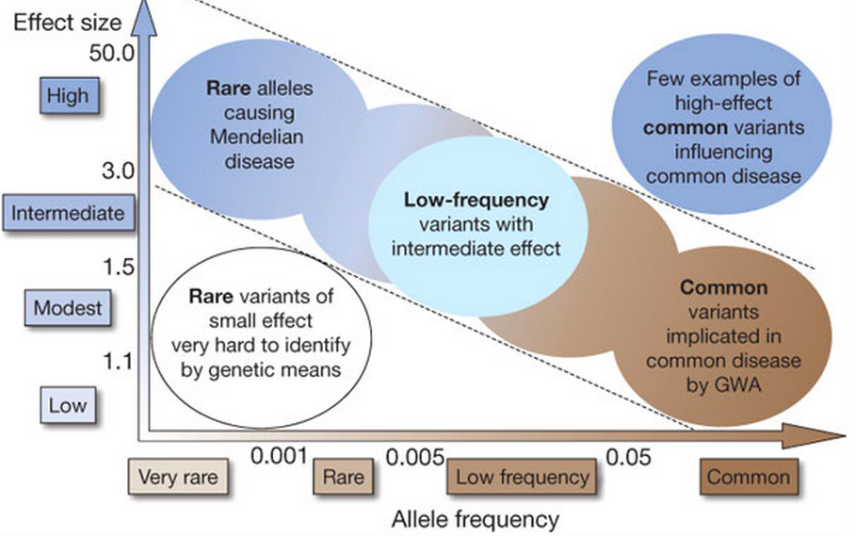
Distribution of genetic variation
Teri A. Manolio, et al. Finding the missing heritability of complex diseases. Nature 461, 747-753(8 October 2009)

Slide 13
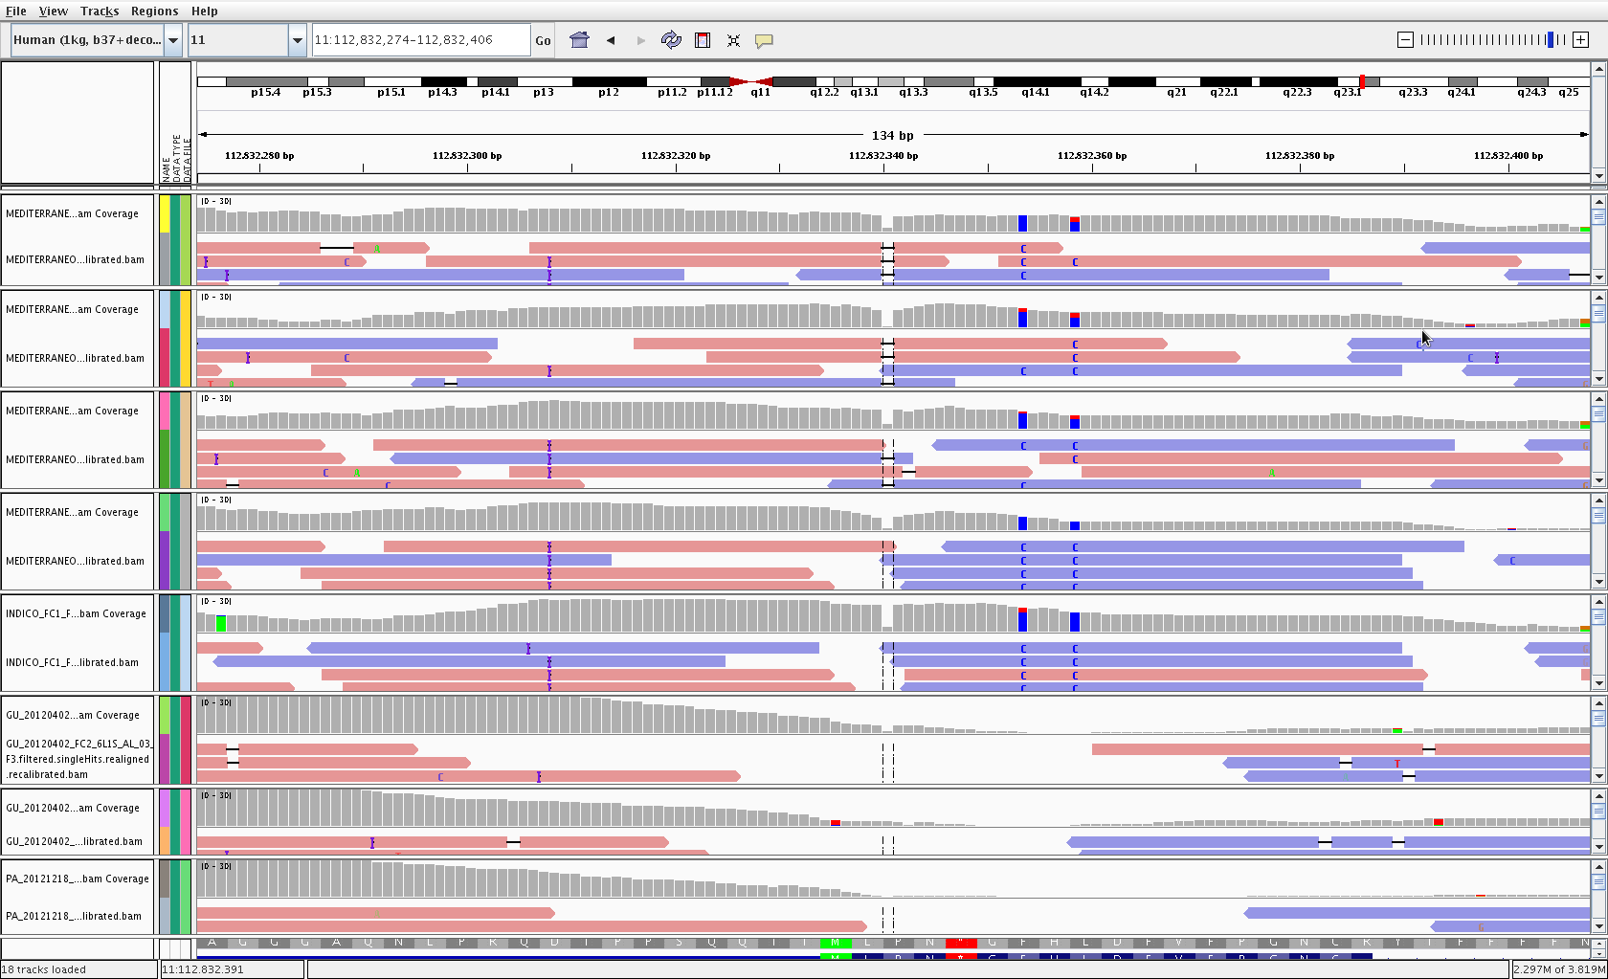
Strategies
Case - control
Filtering using family information
Rare variant association
  Single variant tests
  Gene or region-based aggregation tests
Network (Systems biology) approaches
  PPIs
  Gene regulatory elements (miRNAs, Tfs)
  GO terms

Slide 14
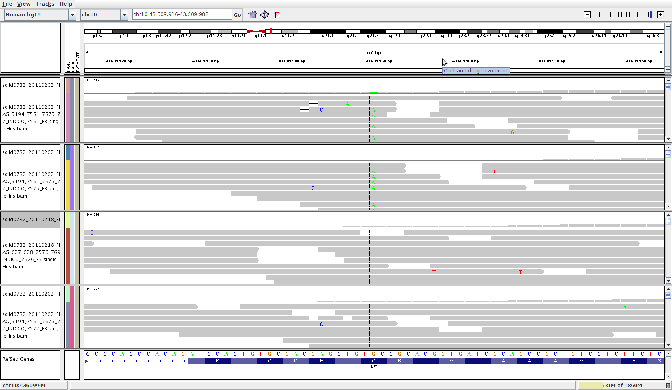
Using family information
Families containing control and disease individuals can help us to reduce the number of variants obtained
Individuals from the same family → less variability
Filter variants present in healthy relatives
Segregation within a pedigree
A
B
D
C

Slide 15
Using family information
Dominant inheritance
?
?
?

Slide 16

Using family information
Recessive homozygous

Slide 17
Using family information
Recessive – Compound heterozygosity

Slide 18
Rare variant association
Genome-wide association studies (GWAS) have been widely used with microarray data to evaluate common genetic variants
(MAF > 5%)
Despite many discoveries, much of the genetic contribution is still unexplained → missing heritability
Low frequency (0.5% ≤ MAF ≤ 5%) and rare variants (< 0.5%) could explain additional disease risk

Slide 19
Methods for rare variant association
Single variant tests
Evaluate each variant for association with a trait individually
Less powerful for rare variants than for common variants with same sample size
Gene or region-based aggregation tests of multiple variants
Evaluate cumulative effects of multiple genetic variants in a gene or region, increasing power when multiple variants in the group are associated with a given disease or trait.

Slide 20
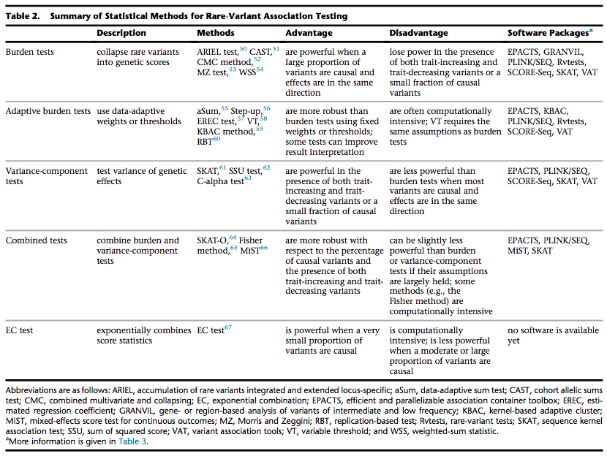
Methods for rare variant association
Lee, Seunggeung, et al. "Rare-variant association analysis: study designs and statistical tests." The American Journal of Human Genetics 95.1 (2014): 5-23.

Slide 21
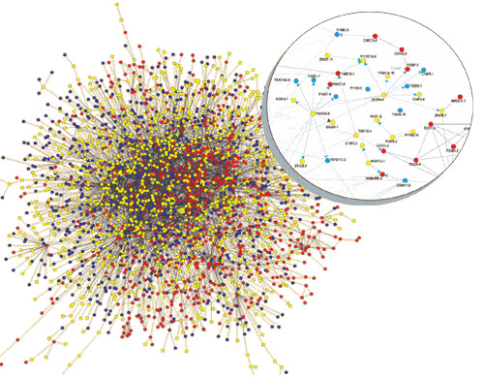
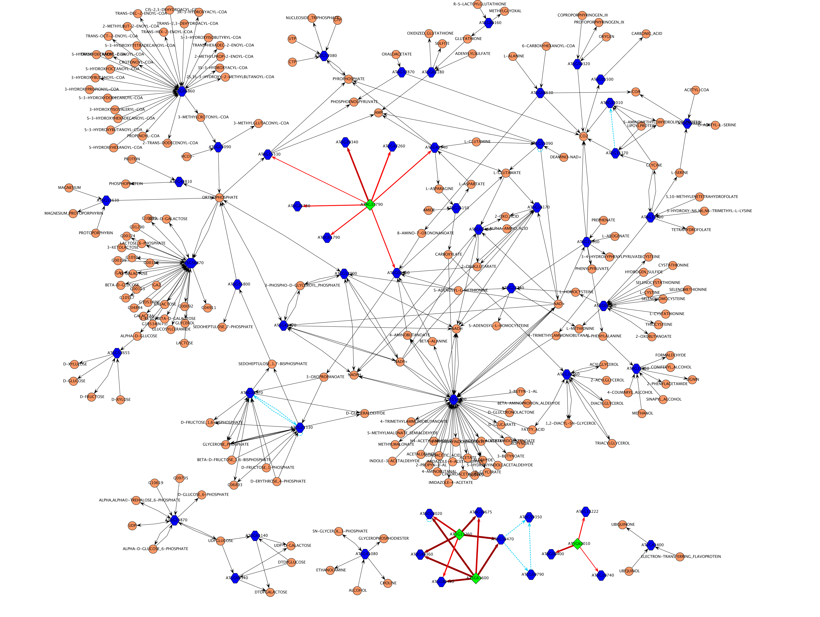
Using network information

Slide 22
Example with Inherited Retinal Dystrophies (IRD)
Prevalence 1 in 3000
Clinically and genetically very heterogeneous
190 GENES account for aprox. 50% of IRDs.
Is genetic overlapping among IRDs related to protein interaction?
Notes:
Las distrofias de retina con un grupo de enfermedades genética y fenotípicamente heterogéneas caracterizadas por la degeneración de la retina, que conduce a una ceguera parcial o total.
La identificación de nuevos genes responsables de enfermedades de retina es la base por tanto de los avances en el conocimiento de la fisiología y la patología de la retina; de esta manera, será posible establecer nuevas líneas celulares y modelos animales para estudiar las funciones de los genes relevantes que permitan en última instancia mejorar las alternativas terapéuticas para las distrofias de retina.

Slide 23
Example with Inherited Retinal Dystrophies (IRD)
BBS
LCA
ARL6, BBS2, BBS4,
BBS5, BBS7, BBS9,
BBS10, BBS12,, INPP5E,
LZTFL1, MKKS, MKS1,
SDCCAG8, TRIM32, TTC8
LCA5,
RD3
CORD/COD
CEP290
CACNA1F,
CACNA2D4
CVD
CABP4,
GNAT2
CORD/COD
AIPL1,
GUCY2D,
RPGRIP1
CRB1, IMPDH1,
LRAT, MERTK,
RDH12, RPE65,
SPATA7, TULP1
BBS1
GRK1,
GRM6,
NYX,
TRPM1
NB
PDE6B,
RHO,
SAG
ADAM9,
GUCA1A,
HRG4/UNC119,
KCNV2, PDE6H,
PITPNM3, RAX2,
RDH5, RIM1
CRX
C2ORF71, C8ORF37,
CA4,CERKL, CNGA1, CNGB1,
DHDDS,EYS, FAM161A, IDH3B,KLHL7
IMPG2, MAK, NRL, PAP1, PDE6A,
PDE6G, PRCD, PRF3, PRPF8, PRPF31
RBP3, RGR, ROM1, RP1, RP2,
SNRNP200, TOPORS, TTC8
ZNF513
RLBP1,
SEMA4A
RP
LCA-Leber Congenital Amaurosis
CORD/COD- Cone and cone-rod dystro.
CVD- Colour Vision Defects
MD- Macular Degeneration
ERVR/EVR- Erosive and Exudative
Vitreoretinopathies
USH- Usher Syndrome
RP- Retinitis Pigmentosa
NB- Night Blindness
BBS- Bardet-Biedl Syndrome
ABCA4,
PROM1,
PRPH2,
RPGR
CVD
CNGA3,
PDE6C
BCP,
GCP,
RCP
FSCN2,
GUCA1B
CLRN1,
USH2A
C1QTNF5,
EFEMP1,
ELOVL4,
HMNC1,
RS1,
TIMP3
BEST1
NR2E3
ABHD12, CDH23, CIB2, DFNB31, GPR98, HARS, MYO7A, PCDH15, USH1C, USH1G
FZD4, KCNJ13,
LRP5, NDP,
TSPAN12, VCAN
MD
USH
ERVR/EVR

Slide 24
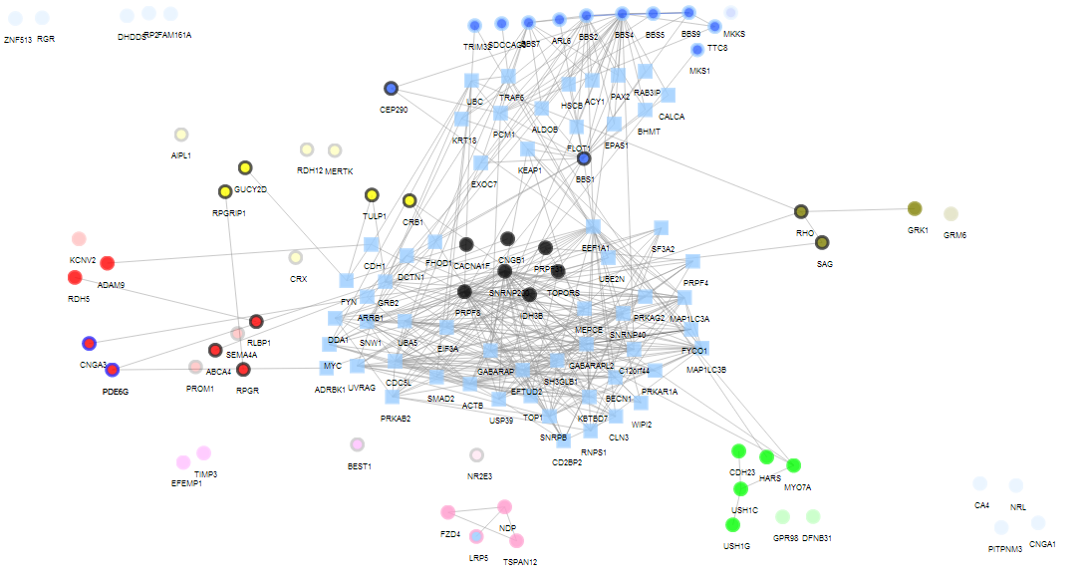
Example with Inherited Retinal Dystrophies (IRD)
LCA-Leber Congenital Amaurosis
CORD/COD- Cone and cone-rod dystro.
CVD- Colour Vision Defects
MD- Macular Degeneration
ERVR/EVR- Erosive and Exudative
Vitreoretinopathies
USH- Usher Syndrome
RP- Retinitis Pigmentosa
NB- Night Blindness
BBS- Bardet-Biedl Syndrome
Significant Clustering coefficient,
p-value=0.0103
LCA
BBS
CORD/COD
NB
RP
CVD
USH
MD
ERVR/EVR
SNOW Tool. Minguez et al., NAR 2009 Implemented in Babelomics (http://www.babelomics.org)

Slide 25
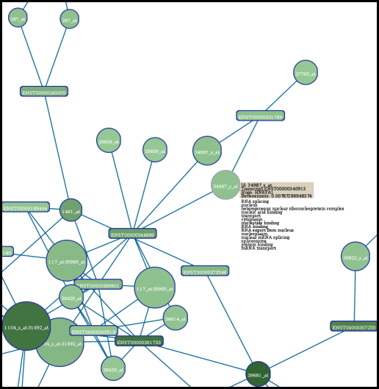
SNOW
The SNOW tool introduces protein-protein interaction data into the functional profiling of genomic data
  Evaluates role of the list within the interactome: identifies hubs in the list of proteins/genes (nodes) and evaluates the topological parameters of the within the interactome
  Evaluates the list’s cooperative behavior as a functional module
http://babelomics.bioinfo.cipf.es/functional.html

Slide 26
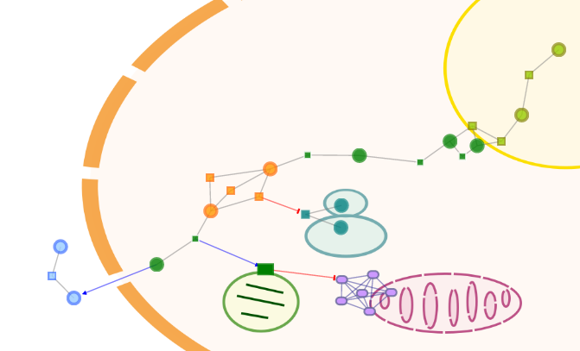
NetworkMiner
Prioritizing disease candidate genes
Scenario
You have:
a list of disease candidates (ranked by their population frequency)
a list of genes that are known to be associated to the disease
You want to see:
which of your candidates are functionally related or interacting with the known disease genes
NetworkMiner Study
Tests whether any of the candidates is significantly located in the neighborhood of the known disease genes
http://babelomics.bioinfo.cipf.es/functional.html

Slide 27
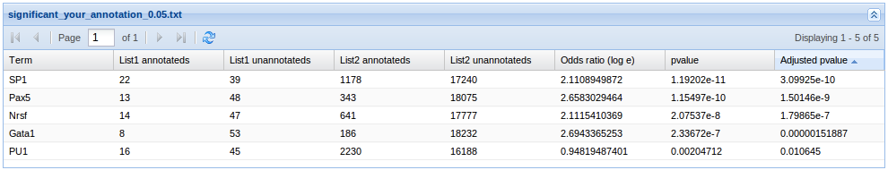
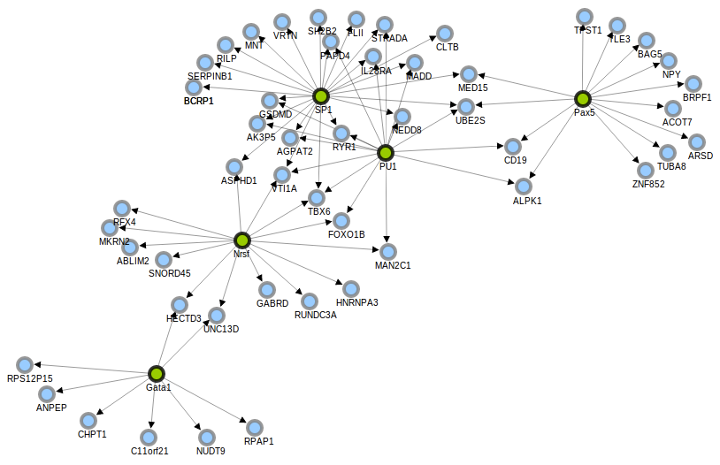
RENATO (REgulatory Network Analsis TOol)
Identifying common regulatory elements
Sometimes, the problem is not in the gene but in its regulators
Tool for the interpretation and visualization of transcriptional (TFs) and post-transcriptional (miRNAs) regulatory information
Designed to identify common regulatory elements in a list of genes
RENATO maps these genes to the regulatory network, extracts the corresponding regulatory connections and evaluate each regulator for significant over-representation in the list.
http://renato.bioinfo.cipf.es

Slide 28
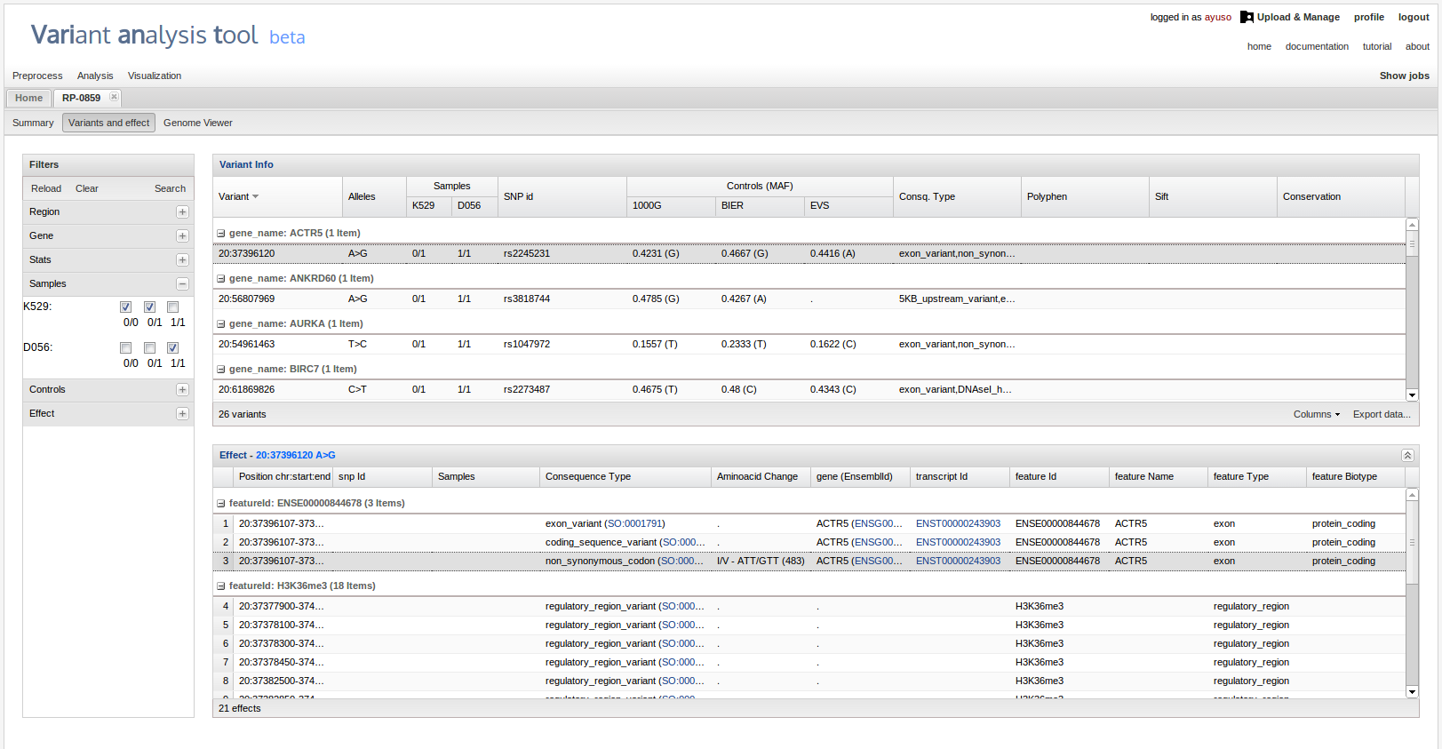
BierApp
Bierapp.babelomics.org

Slide 29
THANK YOU.

