Slide 1

Visualization of mapped reads
Integrative Genomics Viewer (IGV)
University of Edinburgh
Edinburgh, UK
22nd October 2015

Slide 2
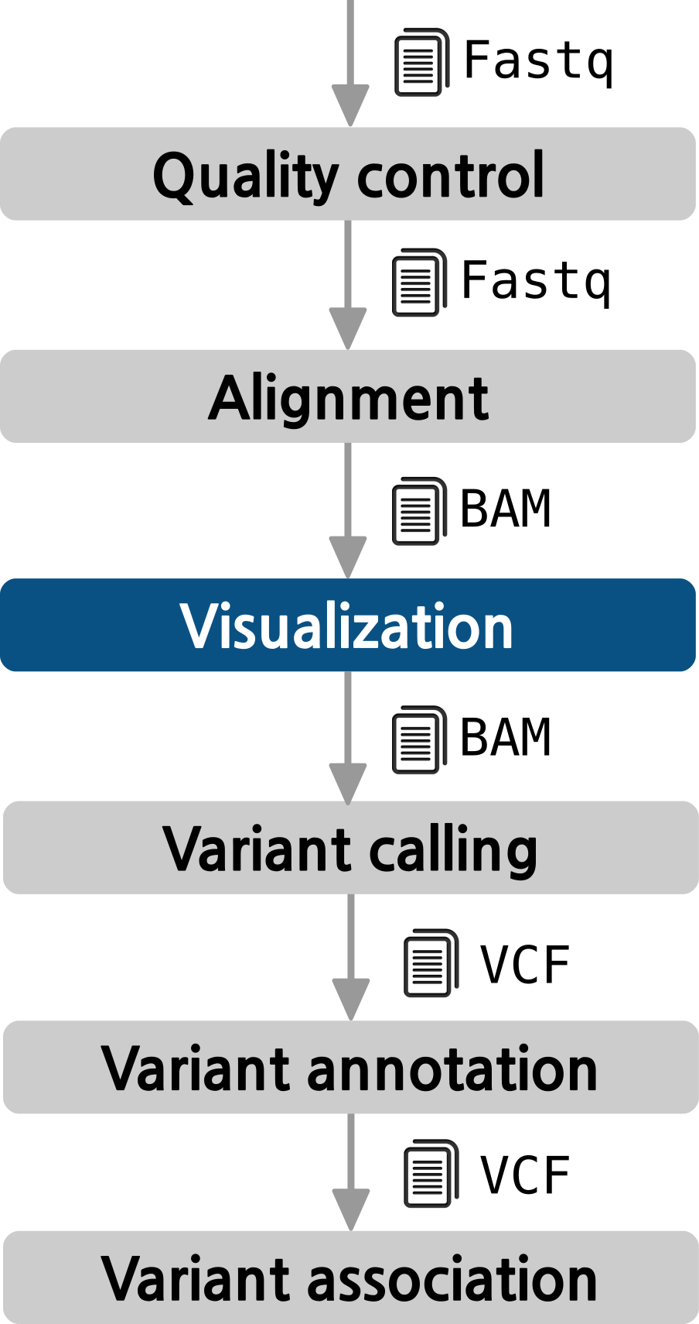
The pipeline

Slide 3

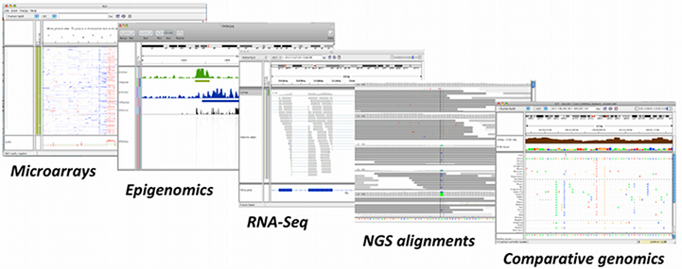



Introduction
Large quantities of genomic data (NGS, array based methods, etc)
Human interpretation and judgment using visualization can help complex biological relationships
Integrative Genomics Viewer (IGV)
  Integrate different data types simultaneously
  View large datasets easily
  Faster navigation or browsing
  Runs locally on your desktop
  Used by large-scale projects
  Open source and freely available
Helga Thorvaldsdóttir, James T. Robinson, and Jill P. Mesirov
Integrative Genomics Viewer (IGV): high-performance genomics data visualization and exploration
Brief Bioinform (2013) 14 (2): 178-192

Slide 4
Data types
Any data related to genome coordinates
Sample annotations or attributes
Genome annotations
Recommended file formats
Source data | Recommended File Formats
Sequence alignment data | SAM (must be sorted/indexed) BAM (must be indexed)
Genome annotations | GFF or GFF3 format BED format
Variant data | VCF
Any numeric data | IGV format, TAB format WIG format
Gene expression data | GCT format RES format

Slide 5
Indexing a BAM file
BAM format: Binary SAM file → Reduces disk space and time
BAM/SAM files need to be indexed (using samtools) → SAM files will be sorted by start position and indexed
Index files must reside in the same directory as the BAM or SAM file
Indexing BAM file
samtools index example.bam

Slide 6
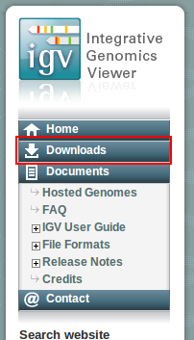
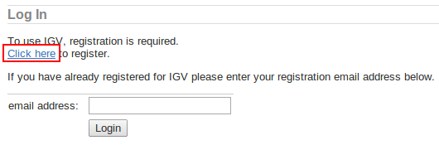





Registration and download
Be sure that Java 6 or later is installed on your machine
Go to the IGV website:
Click Downloads at the left panel
Click to register and fill the form
Download the most suitable file for your system
* Requires Java 7
http://www.broadinstitute.org/igv/home

Slide 7

IGV interface
Tool Bar
Ideogram
Ruler
Tracks
Features

Slide 8
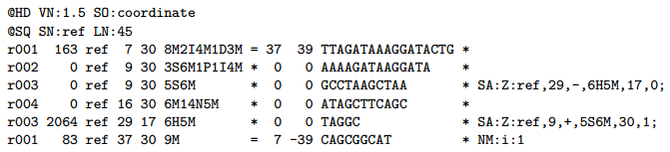
IGV interface
Tool Bar
Ideogram
Ruler
Tracks
Features

Slide 9
Hands on!

Slide 10
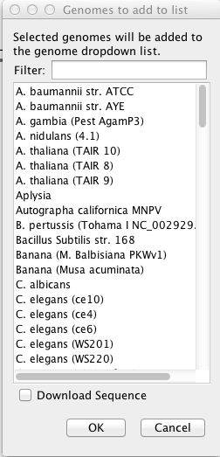
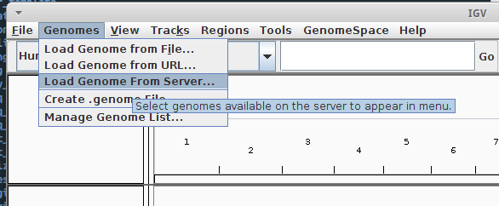
Download genome
Current version of IGV has "Human hg18" and "Human hg19" already loaded
IGV provides a number of genomes that are hosted on a server at the Broad Institute
List of genomes hosted: http://www.broadinstitute.org/software/igv/Genomes
Genomes → Load genome from server...
Select Human hg19

Slide 11
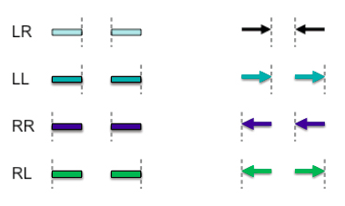
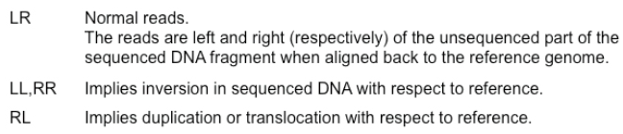
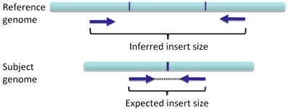
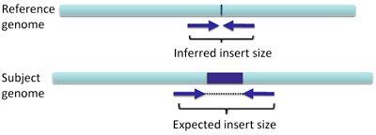
IGV: interpreting colored reads
Read pair orientation
Insert size
Larger than expected (Deletion)
Smaller than expected (Insertion)
Mate of paired end reads that map to other chromosomes
Deletion
Insertion

Slide 12
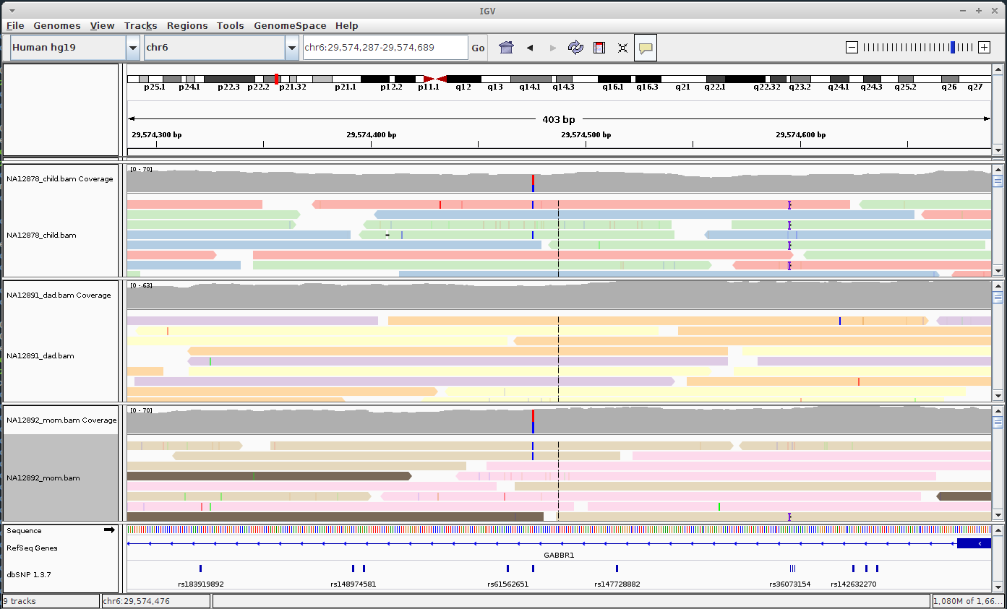
Loading and browsing files
File → Load from file...
Select NA12878_child.bam, NA12891_dad.bam and NA12892_mom.bam

Slide 13





IGV Tool Bar
 | Genome drop-down box
 | Chromosome drop-down box
 | Search box
 | Whole genome view
 | Moves backward and forward through views of the genome
 | Refreshes the display
 | Defines a region of interest on the chromosome
 | Reduces the row height on all tracks to fit all data
 | Toggles the pop-up information windows in IGV on or off
 | Zooms in and out on a chromosome

