Slide 1
Discussion on Genomic/Metagenomic Data for ANGUS Course
Adina Howe

Slide 2
Hi!
About me
Your own data → all the data → Big Data!
Two databases:
NCBI (genomic)
MG-RAST (metagenomic)

Slide 3
What I’ll teach you
Recommended ways of getting sequencing data
Recommended ways of getting specific sequencing data
Methods to download annotations (MG-RAST)
A Tour Through MG-RAST
Happy Things
Hard Things

Slide 4
Let’s think…
If you were building a database of sequences, what would you want in it?
How would you want it organized?
How would you make that information available?

Slide 5
What I do with my sequencing data
Compare it to known references (BLAST, alignment mapping, HMMs)
Database gaps, 50%+ in soil metagenomes unknown
Annotation errors
Assembly (site specific reference)
Dependent on sequencing depth
Largest soil datasets, 1 billion reads, 10% assembled
Co-occurrence / binning
Abundance or nucleotide based
Sequencing coverage dependent, need “unique” bins
Particularly problematic for short reads
Notes:
Who is important and how can I reduce the noise?

Slide 6
Sentinels in metagenomic data?
Presence/Absence? Quantification?
Phyla? Strain? Functional level?
Strong signals of similarity or differences in both “annotatable” and unknown sequences
Information about targets for which we need more references (by other methods)
Indexes (alpha diversity, copiotroph/oligotroph, % polymorphism, recA/16S gene count)

Slide 7
What I do with my sequencing data
Compare it to known references (BLAST, alignment mapping, HMMs)
Database gaps, 50%+ in soil metagenomes unknown
Annotation errors
Assembly (site specific reference)
Well developed pipelines and tutorials
Almost too many choices
Co-occurrence / binning
Some tools available, still in development largely
Eventually need to link to knowns for validation (or experimental validation)
Notes:
Who is important and how can I reduce the noise?

Slide 8
What has been done – MG-RAST
Free
Easy
Growing in usage by many
Not used by the “leading wedge” (at least as more than a blast engine)
Free data / annotation storage and maintenance
NEON – do you want to build your own? Does MG-RAST suffice?

Slide 9
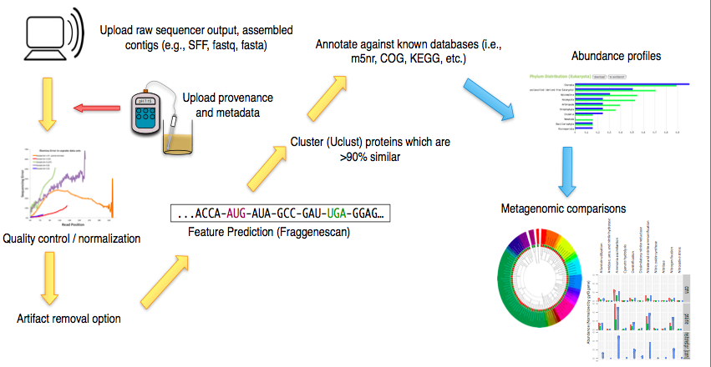
MG-RAST

Slide 10
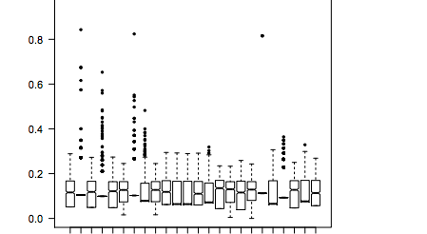

Slide 11
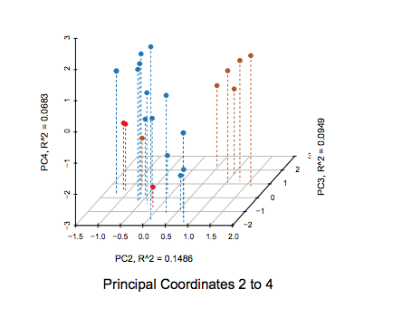

Slide 12
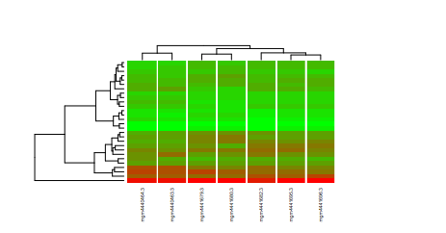

Slide 13
Fine tuning is not possible
What happens when your sequence matches two known genes equally?
What happens if there are multiple taxa related to one function?
What if you want more than ordination (e.g., primer evaluation?)
What if you want to change your distance matrix for ordination?
How do (not) you normalize / rarify your data?
What if you want more sensitivity than a BLAT analysis (e.g., amplicons)
Computationally-optimized, not biologically
Denitrification, Nitrate reductase, nitrate ammonification all distinct categories in Level 3
If you want to merge, not trivial – especially in dealing with abundance estimations

Slide 14
Looking forward
Development of all-pleasing computational, statistical, visualization tool will be impossible
Community demands will more than likely be easy to use and aimed at reducing (perhaps overly simplified) complex data into comparable metrics (TBD)
Data management and associated “metadata” may be the larger challenge (in the face of rapidly changing datasets)

Slide 15
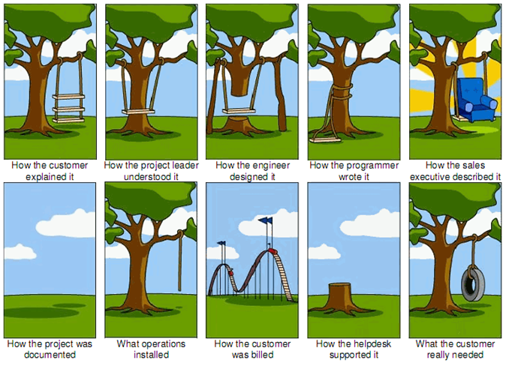
http://tamingdata.com/wp-content/uploads/2010/07/tree-swing-project-management-large.png

