Slide 1
Welcome!

Slide 2
Introducing myself
Until January, MSU asst professor in Microbiology and Computer Science.
As of January, assoc professor in School of Veterinary Medicine at UC Davis
Background: programming, evolutionary biology, math, climatology & astronomy, dev bio, regulatory genomics, genomics, gene regulatory networks, bioinformatics.

Slide 3
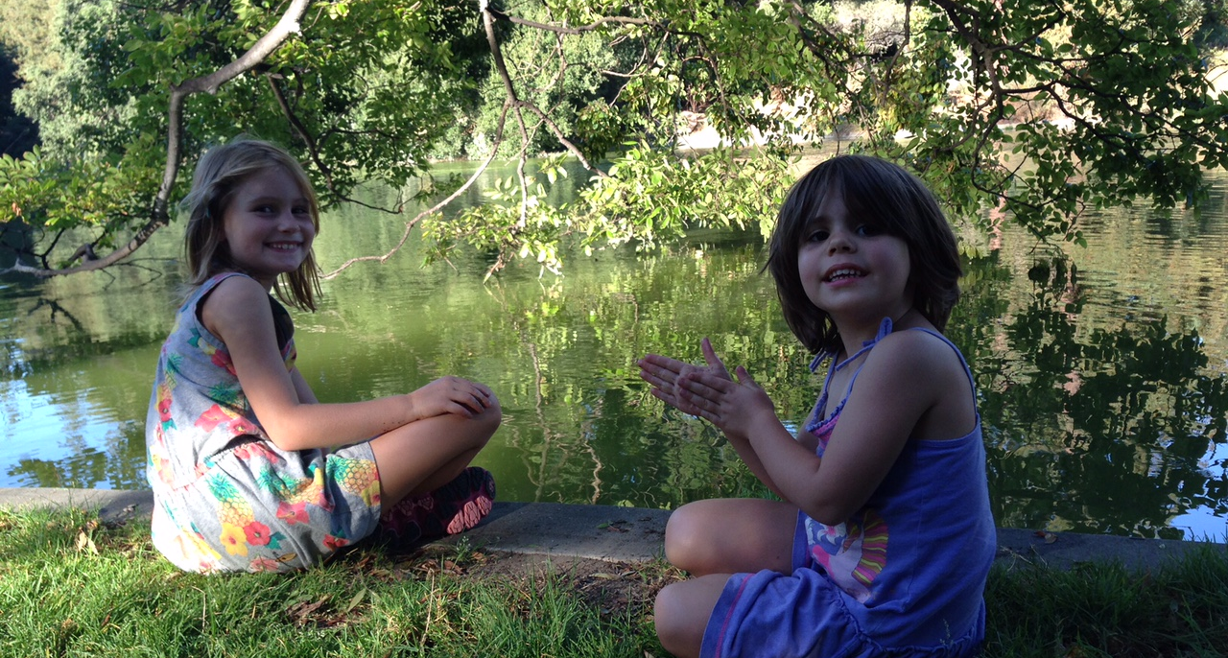
Family! (Not here ☹)

Slide 4
What are the goals of this workshop?
Two weeks of lessons before this… how is this different?
More, different instructors.
More experienced students.
More topics.
Why?

Slide 5
1. More & more advanced lessons
The two week workshop tries to teach to inexperienced folk. We can rely on a bit more experience here.
Also, lessons are limited to what the instructors know. So let’s invite more instructors!

Slide 6
2. Opportunity to try out new lessons
It is often useful for instructors to trial new lessons on more advanced audiences!
Also, we can get teaching feedback from many passionate and involved and active teachers!

Slide 7
3. Opportunity for instructors to learn something new!
I don’t actually know much about many of these topics.
I’m guessing that’s true of many of the instructors!

Slide 8
Other thoughts:
Opportunity to find out what people now know they need to learn, vs what was taught in the two week course.
I’d love to discuss new ideas for teaching and training.
???

Slide 9
Written rules
No night-swimming without a buddy.
I mean it.

Slide 10
Code of Conduct
http://angus.readthedocs.org/en/2015/code-of-conduct.html
tl;dr? Don’t be a jerk.
Note: this is not because of known prior problems, ICYAW.

Slide 11
Food and drink
Anything group-intended can be purchased by Jessica. Please write it down on the list in the back.
Jessica can also drive you to the market; he’ll probably go every two or three days.
Please don’t ask Jessica to spot you $$; ask me.

Slide 12
Games and location.
We have volleyball, frisbee, frisbee golf, boche ball…?
Also cards. Other board games needed?
There’s good places to run, to swim, to hike, to bike, and to fish.
We also have laundry and weight room (?)

Slide 13
Free time, more generally.
Please be sure to take time off as you need it.
Not only is relaxation important, given the next two weeks, but the networking is also important.
Plus, the TAs and profs need the time off too :>

Slide 14
Unwritten rules

Slide 15
Any questions or comments?

