Slide 1
Shotgun sequencing
“Coverage” is simply the average number of reads that overlap
each true base in genome.
Here, the coverage is ~10 – just draw a line straight down from the top through all of the reads.

Slide 2
Reducing to k-mers ⬄overlaps
Note that k-mer abundance is not properly represented here! Each blue k-mer will be present around 10 times.

Slide 3
Errors create new k-mers
Each single base error generates ~k new k-mers.
Generally, erroneous k-mers show up only once – errors are random.

Slide 4
So, k-mer abundance plots are mixtures of true and false k-mers.

Slide 5
Counting k-mers - histograms
Low-abundance peak (errors)

Slide 6
Counting k-mers - histograms
High-abundance peak
(true k-mers)

Slide 7
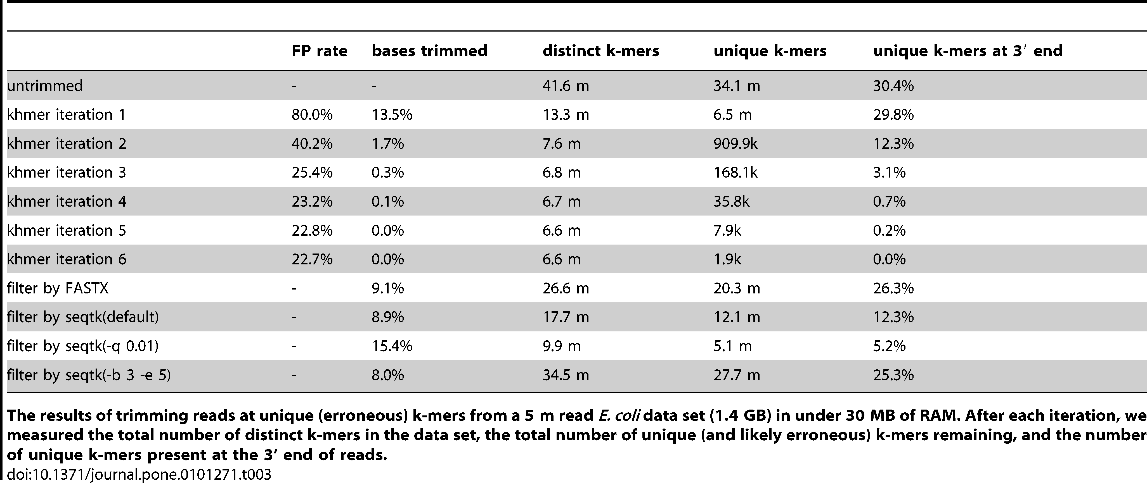
K-mer abundance trimming removes errors effectively!
Zhang et al. PLoS One, 2014

Slide 9
Shotgun sequencing and coverage
“Coverage” is simply the average number of reads that overlap
each true base in genome.
Here, the coverage is ~10 – just draw a line straight down from the top through all of the reads.

Slide 10
Random sampling => deep sampling needed
Typically 10-100x needed for robust recovery (300 Gbp for human)

Slide 11
Various experimental treatments can also modify coverage distribution.
(MD amplified)

Slide 12
Non-normal coverage distributions lead to decreased assembly sensitivity
Many assemblers embed a “coverage model” in their approach.
Genome assemblers: abnormally low coverage is erroneous; abnormally high coverage is repetitive sequence.
Transcriptome assemblers: isoforms should have same coverage across the entire isoform.
Metagenome assemblers: differing abundances indicate different strains.
Is there a different way? (Yes.)

Slide 13
Memory requirements (Velvet/Oases – est)
Bacterial genome (colony)
Human genome
Vertebrate mRNA
Low complexity metagenome
High complexity metagenome
1-2 GB
500-1000 GB
100 GB +
100 GB
1000 GB ++

Slide 14
Practical memory measurements

Slide 15
K-mer based assemblers scale poorly
Why do big data sets require big machines??
Memory usage ~ “real” variation + number of errors
Number of errors ~ size of data set

Slide 16
Why does efficiency matter?
It is now cheaper to generate sequence than it is to analyze it computationally!
Machine time
(Wo)man power/time
More efficient programs allow better exploration of analysis parameters for maximizing sensitivity.
Better or more sensitive bioinformatic approaches can be developed on top of more efficient theory.

Slide 17
Approach: Digital normalization (a computational version of library normalization)
Suppose you have a dilution factor of A (10) to B(1). To get 10x of B you need to get 100x of A! Overkill!!
This 100x will consume disk space and, because of errors, memory.
We can discard it for you…

Slide 18
Digital normalization

Slide 19
Digital normalization

Slide 20
Digital normalization

Slide 21
Digital normalization

Slide 22
Digital normalization

Slide 23
Digital normalization

Slide 24
Digital normalization approach
A digital analog to cDNA library normalization, diginorm:
Is single pass: looks at each read only once;
Does not “collect” the majority of errors;
Keeps all low-coverage reads;
Smooths out coverage of regions.

Slide 25
Coverage before digital normalization:
(MD amplified)

Slide 26
Coverage after digital normalization:
Normalizes coverage
Discards redundancy
Eliminates majority of
errors
Scales assembly dramatically.
Assembly is 98% identical.

Slide 27
Digital normalization approach
A digital analog to cDNA library normalization, diginorm is a read prefiltering approach that:
Is single pass: looks at each read only once;
Does not “collect” the majority of errors;
Keeps all low-coverage reads;
Smooths out coverage of regions.

Slide 28
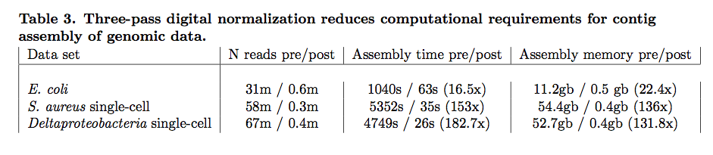
Contig assembly is significantly more efficient and now scales with underlying genome size
Transcriptomes, microbial genomes incl MDA, and most metagenomes can be assembled in under 50 GB of RAM, with identical or improved results.
Notes:
Goal is to do first stage data reduction/analysis in less time than it takes to generate the data. Compression => OLC assembly.

Slide 29
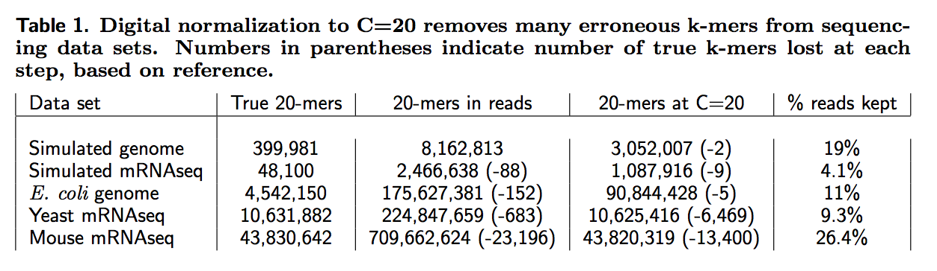
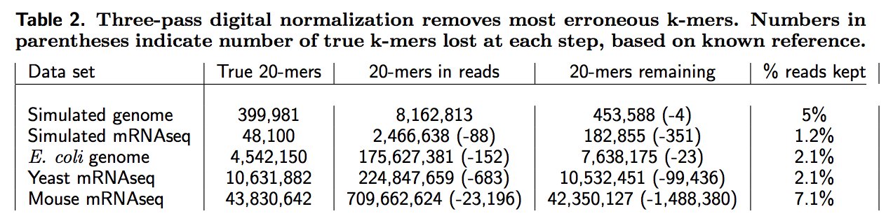
Digital normalization retains information, while discarding data and errors

Slide 30
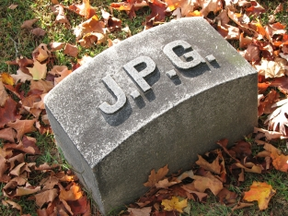
Lossy compression
http://en.wikipedia.org/wiki/JPEG

Slide 31

Lossy compression
http://en.wikipedia.org/wiki/JPEG

Slide 32

Lossy compression
http://en.wikipedia.org/wiki/JPEG

Slide 33

Lossy compression
http://en.wikipedia.org/wiki/JPEG

Slide 34
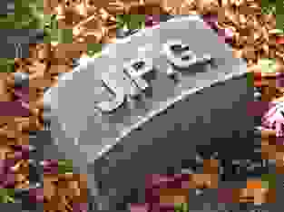
Lossy compression
http://en.wikipedia.org/wiki/JPEG

Slide 35
Can we apply this algorithmically efficient technique to variants? Yes.
Single pass, reference free, tunable, streaming online variant calling.

Slide 36
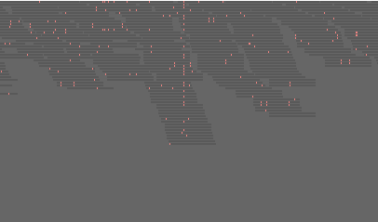
Coverage is adjusted to retain signal

