Slide 1
Welcome!

Slide 2
Everything’s going to be OK.
This is the 6th year we’ve run this course (!!)
You’re in experienced hands.
(I won’t say “good”, necessarily. But experienced.)

Slide 3
Everything’s going to be OK.
Number of emergency room trips: 1
Let’s avoid incrementing that number…

Slide 4
Introducing myself
Until January, MSU asst professor in Microbiology and Computer Science.
As of January, assoc professor in School of Veterinary Medicine at UC Davis
Background: programming, evolutionary biology, math, climatology & astronomy, dev bio, regulatory genomics, genomics, gene regulatory networks, bioinformatics.

Slide 5

Family! (Not here ☹)

Slide 6
Others in the room:
Matt MacManes (UNH)
Amanda Charbonneau (MSU)
Lisa Cohen (UC Davis)
Phil Brooks (MSU)
Jessica Mizzi (MSU / UC Davis)

Slide 7
What are the goals of this workshop?
Expose you all to a bunch of approaches and ideas and details.
Expose you to a particular way of thinking.
Train you in a particular way of learning and doing.
Networking!
At the worst, you will find out you know more (or less) than you thought.

Slide 8
Our approach.
Provide a safe & welcoming place to experiment.
Lots and lots of help (in the form of Tas)
Provide lots of data sets, tools, scripts.
Research specific help as possible.

Slide 9
Daily schedule (generally)
7-9: breakfast
9:15am – lecture
10:30am – tutorial 1
12-1pm - lunch
1:15pm – tutorial 2
3pm – free time!
6-7- dinner (unless noted otherwise)
7pm – tutorial/lecture and/or fun

Slide 10
Workshop materials
All the workshop materials will be openly available forever!
(Or at least indefinitely.)
You can download them and cherish them forever (I’m happy to show you how).
They may not be up to date until ~the lecture/tutorial, though.

Slide 11
Something that we don’t talk about enough in this workshop:
Most / best bioinformatics information is online:
Blogs
Twitter
SeqAnswers
Biostars
Spend some time poking around while you’re here. We have some suggestions on the course web site.

Slide 12
Written rules
No night-swimming without a buddy.
I mean it.

Slide 13
Code of Conduct
http://angus.readthedocs.org/en/2015/code-of-conduct.html
tl;dr? Don’t be a jerk.
I will post Judi Brown Clark’s contact information on the wall shortly.
Note: this is not because of known prior problems, ICYAW.

Slide 14
Food and drink
Anything group-intended can be purchased by Jessica. Please write it down on the list in the back.
Jessica can also drive you to the market; he’ll probably go every two or three days.
Please don’t ask Jessica to spot you $$; ask me.

Slide 15
Games and location.
We have volleyball, frisbee, frisbee golf, boche ball…?
Also cards. Other board games needed?
There’s good places to run, to swim, to hike, to bike, and to fish.
We also have laundry and weight room (?)

Slide 16
Free time, more generally.
Please be sure to take time off as you need it.
Not only is relaxation important, given the next two weeks, but the networking is also important.
Plus, the TAs and profs need the time off too :>

Slide 17
Unwritten rules

Slide 18
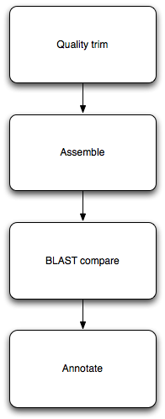
How does this stuff work?
Typically, you need to run multiple different programs in sequence.
Each program takes in data, in files; and outputs data, in files.
(Some programs also produce pretty pictures via the Web.)
Notes:
Ipython notebook

Slide 19
Automation & computational efficiency matter
You’ll learn to run lots of different programs here.
We’ll run into some practical problems:
Some programs take a long time to run.
Some programs take many different parameters; which are best?
Some programs don’t finish on “cheap” hardware.
How do we run many long-running programs? How do we remember what we did? How do we get our programs to finish?

Slide 20
“Heuristics”
What do computers do when the answer is either really, really hard to compute exactly, or actually impossible?
They approximate! Or guess!
The term “heuristic” refers to a guess, or shortcut procedure, that usually returns a pretty good answer.

Slide 21
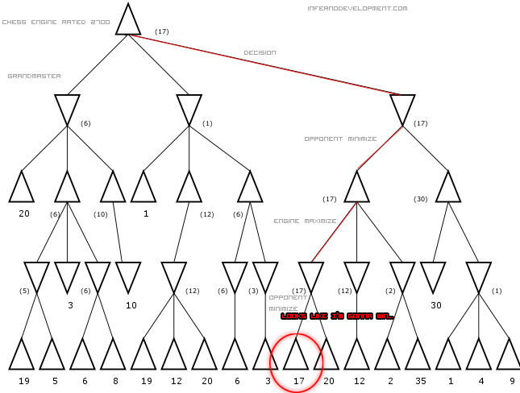
Often explicit or implicit tradeoffs between compute “amount” and quality of result
http://www.infernodevelopment.com/how-computer-chess-engines-think-minimax-tree

Slide 22
This kind of issue comes up a lot.
Mapping.
Assembly.
Statistics (Monte Carlo and resampling methods).
Simulations.
More generally, most “interesting” algorithms involve approximations and shortcuts. When are they (in)appropriate for your task?

Slide 23
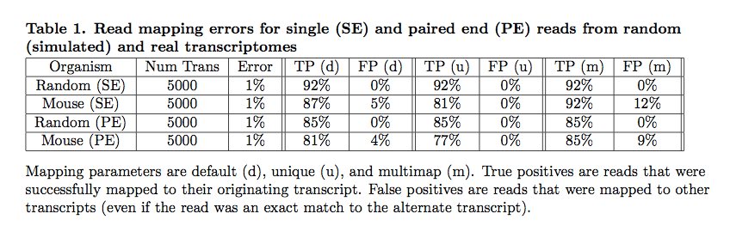
What are the limits of data + compute?
Mappers will ignore some fraction of reads due to errors.
Pyrkosz et al., unpub.

Slide 24
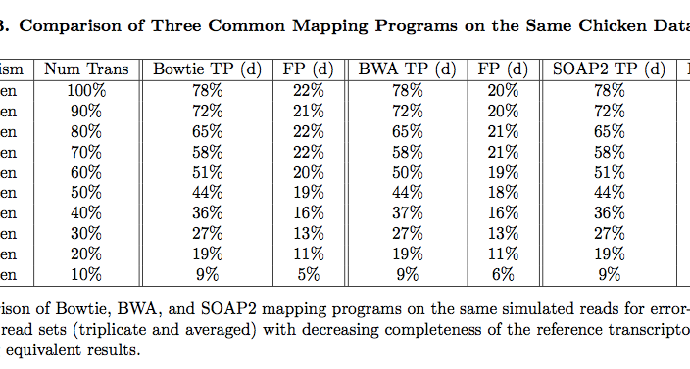
Does choice of mapper matter?
Reference completeness matters more!
Pyrkosz et al., unpub.

Slide 25
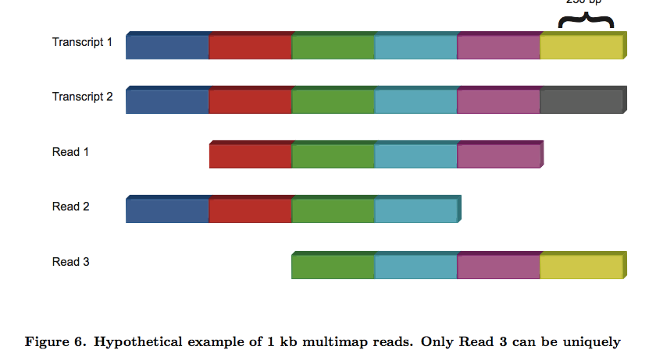
Real problem? Our data can’t uniquely specify solution!
Here, there is no direct way to know if last exon is connected to first exon.
Pyrkosz et al., unpub.

Slide 26
Concluding thoughts
There’s what you can do today, computationally, with existing programs. This is often limited by our time, experience, etc.
There’s what you could, in theory, do with the data you had. This is the upper limit on your accuracy.
Figuring out the difference is one of the main reasons you’re here :)

Slide 27
Process and materials!
Use the ngs-2015@lists.idyll.org list to organize things!
Twitter: #ngs2015; I’m @ctitusbrown
Facebook group.

Slide 28
Use the stickies, Luke…

Slide 29
Any questions or comments?

