Slide 1
(Shotgun) sequencing
Titus Brown

Slide 2
Three basic problems
Resequencing, counting, and assembly.

Slide 3
1. Resequencing analysis
We know a reference genome, and want to find variants (blue) in a background of errors (red)

Slide 4
2. Counting
We have a reference genome (or gene set) and want to know how much we have. Think gene expression/microarrays.

Slide 5
3. Assembly
We don’t have a genome or any reference, and we want to construct one.
(This is how all new genomes are sequenced.)

Slide 6
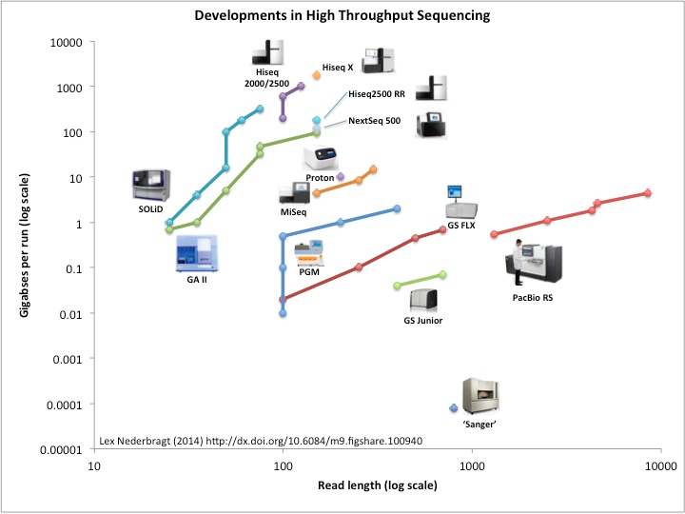

Slide 7
Outline
Shotgun sequencing
The magic of polonies, and how Illumina sequencing works
Sequencing depth, read length, and coverage
Paired-end sequencing and insert sizes
Coverage bias
Long reads: PacBio and Nanopore sequencing

Slide 8
Shotgun sequencing
It was the best of times, it was the worst of times, it was the age of wisdom, it was the age of foolishness
It was the best of times, it was the wor
, it was the worst of times, it was the
isdom, it was the age of foolishness
mes, it was the age of wisdom, it was th

Slide 9
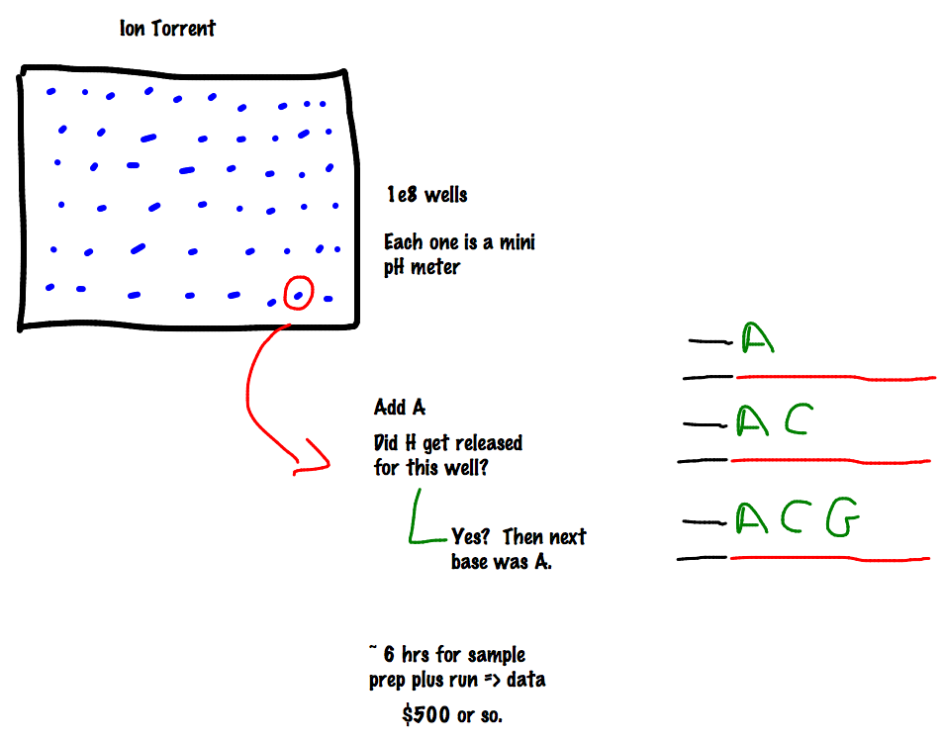

Slide 10
Two specific concepts:
First, sequencing everything at random is very much easier than sequencing a specific gene region. (For example, it will soon be easier and cheaper to shotgun-sequence all of E. coli then it is to get a single good plasmid sequence.)
Second, if you are sequencing on a 2-D substrate (wells, or surfaces, or whatnot) then any increase in density (smaller wells, or better imaging) leads to a squared increase in the number of sequences yielded.

Slide 11
Random sampling => deep sampling needed
Typically 10-100x needed for robust recovery (300 Gbp for human)

Slide 12
“Coverage”
“Coverage” is simply the average number of reads that overlap
each true base in genome.
Here, the coverage is ~10 – just draw a line straight down from the top through all of the reads.

Slide 13
Illumina yields the deepest sequencing available
MiSeq
30 million reads per run
300 base paired-end reads
HiSeq 2500 RR/X 10
6 billion reads per run
150 base paired-end reads
PacBio
44,000 reads per run
8500 bp in length
http://flxlexblog.wordpress.com/2014/06/11/developments-in-next-generation-sequencing-june-2014-edition/

Slide 14
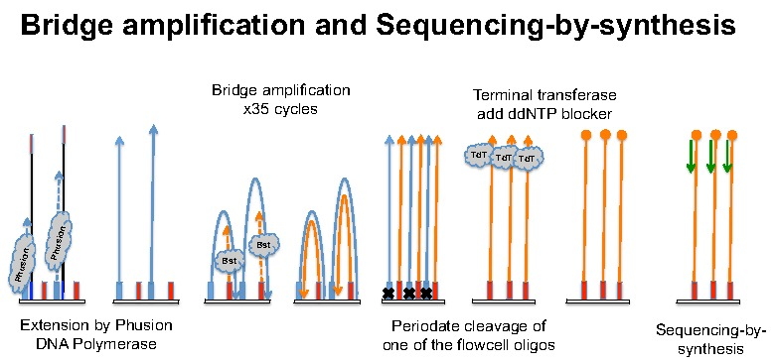
Illumina basics
(See http://seqanswers.com/forums/showthread.php?t=21 for details)
http://ted.bti.cornell.edu/cgi-bin/epigenome/method-1.cgi

Slide 15
A movie of Illumina sequencing:
https://www.youtube.com/watch?v=tuD-ST5B3QA#t=61

Slide 16
What goes wrong with basic assumptions?
Not all sequence is as easily sequenced as other, depending on your sequencing technology (e.g. GC/AT bias);
Some RNA not be as accessible as others (secondary structure);

Slide 17
FASTQ
@895:1:1:1246:14654/1
CAGGCGCCCACCACCGTGCCCTCCAACCTGATGGT
+
][aaX__aa[`ZUZ[NONNFNNNNNO_____^RQ_
@895:1:1:1246:14654/2
ACTGGGCGTAGACGGTGTCCTCATCGGCACCAGC
+
\UJUWSSV[JQQWNP]]SZ]ZWU^]ZX][^TXR`
@895:1:1:1252:19493/1
CCGGCGTGGTTGGTGAGGTCACTGAGCTTCATGTC
+
OOOKONNNNN__`R]O[TGTRSY[IUZ]]]__X__

Slide 18
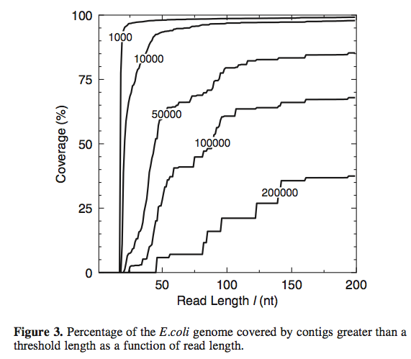
Read length and reconstructability
Whiteford et al., Nuc. Acid Res, 2005

Slide 19
“Reconstructability”
Assembling new genomes or transcriptomes…
Haplotyping - think human genetics & viruses, both.

Slide 20
Repeats! (and shared exons)

Slide 21
Longer reads … OR … Paired-end/mate pair sequencing

Slide 22
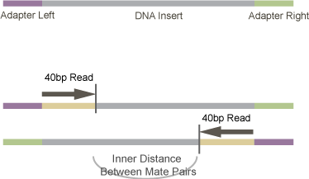
Paired-end sequencing
http://vallandingham.me/RNA_seq_differential_expression.html

Slide 23
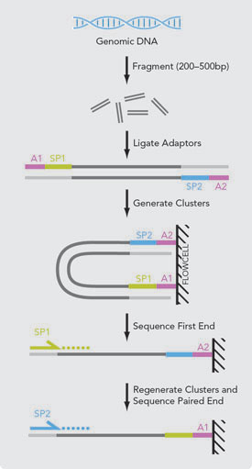

Slide 24
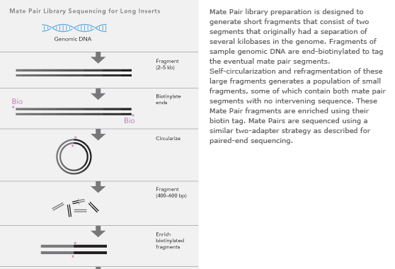
Mate-pair sequencing
(long insert)

Slide 25
Longer reads
PacBio
Moleculo
Nanopore

Slide 26
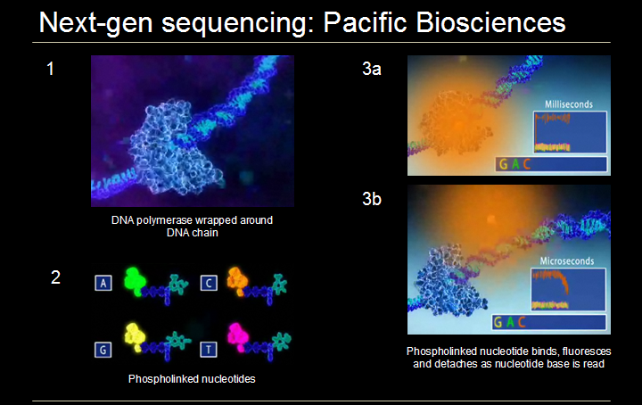
http://www.melanieswan.com/FOLS.html

Slide 27
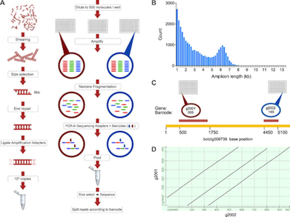
Moleculo (Illumina)
http://nextgenseek.com/2013/07/illumina-announces-moleculo-long-read-technology-and-phasing-as-service/

Slide 28
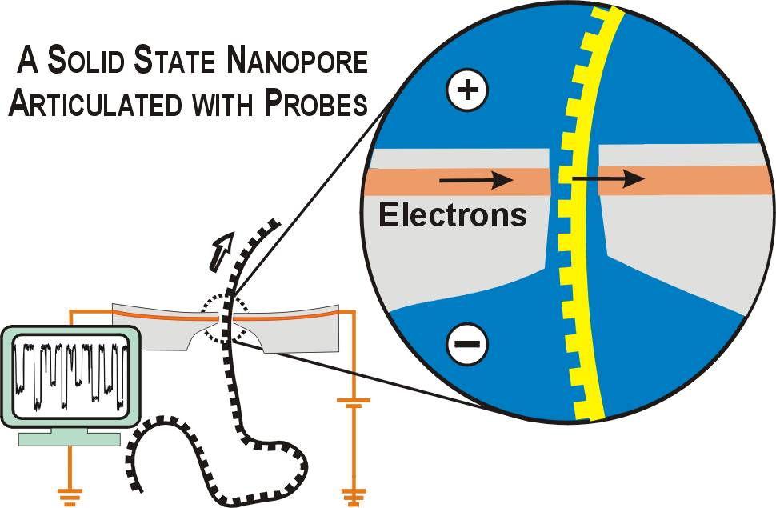
http://labs.mcb.harvard.edu/branton/projects-NanoporeSequencing.htm

Slide 29
Actual yields
MiSeq
30 million reads per run
300 base paired-end reads
HiSeq 2500 RR/X 10
6 billion reads per run
150 base paired-end reads
PacBio
44,000 reads per run
8500 bp in length
http://flxlexblog.wordpress.com/2014/06/11/developments-in-next-generation-sequencing-june-2014-edition/

Slide 31
Your basic data (FASTQ)
@895:1:1:1246:14654/1
CAGGCGCCCACCACCGTGCCCTCCAACCTGATGGT
+
][aaX__aa[`ZUZ[NONNFNNNNNO_____^RQ_
@895:1:1:1246:14654/2
ACTGGGCGTAGACGGTGTCCTCATCGGCACCAGC
+
\UJUWSSV[JQQWNP]]SZ]ZWU^]ZX][^TXR`
@895:1:1:1252:19493/1
CCGGCGTGGTTGGTGAGGTCACTGAGCTTCATGTC
+
OOOKONNNNN__`R]O[TGTRSY[IUZ]]]__X__

Slide 32
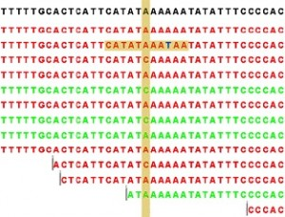
Mapping
U. Colorado
http://genomics-course.jasondk.org/?p=395
Many fast & efficient computational solutions exist.
You have to figure out how to choose parameters to maximize sensitivity/specificity, and when to validate.

Slide 33
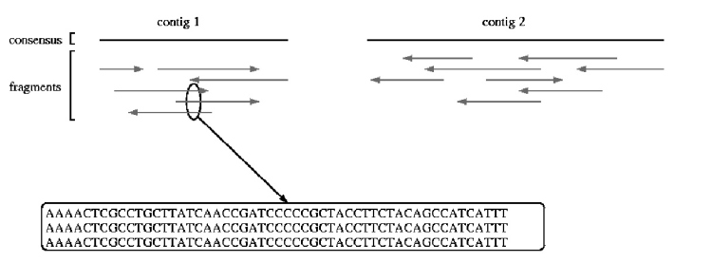
Assembly
Reassemble random fragments computationally.
UMD assembly primer (cbcb.umd.edu)

Slide 34
Shotgun sequencing
It was the best of times, it was the wor
, it was the worst of times, it was the
isdom, it was the age of foolishness
mes, it was the age of wisdom, it was th
It was the best of times, it was the worst of times, it was the age of wisdom, it was the age of foolishness

Slide 35
Where does # of reads count?
Resequencing, counting, and assembly.

Slide 36
Where does reconstructability matter?
Resequencing, counting, and assembly.

Slide 37
Summary
Coverage matters for SNP calls and assembly;
# of reads matters for counting;
Length of reads matters for reconstructability (assembly & haplotyping);
Illumina is still “best” for high coverage;
PacBio and Moleculo => genome assembly;
Nanopore: still tricky but lots of progress being made.

Slide 38
Bad data
I asked:
https://twitter.com/ctitusbrown/status/624721875252420608
I received:
http://www.bioinfo-core.org/index.php/Interesting_NGS_failures
http://bioinfo-core.org/index.php/9th_Discussion-28_October_2010
https://biomickwatson.wordpress.com/2013/01/21/ten-things-to-consider-when-choosing-an-ngs-supplier/

Slide 39
Sequencing Bloopers
Simon Andrews
Tim Stevens

Slide 40
Technical sequencer problems

Slide 41
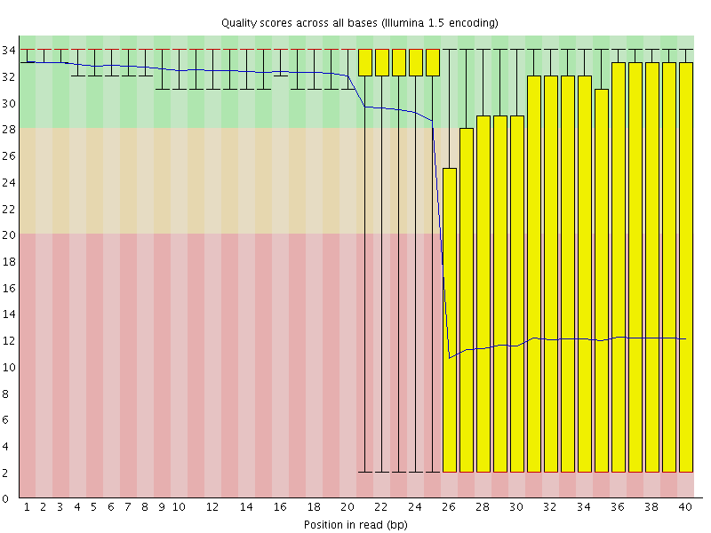
Manifold burst in cycle 26

Slide 42
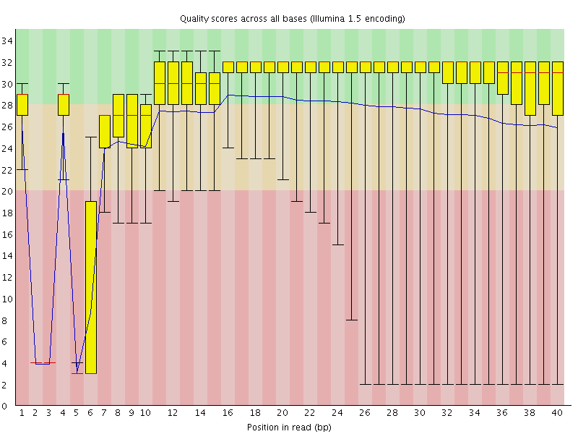
Specific cycles lost

Slide 43
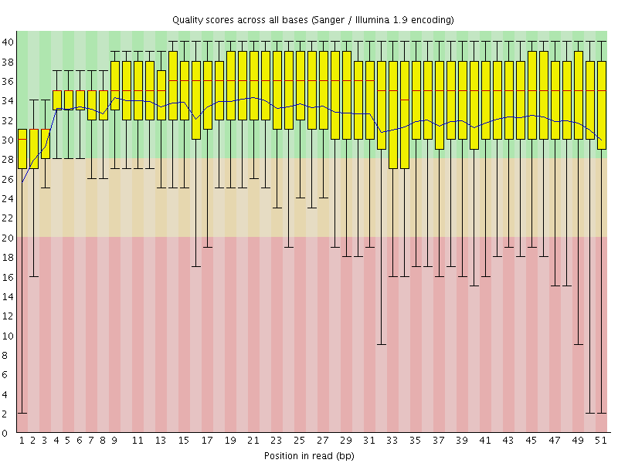
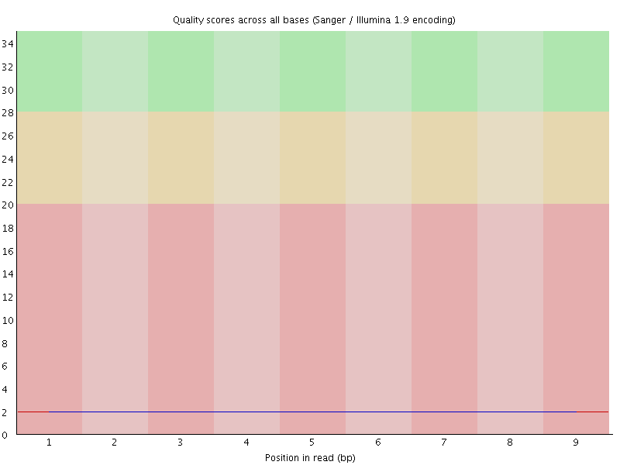
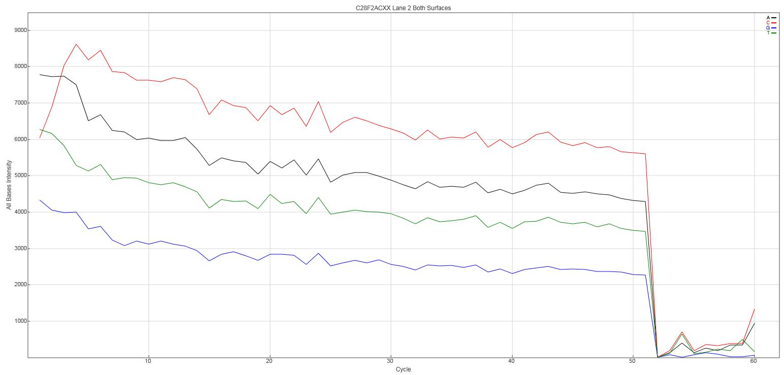
No priming /signal (Wrong adapters used)
Read 1
Read 2
(barcode)

Slide 44
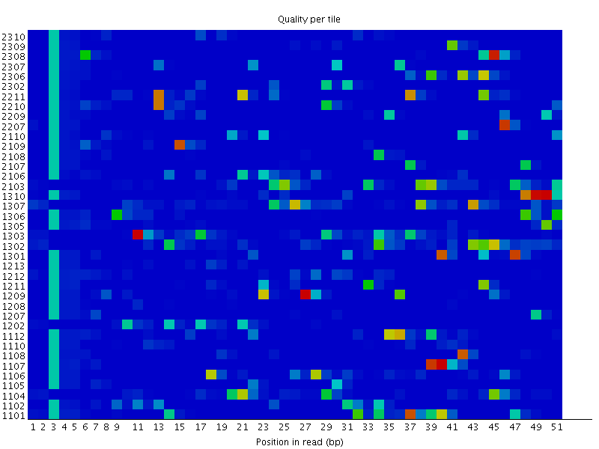
Tile Problems - Overclustering

Slide 45
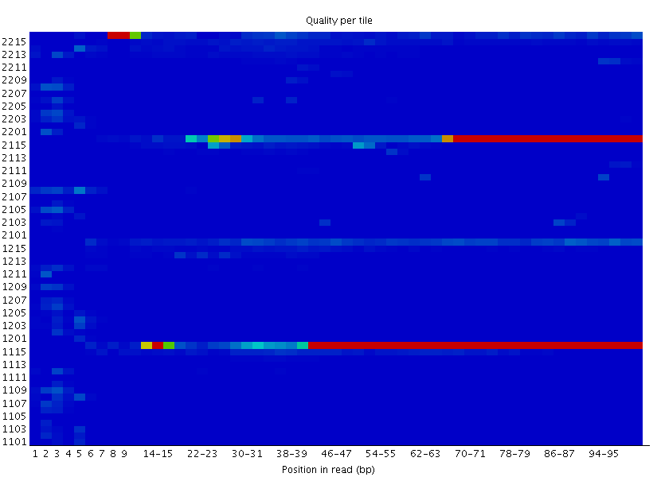
Tile Problems – Consistent tile fail

Slide 46
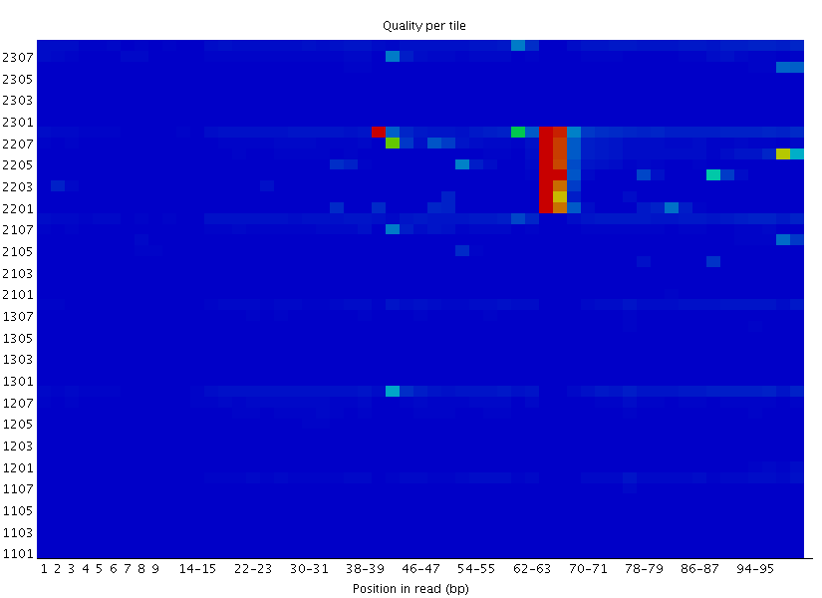
Tile problems – transient tile fail

Slide 47
Incorrect Phred Scores
“the NCBI SRA makes all its data available as standard Sanger FASTQ files
(even if originally from a Solexa/Illumina machine)”
Nucleic Acids Res. 2010 Apr; 38(6): 1767–1771.
SRR619473
Phred64 (Illumina)
Phred33 (Sanger)
Found LOTS of examples of this in the SRA

Slide 48
Data Extraction

Slide 49
Wrong barcode annotation
Expected barcode
Not expected barcode

Slide 50
Contaminated Barcode Stocks
Expected barcode
Not expected barcode

Slide 51
Odd sequence composition

Slide 52
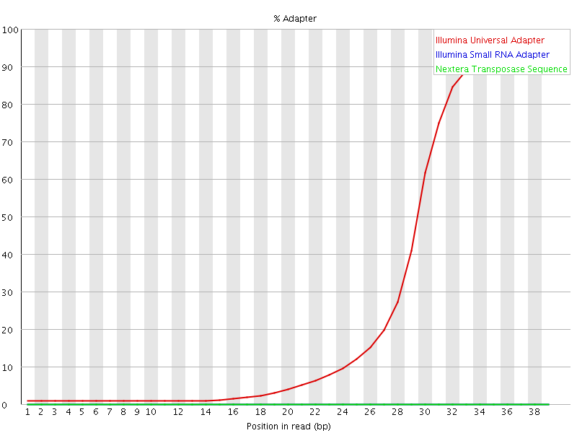
Read through adapter

Slide 53
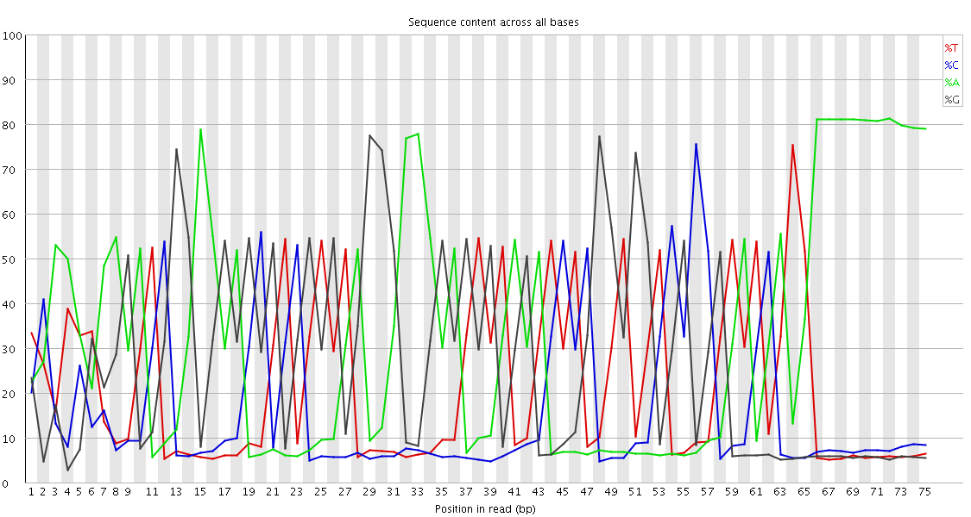
Adapter dimer overload
Sequence | % | Possible Source
CCTAAGGAGATCGGAAGAGCGTCGTGTAGGGAAAGAGTGTAGATCTCGGTGGTCGCCGTATCATTAAAAAAAAAA | 9.42 | Illumina Single End PCR Primer 1
TCAATGAAGATCGGAAGAGCGTCGTGTAGGGAAAGAGTGTAGATCTCGGTGGTCGCCGTATCATTAAAAAAAAAA | 7.30 | Illumina Single End PCR Primer 1
GAGACTCAGATCGGAAGAGCGTCGTGTAGGGAAAGAGTGTAGATCTCGGTGGTCGCCGTATCATTAAAAAAAAAA | 5.65 | Illumina Single End PCR Primer 1
gi|372098977|ref|NT_039624.8| Mus musculus chr16 GRCm38
CTGGAAGGGAGAAAAGTCCAAACATTCTGGCTCTAACTTCT
||||||||||||||||||||||||||||||||| || ||||
CTGGAAGGGAGAAAAGTCCAAACATTCTGGCTCCAAGTTCT
gi|372098992|ref|NT_039500.8| Mus musculus chr10 GRCm38
CTTTCTCTATCTGAATTATAAACAAAAGCACACAGGCCCGCTTACATTTACATGATAAAATGTGCACTTTG
|||||||||| || |||||||||||||||||||||||||||||||| ||||||||||||||| | ||||
CTTTCTCTATATGCATTATAAACAAAAGCACACAGGCCCGCTTACAGGGACATGATAAAATGTGAAATTTG
(Single-cell Hi-C)

Slide 54
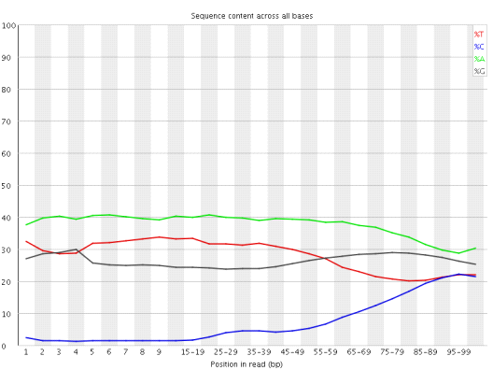
Positional Sequence Bias Application Specific – BS-Seq

Slide 55
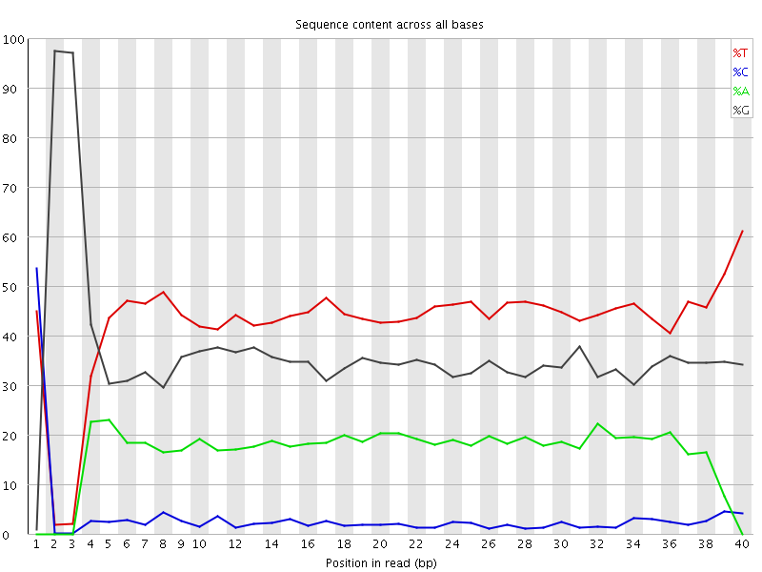
Positional Sequence Biases Expected - RRBS
Also reports of a ‘Chinese CRO’ whose RRBS libraries have the MspI sites missing due to
their proprietary and unexplained pre-processing

Slide 56
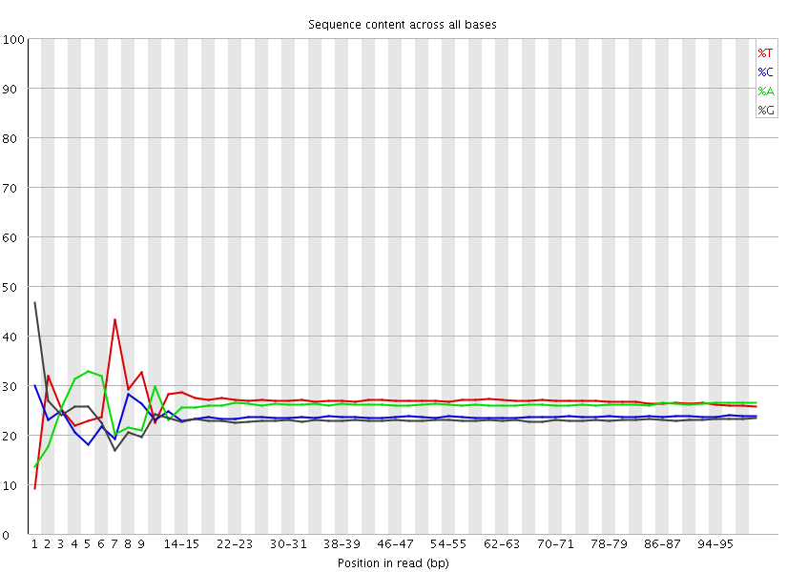
Positional Sequence Biases Unavoidable – RNA-Seq

Slide 57
Positional Sequence Biases Unexpected – Doubled Adapters

Slide 58
Overrepresented Individual Sequences
Adapter dimers
rRNA
Satellite sequences

Slide 59
My data doesn’t map well…

Slide 60
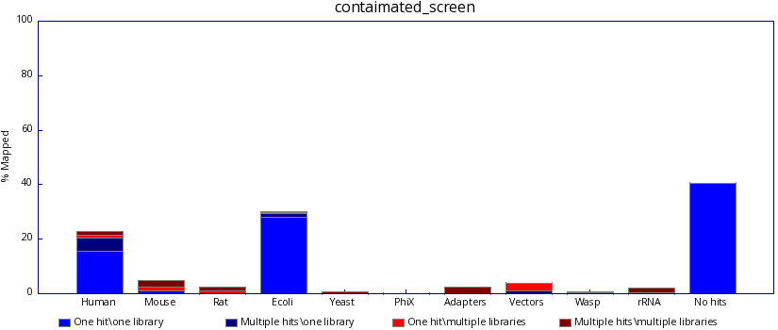
Contaminated with guessable sequence
www.bioinformatics.babraham.ac.uk/projects/fastq_screen

Slide 61
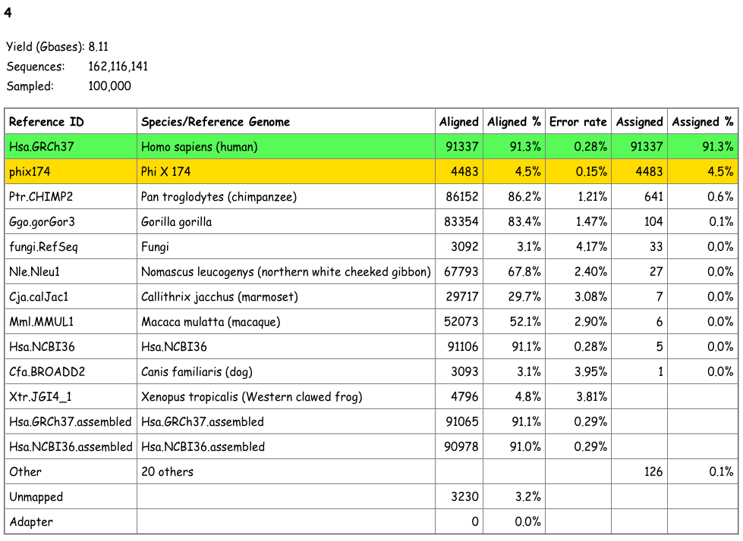
Contaminated with guessable sequence
CRUK Multi-genome alignment system (MGA)

Slide 62
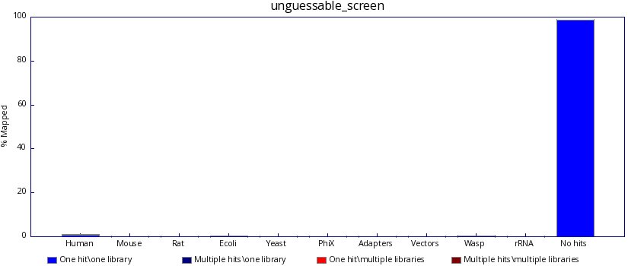
Contamination with unguessable sequence
>AF431889 AF431889.1 Acinetobacter lwoffii type IIs modification
Query: 1 cggtgagcaggcattagaaattgattttttagaaggtgtgttgaagaaactgggccgctt 60
|||||||||||||||||||||||||||||||||||||||||||||||||||||| |||||
Sbjct: 4661 cggtgagcaggcattagaaattgattttttagaaggtgtgttgaagaaactgggtcgctt 4720
>GQ352402 GQ352402.1 Acinetobacter baumannii strain AbSK-17 plasmid
Query: 1 ggtgagcagtggtttacatggttaattgaacaagacatcaacttctgcattcgtg 55
|||||||||||||||||||||||||||||||||||||||||||||||||||||||
Sbjct: 8213 ggtgagcagtggtttacatggttaattgaacaagacatcaacttctgcattcgtg 8159
>AF431889 AF431889.1 Acinetobacter lwoffii type IIs modification
Query: 1 acttgctgcgattaaagcagaaaaaacacttgctgaattgagtgct 46
||||||||||||||||||||||||||||||||||||||||||||||
Sbjct: 4484 acttgctgcgattaaagcagaaaaaacacttgctgaattgagtgct 4529

Slide 63
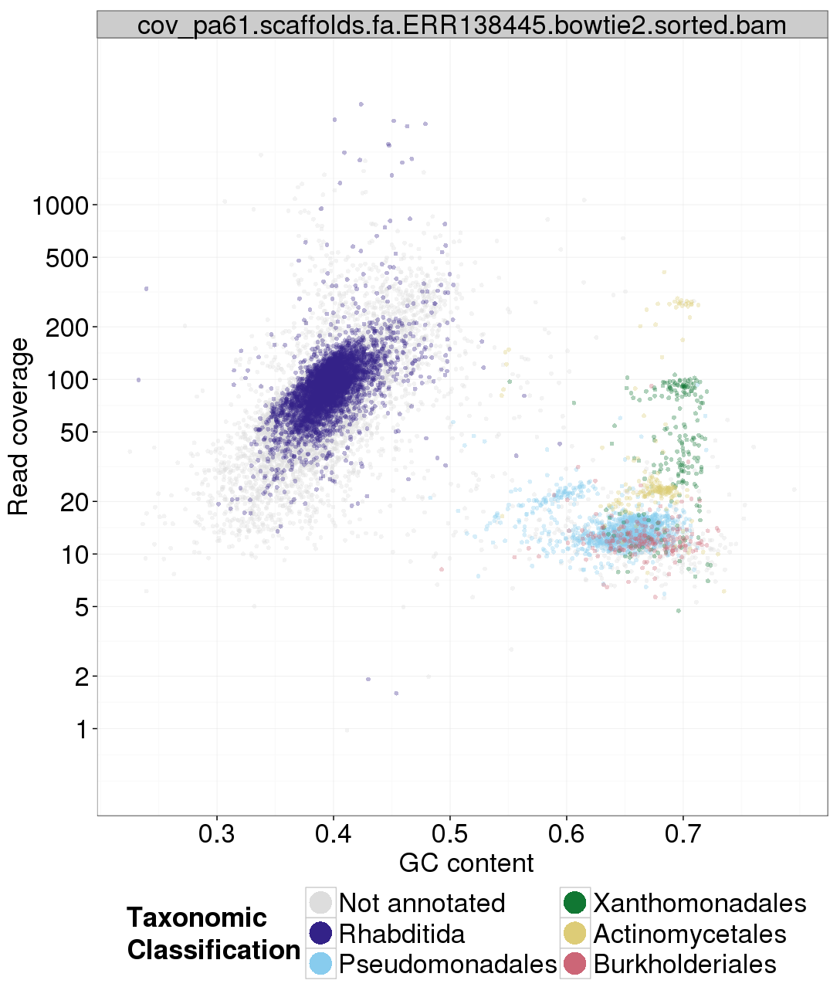
TAGC Plots
Assemble
Filter contigs
Plot %GC vs Coverage
Sample and blast
https://github.com/blaxterlab/blobology

Slide 64

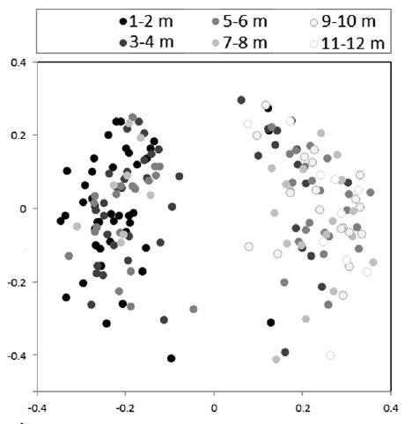
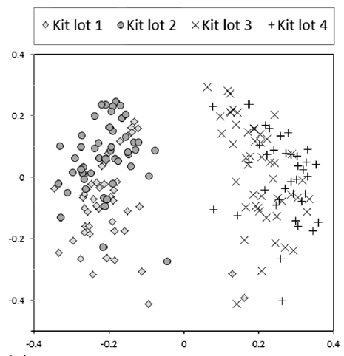
Reagent contamination
Molbio grade water is not the same as DNA free water – heat treated but DNA survives

Slide 65
Later this week --
Many different approaches to evaluating quality/mismatches:
Quality-score based (FastQC etc)
Composition based (FastQC etc)
Reference based (“I know what the answer should look like”)
Assembly-graph / k-mer based

Slide 66
Reference & quality-score independent approaches (k-mers)
Zhang et al., https://peerj.com/preprints/890/

Slide 67
…from a well known data set…
Zhang et al., https://peerj.com/preprints/890/

