Slide 1
Reference-free analysis of genomes with k-mers

Slide 6
Preqc - repeats
https://github.com/jts/sga/wiki/Preqc

Slide 7
Preqc – GC bias / coverage
https://github.com/jts/sga/wiki/Preqc

Slide 8
Preqc – predicted contig lengths
https://github.com/jts/sga/wiki/Preqc

Slide 9
Preqc – estimated genome size
https://github.com/jts/sga/wiki/Preqc

Slide 10
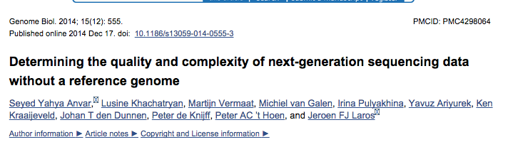

Slide 11
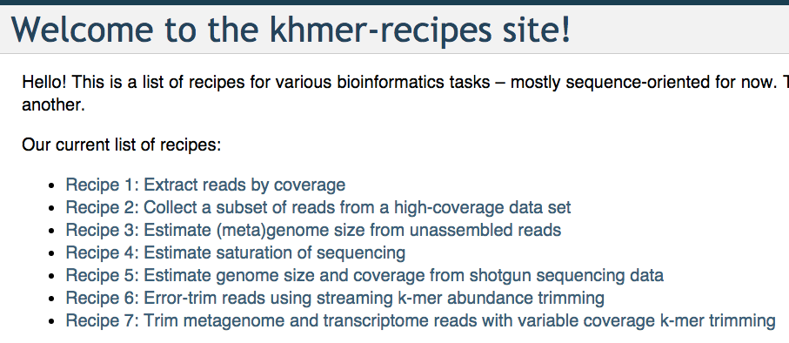
Khmer-recipes
http://khmer-recipes.readthedocs.org/en/latest/

Slide 12
Reference & quality-score independent approaches (k-mers)
Zhang et al., https://peerj.com/preprints/890/

Slide 13
Mouse mRNAseq
Zhang et al., https://peerj.com/preprints/890/

Slide 14
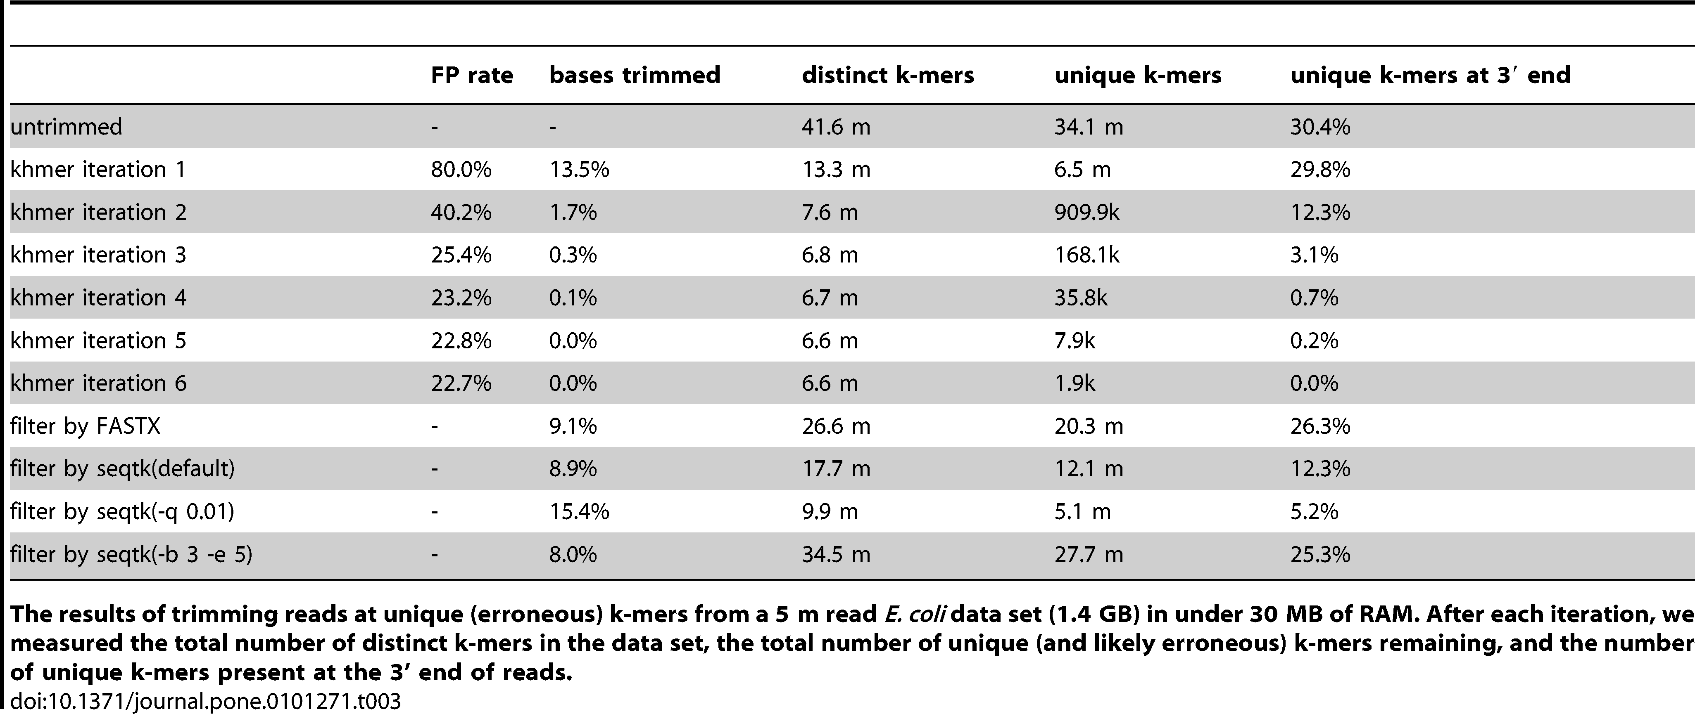
K-mer abundance trimming removes errors effectively!
Zhang et al. PLoS One, 2014

Slide 15
CTB research - diginorm
http://arxiv.org/abs/1203.4802

Slide 16
Approach: Digital normalization (a computational version of library normalization)
Suppose you have a dilution factor of A (10) to B(1). To get 10x of B you need to get 100x of A! Overkill!!
This 100x will consume disk space and, because of errors, memory.
We can discard it for you…

Slide 17
Digital normalization

Slide 18
Digital normalization

Slide 19
Digital normalization

Slide 20
Digital normalization

Slide 21
Digital normalization

Slide 22
Digital normalization

Slide 23
Digital normalization approach
A digital analog to cDNA library normalization, diginorm:
Is single pass: looks at each read only once;
Does not “collect” the majority of errors;
Keeps all low-coverage reads;
Smooths out coverage of regions.

Slide 24
Coverage before digital normalization:
(MD amplified)

Slide 25
Coverage after digital normalization:
Normalizes coverage
Discards redundancy
Eliminates majority of
errors
Scales assembly dramatically.
Assembly is 98% identical.

Slide 26
Digital normalization approach
A digital analog to cDNA library normalization, diginorm is a read prefiltering approach that:
Is single pass: looks at each read only once;
Does not “collect” the majority of errors;
Keeps all low-coverage reads;
Smooths out coverage of regions.

Slide 27
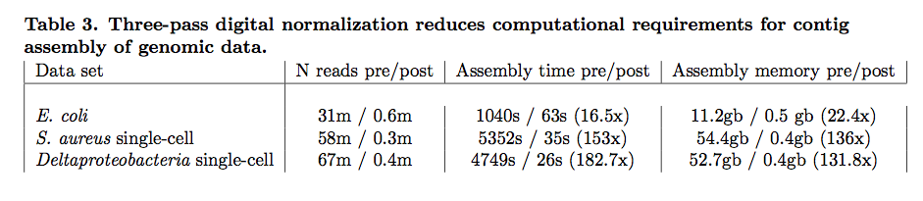
Contig assembly is significantly more efficient and now scales with underlying genome size
Transcriptomes, microbial genomes incl MDA, and most metagenomes can be assembled in under 50 GB of RAM, with identical or improved results.
Notes:
Goal is to do first stage data reduction/analysis in less time than it takes to generate the data. Compression => OLC assembly.

Slide 28
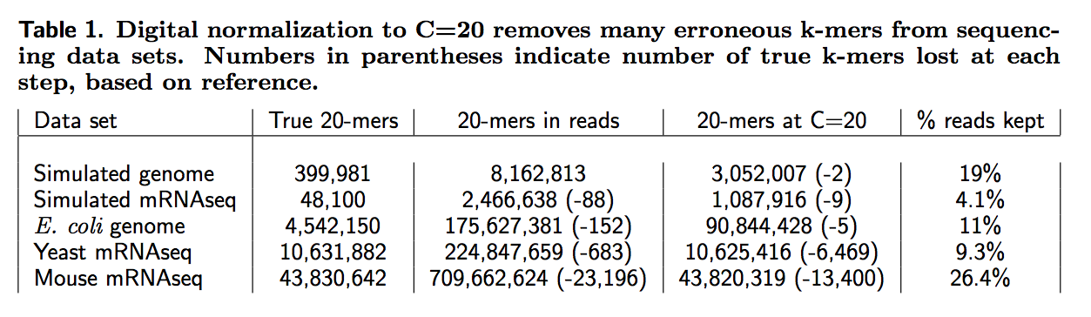
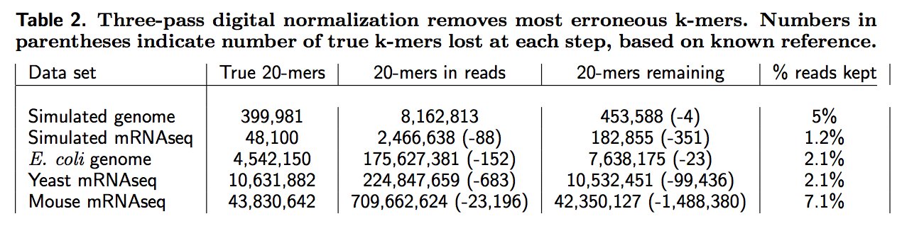
Digital normalization retains information, while discarding data and errors

