Slide 1
Basics of Genome Annotation
Daniel Standage
Biology Department
Indiana University
Notes:
For this lecture, we’re going to discuss annotation as it relates to NGS-driven genome projects.
Genome annotation is not strictly an NGS problem, and most of the methods we’ll cover were developed before the days of ultra-high throughput sequencing; you know, back when large genomes were sequenced BAC-by-BAC using Sanger sequencing.
However, any biologist with a few thousand dollars these days can sequence their critter’s genome at sufficient depth for a draft de novo assembly, and RNA-seq costs even less.
Chances are, at some point in the near future have a genomic sequence assembled exclusively using NGS reads, which you will need to annotate assisted only by transcripts assembled exclusively from RNA-seq reads.
You will also need to work with such annotations that have been produced by others.
Here, we’ll discuss the basics of how such annotations are produced and, more importantly, how to critically assess them for use in your research.

Slide 2

An-no-ta-tion \ˌa-nə-ˈtā-shən\
A critical or explanatory note or body of notes added to a text
The act of annotating
http://dictionary.reference.com/browse/annotation?s=t
Notes:
So when we say “annotation” what do we mean?
In general, the English word “annotation” definition refers to highlighting or adding marginal notes to a text as a criticism or to provide additional information.
This definition actually holds pretty well for biology, our “text” being a sequence of letters representing a molecule such as a stretch of genomic DNA, a transcript, or a protein.
I understand there are going to be a lot of tutorials on RNA-seq and transcriptome stuff, so my focus here is going to be on annotating genomic sequences.

Slide 3
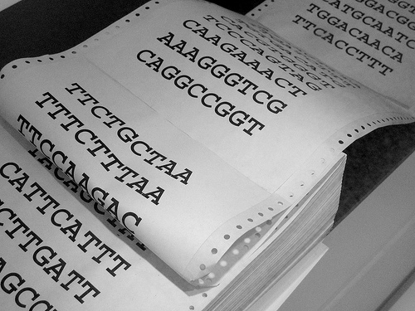
Notes:
So if we to to take the definition of annotation literally, we could annotate our genome by:
printing out the sequence
marking genes in yellow highlighter
underlining exons with red sharpie
writing gene function in the margin with black pen
Of course, this would be a ridiculously horrible idea.
We store the sequence data on the computer, so we should store our annotations on the computer as well.

Slide 4
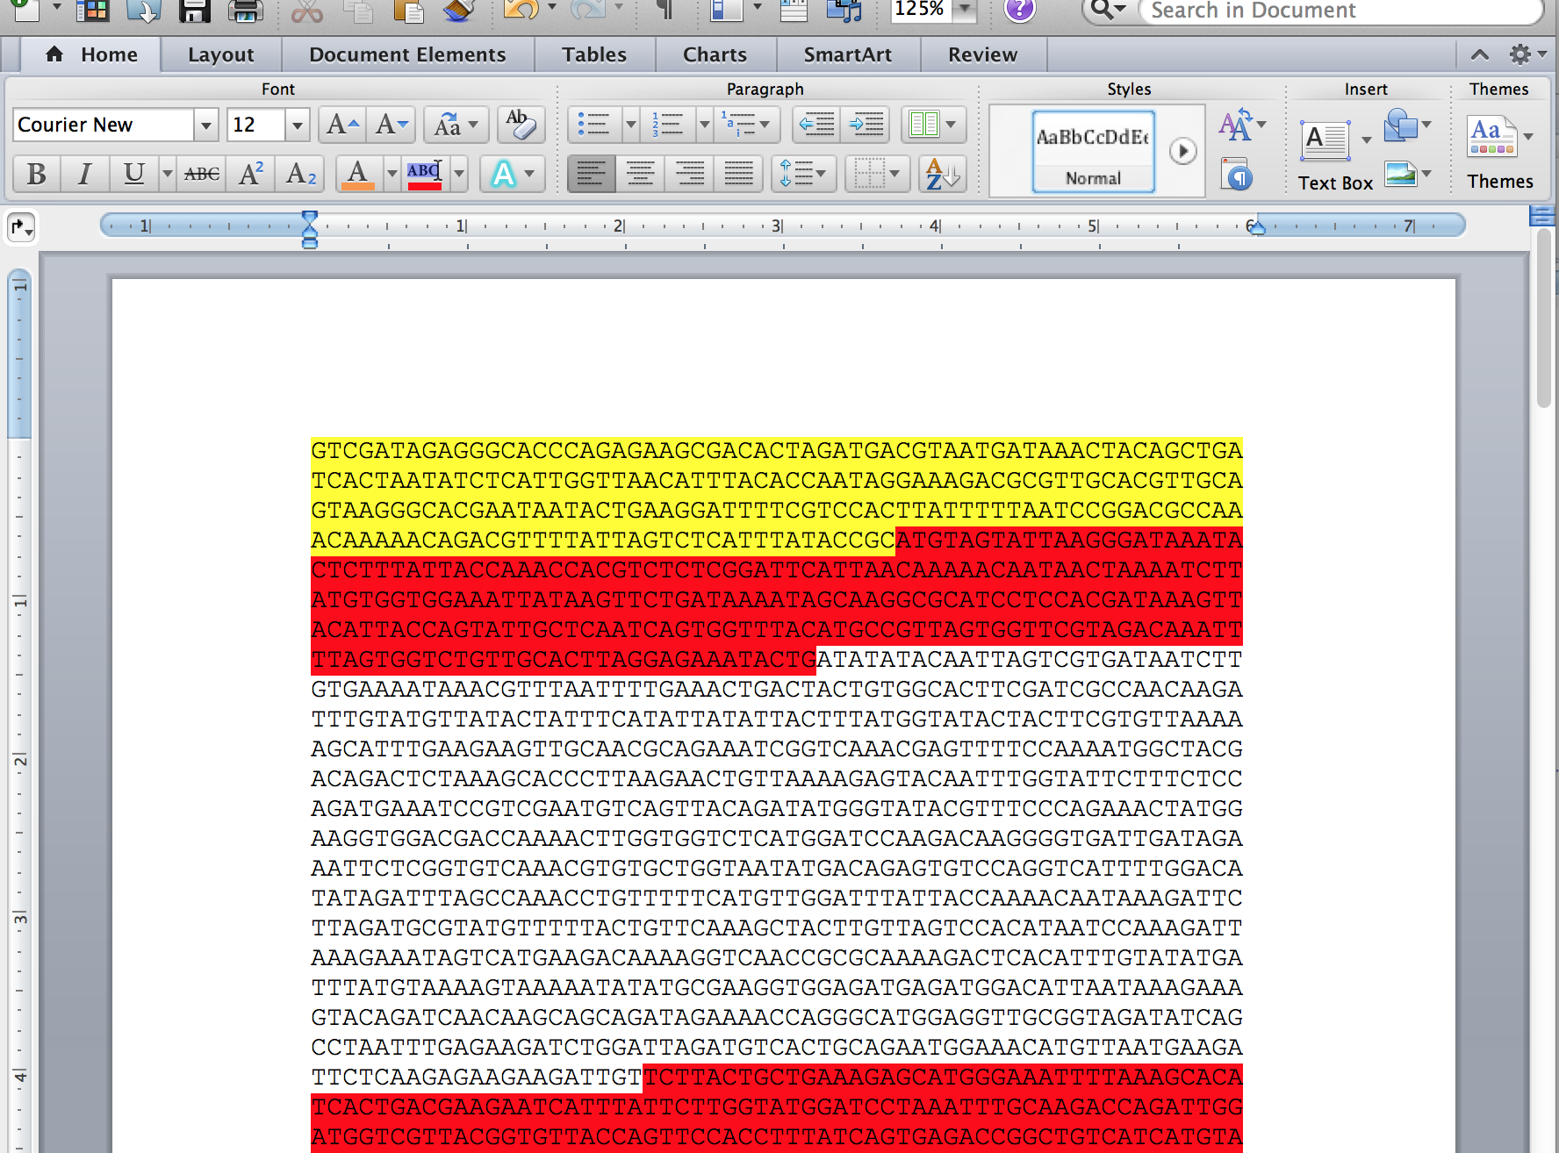
Notes:
We could apply the same approach using Microsoft Word, but this would be just as bad.
If you’re going to annotate your sequence in Word, you might as well just print it out and use highlighters and pens.
Seriously.

Slide 5
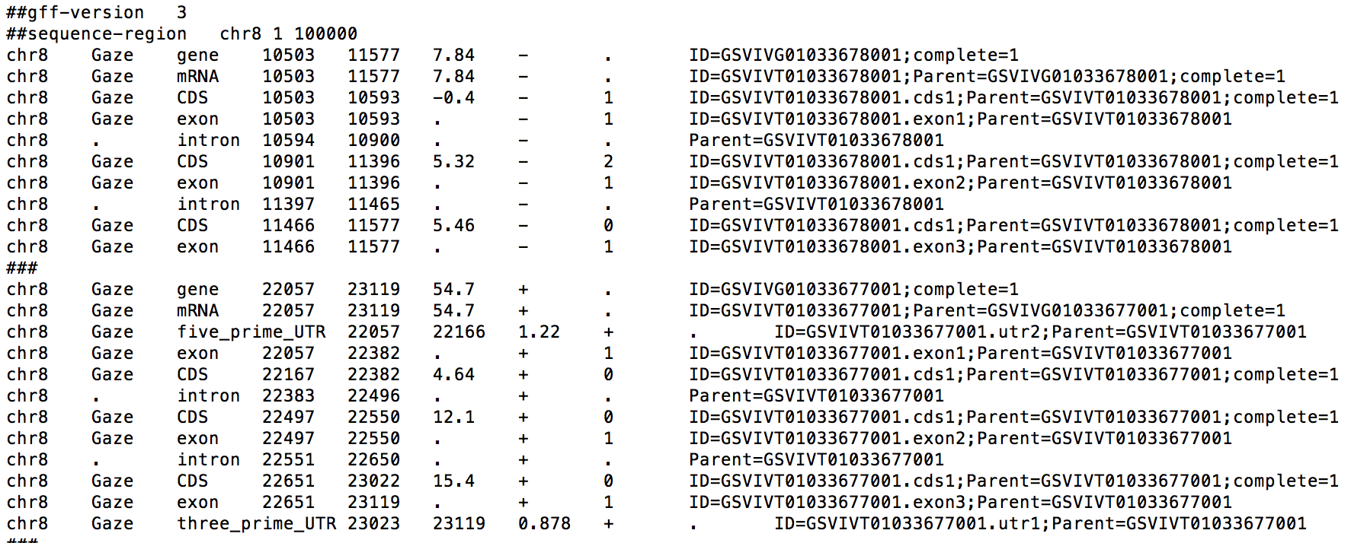
Genome annotation
Notes:
Highlighting and marking a text is simply a metaphor.
Instead we use text files in GFF3 (or GTF or BED) format to metaphorically “highlight” portions of a sequence: for example, chr8 positions 10503-11577 contain a gene on the reverse strand, the 5’ exon is from 11466-11577, etc.
Annotations in this type of format are human readable, but they’re designed more for computers than for humans.
By storing our annotations in this format, it enables a few things: first, we can write software to process the annotations very quickly and efficiently; second, we can generate visualizations of the genomic features.

Slide 6
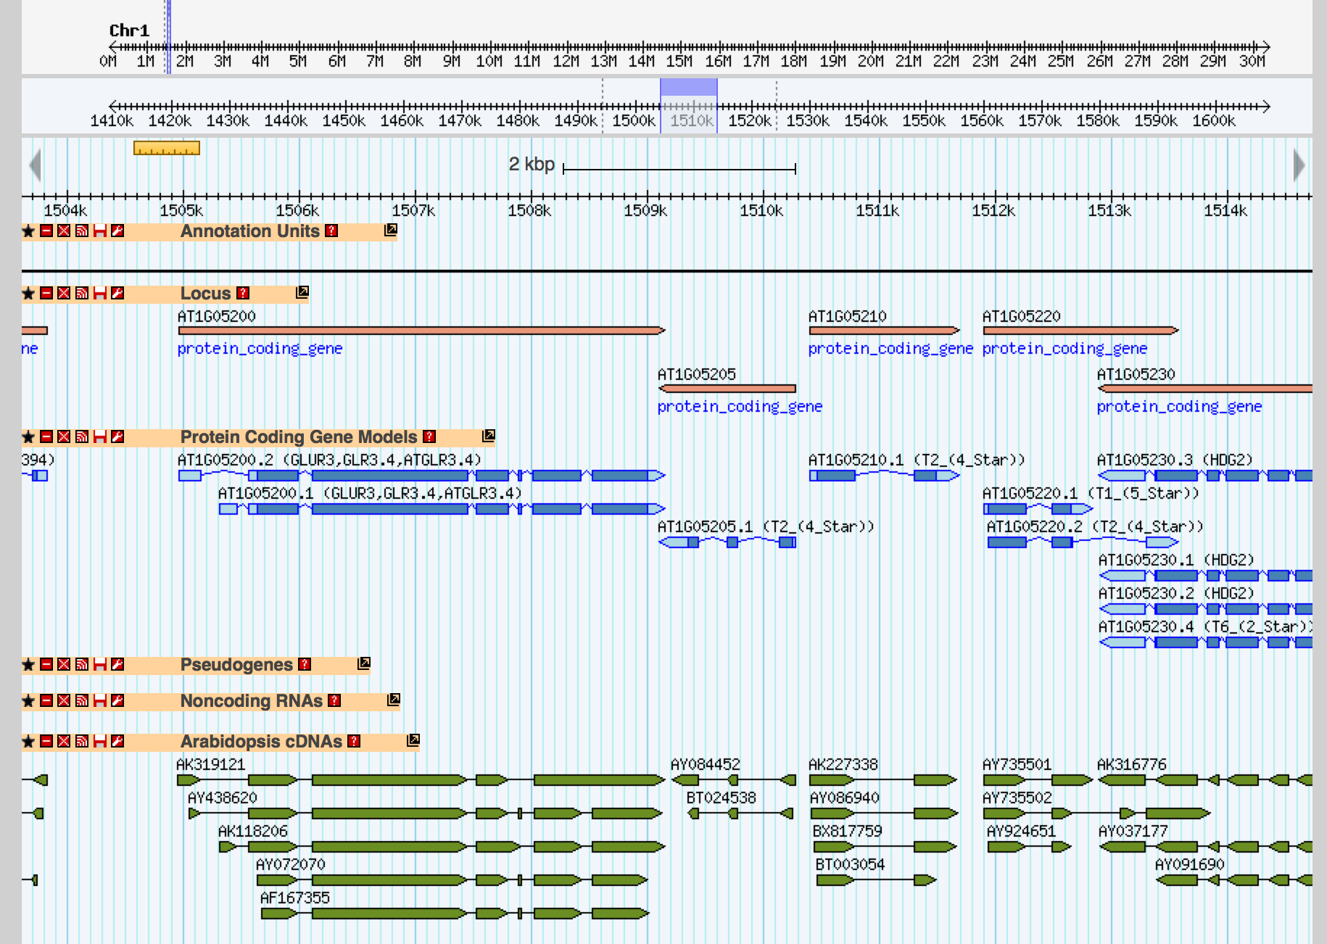
Genome annotation
Notes:
You’re probably familiar with genome browsers such as GBrowse or the UCSC Genome Browser.
At the resolution of individual genomic features, it’s hard to beat visual examination, and the most popular genome browsers are accessed using a basic web browser like Firefox or Chrome.

Slide 7
Genome annotation
Information itself (e.g., this gene encodes a cytochrome P450 protein, with exons at…)
Annotation process (operational definition)
Data management
formatting
storage
distribution
representation
Notes:
So just to be clear, within the context of genome annotation, the word “annotation” refers to different things.
It refers to the information attached to the genome, such as the location of a gene’s exons and the function of its protein product, or the location of a disease-related SNP, or the location of a transposable element in the sequence.
It refers to the process used to produce the annotation, along with any software used and parameter settings selected for the underlying statistical models.
It refers to how the data is managed: how do we format and store the data, how do we share it within our research group and with collaborators, and how to we present the data in useful ways for analysis?
There are many different features you could potentially annotate in any given genome.
Protein coding genes are definitely the most common type of annotation, but others include pseudogenes, repeats, binding sites, and genomic variations.
The data management concerns are pretty similar regardless of what genomic features you’re describing, but of course the annotation process will be very different depending on what you’re investigating.
For the remainder of the discussion we’re going to focus on protein coding genes.

Slide 8
Methods for gene finding
Ab initio gene prediction
Gene prediction by spliced alignment

Slide 9
Ab initio gene prediction
Ab initio: “from first principles”
Requires only a genomic sequence
Uses statistical model of genome composition to identify most probable location of start/stop codons, splice sites
Popular implementations
Augustus
GeneMark
SNAP
Notes:
Sensitive to genome composition and codon usage; requires training

Slide 10
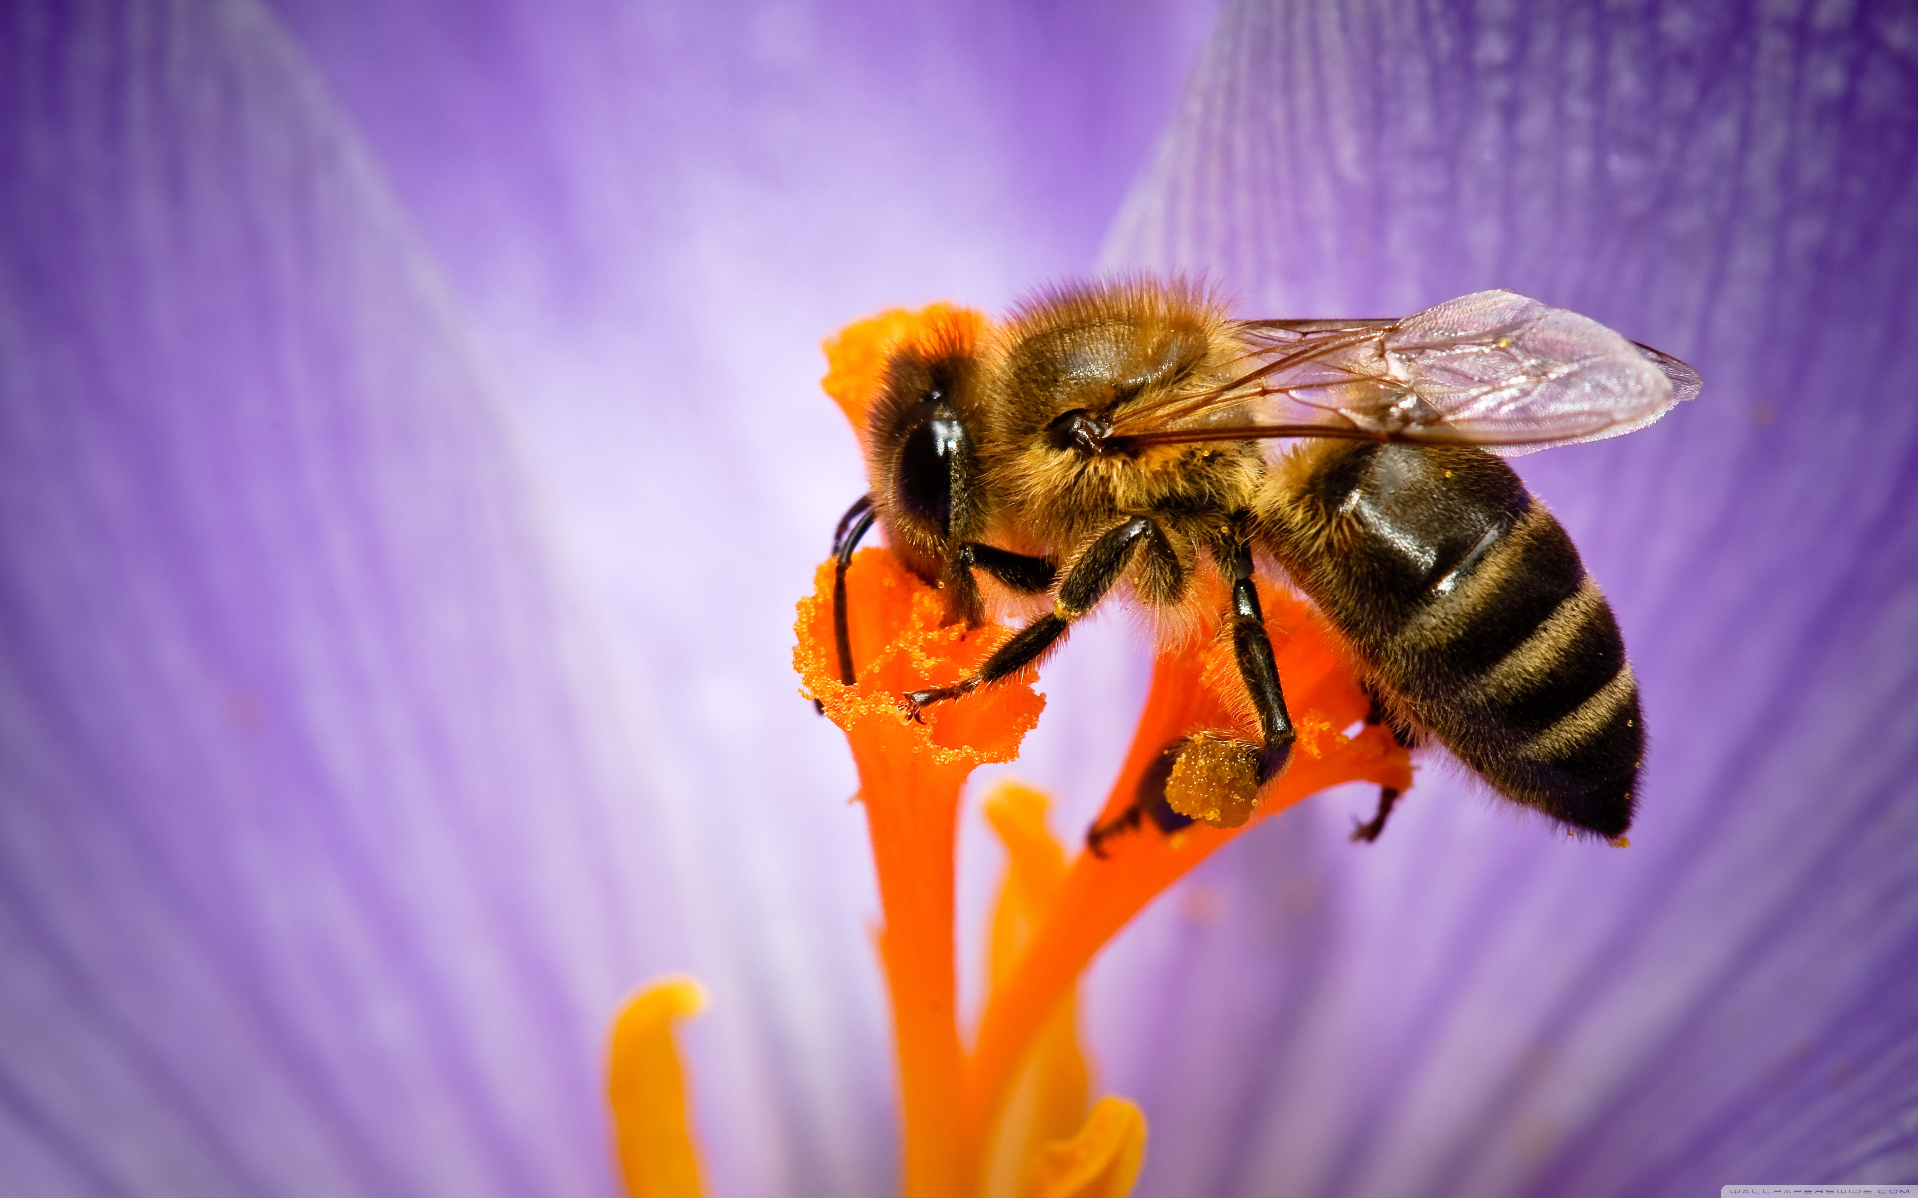
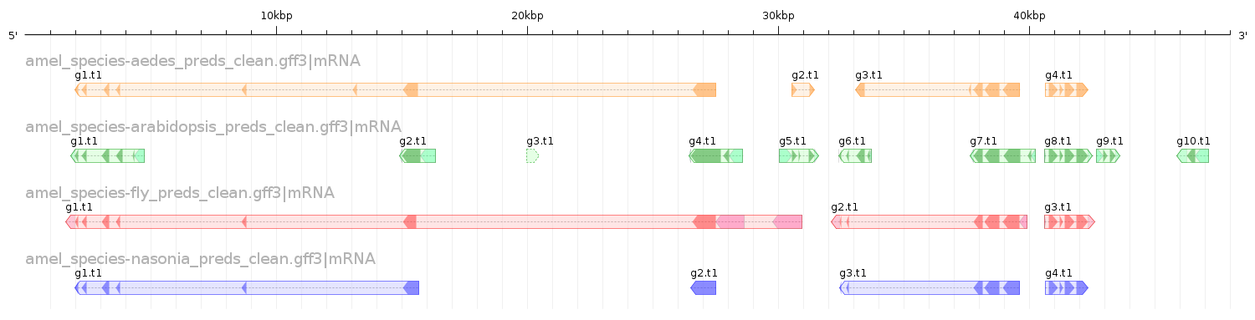
Ab initio gene prediction

Slide 11
Prediction by spliced alignment
Utilizes experimental (transcript) and/or homology (reference proteins) data
Spliced alignment of sequences reveals gene structure
matches = exons
gaps = introns
Popular implementations
GeneSeqer
Exonerate
GenomeThreader
Notes:
Back in the day, transcripts referred to ESTs and full-length cDNAs.
More and more, however, transcripts refers to contigs of assembled RNA-seq reads, which introduces additional sources of uncertainty.

Slide 12
Comparison of prediction methods
Ab initio | Spliced alignment
Do not require extrinsic evidence | Requires transcript and/or protein sequences
Does not benefit from additional transcript data | Accuracy improves with additional transcript data
More likely to recover complete gene structures | More likely to recover accurate internal exon/intron structure

Slide 13
Issues with gene prediction
Accuracy (best methods achieve ≈80% at exon level)
Parameters matter (species-specific codon usage)
Comparison and assessment
Notes:
How many genes do you want?

Slide 14
Recurring theme in genomics
Once I have a result, how to I assess its reliability?
How do I compare it to alternative results?

Slide 15

Recurring theme in genomics
"Why, when you only had one result, did you think that was the correct one?"
Notes:
…which brings us back to gene annotation: should you use ab initio gene prediction or prediction by spliced alignment?

Slide 16

Notes:
Actually, what distinguishes gene annotation from gene prediction is the integration of multiple sources of “evidence.”

Slide 17
Manual annotation
Visually inspect gene predictions, spliced alignments
Determine reliable consensus gene structure
Available software
Apollo: http://apollo.berkeleybop.org
yrGATE: http://goblinx.soic.indiana.edu/src/yrGATE
Notes:
Small batch, artisanal, organic approach to annotation

Slide 18
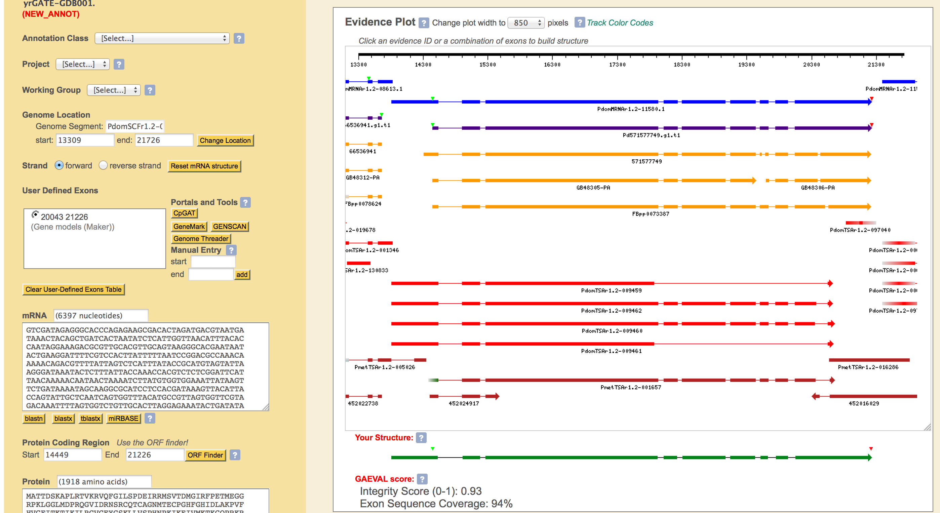

Slide 19


“Combiner” tools
Maker: http://www.yandell-lab.org/software/maker.html
EVidenceModeler: http://evidencemodeler.sourceforge.net
Notes:
Scaled up version, the “McDonald’s” or “Wal-Mart” approach to annotation

Slide 20
Evaluating annotations
Comparison
ParsEval¹: http://standage.github.io/AEGeAn
Quality assessment
Annotation Edit Distance² (Maker)
GAEVAL (PlantGDB)
¹Standage and Brendel (2012) BMC Bioinformatics, 13:187.
²Eilbeck et al (2009) BMC Bioinformatics, 10:67.

Slide 21
Recommendations / Considerations
Automated annotation
Manual refinement
Assessment and filtering for particular analyses
Be very skeptical
Remember: no “one true” assembly / annotation
Notes:
“Where do I get annotations?”

Slide 22
xGDBvm
Pre-installed on iPlant cloud (free for academics!)
Search for xGDBvm image
Includes an EVM pipeline for automated annotation
Includes yrGATE for manual annotation
Visualization, search, access control
More info: http://goblinx.soic.indiana.edu

Slide 23
xGDBvm demo
Polistes dominula example

