Slide 1
Announcements
Coffee!
Evaluation.
Dr. Yoshiki Sasai, R.I.P.

Slide 2
Sequencing considerations

Slide 3
Three basic problems
Resequencing, counting, and assembly.

Slide 4
1. Resequencing analysis
We know a reference genome, and want to find variants (blue) in a background of errors (red)

Slide 5
2. Counting
We have a reference genome (or gene set) and want to know how much we have. Think gene expression/microarrays.

Slide 6
3. Assembly
We don’t have a genome or any reference, and we want to construct one.
(This is how all new genomes are sequenced.)

Slide 7
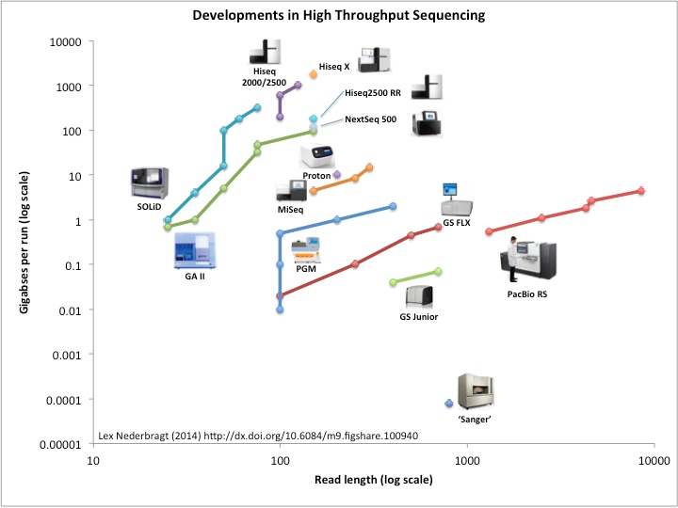

Slide 8
Outline
Shotgun sequencing
The magic of polonies, and how Illumina sequencing works
Sequencing depth, read length, and coverage
Paired-end sequencing and insert sizes
Coverage bias
Long reads: PacBio and Nanopore sequencing

Slide 9
Shotgun sequencing
It was the best of times, it was the worst of times, it was the age of wisdom, it was the age of foolishness
It was the best of times, it was the wor
, it was the worst of times, it was the
isdom, it was the age of foolishness
mes, it was the age of wisdom, it was th

Slide 10
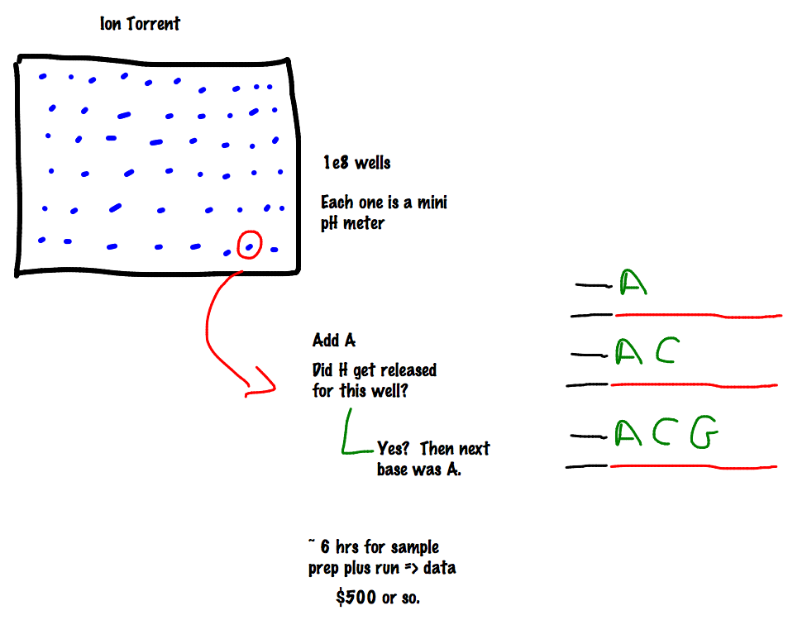

Slide 11
Two specific concepts:
First, sequencing everything at random is very much easier than sequencing a specific gene region. (For example, it will soon be easier and cheaper to shotgun-sequence all of E. coli then it is to get a single good plasmid sequence.)
Second, if you are sequencing on a 2-D substrate (wells, or surfaces, or whatnot) then any increase in density (smaller wells, or better imaging) leads to a squared increase in the number of sequences yielded.

Slide 12
Random sampling => deep sampling needed
Typically 10-100x needed for robust recovery (300 Gbp for human)

Slide 13
“Coverage”
“Coverage” is simply the average number of reads that overlap
each true base in genome.
Here, the coverage is ~10 – just draw a line straight down from the top through all of the reads.

Slide 14
Illumina yields the deepest sequencing available
MiSeq
30 million reads per run
300 base paired-end reads
HiSeq 2500 RR/X 10
6 billion reads per run
150 base paired-end reads
PacBio
44,000 reads per run
8500 bp in length
http://flxlexblog.wordpress.com/2014/06/11/developments-in-next-generation-sequencing-june-2014-edition/

Slide 15
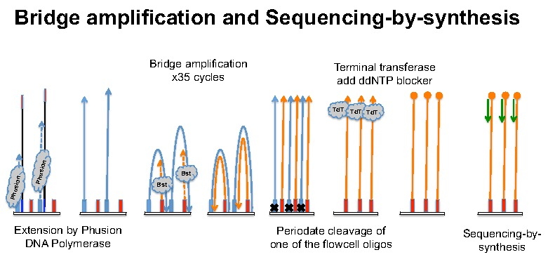
Illumina basics
(See http://seqanswers.com/forums/showthread.php?t=21 for details)
http://ted.bti.cornell.edu/cgi-bin/epigenome/method-1.cgi

Slide 16
A movie of Illumina sequencing:
https://www.youtube.com/watch?v=tuD-ST5B3QA#t=61

Slide 17
FASTQ
@895:1:1:1246:14654/1
CAGGCGCCCACCACCGTGCCCTCCAACCTGATGGT
+
][aaX__aa[`ZUZ[NONNFNNNNNO_____^RQ_
@895:1:1:1246:14654/2
ACTGGGCGTAGACGGTGTCCTCATCGGCACCAGC
+
\UJUWSSV[JQQWNP]]SZ]ZWU^]ZX][^TXR`
@895:1:1:1252:19493/1
CCGGCGTGGTTGGTGAGGTCACTGAGCTTCATGTC
+
OOOKONNNNN__`R]O[TGTRSY[IUZ]]]__X__

Slide 18
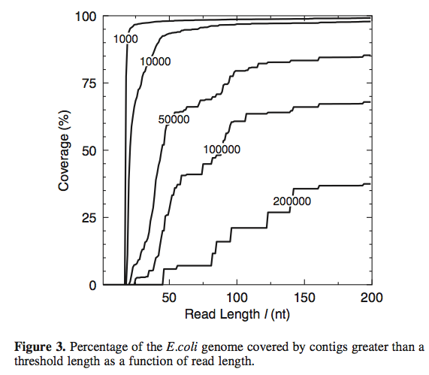
Read length and reconstructability
Whiteford et al., Nuc. Acid Res, 2005

Slide 19
“Reconstructability”
Assembling new genomes or transcriptomes…
Haplotyping - think human genetics & viruses, both.

Slide 20
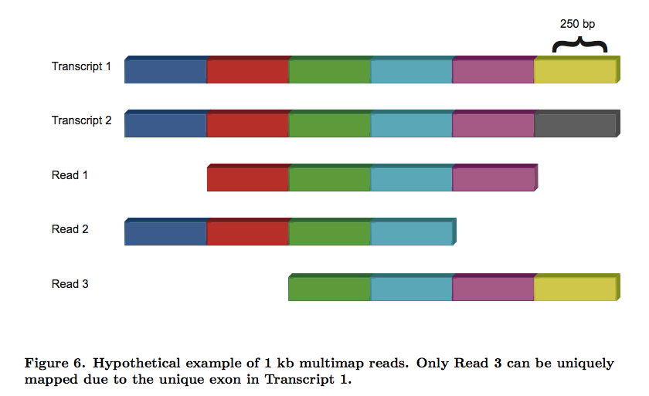
Real problem? Our data can’t uniquely specify solution!
Here, there is no direct way to know if last exon is connected to first exon.
Pyrkosz et al., unpub.

Slide 21
Repeats! (and shared exons)

Slide 22
Longer reads … OR … Paired-end/mate pair sequencing

Slide 23
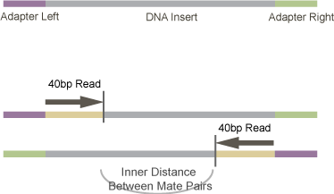
Paired-end sequencing
http://vallandingham.me/RNA_seq_differential_expression.html

Slide 24
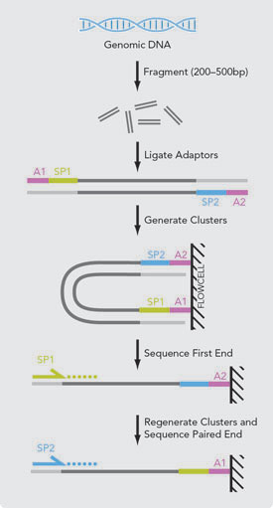

Slide 25
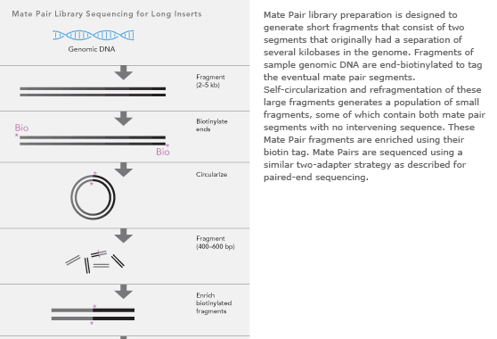
Mate-pair sequencing
(long insert)

Slide 26
Longer reads
PacBio
Moleculo
Nanopore

Slide 27
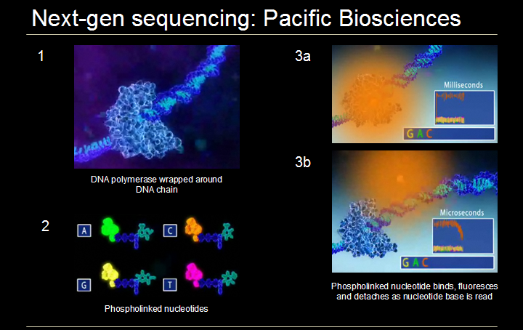
http://www.melanieswan.com/FOLS.html

Slide 28
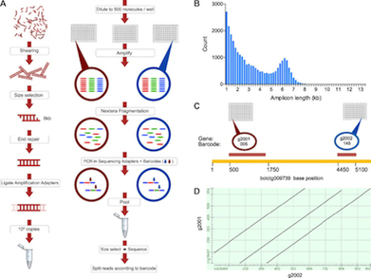
Moleculo (Illumina)
http://nextgenseek.com/2013/07/illumina-announces-moleculo-long-read-technology-and-phasing-as-service/

Slide 29
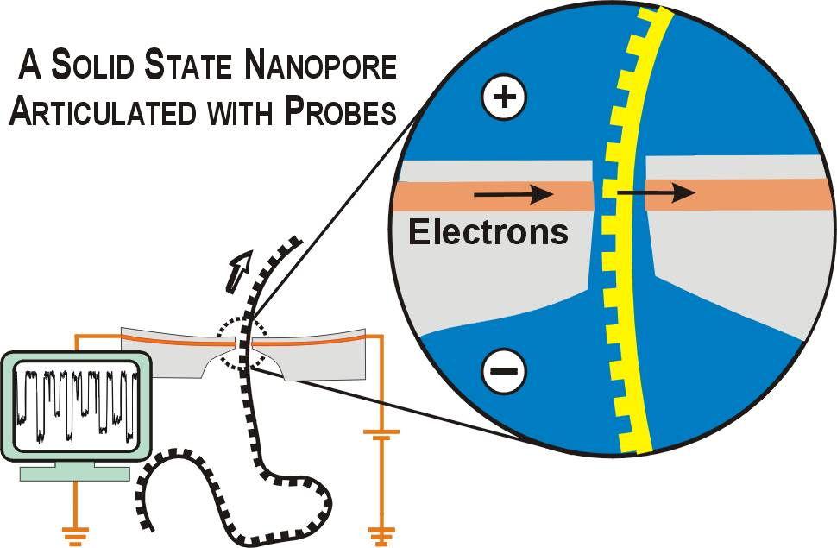
http://labs.mcb.harvard.edu/branton/projects-NanoporeSequencing.htm

Slide 30
Actual yields
MiSeq
30 million reads per run
300 base paired-end reads
HiSeq 2500 RR/X 10
6 billion reads per run
150 base paired-end reads
PacBio
44,000 reads per run
8500 bp in length
http://flxlexblog.wordpress.com/2014/06/11/developments-in-next-generation-sequencing-june-2014-edition/

Slide 32
Your basic data (FASTQ)
@895:1:1:1246:14654/1
CAGGCGCCCACCACCGTGCCCTCCAACCTGATGGT
+
][aaX__aa[`ZUZ[NONNFNNNNNO_____^RQ_
@895:1:1:1246:14654/2
ACTGGGCGTAGACGGTGTCCTCATCGGCACCAGC
+
\UJUWSSV[JQQWNP]]SZ]ZWU^]ZX][^TXR`
@895:1:1:1252:19493/1
CCGGCGTGGTTGGTGAGGTCACTGAGCTTCATGTC
+
OOOKONNNNN__`R]O[TGTRSY[IUZ]]]__X__

Slide 33
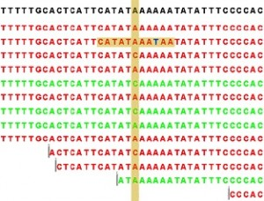
Mapping
U. Colorado
http://genomics-course.jasondk.org/?p=395
Many fast & efficient computational solutions exist.
You have to figure out how to choose parameters to maximize sensitivity/specificity, and when to validate.

Slide 34
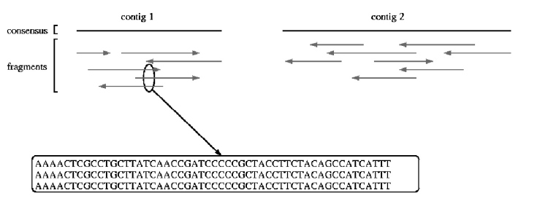
Assembly
Reassemble random fragments computationally.
UMD assembly primer (cbcb.umd.edu)

Slide 35
Shotgun sequencing
It was the best of times, it was the wor
, it was the worst of times, it was the
isdom, it was the age of foolishness
mes, it was the age of wisdom, it was th
It was the best of times, it was the worst of times, it was the age of wisdom, it was the age of foolishness

Slide 36
Where does # of reads count?
Resequencing, counting, and assembly.

Slide 37
Where does reconstructability matter?
Resequencing, counting, and assembly.

Slide 38
Summary
Coverage matters for SNP calls and assembly;
# of reads matters for counting;
Length of reads matters for reconstructability (assembly & haplotyping);
Illumina is still “best” for high coverage;
PacBio and Moleculo => genome assembly;
Nanopore??

Slide 39
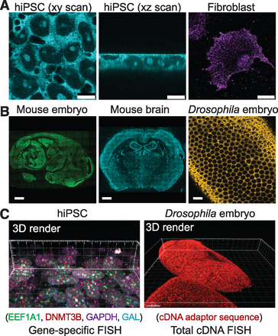
Sequencing in situ!?
Lee et al., http://www.sciencemag.org/content/343/6177/1360.full

Slide 40
Today
More command line stuff
Working with actual data!!
Evaluating the quality of your data…

