Slide 1
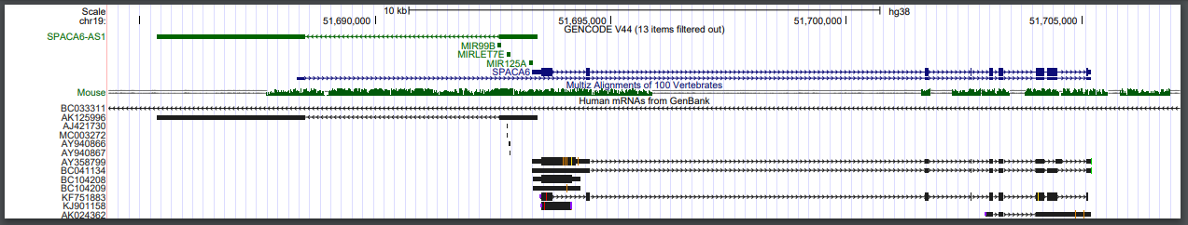
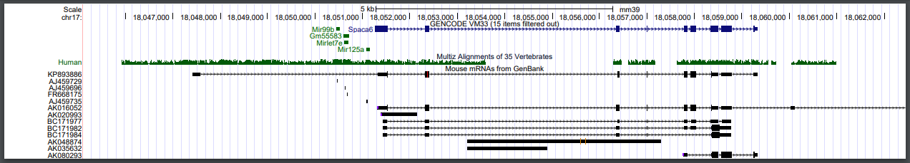
hg38
mm39

Slide 2
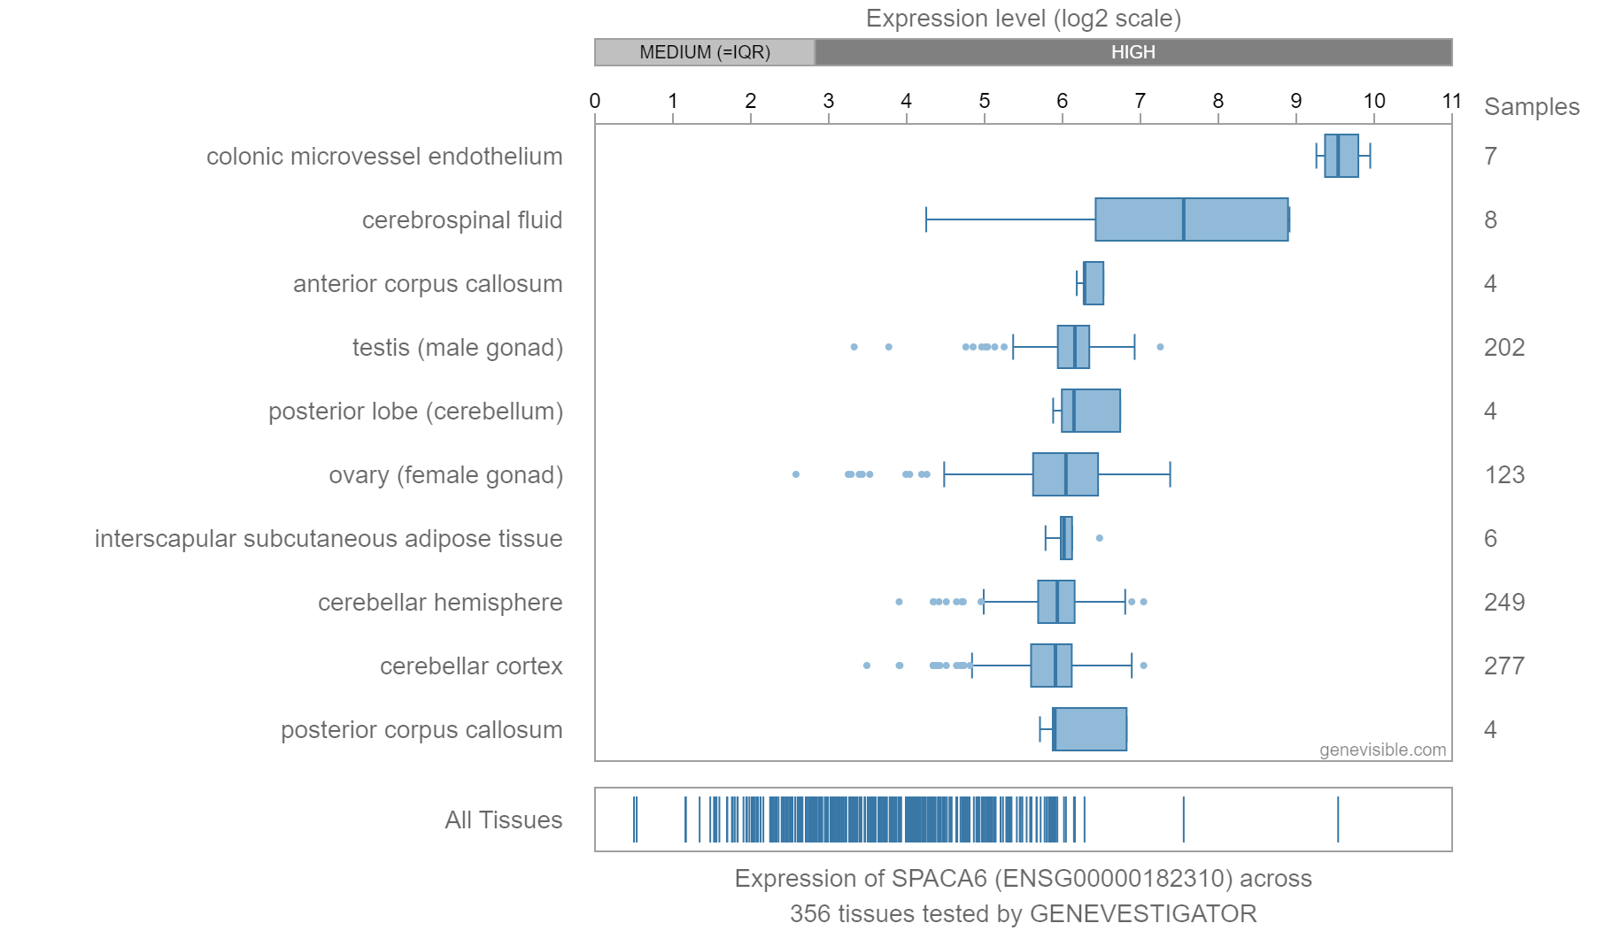
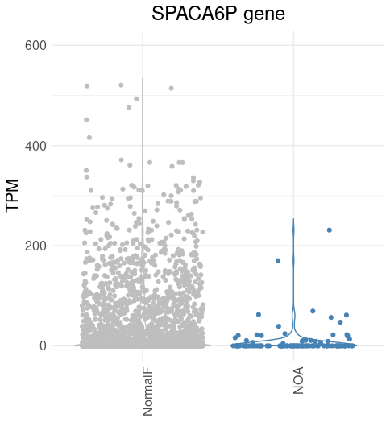
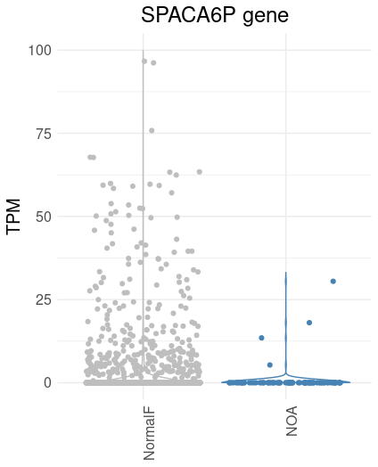
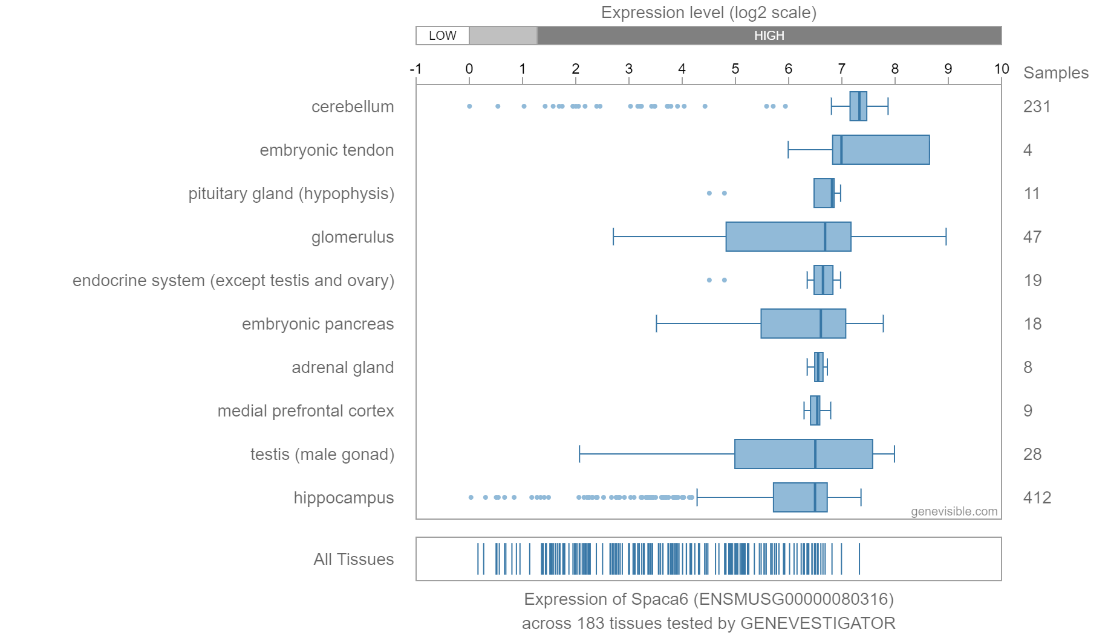
Human
scRNAseq on:
human testicular cells including spermatogonia, spermatocytes, spermatids, and testicular somatic cells
Mouse
NOA= non-obstructive azoospermia
NormalF= normal fertility or obstructive azoospermia (normal spermatogenesis)

Slide 3
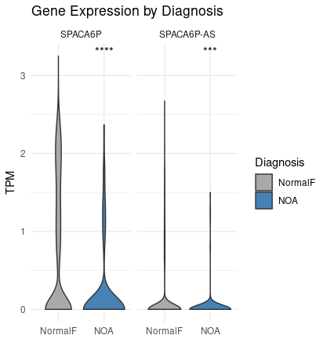

Slide 4
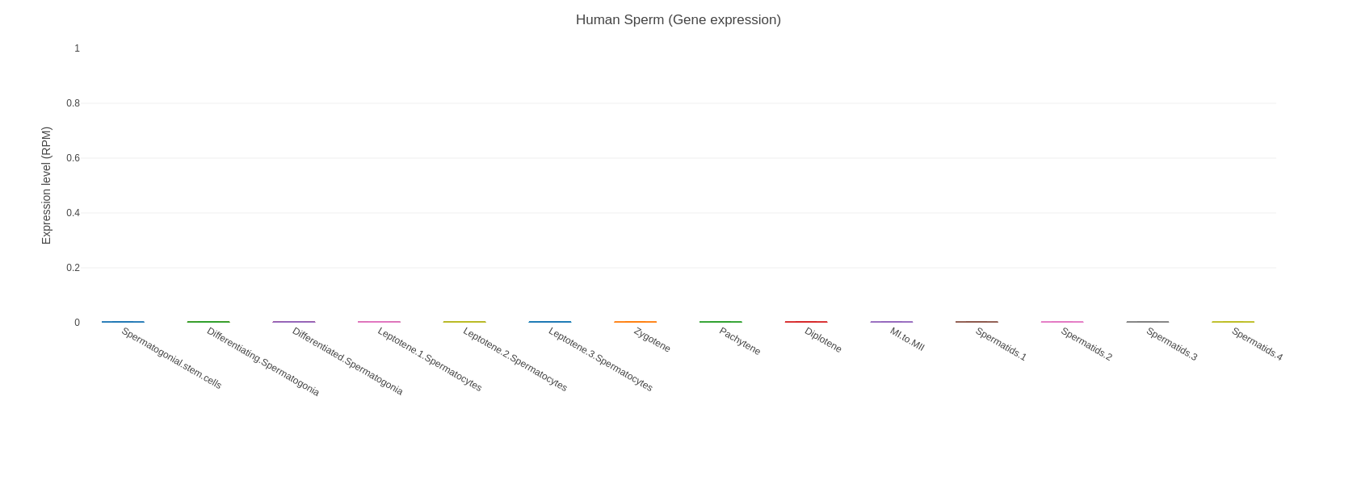
SPACA6
SPACA6-AS1

Slide 5
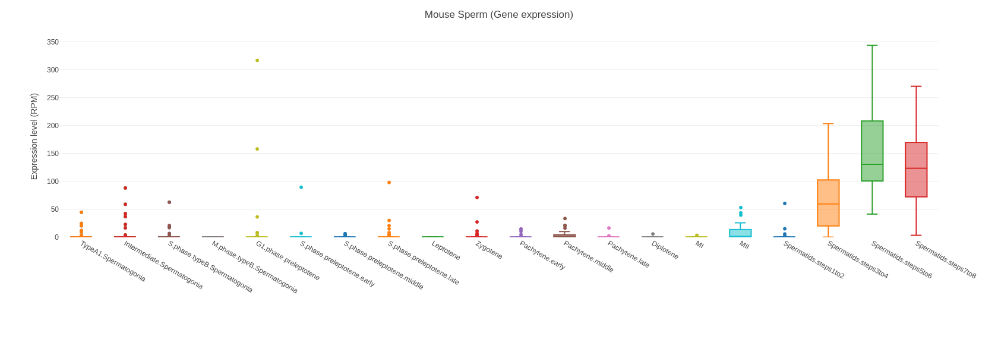
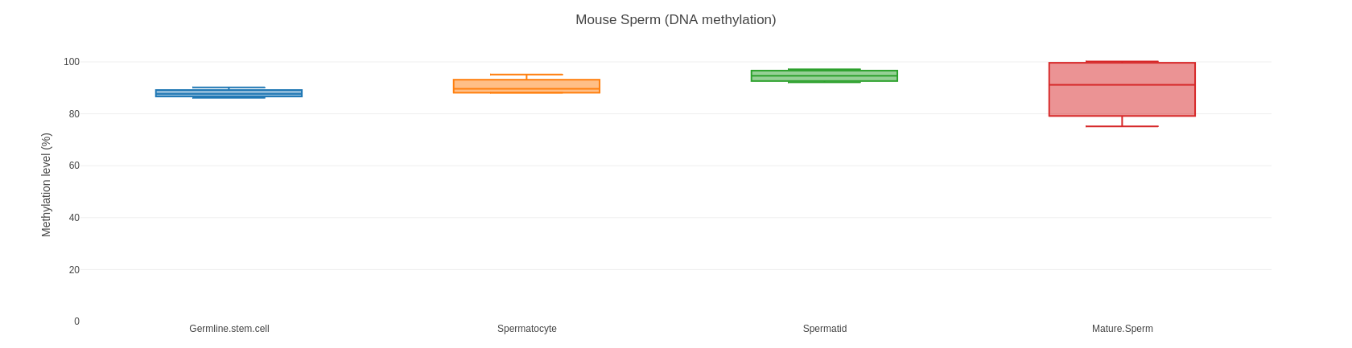
SPACA6

