Slide 1
STIW3064 COMPONENT-BASED DEVELOPMENT
Group <your group>
Members
Name (Leader)
Name 1
Name 2
Name 3

Slide 2
Software Engineering
<discussion on software engineering definitions>
Is an approach on a software development
It include design, develop, maintain, test and evaluate a software
These techniques are used to tell the software development process
Is to solve the quality problem of a software project

Slide 3
Software Development
<discussion on software development concepts>
Is the process use to build a computer program
Is a set of activities that related to computer science especially process of create, design, deploy and support software

Slide 4
Software Development Life-Cycle
<Elaborate on software development life-cycle>
- It also known as software development
It includes several phases that provide an approach to build software to achieve the goals and fulfill the user requirement
Phases of SDLC are, planning, requirement analysis, software design, coding, testing and maintenance

Slide 5
Software Development Approaches
Component based software engineering (CBSE) is a software development approaches for large system.
CBDS is a commonly used approach in software engineering and is widely use when develop a new system.
Essentials of CBSE are:
Components are independent completely. Component interface and implementation (controller and model) should be separate clearly. In addition, if one of the implementation component are replaced by another, the other part will no need to change.
Component standards define interface and facilitate the integration of components. These component standards are display in a component model. It define the method of specifies interface and component communication. Some models will define the interfaces that should implement by component. If the components conform to standards, the operation will be independent with their programming language.

Slide 6
Software Development Approaches
Essentials of CBSE are:
Middleware is a software that provides services to software application outside that what functions are offer by the system. Use middleware to handle component communications, it can make component work together with independent and distributed. Middleware can handle low-level issues and allow software developer can focus on software application related problem.
A development process is related to CBSE. It make requirements to evolve and it depend on the functions of components.

Slide 7
Software Development Approaches
Principle design of CBSE are:
Components are independent. Each interface will operate separately. In addition, hide implementation codes. Once change the component’s implementation, the other parts will not be affected.
Communication of component is through well-define interface. Component can replace by another component with provide additional or enhanced functionality if it are maintained.
Infrastructure of component provide a range of services that can use in software application system. Therefore, it can reduce the amount of codes that has to developed.

Slide 8
Software Development Approaches
Many types of approaches when developing software depend on some factors such as the scale of product
Each software development approaches have same 6 stages. The 6 stages are:
Defining Problem
Planning
Design
Implementation
Testing and Evaluating
Maintenance

Slide 9
Software Development Approaches
Structured Approach - known as Waterfall Method
The approaches which need a lot of time to consume, ordered and controlled, it required highest level of personal skill to complete each stage.
This approach basically used for large projects in a large companies
The advantages of structured approach:
Produce high quality product
Produce high complex product
The disadvantages of structured approach:
Can’t go back to previous stage when find a error
Hard to recognize and fix the mistake
High consuming cost and time
Defining Problem
Planning
Design
Implementation
Testing and Evaluating
Maintenance

Slide 10
Software Development Approaches
Define Problem
Agile Approach
New development method and it is become increasingly famous
This approach basically used for specific product especially tailored and individual seeds
More focus on the system being developed
Not necessary need a complex and complete documentation
Need a good teamwork with good communication skills and work efficiently method
Characterize of agile method:
Easy and fast to get a solution to user
Need a lot of interaction between development team and users
The product can be update, each version can insert new functions
User can give a good respond to change the specification
Plan
Design
Implement
Test and Evaluate
Release working version to user
Define new requirement

Slide 11
Software Development Approaches
Prototyping Approach
Somewhere between structure approach and agile approach
It will repeat the development stage to refine the user requirements
It need a lot of interaction between team and use intense user in the development process to produce a highest quality product and most accurately meet the user’s criteria
The prototype is just an interactive model of user interface
It is better than waterfall method because it have the ability to change the requirement
Defining Problem
Planning
Design
Implementation
Testing and Evaluating
Maintenance

Slide 12
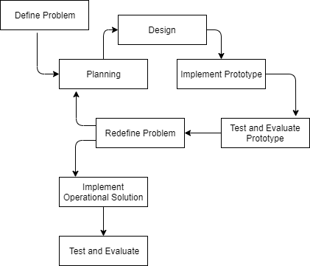
Software Development Approaches
Prototyping Approach
Somewhere between structure approach and agile approach
It will repeat the development stage to refine the user requirements
It need a lot of interaction between team and use intense user in the development process to produce a highest quality product and most accurately meet the user’s criteria
The prototype is just an interactive model of user interface
It is better than waterfall method because it have the ability to change the requirement

Slide 13
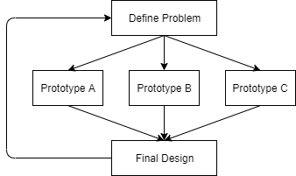
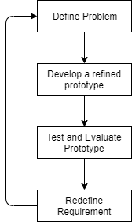
Software Development Approaches
Prototyping Approach
2 major types of prototyping approach
Concept Prototype
To make a discussion and talk about the product
These prototype is rapid prototype, it will be eliminate after evaluation by client and developers
Never be a final project
Evolutionary Prototype
It will produce final product
It can modify and add freely to software product
It need to meet to end user many time to define the requirement
It will produce a product that able to used and launch to customer

Slide 14
Software Development Approaches
Rapid Application Development (RAD)
Main purpose is to reduce time
The result of RAD commonly is lower quality, less usability and less features
The final product of RAD still fulfill all requirements if create a good plan.
Advantages of RAD
Reduced cost because it have shorter software development cycle
Easy to change the requirement
Reduced time because it need less people
Disadvantages of RAD
It not suitable for small project
Not all application is compatible with RAD
Developer need to deliver software on time, if not, it will failed

Slide 15
Software Development Approaches
End User Approach
Never used in companies
The purpose is not earning money
It usually created to solve end user problem, but does not need functions and capabilities or does not budget to afford
It can be modified without communicate with other users
It also does not need a lot of money and very few of man hours

Slide 16
Software Development Process
<Discussion on the software development process>
Is a process to divide software development to become smaller and parallel task

Slide 17
Component-based Development
<How do you posit component-based development within the whole software development context? Discuss/justify>
Is a procedure emphasize the design and the development of a computer based-system with reusable software component
Goals of CBD are saves time and cost, improve the quality of software and detect the defects of system
Advantages = Improve efficiency and quality

Slide 18
References
https://economictimes.indiatimes.com/definition/software-engineering
https://www.ibm.com/topics/software-development#:~:text=Software%20development%20refers%20to%20a,hardware%20and%20makes%20computers%20programmable.
https://acqnotes.com/acqnote/careerfields/software-development-approaches

