Slide 1

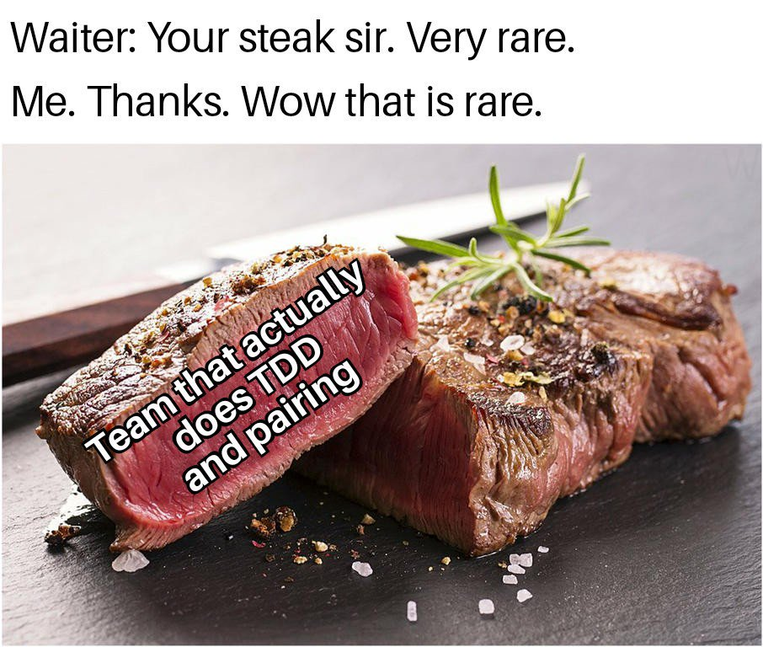
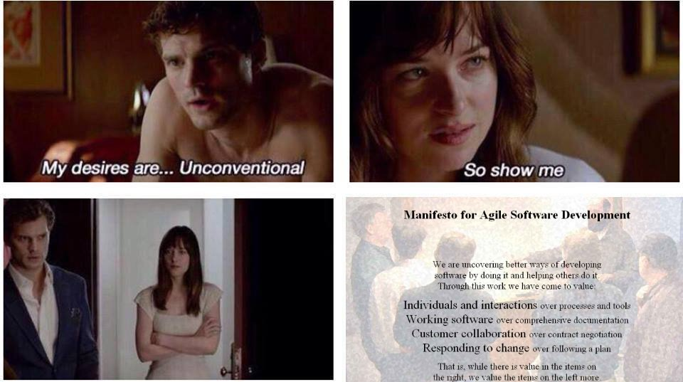
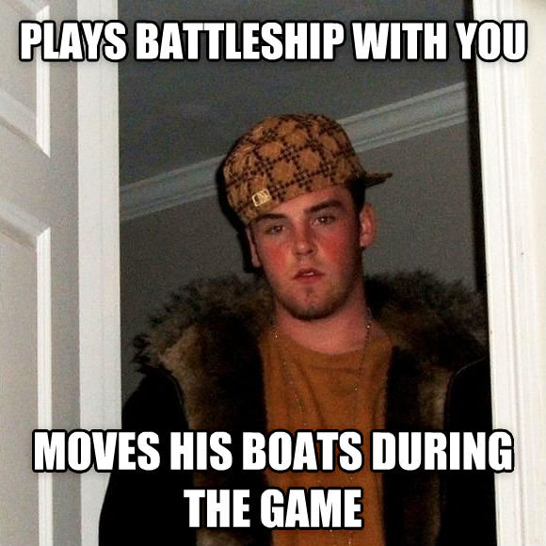
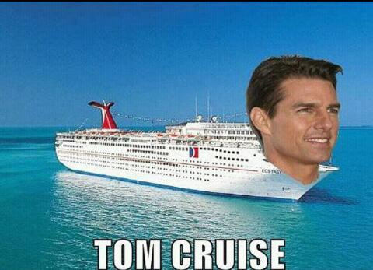
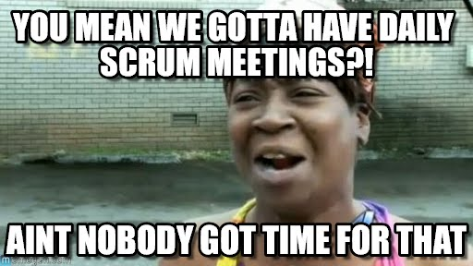
Jason Herning and Simeon Ng
CS372 Project 1 - Battleship

Slide 2

User Stories:
“Developer Hat”
Difficulty ranking: 1-10
As a user I want 10x10 grid - 1
As a user I want to be able to sink various ships. - 3
“ “ “ would like a clear interface for ‘hits’ and ‘misses’. - 3
“ “ “ would like to be able to drop mines. - 4
“ “ “ want custom games. - 5
“ “ “ want a simple text based interface - 5
“ “ “ want to be able to move the ships. - 6
“ “ “ want the standard battleship rules. - 7
“ “ “ would like to place my ships wherever I want. - 7
“ “ “ would like to play via network. - 8
“ “ “ don’t want the second player to be able to see my board. - 8
- (Depends on network implementation).
“ “ “ want to send torpedoes that move 1 space each turn. - 8

Slide 3
User Stories:
“Project Manager Hat”
Priority ranking:
[1(High)-3(Low)]
1's:
As a user I want 10x10 grid - 1
As a user I want a the standard battleship rules- 1
“ “ “ would like a clear interface for 'hits' and 'misses' - 1
“ “ “ want a simple text based interface - 1
“ “ “ want to be able to sink various ships. - 1
“ “ “ would like to place my ships wherever I want. - 1
2's:
“ “ “ don’t want the second player to be able to see my board. - 2
“ “ “ want to be able to move the ships. - 2
“ “ “ want custom games. - 2
3's:
“ “ “ would like to play via network. - 3
“ “ “ want to send torpedoes that move 1 space each turn. - 3
“ “ “ would like to be able to drop mines. - 3

Slide 4
Pair Programming, TDD, and VC
Pair programming at the beginning and end of project.
Beginning was slow. Wanted to make sure the classes we implemented followed the single responsibility principle.
Learning new IDE (CLion) and Cmake.
TDD
Wanted to practice TDD for the entire implementation. Writing tests before writing anything else.
Tapered off near the end of the project because we wanted to meet some of the PMs priorities
Version Control
Used Git, only had a few conflicts.
Had to revert once.

Slide 5
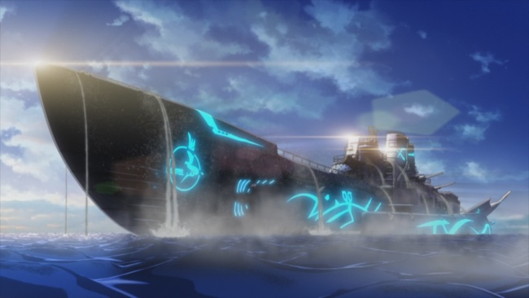
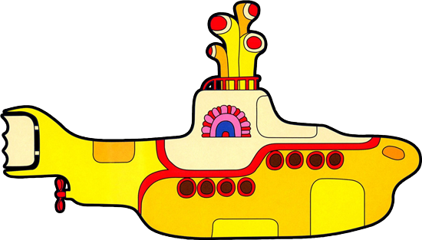
SUB

Slide 6
Class Responsibilities:
GAME
PLAYER
BOARD
SUB
SHIP

Slide 7
DEMO

